Slide 1
Network Management
Using Sensors to Monitor Network Equipment Rooms
Last Update 2014.08.12
1.1.0

Slide 2
Objectives
Learn how to create network monitoring sensors using Arduino and Raspberry Pi

Slide 3
What is Network Monitoring
A common function of network management is monitoring the status of the network
This can range from SNMP based monitoring to hardware based sensors as discussed here
These sensors are used to measure and report any deviation from normal for parameters such as

Slide 4
What is Network Monitoring
  The temperature in the room
  The humidity in the room
  An entry door opening
  Watching the room with a camera
  Detecting water in the room
  Detecting smoke in the room
  Controlling access to the room with RFID

Slide 5
Methods Used
A common way to watch for deviation from normal levels is to mount a device in the network room that will continuously measure values and then send a signal when there is a significant deviation
This device can be mounted in the equipment rack or on a wall
An example of this is the NetBotz line from APC

Slide 6
NetBotz
This device looks like this

Slide 7
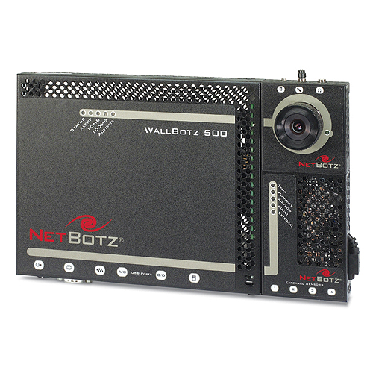
NetBotz

Slide 8
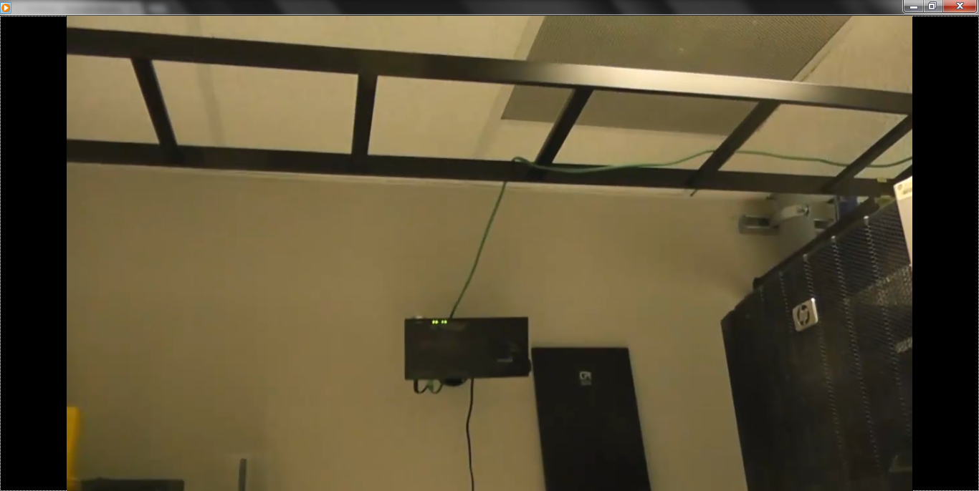
NetBotz

Slide 9
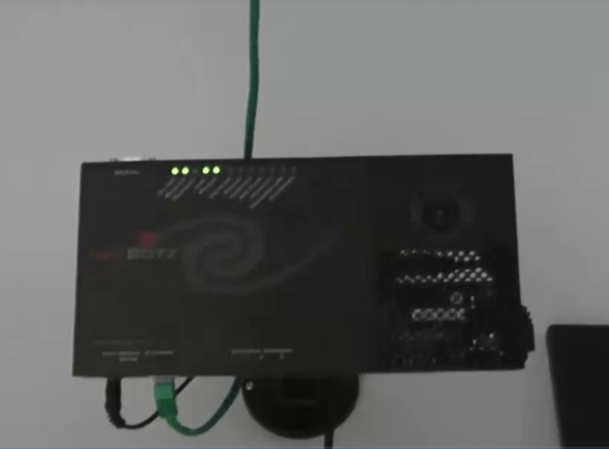
NetBotz

Slide 10
NetBotz
Here is what APC says about it
  The NetBotz 500 protects a room and its valuable contents, like IT equipment, from damage due to water leaks, high or low temperatures, smoke or dust, humidity, vandalism, theft, and many more dangerous environmental and physical factors, by providing advance warning of equipment failure

Slide 11
Build Your Own
What we will do here is to see how these various sensors work while we build a example of this type of system using the Arduino microcontroller and the Raspberry Pi computer

Slide 12
What is Arduino
The Arduino board is basically a microcontroller that can be used to interface with, receive data from, and control devices attached to it using script based programs to interpret and display the data

Slide 13
Arduino Hardware
There are several Arduino boards
The ones we will use are the Uno and the Yun
They look like this
For an idea of size, on the Uno at the top left is the USB connector, on the Yun the top left connector is a RJ-45 jack

Slide 14
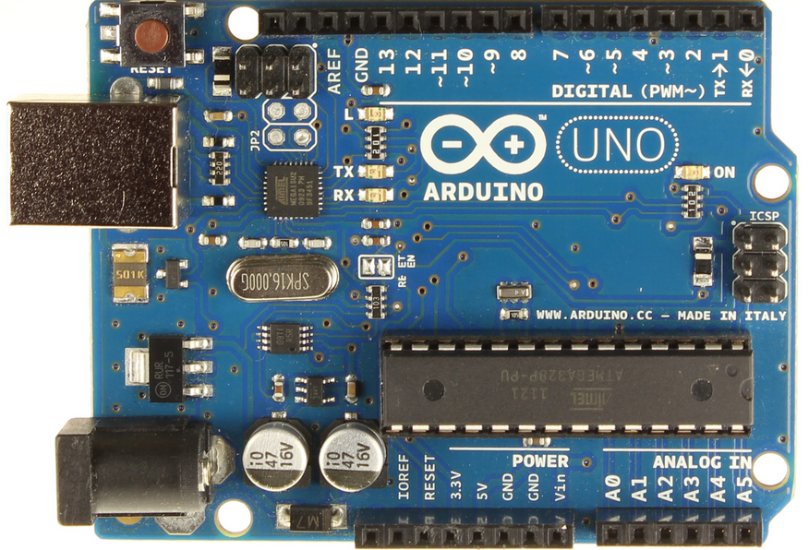
Arduino Uno

Slide 15
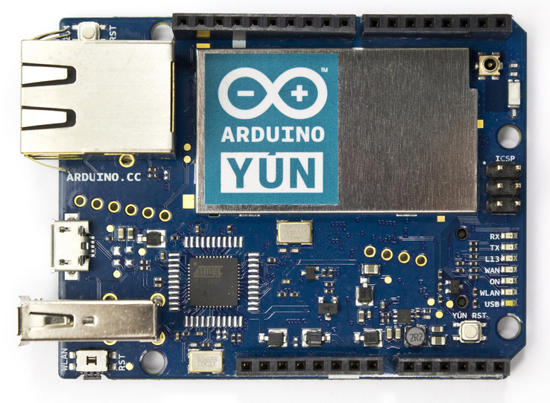
Arduino Yun

Slide 16
Language Used With Arduino
Arduino uses C or C++ more or less
Not everything will run as it only supports a subset of the language
To send the code to the board it is first written in or copied to a program called IDE
Once there it is called a sketch

Slide 17
Language Used With Arduino
In this program you enter the code, verify it, and upload it to the board
If saved from IDE, the file has an ino extension

Slide 18
What is Raspberry Pi
The Raspberry Pi board is a small computer similar to that found in a smartphone
It is based on the same ARM processor found in cell phones
It can be controlled using standard Linux commands or with a script based program that is usually written in Python

Slide 19
Raspberry Pi Hardware
There are several versions of the Raspberry Pi board
Unlike the Arduino line these are mostly improvements to the basic board, rather then boards for different purposes
These are the same size as the Arduino board

Slide 20
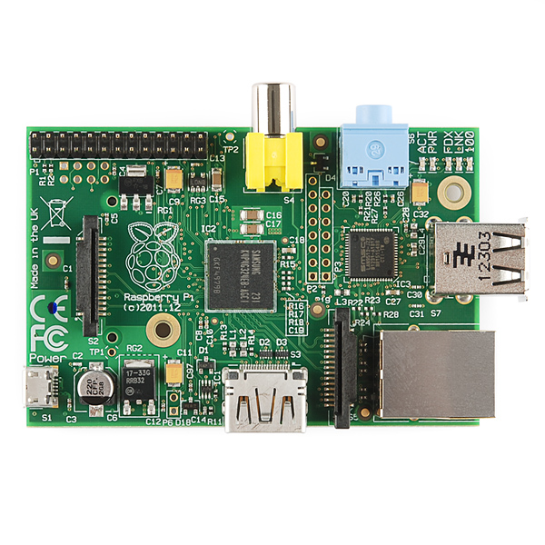
Raspberry Pi Hardware

Slide 21
Language Used With Raspberry
Python is the primary language used

Slide 22
Basic Electronics
Before we begin building let’s see how the components and the connections between them work together to measure and display the information we need

Slide 23
Circuits
The components are connected to each other with circuits
Circuits are closed loops of wire with a power source and something to do something useful with the energy, a load
In a circuit, electricity flows from a point of higher potential energy usually referred to as power or + to a point of lower potential energy

Slide 24
Circuits
Ground often represented with a - or GND is generally the point of lower potential energy in a circuit
In the circuits used here electricity only flows in one direction
This type of circuit is called direct current, or DC circuit
A circuit is a circular path that starts and stops at the same place

Slide 25
Circuit
A circuit looks like this first as a board as used and then as a visual representation called a schematic

Slide 26
Circuit

Slide 27
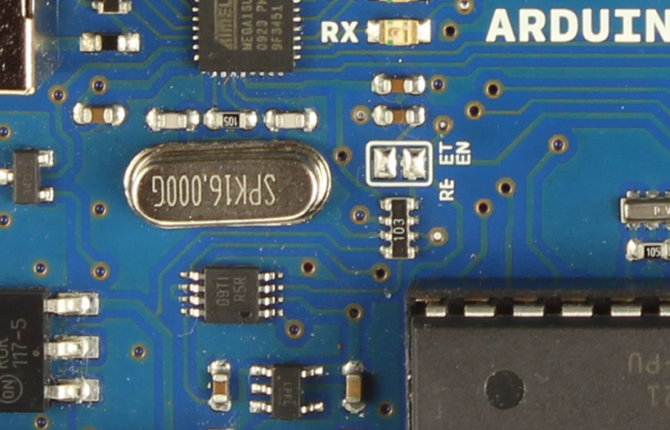
Circuit

Slide 28
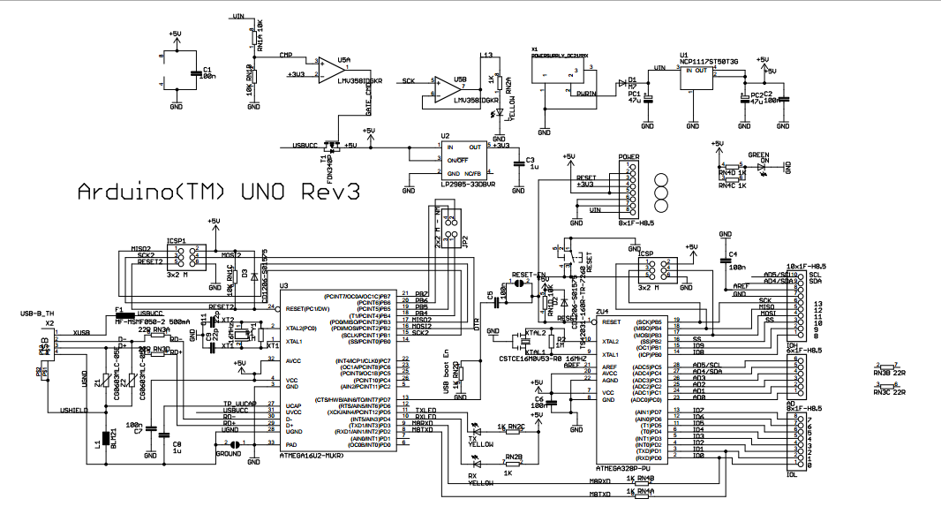
Circuit

Slide 29
Relationship of V I R
To make a circuit do something voltage current and resistance are used
  Voltage - V
  Current - I
  Resistance - R
Their relationship is

Slide 30
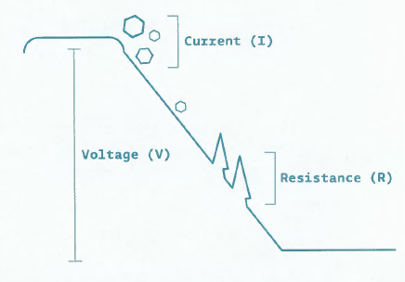
Relationship of V I R

Slide 31
How Does a Circuit Work
Let’s see how a circuit does what it does as explained by SparkFun a supplier of many of the parts we will use
  You’ve probably heard that a battery or a wall outlet has a certain number of volts
  This is a measurement of the electrical potential produced by the battery, or the utility grid connected to the wall outlet

Slide 32
How Does a Circuit Work
  All those volts are sitting there waiting for you to use them, but there’s a catch: in order for electricity to do any work, it needs to be able to move
  It’s kind of like a blown-up balloon; if you pinch it off, there is air in there that could do something if it’s released, but it won’t actually do anything until you let it out

Slide 33
How Does a Circuit Work
  Unlike air coming out of a balloon, electricity can only flow through materials that can conduct electricity, such as copper wire
  If you connect a wire to a battery or wall outlet, you will be giving the electricity a path to follow
  But if the wire isn’t connected to anything else, the electricity won’t have anywhere to go and still won’t move
  What makes electricity move

Slide 34
How Does a Circuit Work
  Electricity wants to flow from a higher voltage to a lower voltage
  This is exactly like the balloon: the pressurized air in the balloon wants to flow from inside the balloon - higher pressure - to outside the balloon - lower pressure
  If you create a conductive path between a higher voltage and a lower voltage, electricity will flow along that path

Slide 35
How Does a Circuit Work
  And if you insert something useful into that path like an LED, the flowing electricity will do some work for you, like lighting up that LED
  So, where do you find a higher voltage and a lower voltage
  Here’s something really useful to know: every source of electricity has two sides
  You can see this on batteries, which have metal caps on both ends, or your wall outlet that has two or more holes

Slide 36
How Does a Circuit Work
  In batteries and other DC - Direct Current voltage sources, these sides are named positive or +, and negative or -

