Slide 1
The Cloud Last Update 2014.02.06 1.0.0

Slide 2
Objectives
Learn what cloud computing is

Slide 3
What is Cloud Computing
The first thing to know about cloud computing is that it is not new
The concept of sharing resources is as old as computers
It is as simple as having someone else do something for you
Because you cannot, you don’t want to, it is cheaper to turn it over to someone else

Slide 4
What is Cloud Computing
Keep in mind that the majority of organizations do not make money off of their IT operations
Instead it is an expense
As with all expenses they want to reduce it
One way of doing so is to let someone else do it for you

Slide 5
What is Cloud Computing
They may be able to do it at a lower price as they are sharing resources among numerous customers

Slide 6
Time Sharing
All of this began back in the 1960s when computers, mainframes in this case, became reliable enough and affordable enough to be purchased by commercial companies
Some of these organizations used the computer to process their own information

Slide 7
Time Sharing
Others just rented out time to those companies who could not afford or justify buying a mainframe computer for the data processing they needed to do
But they could justify buying access to someone else’s

Slide 8
Time Sharing
In addition, universities such as the one I attended as an undergraduate installed a mainframe for use by the students on a shared basis
In the late 60s and early 70s I would prepare a stack of punch cards that detailed what I needed done

Slide 9
Time Sharing
These would be deposited with the computer operator who would run this job along with hundreds of others overnight
The next day the card deck and results printed on huge folding paper could be picked up

Slide 10
Time Sharing
This method allowed the administration to use the computing resources during the day, with the students using those resources at night when otherwise they would be unused
Here is what this method looked like

Slide 11
IBM/360 Computer Room

Slide 12
Punch Card Machine Lab Room

Slide 13
Punch Card Machine

Slide 14
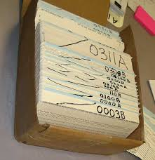
Card Deck

Slide 15
Printout

Slide 16
Local Area Networks
In the 1980s as smaller computers appeared companies such as Novell developed network operating systems that allowed organizations to own their own computing resources
This resulted in the end of time sharing on large expensive mainframes
Why turn over to someone else something you can do for yourself

Slide 17
Virtualization
This form of computing as isolated LANs or interconnected LANs using directory services running locally and in data centers continued until around 2001 when VMware introduced their server virtualization product
Up to this point all of the aspects of computing were kept separate from each other

Slide 18
Virtualization
Computing, storage, and the network were each distinct entities
With server virtualization servers that typically ran one operating system and one application could be combined on a single physical machine
To the OS and the application the servers all appeared to be as before on their on hardware

Slide 19
Virtualization
But they were not
Instead multiple servers ran on one physical server
Further these servers as they were now files could be moved, copied, backed up to anywhere at anytime
This concept was first called elastic computing

Slide 20
Virtualization
Not long after this companies such as Amazon noticed that their budget cycles where purchases had to be made on a yearly basis did not match the use of their resources
They would install equipment intended for future growth which would not be used for months

Slide 21
Virtualization
It occurred to these companies that they could generate revenue from these unused resources by renting them out to other organizations
Unlike the original concept of time sharing there developed the idea of offering specific services to customers such as data storage, application storage, and the old style time sharing

Slide 22
Cloud Computing
The general term cloud computing emerged as the name for these various services
Let’s look at each of these

Slide 23
SAAS
With SAAS – Software As A Service the cloud provider provides access to a program
The cloud provider manages the application for the customer
Here is an example

Slide 24
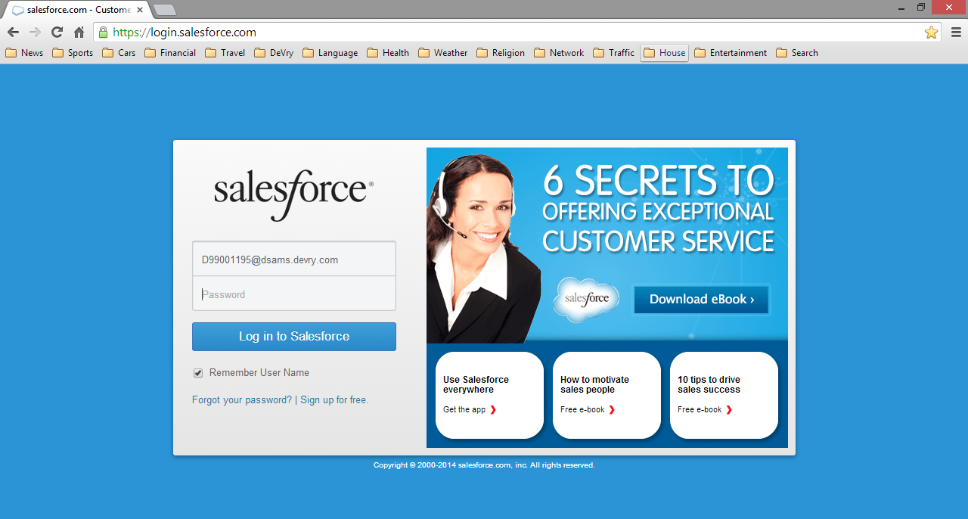
SAAS

Slide 25
IAAS
At the other end of the spectrum IAAS – Infrastructure As A Service provides just a virtual machine environment
The customer must install and manage their own OS and applications
This is then a remote data center

Slide 26
PAAS
In PAAS – Platform As A Service we are back to the old time sharing method where cloud service providers deliver a computing platform, such as an installed operating system, program execution environment, data storage, and so forth
The organization can run their programs on these remote computers

Slide 27
PAAS
Unlike IAAS the customer does not need to manage the hardware directly

