Slide 1
Windows Server 2008 Chapter 2
Last Update 2012.05.01
1.0.0

Slide 2
Objectives
Plan and make the appropriate preparations for installing Windows Server 2008
Understand the different installation methods used and install Windows Server 2008
Set up Windows Server 2008 from the Initial Configuration Tasks window
Activate Windows Server 2008

Slide 3
Objectives
Install and configure Windows Deployment Services
Install service packs
Troubleshoot installation problems
Uninstall Windows Server 2008

Slide 4
Preparing for Installation
Preinstallation tasks
Identify the hardware requirements and check hardware compatibility
Determine disk partitioning options
Understand the file system
Determine upgrade options
Plan user licensing
Determine domain or workgroup membership

Slide 5
Preparing for Installation
Preinstallation tasks
Choose a computer name
Determine whether to install Server Core or the full version
Identify the server roles to implement
Determine the immediate preparations

Slide 6
Hardware Requirements
Most operating systems come with a list of minimum hardware requirements
Always better to exceed the minimum recommendations
By how much will be determined by what role the Windows Server 2008 server will play on the network
Redundant array of inexpensive disks (RAID)
An array of multiple hard drives designed to extend the life of disk drives and to prevent data loss from a hard disk failure

Slide 7
Hardware Requirements
Hardware compatibility testing
The most up-to-date listing of compatible hardware (and software) is the Catalog of Tested Products on Microsoft’s Web site
www.windowsservercatalog.com
Recommended that you select hardware listed on the Catalog of Tested Products or labeled with the Certified for Windows Server 2008 logo
Might still be necessary to upgrade the basic input/output system (BIOS)

Slide 8
Determining Disk Partitioning Options
Creating a partition
A process in which a hard disk section or a complete hard disk is prepared for use by an operating system
A disk can be formatted after it is partitioned
Process divides the disk into small sections called tracks and sectors for the storage of files by a particular file system
The Windows Server 2008 installation program will detect how your hard disk is currently partitioned
Allows you to install the operating system on an existing partition or create a new one

Slide 9
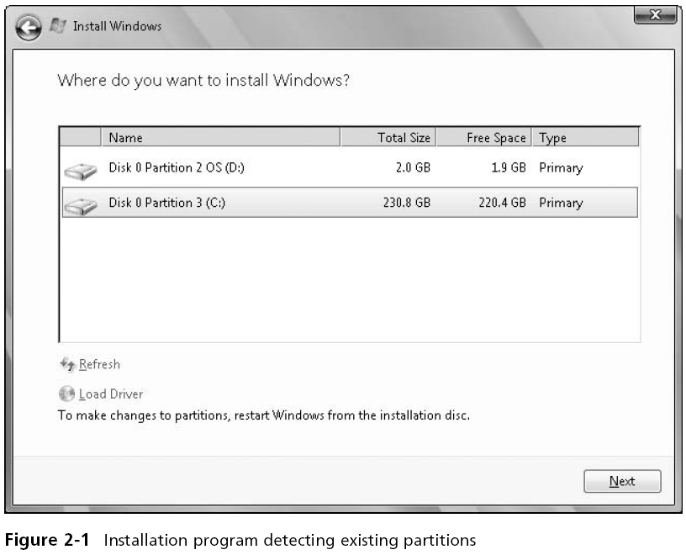

Slide 10
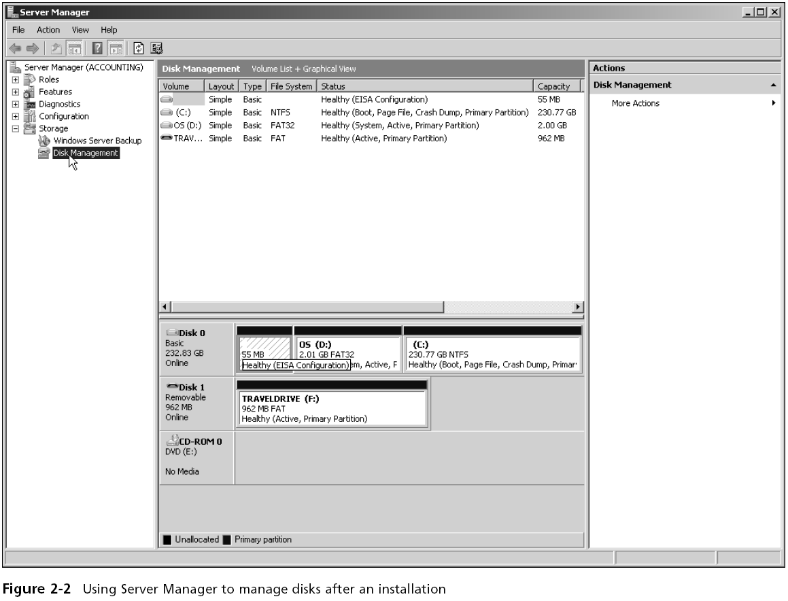

Slide 11
Understanding NTFS
New Technology File System (NTFS)
The native Windows Server file system
NTFS features include
Local security through file and folder permissions
Compression
Disk quotas
Encryption
Indexing
POSIX.1 support

Slide 12
Understanding NTFS
NTFS features include
Journaling
Large volume capacity
Hard links
Self-healing
Portable operating system interface (POSIX)
A set of standards designed to enable portability of applications from one computer system to another
Journaling by a file system means that it tracks changes to files and keeps a record of these changes in a separate log file

Slide 13
Understanding NTFS
You cannot install Windows Server 2008 on a FAT volume
Check to ensure that any File Allocation Table (FAT) volumes are first converted to NTFS

Slide 14
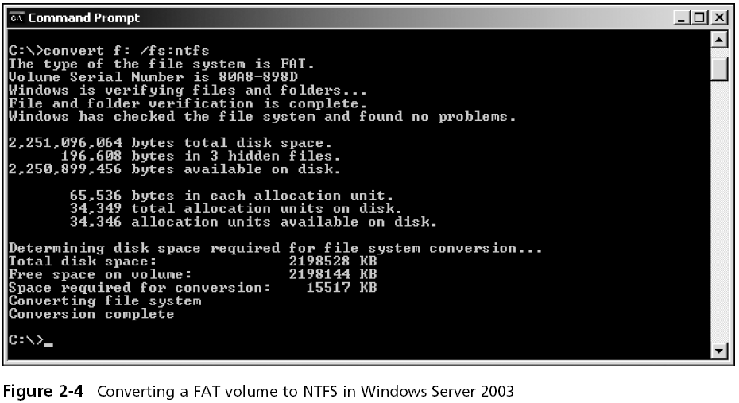
Understanding NTFS

Slide 15
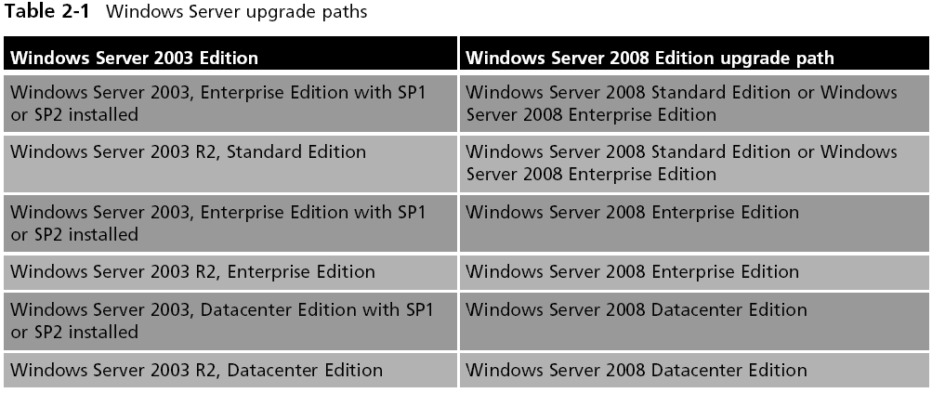
Upgrading to Windows Server 2008

Slide 16
Planning User Licensing
For the Standard and Enterprise editions
You currently can purchase your initial edition with five or 25 client access licenses (CALs)
For the Datacenter and Itanium-Based editions
You pay one flat cost per processor
When there is a virtual server set up for Windows Server 2008 Standard Edition
Users may have one virtual access per CAL
For Windows Server 2008 Datacenter Edition
A workstation can have unlimited virtual accesses per processor license

Slide 17
Domain or Workgroup
Determine the type of network access for which your computer will be configured
You can specify a domain or workgroup on the Initial Configuration Tasks window
Requirements for adding the computer to a domain
Provide the DNS name of the domain you want to join
You must have a computer account in the domain you want to join
One domain controller and a DNS server must be online before you can join the domain

Slide 18
Choosing a Computer Name
The installation process assigns a randomly generated name for the server computer
Some organizations have a predetermined naming scheme for computers on their network
Microsoft’s recommendations for creating a computer name include the following
The maximum length is 63 characters
Use shorter names up to 15 characters for easier typing

Slide 19
Choosing a Computer Name
Microsoft’s recommendations for creating a computer name include the following
The computer should have a name that is different from any other computer name on the local network or in the domain
If no DNS server exists on the network, use only standard Internet characters
If a DNS server is present on the network, use standard Internet characters plus additional characters such as $, %, &, , and others

Slide 20
Install Server Core or the Full Version
Some scenarios for a Server Core installation
Your organization is medium or large in size and wants to dedicate one server to operate as a DHCP or combined DHCP and DNS server
Your organization offers many shared folders to users for their work and the organization wants to centralize all of the shared folders on one computer
The server contains only centralized databases accessed by users
The server holds critical files for the organization and needs to have the smallest attack surface
The server is dedicated to one narrow task

Slide 21
Install Server Core or the Full Version
Sample scenarios for installing the full version are
Your organization is a small or medium-size business and does not plan to dedicate a server for a specific function, such as for DHCP
You prefer to work in a GUI environment
Your organization needs to have GUI-based software on the server
The server administrator is relatively new to Windows Server 2008 and wants to use wizards for guidance
The server must have .NET Framework for the applications on it

Slide 22
Identifying Server Roles
Active Directory Certificate Services Role
Four services are incorporated into this role, as shown in Table 2-2
Active Directory Domain Services Role
Central to implementing Active Directory and creating one or more domains
Active Directory Federation Services
Used to manage security tokens and security services on a Windows Server 2008 Web-based network

Slide 23
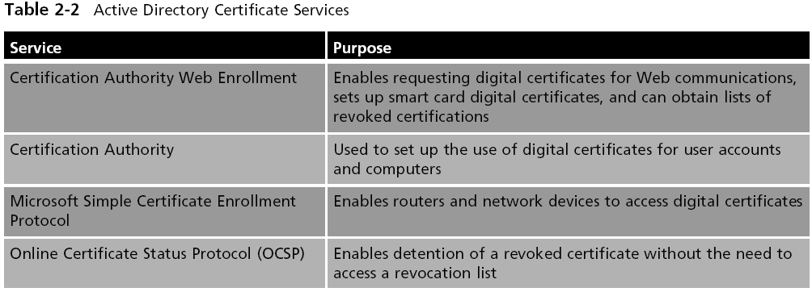
Identifying Server Roles

Slide 24
Identifying Server Roles
Active Directory Lightweight Directory Services
Intended for servers that primarily manage applications for users
Active Directory Rights Management Services Role
Uses security capabilities such as encryption, user authentication, and security certificates to help safeguard information
Application Server Role
Places the Windows Server 2008 server in the role of a computer that makes applications available to users on a network or over the Web

Slide 25
Identifying Server Roles
DHCP Server Role
Role in which the server leases IP addresses to network clients
DNS Server Role
DNS maintains tables from which this service translates domain and computer names into IP addresses and vice versa
Fax Server Role
Through the Fax Server role, you can manage all fax resources on a network

Slide 26
Identifying Server Roles
File Services Role
Enables users to access and share files through one or more servers
Hyper-V Role
Enables Windows Server 2008 to function as a virtual server
Network Policy and Access Services Role
A network is kept secure and healthy by having policies governing who can access it

Slide 27
Identifying Server Roles
Print Services Role
Includes a service to make a Windows Server 2008 server a formal Print Server that manages print jobs and network printers from one place
Terminal Services Role
Enable client computers to run services and software applications on the server instead of on the client
UDDI Services Role
Enables the discovery of existing Web services and program resources that can be used over and over in different Web applications

Slide 28
Identifying Server Roles
Web Server (IIS) Role
Enables Windows Server 2008 to provide an ever-expanding range of Web services
Windows Deployment Services Role
Enables an organization to purchase multiple computers without operating systems and then install Windows Server 2008 on all of the computers

Slide 29
Making Immediate Preparations
Immediate preparations include
If you are upgrading, back up the files before starting
Ensure that all important hardware are preinstalled
Disconnect or remove removable storage devices
Disconnect any connection for communications with an (UPS)
Have on hand CD/DVDs or other media with drivers for new peripherals
Use the test software disc that comes with the server to verify that the CPU, memory, and disk drives are working properly

Slide 30
Installation Methods
The primary installation methods are as follows
DVD installation
Upgrade from Windows Server 2003
Installation for a virtual server using Hyper-V
Windows Deployment Services

Slide 31
DVD Installation
To start the installation from DVD
Make sure the computer’s BIOS is set to boot first from the CD/DVD drive
Insert the Windows Server 2008 installation DVD
Power off the computer
Turn on the computer, and if necessary, press the key combination to boot from the CD/DVD drive
Follow the instructions for installing Windows Server 2008

Slide 32
Upgrading from Windows Server 2003
The general steps to begin an upgrade are as follows
Boot the computer to use its current operating system
Insert the Windows Server 2008 installation DVD
If you see the Autoplay window, click the option to Run setup.exe.
When you see the Install Windows window, click Install now
Follow the instructions for installing Windows Server 2008

Slide 33
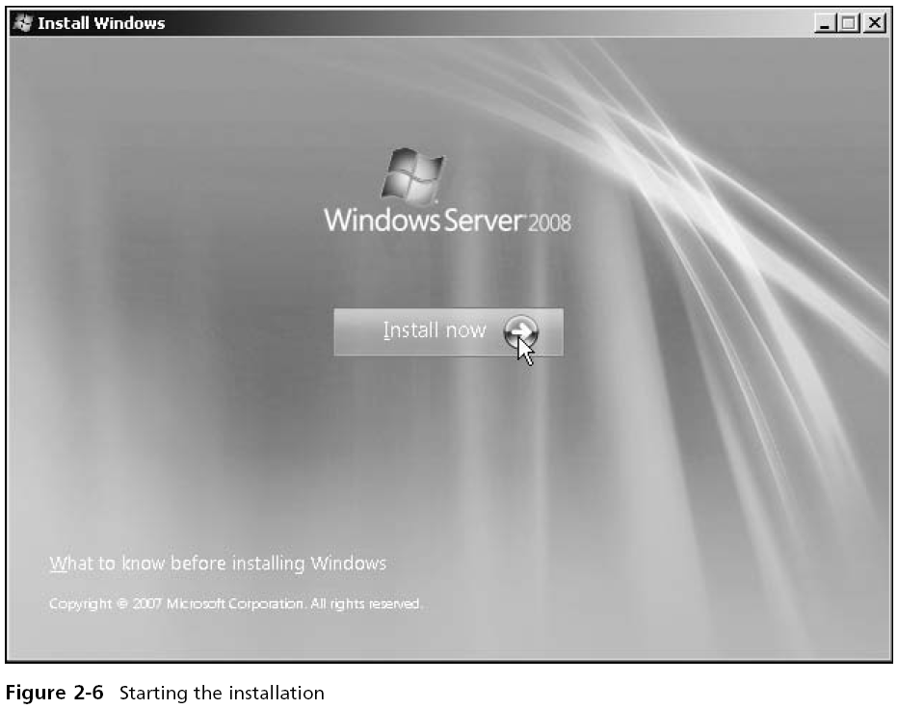

Slide 34
Virtual Server Using Hyper-V
The actual installation steps of Windows Server 2008 as a virtual server are nearly the same as those for a DVD installation
But first you need to go through the steps to set up a virtual server

Slide 35
Windows Deployment Services
The WDS role is designed to enable the installation of Windows operating systems, Windows Vista and Windows Server 2008, on multiple computers
When you use WDS, it’s not necessary to stay at the computer during the operating system installation
An installation DVD is not necessary
The installation files are sent over a network from the Windows Server 2008 Windows Deployment Services server
However, you do need to have licenses for all of the operating systems you install through WDS

Slide 36
Initial Configuration Tasks Window
In this window, you can do the following
Provide Computer Information
Update This Server
Customize This Server
You don’t need to complete all of the tasks at this time
But you should complete some preliminary tasks right away
After configuring the computer information, plan to configure how to update the computer

Slide 37
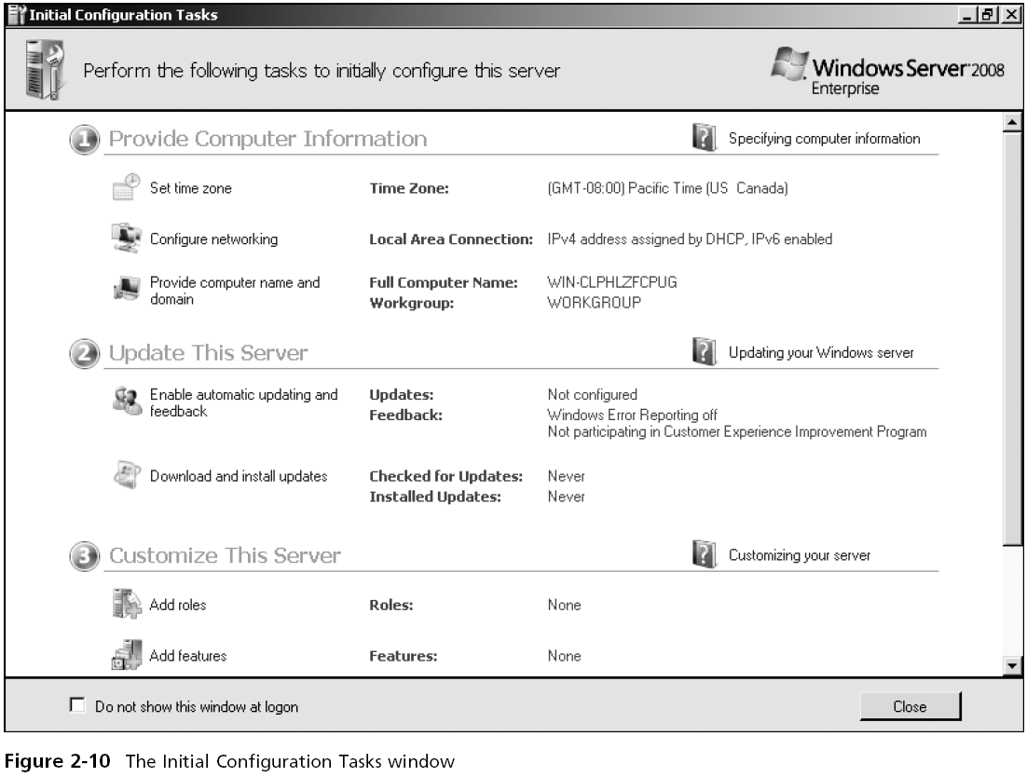

Slide 38
Server Activation
After Windows Server 2008 is installed
Necessary to activate the copy of the operating system
You need to activate your copy of Windows Server 2008 before the short activation period expires
Or else many functions of the operating system are disabled
Windows Server 2008 can be activated through the Internet or by telephone

Slide 39
Using Windows Deployment Services
Benefits
Installs Windows Server 2008 and Windows Vista
Retains the ability to install Windows Server 2003 and Windows XP
Enhances performance
Provides updated boot format
Uses image-based installation techniques
Can utilize multicasting for network efficiency
Offers a redesigned presentation for choosing which operating system to install

Slide 40
Using Windows Deployment Services
Windows Deployment Services operate in a Preboot Execution Environment (PXE)
The target computer on which to install the operating system already has software to be PXE-enabled
A PXE-enabled client can connect to the network and communicate with a server (or boot from the server)
Without first having to boot from an operating system on the client’s hard disk

Slide 41
Windows Deployment Services
Requirements
A DNS server already configured on the network
A DHCP server already configured on the network
Active Directory Domain Services already installed on a network server and the WDS server is part of the domain managed by Active Directory
NTFS as the file system on the Windows Deployment Services server
You can install the Windows Deployment Services role from either the Initial Configuration Tasks window or from Server Manager

Slide 42
Unattended Installation
To set up for an unattended installation, it is necessary to do the following
Create the client-side unattend file, unattend.xml, in the \WDSClientUnattend folder
Configure Windows Deployment Services to use the unattend.xml file

Slide 43
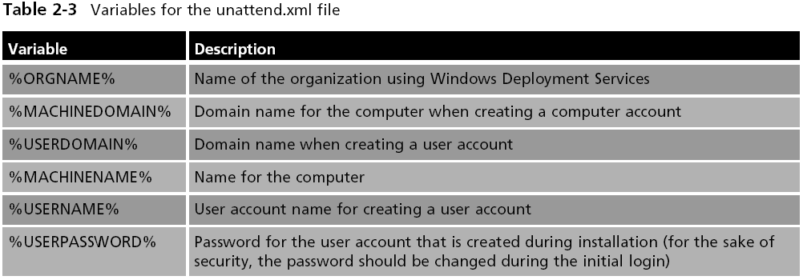
Unattended Installation

Slide 44
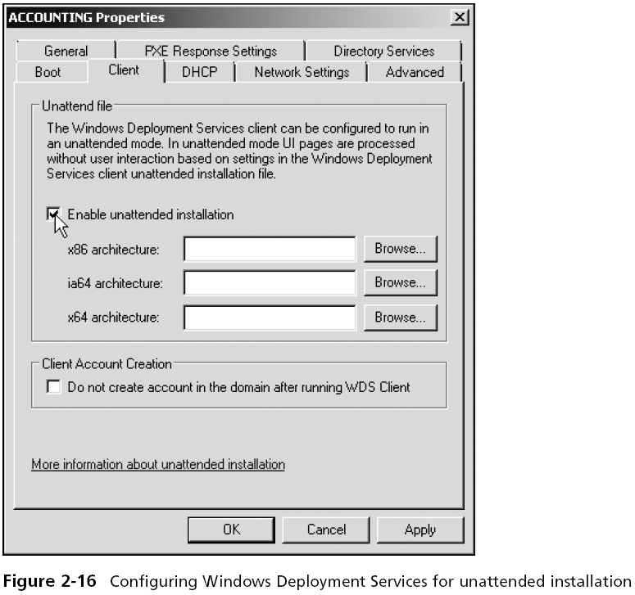

Slide 45
Installing Windows Server Core
The steps for installing Windows Server Core are nearly identical to the steps for a full installation
Until you reach the end of the process when you need to log on to the newly installed system
You can implement all or portions of the following server roles
Active Directory Domain Services
Active Directory Lightweight Directory Services
DHCP and DNS Servers
File, Print and Web Services

Slide 46
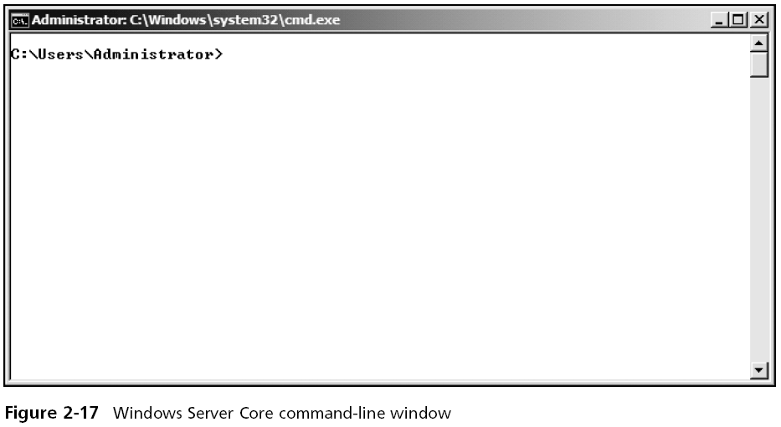
Installing Windows Server Core

Slide 47
Installing Windows Server Core
For many of these roles, not all role services can be installed as in the full installation of Windows Server 2008
This is in keeping with the design concept of having a smaller attack surface to discourage attackers and malicious software
Use the start command to install a particular role
Use the /uninstall option to uninstall a role
At the command line, enter help to view a listing of commands

Slide 48
Installing and Managing Service Packs
Service packs are designed to correct things such as security issues
As well as problems affecting stability, performance, or the operation of features included with the operating system
Guidelines when installing the latest service packs
Download the latest service pack from Microsoft’s download site
Review the documentation that comes with the service pack

Slide 49
Installing and Managing Service Packs
Guidelines when installing the latest service packs
Perform a full backup before you do the service pack installation
If the server is already available to clients, schedule when the service pack will be installed
Once the service pack is installed, document any problems that occurred and how you fixed them for future reference
You can install the latest service pack by using Windows Update

Slide 50
Troubleshooting Installation Problems
Keep the following points in mind to avoid problems
Ensure that the hardware has the Certified for Windows Server 2008 sticker or is in the Windows Server Catalog of Tested Products
Test all hardware before installing the operating system
Run the computer manufacturer’s diagnostics before installing the operating system
Run a comprehensive test of the hard disk to ensure it is functioning properly

Slide 51
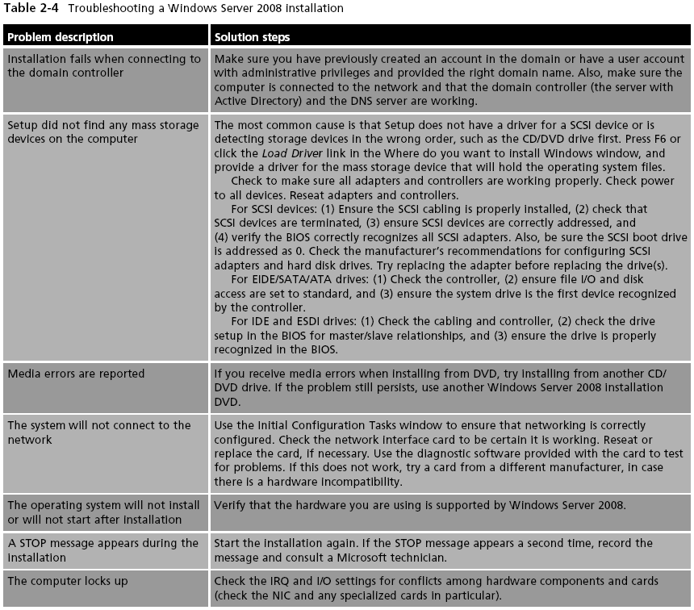

Slide 52
Uninstalling Windows Server 2008
Uninstalling Windows Server 2008 is a relatively straightforward process
And requires you to format the partition on which it has been installed
If you are installing another operating system
You are usually given an opportunity to format the hard drive for that operating system
You can also use the FDISK and FORMAT utilities
Another option is to use the DISKPART utility

Slide 53
Summary
Before you install Windows Server 2008, complete the preinstallation tasks to help ensure the best result
Windows Server 2008 has many server-based roles, from housing Active Directory functions to offering DNS or DHCP services to providing file and print services
Windows Server 2008 can be installed using any of several methods, which include DVD installation, upgrading from Windows Server 2003, using Hyper-V for a virtual server, and WDS

Slide 54
Summary
After Windows Server 2008 is installed, you can perform basic configuration activities from the Initial Configuration Tasks window
So that you can retain full use of Windows Server 2008, plan to activate the operating system immediately
If your organization is planning to install multiple servers or many Windows Vista computers, you can use Windows Deployment Services to save time and effort

Slide 55
Summary
Service packs should be installed to fix any known problems with the operating system
If you run into installation problems, try the troubleshooting suggestions in Table 2-4
To uninstall Windows Server 2008, use the installation of another operating system to overwrite the Windows Server 2008 installation or use tools such as FDISK, FORMAT, and DISKPART

