Slide 1
Wireless Design
Last Update 2013.09.06
3.3.0

Slide 2
Wireless Design Considerations
The design of a wireless network is science and art
Much is known and much is unknown, so guidelines based on experience are commonly used rather than exact formulas at this stage of development

Slide 3
Wireless Design Considerations
There is an important consideration to keep in mind when designing a wireless network
In a wired network the signal is contained in a wire
When laying out or troubleshooting the network, the confines of the network are readily apparent

Slide 4
Wireless Design Considerations
It is in the wires and the devices that connect to those wires
Whereas, in a wireless network the actual network is three dimensional and uncontained
Issues such as beamwidth, interference, atmosphere, and so on have a significant affect on the ability and consistency of the wireless network to do its work

Slide 5
Wireless Design Considerations
To successfully design a wireless network you must learn to think and operate multidimensionally in a constantly changing environment

Slide 6
Coverage
In this presentation the majority of the material will focus on wireless LAN design
The design of a CAN link uses the same basic principles as the wireless LAN design
The major difference being the types of obstacles encountered outside, such as trees
Otherwise the approach is the same

Slide 7
Coverage
The design of a wireless MAN is very dependent on the type of network it is
A licensed cellular MAN is much different from an unlicensed SCADA network
There is little general design guidance that can be offered for these proprietary systems as the manufacturer of the equipment used will provide the design details

Slide 8
Uses of a Wireless LAN
In addition to the usual uses for wireless local area networks new uses are being suggested as data rates increase
For example this slide from an Agilent webinar from January 2012 shows some of these new uses

Slide 9
Uses of a Wireless LAN

Slide 10
Designing a Wireless LAN
The way to start any network design is to apply a top down approach that relates the business needs of the organization to the technical implementation of the network
Based on this systematic design approach a physical network is laid out on paper
The discussion here is the changes to this network design brought about by the use of wireless devices

Slide 11
Designing a Wireless LAN
In a network where the parts are connected with wires, in general, one need only decide where to place the parts and what capabilities each of these parts require to create an effective and efficient network

Slide 12
Design Methods
A wireless network can be designed
By hand using experience and guidelines
or
Using an automated design program

Slide 13
Wireless LAN Network Design
To do this by hand acquire or create a drawing of the site of sufficient scale so that
Device locations can be marked
Radio signal coverage areas can be indicated
Notes can be made

Slide 14
Wireless LAN Network Design
Next, using experience from actual practice or based on guidelines discussed here, place the access points and their presumed coverage areas on the drawing, such as

Slide 15
Wireless LAN Network Design
CELL 1
802.11b/g
CHANNEL 1
11 Mbps TO EDGE
CELL 2
802.11b/g
CHANNEL 6
11 Mbps TO EDGE
CELL 3
802.11b/g
CHANNEL 11
11 Mbps TO EDGE
CELL 4
802.11b/g
CHANNEL 6
11 Mbps TO EDGE
CELL 5
802.11b/g
CHANNEL 11
11 Mbps TO EDGE
CELL 6
802.11b/g
CHANNEL 1
11 Mbps TO EDGE
CELL 7
802.11b/g
CHANNEL 16
11 Mbps TO EDGE

Slide 16
Wireless LAN Network Design
To crosscheck this, in some cases it will be necessary to perform some basic calculations to check for proper signal propagation
These calculations and the AP placement itself must take into account the physical characteristics of the site as well as the equipment being used, such as the type and directional nature of the antenna

Slide 17
Wireless LAN Network Design
For example, an omnidirectional antenna will radiate the signal equally in all directions
If the AP is placed against the outside wall of the building, the radiation pattern and therefore the ability to intercept the signal may extend into a nearby street

Slide 18
Wireless LAN Network Design
A directional antenna and more access points may be a better choice in this case, if relocation of the omnidirectional antenna is not possible

Slide 19
The Goal
The goal of the network design is to propagate a signal that serves the needs of the network’s users
The two main considerations are
Coverage
Capacity

Slide 20
Coverage
Coverage is designed to provide a low density of users with low throughput demands

Slide 21
Capacity
Capacity is designed to support a large number of users using high bandwidth requirement applications such as voice and video
The focus for this type of design is a high density of access points, which can mean stacking access points physically on top of each other, to serve an area

Slide 22
Capacity
Support for lower data rates must be disabled
Like a wired network each device should connect at the maximum rate or not connect at all
This calls for a large number of access points
In most cases this means moving to an all 802.11n 5GHz network

Slide 23
Capacity
The 2.4GHz range and 802.11a/b/g devices must be abandoned
Next, the critical factor in maintaining connectivity for high capacity is the SNR – Signal to Noise Ratio
The higher the SNR the better the performance
The actual signal an noise levels are less important

Slide 24
Signal to Noise Ratio Guidelines
40 dB or higher
Excellent
Always associated
Very Fast
25 to 40 dB
Very good
Always associated
Fast

Slide 25
Signal to Noise Ratio Guidelines
15 to 25 dB
Low
Always associated
Usually fast
10 to 15 dB
Very low
Mostly associated
Usually slow

Slide 26
Signal to Noise Ratio Guidelines
5 to 10 dB
No signal
Not associated
Not useable

Slide 27
Signal Levels
Some devices are more demanding of a strong signal than others
A suggested minimum is

Slide 28
Signal Levels

Slide 29
Receive Sensitivity
Next in importance in maintaining a high data rate connection is the receive sensitivity of the radio
Here are the sensitivities required for various data rates from a white paper from Juniper Network in 2011 and from Agilent from January 2012

Slide 30
Receive Sensitivity

Slide 31
Receive Sensitivity

Slide 32
Access Point Spacing
Gast reports in his 802.11ac book that in general a single access point can provide coverage for about 3000 sf regardless of the 802.11 version used
According to a White Paper by Gigawave provided by Global Knowledge from 2009 access points should be between 40 and 70 feet from each other for good coverage

Slide 33
Access Point Spacing
They should not be any closer to each other than 28 feet
Antennas should not be higher than 20 feet

Slide 34
The Low Data Rate Problem
An additional problem with allowing the lower data rates on a network designed for high capacity is pointed out by Juniper in the same white paper
As they say

Slide 35
The Low Data Rate Problem
The shared media nature of 802.11n means that the problems related to a highly variable association rate are aggravated by Head-of-Line Blocking, because there is nothing to stop the transmission of larger, low priority packets ahead of smaller, high priority packets on ingress

Slide 36
The Low Data Rate Problem
Because more clients might be connected at the lower link rates, an access point’s aggregate throughput can plummet when it needs to allocate more airtime to those users transferring data at low rates

Slide 37
The Low Data Rate Problem
To make matters worse, the low rate users on the edge of the network also tie up a disproportionate amount of airtime—50% of all users might be consuming more than 70% of airtime, for example—degrading performance for everyone else sharing the same radio
Transmission of a 1 MB file at the MCS0 rate takes 20 times longer than transmission at MCS15

Slide 38
The Low Data Rate Problem
Because 802.11n uses a shared media paradigm, only one client can transmit data at a time, which means that all other clients must wait their turn to transmit

Slide 39
Reduce Power
The next point Juniper makes is the gains achieved by reducing the transmit power of the access points
While turning down transmit power may seem counterintuitive, a reduction in transmit power levels is a valuable technique for maximizing throughput for both an access point and its neighbors

Slide 40
Reduce Power
Turning down the power slightly reduces the radius of the service area, but it also reduces interference by a much greater factor
Turning down transmit power is a prudent and proven technique for maximizing throughput for an access point and its neighbors in a high-density deployment
This makes it a best practice for a WLAN designer to streamline a wireless cell for optimal performance

Slide 41
High Capacity Summary

Slide 42
Next Steps to Higher Capacity
In the future as client devices are produced with better MIMO support this will increase throughput for these high capacity networks

Slide 43
Other Considerations
In addition to the above the following needs to be considered in wireless network design

Slide 44
Site Considerations
Things to consider when designing a network that will use wireless devices include
Materials the site is made of
Size of the network
Existing networks
Mounting points
Electrical power for the access points
Purpose of the network

Slide 45
Site Considerations
Bandwidth required
Roaming required
Security requirements

Slide 46
Materials Effect on Signal Loss
The materials in the site have a major impact on the received signal strength and therefore on the coverage area
Different materials have different effects on the radio waves in order of most to least
Metal in walls
Tinted or coated windows
Metal in ceilings or floors

Slide 47
Materials Effect on Signal Loss
Wood
Glass
Brick and concrete
The building’s construction has a major impact
Radio signal obstructions commonly found in buildings include
Steel studs in walls
Steel doors

Slide 48
Materials Effect on Signal Loss
Large structures inside the building
These large structures, such as elevator shafts and stairwells, have considerable metal in their structure
These areas will cast a radio signal shadow or area where the signal is entirely blocked
Steel reinforced floors have the same effect

Slide 49
Materials Effect on Signal Loss
In an office environment the furniture itself may also have an effect, for example
Metal filing cabinets
Metal mesh furniture
In a warehouse environment other elements may come into play, such as
Metal racks
The products themselves as

Slide 50
Materials Effect on Signal Loss
Anything with a high water content will block the signal
This is true of both the product and the packaging
Paper and cardboard can have a high water content

Slide 51
Materials Effect on Signal Loss
Obstruction | Additional Loss dB | Effective Range Feet
Open Space | 0 | Up to 100
Window – Glass | 3 | 70
Window – Metal Tint | 5-8 | 50
Drywall | 5-8 | 50
Woodwall | 10 | 30
6” Wall | 15-20 | 15
12” Wall | 20-25 | 10
Floor/Ceiling | 15-20 | 15
Floor/Ceiling – Thick | 20-25 | 10
Source: CWNA Study Guide Page 336

Slide 52
Materials Effect on Signal Loss
Type of Building | Loss in dBs | Frequency in MHz
Grocery Store | 5.2 | 914
Retail Store | 8.7 | 914
Open Plan Factory | 7.9 | 1300
Open Plan Factory | 3.7 | 1300
Open Plan Factory | 4.0 | 1300
Open Plan Factory | 9.2 | 1300
Open Plan Factory | 9.7 | 1300
Open Plan Office Building | 9.6 | 915
Open Plan Office Building | 14.1 | 1900
Open Plan Office Building wit Partitions | 14.2 | 915
Open Plan Office Building with Partitions | 12.7 | 1900
These figures are from a study on cellular phone frequency penetration with frequencies in the 910 to 1900 MHz range. It is unclear from the text, but these appear to be average loss figures for the building as a whole.
Sarkar and others from IEEE Antennas and Propagation Magazine Vol.45 No.3 June 2003

Slide 53
Materials Effect on Signal Loss
Location |  | Loss in dBs
Building 1 | 1 Floor | 12.9
 | 2 Floors | 18.7
 | 3 Floors | 24.4
 | 4 Floors | 27.0
Building 2 | 1 Floor | 16.2
 | 2 Floors | 27.5
 | 3 Floors | 31.6
These figures are from a study on cellular phone frequency penetration with frequencies in the 910 to 1900 MHz range. Sarkar and others from IEEE Antennas and Propagation Magazine Vol.45 No.3 June 2003

Slide 54
802.11bb/g Coverage
In general when using 802.11b/g equipment in a typical office environment it is safe to assume a 30 dB loss for every 100 feet
This translates into
In a closed office
50 to 60 feet
In an office setup with cubicles
90 feet

Slide 55
802.11b/g Coverage
In hallways and large rooms
150 feet
For the number of walls that can be penetrated
Solid concrete
One or two
Concrete blocks
Three to four
Wood and drywall
Five to six

Slide 56
802.11a Coverage
The coverage area for 802.11a is less than 802.11b/g
This is due to the use of a higher frequency
The same area can be covered as 802.11b/g, but the number of access points will have to be increased

Slide 57
Attaching to the Wired Network
As part of the wireless design the attachment or attachments to the wired network must be considered as well
There are two ways to attach the AP to the wired network
Use a separate switch for the wired network and another one for the wireless network
Use one switch with VLANs used to divide ports between wired and wireless networks

Slide 58
Isolation of the Network
In addition to using a separate switch or VLAN for the wireless network, further isolation of the wireless from the wired network can be provided by placing the wireless equipment in a DMZ area
This is an area that is isolated from the wired network by a firewall

Slide 59
Isolation of the Network
Regardless of the method used to attach to the wired network and no matter how large the wireless network is, all access points should be in a single IP address subnet to provide isolation for the wireless network
A separate DHCP server should be used for the wireless clients

Slide 60
802.11b/g Channel Layout
One problem with increasing the coverage area of an 802.11b/g network is the limited number of channels
Although there are 11 channels, any channel used must be separated by at least 5 channels

Slide 61
802.11b/g Channel Layout
These then are the three channels that can be used
1
6
11
These channels can be used to increase the coverage area
Three APs can also be used to serve a single area, thereby increasing throughput

Slide 62
802.11b/g Cell Channel Layout

Slide 63
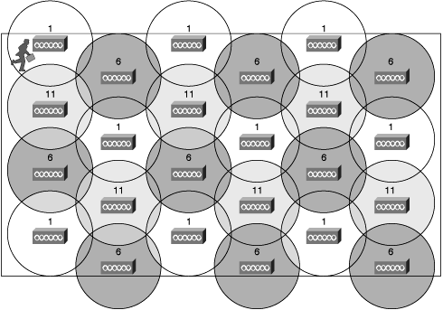
802.11b/g Cell Channel Layout

Slide 64
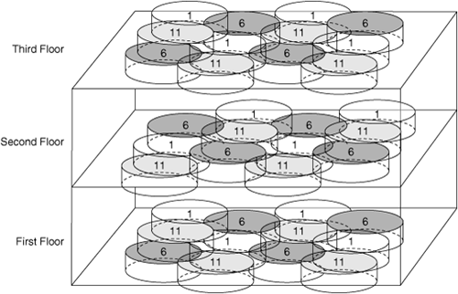
802.11b/g Cell Channel Layout

Slide 65
802.11b/g Channel Layout
As a general rule the useable transmission radius of an access point should not overlap more than two other access points
In other words no single point anywhere on the plan should be touched by more than three circles
In practice it is often possible to use channels 1, 4, 8, and 11 in the same area at the same time

Slide 66
802.11b/g Channel Layout
There is minimal overlap among this set of channels

Slide 67
Transmitting Power
As the amount of power that can be used by a transmitting device is regulated in most countries, this is not a variable that can be adjusted for the most part
Many people want to immediately amplify a signal to allow more devices to receive it
But as a wireless network must talk back and forth, amplification at one end is going to call for amplification at the other end as well

Slide 68
Transmitting Power
The second problem with amplifying the desired signal is that it also amplifies the noise
Usually amplification is not as useful as it would seem at first
Higher gain antennas are a better choice

Slide 69
Transmitting Power
Typical transmit power ratings seen in a wireless LAN include
100 mW – 20 dBm
50 mW – 17 dBm
30 mW – 15 dBm
20 mW – 13 dBm
5 mW – 7 dBm

Slide 70
Errors
Even though a readable signal at an acceptable data rate may be present, if too many errors occur, then the network will be unusable due to excessive traffic from retransmissions
Both the CRC error count and the packet retry count indicate the presence of bad packets on the wireless network

Slide 71
An Error Metric
An error metric to use is the percentage of bad packets to good packets at the data rate of interest
Recall that on a wireless network the data rate can vary
The problem is finding a tool to provide this information

Slide 72
Errors
If the network has less than 10 percent bad packets at the desired speed, it is operating properly
If the network has more than 30 percent bad packets at the desired speed, it needs attention
Keep the operating speed in mind
A network that has less than 10 percent bad frames, but is only working at 2 Mbps is not what is desired

Slide 73
CRC Errors
Now for some details on the two types of errors mentioned above
Every frame ends with a FCS – Frame Check Sequence, more commonly called the CRC – Cyclic Redundancy Check
Whenever the bits in the frame have been corrupted the CRC calculated by the receiver will not match the CRC that was stored in the frame by the sender

Slide 74
CRC Errors
In such a case the frame is discarded by the receiver

Slide 75
Retry Packet Count
The second type of error occurs when a frame is not acknowledged, it is assumed to have not arrived and is resent
In this case the retry packet count will go up
This is seen in the Retry field of the 802.11 MAC Header
For a normal frame the bit is set to 0, on a retry it is set to 1

Slide 76
Path Loss
What produces the variation in all of this, data rate and signal strength and error count, is the path loss that is always present in a wireless as opposed to a wired network
In some cases calculations based on the actual environment in which the network will be installed are called for, rather than just using estimates and guidelines

Slide 77
Real World Path Loss
Formulas tend to reflect a lab environment
They must be adjusted for the much dirtier and RF obstructed real world
For example in a typical office, just the structure, such as wallboard, that makes the offices themselves will increase signal loss

Slide 78
Real World Path Loss
If the environment has an unusual amount of metal objects, such as metal wall studs, shelving and so forth, or the environment has a high water content, such as plants, then the signal loss will be greater
This is especially if we are talking about an 802.11b/g network at 2.4 GHz

Slide 79
Calculating Path Loss
Let’s do a calculation for a typical real world office environment
Assume
100 mW access point transmitting at 20 dBm
Most 802.11b/g APs have transmitter output power of 15 to 20 dBm’s
Receiver 75 feet from the access point
8 walls in between the AP and the receiver at 6 dB per wall

Slide 80
Calculating Path Loss
Calculate total loss
Free space loss
30 dB per 100 feet
30 dB X .75 = 22.5 dB
Wall Loss
6 dB per wall
6 dB X 6 = 36 dB
Fade margin
30 dB

Slide 81
Calculating Path Loss
Total Loss
22.5 dB + 36 dB + 30 dB = 88.5 dB
Free Space Loss
Free space loss is the loss that would be experienced in a vacuum
It is the natural spreading out of the signal much as water spreads out as it leaves the end of a hose
As frequency increases, so does free space loss

Slide 82
Calculating Path Loss
As stated above it can be estimated as 30 dB per 100 feet for an 802.11b/g network
Wall Loss
This is the added loss that occurs when the signal not only has to traverse free space, but also penetrate a wall
Here six walls

Slide 83
Calculating Path Loss
Fade Margin
This is the way engineers try to account for the known but unmeasurable effects of things encountered in the environment, such as reflection, absorption, refraction, and diffraction of the RF signal
This is basically a fudge factor
20 to 30 dB is a common value for this in a wireless LAN

Slide 84
Calculating Path Loss
For the industrious there is also the Barnett-Vignant reliability equation
F = 30LOG₁₀(D) + 10LOG₁₀(6ABf) – 10LOG₁₀(1 – R) – 70
F = fade margin in dB
D = distance in kilometers
A = terrain roughness factor, where 4 is used for a smooth surface, 1 for average, and .25 for rough
B = weather factor, where 1 is for the worst case, .5 for hot humid areas, .25 for inland areas, and .125 for dry or mountainous areas

Slide 85
Calculating Path Loss
f = frequency in GHz
R = reliability expressed as a decimal, such as .9999

Slide 86
Calculating Path Loss
The result would be at the receiver 75 feet from the AP with the eight walls in between
20 dBm – 88.5 dB = -68.5 dBm
Based on the guideline given above of at least -65 dBm being required at the receiver, this location is too far away

Slide 87
Calculating Path Loss
But a signal would still be receivable as the -68.5 figure is within the minimum range called for by the standard

Slide 88
Calculating Path Loss
Either the
Access point will have to be relocated
The receiver will have to be relocated
A directional antenna aimed toward the receiver will have to be installed
Some of the obstructions to the RF signal will have to be removed, such as busting a large hole in a couple of the walls
Well not really, but you get the idea

Slide 89
Wiring for Access Points
The introduction of 802.11n will bring changes to the way cabling is provided to access points
Even though the theoretical 600 Mbps speeds discussed are unlikely, speeds of 75 to 150 Mbps are likely in a pure 802.11n environments

Slide 90
Wiring for Access Points
This means each of these access points will need at least a 100 Mbps wired connection back to the MDF
In a large environment where multiple access points connect to an IDF with a single backbone cable to the MDF a Gigabit wired connection may be needed as the aggregate from the multiple access points will surely exceed 100 Mbps

Slide 91
Wiring for Access Points
In an ideal 802.11n environment, you might even consider a 10G backbone

Slide 92
Alternative to Rewiring
Motorola has an interesting access point that can be installed in place of an existing RJ-45 jack in a room
The existing wallplate is removed
A short cable connects the existing RJ-45 jack to the AP
The AP is mounted to the existing hole in the wall

Slide 93
Alternative to Rewiring
This provides a tight signal for just one room, such as in a dormitory, classroom, patient room, or hotel
This can be standalone or centrally managed
Here is what it looks like

Slide 94
Alternative to Rewiring

Slide 95
Bandwidth Requirements
What type of bandwidth do you really need for common wireless network uses
A BICSI newsletter from June 2008 suggested these numbers

Slide 96
Bandwidth Requirements

Slide 97
Over Subscription
Of course you do not need to provide the maximum data rate to each user at every moment in time
Just like in a retail establishment queuing theory tells you that not everyone will do the same thing at the same time
The same BICSI newsletter suggested these over subscription rates

Slide 98
Over Subscription

Slide 99
Tools Used
At present there is no single, low cost tool that can be used to do a site survey for a LAN
To work around this most people do one or both of the following
They rely on the guidelines discussed above
They just use the tools that are supplied with the hardware they are installing

Slide 100
Spectrum Analyzer
Let’s discuss some of these common tools
Spectrum Analyzer
Site Survey Tool
Network Analyzer
A spectrum analyzer is used to look for and measure the strength of radio frequency signals within the band to be used

Slide 101
Spectrum Analyzer
This device is expensive, from $2,000 to $10,000 depending on the features and frequencies included
It looks like this

Slide 102
Spectrum Analyzer

Slide 103
Spectrum Analyzer
Be sure to buy one with a peak hold function
There are low cost very basic spectrum analyzers that can be used for 802.11 networks
One of these is by Metageek
The hardware is a USB receiver

Slide 104
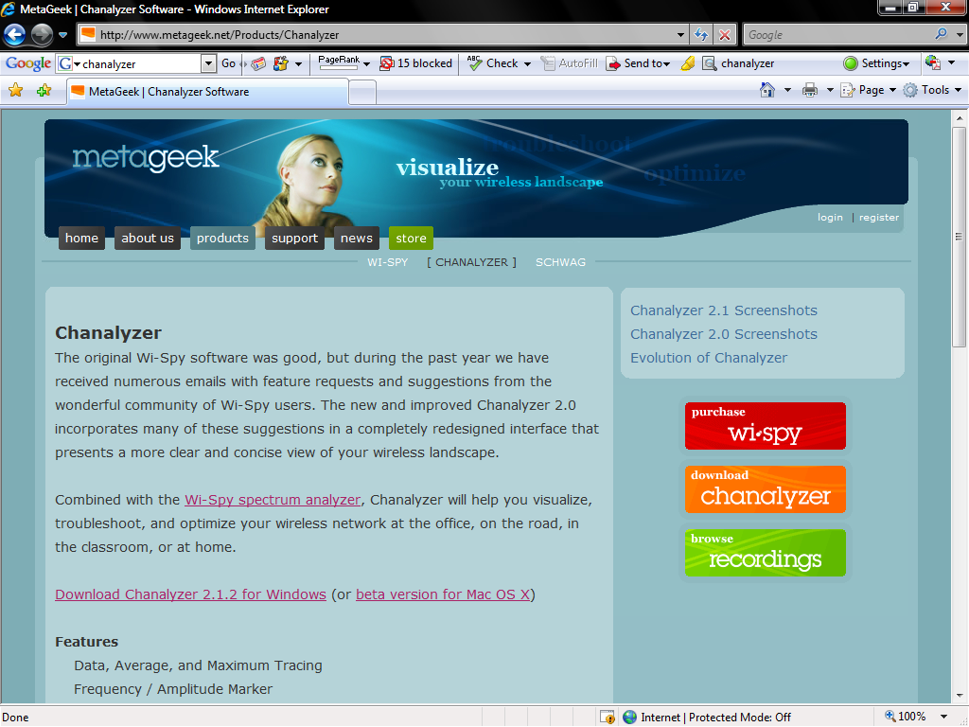
Spectrum Analyzer

Slide 105
Spectrum Analyzer

Slide 106
Spectrum Analyzer

Slide 107
Site Survey Tool
Once it has been determined that the site is free of any interference that might cause a problem for the frequencies to be used, measurements can be taken to determine if the placement of the devices is suitable
The tool for this is one that will measure at least
Signal strength
Noise level

Slide 108
Site Survey Tool
As discussed above the best way to use these two measurements is to display a signal to noise ratio

Slide 109
Site Survey Tool

Slide 110
Site Survey Tool
As seen on this tool from Cisco’s the most important parameters
Signal Strength
Noise Level
Signal to Noise Ratio
The screenshot above is from the tool running in passive mode
In active mode it gives an indication of the errors being seen on the network

Slide 111
Site Survey Tool

Slide 112
Site Survey Tool
In this case things look pretty good as no errors are showing right now
The way to use this tool is to set it up on a laptop
Then walk around the site to check the effect on signal and noise levels
By doing this the suitability of the original plan can be determined and devices rearranged as required

Slide 113
Network Analyzer
A network analyzer, such as Sniffer Wireless from Network Associates or AiroPeek from Wild Packets, will show some information useful for a site survey
Sniffer Wireless will be used to illustrate this

Slide 114
Network Analyzer
The opening display is the same as Sniffer has been for quite a while
The only apparent difference for a wireless network is in the title bar

Slide 115
Network Analyzer

Slide 116
Network Analyzer

Slide 117
Network Analyzer
In the title bar we can see that
This is a wireless network
It is using 802.11b/g
The modulation scheme is DSSS
The current channel is 1
The signal strength on channel 1 is 63%

Slide 118
Gauge Dashboard View
To make the dashboard appear, click on the dashboard button on the toolbar

Slide 119
Gauge Dashboard View

Slide 120
Gauge Dashboard View
The dashboard is a set of gauges showing
Utilization
Packets per Second
Errors per Second
Throughput
Below this is a line chart
Utilization is selected by default
Other lines can be added by checking the boxes

Slide 121
Gauge Dashboard View

Slide 122
Detail Dashboard View
The information seen in the gauges can be expanded to show more detail by clicking the Detail tab

Slide 123
Detail Dashboard View

Slide 124
Detail Dashboard View

Slide 125
Detail Dashboard View
Two items in this view relate specifically to wireless networks

Slide 126
Detail Dashboard View

Slide 127
Detail Dashboard View

Slide 128
Detail Dashboard View
PLCP and WEP ICV are peculiar to a wireless network
PLCP is a physical layer sublayer
What is shown here are the number of PLCP errors seen on the network
PLCP errors occur when a wireless station receives a Physical Layer Convergence Protocol header with an invalid checksum

Slide 129
Detail Dashboard View
WEP ICV refers to the security on a wireless network
This is the number of packets sent indicating an invalid WEP ICV

Slide 130
The Problem With the Tools
We will stop here as there is much more that a network analyzer can do that relates to a wireless network, but this is covered in detail in the How to use Sniffer Wireless presentation
As can be seen there is no single, low cost tool that gives us all of the parameters we need

Slide 131
The Problem With the Tools
Specialized tools can be purchased for this purpose, but they can be expensive
AirMagnet is an example of this type of tool

Slide 132
Automatic Design
Some companies are attempting automate more and more of the installation and management of wireless networks
For example Aruba Wireless Networks has a product called RF Director
When using the Aruba APs with this tool an AutoCAD drawing of a building can be imported

Slide 133
Automatic Design
Based on this and standard parameters the Aruba tool places the APs on this diagram, as well as selecting the channels to use and the power settings
Once the APs are installed the tool is run again
It then adjusts the settings based on the actual affects of the building on the wireless signal

Slide 134
Testing
If the calculations are not definitive or if the network is so critical that it must work right out of the box, then a test network may be called for
To check the data rate and the other factors, lay out a typical network, including workstations, in the actual environment

Slide 135
Testing
Then transfer data between devices using some sort of automated operation, such as a batch file, a NIC utility program, or a program designed for this
Examples of this type of program include
FTP transfers, although the requirement of FTP to read and write to disks may affect the result

Slide 136
Testing
Netperf, a free tool from www.netperf.org
Two products from NetIQ, the free QCheck and the more powerful Chariot
Once the data is flowing, measure the data rate, signal strength, and errors at various parts of the network

