Slide 1
WAN Design
Last Update 2007.06.06
1.1.0

Slide 2
Objectives of This Section
Learn some aspects of network design that are specific to a WAN

Slide 3
What is a WAN
A WAN is any network larger than a MAN
In addition many MANs are large enough or located in such a way that WAN connection methods must be used
A WAN type connection will always require a service provider’s service be used
Unlike a LAN or CAN where the entire network could be located on property you control

Slide 4
What is a WAN
For a WAN it is unlikely you will be able to directly control all aspects of the network
The data lines and perhaps some of the equipment will be under the control of a service provider

Slide 5
WAN Application Requirements

Slide 6
Enterprise Services
In the Cisco design model the WAN connections are typically part of the distribution layer on small and medium sized organizations
In larger networks the connection is at the core layer
In all cases the WAN connections are part of the Enterprise Services section

Slide 7
Enterprise Services
Enterprise Services are those common to all users in the organization
Such as, email, Internet access, or video conferencing
These services are placed within their own network near the backbone network that connects all of the organization’s networks
Traffic to and from these services must cross a layer 3 device

Slide 8
Shared Block
Within the Enterprise Services section the WAN connections are part of a Shared Block
A Shared Block contains such things as
A server farm
Connection to the WAN
Connection to the Internet

Slide 9
Enterprise Composite Model

Slide 10
Enterprise Edge

Slide 11
Network Layouts
The size and the amount of redundancy required in the network will dictate the basic network design, as will the available funding
The common network layouts include

Slide 12
Network Layouts
Point-to-Point
Hub and Spoke
Partial Mesh
Full Mesh

Slide 13
Point-to-Point

Slide 14
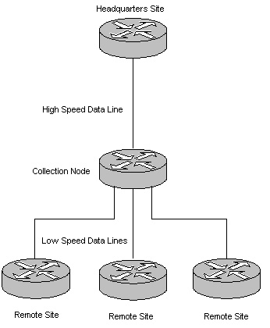
Hub and Spoke

Slide 15
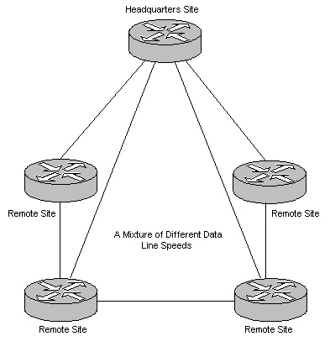
Partial Mesh

Slide 16
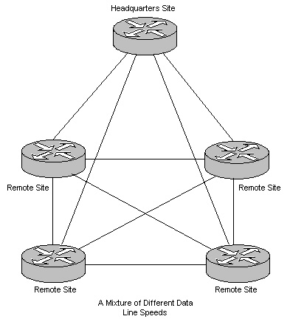
Full Mesh

Slide 17
Redundancy
Of course neither the Point-to-Point or the Hub and Spoke utilize any redundancy
Both the mesh network do
The design used today is dependent on the type of data line used
Let’s look at the progression of data line usage that has occurred over time

Slide 18
Progression of Data Line Usage
In medium to large networks the trend has been from
Private Lines
to
Frame Relay
to
MPLS

Slide 19
Progression of Data Line Usage
In each case the desire has been to lower the costs
The way to do this has been to move to networks where the data travels over a shared network backbone

Slide 20
Private Lines
The original design was to use private lines
Depending on speed this has been one or more of the following
DDS
T1
T3

Slide 21
Private Lines
To provide redundancy a private line was required between each location on the network

Slide 22
Frame Relay
With a frame relay network a single data line connects each location to the service provider’s frame relay network
This lowered the cost as only a single data line was required at each location including the headquarters where all of the locations connect
PVCs then provide connectivity over the shared line to each location

Slide 23
Frame Relay
A PVC is required to connect each redundant connection as well

Slide 24
MPLS
In the current implementation using MPLS, tunnels are built from any site to any site through the service provider’s MPLS network

Slide 25
Progression of Data Line Usage
In each case costs have dropped because of the shared nature of the network, while redundancy has been enhanced
The cost of private lines meant that little high speed redundancy was possible at a reasonable cost
Frame relay connections allowed more redundancy
MPLS allows a full mesh approach

Slide 26
The Internet as the Network
Some see the next trend as being the use of the Internet as the WAN network to provide the ultimate in cost control
However, this is problematic at best due to
Lack of SLA
Lack of known latency
No single point of contact
But lower cost

Slide 27
What is a SLA
SLA stands for Service Level Agreement
In reality it is a prenuptial agreement
Something overpriced lawyers use as weapons both for you and against you
Something you never look at or use, until things start going wrong
More specifically it
Details the level of service that is guaranteed
Details the remedy, if that level is not met

Slide 28
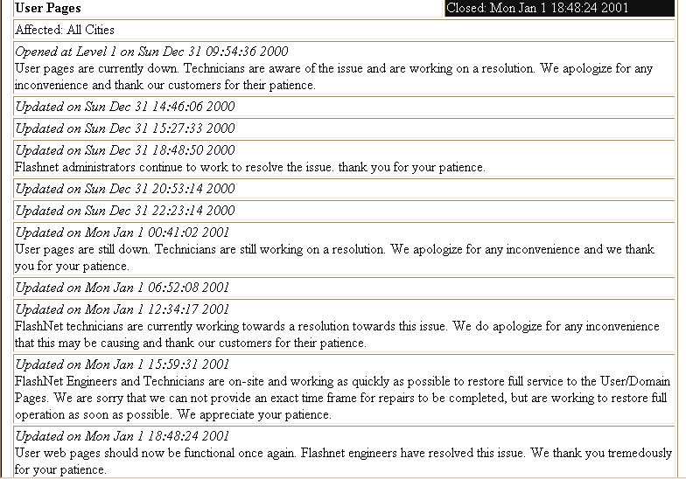
This is Why You Need One

Slide 29
A SLA is Useless
Fundamentally a SLA is totally useless, but you must have one for any large contract for service
It is useless because as we will see below the only remedy is that the service provider will pay you some small amount of money or have a high ranking executive tell you how sorry they are
What you really need is for them to roll back time

Slide 30
A SLA is Useless
What you need is that time lost to be given back
This is impossible
So a SLA is useless, but get one anyway

Slide 31
Define in the SLA
There are two main elements to a SLA
Performance
Availability
For these two elements there are three things to include in the SLA
Standard
A measurable benchmark
Measure
Must be quantifiable

Slide 32
Define in the SLA
Remedy
The penalty
Other things to include in the SLA are
Clearly define responsibilities
Each person responsible for seeing that a function is performed should be identified by position
Cover corrective action
Define who resolves each type of problem
List all parties involved in the agreement
Especially if there are multiple service providers

Slide 33
Define in the SLA
Specify the period of time the agreement covers
Usually one or two years
Identify and define each service covered
Identify service level indicators
Describe how the indicator is measured
Define who is responsible for performing the measurement
Common indicators include
Bandwidth used or data throughput levels, such as bps
Latency
Availability, such as percent of uptime

Slide 34
Define in the SLA
Define nonperformance
What constitutes nonperformance
What is done if the indicators are not met
These are often qualified
Instead of saying all transactions will not have more than a 2 second response time
Most will say 95% of all transactions will have a 2 second or less response time

Slide 35
Define in the SLA
Define the reports to be produced
Frequency of reporting
Who will have access to the reports
Availability of real-time reports as well as periodically produced reports
The remedies themselves must be
Simple to calculate
Reasonable

Slide 36
Define in the SLA
If they are to hold up in arbitration or court
The remedy is usually a percentage of the monthly fee
It should be enough to remove the profit, but not so much as to put them out of business
It should also escalate with repeated occurrences

Slide 37
Other Remedies
As money in exchange for time is not very useful, some have suggested an additional remedy to use to help focus the service provider on actually solving problems
Craft a defined escalation policy that ensures that any issues receive immediate attention from the right people inside the service provider's organization

Slide 38
Other Remedies
First, define what constitutes a service incident
Then create severity tiers that characterize the impact of a service weakness
For example, outright service cessation is obviously Tier 1
But you also should consider latency spikes, which can affect user response-time

Slide 39
Other Remedies
Sustained latency of 250 msec or more for periods of longer than 1 minute may constitute a Tier 2 event
Once the tiers are defined, determine how quickly the carrier should inform you of an incident, how quickly it should respond to your notification, and how quickly you can expect restored service

Slide 40
Other Remedies
After that, get the names, job descriptions, and phone numbers for the individuals who will be directly responsible for repairs
Get the contact information for the individuals to whom they report
Then, define explicitly when the service provider will escalate an incident

Slide 41
Other Remedies
The service provider should agree to inform you directly every time an incident has been escalated
Now for the secret to this method
Explicitly specify that a senior member of management will address any issues that are not resolved in a timely fashion and to your complete satisfaction, at a time and date of your choosing

Slide 42
Other Remedies
In other words, if you are sufficiently unhappy, an executive vice president will fly out to your site to explain why your service doesn't work
This works for a simple reason
Nobody wants to tell the vice president he has to exchange a Friday tee time for a room full of angry customers

Slide 43
Other Remedies
The result is a more energetic effort to avoid the situation, which is exactly what you wanted in the first place
The forgoing excellent suggestion, assuming you are a large enough customer to talk them into thus, is from a column in Network World by Johna Till Johnson

Slide 44
SLA Problems
Often an SLA means nothing in practice
For example
“When SLA's are offered by Qwest, they apparently don't mean much.
Our DSL has been down for nearly 3 days already- they promised a fix today, now they are saying Monday to even get a tech on it (apparently their remote dslam stinger has gone bad and I guess they don't stock a spare).

Slide 45
SLA Problems
Meanwhile we are half dead in the water. Very unimpressive service to say the least.”

Slide 46
SLA Caution Areas
Be careful if performance is measured using averages
If 90 out of 100 things are averaging 40 ms latency and the remaining 10 average 80 ms latency, then the overall average is 44 ms
The average might then be within the tolerance
However a delay of 80 ms for any one thing may be too high

Slide 47
SLA Caution Areas
The definition of uptime is a slippery slope
Percentage is not as important as the time period over which it is measured
What is covered under the uptime is also important
For example, in a circuit is it just part or the whole thing end-to-end
If just one part has a 100% uptime guarantee, but another part has a 97% uptime guarantee, then the circuit uptime guarantee is 97%, not 100%

Slide 48
SLA Caution Areas
The part most likely to fail is the one that is always guaranteed at the lower level
Another uptime issue is related to the percentage of uptime guaranteed and over what period of time it is guaranteed
For example
Let’s say the uptime guarantee is 99%
That comes out to just 87.6 hours of downtime in an entire year

Slide 49
SLA Caution Areas
That sounds pretty good
But what if you are an online flower shop
What if all of those hours happen to span the 4 days just before Mother’s Day

Slide 50
SLA Uptime Table
Uptime Percentage | 8 Hour Day Downtime | 24 Hour Day Downtime
90 | 291.2 hours | 876 hours
95 | 145.6 hours | 438 hours
99 | 29.12 hours | 87.6 hours
99.9 | 2.91 hours | 8.76 hours
99.99 | 17.47 minutes | 52.56 minutes
99.999 | 1.747 minutes | 5.246 minutes

Slide 51
Monitoring the SLA
There are two ways to ensure the SLA is being adhered to
Just trust the service provider
or
Watch it yourself
Monitoring can even be outsourced
Companies monitor and argue for you
In such a case, you have outsourced the outsourcing

Slide 52
Putting It Into Practice
Let’s evaluate a sample SLA
Using the SLA handed out to you
Take a few minutes and look for the following

Slide 53
Putting It Into Practice
Latency Guarantees
Part of network covered
Latency allowed
Is it averaged
What is Force Majeure
Remedy

Slide 54
Putting It Into Practice
Uptime levels
Part of network covered
Percent of uptime guaranteed
Excluded events
Remedy

Slide 55
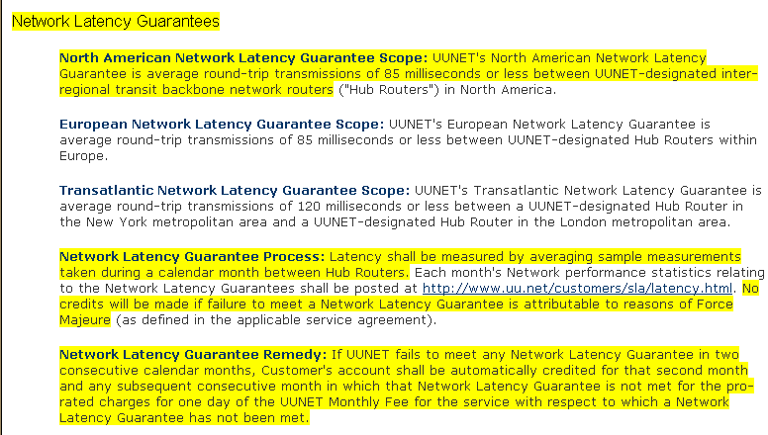
UUNET SLA

Slide 56
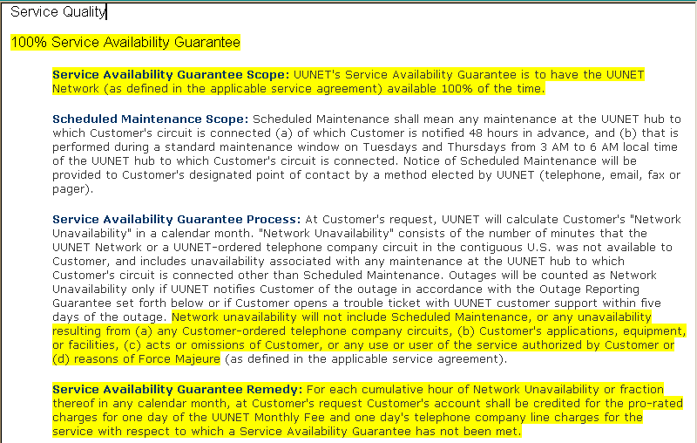
UUNET SLA

Slide 57
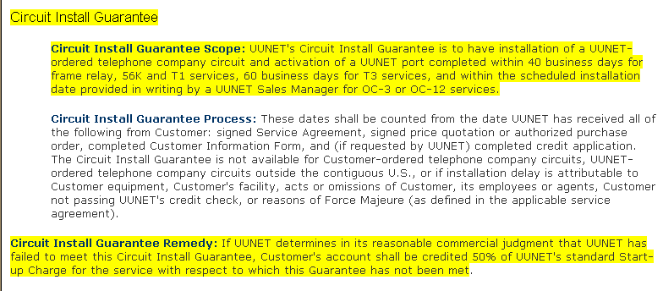
UUNET SLA

Slide 58
AT&T DSL SLA
This summary page describes the Service Level Agreement (SLA) applicable to the AT&T Yahoo! High Speed Internet Business Edition family of services
A. Network Availability - 99.99%
AT&T POPs on the IP/DSL Backbone Network shall be "Available" 99.99% of the time in delivering traffic to/from other AT&T POP locations on the IP/DSL Backbone measured over a calendar month

Slide 59
AT&T DSL SLA
Network Availability shall be calculated based on an aggregate monthly measurement average between AT&T MegaPOP and MiniPOP endpoints within the USA
Customer shall be entitled to one (1) day's credit prorated from the Customer's Recurring Monthly Service Fees if AT&T fails to meet the aggregate Network Availability guarantee during any calendar month

Slide 60
AT&T DSL SLA
Any calculation of Network Availability shall not include any unavailability resulting from (a) scheduled Network maintenance; (b) the occurrence of a Force Majeure event, unavailability of an AT&T Virtual POP, or (c) the failure of non-service impacting equipment or systems responsible for network measurements

Slide 61
AT&T DSL SLA
B. Installation Interval - 5 Calendar Days
For completed, End User circuits on which billing has commenced, “Installation Interval” is calculated as the number of whole calendar days between the date AT&T received the customer order and the service activation date

Slide 62
AT&T DSL SLA
*Customer shall be entitled to 50% credit of the first whole month’s monthly recurring charge for that particular circuit if AT&T fails to meet the Installation Interval guarantee during the initial installation phase of the order
This calculation excludes: (a) any customer that does not have an active voice line currently in service with AT&T (must add high-speed Internet service to existing line), (b) any requested due date that occurs after the first available install date,

Slide 63
AT&T DSL SLA
(c) lack of facilities within the AT&T network, (d) any orders which are changed by the customer after original date of submission, (e) orders must be placed before 12PM local time or the interval will not start until the following calendar day, (f) any customer with access provided by AT&T SPORT or (g) any delay resulting from Force Majeure events

Slide 64
AT&T DSL SLA
C. Network Latency - 40ms:
AT&T's aggregate monthly average, roundtrip POP-to-POP latency on the IP/DSL Backbone Network shall be 40.0 milliseconds or less between MegaPOP locations on the AT&T IP/DSL Backbone

Slide 65
AT&T DSL SLA
Aggregate monthly roundtrip latency shall be calculated based on the geometric mean of regular measurement samples between AT&T MegaPOP endpoints within the contiguous forty-eight (48) States of the USA
Customer shall be entitled to one (1) day's credit pro-rated from the Customer's Recurring Monthly Service Fees if AT&T fails to meet the aggregate Network Latency Guarantee during any calendar month

Slide 66
AT&T DSL SLA
Any calculation of Network Latency shall not include any failure attributable to (a) scheduled Network maintenance; (b) the occurrence of a Force Majeure event, or (c) the failure of non-service impacting equipment or systems responsible for network measurements

Slide 67
AT&T DSL SLA
D. Data Delivery (Packet Loss) - 99.9%:
AT&T's aggregate monthly average packet loss between AT&T POPs on the IP/DSL Backbone shall not exceed 0.1%
Packet Loss shall be calculated based on the arithmetic mean of aggregate monthly measurements between AT&T MegaPOP and MiniPOP endpoints within the USA

Slide 68
AT&T DSL SLA
*Customer shall be entitled to one (1) day‘s credit pro-rated from the Customer's Recurring Monthly Service Fees if AT&T fails to meet the aggregate Network Packet Loss SLA during any calendar month

Slide 69
AT&T DSL SLA
Any calculation of Network Packet Loss shall not include any failure attributable to (a) scheduled Network maintenance; (b) the occurrence of a Force Majeure event, or (c) the failure of non-service impacting equipment or systems responsible for network measurements

Slide 70
AT&T DSL SLA
E. 24 Hour Service Restoration:
Customer connectivity shall be restored in 24 hours or less from the time AT&T is notified of the outage
*Customer shall be entitled to one (1) day's credit (based on 30 day calendar month) from the Customer's recurring monthly service fees if AT&T fails to meet the 24 Hour Service Restoration SLA

Slide 71
AT&T DSL SLA
Any calculation of 24 Hour Service Restoration shall not include any failure attributable to (a) scheduled Network maintenance; (b) the occurrence of a Force Majeure event; (c) the failure of non-service impacting equipment or systems responsible for network measurements; or (d) any CPE failures; (e) any outage involving access facilities; including Central Office (CO), Remote Terminal (RT), or Digital Subscriber Line Access Multiplexer (DSLAM) equipment

Slide 72
AT&T DSL SLA
(*) Credits are not automatically applied. Customer must apply via the Business DSL SLA website located at http://www.att.com/businessdslsla, or by calling our Customer Care at 1-877-722-3755

Slide 73
AT&T DSL SLA
G. Scheduled Network Maintenance:
Scheduled Network Maintenance refers to upgrades or modifications to network equipment software, network equipment hardware, or Network capacity
Scheduled Network Maintenance may temporarily degrade the quality of AT&T’s Internet Service, including the possibility of short-duration outages

Slide 74
AT&T DSL SLA
Such effects related to Scheduled Network Maintenance shall not give rise to service credits under this SLA
Scheduled Network Maintenance shall be undertaken only on Tuesday and Thursday mornings between the hours of 2:00AM and 5:00AM Central Time in the United States independent of the local time zone of each respective AT&T Point-of-Presence (POP)

Slide 75
AT&T DSL SLA
AT&T reserves the right to change Scheduled Network Maintenance dates & times upon 30 days notification via update to be posted at this site

Slide 76
AT&T DSL SLA
H. Emergency Network Maintenance:
Emergency Network Maintenance refers to efforts to correct network conditions that are likely to cause a material Service outage and that require immediate action. Emergency Network Maintenance may temporarily degrade the quality of AT&T’s Internet Service, including the possibility of short-duration outages

Slide 77
AT&T DSL SLA
Such effects related to Emergency Network Maintenance shall entitle Customer to service credits as set forth in this SLA if and only if service degradation or loss-of-service occurs outside of Scheduled Network Maintenance time windows identified in Section F

Slide 78
AT&T DSL SLA
AT&T may undertake Emergency Network Maintenance at any time deemed necessary and shall provide notice of Emergency Network Maintenance to Customer as soon as is commercially practicable under the circumstances

Slide 79
AT&T DSL SLA
I. Force Majeure:
Neither AT&T nor Customer shall be responsible for damages or for delays or failures in performance resulting from acts or occurrences beyond their reasonable control, including without limitation: fire, lightning, explosion, power surge or failure, water, acts of God, war, revolution, civil commotion or acts of civil or military authorities or public enemies; any law, order, regulation,

Slide 80
AT&T DSL SLA
ordinance, or requirement of any government or legal body or any representative of any such government or legal body; or labor unrest, including strikes, slowdowns, picketing or boycotts; inability to secure raw materials, transportation facilities, fuel or energy shortages, or acts or omissions of other common carriers

Slide 81
AT&T DSL SLA

Slide 82
AT&T T Carrier SLA
AT&T’s commitment on provisioning
30 Days from Technical Interview
Excludes any LEC facility issues
AT&T commitment on On-net Network Availability
99.999% AT&T’s IP network has continually outperformed its major competitors for over a year

Slide 83
AT&T T Carrier SLA
Proof is readily available on the Internet
AT&T’s IP network performance statistics are publicly available at www.att.com/ipnetwork

Slide 84
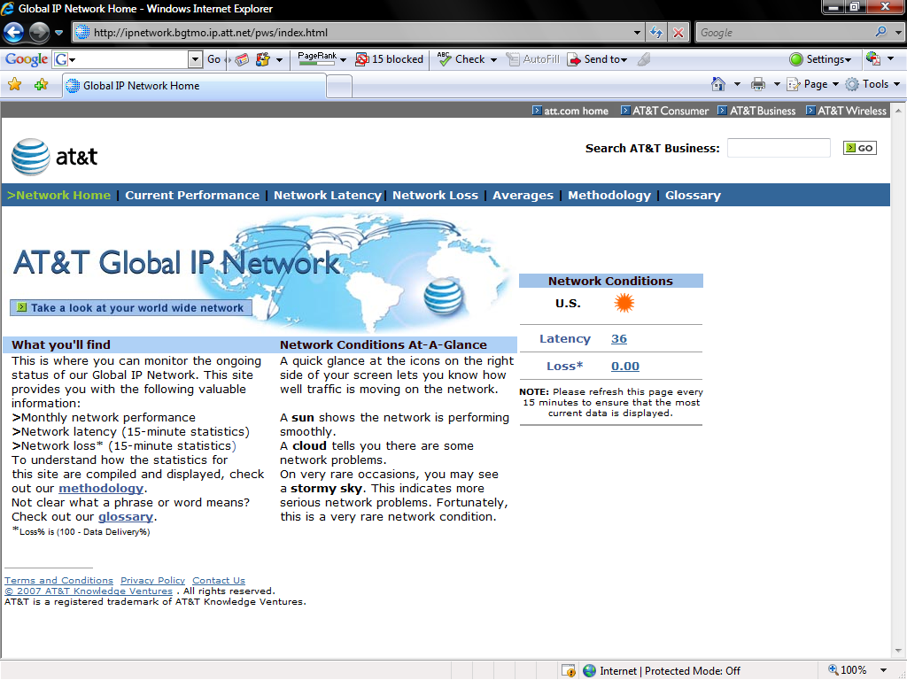
AT&T T Carrier SLA

Slide 85
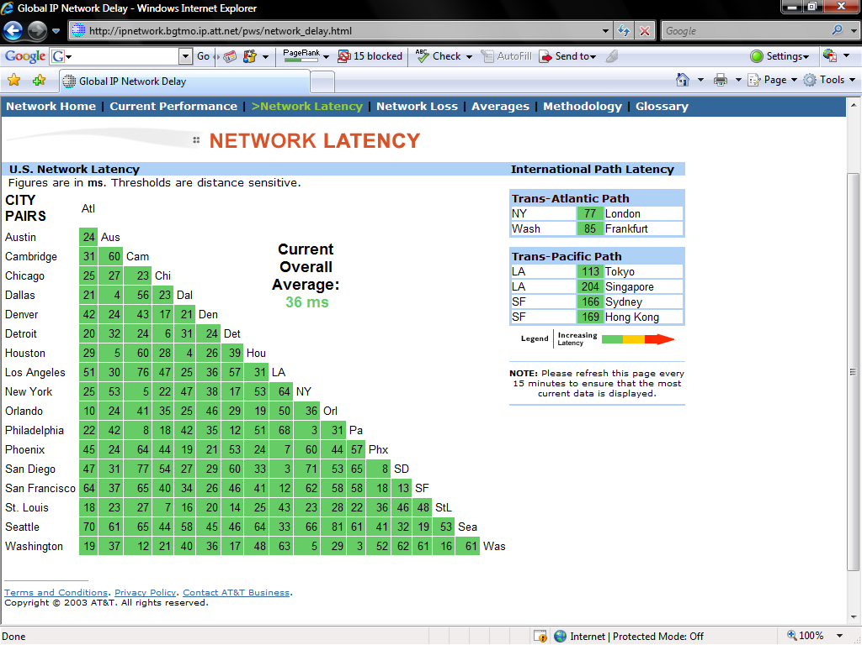
AT&T T Carrier SLA

Slide 86
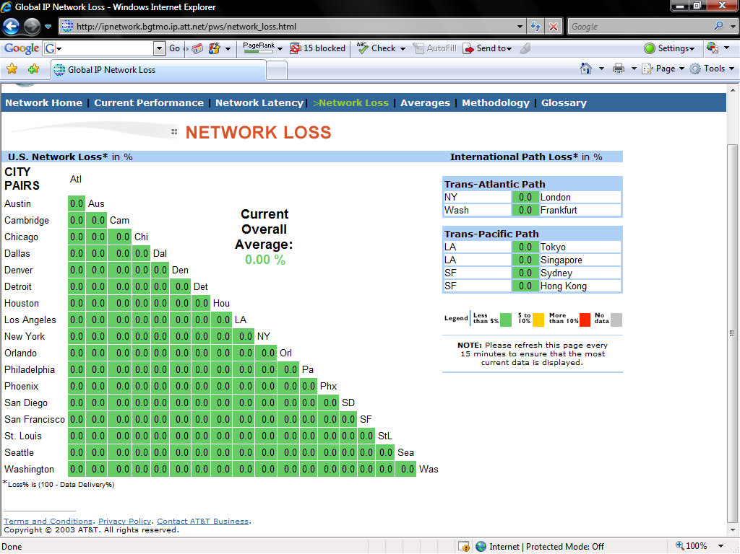
AT&T T Carrier SLA

Slide 87
AT&T T Carrier SLA
AT&T/SBC's commitment on Off-net Network Availability
The monthly average full-page download time for the Keynote Business 40 websites, from within selected domestic MegaPOP locations, will not exceed 110% of the US25 Overall metric

Slide 88
AT&T T Carrier SLA
The Keynote Business 40 (KB40) Internet Performance Index measures the average download time for the home pages of 40 significant US-based business Web Sites
These measurements are taken by automated agents attached to key points in the Internet backbone in the 25 largest metropolitan areas of the United States

Slide 89
AT&T T Carrier SLA
AT&T's commitment on Maximum Time to Restore
< 3 hours AT&T's commitment on Data Delivery
99.9% Internet Service Availability
SBC’s Dedicated Internet Access Service will be available to Customer 99.95% of the time in a calendar month

Slide 90
AT&T T Carrier SLA
Service Unavailability exists when the Internet connection is unable to transmit and receive IP Packets to/from On-Net Hosts and AT&T records such failure in the trouble ticketing system
Service Unavailability is measured from the time SBC has actual knowledge of a service outage and a trouble ticket is opened, either in response to notification by the Customer or in response to alarms from internal network management systems, to the time Customer’s Impaired DIA Service is again able to transmit and receive IP Packets from SBC On-Net Hosts

Slide 91
AT&T T Carrier SLA
AT&T's commitment on Maximum Latency
39 ms Network Latency
Average round-trip transmissions will be 40 milliseconds or less between selected MegaPOP endpoints within the IP Network, measured by averaging samples taken during a calendar month between these endpoints

Slide 92
AT&T T Carrier SLA
AT&T's commitment on Maximum Packet Loss
0.1% Network Packet Loss
During any calendar month, packet loss will not exceed 0.1% based upon monthly averages, between MegaPOP and MiniPOP endpoints within the IP network

Slide 93
AT&T T Carrier SLA
AT&T's commitment on Throughput
There is a National Maintenance Windows for Tuesday and Thursday mornings at Eastern Time: 3:00 A.M. to 6:00 A.M.
From the contract, "Customer understands and agrees that temporary interruptions may occur as normal and reasonable events in the provision of the Service
All computer systems and networks need routine maintenance from time to time

Slide 94
AT&T T Carrier SLA
SBC generally schedules and performs such maintenance, on an as needed basis, during the times indicated on SBC’s website (located at http://dedicated.sbcis.sbc.com/NDWS/)
Not all scheduled network/systems maintenance will affect Customer’s Service

Slide 95
AT&T T Carrier SLA
However, SBC will endeavor to provide Customer five (5) business days advance notice, or if not possible, reasonable advance notice if SBC believes that such routine scheduled maintenance will affect Customer’s Service

Slide 96
AT&T T Carrier SLA
In the event of a network/systems emergency requiring immediate attention, SBC reserves the right to perform emergency maintenance without notice or upon short notice, and shall use all reasonable efforts to minimize the effect of such work on Customer’s Service.“

Slide 97
Optimization and Acceleration
Once the WAN line is selected and installed thought should be given to how to make the optimum use of the data line
Hardware and software is available that, through various methods, makes better use of the data line than can be achieved by just sending data down the line from the router

Slide 98
Optimization and Acceleration
This is a new and developing field
As a Gartner research report says
Optimization techniques for WANs can improve most organizations' application response times, particularly where network latency is high, which is often due to centralization of servers and IT resources

Slide 99
Optimization and Acceleration
Typically, WAN optimization controllers (WOCs) mitigate the sometimes severe impact of network latency on the performance of applications and the underlying protocols
Through data reduction and prioritization techniques, WOCs can also help organizations avoid costly bandwidth upgrades

Slide 100
Optimization and Acceleration
The WOC market is rapidly maturing, but it is still dynamic with a high level of vendor innovation
This has led to different vendors offering different combinations of features. So, before choosing a vendor, ensure you understand the applications and services running on the network, and the protocols that they use

Slide 101
Optimization and Acceleration
Also conduct a detailed analysis of your network traffic to identify specific problems — for example, excessive latency, bandwidth oversubscription or lack of prioritization for certain types of traffic
Finally, insist on a real-life trial before committing to any purchase.

Slide 102
Optimization and Acceleration

Slide 103
For More Information
Top Down Network Design
Priscilla Oppenheimer
ISBN 1578700698

Slide 104
Review
What is a WAN
What is an SLA
What is the major problem with SLAs

