Slide 1
Modeling Networks Last Update 2011.08.01 121.0

Slide 2
Objectives
To see how networks can be modeling and tested before deployment

Slide 3
Modeling Networks
It is often useful to model a network before it is deployed into the real world
There are different types of modeling tools from simple to complex that can be used
We will look at four types of tools
Application Testing Tool
Simulator
Emulator
Network Modeling Tool

Slide 4
Application Testing Tool
One type of application testing tool is one used to determine what hardware is needed to run an application
It is also good practice to test a new application before deploying it on the network to see how it will respond to common network problems
To do this a software based tool can be used to stand in for the network

Slide 5
Application Testing Tool
This allows a real workstation to access a real server with the traffic going through the software based tool

Slide 6
Simulator
A simulator is a program that is designed to present an environment that looks as near as possible to the real equipment it is simulating
The simulator used here is Packet Tracer

Slide 7
Emulator
An emulator is a program designed to run programs on a computer that would normally be run on a separate piece of equipment
Virtualization programs such as VMWare are emulators
The emulator used here is GNS3

Slide 8
Network Modeling Tool
Network modeling tools are designed to present as realistically as possible a complex real world network
The network modeling tool that will be used in this example is Opnet

Slide 9
Application Testing Tool
Let’s look at an example of a sizing tool used before deploying an application

Slide 10
Application Testing Tool
Now let’s see how application performance is tested using WANem as an example of this type of tool
WANem works by attaching three computers to a network
Typically one computer is used as a workstation such as an end user would use to access the application

Slide 11
Application Testing Tool
Another is used to run the application on a server such as would be used in the actual deployment of the application
The last runs WANem to serve as the network
As the WANem documentation points out it looks like this

Slide 12
Application Testing Tool

Slide 13
Application Testing Tool
Once the network is created as shown above one or more problems are introduced into the network while the application is being accessed by the end user
The impact of this can then be seen at both the end user and server ends

Slide 14
Sample Network Simulation
Let’s create a sample network to see how Packet Tracer simulates a network

Slide 15
Sample Network Simulation
Start creating the network by loading a background grid using the Set Tiled Background button
Select the
grid_25x25.png
for this example

Slide 16
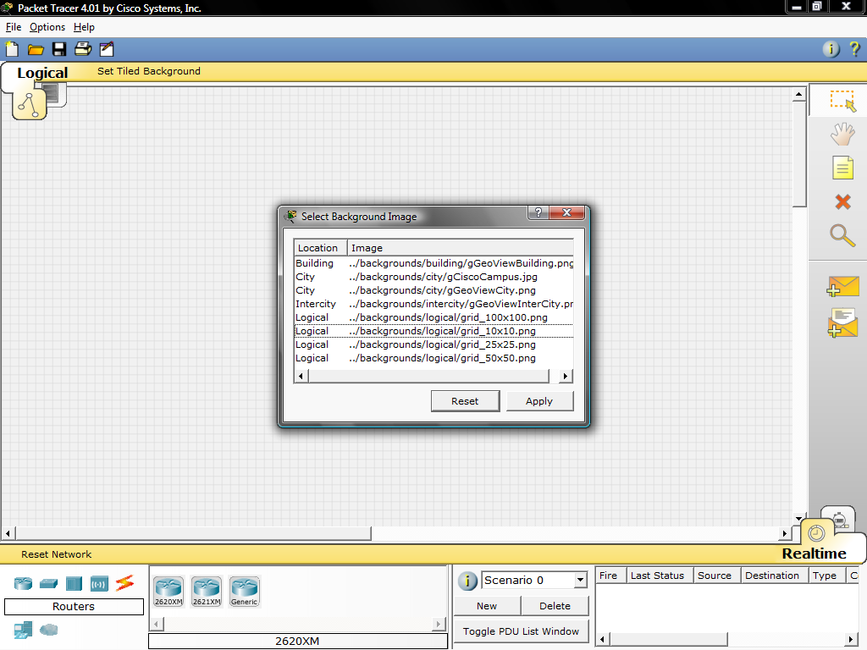
Sample Network Simulation

Slide 17
Sample Network Simulation
Select the Generic PC under End Devices and drag it as the first PC onto the workspace

Slide 18
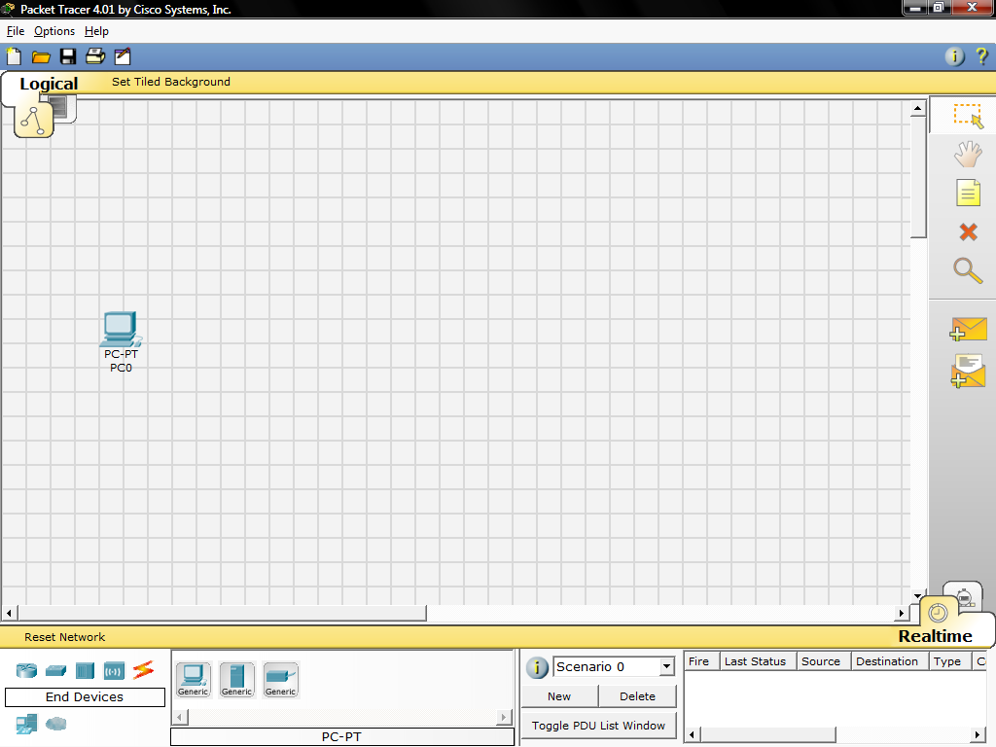
Sample Network Simulation

Slide 19
Sample Network Simulation
Always remember to close windows after you're done viewing them, otherwise, they will clutter the workspace
Open the PC's configuration window and change its settings by going to the Config tab

Slide 20
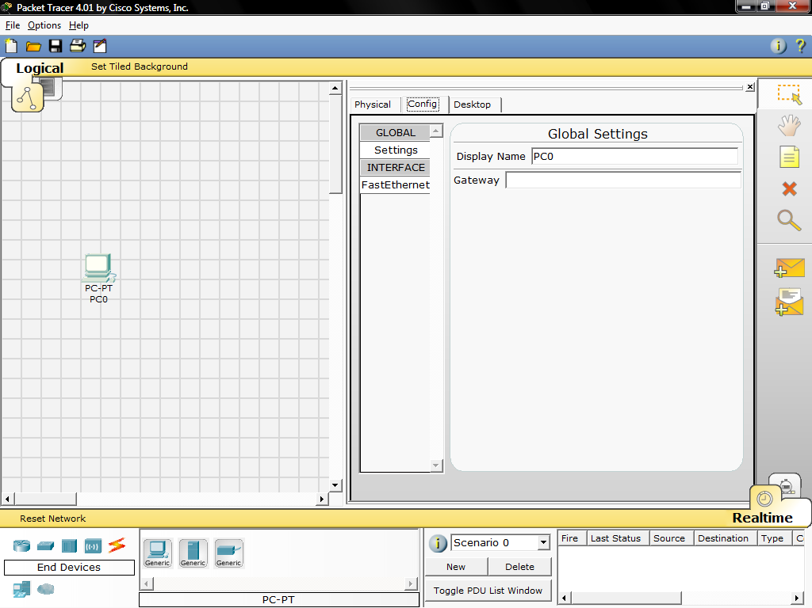
Sample Network Simulation

Slide 21
Sample Network Simulation
Change the PC's name to Tokyo
Under Interface, click on FastEthernet and set the IP address as 192.168.1.1

Slide 22
Sample Network Simulation
It will assume other settings for you
Make sure that the Port Status is on
Note for future reference that you could modify other Ethernet interface settings, such as bandwidth, duplex, MAC address, and subnet mask in this window
Drag another PC to the workspace, name it Paris and set its IP address as 192.168.1.2

Slide 23
Sample Network Simulation
Make sure that the Port Status is on
Under Connections, select the Copper Straight-through cable, the solid black line, and make a connection between the devices with it
The red lights on the link indicate that the connection is not working
The point is the simulator will do what you tell it, whether that is right ort wrong

Slide 24
Sample Network Simulation
Now, using the Delete tool, remove the Copper Straight-through cable, and use a Copper Cross-over cable instead

Slide 25
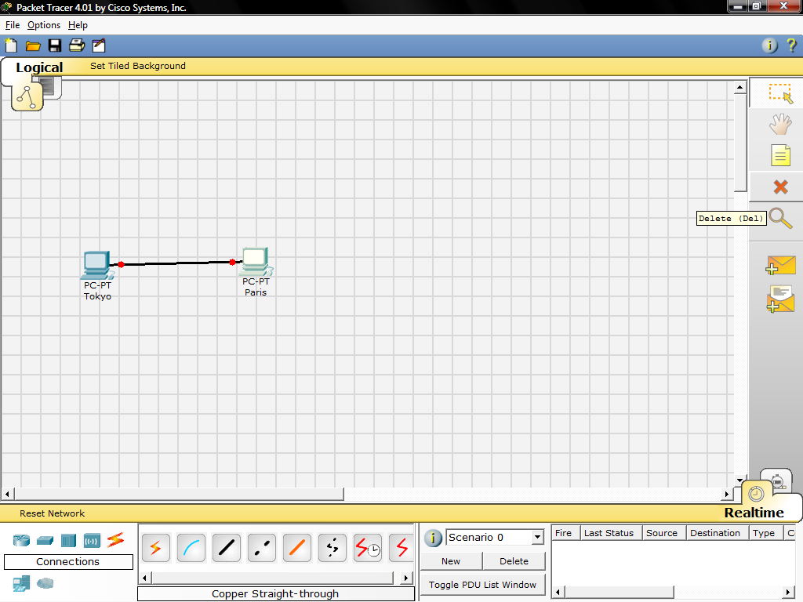
Sample Network Simulation

Slide 26
Sample Network Simulation
The lights should turn green at this point, and if you mouse over or hover over either PC, you'll see the link status indicated as up

Slide 27
Sample Network Simulation
Your network should look similar to this

Slide 28
Sample Network Simulation

Slide 29
Sample Network Simulation
Reposition your network devices by dragging them
Add an overall network description by using the i button on the upper right corner of Packet Tracer
Then add some text labels on the logical workspace by using the Place Note tool

Slide 30
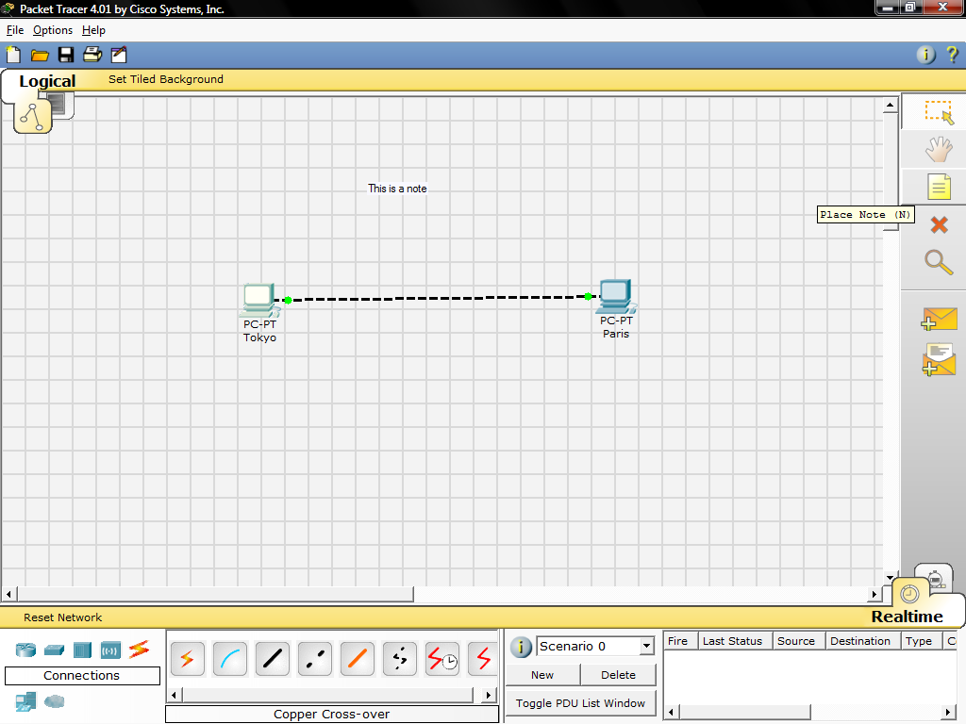
Sample Network Simulation

Slide 31
Sample Network Simulation
Single click on the Tokyo PC
Turn the PC on and off and on again, while paying attention to the link lights
Do the same step for the Paris PC
Turning devices off will result in red link lights meaning that the link is down
Save your work by using the File -> Save As option

Slide 32
Sample Network Simulation
Start with your original saved file open
Notice you are in Realtime Mode
Use the Add Simple PDU tool to send a simple 1-time ping message called an echo request, to the other PC, which responds with an echo reply because you have properly configured their IP address settings

Slide 33
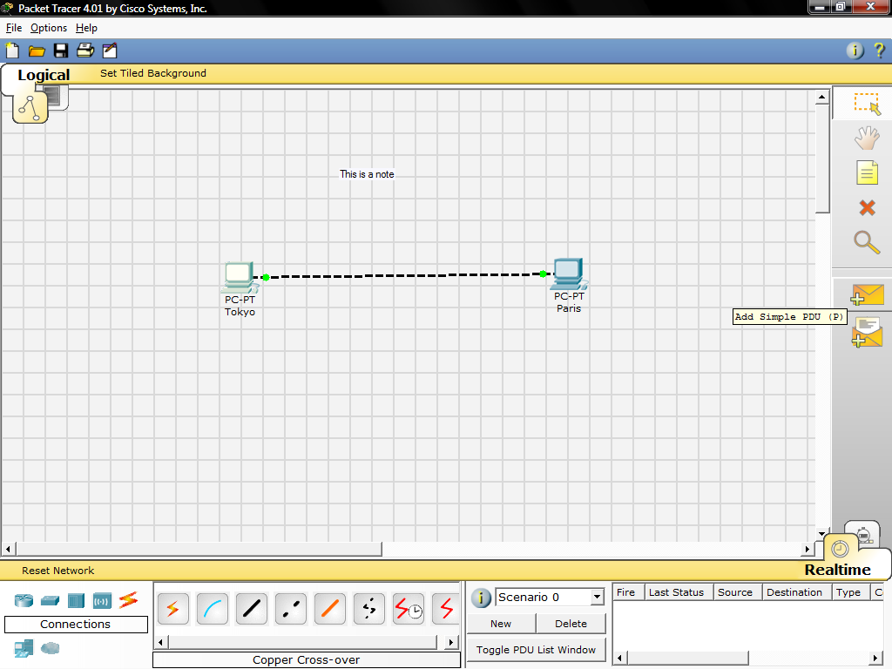
Sample Network Simulation

Slide 34
Sample Network Simulation
To use the Add Simple PDU tool
Click on it
Click on the first PC
Click on the second PC
Then look down in the bottom right corner to see if the ping was successful

Slide 35
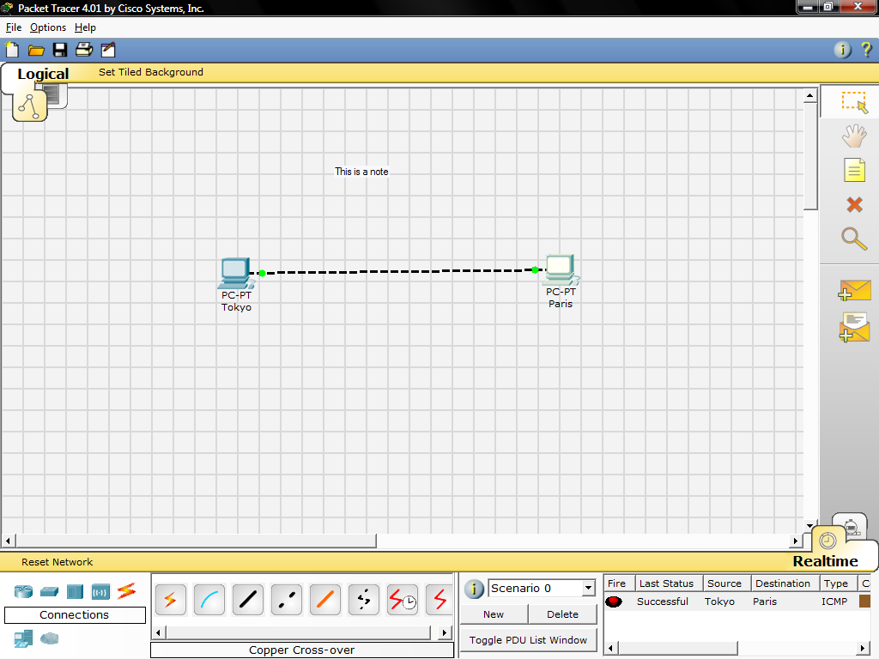
Sample Network Simulation

Slide 36
Sample Network Simulation
Scroll around in the User Created Packet Window to see the different aspects of this ping message, including an indication that the ping was successful
Alternatively, toggle the PDU List Window to see a larger display of this message

Slide 37
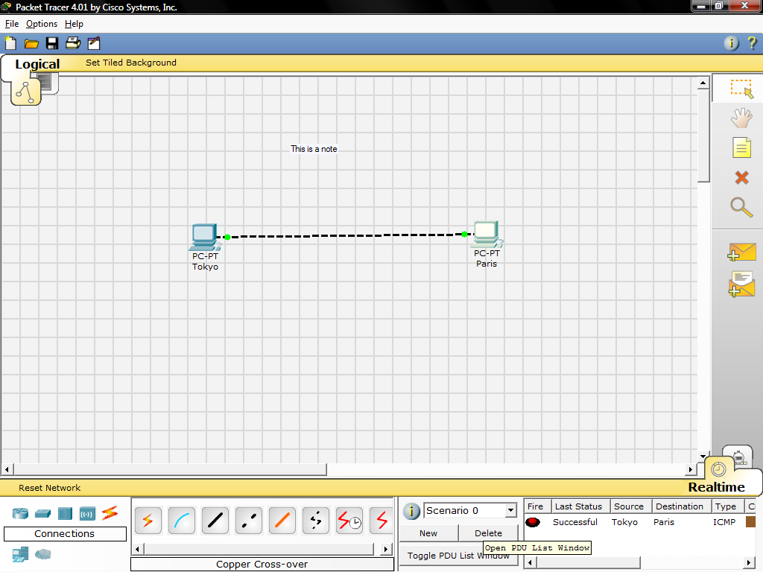
Sample Network Simulation

Slide 38
Sample Network Simulation
You can save one or more of these messages as a scenario
When you start, you are in Scenario 0
Label this first scenario with an i note
Different scenarios allow you to use the same topology for experiments with different groupings of user created packets
Click on New to create a new scenario

Slide 39
Sample Network Simulation
New scenarios will always initially be blank
Add two packets by using the Simple PDU tool, perhaps a PDU from Paris to Tokyo and a different PDU from Tokyo to Paris
Then add a little i note describing the scenario, to complete Scenario 1
An example is shown next

Slide 40
Sample Network Simulation

Slide 41
Sample Network Simulation
Go back and forth between Scenario 0 and 1
Several different scenarios can be saved for a single network
Now delete Scenario 1 using the Delete button
You are back at Scenario 0

Slide 42
Sample Network Simulation
If you want to remove the PDU, you could scroll across in the User Created Packet Window and click on delete on the last column
Do so
Delete the whole scenario

Slide 43
Sample Network Simulation
Start with your original saved file open
In Realtime Mode, send a simple PDU from Tokyo to Paris
Delete the PDU by using the method learned in the previous section
Switch to Simulation Mode

Slide 44
Sample Network Simulation
In this mode, time freezes, therefore you can watch your network run at a slower pace, observing the paths that packets take and inspecting them in detail packet tracing
Under the Event List Filters, click on All/None to uncheck all fields, and then click on ICMP to only view ICMP packets in the animation

Slide 45
Sample Network Simulation
Add a simple PDU from Tokyo to Paris
The eye icon at the left of the Event List indicates that this packet is currently displayed as an envelope
Click on Capture/Forward button once
This acts like a network sniffing program, capturing the next event that occurs on the network

Slide 46
Sample Network Simulation
Note that after clicking on Capture/Forward, the packet in the workspace moves from one device to another - this is the ICMP echo request message from Tokyo to Paris
Another event is also added in the Event List this reflects the change that happened in the workspace

Slide 47
Sample Network Simulation
The first time through an animation, the meaning of the Capture/Forward is Capture; after resetting the simulation, the meaning would be Forward
Adjust the speed of the animation by dragging the Play Speed slider to the right
Click on Capture/Forward button a second time

Slide 48
Sample Network Simulation
This captures the next network event - this is the echo reply from Paris to Tokyo, shown as successful with a green check mark on the envelope, and the animation plays faster this time
Dragging the speed slider to the opposite direction - to the left - would have slowed the animation
Click on Capture/Forward button again

Slide 49
Sample Network Simulation
At this point, Paris has already sent an echo reply to Tokyo therefore, there are no more ICMP events left to capture
A No More Events window will appear notifying you of this, as shown in the screenshot below
Click OK

Slide 50
Sample Network Simulation

Slide 51
Sample Network Simulation
Continuing from the last activity, click on Reset Simulation
This clears the entries in the Event List except for the original packet
Click on the packet envelope on the workspace to bring up the PDU Information window like the one shown in the screenshot below

Slide 52
Sample Network Simulation
This window contains the OSI model tab which shows how the packet is processed at each layer of the OSI model by the current device
Close this window, and note that this packet is indicated in the Event List by the eye icon
The whole row in the Event List is also highlighted

Slide 53
Sample Network Simulation
For this row, clicking on the color square in the Info column is equivalent to clicking directly on the packet envelope

Slide 54
Sample Network Simulation

Slide 55
Sample Network Simulation
Use the Next Layer and Previous Layer buttons to see details of the packet processing at the relevant OSI Layers
Note that only the Out Layers can be viewed in the case of this original echo request message

Slide 56
Sample Network Simulation
Click on the Outbound PDU Details tab
This shows exactly what is in the PDU headers, broken up into header type and the individual fields in each header
Close the PDU Information window
Click on Capture/Forward button once

Slide 57
Sample Network Simulation
Click again on the packet in the workspace to open the PDU Information window
Notice that this time, information regarding the In Layers and Out Layers can both be viewed
Click on the Inbound PDU Details tab

Slide 58
Sample Network Simulation
In this case this shows the details of the inbound echo request packet from Tokyo to Paris
Click on the Outbound PDU Details tab, which shows similar information, but in this case for the echo reply packet from Paris to Tokyo

Slide 59
Sample Network Simulation
Click on Reset Simulation again
This time click on Auto Capture/Play
The echo request and echo reply will be automatically captured, and the No More Events message will occur automatically

Slide 60
Sample Network Simulation
Click on the Back Button twice to rewind the animation one step at a time
Now click on the Capture/Forward button twice to forward the packet through the animation
Also note the change in which packet is highlighted in the Event List

Slide 61
Sample Network Simulation
Remember that at any time, you can either click on the packet envelope directly, or click on the Info column in the Event List, to open up the PDU Information window
Click on the Back Button twice to rewind the animation
This time click Auto Capture/Play and the packet animation will automatically occur

Slide 62
Sample Network Simulation
Start by closing the existing workspace and reopening your original saved file
Open the ARP Tables for both PCs by clicking on each PC using the Inspect tool
The ARP tables always appear on the same spot
Reposition one of them to make them both visible

Slide 63
Sample Network Simulation
You can also resize the tables for better viewing
In Realtime Mode, send a simple PDU from Tokyo to Paris
Notice that the ARP tables are filled in automatically as shown here

Slide 64
Sample Network Simulation

Slide 65
Sample Network Simulation
Delete the PDU using the method learned in the previous sections
Notice that the entries in the ARP tables are not cleared
This is so because the ARP entries for both devices have already been learned
Deleting the user created PDUs does not reset what already occurred in the network

Slide 66
Sample Network Simulation
Click Reset Network
Notice that the ARP tables are cleared
The Reset Network button power cycles devices by turning them off and then on
By doing so, they lose temporary information like the tables they learned
Go to Simulation Mode

Slide 67
Sample Network Simulation
In the Event List Filters, make sure that ICMP and ARP are checked so that you can view ICMP and ARP packets in the animation
Create a new simple PDU from Tokyo to Paris
Notice that since you reset the network earlier, the ARP tables are empty

Slide 68
Sample Network Simulation
ARP request packets need to be issued before the ICMP ping packets, so that the devices in the network can learn about each other
Click on Auto Capture/Play to watch the animation
Click on Reset Simulation

Slide 69
Sample Network Simulation
Notice that even though the Event List is cleared - except for the user created PDU, the ARP tables still remain full
Click on Capture/Play
This time, since the ARP tables are full, there are no new ARP packets issued
Click on Reset Network
Doing so will empty the tables

Slide 70
Sample Network Simulation
Notice that a new ARP request packet appears automatically on the Event List
Single-clicking on the Delete button removes the entire scenario including all the PDUs associated with it
Double-clicking on (delete) in the far right column in the PDU List window deletes individual PDUs

Slide 71
Sample Network Simulation
The Reset Simulation button clears all entries in the Event List, except for User Created PDUs, and allows you to restart the animation
This, however, does not reset the device tables
The Reset Network button allows you to power-cycle all of the devices in your network

Slide 72
Sample Network Simulation
It turns all devices off and then turns them back on so the tables that the devices built are lost along with configurations and other information not automatically saved
Saving your work periodically prevents you from losing configurations and changes in the network that you want to keep

Slide 73
Sample Network Emulation
Let’s switch to emulating instead of simulating the network design
In this example using GNS3 we will be running not a simulation of the Cisco IOS, but the real Cisco IOS
This brings the experience nearer to what you would see in the actual network

Slide 74
Sample Network Emulation
To see how GNS3 works we will create a simple topology
The GNS3 window is divided into four panes by default
The left-most pane lists the types of nodes available
You will see router icons for the various platforms, a PIX firewall, Ethernet switch, ATM bridge, ATM switch, Frame Relay switch, and Cloud
Other node types may be added as explained later

Slide 75
Sample Network Emulation
The right-most pane will provide a topology summary that will be better understood when we built more complex topologies
For now, just know that the pane exists
The middle section contains two panes
The top pane is your work area where a topology may be graphically built
The bottom pane, called the Console, shows Dynagen at work
Click on a router icon under Nodes Types corresponding to the IOS platform you are using
In our example, we are using a 7200 platform

Slide 76
Sample Network Emulation
Drag an appropriate router node type over to the workplace pane in the middle and let go
We now have a router ready to configure
Right-click the router and choose Configure
Click the Slots tab to see what is already there if anything
If there are none, select some
Click
Ok

Slide 77
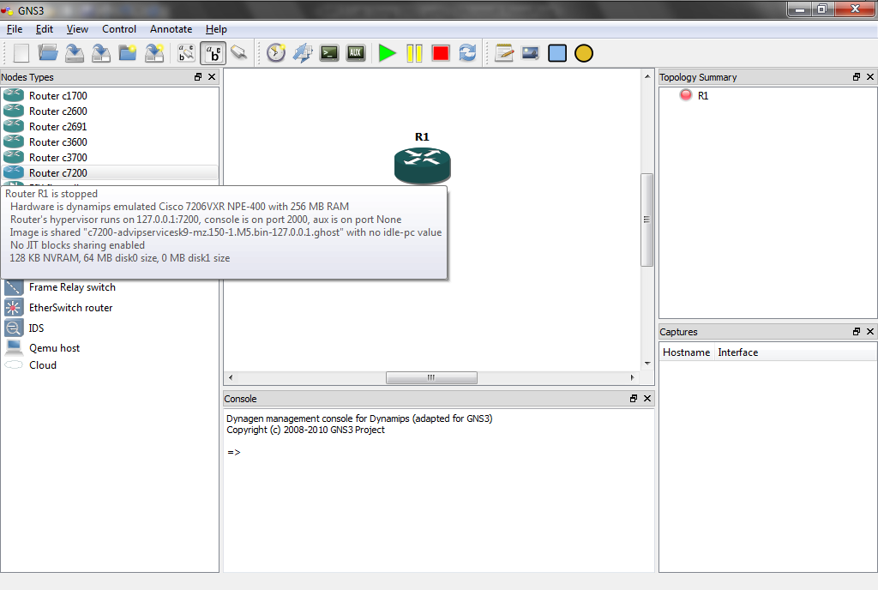
Sample Network Emulation

Slide 78
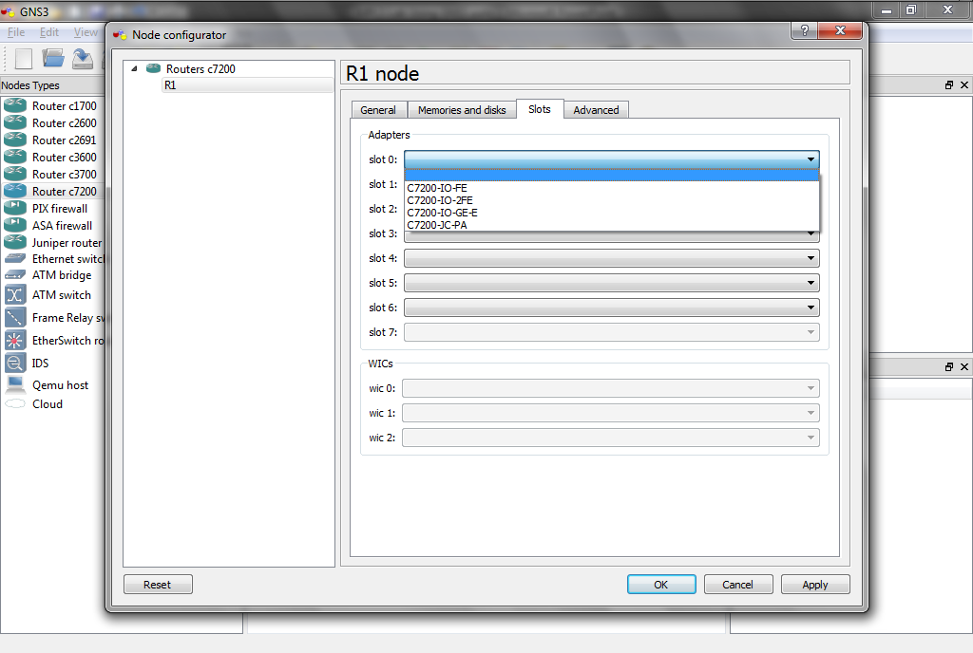
Sample Network Emulation

Slide 79
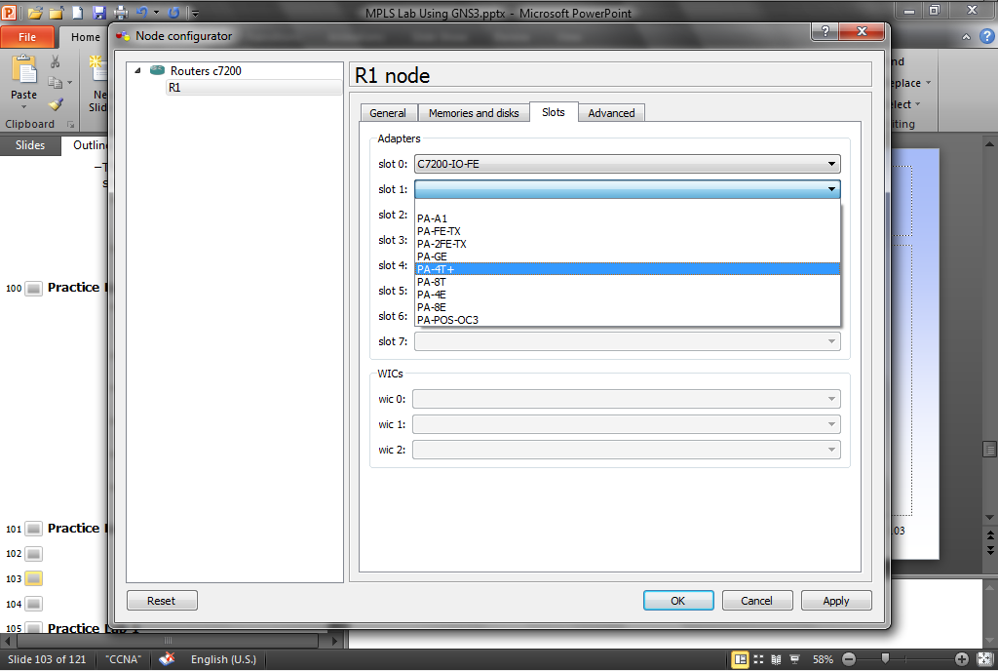
Sample Network Emulation

Slide 80
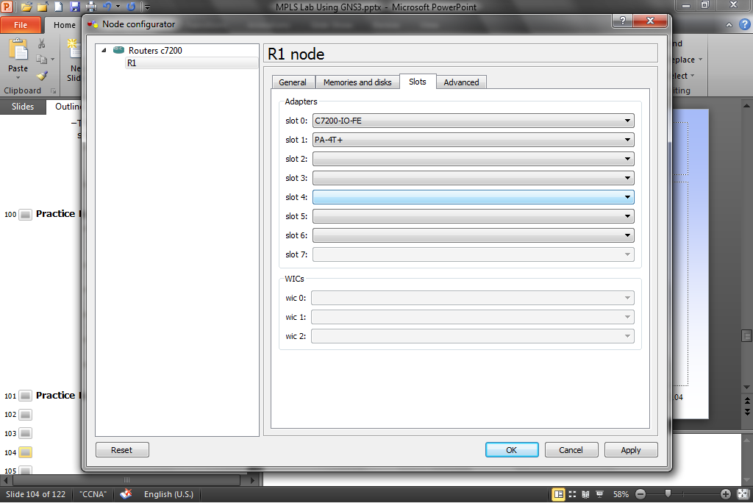
Sample Network Emulation

Slide 81
Sample Network Emulation
Start the router by right clicking on the router and selecting
Start

Slide 82
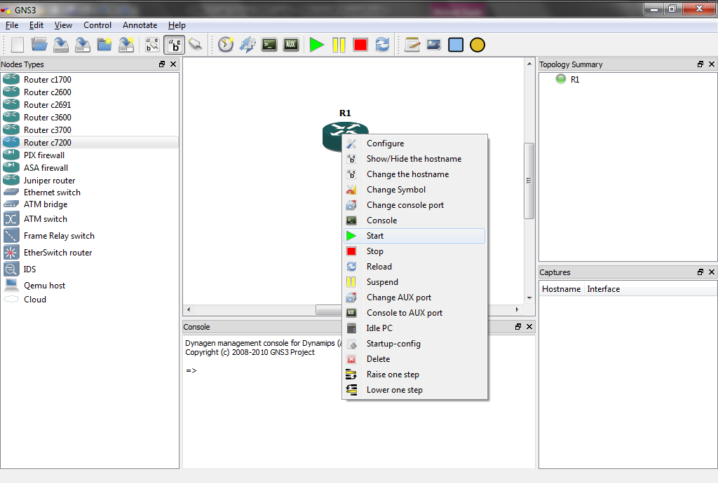
Sample Network Emulation

Slide 83
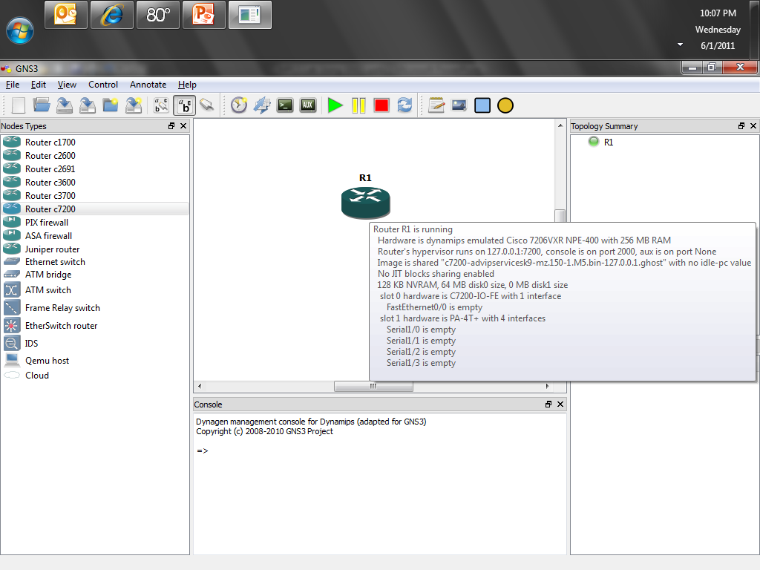
Sample Network Emulation

Slide 84
Sample Network Emulation
Now access the command line of the IOS by right clicking on the router and selecting
Console

Slide 85
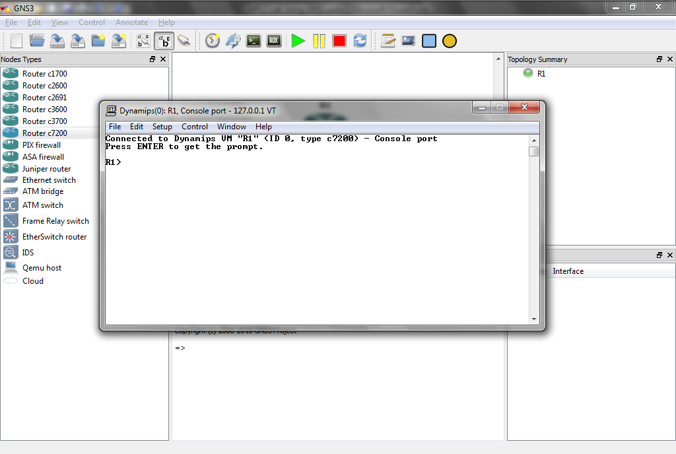
Sample Network Emulation

Slide 86
Sample Network Emulation
Look around as you would do on any Cisco router

Slide 87
Adjust the Balance
Another digression
When the first lab is done a setting needs to be adjusted so that Dynamips does not use up all of the resources of the computer it is running on
This should be done with just one router in place

Slide 88
Adjust the Balance
To do this
Right-click the router and choose Idle PC
GNS3 will spend a moment calculating an Idle PC value before presenting the screen to the right
If you click the drop-down arrow, you see a list of possible idlepc values
Potentially better idlepc values are marked with an asterisk
Choose one of the values with an asterisk and click OK

Slide 89
Adjust the Balance
You’ll receive a confirmation that the idlepc value has been applied

Slide 90
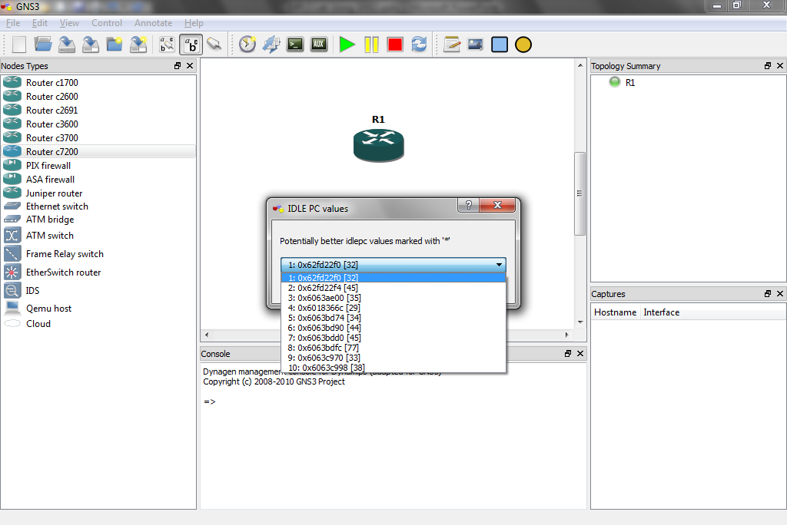
Adjust the Balance

Slide 91
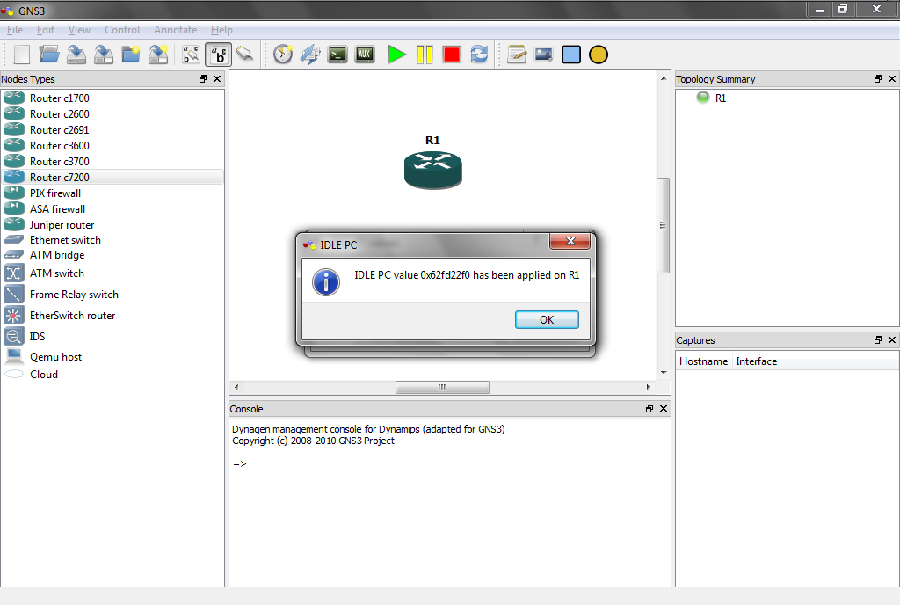
Adjust the Balance

Slide 92
Adjust the Balance
If you choose IOS images and hypervisors on the Edit menu, and doubleclick on the image under the IOS Images tab, you’ll see the new idlepc value displayed under Settings
You may repeat this process to find the value that reduces CPU usage the most

Slide 93
Adjust the Balance
To observe CPU usage in Windows, press Ctrl+ALT+DEL and choose Task Manager
Click on the Performance tab to view CPU usage
You will observe that without an idlepc value, CPU usage will be at or near 100%, but with an idlepc value, CPU usage will drop to a very low value

Slide 94
Sample Network Emulation
You may now return to your client window to use your router
You are actually running the Cisco IOS that you found
All commands supported by the IOS are available
Remember earlier we chose a FastEthernet adapter and a four-port serial adapter

Slide 95
Sample Network Emulation
If you issue the show ip interface brief command, you’ll see the designations for these ports on the router
Exit GNS3

Slide 96
Sample Network Emulation
Although a single router is useful to get familiar with commands, it would be nice to build more complex topologies
With GNS3 very complex topologies may be built
Let’s build a topology with three routers

Slide 97
Name the Project
The next time GNS3 is started it will ask for a project name
Start GNS3
You can name a project if you wish or click Cancel

Slide 98
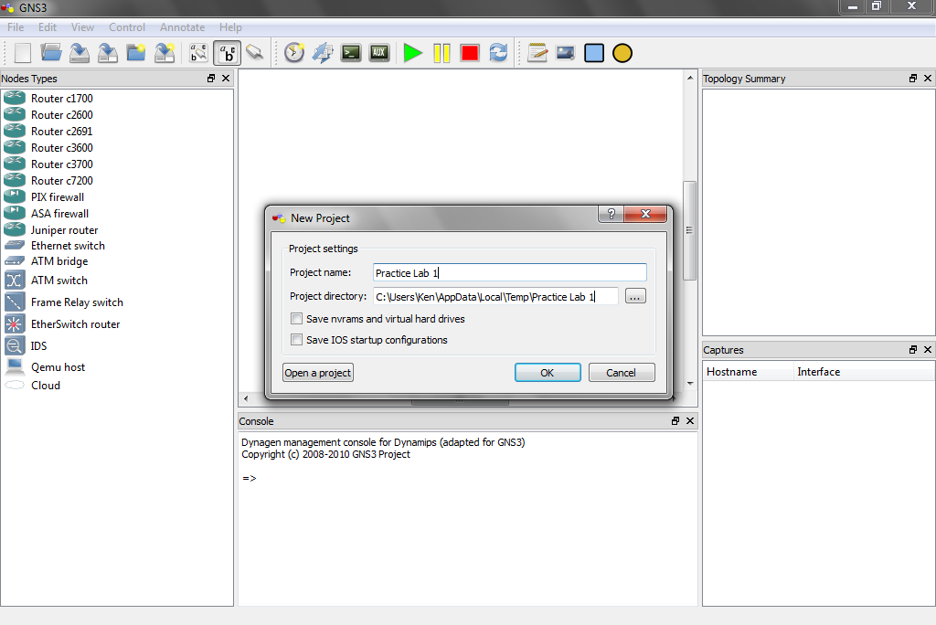
Name the Project

Slide 99
Sample Network Emulation
Drag three routers running an IOS you have configured into the workspace
Right-click each router and choose Configure under the Slots tab, include a FastEthernet adapter and PA-4T serial adapter
Now we’re ready to connect the routers together

Slide 100
Sample Network Emulation
Click the Add a link button on the toolbar at the top

Slide 101
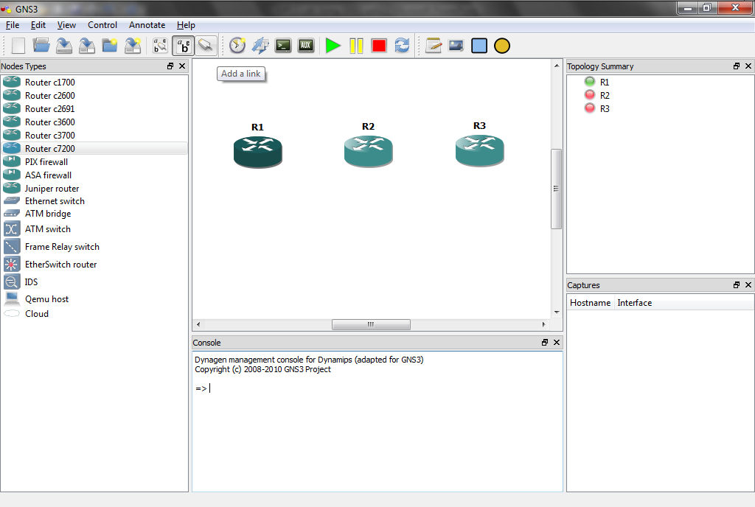
Sample Network Emulation

Slide 102
Sample Network Emulation
Choose Manual from the drop-down menu
Your cursor will change to a cross
Click on R1 and select s1/0 – then click on R1 and select s1/0
Click on R2 again and select s1/1 – then click on R3 and select s1/1

Slide 103
Sample Network Emulation
Now click the Add a link button again, it looks like a red stop sign with an X
After clicking on it, the icon will change back to a connector look
Notice the right-pane call Topology Summary
Your connections are now available for viewing by clicking beside each router

Slide 104
Sample Network Emulation
Configure the routers
Then test the connectivity

Slide 105
Sample Network Model
Application testing, simulation, and emulation work well for basic network designs
For more complex ones a network modeling tool such as Opnet is needed to validate the design before deployment
Let’s see how Opnet works

Slide 106
Sample Network Model
To illustrate how to use IT Guru let’s create a Sample Network Model with one scenario
Select
File
New

Slide 107
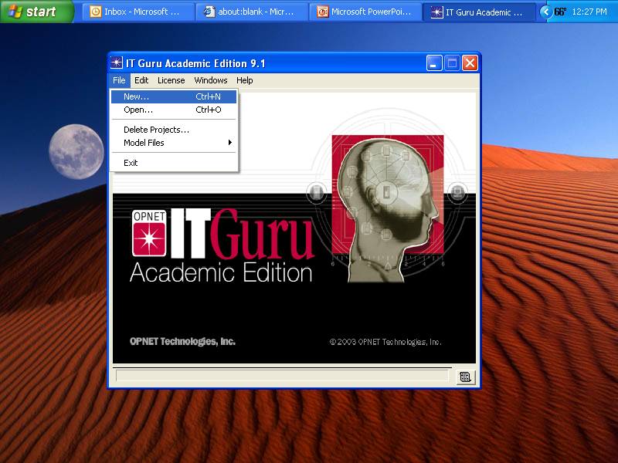
Sample Network Model

Slide 108
Sample Network Model
The Project screen appears
Although there are other options in the drop down box, Project is the only one commonly used
Click
OK

Slide 109
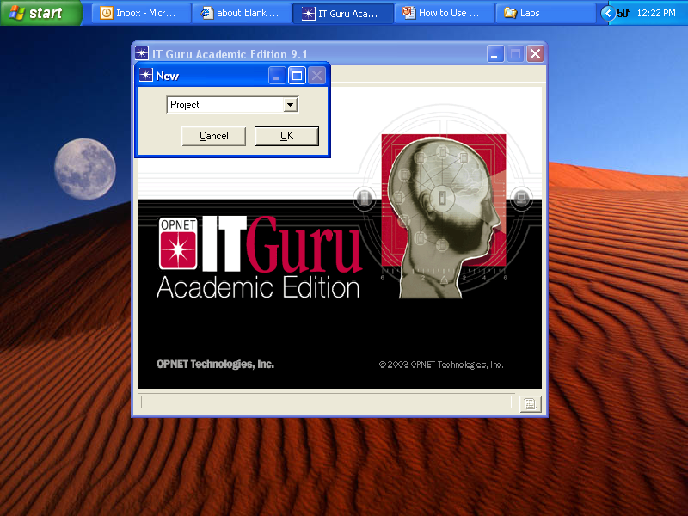
Sample Network Model

Slide 110
Sample Network Model
On this screen you may name the project
You may also name the scenario
Spaces are not allowed
Click
OK

Slide 111
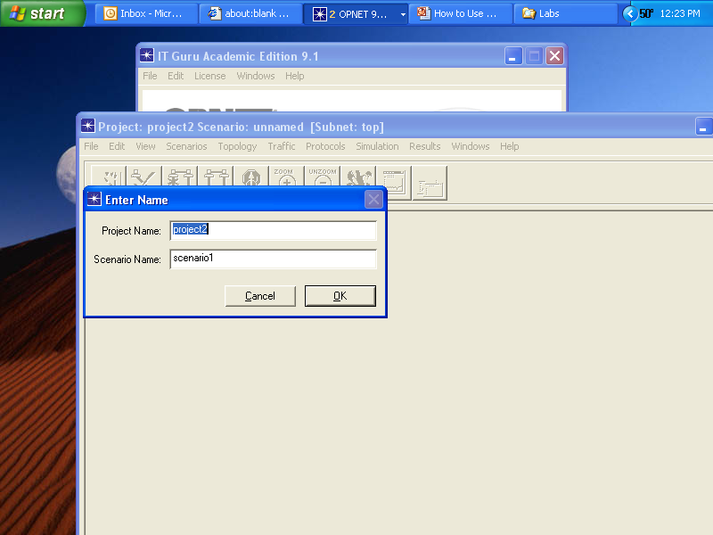
Sample Network Model

Slide 112
Sample Network Model
On the next screen, Startup Wizard: Initial Topology, commonly the default Create Empty Scenario is used
Click
Next

Slide 113
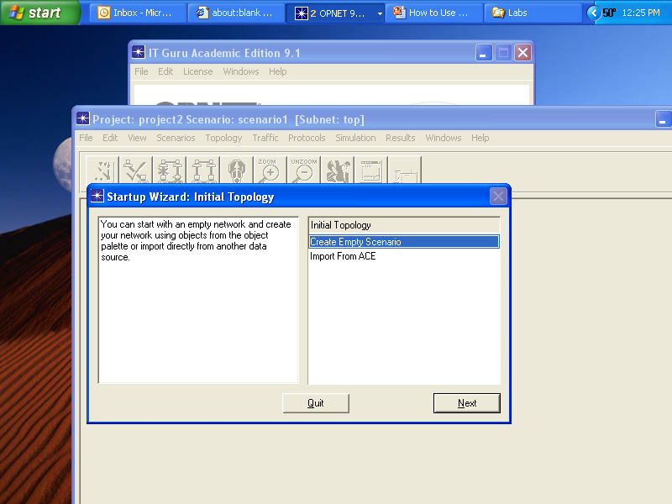
Sample Network Model

Slide 114
Startup Wizard
The Startup Wizard is used to create the basic layout of the network
The elements it uses are
Define the network’s scale such as the world or an office
Define the size of the area in which the network will function, such as the US or a certain size office
Select a palette that will provide the objects

Slide 115
Sample Network Model
On this screen select the scale of the network
For this example use the Office
Click
Next

Slide 116
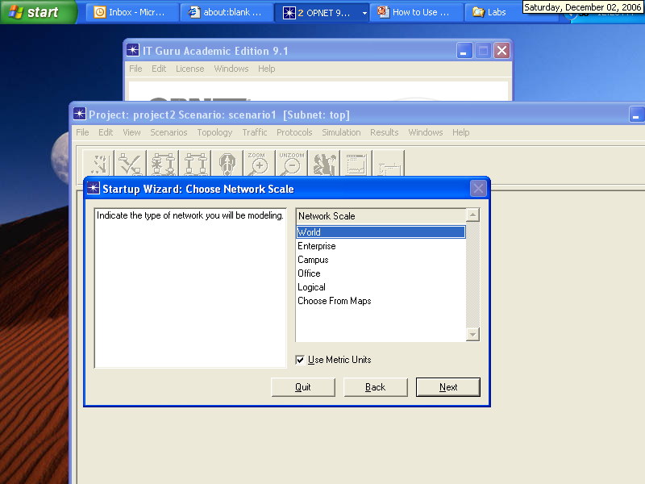
Sample Network Model

Slide 117
Sample Network Model
Set the size of the network just specified
For this example use 100 by 100 meters
Click
Next

Slide 118
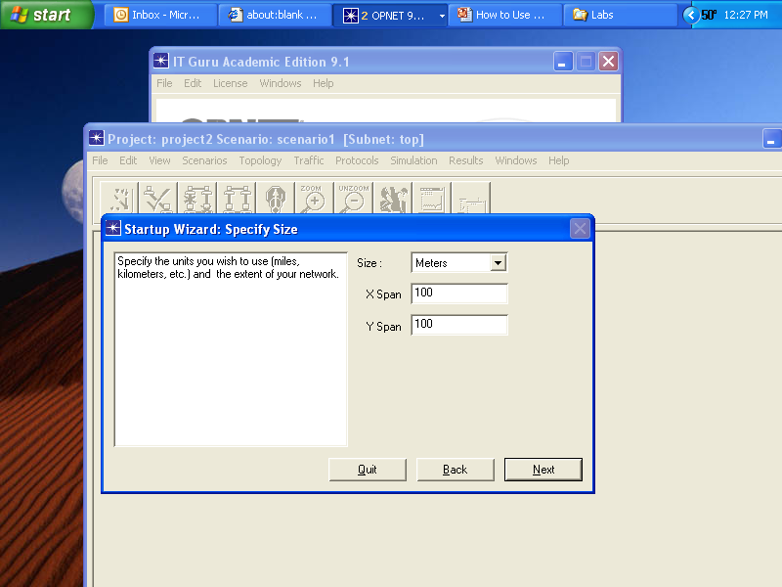
Sample Network Model

Slide 119
Sample Network Model
Select the Palette contents
The Palette holds the icons for the elements that can be dragged and dropped onto the network space just created
There are a large number of these
It is best to add the ones you think might be useful based on the name of the Palette

Slide 120
Sample Network Model
Then experience will tell you which ones are most useful to your situation
The basic ones are

Slide 121
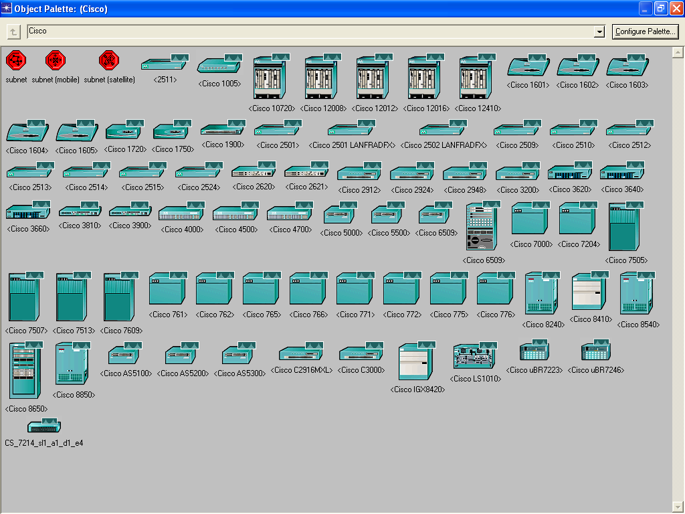
Cisco

Slide 122
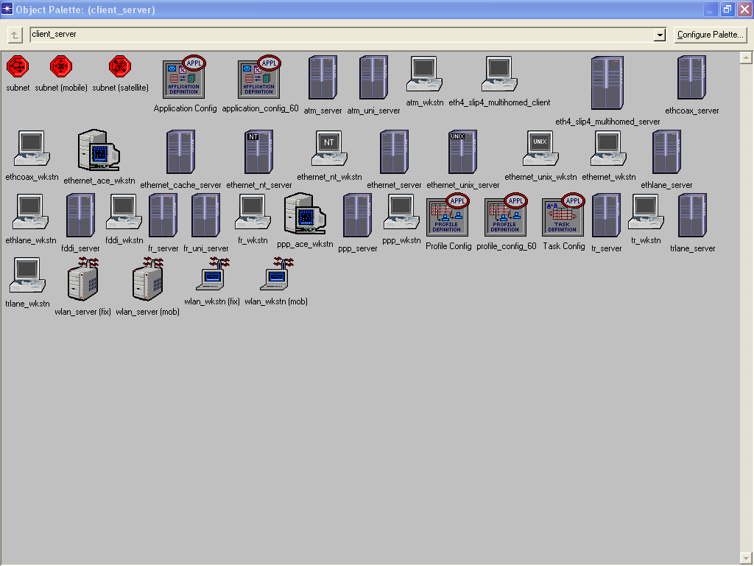
Client Server

Slide 123
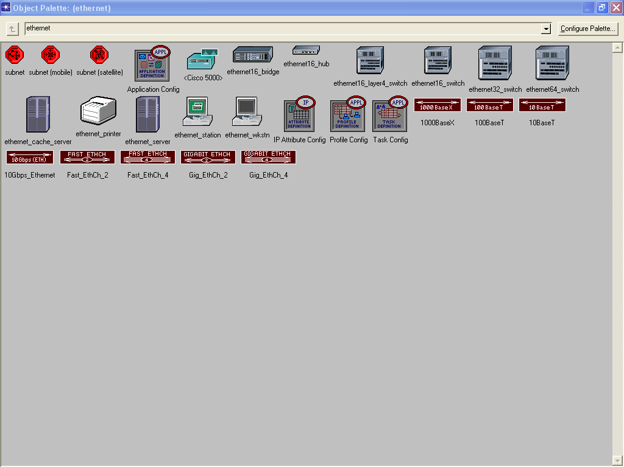
Ethernet

Slide 124
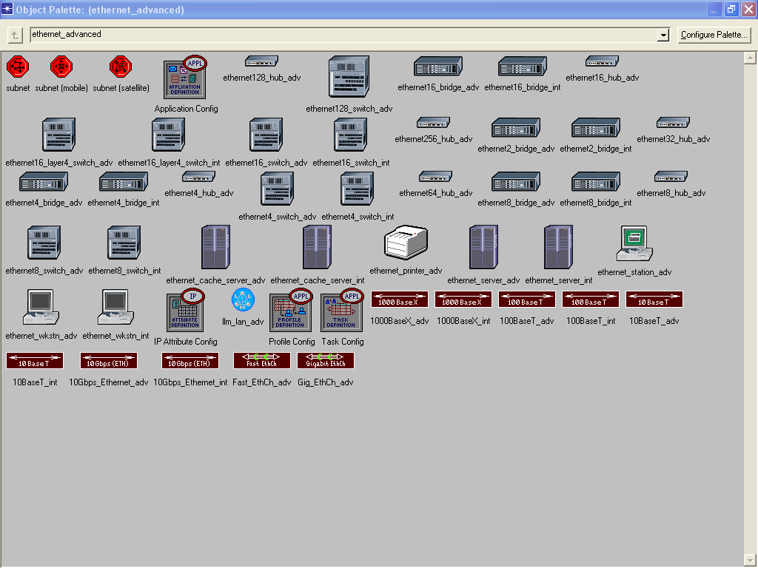
Ethernet Advanced

Slide 125
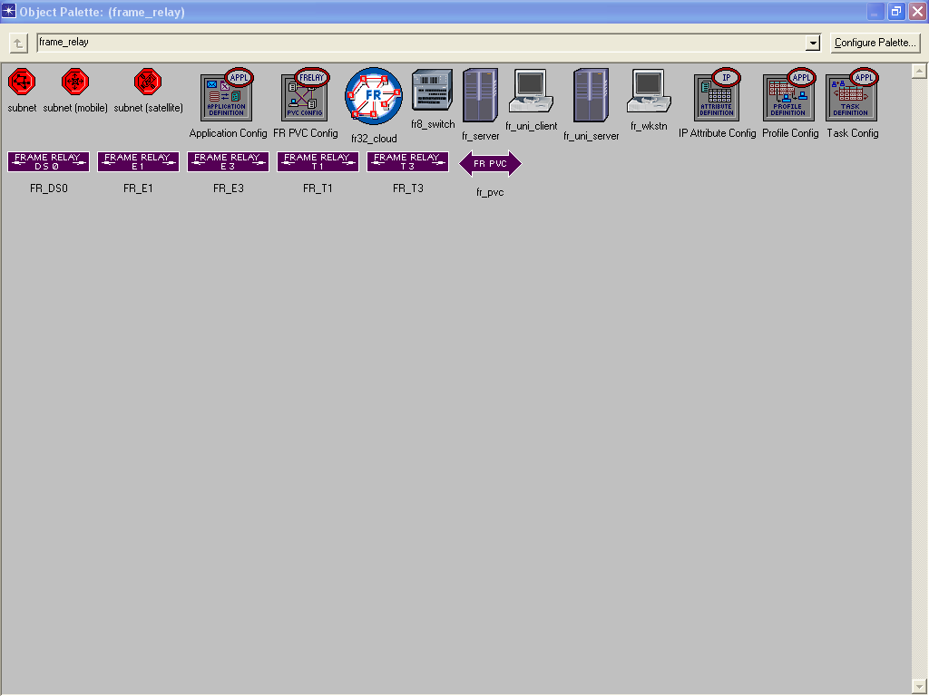
Frame Relay

Slide 126
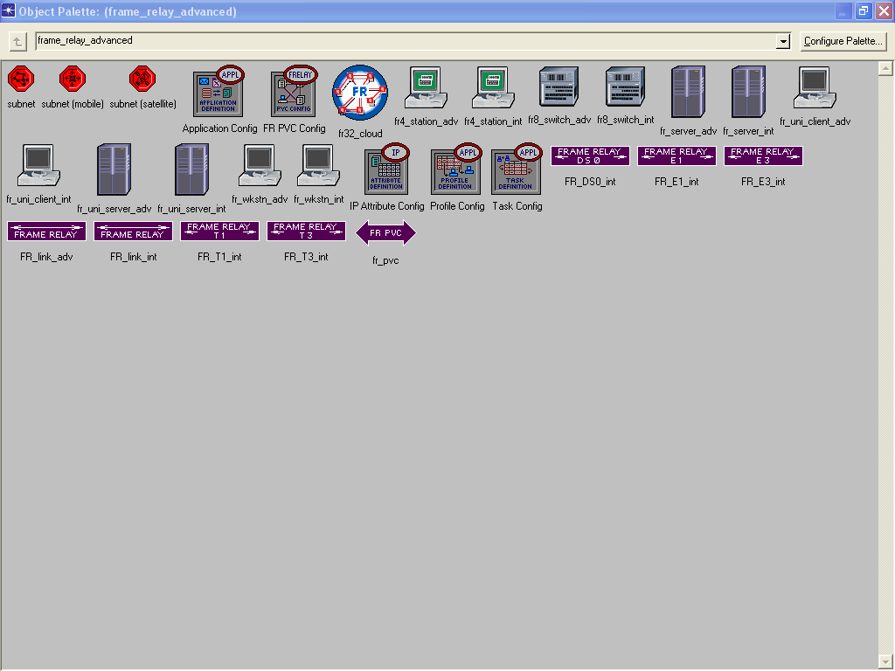
Frame Relay Advanced

Slide 127
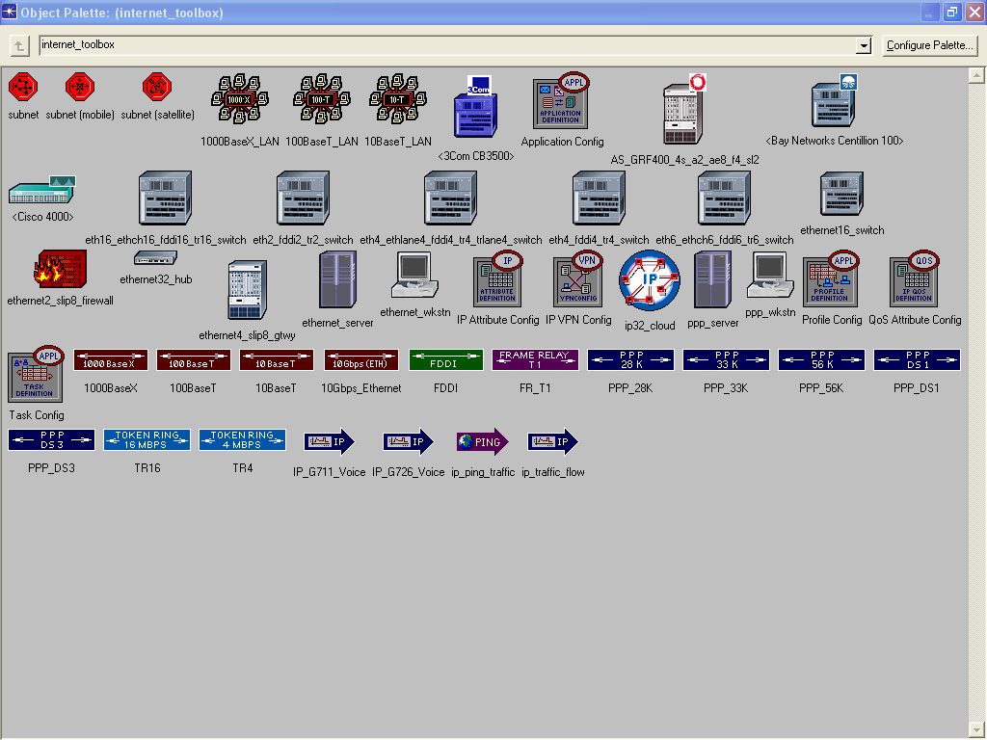
Internet Toolbox

Slide 128
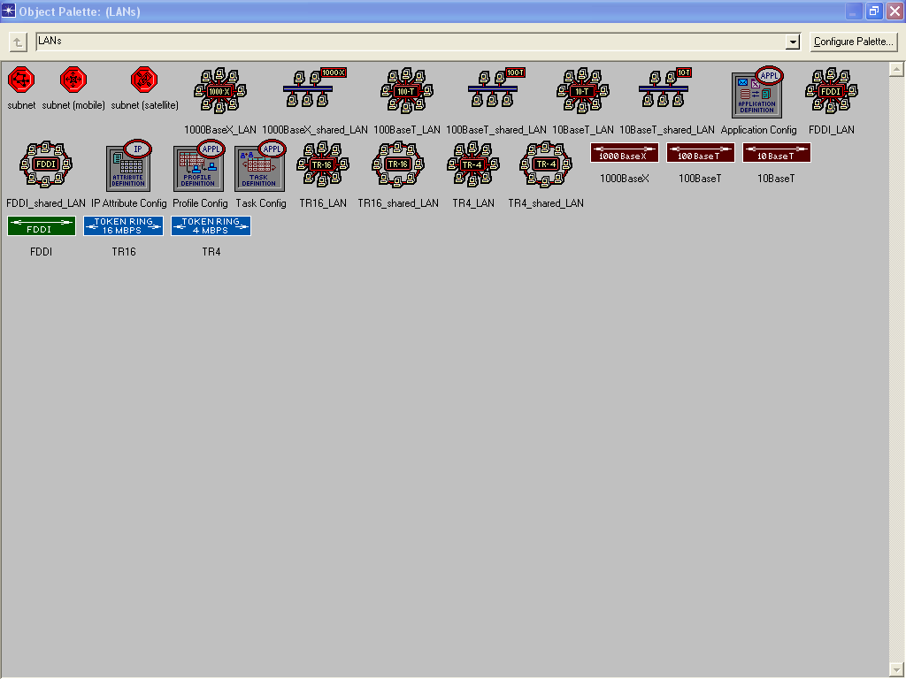
LANs

Slide 129
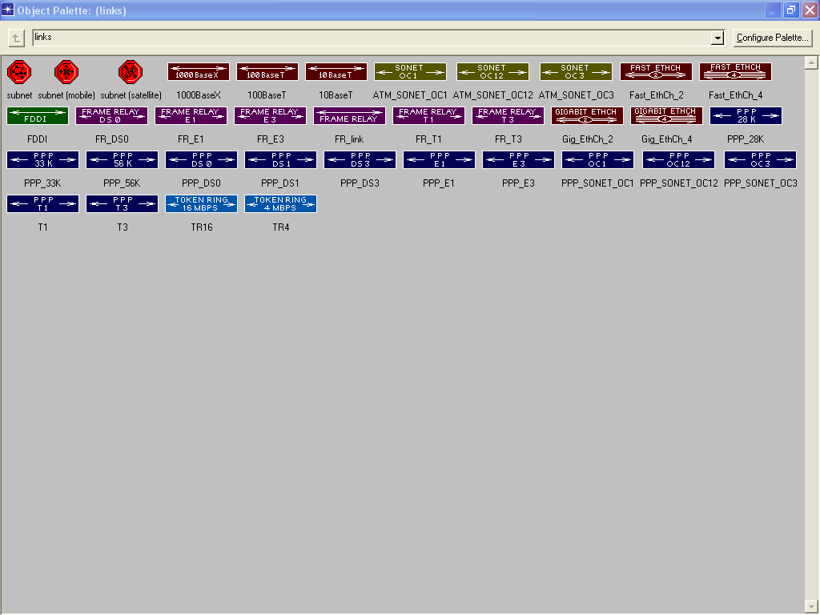
Links

Slide 130
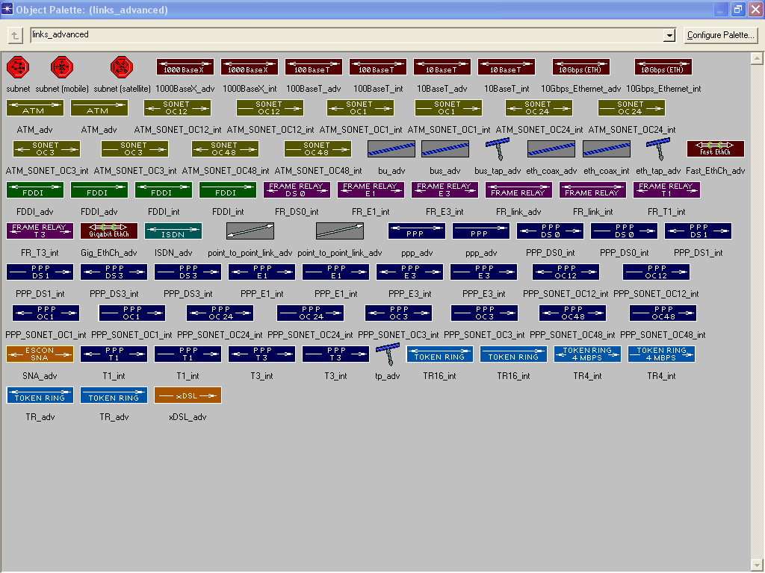
Links Advanced

Slide 131
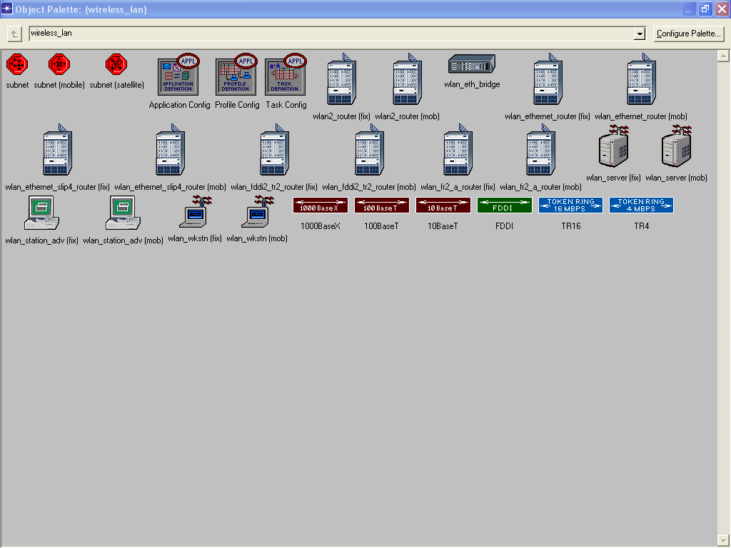
Wireless LAN

Slide 132
Sample Network Model
Once the palette or palettes are selected click
Next

Slide 133
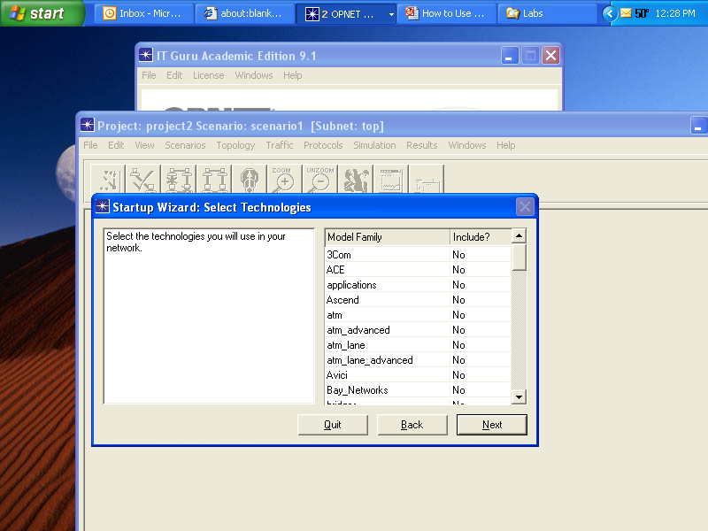
Palette List

Slide 134
Sample Network Model
If you need additional devices other devices can be added to the palette by selecting
Configure Palette
from the Palette window
This produces this list

Slide 135
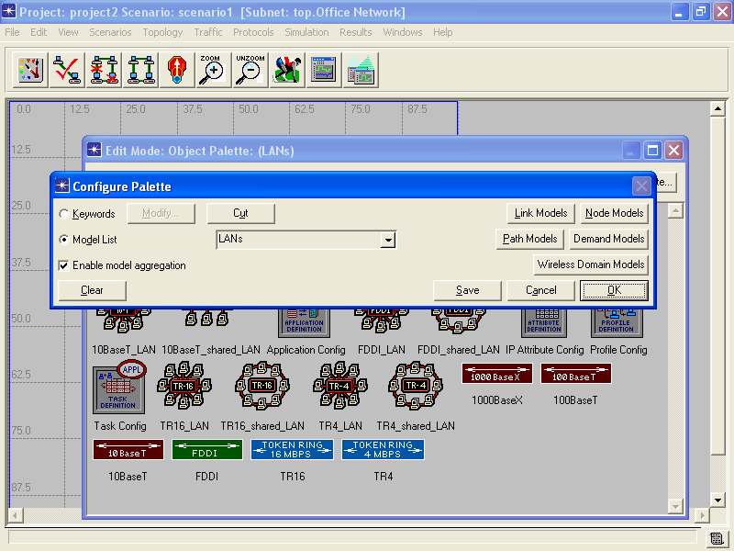
Sample Network Model

Slide 136
Sample Network Model
Then the drop down list can be used to select one or more palettes
The existing palette can be removed by selecting
Clear

Slide 137
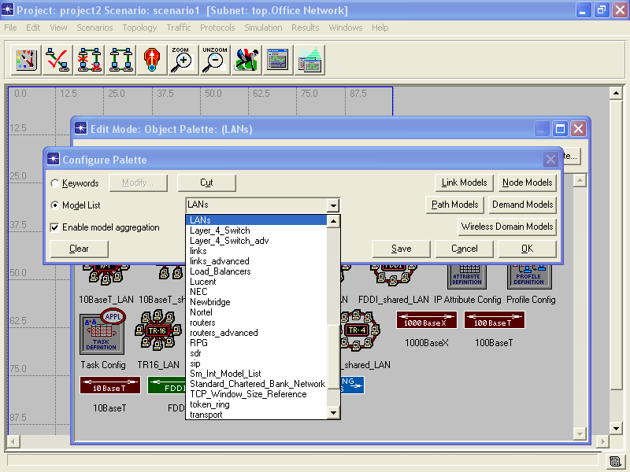
Sample Network Model

Slide 138
Sample Network Model
In this example we will use the Ethernet palette to create a basic LAN

Slide 139
Sample Network Model
The Startup Wizard: Review screen appears
If everything is as desired, then click
OK
If not, click
Back

Slide 140
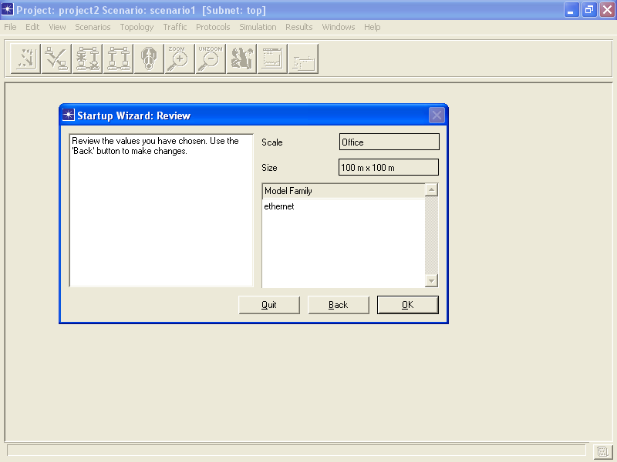
Sample Network Model

Slide 141
Sample Network Model
The workspace with the palette appears

Slide 142
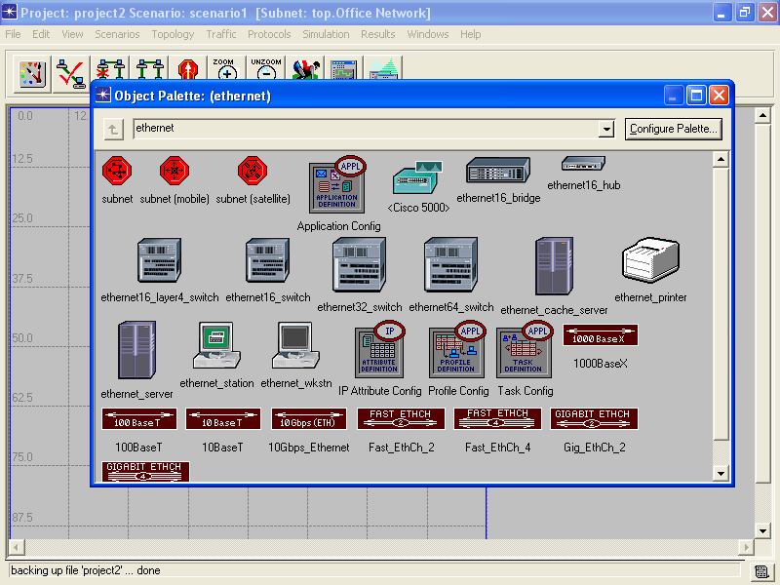
Sample Network Model

Slide 143
Sample Network Model
Notice that the palette often gets in the way of the workspace where the network elements are placed
To remove the palette from the screen click on the
X box in the window
To return it to the screen click on the Palette button

Slide 144
IT Guru Interface
Where is the palette button
Let’s look at the rest of the IT Guru interface

Slide 145
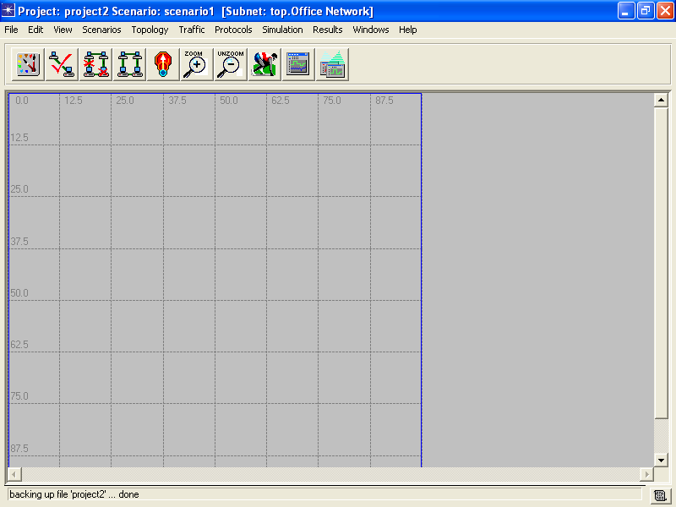
IT Guru Interface

Slide 146
Palette Button

Slide 147
Palette Button
This button makes the palette appear, if you removed it from the screen

Slide 148
Consistency Button

Slide 149
Consistency Button
Check consistency of network links

Slide 150
Failed Button

Slide 151
Failed Button
Mark selected node or link as failed

Slide 152
Restored Button

Slide 153
Restored Button
Mark selected node or link as restored

Slide 154
Level Button

Slide 155
Level Button
Go to next higher level in network hierarchy

Slide 156
Zoom In Button

Slide 157
Zoom In Button
Zoom in for a closer look

Slide 158
Zoom Out Button

Slide 159
Zoom Out Button
Zoom out for a wider look

Slide 160
Simulation Button

Slide 161
Simulation Button
Configure, then run the simulation

Slide 162
Results Button

Slide 163
Results Button
View graphs and tables of collected statistics

Slide 164
Graphs Button

Slide 165
Graphs Button
Hide or show all graphs

Slide 166
Sample Network Model
Back to the sample project
With the palette showing drag and drop the devices needed for the network of interest
These can be of two types
Node
Link

Slide 167
Nodes
Nodes are devices that can send and receive information, such as
Switch
Workstation
Printer
Server

Slide 168
Links
Links are media that connect nodes to each other

Slide 169
Drag and Drop Behavior
Another oddity of IT Guru is the behavior of the drag and drop function
You left click on the object in the palette, then drag it over to the workspace
However, unless you deselect the object or go back to the palette, each subsequent click on the workspace will deposit another object of the same type

Slide 170
Drag and Drop Behavior
To unselect an object, click the right mouse button
Then go back to the palette for the next object
The point to this behavior is to allow multiple copies of the same object to be placed one after the other
The object still looks like it is selected, but it is not

Slide 171
Drag and Drop Behavior
Just click elsewhere on the workspace to make the circle around the object disappear

Slide 172
Network Creation Methods
There are three ways to create a network
Drag and Drop
Rapid Configuration
Importation

Slide 173
Drag and Drop
In Drag and Drop nodes and links are selected on the palette, then dragged to the workspace

Slide 174
Rapid Configuration
Rapid Configuration is faster than Drag and Drop for large networks
Select
Topology
Rapid Configuration
Then complete the options presented

Slide 175
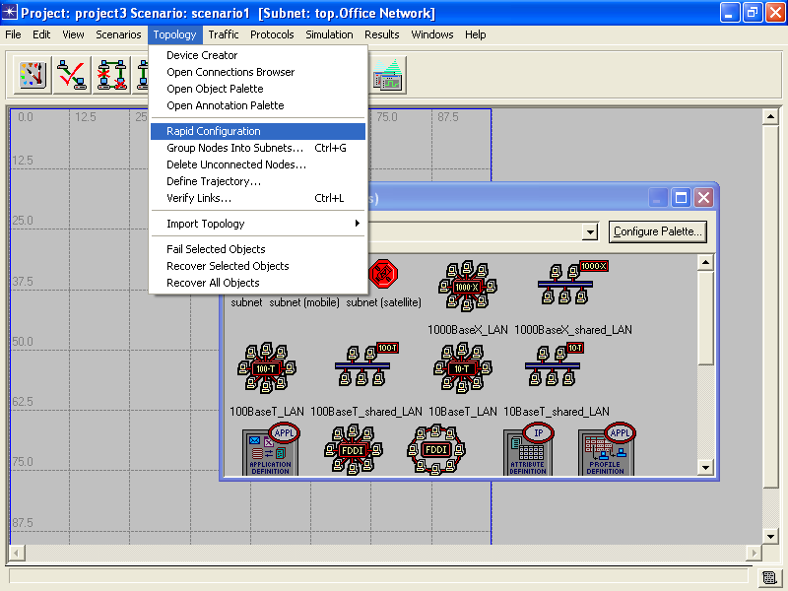
Rapid Configuration

Slide 176
Rapid Configuration
Let’s create a basic LAN using this method
This step is done after the workspace is completed as discussed above
A basic LAN will require
The Ethernet palette
Star configuration
A 16 port switch
Links using 100 Mbps
10 workstations

Slide 177
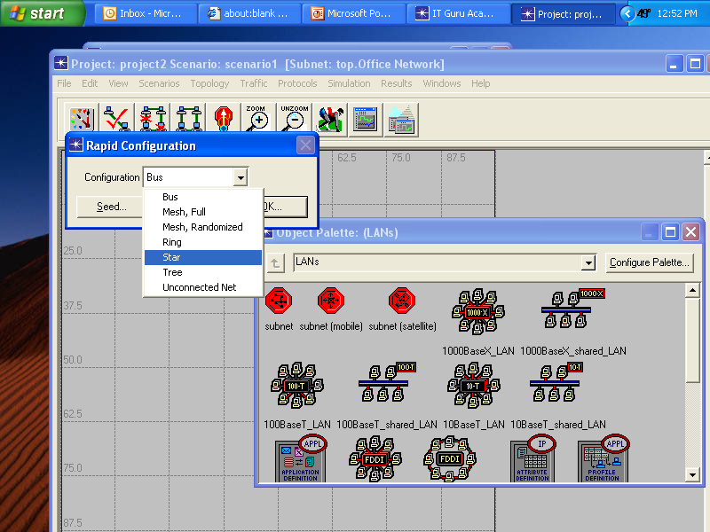
Rapid Configuration

Slide 178
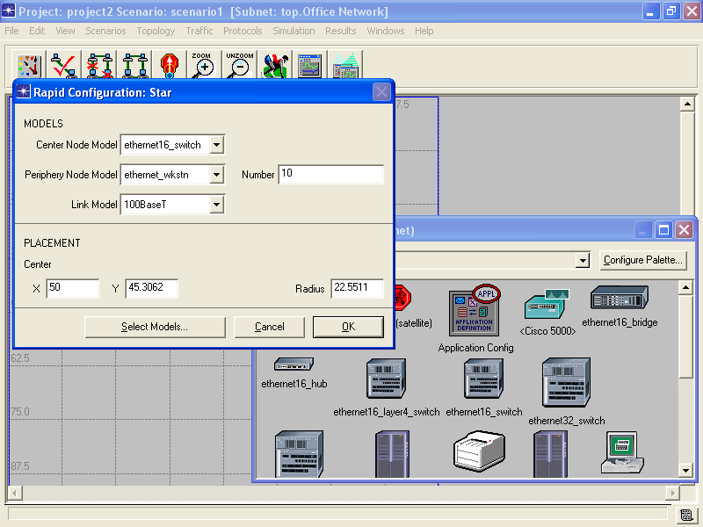
Rapid Configuration

Slide 179
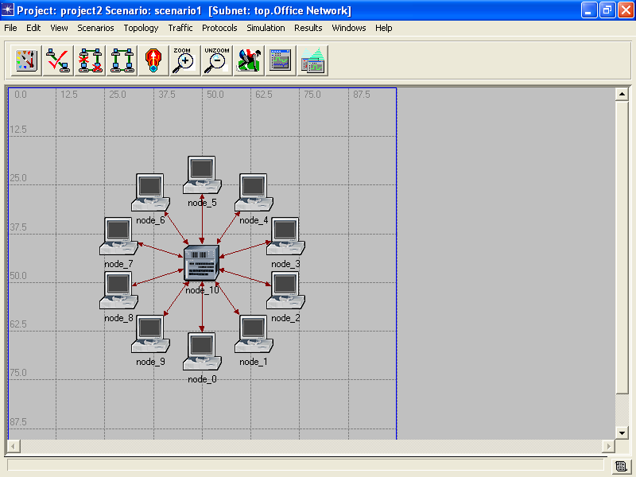
Rapid Configuration

Slide 180
Rapid Configuration
This only sets up the basic layout, such as what everything attaches to, the number of workstations, and the link speed between devices
This method will not bring in devices, such as servers
It also will not place the application or profile icons in the workspace

Slide 181
Rapid Configuration
The palette is used to bring the rest of the objects in

Slide 182
Importation
Go on to the next slide as this section has not been completed yet

Slide 183
Sample Network Model
The link objects are used to connect the devices to each other
In this example the 100BaseT link will be used
It does not matter what order is used to connect the devices to each other
Just click on one, then the other
Again right click to deselect the link object

Slide 184
Sample Network Model
For our sample project reduce the number of workstations to five by deleting nodes 5 through 9
To delete an object select it, then right click
We also need to and a server and a printer
From the Ethernet palette select and place these two objects

Slide 185
Sample Network Model
Now we have a functioning network so the palette can be dismissed from the workspace
With the palette gone rearrange the devices so they are easier to see
This is the result for my sample network

Slide 186
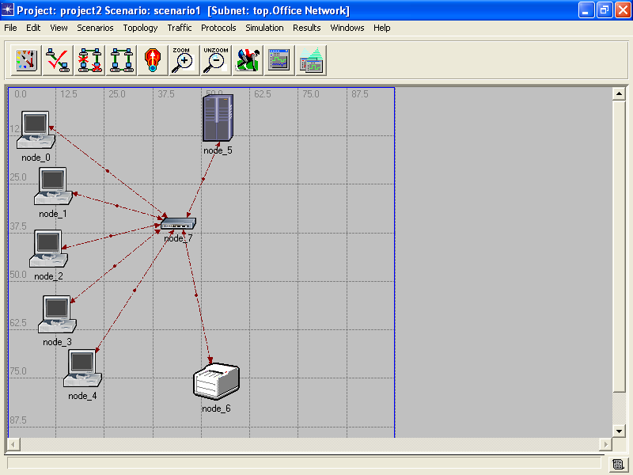
Sample Network Model

Slide 187
Sample Network Model
We have the devices we need, but the devices can do nothing without two additional elements
These are the ones mentioned above
Application Definition
Applications that will run on the network
Profile Definition
Applications an object will use

Slide 188
Sample Network Model
You drag and drop these two elements from the palette as well
These last two objects are used to set the overall behavior for the simulation
This makes the sample network look like this

Slide 189
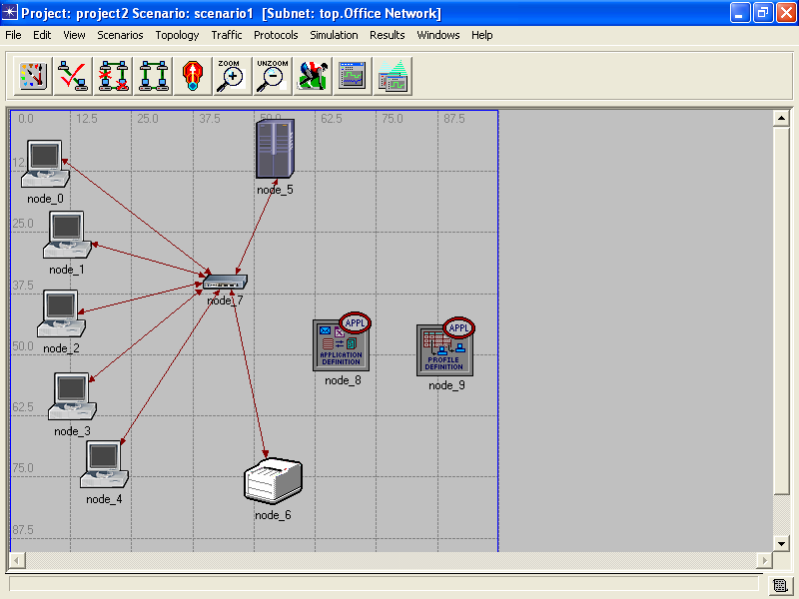
Sample Network Model

Slide 190
Set Application Attributes
The Application Definition object defines what applications will run over the network
To select the applications right click on the Application Definition object
Don’t worry about the following diagram being different from our sample network, this is just an illustration of how to select the Application Definition object

Slide 191
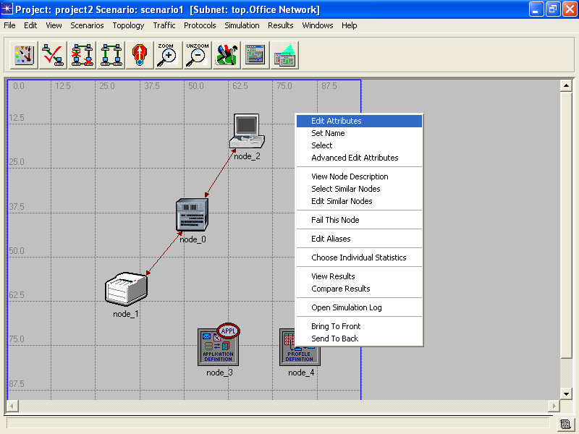
Set Object Attributes

Slide 192
Set Object Attributes
Select
Edit Attributes
To add applications click on the
Applications Definitions
line
The click on the number to the right of
Rows

Slide 193
Set Application Attributes
Click on the
0
to the right of Rows
Select the number of applications that will run on the network
That number of application rows will appear
The row numbering will start with 0

Slide 194
Set Application Attributes
Click on the
+
for the row
Then click on the
+
beside the word Description
This produces a list of the common applications found on a network

Slide 195
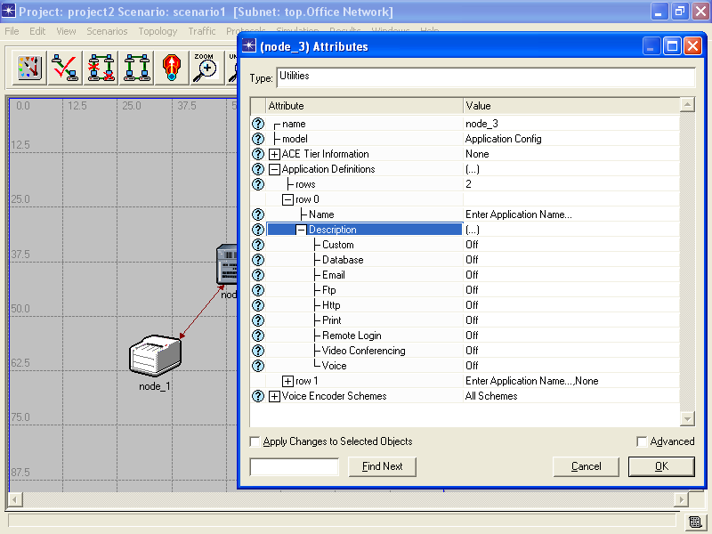
Set Application Attributes

Slide 196
Set Application Attributes
To add an application click on the
Off
to the right of the name of the application

Slide 197
Set Application Attributes

Slide 198
Set Application Attributes
After the applications that will run on the network are set click
OK

Slide 199
Set Application Usage
OPNET uses a probabilistic model to create the traffic
These values can be adjusted to match your network or the default values can be used
The exact name of the various objects may differ slightly from the examples shown next depending on the version of OPNET being used

Slide 200
Set Application Usage
Database Access (Light)
50% database queries, 50% database entries
Transactions arrive with inter-arrival times exponentially distributed with mean 30 seconds
Each transaction is 16 bytes

Slide 201
Set Application Usage
Email (Light)
Emails are sent with inter-arrival times exponentially distributed with mean 3600 seconds
Each email is sent to a group of 3
Emails are received with inter-arrival times exponentially distributed with mean 3600 seconds
Each email is received by a group of 3
Each email is 500 bytes.

Slide 202
Set Application Usage
File Transfer (Heavy)
50% of file transfers from client to server (put), 50% from server to client (get)
The time between each client’s file transfer requests, is exponentially distributed with mean 360 seconds
All files are 50000 bytes

Slide 203
Set Application Usage
File Transfer (Light)
50% of file transfers from client to server (put), 50% from server to client (get)
The time between each client’s file transfer requests, is exponentially distributed with mean 360 seconds
All files are 1000 bytes

Slide 204
Set Application Usage
File Print (Light)
Print requests arrive with inter-arrival times exponentially distributed with mean 90 seconds
Print requests are normally distributed with mean 3000 bytes, standard deviation of 300 bytes

Slide 205
Set Application Usage
Web Browsing (Heavy HTTP 1.1)
Page inter-arrival times are exponentially distributed with mean 60 seconds
Each Page has 1000 bytes of text 5 “medium images” each with size randomly picked with a uniform distribution on [500,2000] bytes

Slide 206
Set Application Usage
Web Browsing (Light HTTP 1.1)
Page inter-arrival times are exponentially distributed with mean 720 seconds
Each Page has 500 bytes of text 5 “small images” each with size randomly picked with a uniform distribution on [10,400] bytes

Slide 207
Set Application Usage
Telnet (Light)
Inter Command time normally distributed with mean 120 seconds, variance 10
Each command from terminal to telnet host consists of a normally distributed amount of bytes with mean 10, variance 4
Each command from telnet host to terminal consists of a normally distributed amount of bytes with mean 5, variance 2.778

Slide 208
Set Application Usage
A default set of applications can be used instead of defining each one individually
To use the default set
Right click on the Application Definition element
Select
Edit Attributes
On the Application Definitions row click on the right side

Slide 209
Set Application Usage
Select
Default

Slide 210
Set Application Usage

Slide 211
Set Application Usage
This provides a common set of network applications such as
HTTP
FTP
Email
Database
And so on

Slide 212
Set Application Usage
The next task is to create profiles
These profiles are collections of applications, as just defined above, that individuals or groups using the network will use
This is the second step in placing activity on the network

Slide 213
Set Application Usage
The last part of injecting traffic is to assign a profile to an object on the network, such as a server or a workstation
The Profile Definition element is used for this purpose
To configure the Profile Definition object right click on it
Then select
Edit Attributes

Slide 214
Set Application Usage

Slide 215
Set Application Usage
Profile Configuration
Click on the right side of the
row
This will produce a drop down list
Select
Edit

Slide 216
Set Application Usage

Slide 217
Set Application Usage
Another window will appear
Click on the 0 in the box top the left of Rows

Slide 218
Set Application Usage

Slide 219
Set Application Usage
Select
1
row for this example

Slide 220
Set Application Usage

Slide 221
Set Application Usage
The row or rows will appear above

Slide 222
Set Application Usage

Slide 223
Set Application Usage
Change the profile name under the Profile Name column on the left by clicking on
Enter Profile Name…
For this example enter
Web User

Slide 224
Set Application Usage

Slide 225
Set Application Usage
Also for this example change the Repeatability to
unlimited

Slide 226
Set Application Usage

Slide 227
Set Application Usage
Under the Applications column select
Edit
Then select
1
In the box to the left of Rows

Slide 228
Set Application Usage

Slide 229
Set Application Usage
Click under the Name column
Select
Web Browsing (Heavy HTTP 1.1)
for this example
Then close all windows by clicking
OK
OK
OK

Slide 230
Set Application Usage

Slide 231
Set Application Usage
The traffic profile has been created
Now it can be applied to the workstations

Slide 232
Set Application Usage
Select one of the workstations by clicking on it
Right click on it
From the pop up menu select
Select Similar Nodes

Slide 233
Set Application Usage

Slide 234
Set Application Usage
In general end devices, such as workstations generate traffic
Connection points, such as switches, do not
In this example, left click on the workstation

Slide 235
Set Application Usage
While holding down the Crtl key click on the remaining workstations so all of then are selected
Right click and select
Edit Attributes

Slide 236
Set Application Usage

Slide 237
Set Application Usage
On the Attributes window select
Apply Changes to Selected Objects
In the bottom left corner of the window so the changes made in this window will apply to all the workstations

Slide 238
Set Application Usage

Slide 239
Set Application Usage
Click the
+
beside Application Supported Profiles
And the
0
To the right
Then select the number of profiles to be used

Slide 240
Set Application Usage
In this case
1
One row will appear
Select
Web User
as defined above

Slide 241
Set Application Usage

Slide 242
Set Application Usage
Click
OK
The workstations are ready to generate traffic
For this example the server must be configured as well so the web traffic has somewhere to go
Right click on the Server
Select Edit Attributes

Slide 243
Set Application Usage
Select
Edit
On the Application Supported Services row
A new window appears

Slide 244
Set Application Usage

Slide 245
Set Application Usage

Slide 246
Set Application Usage
Select
1
In the box to the left of Row

Slide 247
Set Application Usage

Slide 248
Set Application Usage
Select
Web
By clicking on
None
In the Name column
As above select
Web Browsing (Heavy HTTP 1.1)
to create a generic HTTP server

Slide 249
Set Application Usage
Then Click
OK
OK

Slide 250
Set Application Usage

Slide 251
Select Functions to Measure
The last configuration step is to select what to measure
There are two basic types of measures
Individual
Global
Individual measures apply to an object
Global measures apply to the network as a whole

Slide 252
Select Individual Measures
To select individual measures right click the object, such as a server
The select
Chose Individual Statistics
from the popup menu
This shows a list of things that can be measured

Slide 253
Select Individual Measures

Slide 254
Select Individual Measures
To select on expand the item of interest by clicking on the
+
Then select the items to be measured
Such as
Server Http
Traffic Received (bytes/sec)
Traffic Sent (bytes/sec)

Slide 255
Select Individual Measures

Slide 256
Select Individual Measures

Slide 257
Select Global Measures
To select a global measure right click on the workspace away from the objects
The select
Chose Individual Statistics
There will be a short delay as IT Guru initializes itself for this function

Slide 258
Select Global Measures

Slide 259
Select Global Measures

Slide 260
Set Global Measures
The global statistics list appears
Expand
Global Statistics

Slide 261
Select Global Measures

Slide 262
Set Global Measures
Select the measures
In this case
Node Statistics
TCP
Connection Aborts
Delay
Retransmission Count

Slide 263
Select Global Measures

Slide 264
Select Global Measures

Slide 265
Set Global Measures
Click
OK

Slide 266
Save the Simulation
If desired save the simulation by selecting
File
Save
Provide a name

Slide 267
Run the Simulation
Everything is now completed
To run the simulation click on the
configure/run simulation
Button
Usually the default values have to be changed

Slide 268
Run the Simulation

Slide 269
Run the Simulation
In this case the duration is set to 30 minutes

Slide 270
Run the Simulation

Slide 271
Run the Simulation
Click on
Run
The next two screens appear one after the other
When the simulation is finished
Click on
Close

Slide 272
Run the Simulation

Slide 273
Run the Simulation

Slide 274
Examine the Results
To view the results of the simulation each individual measure must be selected, as well as any global measures
To examine an individual measure
Right click on the object of interest such as the server

Slide 275
Examine the Results
Select
View Results
Expand the hierarchy to show the measure
Click on the checkbox to select the measure
Click the
Show
button

Slide 276
Examine the Results
A graph of the results appears

Slide 277
Examine the Results

Slide 278
Examine the Results

Slide 279
Examine the Results

Slide 280
Examine the Results
To examine the global measure
Right click in the workspace
Select
View Results
Click on the checkbox to select the measure
Click the
Show
button

Slide 281
Examine the Results
A graph of the results appears

Slide 282
Compare Results
Once the first scenario is working a baseline for the network of interest has now been created
The effects of a change to the network can be assessed by creating a new scenario, then comparing the results of the two scenarios

Slide 283
Compare Results
For example, a second floor might be added to the network
What impact will this have on the existing single floor network we just setup

Slide 284
Create Second Scenario
To do this first create a new scenario by copying, then modify what was just done
Select
Scenarios
Duplicate Scenario
Provide a name for the new scenario
Click
OK

Slide 285
Create Second Scenario
Setup the second scenario just as you did the first one
Just change what needs to changed or add any additional network segments or nodes
As before run the simulation

Slide 286
Compare Results
To compare the affect of the added load on the original network select
Compare Results
from the pop up menu that appears when right clicking on the object or on the workspace
Now two lines will appear in the results graph for the measure of interest

Slide 287
Summary
As we can see when examining these four different types of tools the simulator and the emulators are very similar
The main difference being how close to the actual equipment the user experience is
The emulator produces the nearer to real experience, but it is but it is limited in what can be built

Slide 288
Summary
The dedicated network modeling tool has much more detail that can be set so as to better represent the network that will be deployed
However, simulators and emulators range from free to very low cost, whereas a network modeling toll can be very costly
The type and complexity of the network being modeling will guide which tool to use

