Slide 1
Network Design Methodology
Last Update 2012.02.22
1.26.0

Slide 2
Objectives of This Section
Learn
How to design a network using the correct techniques
Some common guidelines used to evaluate a network design

Slide 3
Organization Size
Books and articles in the trade press would make you think that every organization in the country is huge
That each one of these has a highly complex network with layer after layer of equipment
In reality most organizations are fairly small

Slide 4
Network Size
The network needed by most organizations is therefore also fairly small
Keep in mind that a single broadcast domain can work just fine with several hundred active users depending on the nature of the network traffic

Slide 5
Organization Size
Let’s see how many firms and the dependent establishments there are at various sizes
Here is data from 2008 from the Census Bureau

Slide 6
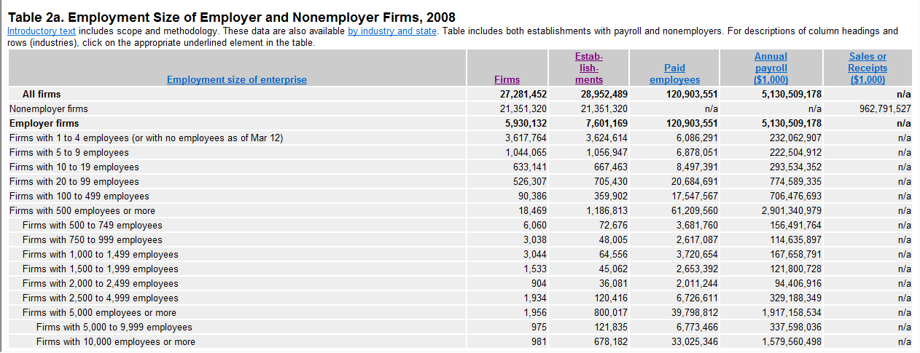
Organization Size

Slide 7
Organization Size
As the chart shows there are a total of 27,281,452 firms with 120,903,551 employees
However, over 78 percent or 21,351,320 of these firms have no employees
All 121 million employees work for just 6 million firms
How big are these firms

Slide 8
Organization Size
Well 5,821,277 or 98 percent of these 6 million firms have 99 employees or less
Clearly the overwhelming number of firms are at best classified as small firms
Another 90,386 or 1 ½ percent are considered to be medium size firms

Slide 9
Organization Size
This leaves just 18,469 or ½ of a percent out of 6 million firms that can be considered to be large or enterprise size organizations

Slide 10
Organization Size

Slide 11
SOHO
Let’s look first at the very small firms
Those with 1 to 19 employees
As this table shows there are 5,821,277 of those
Again that is 98 percent of all firms
Clearly none of these need more than a single local area network consisting of a single switch, a server or NAS box, and a printer

Slide 12
SMB
Small and Medium sized businesses are defined as those with 500 or fewer employees
No doubt an organization with up to 500 staff in a single location could also work well with a single or at worst a handful of local area networks, a set of switches, a server, maybe separate storage, and a number of printers

Slide 13
SMB
This too is not a very complicated setup

Slide 14
Large
This leaves just 18,469 organizations with 500 or more employees out of over 6 million total firms

Slide 15
Do Not Over Complicate
What is the point to this discussion
To point out to you to not over complicate this
A basic, simple, single layer network design will work for over 98 percent of all firms

Slide 16
Approach to Network Design
The approach in this presentation will be on the necessity to account for all seven layers of the OSI model when creating a design for a network
As well as accounting for that all important eighth layer, in other words the political factors that always have an effect on any technical decision

Slide 17
Approach to Network Design
Too many technical managers focus on only the bottom two or three OSI layers
Failure to account for the political layer has sunk many a project
Network design must be a complete process that matches business needs to the available technology to deliver a system that will maximize the organization

Slide 18
Approach to Network Design
Keep in mind that for most organizations the network is just an expense
An expense they would like to reduce
It is up to you as the network designer and manager to deliver a network that advances the interests of the organization

Slide 19
What is the Point to This
The first consideration is what will the network be sharing and with whom
Because, if there is nothing that needs to be shared, there is no need for a network
Then whatever needs to be shared and with whom, will determine the type and scope of the network

Slide 20
What is the Point to This
For example, if this is a LAN that is needed, what it is that needs to be shared will guide you as to whether this can be a peer-to-peer or a server based network
If users outside of the LAN need access to something on the LAN, then their location will determine whether a CAN, MAN, or WAN connection is required to hook them up to the resource to be shared

Slide 21
The Framework
The framework that will be used here is based on Top Down Network Design Third Edition by Priscilla Oppenheimer from Cisco Press
Oppenheimer lists a number of steps and several aspects to each step
We will discuss some of these in detail

Slide 22
The Framework
Some others will be dealt with quickly, because the details on these are covered in other presentations available on this web site or in Top Down Network Design itself
The steps are

Slide 23
Oppenheimer Steps
Part 1 – Identifying Customer Needs/Goals
Analyzing Business Goals and Constraints
Analyzing Technical Goals and Tradeoffs
Characterizing the Existing Network
Characterizing Network Traffic

Slide 24
Oppenheimer Steps
Part 2 – Logical Network Design
Designing a Network Topology
Designing Models for Addressing and Naming
Selecting Switching and Routing Protocols
Developing Network Security Strategies
Developing Network Management Strategies

Slide 25
Oppenheimer Steps
Part 3 – Physical Network Design
Selecting Technologies and Devices for Campus Networks
Selecting Technologies and Devices for Enterprise Networks

Slide 26
Oppenheimer Steps
Part 4 – Testing Optimizing Documenting
Testing the Network Design
Optimizing the Network Design
Documenting the Network Design

Slide 27
Business Goals and Constraints
The first thing to do is to understand the business goals for the project, such as
Why are we here
What advantage to the business will this project bring
It is also important to understand the business constraints

Slide 28
Business Goals and Constraints
For example
What we want is an unlimited budget and time to work
But we will not get this

Slide 29
Collect Information
The next step is to ensure that before meeting with the client, whether internal or external some basic business related information has been collected
Competition
Market Conditions
Future of the Industry
Products Produced/Services Supplied
Financial Condition

Slide 30
Meet With the Customer
Once the basic information has been collected, meet with the customer to hear what they have to say
At that meeting, collect information on the project

Slide 31
Meet With the Customer
Specifically try to get
A concise statement of the goals of the project
Problem to be solved
New capability to be added
What has the competition just done to them
What must happen for the project to be a success

Slide 32
Meet With the Customer
What will happen if the project is a failure
Is this a critical business function
Is this just something they want to try
Do they really think it will work
Get a copy of the organization chart
This will show the general layout of the organization
It will suggest users to be accounted for
It will suggest geographical locations to account for

Slide 33
Meet With the Customer
Find out about biases the customer has
For example
Will they only use certain companies products
Do they avoid certain things
This applies to the technical and management staff

Slide 34
Gather Information at the Site
Once all of the basic information has been collected, it is time to start gathering information at the site concerning the actual project
This information begins with information on the applications
List all the applications that cross the network
Now and after the project is completed
Both productivity and management applications

Slide 35
Application List
Oppenheimer likes to use tables to collect information on the network
For example

Slide 36
Application List
Application Name | Application Type | New Existing | Importance | Notes
MAS90 | Enterprise accounting | Existing | Critical | A new version that switches from client/ server to browser/server will be out in one month
Quicken | Accounting | Existing | Low | CEO uses for home budget
OpenView | System | Existing | High | Monitors routers
MRTG | System | New | High | Produces network usage data

Slide 37
Business Constraints
Constraints on the project might include those related to business practices, such as
The security of the facility
When can work be done

Slide 38
Business Constraints
Other constraints might relate to their staff
What of their staff can you use
When can you use their staff
What is the level of competence of their staff, as they may be more of a problem than a help
The timeframe is always a constraint
Due dates
Milestones

Slide 39
Technical Goals and Tradeoffs
Besides the business goals and constraints, it is important to understand the technical goals
The technical tradeoffs must be understood as well
Oppenheimer lists eight things to consider

Slide 40
Scalability
Scalability refers to what is needed today as well as the future
The ability to grow, for example
Cabling is meant to last for 10 years
Switches and routers are meant to last for 2 to 5 years, since it is easier to change these
Get an idea of the needs for next 2 to 5 years

Slide 41
Scalability
At least you need to know
Number of sites to be added
What will be needed at each of these sites
How many users will be added
Where might servers be located
New lines of business
This is not the current project, but perhaps only things dimly in the future

Slide 42
Availability
Availability is the uptime
It is expressed as a percent and is related to the time period
Such as
99% per minute
95% per month
Small variations translate into big times
Different applications may require different levels

Slide 43
Performance
Performance is a key indicator for most projects
In some cases it is only that
“No one complains”
In most cases it is more definitive

Slide 44
Performance
Common performance measures include
Capacity v Throughput
Bandwidth Utilization
Offered Load
Accuracy
Efficiency
Latency
Response
Device CPU Utilization

Slide 45
Capacity v Throughput
Before getting into the details of what each of these measures of performance mean, let’s have a general discussion of two terms commonly used in relation to performance, capacity and throughput
What follows is a response from Priscilla Oppenheimer to a question concerning this on a newsgroup in May 2003

Slide 46
Capacity v Throughput
Throughput and capacity are not the same thing
Capacity is commonly stated as the pipe size, such as 1.544 Mbps
Capacity is what the link is capable of
Throughput is the measured quantity of data going through the pipe
Throughput is usually less than capacity, but it could be the same as the capacity, at least in theory

Slide 47
Capacity v Throughput
The size of the packets used will have a major effect on capacity v throughput
It depends on how much time there is between packets
During any silence between packets, the throughput is 0 bps
That reduces overall throughput that you measure over a longer period of time

Slide 48
Capacity v Throughput
When you use 64-byte packets, compared to 1500-byte packets, it takes many more packets to send some quantity of user data
With 64-byte packets, there are many more gaps between packets then there are with 1500-byte packets
In other words, this is another argument for big packet sizes
Theoretically, most WAN links don't require any gaps between packets

Slide 49
Capacity v Throughput
But the packets don't originate from a WAN device usually
They originate from Ethernet usually
Ethernet does require gaps between packets
Another issue is the packets-per-second rating of devices that originate or forward the packets

Slide 50
Capacity v Throughput
Each packet requires some work, so it's possible your throughput will be negatively affected if there are more packets due to the small packet size
Finally, you need to decide what you mean by throughput
Are you referring to bytes per second, regardless of whether the bytes are user data bytes or packet header bytes

Slide 51
Capacity v Throughput
In that case, packet size doesn't matter, except for the caveats mentioned above
Or are you concerned with application-layer throughput of user bytes, sometimes called "goodput“
In that case, you have to consider that bandwidth is being "wasted" by the headers in every packet

Slide 52
Capacity v Throughput
So you want to reduce the number of packets required to send user data by using large packet sizes

Slide 53
Capacity v Throughput
Here is an example for Ethernet at various speeds and frame sizes from an Agilent white paper on RFC 2544 testing

Slide 54
Capacity v Throughput

Slide 55
Capacity v Throughput

Slide 56
Capacity v Throughput

Slide 57
Performance
Bandwidth Utilization
The percent of total available capacity in use
Offered Load
This is the sum of all the data all network devices have ready to send at a particular time

Slide 58
Performance
Accuracy
Exactly what goes out gets to the other end
To check accuracy use a network analyzer to check the CRC on received frames

Slide 59
Performance
Track the number of frames received with a bad CRC every hour for one or two days
It is normal for errors to increase as network utilization goes up
So check the number of errors against the network load
The error rate is acceptable if there are not more than one error per megabyte of data

Slide 60
Performance
Efficiency
How much overhead is required to deliver an amount of data
How large a packet can be used
Larger better
Too large means too much data is lost if a packet is damaged
How many packets can be sent in one bunch without an acknowledgment

Slide 61
Performance
Latency
This is the delay in transmission
or
The time that passes from when a user expects something to appear, to when it does appear
Instantaneous response is the only goal

Slide 62
Performance
Response
Related to latency, but also a function of the application and the equipment the application is running on
Most users expect to see something on the screen in 100 to 200 milliseconds

Slide 63
Performance
Device CPU Utilization
High utilization on a device may create a bottleneck as the device will be unable to handle the offered load regardless of the bandwidth coming in or going out of the device
In other words, the device becomes the bottleneck
So what is high CPU utilization

Slide 64
Performance
It depends of course on the type of device and the manufacturer of the device
As an example Cisco has provided some guidelines for their very common 2900XL and 3500XL switches
Cisco says under just normal load a CPU utilization figure of 35% to 50% is common
High CPU utilization on these devices is considered to be 80% to 99% by Cisco

Slide 65
Performance
On newsgroups 25% to 65% is reported to be normal on most brands of switches under normal load
For routers Cisco says to watch for the following
High percentages in the show processes cpu command output
Input queue drops
Slow performance

Slide 66
Performance
Services on the router fail to respond, for instance
Slow response in Telnet or unable to Telnet to the router
Slow response on the console
Slow or no response to ping
Router doesn't send routing updates
Once again what is high, Cisco does not say
But newsgroup reports say 1% to 20% is normal and 80% and above is high

Slide 67
Security
In assessing the amount of security, balance the risks against the cost
There is no point in locking things down so tight, nothing can be used
Common risks include
Use of resources
Loss of data
Alteration of data
Denial of service

Slide 68
Manageability
Manageability refers to how easy will it be to monitor the network
To check for
Performance problems
Errors
Security problems
Configuration
Accounting, if chargeback used

Slide 69
Ease of Use
How difficult will it be for the network management team to run the network you will be leaving
This is why you need to find out the technical level of the staff in the beginning
How difficult will it be for the network team to change the network by themselves

Slide 70
Adaptability
A network must be adaptable
Can the network change as circumstances change
Proprietary technologies reduce adaptability
Standards are preferred if possible

Slide 71
Affordability
Do not propose a network they cannot pay for
It must be affordable
Find out the budget in the beginning
Adhere to the budget
Get all change orders approved in writing before changes are made

Slide 72
The Existing Network
We now know where we want to go based on the analysis that was just done
We next need to determine where we are starting from
If this is an entirely new network, this step does not need to be done

Slide 73
Information to Collect
A network map is the first thing to work on
This map should include
Geographic locations
WAN connections between sites
Labeled with type/speed/protocols/media/service provider
Buildings and floors where equipment will be
Connections between buildings and floors
Labeled with type/speed/protocols/media

Slide 74
Information to Collect
Location of connection points like routers and switches
Internet connections
Remote access points
A baseline will be needed as this will tell you where the network is today

Slide 75
Information to Collect
Measure
Bandwidth utilization by time of day and protocol
Be sure to account for print jobs, especially large ones
Errors per MB of data
Response time
Pings may be used for this

Slide 76
Information to Collect
Trend Analysis
Collect the same basic information discussed in baselining, but do this over time
This allows you to anticipate problems, before they become so
It also allows you to justify buying new toys at the end of the year when a budget surplus is discovered and must be spent quickly

Slide 77
Compare Data to Guidelines
Compare the data collected to the following guidelines
On a switch based network to allow for burst a 70% average utilization over a ten minute period is the maximum to allow
On a point to point link, to allow for bursts, 70% average utilization over a ten minute period is a good guideline for both WANs

Slide 78
Compare Data to Guidelines
The response time should be less than 100 milliseconds
No segment should have more than 10 to 20 percent broadcast traffic
No segment should have more than 1 CRC error per MB of data

Slide 79
Characterizing Network Traffic
In this step the flow of the traffic both existing and to be added or changed will be accounted for
This is done by identifying
Sources and destinations of traffic
Direction and type of flow between these points
Volume of traffic

Slide 80
Collecting Network Traffic
To determine the sources and destinations of traffic first, identify the user communities
A user community is a collection of staff that do basically the same thing, such as the accounting program users
This may be a limited group, isolated to a single area or building or it may be the email users who are widely geographically distributed
Create a chart of these groups

Slide 81
User Community List
Community Name | Number of Users | Location | Application
Enterprise Accounting | 5 | Building B Floor 2 Rooms 3-5 | MAS90
CEO Accounting | 1 | Building A Corner Office | Quicken
Network Managers | 3 | Building C Deep Dark Basement | OpenView
Network Managers | 3 | Building C Deep Dark Basement | AlertPage

Slide 82
Collecting Network Traffic
Next identify where the data these user communities use is located
This could be a
Server
Server Farm
Mainframe offsite
NAS
Create a chart of these sites along with the user communities

Slide 83
Data Stores List
Data Store Name | Location | Application | Used By
Accounting Data | Building C Even Deeper and Darker Basement | MAS90 | Enterprise Accounting
CEO‘s Budget | Building A Corner Office | Quicken | CEO
OpenView Logs | Building C Deep Dark Basement | OpenView | Network Managers
AlertPage Logs | Building C Deep Dark Basement | AlertPage | Network Managers

Slide 84
Collecting Network Traffic
For the data flow from the user communities to their data stores, measure or estimate the traffic flow over the links
Use a network analyzer or network management tool for this
This is not likely to be exact
It is being used to identify bottlenecks

Slide 85
Traffic Flow List
Application | Traffic Type | Protocols Used | User Community | Data Store | Bandwidth Needed | QoS

Slide 86
Collecting Network Traffic
The type of traffic is important
This will influence the type of link required
At this stage the QoS is important as well since it will affect the type of link
Only some link types can support QoS
Again a chart is used to collect this information

Slide 87
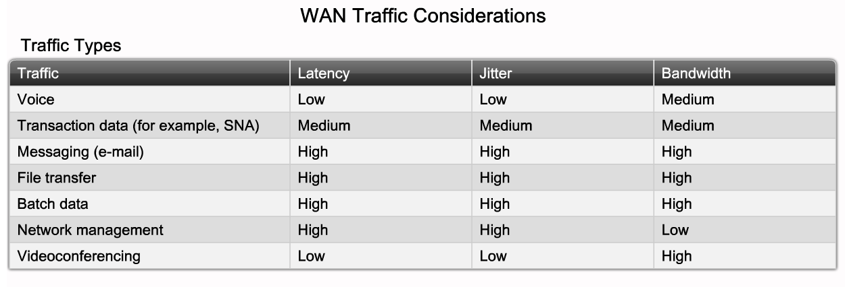
Types of Traffic

Slide 88
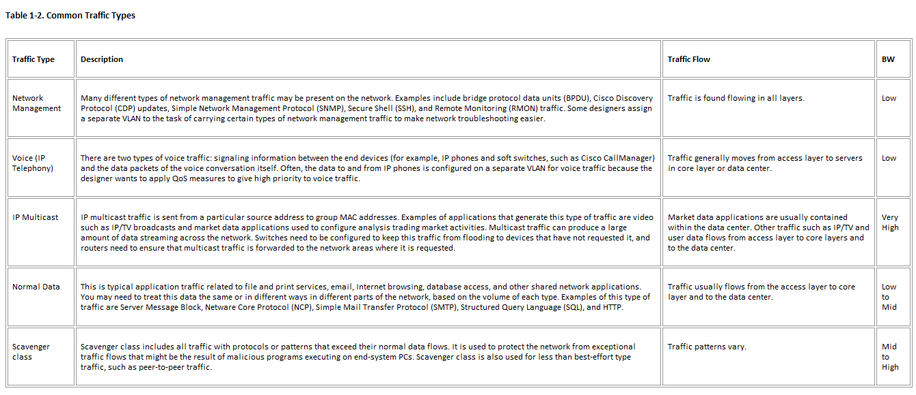
Types of Traffic

Slide 89
Types of Traffic
Different traffic types have different characteristics
Terminal/Host
Asymmetrical
Terminal sends a few characters
Host sends back many characters
Client/Server
Similar to above
Client sends more data as does the server

Slide 90
Types of Traffic
Browser/Server
Similar to a terminal/server
Uses a web browser instead of a dedicated program
The server response will be quite large possibly
Peer-to-Peer
This flow is bi-directional and symmetric
Unix-to-Unix workstations often use this

Slide 91
Types of Traffic
Server-to-Server
The flow depends on the relationship between the servers
If mirrored, then one way and high level
Other relationships may be more bi-directional
Distributed Computing
Several computers join together to solve a single problem
Normally the exchange is quite high
It is bi-directional and symmetrical

Slide 92
Type of Traffic List
Application | Type of Traffic | Protocol | User Community | Data Store | Bandwidth | QoS
Enterprise Accounting | Client/Server Browser/Server | IP | Enterprise Accounting | Accounting Data | Average of 2 Mbps from 8 to 5 weekdays | None
Note this is blank | Because the CEO’s | Quicken Data | Does not leave CEO’s office | NA | NA | NA
OpenView | Terminal/Server | IP | Average of 2 Kbps 24X7X365 | OpenView Logs | Average of 2 Kbps 24X7X365 | None
AlertPage | Terminal/Server | IP | Average of 65 Kbps Every hour 24X7X365 | AlertPage Logs | Average of 65 Kbps Every hour 24X7X365 | None

Slide 93
Types of Traffic
A quick estimate of traffic flow can be made by using the following table
This table shows the average flows for the different types of data
In many cases, especially when tools such as a baselining tool or protocol analyzer are not available, this is the best that can be done

Slide 94
Traffic Flow Estimates List
Type of Application | Typical Data Size Kbytes | Type of Application | Typical Data Size Kbytes
Terminal Screen | 4 | Graphical Screen | 500
Email | 10 | Presentation Document | 2,000
Web Page | 50 | High Resolution Image | 50,000
Spreadsheet | 100 | Multimedia Object | 100,000
Word Processing Document | 200 | Database | 1,000,000

Slide 95
Measuring Traffic Flow
How do you actually determine what size data lines are required
This is often difficult and inexact
Formulas are available as discussed below, but often the best way is to send the normal files over a controlled circuit and time it

Slide 96
Measuring Traffic Flow
For example as Pricilla Oppenheimer, the author of the book this presentation is based on, pointed out in an email message to groupstudy.com
Instead of using a formula, you should probably just do some measurements
These will account for the overhead
Why might mere calculations using a formula not work

Slide 97
Measuring Traffic Flow
The file isn't going to cross the network in one big monolithic package
It will be divided into packets
Each packet will have a size, hopefully as big as 1500 bytes, but that depends on the protocol, configuration settings, application, operating system, and so on

Slide 98
Measuring Traffic Flow
Each 1500 byte packet will be encapsulated in the Frame Relay header and followed by the 2-byte Frame Check Sequence
Also, Frame Relay packets are encapsulated in a 1-byte Flag field at the beginning and end
You have to take those bytes into account for each packet
That 1500 bytes won't all be data from the file, however

Slide 99
Measuring Traffic Flow
Some of the bytes will be used by
A network-layer header
A transport-layer header
One, or more upper-layer headers
The packets will undoubtedly be acknowledged at one or more layers
Those ACKs use bytes and time

Slide 100
Measuring Traffic Flow
Will you be using a protocol that allows for a sliding window and can send many packets without waiting for an ACK until the send window slides closed
If so, how big is the send window by default
This usually depends on the recipient's receive window
Does the window tend to slide closed a lot
Or will you use a ping pong protocol that requires an ACK for each packet

Slide 101
Measuring Traffic Flow
Does the recipient tend to store the data in RAM and ACK quickly or does it write to disk, a slow mechanical process, and then ACK
This may depend on the state of the receive window, the amount of RAM available, and so forth
What sort of negotiation happens before the data can be sent
Any transport or session layer establishment, such as a TCP 3-way handshake

Slide 102
Measuring Traffic Flow
How about at the upper layers
Before file bytes are sent, are there negotiations and packets related to file size, file name, file access rights
Is a user name and password sent
Are these challenged with some sort of security feature, adding bytes and time to your calculation

Slide 103
Measuring Traffic Flow
Are you using any sort of encryption or compression
Is this a VPN or IPSec or other tunnel that adds even more bytes to each packet
What about the error rate
Do some packets get dropped due to an error and have to be retransmitted
That adds bytes and time

Slide 104
Measuring Traffic Flow
And how about queuing delay at the local routers and any Frame Relay switches inside the provider's network
And processing delay
How quickly does the recipient process the packets and send ACKs
What is the turnaround time at the sender
How quickly does it prepare and output the next set of packets after an ACK is received

Slide 105
Measuring Traffic Flow
So, in summary, a formula may be mathematically correct
But if it is not based on how data is sent on a network, then it will not produce accurate answers
So you need to get answers about which protocols and application are sending this data

Slide 106
Measuring Traffic Flow
FTP behaves one way while TFTP behaves another way, NetWare Core Protocol, Apple Filing Protocol, Server Message Block used in Windows networking all have their own quirks
Often then the best thing would be to do a few file transfers and get some actual data on throughput
See chapter 4 in Top Down Network Design for another method to calculate theoretical traffic load

Slide 107
Traffic Flows Estimate Formula
Although Oppenheimer does not care for formula estimates some use them
Here is to use a formula developed by Ravi Ramaswamy of AT&T
In his view the bandwidth that is required for any given connection is a function of three factors
The number of users
The requirements of the specific applications

Slide 108
Traffic Flows Estimate Formula
How each application is used
Application use means for example, a site with five users that all access a highly interactive application for twelve hours per day may require more bandwidth than a site in which a dozen users sporadically access a client-server application in which most of the processing is performed by the remote server

Slide 109
Traffic Flows Estimate Formula
The first step in sizing bandwidth using this method is to determine the requirements for the specific applications that will be deployed
A protocol analyzer is used to trace an application session to determine the average packet size and the average number of packets for a given transaction

Slide 110
Traffic Flows Estimate Formula
Once these values are known, the number of users, the required latency, and the amount of time that typically exists between transactions are all put into the following formula

Slide 111
Traffic Flows Estimate Formula
8 x N x K x M / (K x P + T)
N
Number of active users at a location
That is the number of users that will simultaneously use an application
K
Number of packets per transaction in any given direction
M
Number of bytes per packet in any one direction
P
One-way network latency
T
User think time
How much time typically exists between inquiries

Slide 112
Traffic Flows Estimate Formula
This calculation must be performed for both directions of the connection
The required bandwidth is then the maximum bandwidth estimated by this formula
In some cases, such as Frame Relay which allows for different bandwidth allocations for each direction, the two directions can have different values

Slide 113
Traffic Flows Estimate Formula
But normally the highest number is the bandwidth size
Another concern in the bandwidth sizing is delay
Certain applications such as voice and video may require a low level of delay as well as a low variability in delay

Slide 114
Traffic Flows Estimate Formula
These requirements may add significant complexity to the design process
This formula only applies to client-server type applications in which there is a substantial amount of two-way traffic

Slide 115
Environmental Considerations
In addition to network traffic there are other factors that must be taken into account
For example is the site able to support the environmental load
These factors include such things as
Electrical load
Air conditioning
Heating
Ability to place new cables

Slide 116
PoE
PoE – Power Over Ethernet is a standard from the IEEE
This 802.3af standard specifies how electrical power can be delivered to end user devices through the data cable
PoE can place an unusually heavy electrical load on the LAN room
Most equipment rooms are not wired for this type of load

Slide 117
Designing a Network Topology
In this step information collection is finally over
The information will now be put to use
The first thing to do is to layout the network on a large scale
This will be a map or diagram that will show all network segments, interconnection points, and user communities

Slide 118
Designing a Network Topology
Network design is an art, not a science
There are no absolutes
There are no precisely correct formulas
It always depends
There are two basic types of network designs
Flat
Hierarchical

Slide 119
Flat Network
In a flat network all connecting devices are on the same level

Slide 120
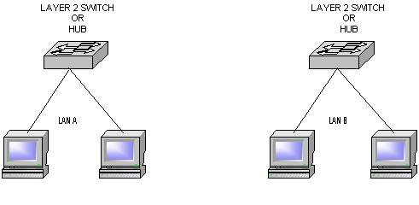
Flat Network

Slide 121
Flat Network Design
A flat design is appropriate for a small and static network
A flat network is a single collision domain or one that is not divided hierarchically
There is a limit to the number of stations that can be supported in a flat design
Broadcast domains are divided using
Layer 3 Switches
Routers

Slide 122
Hierarchical Network
In a hierarchical design all connecting devices are still on the same level, but these are interconnected at a level above it

Slide 123
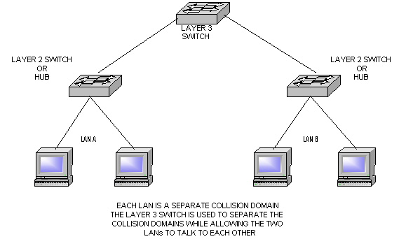
Hierarchical Network

Slide 124
Hierarchical Types
In the Cisco world any network design is hierarchical
This is so the network can be
Organized
Managed
Scaled
Upgraded

Slide 125
Cisco’s Approach to Design
In addition to the high level methodology Oppenheimer discusses in her book, Cisco has specific ideas on how network design should be done as well
However, Cisco is obviously having a significant internal argument over how to present their design philosophy
In the past they used a simple three layer model of access, distribution, and core

Slide 126
Cisco’s Approach to Design
Later they subdivided the distribution and core layers using the concept of blocks, such as a switch block or server block
Now that have overlaid the basic model with several layers, few of which make much sense
I expect eventually this internal argument will cease, and they will simplify this convoluted mess

Slide 127
Cisco’s Approach to Design
In this presentation we will discuss the elements of this current design philosophy that make sense
If you want the full treatment, it is in the textbook as well as in various white papers on the Cisco web site

Slide 128
Network Design Hierarchy
In the traditional Cisco network design model there are three basic levels
Access
Where switching is the primary activity
Distribution
Where routing occurs
Core
Which forms a backbone for connecting the distribution level segments of larger networks

Slide 129
The Layers

Slide 130
The Layers

Slide 131
The Modular Approach
This modular approach has significant benefits including
The network is easy to scale
The problem domain can be more easily isolated
It creates logical interconnection points where protocols changes can occur
Failure in any component isolates the devices affected

Slide 132
Access Layer
This level provides local or remote workgroup or user access to the network
It grants users access to network resources
Typically this is through a Layer 2 switch
VLANs may be defined at this layer
Limit VLANs to a single closet whenever possible

Slide 133
Access Layer
Do not uplink switches here, stack or use blades in a chassis instead to avoid loop problems
The switches in the access layer are connected to two separate distribution layer switches for redundancy

Slide 134
Access Layer

Slide 135
Distribution Layer
The distribution layer devices control access to the shared resources that the network provides
At the distribution level policy based connectivity issues such as security, traffic loading, and routing occur
In a small network the access and distribution layers are combined, and there is no core layer

Slide 136
Distribution Layer
This layer also aggregates bandwidth by concentrating multiple lower speed access layer lines into high speed connections to the shared resources at the core layer or at the distribution layer itself in medium sized networks
Redundant connections from the access to the distribution layer can be used to enhance availability

Slide 137
Distribution Layer
Routing and any packet manipulation occurs here
Use dual equal cost redundant connections to the access and core layers for fastest convergence
Address summarization from the access layer occurs here
Any media translation occurs here as well

Slide 138
Distribution Layer

Slide 139
Core Layer
For large networks the core level provides high speed transport between different parts of the network that have been subdivided at the distribution level as the network has grown in size
The core layer provides a high speed backbone that should be designed to switch packets as quickly as possible

Slide 140
Core Layer
The core should have a high level of redundancy
A full mesh network is best
No packet manipulation should occur here

Slide 141
Core Layer

Slide 142
Core Layer

Slide 143
Use of These Layers
None of the layers are required for a network except the access layer
In many small and medium size networks the access layer is the only one present

Slide 144
Traditional Three Level Model
Cisco has decided that this three level model of access, distribution, and core levels does not provide sufficient detail
It is fine as a general conceptual model, but it lacks guidance as to exactly what to deploy where
To address this Cisco has added the Enterprise Composite Model

Slide 145
Traditional Three Level Model
In Cisco’s view as copied from the CCNP BSCI Certification Guide by Stewart and Gough the traditional model had these characteristics
Access devices are Layer 2 switches based on price per port and are chosen to get the needed number of ports
Access switches are responsible for attaching end systems to the network and assigning them VLANs

Slide 146
Traditional Three Level Model
Distribution devices are Layer 3 switches and act as intermediate devices that route between VLANs and apply traffic policies such as firewalling and quality of service (QoS) decisions
Core devices, also known as the backbone, provide high-speed paths between distribution devices

Slide 147
Traditional Three Level Model
Note that the distribution layer is the sweet spot for managing the network
Implementing policy on access devices would drive up the complexity and costs of those devices and slow them down, plus it would mandate complex management of a large number of devices
Implementing policy at the core would slow down devices that are primarily tasked with moving traffic quickly

Slide 148
Traditional Three Level Model
This early model was a good starting point, but it failed to address key issues, such as
Implementing redundancy
Adding Internet access and security
Accounting for remote access
Locating workgroup and enterprise services
Cisco developed the enterprise composite network model to addresses these issues

Slide 149
Enterprise Composite Model
A revision and extension to this model is the Enterprise Composite Network Model
This models adds further physical, logical, and functional boundaries to help in scaling the basic hierarchal model
This model exists within the overall framework of the SONA approach discussed below

Slide 150
Enterprise Composite Model
In this approach the access, distribution, and core hierarchy is applied to the various modules as required
The enterprise composite model is broken up into three large pieces
Enterprise campus
Enterprise edge
Service provider edge

Slide 151
Enterprise Composite Model
By using this concept a deterministic network with clearly defined boundaries between modules is created
The model has clear demarcation points
The network designer knows exactly what traffic is allowed into and out of these demarcation points

Slide 152
Enterprise Composite Model
This model has three major functional areas
Enterprise Campus
Enterprise Edge
Service Provider Edge

Slide 153
Enterprise Campus
The enterprise campus features four sections
Building access
Building distribution
Campus core or backbone connection
Server farm
An enterprise can have more than one campus

Slide 154
Enterprise Campus
As you can see, the enterprise campus builds on the switch block idea but gives specific guidance about where to place servers and management equipment
Notice that the server farm looks like a switch block, but here all the servers are directly and redundantly attached - also called dual-homed - to the switches

Slide 155
Enterprise Campus

Slide 156
Enterprise Edge
This functional area aggregates the connectivity from the various elements at the edge of the enterprise model
The edge filters traffic from the edge modules and routes it to the campus
The enterprise edge details the connections from the campus to the wider area and includes

Slide 157
Enterprise Edge
E-Commerce
Internet connectivity
Remote access
WAN
Note that the enterprise edge is basically just another switch block with redundant distribution elements and resources within, only with some extra definition

Slide 158
Enterprise Edge

Slide 159
Service Provider Edge
This functional area provides connectivity to other networks using WAN technologies as well as with ISPs
ISP
PSTN WAN Services

Slide 160
Enterprise Composite Model

Slide 161
Enterprise Campus Modules
Campus Infrastructure Module
Network Management Module
Server Farm Module
Edge Distribution Module

Slide 162
Campus Infrastructure Module
This module is composed of one or more buildings connected to each other
This module has three submodules
Building Access
Building Distribution
Campus Backbone

Slide 163
Building Access
This submodule contains the Layer 2 switches that connect the users to the network

Slide 164
Building Distribution
This submodule aggregates the access networks using Layer 3 switches
As at any distribution level routing, QoS, and access controls operate here

Slide 165
Campus Core
This submodule switches or routes traffic as fast as possible from one module to another
Layer 3 switches handle this function

Slide 166
Server Farm Module
This area contains the shared servers
Full redundancy is implemented here

Slide 167
Edge Distribution Module
This module provides connectivity between the Enterprise Campus and Enterprise Edge

Slide 168
The Modules

Slide 169
Enterprise Edge
Just like the Campus Module the Enterprise Edge contains several submodules
E-commerce submodule
Internet Connectivity submodule
VPN and Remote Access submodule
WAN submodule

Slide 170
Enterprise Edge

Slide 171
SONA
On top of the traditional access-distribution-core layers and the new Enterprise Composite Model Cisco has overlaid this with the SONA concept
The basic idea behind SONA is to connect the hardware to the software, as well as the use of these two to deliver a business solution
In this model there are three basic layers

Slide 172
SONA
These three layers are
Network Infrastructure
Integrated Services
Application

Slide 173
SONA

Slide 174
Network Infrastructure Layer
This is the connecting point between the older hardware oriented Cisco design models and this new approach that brings in the business needs of the network
More specifically it is where
Resources are interconnected
Includes servers, storage, and clients
Ensures connectivity

Slide 175
Integrated Services Layer
This layer focuses on the optimization of the network
The focus here would be to create the best possible distribution layer in terms of fine tuning
Routing
Switching
Server load balancing
And so on

Slide 176
Application Layer
This layer details the applications that interact with the hardware based layers

Slide 177
Summary of the Design Model
As you can see this model is somewhat lacking in simplicity
Obviously Cisco is attempting to do too much in too small of a space
I hope we see a revision of this soon

Slide 178
Network Size
Back to the Oppenheimer methodology
In term is network size here are some guidelines
Small
200 or fewer end devices
Medium
200 to 1,000 end devices
Large
More than 1,000 end devices

Slide 179
Decide on the Basic Layout
Let’s also review the layouts that can be used for a network
In this example as used at the core level
Point-to-Point
Hub and Spoke
Partial mesh
Full mesh

Slide 180
Point-to-Point
A point-to-point design is all that is needed if only two sites are to be connected

Slide 181
Point-to-Point

Slide 182
Hub and Spoke
For a multiple site design the hub and spoke is the least expensive option
But is has no redundancy
If the line to a site goes down, there is no way around it
If the line to the collection node or headquarters fails nothing can happen since in this type of arrangement all traffic typically goes all the way to the top before coming back down

Slide 183
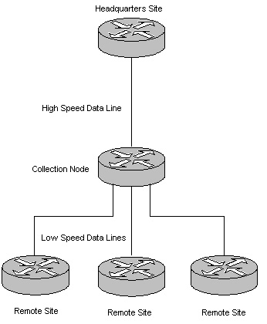
Hub and Spoke

Slide 184
Partial Mesh
Redundancy can be added at some additional cost by using a partial mesh design

Slide 185
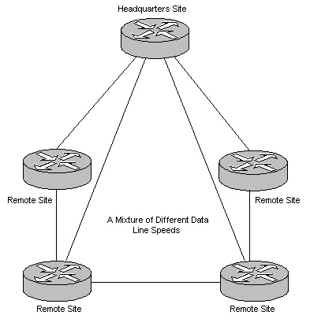
Partial Mesh

Slide 186
Full Mesh
For maximum redundancy a full mesh is used
This also generates the maximum cost
Use this formula to determine the number of links required
(N*(N-1)/2
Where N is the number of connection devices like routers or switches

Slide 187
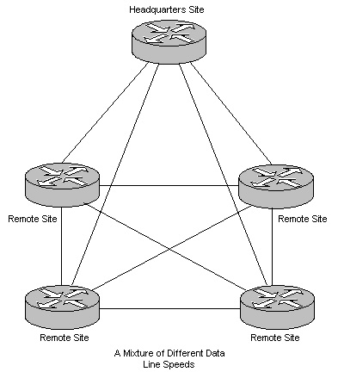
Full Mesh

Slide 188
General Rules
General rules for network design include
If a problem is protocol related such as broadcasts or service advertisements
Then use routers or layer 3 switches to divide the network
If the problem is media contention
Replace hubs with switches
If the problem is bandwidth
Uses higher speed technologies
Fast Ethernet/Gigabit Ethernet/ATM

Slide 189
Addressing and Naming
More detail on this will be provided in another presentation, but now recall that for a network to scale properly a plan for addressing and naming must be developed
IP addressing should follow along with the number of discrete networks that will ultimately be needed

Slide 190
Addressing and Naming
Names should reflect the type of device and location as this will help in troubleshooting

Slide 191
Protocols
Oppenheimer shifts at this stage to a discussion of how to select protocols
At least at the LAN level, there is no decision anymore
Ethernet is the only choice
At this level switches are the only choice for a new network
There is no reason to use a hub anymore

Slide 192
Protocols
At the CAN level for short distances under 500 meters or so there is no decision anymore either
Ethernet is again the only choice
At this level we use layer 2 and layer 3 switches with MMF ports

Slide 193
Protocols
At the MAN level several technologies are used - such as Ethernet, ATM, and SONET - depending on the distance, budget, and experience and training level of the technical staff

Slide 194
Protocols
At the WAN level there are decisions to be made concerning routing protocols at least
Routing Protocols are used by routers to learn how to reach other networks
Which to use depends on
Network size
Equipment manufacturer
Equipment age

Slide 195
Routing Protocols
Available routing Protocol include
Distance Vector
RIP
EIGRP
Link State
OSPF
IS-IS
Path Vector
BGP

Slide 196
Routing Protocols
With a distance vector routing protocol the entire routing table is sent out on a regular basis
These are appropriate for small networks and stable networks
The link state protocols only send out updates when a change occurs
These work better in the larger networks

Slide 197
Network Security Strategies
The next step is to examine the security needs of the network
Security must pay attention to
Assets to protect
Risks to these assets
Establishing a clear and enforceable security policy
User community training

Slide 198
Network Security Strategies
Security is implemented through
Authentication
Authorization
Auditing
Encryption
Connection Control
Physical Protection

Slide 199
Network Management
Management of the network is another consideration to build in
Management requires timely information
Performance
Utilization
Delay
Downtime
Throughput
Error rates

Slide 200
Technologies and Devices
We now know what the network will look like
We know what capabilities the networks needs, such as security and management
We are now ready to start picking out the bits and pieces to buy
Here are some guidelines to follow for each type of network

Slide 201
Technologies and Devices
At the LAN level
For cabling use
Copper UTP rated for Category 5E, 6, or 6A unless there is a good reason not to
To future proof the network
Use 6 or 6A instead of 5E
In special cases
Use MMF for bandwidth intensive applications
Or install fiber along with the copper

Slide 202
Technologies and Devices
At the LAN level also
The speed to the desktop should be at least 100 Mbps
The connection device to the desktop should be a layer 2 switches

Slide 203
Technologies and Devices
For a CAN
For cabling use
Use SMF
Unless unusual circumstances occur and cable cannot be run, then use a wireless method
To future proof
Run cable that contains both MMF and SMF
The speed should be whatever is required based on traffic expected
Maybe using multiple connections for load balancing

Slide 204
Technologies and Devices
The connection devices should be Ethernet layer 3 switches in most cases
ATM is also a possibility

Slide 205
Technologies and Devices
For a MAN you may control things from end to end, if the organization is large enough
More likely you will need to call on an outside supplier for at least the physical links, such as dark fiber between sites
If you select the cabling, the only thing to use is SMF
Wireless using RF is an option

Slide 206
Technologies and Devices
Connection to this fiber can be by
SONET
ATM
Ethernet
A WAN method

Slide 207
Technologies and Devices
For a WAN as you no longer can control it from end to end, you must rely on someone else
For the access method most still use Frame Relay or T Carrier
But DSL and VPNs of all types are getting more an more attention, despite the reliability and latency problems

Slide 208
Technologies and Devices
The basic decision points for a WAN are
Cost of the service
Services and technologies offered at the locations
Reliability
Performance
Security
Technical support offered

Slide 209
Technologies and Devices
When selecting the technologies and devices to be used in a CAN, MAN, or WAN link keep in mind that decisions must be made as to what will be used at all seven layers of the OSI model
All of the functions defined by the model must be accounted for
Let’s start at the top as this is easy these days

Slide 210
Technologies and Devices
For layer 7 down to 3, TCP/IP should be used
Then jump down to layer 1
What will be used at layer 1 is mostly determined by what is available
For example, you may wish to use a low cost DSL line, but you may only have access to an ISDN connection at the location

Slide 211
Technologies and Devices
Once the layer 1 decision is made, this will limit you to what layer 2 encapsulation methods are available for that layer 1 technology

Slide 212
Testing the Network Design
A network is too expensive to just put in place without some prototyping and testing before hand, especially in the CAN, MAN, and WAN areas
Try to get the vendors of the products to setup a test of the proposed solution
If not, do what can be done in the test lab
Use modeling tools such as Opnet

Slide 213
Testing the Network Design
Deploy out to just a few limited sites at first
Rely on trade publications for results of tests and surveys on the hardware and service providers

Slide 214
Testing the Network Design
Areas to look at in the test phase include
Verify the design meets the business and technical goals
Validate the design selections
Identify bottlenecks
Test redundant channels
Assess the impact of total network failure
Identify anything that might impede full deployment

Slide 215
Testing the Network Design
Performance
Test the application with transaction volume that is within and at the top of the range expected from the business requirements
Make sure that the resulting system behavior is within expectations or any formal service level agreements

Slide 216
Testing the Network Design
Stress
Expose the system to transaction volume substantially higher than what would normally be expected and over a concentrated time period
Failure
Regression tests look to see what no longer works when the new stuff goes on line

Slide 217
Testing the Network Design
Security
Ensure that people have the access level that is required and no more and that unauthorized people cannot access the system
Requirements
Track each business requirement through the development process and make sure that it is included in the final system

Slide 218
Testing the Network Design
Usability
Determine that people can use the system easily and without frustration
Documentation
Check that hard-copy and online documentation are understandable and accurate

Slide 219
Testing the Network Design
Training
Ensure that online or in-person training is effective and meets the training requirements
Interface
Test your application interfaces with external databases or third-party companies

Slide 220
Testing the Network Design
Disaster Recovery
See whether you can recover the system from a simulated disaster
Multiple Locations
Verify your system can function between multiple locations, if necessary

Slide 221
Optimizing the Network Design
Once the network is in place and running, it should be optimized
Exactly how to do this will depend on the hardware and protocols used, so it will not be discussed here in detail

Slide 222
Assessing the Design
Once the network is designed or when revisiting a network to asses if it needs alterations, what factors should you look at
The consulting firm Greenwich Technology Partners developed this quiz a while to help you assess the health of your network
To take the quiz, answer each question, then add up the score and compare it to their guidance below

Slide 223
Assessing the Design
1. What is the maximum number of router hops in your network?
a. Less than three
b. More than three, less than five
c. More than five

Slide 224
Assessing the Design
2. What is the maximum latency on the North American portion of the WAN?
a. Less than 60 msec
b. Less than 100 msec
c. Less than 120 msec

Slide 225
Assessing the Design
3. How much jitter occurs on your network?
a. 20 msec or less
b. 40 msec or less
c. 80 msec or less

Slide 226
Assessing the Design
4. What is the difference between your peak and off-peak response time?
a. Less than 20% of the low-hour response time
b. Less than 40% of the low-hour response time
c. Less than 100% of the low-hour response time

Slide 227
Assessing the Design
5. How often do network outages isolate remote sites?
a. Never
b. Once a year
c. Monthly

Slide 228
Assessing the Design
6. Do you make routing decisions based on application protocols above the IP protocol layer (multicast, user ID)?
a. Only at our Internet gateway
b. Between regions
c. At every kind of routing layer we can

Slide 229
Assessing the Design
7. What's the best way to improve your network? It needs to be more:
a. Flexible
b. Scalable
c. Modular

Slide 230
Assessing the Design
8. Do your remote users experience the same application performance that your central office users experience?
a. Yes
b. For the most part
c. Not at all

Slide 231
Assessing the Design
9. What's your packet drop rate?
a. 1%
b. 2%
c. 3%

Slide 232
Assessing the Design
10. Do you trade off lower transmission speeds than you need to reduce band width costs?
a. Absolutely
b. Sometimes
c. Never

Slide 233
Assessing the Design
11. How often do users experience time outs within the corporate LAN?
a. Occasionally
b. Rarely
c. Never

Slide 234
Assessing the Design
12. What is the peak sustained processor utilization on your core routers?
a. Less than 25%
b. 25% to 50%
c. Greater than 50%

Slide 235
Assessing the Design
13. What is the peak sustained processor utilization on your edge routers?
a. Less than 25%
b. 25% to 50%
c. Greater than 50%

Slide 236
Assessing the Design
14. What is the target bandwidth utilization on your WAN links?
a. Less than 25%
b. 25% to 50%
c. Greater than 50%

Slide 237
Assessing the Design
15. How often do you exceed your target bandwidth utilization?
a. More than an hour per day
b. Less than an hour per day
c. An hour or less per week

Slide 238
Assessing the Design
16. Does adding server processing capacity boost application performance for end users?
a. Always
b. Often
c. Only occasionally

Slide 239
Assessing the Design
17. Does your help desk receive more "application not available" than "server not available" reports?
a. Every day
b. Now and again
c. Never

Slide 240
Assessing the Design
18. Does your network support protocols other than IP (SNA, IPX, DLSW)?
a. No
b. Less than 10 % of total traffic
c. More than 10%, less than 50% of traffic

Slide 241
Assessing the Design
19. Does your network provide the same performance levels across primary and redundant circuits and architecture?
a. Yes
b. No, but it should
c. No, and doesn't need to

Slide 242
Assessing the Design
20. What is the primary reason you'd implement quality of service?
a. Manage existing performance affecting traffic congestion
b. Avoid possible performance impacting traffic congestion
c. Develop service application offerings around traffic shaping

Slide 243
Assessing the Design
Total:
Score yourself
Every A counts for three points; every B counts for two points; and every C counts for one point
If your score equals

Slide 244
Assessing the Design
20 to 33 - Slow network
You have to improve your network performance with reengineering and process structuring
An application-aware infrastructure assessment can assist in this effort
This approach reviews current application profiles, traffic profiles and existing infrastructures to develop an approach to remedy all performance problems

Slide 245
Assessing the Design
34 to 51 - Acceptable performance
You should examine improved performance and network failure tools such as synthetic transaction monitors or high-volume transaction monitors that provide insight into rare slow transactions

Slide 246
Assessing the Design
You also might benefit from one or more of the following
Define the target for quality of service (QoS) and translate these service- level agreement targets into specific rules for network behavior
Enable QoS for the corporate infrastructure
Work to define the tool sets that will enforce the QoS policies
Classify the performance metrics required for mission-critical traffic
Develop a complete, end-to-end QoS model

Slide 247
Assessing the Design
52 to 60 - Fast network
Your network has great performance consistently
You'll need to capacity plan and baseline new applications such as VoIP and video to keep up this performance
Perhaps you should investigate data engineering considerations such as using MPLS for convergence

Slide 248
Documenting the Design
At this stage in the book Oppenheimer discusses how and what to present to management in support of the network design
Refer to the Top Down Network Design book for the details on this as it is not a subject covered here

Slide 249
Do It All Over Again
The final step in network design is to do it all over again
Well not immediately, but on a consistent schedule
There is a life cycle to a network design plan just as there is for anything
Oppenheimer uses the Cisco PDIOO – Plan Design Implement Operate Optimize model to illustrate this

Slide 250
PDIOO
 | Step
 | Plan
 | Design
 | Implement
 | Operate
 | Optimize
 | Retire

Slide 251
Network Design Life Cycle
The idea here is to make this an ongoing process
Oppenheimer has added a last step to the basic PDIOO model
This is retirement
At some point some devices need to be abandoned
For example a network I worked on was once entirely based on Token Ring LAN devices

Slide 252
Network Design Life Cycle
Although these still worked, carried the load placed on it, and for which we had many replacement parts it was time to retire it
We began a process of slowly converting each site to Ethernet

Slide 253
Equipment Life Cycles
Network World published an article on 28 November 2005 on guidelines provided by one of their advisory boards on when to upgrade certain devices
This information will help in the design process so you will know how long things should last
Here is the summary chart they provided

Slide 254
Equipment Life Cycles

Slide 255
For More Information
Top Down Network Design – Third Edition
Priscilla Oppenheimer
ISBN-10: 1-58720-283-2
ISBN-13: 978-1-58720-283-4

