Slide 1
MAN Design
Last Update 2007.05.7
1.1.0

Slide 2
Objectives of This Section
Learn some aspects of network design that are specific to a MAN

Slide 3
What is a MAN
Recall that a MAN – Metropolitan Area Network refers to a network that is larger than a single CAN, but not so large that you cannot get to all of its locations and back by driving around in a single city or county
This is a general, nonscientific definition, but will work for the purpose of this presentation

Slide 4
What is a MAN
For example here is a map of a MAN installed by American Fiber Systems in Cleveland, Ohio

Slide 5
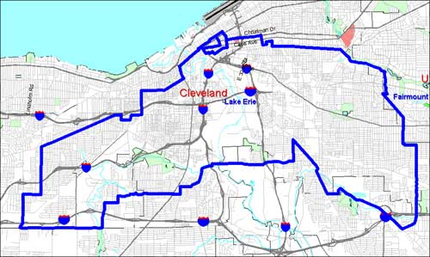
What is a MAN

Slide 6
Aspects of MAN Design
Installing a MAN is a very large and very expensive undertaking
It is much more difficult than setting up a CAN, where you normally control all of the real estate
It is much more difficult than setting up a WAN, where you just call a service provider to provide the connections between points

Slide 7
Aspects of MAN Design
In setting up a MAN you have to do everything
The first aspect to consider is why are you doing this
Will this MAN connect only sites you own
Will this MAN be rented out to other people

Slide 8
Aspects of MAN Design
In general you will most likely never install a MAN that connects just your own sites, since installing a MAN is extremely expensive and time consuming
Then what if you move from one of the sites

Slide 9
Aspects of MAN Design
But sometimes you do, such as the highway department installing a MAN around a highway loop in order to connect to sensors and camera so as to monitor traffic
Usually people put in MANs because they intend to rent out access to the MAN

Slide 10
Aspects of MAN Design
The elements in any MAN design for either case, but especially for the purpose of renting access to the MAN include
Selecting the City
Laying out the Network
Choosing the Network Materials
Dealing with Last Mile Connections
Making Sure it Works

Slide 11
Selecting the City
A MAN is fundamentally a real estate deal, so it follows that the most important thing is of course - location, location, location
In general the best locations are already taken
Today focus on the middle tier cities and rural areas

Slide 12
Laying Out the Network
Once the city is selected, where in the city to spend all of this money
First, you begin exhaustive research to identify all the telecom service providers and traffic patterns within the local area, paying special attention to high concentrations of access lines

Slide 13
Laying Out the Network
Then, you match this data with research on the location of major users of telecom services, such as high-tech business parks, manufacturing areas, and medical complexes

Slide 14
Laying Out the Network
Finally you examine population growth charts to determine areas of the region where development and growth are expected so that you can more effectively plan the network scope and reach
Any MAN of this type is a ring topology

Slide 15
Laying Out the Network
As the presentation on fiber optic cable points out, actually installing the cable in a city environment is by far the most expensive part of this
Mostly this has to do with right-of-way acquisition, permits, and construction costs

Slide 16
Choosing the Network Materials
In long-haul networks of this type, full-spectrum fiber optic cable is typically used
With this type of fiber the entire spectrum from 1280 nm to 1625 nm can be used
This is laid in the ground in protective conduit

Slide 17
Dealing With the Last Mile
This is the trickiest part of an already tricky process
The high cost of making these last mile connections and gaining access to the customer’s building has proven to be the most expensive and difficult part of deploying a MAN
Building owners want to be paid to allow access to their buildings

Slide 18
Dealing With the Last Mile
Customers in these buildings do not want to pay much for access
These two factors lead to high cost and low return

Slide 19
Making Sure It Works
Once the network is up and running, it must stay up and running
Management must be built-in to the design from the beginning

Slide 20
Sources
The map and the outline of the steps is from an article in Outside Plant by American Fiber Systems

Slide 21
Review
What is a MAN

