Slide 1
High Availability Networking
Last Update 2012.08.21
1.13.0

Slide 2
Objectives of This Section
Learn how to
Keep a network working regardless
Maintain maximum uptime

Slide 3
Quantify the Cost of Downtime
Before we get carried away creating high availability, it is wise to consider one very important thing
Never spend more money fixing a problem than tolerating it will cost you

Slide 4
Calculate the Cost of Downtime
Let us begin by calculating the actual cost of downtime
The following method is from an article on TechRepublic by Michael Sisco
First, to develop a cost of downtime concept, you don’t have to be precise
The quantified impacts are generally large enough that you just need to be in the ballpark to get your message across

Slide 5
Calculate the Cost of Downtime
To begin, access the degree of impact of the downtime
Possible categories include
Business application is down
Such as the accounting package
This may not affect many people, but they may also be very significant people
Technology services are affected
Work has to be switched to paper

Slide 6
Calculate the Cost of Downtime
Then everything done must be entered once the system comes backup along with the current work
Productivity services are not available
Email stops so people have to switch to long distance faxing for example
Internal process stop
Such as forms and manuals on an intranet will not be accessible
The infrastructure collapses
This could be one small network or the entire organization from a routing configuration problem

Slide 7
Calculate the Cost of Downtime
Next calculate the cost to the company on an hourly basis using whatever method makes sense for the situation
An example table to fill out is shown in the next slide
The slides after the table explain what each entry is designed to capture

Slide 8
Calculate the Cost of Downtime
Cost | Amount | Comments
Direct Employee Cost
Indirect Employee Cost
Employee Recovery Cost
Nonemployee Cost
Client Service Value
IT Recovery Cost
Other
Total

Slide 9
Calculate the Cost of Downtime
Direct employee costs
The hourly estimate for all employees affected by the downtime
In other words for everyone who cannot do their job
Indirect employee costs
Additional management time required for managers to deal with the affects of the downtime

Slide 10
Calculate the Cost of Downtime
Employee recovery cost
The value of the hours needed to catch-up once the system is again available
Nonemployee cost
Phone calls made
Faxes sent
Packages shipped
All required because online system not available

Slide 11
Calculate the Cost of Downtime
Client service value
Make a guess as to how much business is lost when the clients go somewhere else
IT recovery cost
Time, parts, software needed to bring the system back online
Other
Anything else

Slide 12
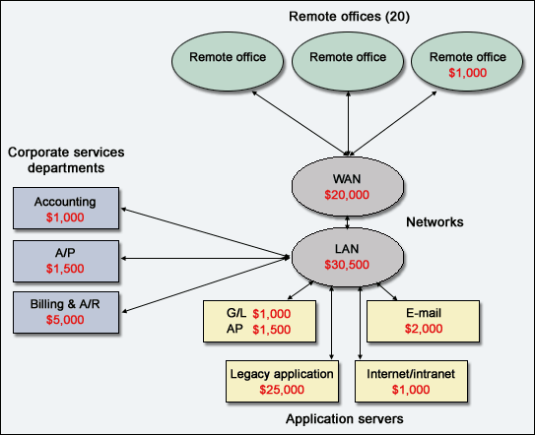
Calculate the Cost of Downtime

Slide 13
Factors to Consider
There are a number of factors that affect all of this including
The number and duration of outages
The number of users affected
The loss of productive time or overtime
The transaction rate and average turnover value per transaction
The capacity of the system to handle and the time required for workload repetition

Slide 14
Baselining
The real work begins with seeing where you are
First, analyze all outages
Analyze the major causes of the unavailability
Differentiate between
Unavoidable problems
Partially available
Totally avoidable

Slide 15
Baselining
Categorize outages into significant and less significant
Less significant ones may not be worth further study unless they indicate a trend
Identify any secondary problems that contributed to the duration or frequency of outages
Review existing recovery procedures and support structures for their currency and effectiveness

Slide 16
Availability
Availability is what we are looking for
It can be described using two numbers
MTBF – Mean Time Between Failures
MTTR – Mean Time To Repair
The calculation for availability then is
Availability=(MTBF/(MTBF+MTTR))X100
or
Availability=(Uptime/(Uptime+Downtime))X100

Slide 17
MTBF
MTBF is a useless number
MTBF means the average time before a device fails
In all cases this will be more years than anyone would ever use the device
We are concerned about is that device that fails while in service
It does matter if this is the day after it is installed or next year sometime

Slide 18
MTTR
The key to this is MTTR
MTTR is always called Mean Time To Repair
It should more properly be called Mean Time to Restore, because you rarely actually leave anything off or a site down while you physically repair the broken part

Slide 19
MTTR
A much better plan, for high availability at least, is to bypass the part with
Redundant path
Hot standby
Cold standby
When a redundant path exists, an alternate path is created

Slide 20
MTTR
That way the entire path that contains the failed component, even if some part of the path is still up, can be bypassed
With a hot standby a redundant part is already in place and the system is running a protocol that will detect the failure and move traffic automatically to the hot standby part

Slide 21
MTTR
A cold standby is a replacement part that is in place ready as a replacement part, but inactive

Slide 22
Availability
To measure availability correctly we must combine the availability of all of the links and pieces of equipment
So overall availability is computed as
Availability_{Overall=}Availability_{A} X Availability_{B} X Availability_{C}
This type of inline circuit is called serial availability

Slide 23
Availability
For example
Availability_{A}=.99
Availability_{B}=.97
Availability_{C}=.98
Availability_{Overall}=.99 X .97 X .98
or
.94
Which is of course lower than any of the single availability factors

Slide 24
Real World Availability Example
For a T1 link you might have
Router=.94
Cable=.99
CSU/DSU=.95
Cable=.99
T1 Link=.93
Cable=.99
CSU/DSU=.95
Cable=.99
Router=.94

Slide 25
Real World Availability Example
The product of these is .71
That does not look so good does it
Since at first glance all of the individual components availability numbers are in the 90s

Slide 26
Availability With Redundancy
To calculate the availability of a link that has a redundant path we need to look at the probability that both paths will be down at the same time
For example

Slide 27
Availability With Redundancy
In standard serial availability without redundancy to get to C from A, we must go through B
If B is down, the entire path is down
A | B | C

Slide 28
Availability With Redundancy
With a redundant path, if B is down, traffic can be rerouted through D
Of course this assumes D is not also down
 |  | B
A |  |  |  | C
 |  | D

Slide 29
Availability With Redundancy
To calculate the added availability that results from redundancy
Calculate the availability of A and C
Then also calculate the availability of the B+D combination
The availability of B+D is equal to
1-(Unavailability_{B} X Unavailability_{D})
Which is equal to
1-((1-Availability_{B)} X (1-Availability_{D}))

Slide 30
Availability With Redundancy
In this example
Availability_{B} = .97
Availability_{D}=.95
So the unavailability of each is
Unavailability_{B}=.03
Unavailability_{D}=.05
Therefore
1 – ((1-.03) X (1-.05))
Is equal to
1-.0015 which is .9985

Slide 31
Availability With Redundancy
Reliability of the redundant path then is
Availability_{Overall}=Availability_{A} X Availability_{B+D} X Availability_{C}
Which in this example is
.99 X .9985 X .98
Which is equal to
.969 or 96.9%

Slide 32
Availability With Redundancy
Of course improving availability through redundancy only holds true when the two links do not share any failure modes
For example two T1 lines that both terminate at a common point and are plugged into a common electrical source do indeed share a failure mode

Slide 33
Availability With Redundancy
Further if both links go through the same local loop, same central office, same concentration center, same long distance backbone, or any number of other items then redundancy is less than would be expected at first look
It is not easy to ensure that the redundancy that was built in at the beginning stays
Especially through the carrier’s network

Slide 34
Availability With Redundancy
Who knows what deals the carriers have to handle each other’s traffic
True redundancy requires connection to two separate central offices
This can be very expensive
And even two different central office may share the same backbone

Slide 35
Availability With Redundancy
For example, notice the degree that this manager went to in order to ensure redundancy and as the person on the Nanog list, which is a mailing list for operators of large networks, notes; even this may not help

Slide 36
Availability With Redundancy
The Wall Street Journal had an article Thursday about the problems executives with large multi-national companies are having re-engineering their telecommunication networks. None of this should come as a surprise to long-time readers of any of the networking lists
Just in Case, Many Firms Work to Set Up Redundant Telecommunications Systems
By DENNIS K.BERMAN Staff Reporter of THE WALL STREET JOURNAL
Thursday December 20 2001
John Smiley typically wears suits. But as the executive in charge of telecommunications for Lufthansa Systems' North American operations, he recently put on jeans and work boots to inch his way into a dirty train tunnel beneath New York City's Grand Central Terminal. His mission: to inspect new fiber-optic cables that snake through abandoned gas pipes, ensuring that they are running on a safe, separate path from a set of nearby fibers carrying the German airline's reservations data.
I've done something similar in the past. But it doesn't solve the problem. Even if the sales person promises you diversity, even if you physically inspect every meter of fiber, even if you pay more, after six months your network won't be diverse. On a long-term basis, how do you check carriers are keeping their promises? Are there any commercial products which let subscribers automatically check DLR's from carriers for changes and conflicts? Since DLR's only show the active components in a circuit, has anyone developed a product to check for passive and location risks?

Slide 37
Availability With Redundancy
Finally ask your suppliers about their redundancy and disaster recovery plans
Find out what they will do if their connections are severed
How long till they are back in operation

Slide 38
WAN Links
WAN links are different from other components
In that they are controlled by someone else
This makes it difficult to know what the actual reliability is

Slide 39
WAN Links
They also have two distinct failure modes
They may fail completely without warning
or
They may fail gradually without warning as seen in gradually increasing BER – Bit Error Rate

Slide 40
BER
BER – Bit Error Rate means the number of bits that have an error in a set number of bits
Why be concerned about such a thing
Monitoring BER and noticing that it is slowly getting worse, may predict an impending failure that can be dealt with now, instead of after the failure

Slide 41
PER
BER is normally expressed along the lines of 1 in 10⁶
This means that on average for every million bits sent, one will have an error
Now this sounds pretty good until you translate it into something more meaningful, such as the PER – Packet Error Rate or the number of frames that have an error

Slide 42
PER
For Ethernet with 1500 byte frames 1 in 10⁶ means one bad frame in every 83
This is not so good
BER is another reason the size of the protocol data unit being used affects network efficiency
Let’s look at some examples using different size PDUs – Protocol Data Units

Slide 43
BER
A BER of 1 in 10⁶ means 1 bit has an error in every 1,000,000 bits This computes to 1 PDU with an error for every
1,953 PDUs | When the PDUs are 64 bytes
83 PDUs | When the PDUs are 1,500 bytes
7 PDUs | When the PDUs are 18,000 bytes

Slide 44
BER
Further, what this means depends on the type of link the BER is referring to
For example 1 in 10⁶ would be terrible for an Ethernet link, but quite good for a dial-up connection

Slide 45
Checking BERs
To detect a problem on an active link the usual practice is to periodically exchange hello packets of some sort between the components on each end
Of course these are just overhead, so how often to send them and how big is an issue
Too small may pass without showing an error
Too large may use up too much bandwidth

Slide 46
Acceptable BERs
Acceptable BERs are
Copper
1 in 10⁸ for Coax
1 in 10³ to 1 in 10⁶ for UTP with 1 in 10⁶ being the common figure
Fiber
1 in 10¹⁰ to 1 in 10¹⁶
Commonly 1 in 10¹¹
Analog
1 in 10⁵

Slide 47
Acceptable BERs
SONET
1 in 10¹⁰
DDS
1 in 10⁷
T Carrier
1 in 10⁷

Slide 48
Acceptable PERs
Ethernet
1 frame in 10,000
Which is 1 in 10⁸ for a 1,500 byte Ethernet frame
In general TCP/IP will work adequately down to an 8 percent PER with 1000 byte packets
Worse than this and TCP/IP will fail
For small packet sizes a PER of 3 percent is all that is tolerable

Slide 49
Acceptable PERs
Large packets can have a PER up to 11 percent

Slide 50
Need for Testing
When a link is not in continuous use, the availability is no longer a function of MTBF and MTTR only
This is because MTTR only considers how long it takes to repair a problem, not how long it takes to determine that repair is needed

Slide 51
Need for Testing
The way to determine if something is working or not is to test it on a regular basis
To calculate this we must also look at
Probability_{StillFunctional}
Which is
Probability_{StillFunctional}=e minus failure rate X time

Slide 52
Need for Testing
We will not calculate these since it gets somewhat complex
But instead look at the following table which shows the maximum time between tests that can be tolerated for a particular probability that the devices is still functioning at the needed level

Slide 53
Need for Testing
Number Of Nines | Probability Still Functional | Time Between Tests MTBF=1 Year | Time Between Tests MTBF=25,000 Hours
5 | .99999 | 5.25 m | 15 m
4 | .9999 | 52.6 m | 2 h 30 m
3 | .999 | 8 h 46 m | 25 h 1 m
2 | .99 | 3.67 d | 10.47 d
1 | .9 | 38.48 d | 109.75 d

Slide 54
Need for Testing
The trick in testing is to automate it as much as possible
Both to ensure it is actually done and to not waste staff time
Testing cannot be too intrusive into the network either, since that may waste as much productive time as would be saved by testing

Slide 55
Finding Causes of Failure
In looking for the causes of failures do not ignore exogenous factors
Such as
Plot weather against failures
Does a data line show more errors during or just after a rain storm or as the snow melts

Slide 56
Improving Availability
To improve on the current availability we can
Increase the interval between failures
Increase MTBF
Reduce the time required to return to service
Reduce MTTR
Add redundancy so that if one fails the other will assume the load

Slide 57
Techniques for Availability
For LAN equipment as opposed to WAN links there are other techniques that can be used to increase availability
For example, for a single server
Two NICs with separate IP addresses can be installed
or
Multiple NICS with one IP address
This is called port trunking or link aggregation

Slide 58
Techniques for Availability
Going away from a single server to multiple servers can also increase availability
Server clustering shares the load and the possibility of failure over several identical servers

Slide 59
For Higher Data Availability
Besides the server itself the data storage can be configured for higher availability as well
Techniques for this include
RAID
External mirrored storage
NAS
SAN

Slide 60
Designing for Availability
High availability must be built-in to the design of the network from the beginning
This is done by using a hierarchal design, such as the three layer design suggested by Cisco of access, distribution, and core layers

Slide 61
Designing for Availability
In a design using these layers the highest availability and redundancy is placed at the core layer as this layer connects to all the other parts of the network
At the core five nines is desired
Then at the distribution layer four nines can be tolerated

Slide 62
Designing for Availability
As a failure at the access layer will only affect a part of the network, three nines can be tolerated here
To achieve this reliability do not allow a single point of failure
Introduce redundancy at the core and distribution layers

Slide 63
Designing for Availability
Then to increase reliability at the core include hot swapping of all components
To further minimize MTTR, stock these parts on site
Finally, use UPSs for all devices
Include an out of band management path to all devices at the core and distribution layers, even if this must be a separate management only network

Slide 64
Designing for Availability
Create a design for each size and type of facility in the organization, then use that design without change everywhere
This will ease management, network monitoring, troubleshooting, spares stocking, and repair time

Slide 65
High Availability Protocols
Protocols commonly used to achieve high availability include
Routing Protocols at Layer 3
Standby Protocols at Layer 2

Slide 66
Layer 3
At layer 3 the standard routing protocols automatically recognize when the preferred link goes down, and then reroute traffic to the backup link
These include
RIP
EIGRP
OSPF
And so on

Slide 67
Layer 2
At layer 2 these types of protocols are used to switch from a dead connection to the backup line
These include
STP
HSRP
VRRP

Slide 68
STP
For an Ethernet network at layer 2 to function as it is designed there should be only one path between any two devices attached to the network
For the network connections this is done using dual or redundant connections to a single device
These multiple paths create both a physical and a logical loop in the network

Slide 69
STP
A physical loop is fine
A logical loop produces instability
For example

Slide 70
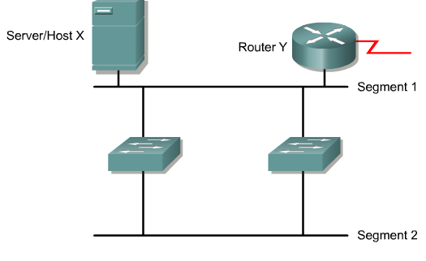
STP

Slide 71
STP
Redundant connections without safeguards in place can case problems in the network such as a broadcast storm

Slide 72
STP
A broadcast storm occurs in a network with redundant connections when broadcasts and multicasts, which are treated as broadcasts by a switch, are flooded out each port, except the one on which it was received
For example

Slide 73
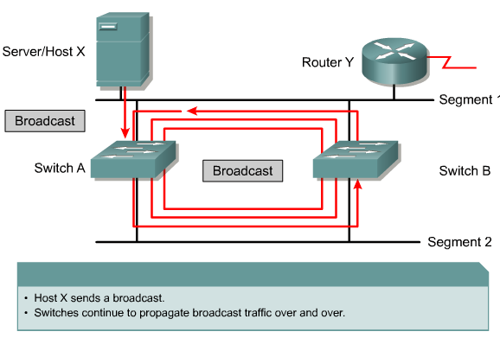
STP

Slide 74
Spanning-Tree Protocol
The solution to these problems while maintaining the redundancy in the network is to use the spanning-tree protocol
All switches do so these days by default
802.1D is the IEEE specification for STP
STP creates a loop free path through the network by blocking unneeded ports from being used unless they are needed

Slide 75
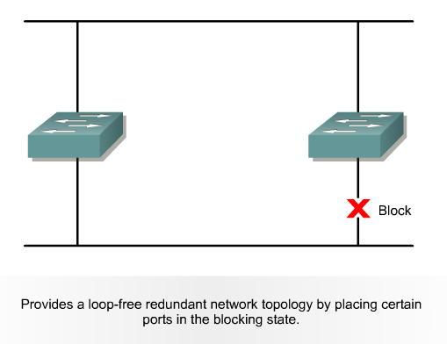
Spanning-Tree Protocol

Slide 76
RSTP
RSTP – Rapid Spanning Tree Protocol does just what it says, it runs faster
This is the 802.1w standard

Slide 77
TRILL
A proposed replacement for STP is TRILL
This is Transparent Interconnect of Lots of Links
It is defined in RFC 5556 from May 2009
The basic idea of TRILL is to replace STP by applying network layer routing protocol concepts to the data link layer

Slide 78
TRILL
It is implemented by using devices called RBridges or Routing Bridges
This creates a combination of bridging and routing
The RBridges run a link state protocol amongst themselves

Slide 79
TRILL
By doing so they are able to establish not just one but multiple paths through the Layer 2 network instead of the single path STP provides
Since it runs directly over Layer 2 it can be run without configuration
This proposed solution will only apply to very large networks, such as data centers

Slide 80
HSRP
HSRP – Hot Standby Routing Protocol is a Cisco proprietary redundancy protocol used to create a fault tolerant default gateway
It is discussed in RFC 2281
This would be used where there are two devices, such as access points, installed as a primary and a backup device

Slide 81
HSRP
If the primary or gateway device fails, HSRP will detect this and reconfigure the standby device to take the place of the failed device
This is done by sending hello messages to the multicast address 224.0.0.2 for version 1 of HSRP, or 224.0.0.102 for version 2, using UDP port 1985, to other HSRP-enabled routers

Slide 82
HSRP
The designated primary device will act as a virtual router with a predefined gateway IP address
It will respond to the ARP request from end devices connected to the LAN with the MAC address 0000.0c07.acXX where XX is the group ID in hex

Slide 83
HSRP
If the primary device should fail, the device with the next-highest priority takes over the gateway IP address and answers ARP requests with the same MAC address, thus achieving transparent default gateway fail-over

Slide 84
VRRP
VRRP – Virtual Router Redundancy Protocol is similar to HSRP
It is a standards based alternative to HSRP being defined in RFC 5798

Slide 85
Levels of Availability
Uptime | Downtime | Time Down Per Year | Time Down Per Month | Time Down Per Day
0.0 % | 100.0 % | 8760.0 hours | 720.0 hours | 24.0 hours
50.0 | 50.0 | 4380.0 | 360.0 | 12.0
80.0 | 20.0 | 1752.0 | 144.0 | 4.8
90.0 | 10.0 | 876.0 | 72.0 | 2.4
95.0 | 5.0 | 438.0 | 36.0 | 1.2
98.0 | 2.0 | 175.0 | 14.0 | 29.00 minutes
99.0 | 1.0 | 88.0 | 7.0 | 14.40
99.9 | 0.1 | 8.8 | 43.0 minutes | 1.44
99.99 | 0.01 | 53.0 minutes | 4.3 | 8.6
99.999 | 0.001 | 5.3 | 26.0 | 0.860
99.9999 | 0.0001 | 32.0 | 2.6 | 0.086

Slide 86
Levels of Availability
Finally, what is considered to be good versus bad availability
Three levels are commonly used as shown next

Slide 87
Levels of Availability
Level | Available | Unplanned Downtime Allowed | Redundancy Required | MTTR
Reliable | 99.9 | 8 h 43 m | No | 24 Hours
High Availability | 99.99 | 53 m | Yes | 4 Hours
Non Stop | 99.9998 | 32.6 s | Yes | 2 Hours

Slide 88
Maintenance Window
All of these availability figures have to be considered in light of scheduled uptime
Every system must have a maintenance window
No single system can actually have 99.999 percent uptime
You would never be able to upgrade anything

Slide 89
Maintenance Window
The users and management must understand that any network must have a maintenance window
This time is not included when calculating uptime
If a network does indeed need to be nonstop, then parallel networks and hot swappable components must be used

Slide 90
Maintenance Window
For example, triple redundancy may need to be used in the network
This is where one part is active, one is in hot standby, and the third is on cold standby
Maintenance and upgrades can be done on the cold spare
Then the upgraded device is moved into service and the active device is worked on

Slide 91
Maintenance Window
This way the old configuration is still available in the hot standby if the change did not work as expected

Slide 92
An Example
Let’s look at an example of uptime
I use Go Daddy for some of my web sites
Here is their uptime guarantee

Slide 93
Availability of Services
Subject to the terms and conditions of this Agreement, Go Daddy shall attempt to provide the Services for twenty-four (24) hours per day, seven (7) days per week throughout the term of this Agreement

Slide 94
Availability of Services
You agree that from time to time the Services may be inaccessible or inoperable for any reason, including, without limitation: (i) equipment malfunctions; (ii) periodic maintenance procedures or repairs that Go Daddy may undertake from time to time; or (iii) causes beyond the control of Go Daddy or that are not reasonably foreseeable by Go Daddy,

Slide 95
Availability of Services
including, without limitation, interruption or failure of telecommunication or digital transmission links, hostile network attacks network congestion or other failures
You agree that Go Daddy has no control of availability of the Services on a continuous or uninterrupted basis

Slide 96
Service Availability Guarantee
Go Daddy offers a service uptime guarantee for the Services of 99.9% ("Service Uptime") of available time
If Go Daddy fails to maintain this level of service availability, You may contact Go Daddy and request a credit of 5% of Your monthly hosting fee from Go Daddy for that month

Slide 97
Service Availability Guarantee
The credit may be used only for the purchase of further products and services from Go Daddy, and is exclusive of any applicable taxes

Slide 98
Service Availability Guarantee
The credit does not apply to service interruptions caused by: (i) periodic scheduled maintenance or repairs Go Daddy may undertake from time to time; (ii) errors caused by You from custom scripting or coding; (iii) outages that do not affect the appearance of the web site but merely affect access to the web site such as FTP and email; (iv) causes beyond the

Slide 99
Service Availability Guarantee
control of Go Daddy or that are not reasonably foreseeable by Go Daddy ; and (v) outages related to the reliability of certain programming environments
Total Service Uptime shall be solely determined by Go Daddy and shall be calculated on a monthly basis

Slide 100
For More Information
High Availability Networking with Cisco
Vincent C. Jones
ISBN 0201704552

