Slide 1
Data Center Design Last Update 2012.10.24 1.1.0

Slide 2
Objectives
To see how the basic design principles should be adjusted for a data center

Slide 3
What is a Data Center
A data center is a place where the data stores and other controlled shared resources are placed
The trend on where the data center should be goes back and forth from centralization to decentralization

Slide 4
What is a Data Center
The argument, to which there is no answer, is between lower cost through centralization as desired by IT and control of resources through decentralization that is desired by the business units
One side will win the battle, then the other side

Slide 5
What is a Data Center
This back and forth cycles on about a five year basis because there are compelling advantages on each side

Slide 6
Mainframe Data Center
Data centers began with the mainframe era beginning in the 1950s
In the early days of computer networks the computers were too expensive for everyone to have
Therefore a single computer was shared by many users
This single large shared computer was called a mainframe

Slide 7
Mainframe Data Center
These original data centers were centralized in one location
Users requested information or asked for jobs to be done by the mainframe computer by interacting with it through a terminal for real time processing or by submitting a job for processing using punch cards

Slide 8
Mainframe Data Center
This job processing could be immediate or overnight
This type of data center still exists although the method of interaction has moved from terminals and punch cards to PCs
The data center format is still used because of its processing power and high availability

Slide 9
Mainframe Data Center

Slide 10
Client Server Data Center
The next iteration of the data center was the client/server model
Applications were installed on servers in a data center
These applications were accessed by users with client software running on their PCs

Slide 11
Client Server Data Center
In many cases these application servers were distributed rather than centralized because of high cost of WAN links and application performance issues
These distributed servers could be individual computers the size of PCs with more robust hardware or mid range size computers that were between mainframes and PCs in size and computing power

Slide 12
Client Server Data Center

Slide 13
Web Based Data Center
In the current model for the data center the servers are once again centralized as the cost of WAN links has dropped while their speed has increased
Further the number of physical servers is being reduced as single servers are being moved to blade servers running virtual machines

Slide 14
Web Based Data Center
The driving force here as always is to reduce the cost

Slide 15
Web Based Data Center

Slide 16
Virtualization in the Data Center
Virtualization in the data center is moving from just virtual servers to include
Server virtualization
Storage virtualization
Network virtualization

Slide 17
Unified Fabric
The physical infrastructure used in the data center has included Ethernet based LANs, Fibre Channel based SANs, and other proprietary connection types
The trend is toward using Ethernet as the single infrastructure with the storage data running on FCoE – Fibre Channel Over Ethernet

Slide 18
Topology
Here is the suggested topology as illustrated in the Official Cert Guide for the CCDA test by Bruno and Jordon from Cisco Press

Slide 19
Topology

Slide 20
Topology
Here is how they describe this data center topology
At the top layer, we have virtual machines which are software entities that have hardware level abstraction capable of running a guest OS on top of a resource scheduler also known as a hypervisor
Within the unified computing resources, the service profile defines the identity of the server

Slide 21
Topology
The identity contains many items such as memory, CPU, network cards, storage information, and boot image
10 Gigabit Ethernet, FCoE, and Fibre Channel technologies provide the unified fabric and is supported on the Cisco Nexus 5000

Slide 22
Topology
FCoE is one of the key technologies that allow native Fibre Channel frames to be used on 10G Ethernet networks
Virtualization technologies such as VLANs and VSANs provide for virtualized LAN and SAN connectivity by logically segmenting multiple LANs and SANs on the same physical equipment
Each VLAN and VSAN operates independently from one another

Slide 23
Topology
At the lowest layer, we have virtualized hardware where storage devices can be virtualized into storage pools and network devices are virtualized using virtual device contexts (VDC)

Slide 24
Layout
A typical data center layout is shown in this slide by Commscope from an October 2012 webinar

Slide 25
Layout

Slide 26
Problem Areas
As data center are centralized issues arise such as
Physical rack space
Electrical power required
Equipment cooling
Limits to scale
Security
Virtualization support
Management effort required

Slide 27
Problem Areas
Here is what Bruno and Jordan say on these issues
Server growth is consistently rising which is requiring more power, which is driving the need for energy efficiency for most data center server deployments
Although rack servers are low cost and provide high performance, unfortunately they take up space and consume a lot of energy to operate

Slide 28
Problem Areas
Because both rack space and power cost money, efficiency gains need to be considered in these areas
Blade servers provide similar computing power when compared to rack mount servers, but require less space, power, and cabling
The chassis in most blade servers allows for shared power, Ethernet LAN, and Fibre Channel SAN connections, which reduce the number of cables needed

Slide 29
Problem Areas
With both rack-mounted servers and blade servers, server virtualization software provides for better utilization of hardware resources, which requires less physical hardware to deploy servers, which in turn increases efficiency
Server virtualization also enables server scalability because more rack and cabinet space is available to deploy new ESX hosts running additional virtual machines

Slide 30
Facility Planning
When planning the physical facility consideration must be given to
Floor space needed
How much load the raised floor can support
Electrical power required
Cooling capacity required
The cabling that will be needed and how to manage it
For example

Slide 31
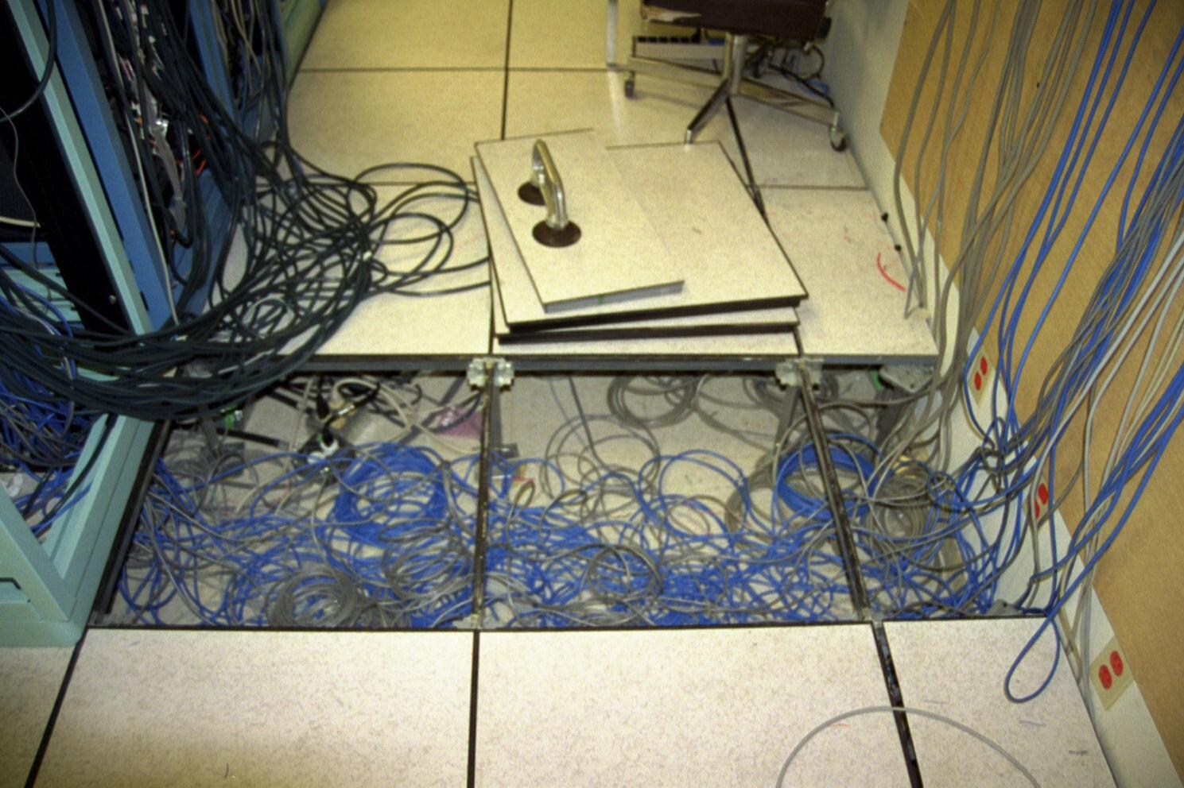
Raised Floor

Slide 32
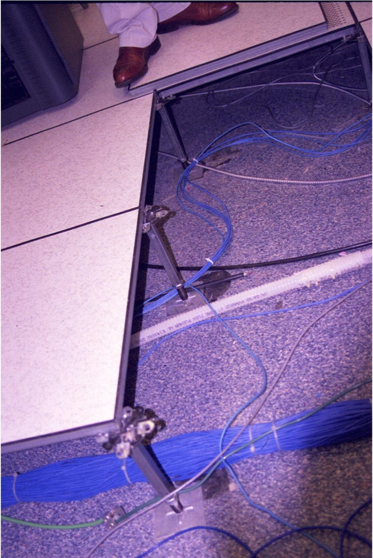
Raised Floor

Slide 33
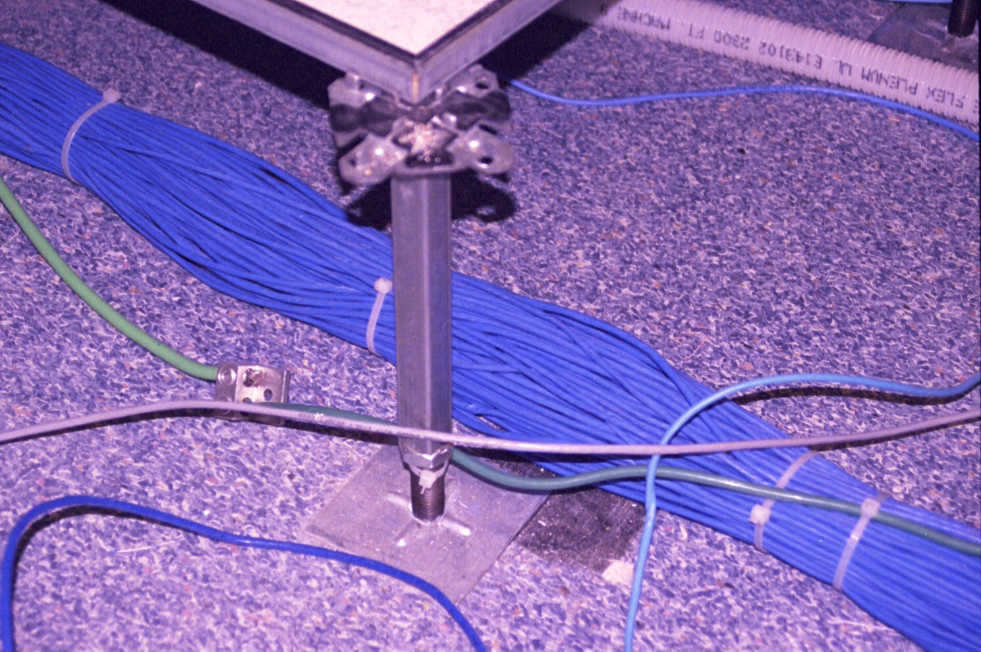
Raised Floor

Slide 34
Raised Floor Layout

Slide 35
Raised Floor v Overhead Rack
Over the last few years opinion has coalesced around the idea that power cables should go under the raised floor and the data cables overhead in basket racks such as these

Slide 36
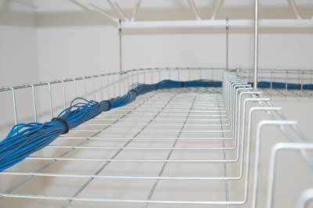
Overhead Cable Racks

Slide 37
Facility Planning
The environmental conditions in the data center is determined by the equipment as certain operating temperatures and humidity levels need to be maintained in the data center
The physical security of the data center must be planned from the beginning

Slide 38
Facility Planning
Here is how Bruno and Jordan summarizes this

Slide 39
Facility Planning

Slide 40
Floor Space
The floor space needed is determined by
The number of servers, amount of storage equipment, and networking equipment that will be needed
The space needed for non-infrastructure areas such as
Shipping and receiving
Server and network staging
Storage rooms, break rooms, and bath rooms
Employee office space

Slide 41
Equipment
As the authors state the equipment used will guide much of this as we consider
Weight of the rack and equipment
Heat expelled from equipment
Amount and type of power needed
Automatic transfer switch for equipment that has single power supplies
Uninterruptible power supplies (UPS)
Redundant power distribution units (PDU)

Slide 42
Electrical Power
Several factors determine how much electrical power will be required including

Slide 43
Electrical Power

Slide 44
Electrical Power
Redundant power supplies are needed in the form of dual electrical supplies to the equipment
UPS based battery backup for short term power
Generator based backup for longer term power

Slide 45
Cooling
Bruno and Jordan point out these considerations when designing the cooling system
Cooling is used to control the temperature and humidity of the devices, and it is applied to zones, racks, or individual devices
Environmental conditions need to be considered and measured by using probes to measure temperature changes, hot spots, and relative humidity

Slide 46
Cooling
A major issue with high-density computing is overheating
There are more hot spots, and therefore more heat overall is produced
The increase in heat and humidity threatens equipment life spans
Computing power and memory requirements demand more power and thus generate more heat output

Slide 47
Cooling
Space-saving servers increase the server density possible in a rack, but keep in mind that density = heat
It might not be a big deal for one chassis at 3 kilowatt (kW), but with five or six servers per rack, the heat output increases to 20 kW
In addition, humidity levels can affect static electricity in the data center

Slide 48
Cooling
So, it is recommended that relative humidity level be in the range of 40 percent to 55 percent
High levels of static electricity can cause damage to data center equipment
Proper airflow is required to reduce the amount of heat generated by the high-density equipment

Slide 49
Cooling
Sufficient cooling equipment must be available to produce acceptable temperatures within the data center
The cabinets and racks should be arranged in the data center with an alternating pattern of “cold” and “hot” aisles

Slide 50
Cooling
The cold aisle should have equipment arranged face to face, and the hot aisle should have equipment arranged back to back. In the cold aisle, there should be perforated floor tiles drawing cold air from the floor into the face of the equipment
This cold air passes through the equipment and flushes out the back into the hot aisle

Slide 51
Cooling
The hot aisle does not have any perforated tiles, and this design prevents the hot air from mixing with the cold air
For example

Slide 52
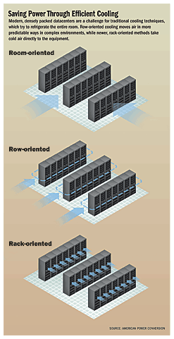
Air Flow Options

Slide 53
Air Flow Options

Slide 54
Cabling
Data center cabling is migrating from everything under the floor to moving the data cabling to overhead wireframe tracks
This helps air flow under the floor as well as making it easier to run and check data cables

Slide 55
More on This
The presentation on Equipment Installation has much more detail on the facility issues briefly discussed here

Slide 56
Design Layers
The data center follows the traditional three layer model

Slide 57
Design Layers

Slide 58
Virtualization
Virtualization is widely used in data centers for these reasons

Slide 59
Virtualization

Slide 60
Virtualization
Areas that can be virtualized include
Servers
Network
Storage

Slide 61
Standards
The TIA-942 standard along with the other structured cabling standards provide a guide to the setup of a data center

Slide 62
Design Specifications
The standard calls for these specifications for the telecommunications room or closet
This room should only be used for telecommunications functions
Equipment not related to telecommunications shall not be installed, pass through or enter the telecommunications room
Multiple closets on the same floor shall be interconnected by a minimum of one 78mm conduit, or equivalent pathway

Slide 63
Design Specifications
Minimum one closet per floor to house telecommunications equipment and cable terminations and associated cross-connect cable and wire
Located near the center of the area being served.
Horizontal pathways shall terminate in the telecommunications room on the same floor as the area served

Slide 64
Design Specifications
One wall should have 20mm (0.75 in.) A-C plywood 2.4m (8 ft.) high
Lighting shall be a minimum of 500 lx (50 foot candles) at 1m (3 ft.) above finished floor (AFF)
False ceilings shall not be provided
Minimum door size 910mm (36 in.) wide and 2000mm (80 in.) high without sill, hinged to open outwards, or slide side-to-side or removable, and fitted with a lock

Slide 65
Design Specifications
Minimum of two dedicated 120V nominal non-switched duplex electrical outlet receptacles or equivalent, each on separate branch circuits
Additional convenience duplex outlets placed at 1.8m (6 ft.) intervals around perimeter, 150mm (6 in.) above floor
Access to the telecommunications grounding system as specified by ANSI-J-STD-607-A

Slide 66
Design Specifications
HVAC requirements to maintain temperature the same as adjacent office area
A positive pressure shall be maintained with a minimum of one air change per hour or per code

Slide 67
Design Specifications

