Slide 1
CAN Design
Last Update 2007.06.03
1.4.0

Slide 2
Objectives of This Section
Learn some aspects of network design that are specific to a CAN

Slide 3
What is a CAN
Recall that a CAN – Campus Area Network refers to a network that is larger than a single LAN, but not so large that you cannot get to all of its locations and back on foot
This is a general, nonscientific definition, but will work for the purpose of this presentation

Slide 4
Campus Design Considerations
The following should be considered when designing a CAN
Network geography
This impacts the physical media used
Network applications
In terms of bandwidth required and the delay that can be tolerated by the applications that run over the network impact its organization

Slide 5
Campus Design Considerations
Layer 2 v Layer 3 Switching
This affects the size to which the network can scale
Media
Future proofing this long term investment is always important

Slide 6
Network Geography
The location of network devices and the distance between them dictates what media can be used

Slide 7
Network Applications
Network designers should determine which applications are critical to the organization and the network demands of these applications to determine enterprise traffic patterns inside the Enterprise Campus network
This process should result in information about network bandwidth usage and response times for certain applications

Slide 8
Network Applications
This too will influence the selection of the transmission medium and the desired bandwidth
Common types of application traffic
Client-Client
Client-Distributed Server
Client-Server Farm
Client-Enterprise Edge

Slide 9
Client-Client
From the network designer's perspective, client-client applications include those applications in which the majority of network traffic passes from one network edge device to another through the organization's network

Slide 10
Client-Distributed Server
Historically, clients and servers were attached to a network device on the same LAN segment
With increased traffic on the corporate network, an organization can decide to split the network into several isolated segments

Slide 11
Client-Distributed Server
Each of these segments has its own locally maintained servers, known as distributed servers, for its application
In this scenario, servers and users are located in the same VLAN
Department administrators manage and control the servers

Slide 12
Client-Distributed Server
The majority of department traffic occurs in the same segment, but some data exchange to a different VLAN can happen over the campus backbone
For traffic passing to another segment, the overall bandwidth requirement might not be crucial

Slide 13
Client-Distributed Server
For example, Internet access must go through a common segment that requires less performance than the traffic to the local segment servers

Slide 14
Client-Server Farm
In contrast all servers may be centrally located in a server farm

Slide 15
Client-Enterprise Edge
This type of traffic goes to the outside world or public servers

Slide 16
Layer 2 v Layer 3 Switching
When designing a campus network the connectivity devices that link the access level Layer switches can be either Layer 2 or Layer 3 switches
When deciding between these the following should be considered
Capabilities required
Size of the network segments
Convergence required

Slide 17
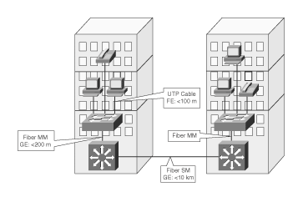
Media

Slide 18
Building Access Layer
Let’s now consider the various layers seen in a CAN design
The access layer aggregates the workstations or hosts on a layer 2 device
This represents one logical segment and is one broadcast domain
VLAN support might be required where multiple departments coexist in the same wiring closet

Slide 19
Building Access Layer
The policies implemented on the access switch are based on layer 2 information
These policies focus on and include the following features
Port security
Access speeds
Traffic classification priorities that are defined on uplink ports

Slide 20
Building Access Layer
When implementing the campus infrastructure's building access submodule, consider the following
How many users or host ports are currently required in the wiring closet, and how many will it require in the future
Should the switches support fixed or modular configuration

Slide 21
Building Access Layer
What cabling is currently available in the wiring closet, and what cabling options exist for uplink connectivity
What layer 2 performance does the node need
What level of redundancy is needed
What is the required link capacity to the distribution layer switches

Slide 22
Building Access Layer
How will the VLANs and STP deployed
Will there be a single VLAN, or several VLANs per access switch

Slide 23
Building Access Layer
Will the VLANs on the switch be unique or spread across multiple switches
The latter design was common a few years ago, but today campus-wide or access layer-wide VLANs are not desirable
Are additional features, such as port security, multicast traffic management, and QoS required

Slide 24
Building Access Layer
Because of their performance requirements, medium-size campus networks are built on Layer 2 access switches and are connected by uplinks to the distribution Layer 3 switches
This forms a clear structure of building access and building distribution module

Slide 25
Building Access Layer
If redundancy is required, an additional Layer 3 switch can be attached to the network's aggregation point with full link redundancy

Slide 26
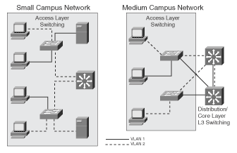
Building Access Layer

Slide 27
Building Distribution Layer
This layer implements many policies based on access lists and QoS settings
The distribution layer can protect the core network segment from any impact of access layer problems by implementing all the policies

Slide 28
Building Distribution Layer
The following require attention at this layer
Performance
Distribution switches should provide wire-speed performance on all ports
This feature is important because of access layer aggregation on one side and high-speed connectivity of the core module on the other side
Intelligent network services
Switches should also incorporate intelligent network services such as high availability, QoS, security, and policy enforcement

Slide 29
Building Distribution Layer
Scalability
Expanding and reconfiguring distribution layer devices must be easy and efficient
Manageability
These devices must support the required management features

Slide 30
Campus Backbone
A campus backbone should be used when three or more buildings are connected
The emphasis is on switch performance
A Layer 3 design is best

Slide 31
Campus Backbone
Layer 3 switched campus backbones provide several improvements over the Layer 2 backbone, including the following
A reduced number of connections between Layer 3 switches
Each Layer 3 distribution switch connects to only one Layer 3 campus backbone switch
This implementation simplifies any-to-any connectivity between distribution and backbone switches

Slide 32
Campus Backbone
Flexible topology without any spanning-tree loops
There is no Layer 2 switching in the backbone or on the distribution links to the backbone because all links are routed links
Arbitrary topologies are supported because of the routing protocol used in the backbone
Multicast and broadcast control in the backbone
Scalable to an arbitrarily large size

Slide 33
Campus Backbone
Better support for intelligent network services due to Layer 3 support in the backbone switches
One of the main considerations when using Layer 3 backbone switches is Layer 3 switching performance
Layer 3 switching requires more sophisticated devices for high-speed packet routing

Slide 34
Campus Backbone
Modern Layer 3 switches support routing in the hardware

Slide 35
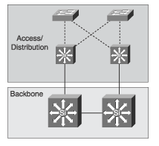
Campus Backbone

Slide 36
Hierarchical Design in a CAN
When applied to a CAN the hierarchical model uses the three layers this way

Slide 37
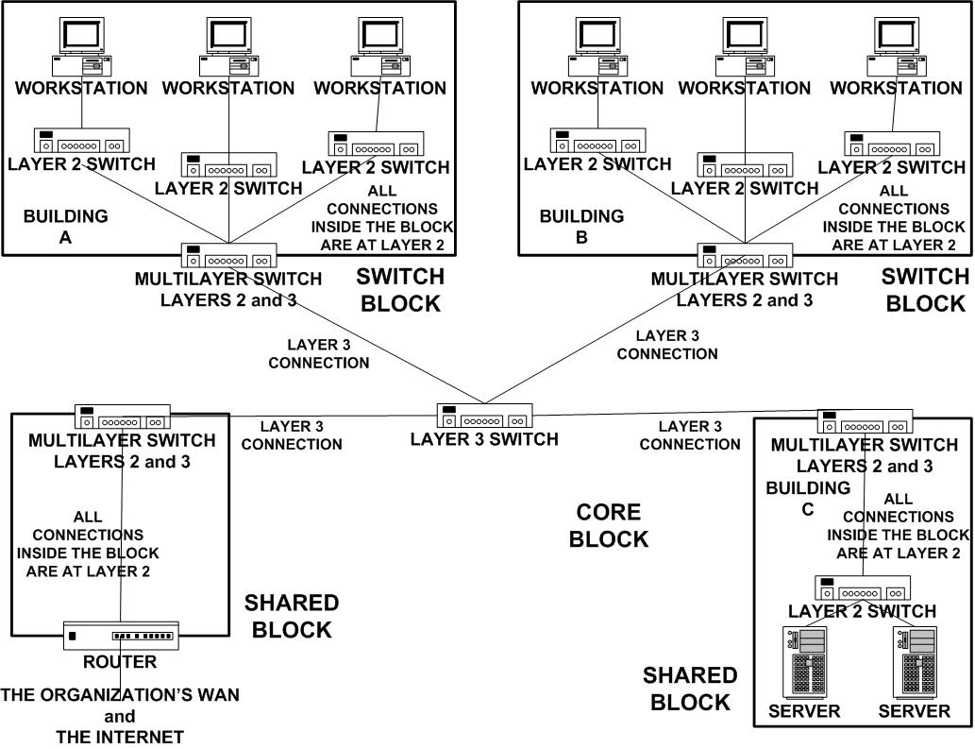
The Current CAN Design Model

Slide 38
Multilayer Switching
With this current model of CAN design that uses multilayer switching, services are separated into three categories
Local services
Remote services
Enterprise services

Slide 39
Local Services
These are the services that most closely fit the traditional view of a LAN
All local traffic stays within a single subnet, a single VLAN, within the inside of a layer 2 switch, and any other similar way of viewing a LAN
None of this traffic would cross a link to a remote network
All traffic is confined to layers 1 and 2

Slide 40
Remote Services
A remote service is an entity that might be geographically near an end user, but is not on the same subnet or in the same VLAN as that end user
This type of traffic would have to cross a layer 3 device
But that layer 3 device might send the request to a local device that has the thing the end user needs to access

Slide 41
Remote Services
This means the traffic will leave the local subnet or VLAN or physical network as defined by a network at layer 2

Slide 42
Enterprise Services
Enterprise services are those common to all users in the organization
Such as, email, Internet access, or video conferencing
These services are placed within their own network near the backbone network that connects all of the organization’s networks
Traffic to and from these services must cross a layer 3 device

Slide 43
Using Blocks
To organize all of these layers and services and devices, a set of blocks is used based on functions that must be performed in a CAN that will hold more than one LAN
All of the users and resources to be used by the users are assigned to one of these blocks

Slide 44
Using Blocks
Edge devices are then added to each block so as to allow the blocks to talk to each other
These blocks are then arranged so as to produce an optimal network design
The blocks used in a CAN are
Switch Block
Core Block
Shared Block

Slide 45
Switch Block
Inside the switch block are the access level devices that connect the end users into the network
At the edge of the switch block is a distribution layer device that connects directly to the core block so that traffic can be routed between the other blocks

Slide 46
Switch Block
The use of a combination of layer 2 and layer 3 devices serves to contain broadcast traffic and network problems entirely within each switch block
The layer 2 devices connect the end users to the local area network contained within the switch block

Slide 47
Switch Block
The layer 2 device is a layer 2 switch, hubs can be used, but are not much any longer
The layer 3 device acts as a distribution layer to connect the switch block to the network core
The layer 3 device can be a multilayer switch or a switch connected to a router

Slide 48
Switch Block
Any individual switch block can be a single physical LAN or a VLAN
In any event a switch block is always a single subnet in terms of IP addressing
If a VLAN, then switch blocks might be physically intermingled in a particular geographic location

Slide 49
Switch Block
So with a VLAN implementation, the logical arrangement overlaid onto the physical arrangement, may become complex as the CAN grows
In general a switch block should never have more than 200 users

Slide 50
Core Block
If there is only a single switch block, then no core block is required
With more than one switch block, a core block then connects to the switch block’s edge device, not to the access level device inside each switch block
The core block is the same as the core layer

Slide 51
Core Block
As such, nothing is done at this layer, except switch traffic as fast as possible
The core block is responsible for transferring all cross-campus traffic as fast as possible
All traffic from one switch block to another switch block, from a switch block to a shared block and back, all of it goes through the core

Slide 52
Core Block
So here we are looking for layer 3 switches that can operate at high speed
The device or devices if redundancy is required should be in Cisco terms something like the
If layer 2
Cisco Catalyst 5500 or 6500 Series
If layer 3
Cisco Catalyst 8500 Series

Slide 53
Shared Block
One other block that might be needed is the shared block
This is the same as the switch block, except that it does not contain end users
All the connecting devices inside the block and at the edge are the same as in the switch block, but the devices connecting to these access level devices are things that are shared with the end users

Slide 54
Shared Block
Such as
A server farm
Connection to the WAN
Connection to the Internet

Slide 55
Let’s Summarize
Recall the diagram we say earlier

Slide 56
The CAN Design Model

Slide 57
How Traffic Moves
How does traffic move between these blocks
The diagram that follows shows the movement from a side view - using the OSI model layers to explain it and a top view – showing the relationship of the blocks to each other

Slide 58
How Traffic Moves

Slide 59
Sources
This presentation is a combination of the technique from Top Down Network Design by Priscilla Oppenheimer, A Cisco Press certification book on Multilayer Switched Networks by Karen Webb, my experiences, and my interpretation of the design techniques that have proven successful in actual practice

Slide 60
For More Information
Top Down Network Design
Priscilla Oppenheimer
ISBN 1578700698
Building Cisco Multilayer Switched Networks
Karen Webb
ISBN 1578700930

