Slide 1
Wireless WAN
Last Update 2012.05.29
3.0.0

Slide 2
Introduction
Recall that a wide area network is a network that connects distant sites when the distance is such that one could not drive there, work on some aspect of the system, and return in a single work day

Slide 3
Wireless WANs
Over the years there have been two types of wireless WANs
One has gone away
The other still exists

Slide 4
AT&T Long Lines Network
First is the wireless WAN that no longer exists
You have probably seen the signs of this wireless WAN when traveling down the highway, especially outside of a major city
The sign to look for to identify the remains of this network is

Slide 5
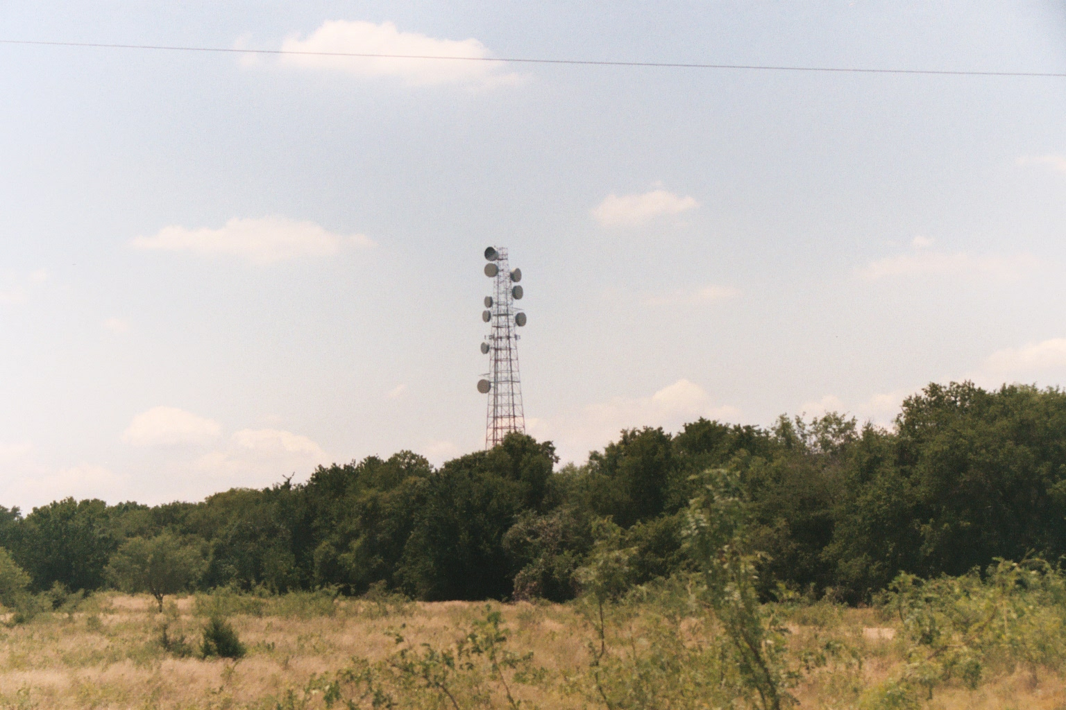
AT&T Long Lines Network

Slide 6
AT&T Long Lines Network
Just like a dinosaur’s skeleton, this is a sign of something that no longer exists
It is the remains of the AT&T Long Lines system
AT&T used these towers from 1947 to the late 1990’s to create the AT&T Long Lines network

Slide 7
AT&T Long Lines Network
This was the long distance network you used whenever you called someone in another city
It connected the central offices throughout the country to each other, and to other provider’s networks
This network used microwave radio frequency links

Slide 8
AT&T Long Lines Network
Each link went from tower to tower
With the towers connected this way, we had a true wireless wide area network
You may be thinking that the Long Lines network was designed to carry voice, and this is correct
Data was added to this traffic mix much later in the life of this network

Slide 9
AT&T Long Lines Network
In fact the addition of data traffic is what ultimately killed this wireless wide area network, as the wireless links did not have enough capacity
Today these links are made using fiber optic cable buried underground from central office to central office in MAN size SONET networks

Slide 10
AT&T Long Lines Network
These 100,000 SONET rings provide the connections that were once the work of the radio waves going between these towers
American Tower Corporation purchased most of the 2,000 towers from AT&T in 1999

Slide 11
AT&T Long Lines Network
For the ones they still own American Tower is using them for cellular and PCS antenna sites, as well as leasing space on them for other wireless uses
The rest have been sold to other providers

Slide 12
Satellite Based Networks
The only true wireless WAN left is one that uses satellites
Satellites are used where nothing else can be used
This is due to the cost of the equipment and the delay in signal transmission

Slide 13
Satellite Based Networks
To illustrate the various problems seen when using these systems a satellite link as is commonly used on cruise ships for Internet access, voice, and corporate data exchange will be used

Slide 14
Satellite Based Networks
Before we get to the source of the problems let’s see how a satellite link works by discussing
  The Bent Pipe
  LEO MEO GEO
  PVCs
  Capacity v Throughput

Slide 15
The Bent Pipe
A satellite link requires a ground station at each end and a satellite in the middle
A communications satellite functions as an overhead wireless repeater station that connects two sites that cannot see each other
To do this each satellite is equipped with a set of 24 transponders

Slide 16
The Bent Pipe
These consist of a transceiver and an antenna tuned to a specific frequency band
Since traditional satellites just receive and retransmit whatever comes in they have been called bent pipes
For example

Slide 17
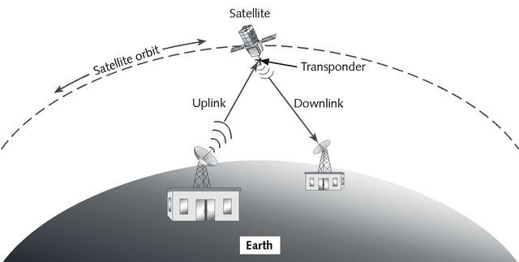
The Bent Pipe

Slide 18
The Bent Pipe
Notice that between the two ground stations there is no wire
And we cannot place a wire there as it is a long way across the sea
Also one end of the connection cannot be seen from the other end
Therefore a normal wireless link will not work

Slide 19
The Bent Pipe
So we will go up to a fixed orbit geostationary satellite and back down to connect the two points

Slide 20
The Parts of the Bent Pipe
The parts required to make all of this work include
  A teleport that talks to all of the satellites
    Photo by MTN Inc. (Seamobile)
  The satellite in the middle
    Graphic by Spaceflight Now
  An antenna and radio at the user end
    Photo by the author
For example

Slide 21
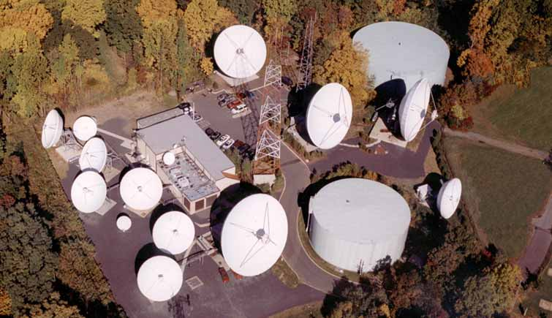
Teleport

Slide 22
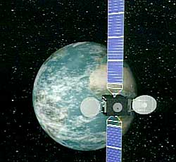
Satellite

Slide 23
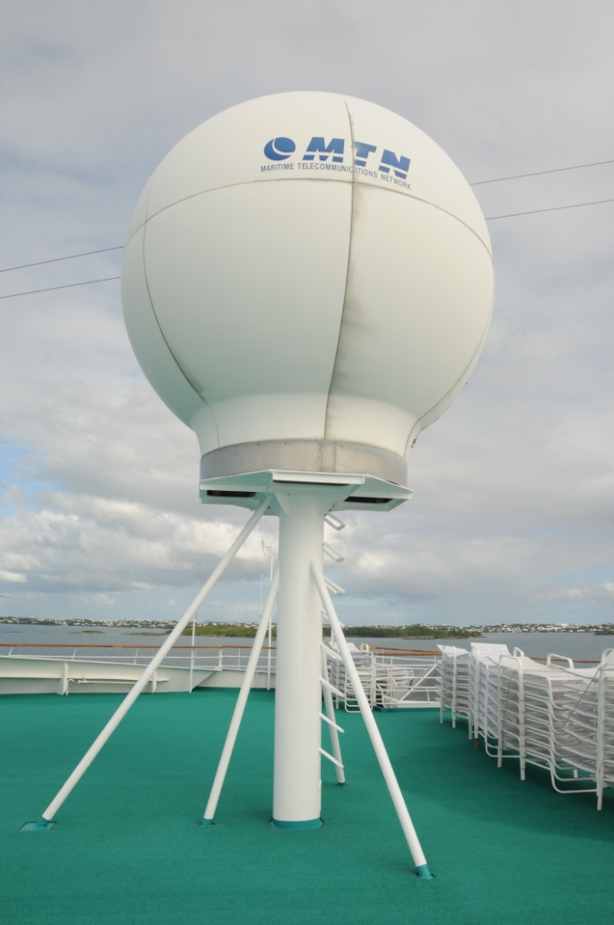
Antenna on the Ship

Slide 24
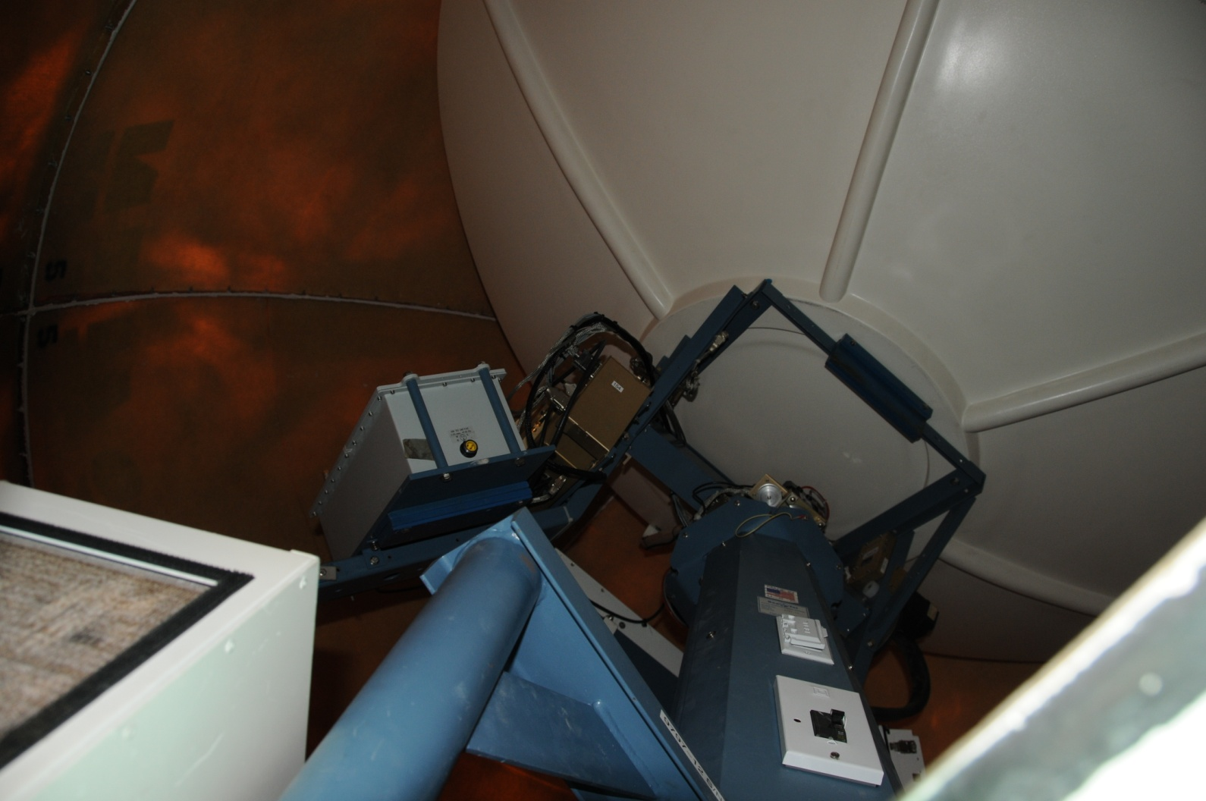
Antenna on the Ship

Slide 25
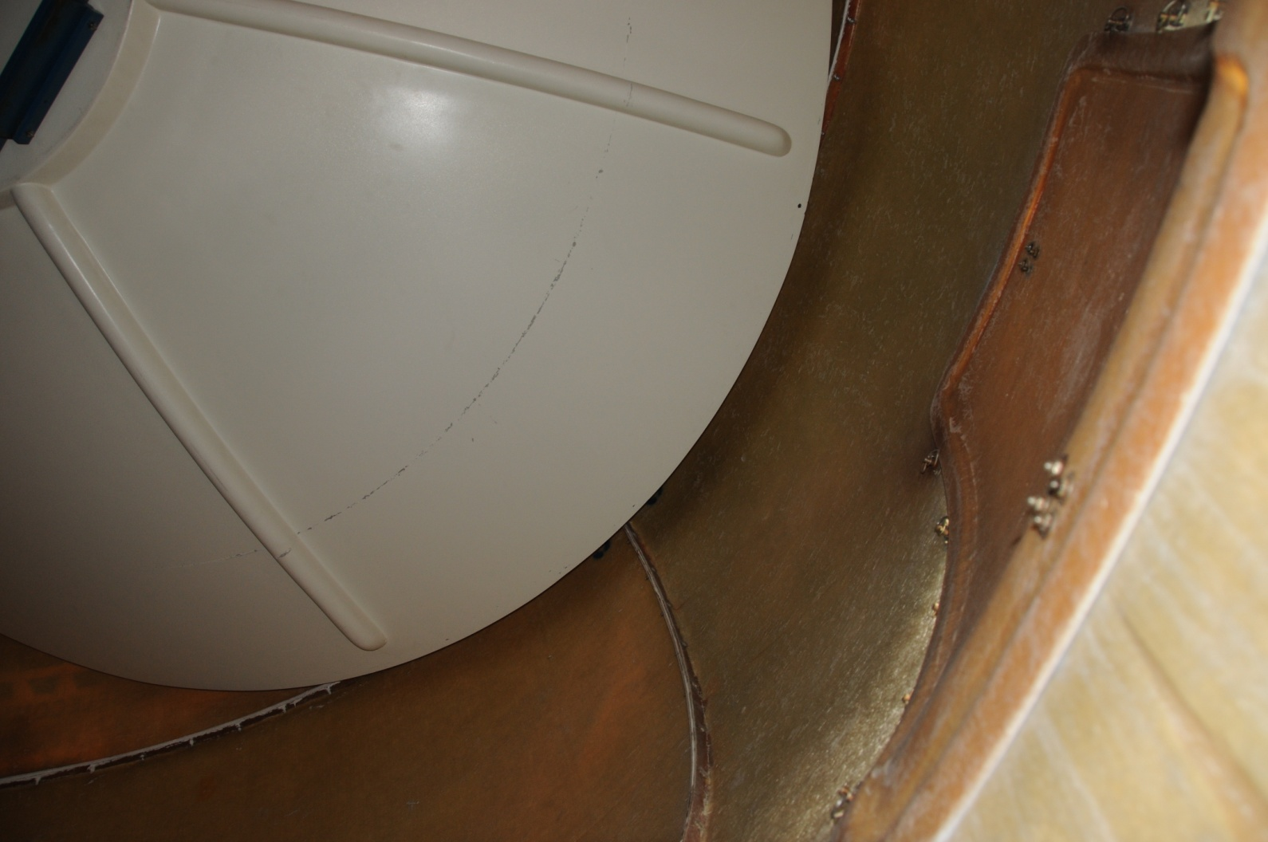
Antenna on the Ship

Slide 26
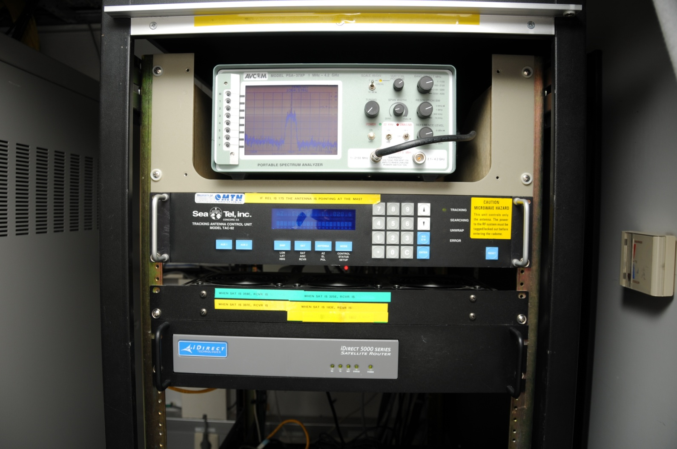
Controller for Connection

Slide 27
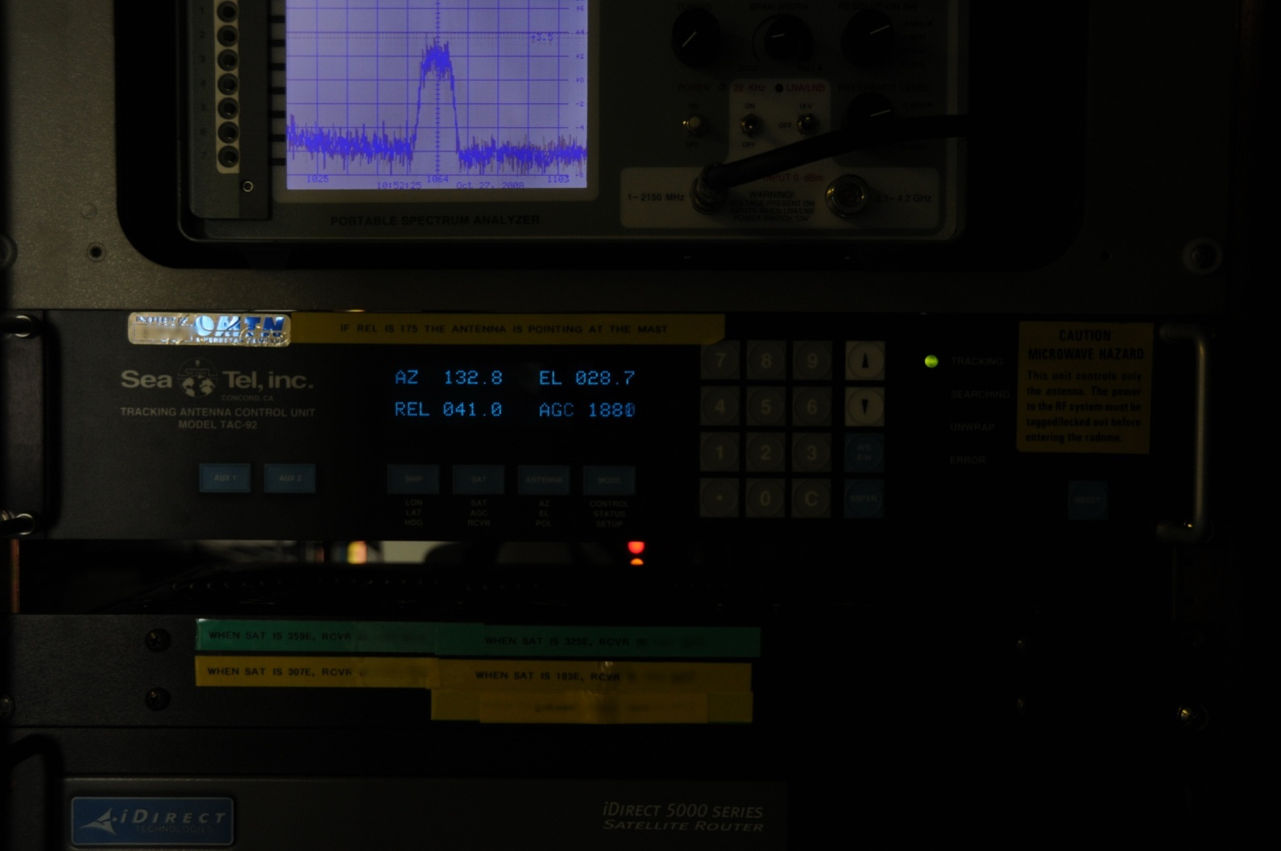
Controller for Connection

Slide 28
The Bent Pipe
Satellite links can operate in various frequency bands including S, C, Ku, Ka, and X
They use separate carrier frequencies for the uplink and downlink
The table below shows the most common frequency bands

Slide 29
Frequency Bands

Slide 30
Frequencies

Slide 31
The Bent Pipe
The C band has been the most used
However this band is getting crowded as terrestrial microwave links also use these same and nearby frequencies
However, the C band will remain dominate for quite some time because it is immune to weather related problems

Slide 32
The Bent Pipe
Alternatives include the higher frequencies of Ku and Ka bands
Attenuation due to rain is a major problem in both of these bands, due to the higher frequencies they use
The ¼ wavelength of these frequencies is about the same size as a raindrop

Slide 33
The Bent Pipe
Also due to the higher frequencies, the equipment is very expensive, therefore the cost per MHz to use these satellites is higher

Slide 34
LEO MEO GEO
There are three levels where satellites operate
  LEO - Low Earth Orbiting
    Around 1,000 km
  MEO - Medium Earth Orbiting
    From 8,000 to 20,000 km
  GEO – Geostationary
    At 35,786 km

Slide 35
LEO
In this orbit it takes quite a few satellites to over the entire surface
Being near the surface their coverage area, called the footprint, is small

Slide 36
MEO
MEO satellites are typically used to cover the two polar areas
This is due to their orbital shape

Slide 37
GEO
The geostationary satellites sit at various locations on the equator
By placing them there they appear to an observer on Earth to be stationary
Each GEO satellite can cover about one third of the Earth’s area
Therefore three satellites in GEO orbits can cover most of the surface

Slide 38
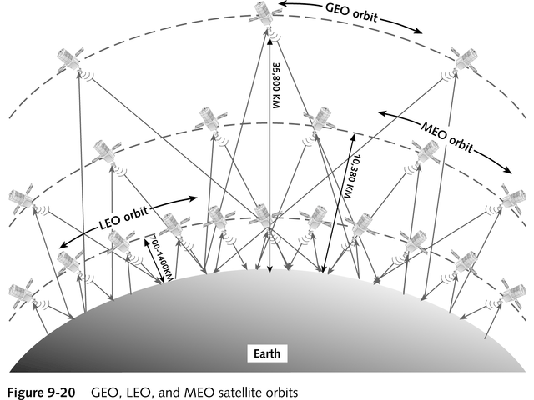
LEO MEO GEO

Slide 39
GEO

Slide 40
Footprint
The satellite footprint defines a region on the surface where signal is receivable
Satellites can have several beams or footprints with many several different coverage areas

Slide 41
PVCs
Satellite circuits are unlike a telephone connection where wires and switches connect one end to the other
A satellite connection uses the concept of a PVC – Permanent Virtual Circuit
A PVC provides a guaranteed bandwidth called a CIR – Committed Information Rate

Slide 42
PVCs
The CIR is what the service provider guarantees you will get
The advantage to a PVC, in this case when using TDMA or CDMA, is the ability to burst up to a higher speed if no one else is using the circuit

Slide 43
Capacity v Throughput
Capacity is the design limit of the transmission line
In the case of the satellite this is the CIR of the PVC as discussed above
The problem is the capacity is never reached
It cannot be
Why

Slide 44
Capacity
Let’s use the example of a freeway
What is a freeway for
Most would say to carry traffic
In other words, cars and trucks and such
But no
In reality it is to carry people, in the case of cars

Slide 45
Capacity
For example, how many people could we fit in a one mile section of a three lane freeway
I would measure it this way
Strip everybody down naked as jaybirds
Pack them nose to you know what, shoulder to shoulder

Slide 46
Capacity
I estimate we could stuff about 103,680 humans in this space
So how is throughput different

Slide 47
Throughput
On this same freeway if we place the people in cars, now how many can we pack into that same mile of three lanes
I calculate this as about 975 people
Quite a difference isn’t it
At least in the case of telecommunications lines typically we will see throughput at 75%

Slide 48
Throughput
When using telecommunications circuits such as a satellite link the data, such as an email message, must be broken up into chunks called frames
When we do that the frame structure becomes overhead, just like the car
The car or frame is needed to carry the people or data, but it is wasted space on the freeway or communications link

Slide 49
Throughput
Therefore, we never see the transfer rate approach the rated speed of the circuit unless the circuit is oversized by at least 20 percent over the CIR requested

Slide 50
Satellite Locations
The satellites we are interested in are those in geostationary orbits
The GEO satellites
For example
  Graphic by Intelsat

Slide 51
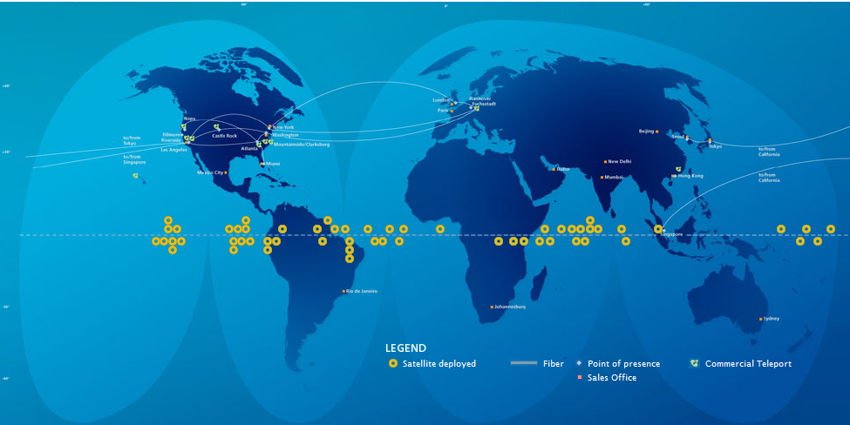
Satellite Locations

Slide 52
Satellite Locations
The transponders on satellites can be tuned to provide general coverage to a large area, a hemisphere, a zone, or spot coverage to a small area
In this example we will assume the cruise ship will tune into the global beam of one of three satellites
These three satellites can provide coverage for the entire globe

Slide 53
Satellite Locations
These are
  Intelsat 903 (AOR)
  Intelsat 906 (IOR)
  NSS-5 (POR)
    Graphic by Intelsat

Slide 54
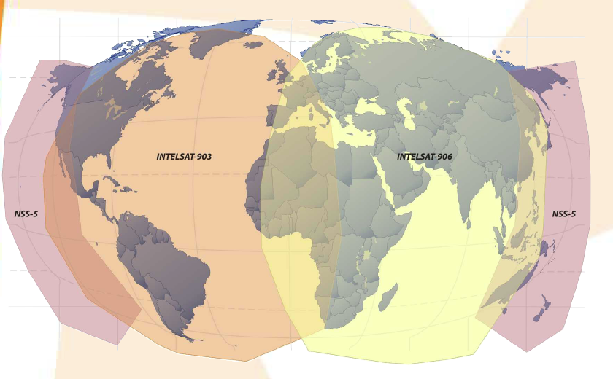
Global C Band Satellites

Slide 55
Global C Band Satellites
Ships use these global coverage satellites when they are out in the ocean
Then nearer to shore they use the regional coverage C band satellites due to their higher signal strength
The smaller foot print of the regional satellites is not a problem when operating in a limited area near shore

Slide 56
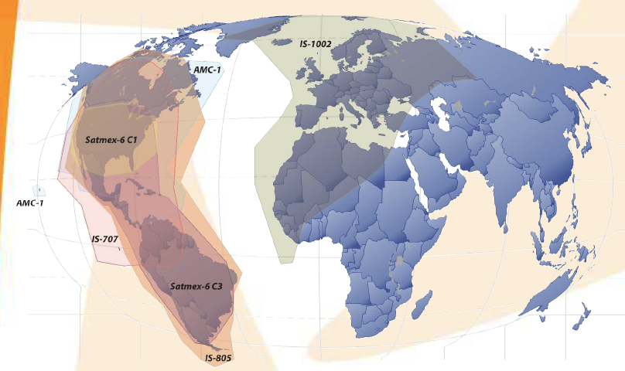
Regional C Band Satellites

Slide 57
Regional Ku Band Satellites
Also available are the regional coverage Ku band satellites
These are used for yachts, commercial vessels, oil and gas vessels, and as a backup to the C band links when needed

Slide 58
Regional Ku Band Satellites
C band connections are subject to interference when the ship is near shore in many areas as the primary licensed user of these frequencies are point to point microwave links and some radar sites
As such the satellite user must accept any interference from these shore based links cause

Slide 59
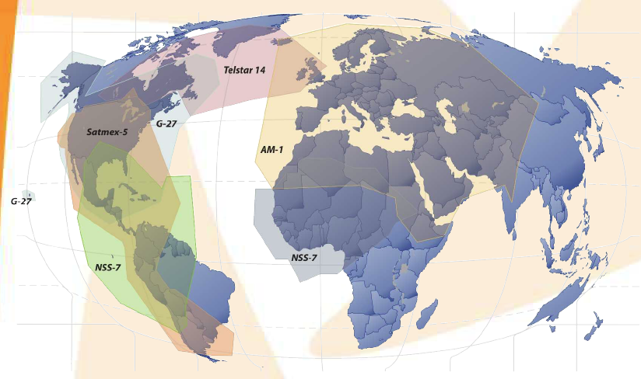
Regional Ku Band Satellites

Slide 60
Problems with Satellite Systems
Satellite-based services pose a set of unique issues to the network designer
Such as
  Look angle
  Latency
  Bit error rates

Slide 61
Look Angle
What is the look angle
Let’s say we have been cruising South America off of Brazil, but the season is now over
So its time to reposition to Greenland to cruise around Greenland, Iceland, and Norway

Slide 62
Look Angle
As we leave South America to head north we will generally follow the 35 degree W longitude line
For Internet access we have been assigned space on Intelsat 903
This satellite is located at 325.5 degrees E or 34.5 W

Slide 63
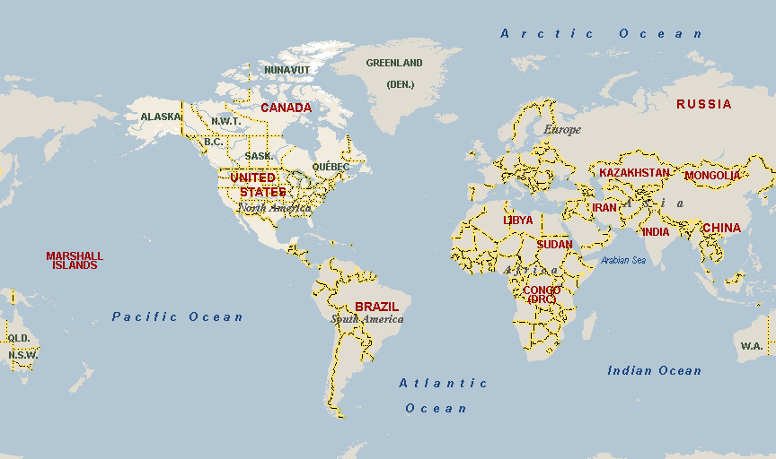
Look Angle

Slide 64
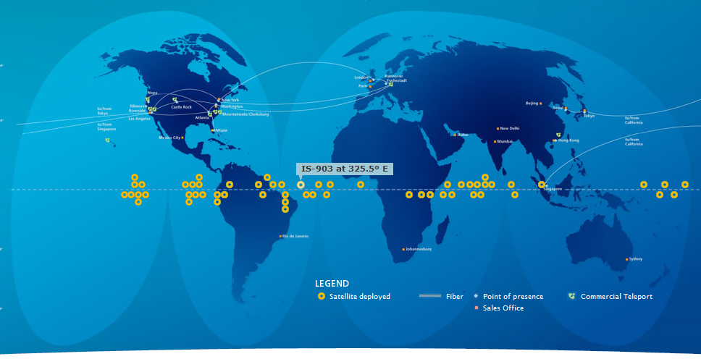
Look Angle

Slide 65
Look Angle
Let’s calculate the angle between the antenna on-board and the satellite
In other words, the direction in which we point the dish
As we set out headed north with this course as we pass the equator the dish hidden inside the dome is pointed up at an angle of 89.411 degrees

Slide 66
Look Angle
So we point the antenna inside this dome almost straight up

Slide 67
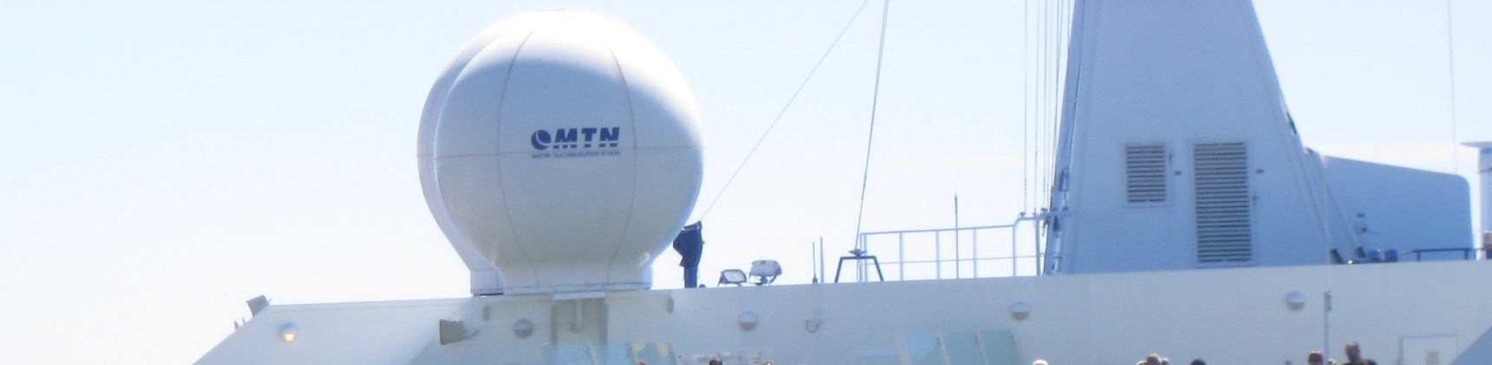
Satellite Dish Dome

Slide 68
Latency
Now regardless of the look angle, physics now intrudes on us in the form of latency
Latency is how long it takes for something to happen
Latency, or delay, is the time a frame takes to travel from the source station to the final destination
Humans are only happy if latency is 100 milliseconds or less

Slide 69
Latency
This is the network design goal
Can we meet this goal
Unfortunately, no
In the best case scenario when we are directly under the satellite the time required for a transmission is about 500 milliseconds for a round trip

Slide 70
Latency
And that’s just the part from antenna to antenna
In reality the time is more like 660 ms to 2.3 seconds
A flatter angle produces an even longer distance, and longer time

Slide 71
Latency
On the cruise ship Crystal Symphony the average response time was 700 ms on a cruise from Montreal to the northern edge of South America
The worst response time seen was slightly over 1400 ms
In rough seas retransmissions are common as seen here

Slide 72
Latency
In this case the seas were from 15 to 25 feet

Slide 73
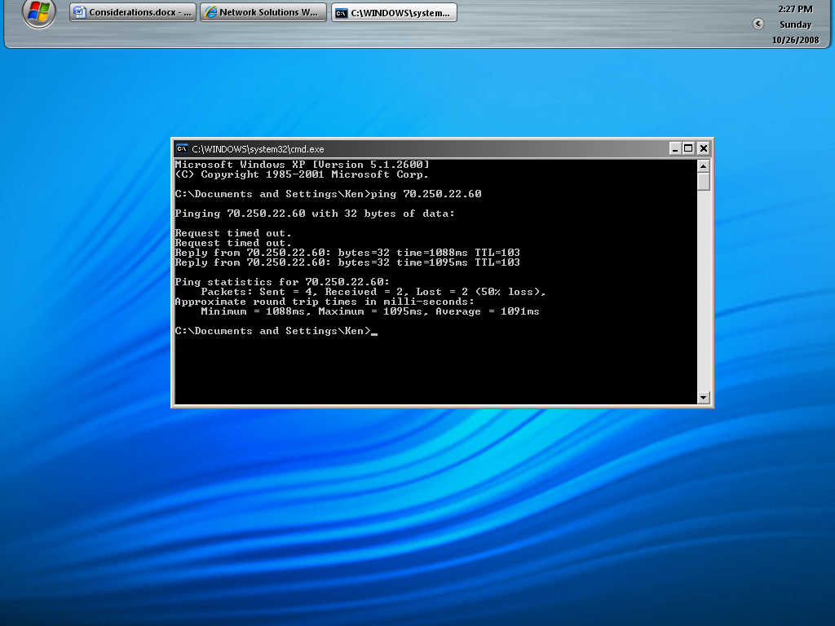
Latency

Slide 74
Look Angle
Let’s see what happens as we sail further north
Off the American coast at latitude 32 N the look angle is 52.742 degrees
In other words, we are leaning the dish down toward the deck
As we cruise Greenland around the Arctic Circle at 70 N the angle drops to 11.474 degrees

Slide 75
Look Angle
As the angle drops a new problem often appears
Let’s look back at the photo of the dome that contains the antenna

Slide 76
Satellite Dish Dome

Slide 77
Look Angle
If the housing on the right side or even worse the funnel of the ship is in the same direction as the satellite, then no signal or at best a very weak signal may be received as these structures block the signal

Slide 78
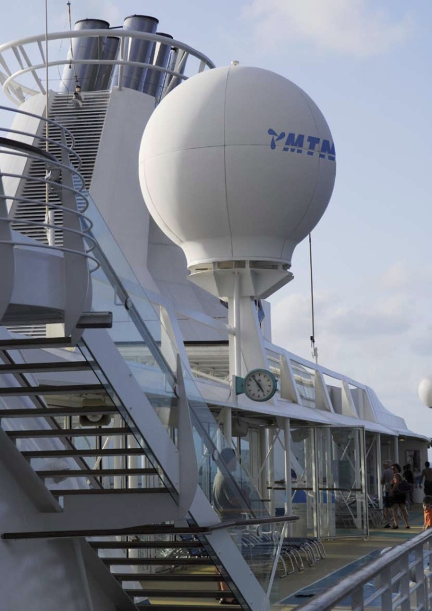
Antenna on the Ship

Slide 79
Look Angle
This leads to outages and retransmissions
Some times the captain will have to change course, just to let the transmissions go out for a while

Slide 80
Look Angle
The look angle can also be a problem near shore

Slide 81
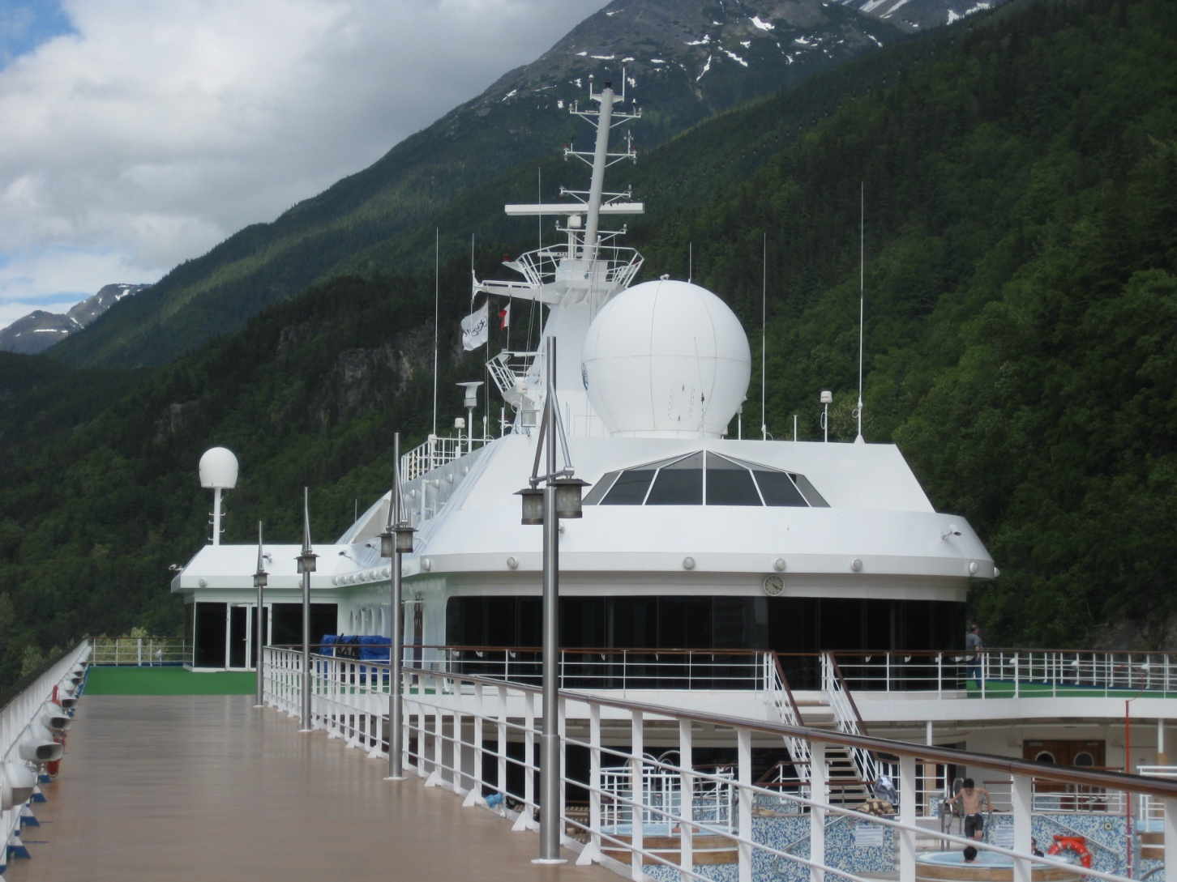
Ship Near Shore

Slide 82
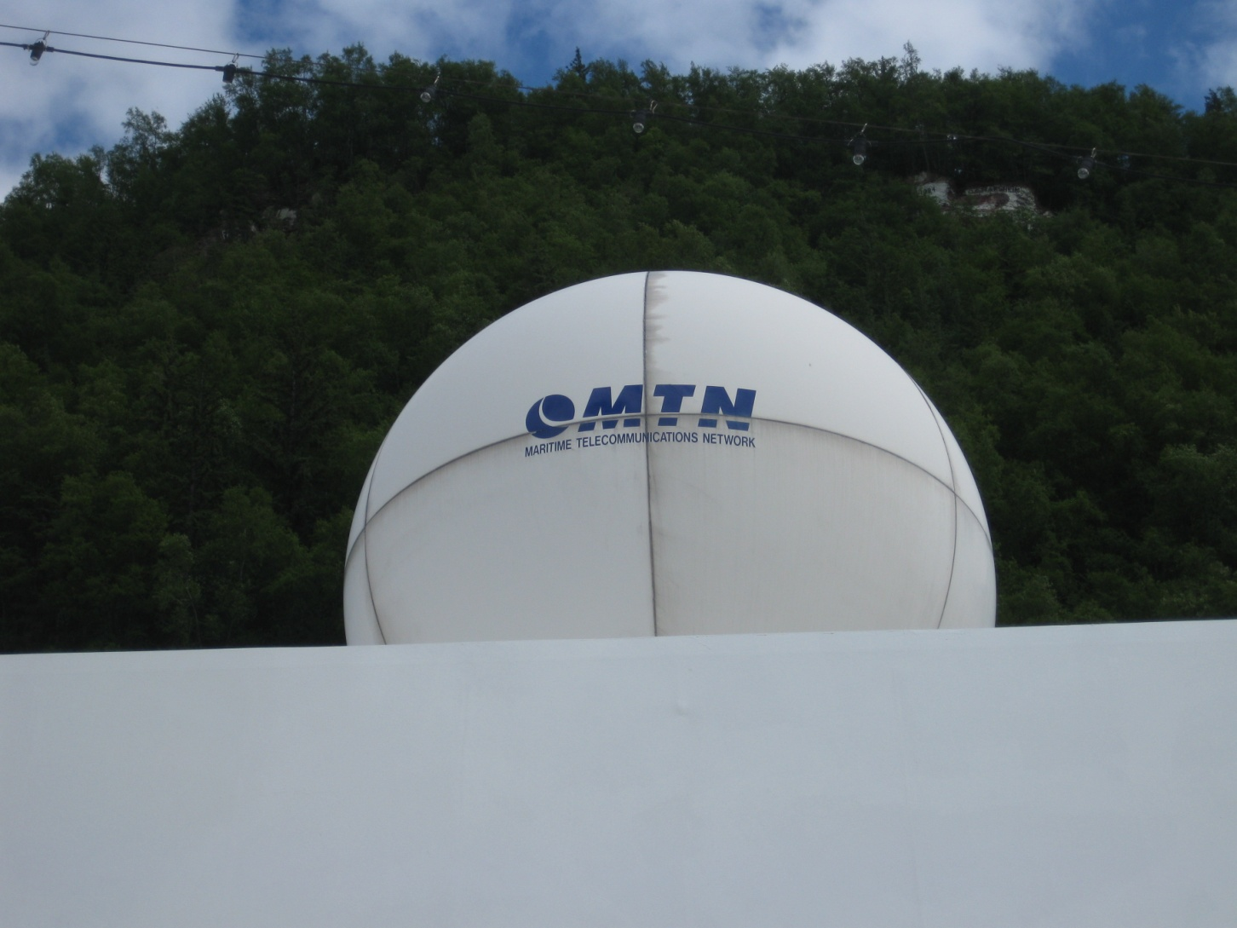
Ship Near Shore

Slide 83
Look Angle
This same problem may happen in port if the dock is surrounded by tall buildings
For example
  Photo from www.cruisecritic.com via www.shutterstock.com

Slide 84
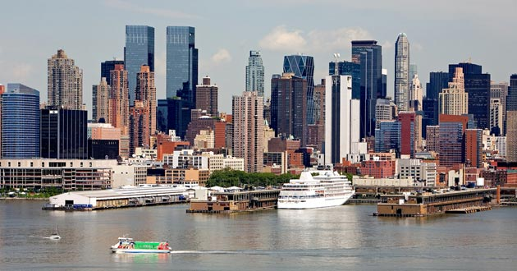
Cruise Ship Near Tall Buildings

Slide 85
Typical Look Angle Problems
On the Crystal Symphony the 2.4 m dish is blocked by the mast when the azimuth is between 175 and 185 degrees
On this ship there are two antennas
The midship antenna is TV only
The forward antenna handles IP, VOIP, IPTV, and cellular service

Slide 86
Typical Look Angle Problems
There is a 56K dial backup for use at latitude 82 and higher
It is an Inmarsat Saturn B system at the L band of 1.6 to 1.7 GHz range

Slide 87
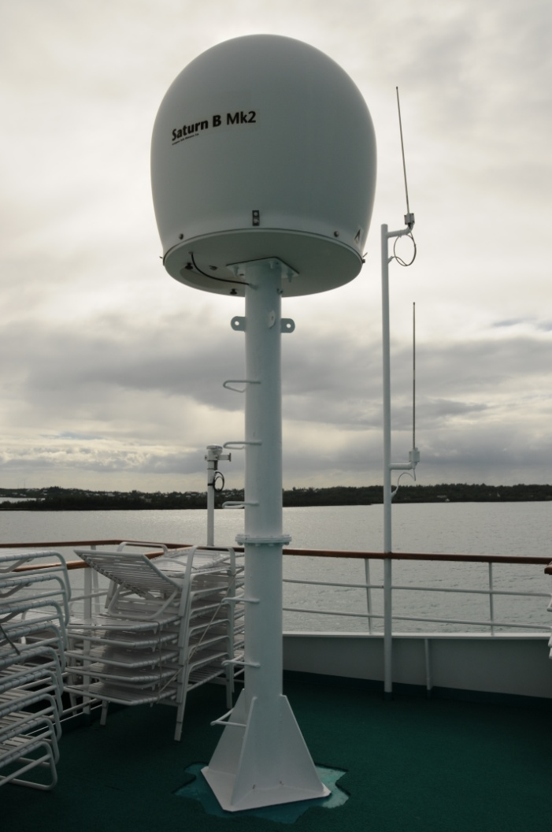
Saturn B Connection

Slide 88
Typical Look Angle Problem
On the Crystal Symphony traveling from Montreal down the St Lawrence river an outage occurred for about 20 minutes due to the ship passing an obstruction on shore it appeared
The ship was at N 49-23-267 by W 065-44-409 headed 95 degrees at 4:30 pm on Wednesday 22 October 2008 when the satellite signal was lost

Slide 89
Typical Look Angle Problem
The calculation showed Intelsat 903, the satellite they were using, to be at 26.004 elevation by 141.372 azimuth
Notice the 4,160 foot mountain nearby
It appears the mountain blocked the signal as the azimuth to the satellite and to the mountain coincided

Slide 90
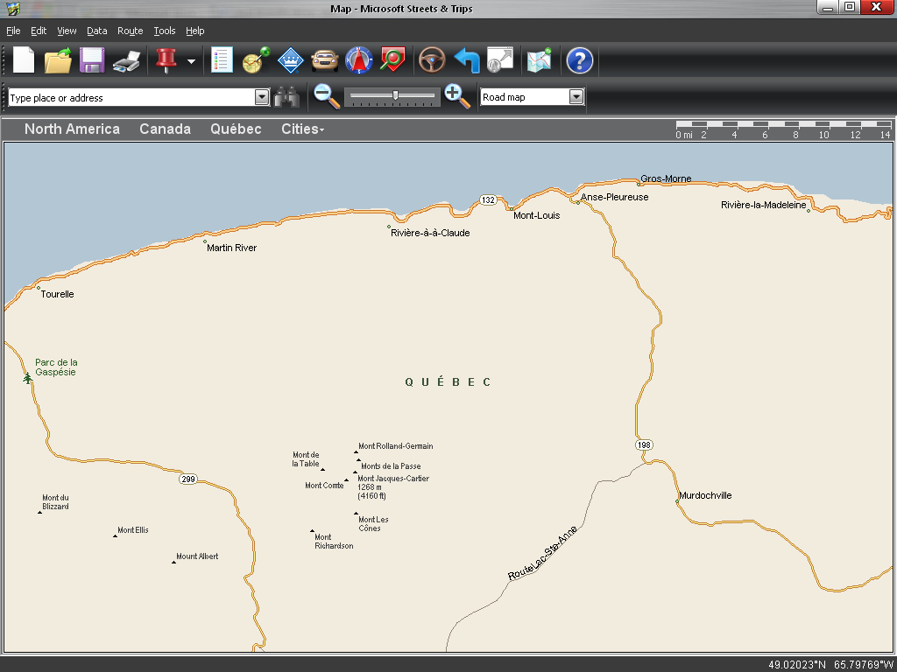
Typical Look Angle Problem

Slide 91
Typical Look Angle Problem
This is true of small dishes as well as the larger dishes seen above
Here is a dish in Alaska
Notice how flat the angle is

Slide 92
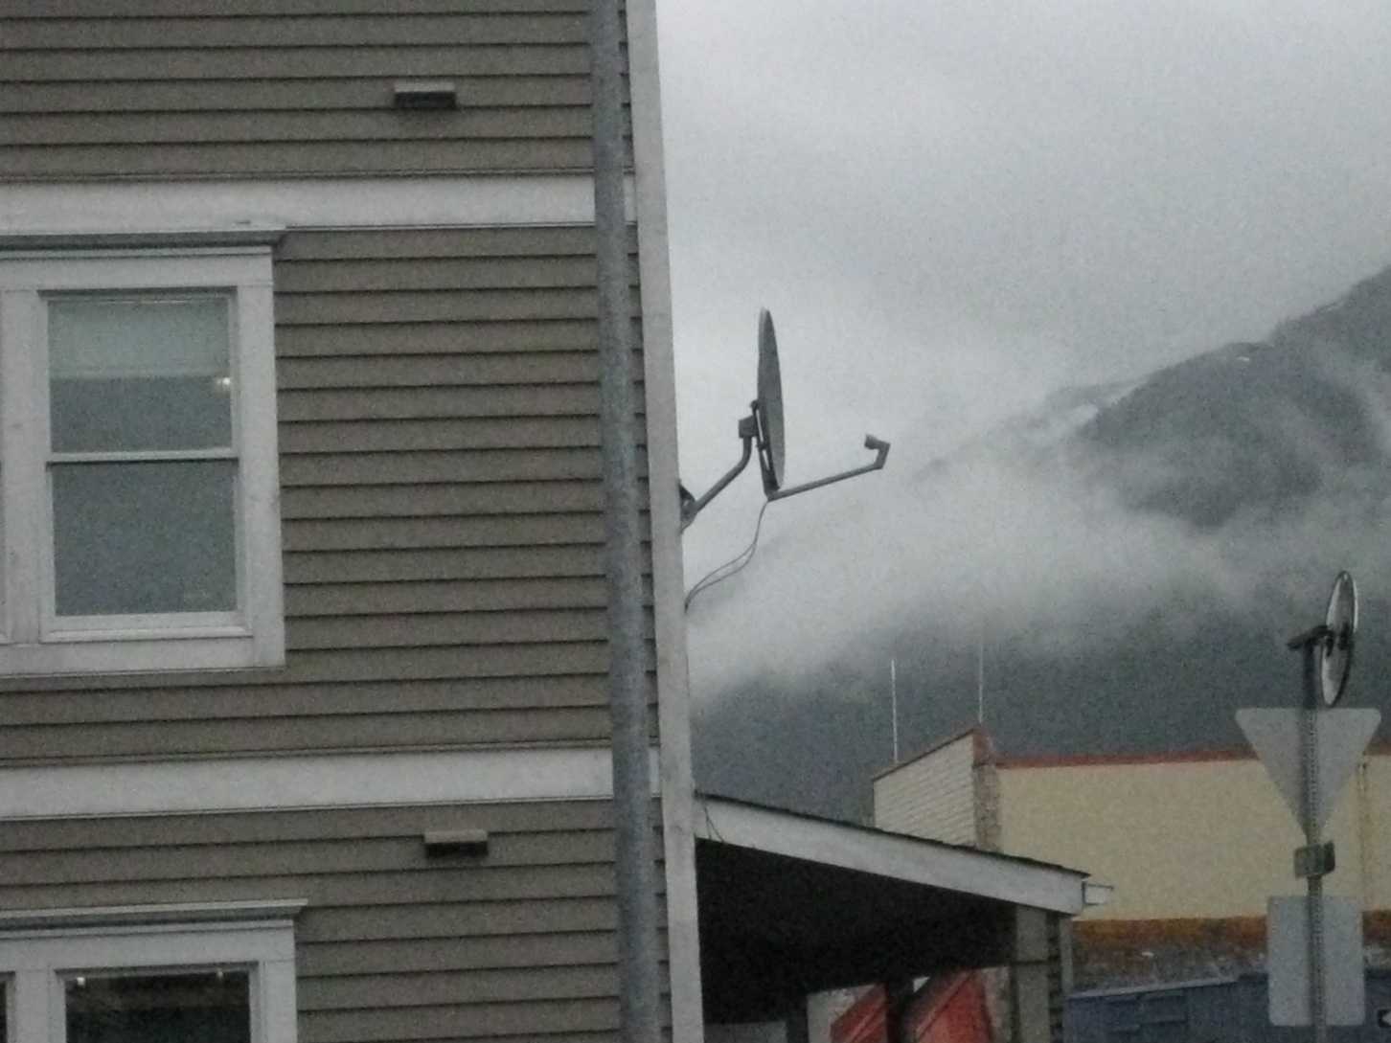
Typical Look Angle Problem

Slide 93
Latency
This Maximum Transmission Unit is the size of the frame that can be sent and received
That typically varies from 500 to 1500 bytes
For example I sent a 2.46 MB size photo of a stop I made in Cabo San Lucas to my web server as a test

Slide 94
Latency
This transfer was done from home over a 500 kbps DSL line
This required 5,807 frames from 32 to 1408 bytes each just for the data
This does not count all of the other traffic on the network at that same time
No wonder it takes so long

Slide 95
Latency
Well, this won’t do
What can we do about this
Nothing
Physics is physics is physics
Why so
Recall our discussion of capacity v throughput

Slide 96
Latency
When this overhead is added to the time required for framing, queuing, and switching a considerable delay is introduced
This delay is enough to cause problems for TCP/IP

Slide 97
Latency
The handshaking used by TCP does not run over links with this much delay
This can be dealt with to some extent by increasing the TCP/IP window size, but there is a limit to this

Slide 98
Latency
A device can be inserted between the user and the satellite called a gateway that handles these functions for all users
This precludes the need to alter the TCP/IP protocol stack settings for every user device

Slide 99
Bit Error Rates
The next problem is due to bit error rates
A bit error is when any bit in a frame is damaged in transit
When this occurs the receiving end throws out the whole frame
The sending end must then resend the frame
Too many of these and things slow down even more

Slide 100
Bit Error Rates
Satellite links are very prone to high bit error rates
What bit error rate is acceptable
1 in 10⁻⁷ is the minimum acceptable for a satellite link
This is one bad bit in every 10,000,000 bits
Now that sounds pretty good doesn’t it

Slide 101
Bit Error Rates
1 in 10⁻⁷, now how could this be a problem
Well, keep in mind that if even one of the bits in a frame is bad the whole frame is thrown out
So PDU – Protocol Data Unit error rates are more important than Bit Error Rates

Slide 102
Bit Error Rates
Here we are talking about frames as the relevant PDU
How many bits are in a frame
It depends on the size of the frame
The minimum frame size on a local area network is 64 bytes
The maximum frame size on a local area network is 1,518 bytes

Slide 103
Latency
So the total number of bits would range between 512 and 12,144
Which would mean one in every 19,531 at best to one every 823 at worst would be thrown away
Each of these must be resent
This slows things down even more

Slide 104
Bit Error Rates
Now of course if the bit error rate is better than 1 in 10⁻⁷ then not so many must be resent
Satellite networks are designed for a 10⁻⁹ environment, but can see bit error rates as bad as 10⁻⁶

Slide 105
Bit Error Rates
Why are satellite links so prone to high bit error rates
  Look angle
  The Sun
  Interference
  Signal blockage
We have already discussed the look angle problem
What does the Sun have to do with this

Slide 106
The Sun
The Sun affects satellite based telecommunications in several ways
The most basic are those outages due to the time of year
This type of outage is due to the Sun emitting strong microwave signals
To the satellite that cannot read these signals it is seen as noise

Slide 107
The Sun
When the noise level is higher than the desired signal level communication slows or ceases entirely
This always happens two times per year when the Sun passes directly behind the satellite
In this case the antennas on the ground are pointed at the Sun

Slide 108
The Sun
For example
  Graphic by Radioelectronics.com

Slide 109
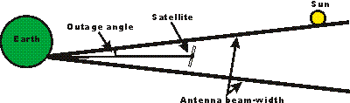
The Sun

Slide 110
The Sun
The timing and duration of the outage depend on
  The ground location
  The satellite location
  The beamwidth of the antenna
This is not an on off type of thing
It is a gradual transition

Slide 111
The Sun
This occurs around the equinoxes
  March and April
  September and October
In the Northern Hemisphere the affect is more pronounced in March and October
In the Southern Hemisphere April and September are the worst months

Slide 112
The Sun
For example, here is the outage prediction for NSS-5 for September 2008
This is the satellite that provides Internet access over the Pacific Ocean

Slide 113
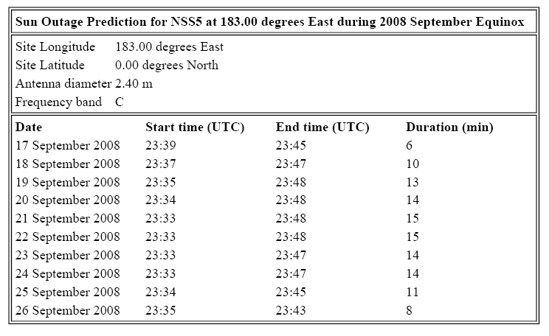
Equinox Outage

Slide 114
The Sun
In addition to these expected outages the Sun can case other problems due to solar activity, such as sun spots
Unfortunately a new cycle of solar activity began in March 2008
It is predicted to last for 11 years

Slide 115
The Sun
This shows up as higher noise with the resultant higher bit error rates, leading to more retransmission, and lower throughput, rather than a complete blockage of the signal
Right now we are in a period of relatively low solar activity
Therefore communication is stable

Slide 116
The Sun
The telecommunications manager can keep up with this by checking the space weather reports at http://www.sec.noaa.gov
There you will see for example

Slide 117
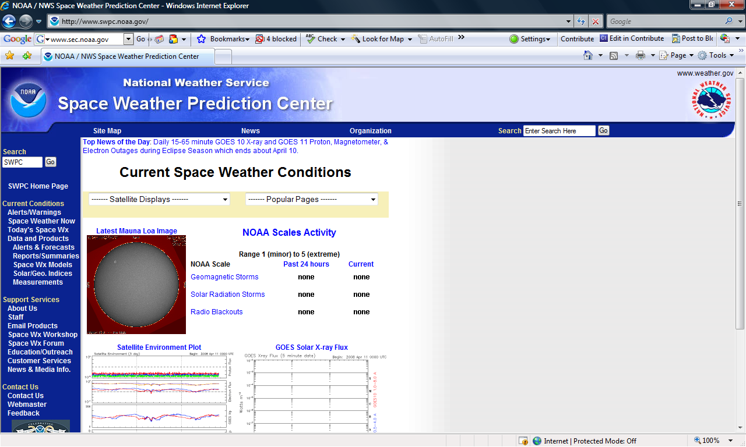
Space Weather Reports

Slide 118
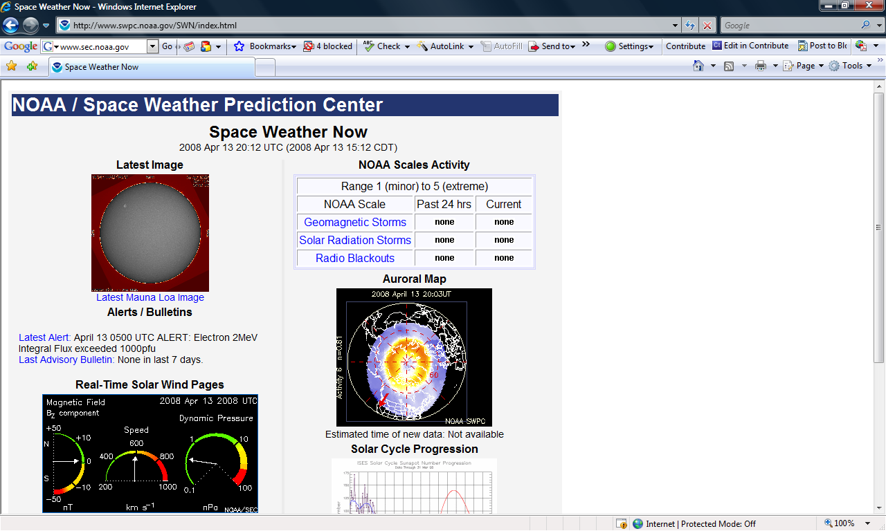
Space Weather Reports

Slide 119
How Can We Fix This
Problems, problems, problems
How can we fix this
  Bandwidth
  Compression
  Caching
  QoS

Slide 120
Bandwidth
The bandwidth of a telecommunications link is similar to the number of lanes on a freeway
The more lanes, the faster the traffic
For example, a dial-up, analog connection to the Internet using a modem can go as fast as 53 kbps
Whereas, a typical ADSL connection is 3 Mbps

Slide 121
Bandwidth
In other words, much, much, much faster
Most cruise ship Internet links are 128 kbps and up
A common speed is 1 Mbps that can burst up to 2 Mbps
Unlike the 53 kbps analog link at $16 a month or so, a typical cruise ship bill is about $10,000 to $15,000 a month

Slide 122
Bandwidth
So cruise lines are reluctant to increase the bandwidth too much due to the high cost of these types of links
In their defense increasing the link speed does not do as much as other methods do to improve the customer experience

Slide 123
Compression
The most basic and easiest thing to do to improve the user experience is to compress the data being sent
There are several ways to do this
In general all compression methods uses a single symbol to represent common elements
For example, this slide is mostly white space

Slide 124
Caching
Instead of sending all of this white space we could use a single symbol to represent any white space, then only one other symbol to indicate how much white space
Caching is simple in concept
All you need to do is notice what most users are looking at, then keep that on a local drive

Slide 125
Caching
When the next user asks for it, the answer comes from the local storage
There is no need to ask for it again from the source

Slide 126
Compression and Caching
What is the impact of using compression and caching
Let’s see what Crystal says
  Before installing the F5 BIG-IP WebAccelerator, the top speed Crystal Cruises could hit on its satellite Internet links was 664 Kbps to 710 Kbps, and that was for a mere two to three hours per day for 18 to 27 days per month

Slide 127
Compression and Caching
  After installing BIG-IP WebAccelerator, the company saw Internet throughput shoot to 2 Mbps to 3 Mbps for 12 to 13 hours per days, a full 30 days per month—an improvement of roughly 300 to 500 percent

Slide 128
Compression and Caching
How exactly is this done
  All Internet traffic flows through the Los Angeles-based BIG-IP WebAccelerator, which caches web pages the first time they’re accessed
  All subsequent hits to the same page are lightning-fast, since they are supplied from the cache

Slide 129
Compression and Caching
  BIG-IP WebAccelerator also provides a high level of compression, which reduces the amount of traffic that has to traverse the satellite links
Now what is odd about Crystal’s implementation is the location of the caching device

Slide 130
Compression and Caching
Crystal has a single box at their Los Angeles location
This requires any request for data to go
  Ship to satellite
  Satellite to ground station
  Ground station to LA
  LA to ground station
  Ground station to satellite
  Satellite to ship

Slide 131
Compression and Caching
It would be faster to locate the box on the ship
Some satellite equipment include this accelerator function as well

Slide 132
QoS
QoS – Quality of Service puts some traffic in front of other traffic
For example, voice traffic which is delay sensitive is put in front of traffic that can handle delays, such as email
This does little for the overall user experience as all it does is put someone at the front of the line instead speeding up the line

Slide 133
QoS
On cruise ships the passenger requests are put in front of the crew traffic for example
However, keep in mind the ship must also use this connection for daily ship activities, such as checking reservations, credit card processing, and talking to the home office
In addition, all those cell phone calls go over this link as well

Slide 134
QoS
On the Crystal Symphony the passenger traffic appears to be limited to about 250 kbps of the total available
The majority of the bandwidth must be reserve for ship use

Slide 135
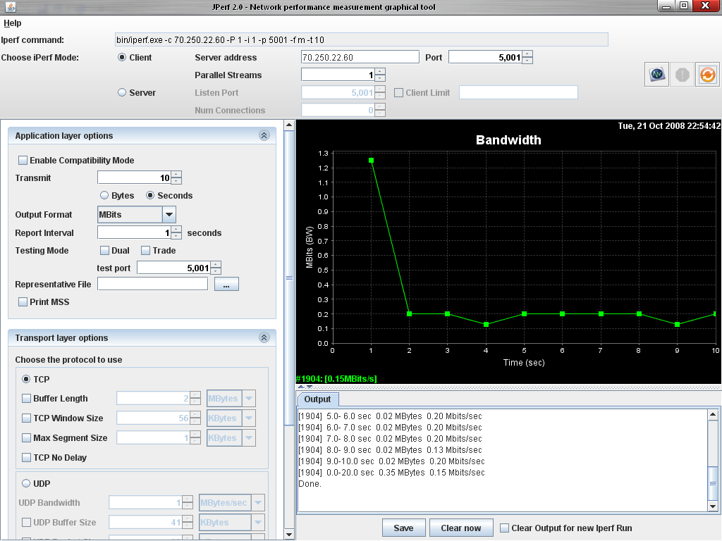
QoS

Slide 136
Satellite Links on Shore
Enough of ships
Where might you use a satellite connection on shore
How about here

Slide 137
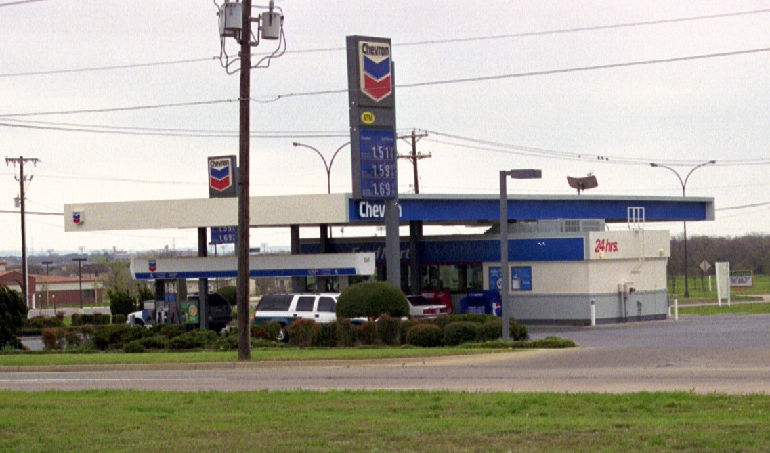
Satellite Links on Shore
Antenna

Slide 138
Other Satellite Link Uses
Other uses now and in the future include
  On aircraft
  From a car
  From a train

