Slide 1
Wireless MAN
Last Update 2013.02.04
2.7.0

Slide 2
Wireless MAN
Recall that a MAN covers an area a few miles in diameter
There are four types of wireless networks that fit this description
Point to Point unlicensed or licensed link
WISP using unlicensed frequencies
Cellular using licensed frequencies
SCADA using both
Let’s look at each type

Slide 3
Point to Point Link
A point to point long distance link can use either an unlicensed or licensed frequency
If unlicensed, 5 GHz is the most commonly used frequency
When licensed 6, 11, 18, and 23 GHz are common
Here is an example of this type of link

Slide 4
Point to Point Link

Slide 5
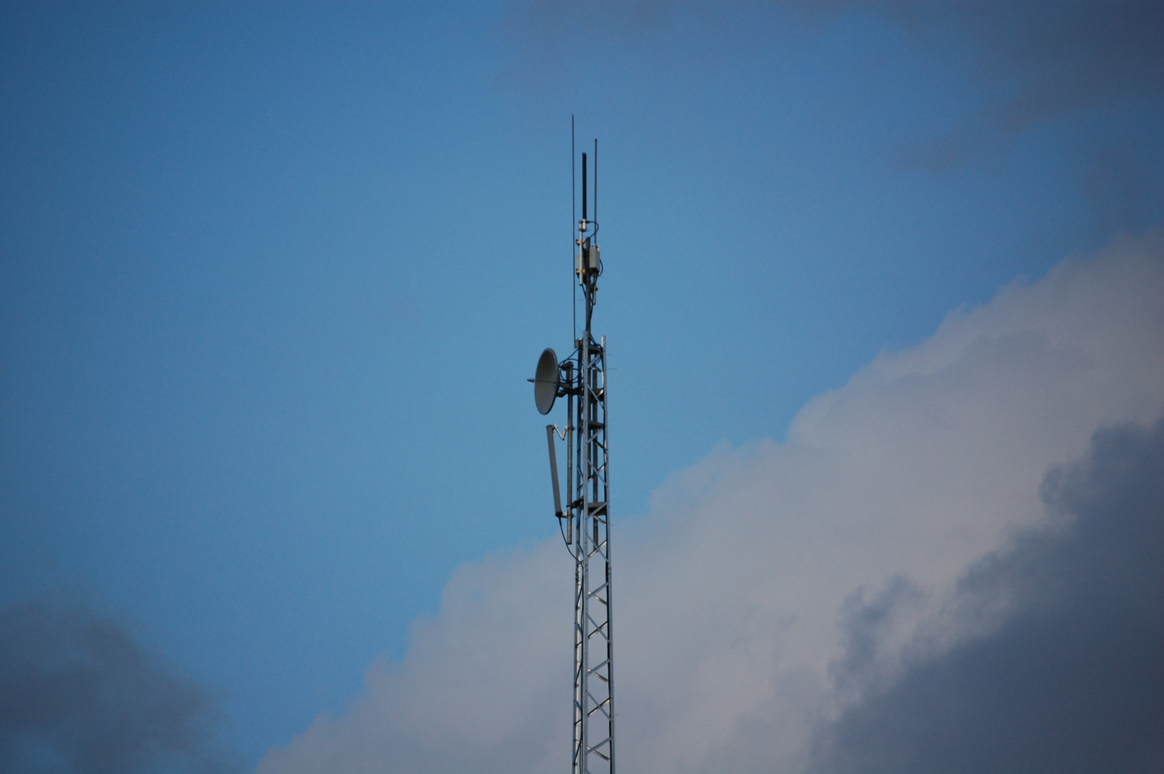
Point to Point Link

Slide 6
Point to Point Link
In this case a backhaul connection is being used to connect two WISP towers about 7 miles apart
This precludes the need to maintain a data line from a service provider to the second tower
A dish antenna is used for a connection over this long of a distance
The frequency is in the 5 GHz range

Slide 7
Point to Point Link
The distance covered depends on the frequency used
Hutton provided some useful information concerning point-to-point links during a webinar in June 2011

Slide 8
Point to Point Link

Slide 9
Point to Point Link
As they point out the equipment used can be mounted in three different ways

Slide 10
Point to Point Link

Slide 11
Point to Point Link
The size of the dish depends on the frequency used with dish size increasing as the frequency decreases

Slide 12
Point to Point Link

Slide 13
Point to Point Link
The climate of the region where the link is installed will impact the availability of the link or the need for a higher fade margin
In general rough dry terrain is better than flat humid areas
Hutton provided these maps to illustrate this

Slide 14
Point to Point Link

Slide 15
Point to Point Link

Slide 16
Point to Point Link

Slide 17
Point to Point Link
Long distance links over very flat terrain, such as desert or water, will often exhibit signal reflection problems
A long link being one around 30 to 40 miles
In this case spatial diversity of the antennas is called for
As Hutton points out

Slide 18
Point to Point Link

Slide 19
Point to Point Link

Slide 20
WISP
A WISP is a wireless ISP
This is a common solution to the last mile problem of providing high speed Internet access to underserved areas
This lack of access is a problem in rural areas
For the most part this industry is made up of individual companies that serve their local area

Slide 21
WISP
The industry has developed this way due to a lack of interest from large nationwide companies, due to the sparse population, as well as the low cost of entering this market
Indeed, a group of students of mine setup a WISP on my property several years ago that I still operate
Let’s look at an example of a typical WISP

Slide 22
Base Station Equipment
At the base station this equipment is typically required
Tower - $2,000 for the tower and $3,000 for installation
Antenna - $150
Lightning arrestor - $95
Cable from antenna to access point - $25
Access point - $250

Slide 23
Base Station Equipment
Cable from access point to router - $0.20 per foot
Connectors for cable - $10
Cable grounding kits - $14 each
Router and CSU/DSU - $2,300
Switch - $40
Battery backup - $120
Equipment Cabinet - $1,000

Slide 24
Base Station Equipment
Installation of equipment - $30.00 per hour
Deliver data line demarc to site – The cost depends on the distance
Deliver electrical power to site – The cost depends on the distance

Slide 25
Customer Equipment
At the customer end of the connection these costs typically occur
Antenna - $70
Antenna mounting - $100
Cable from antenna to inside equipment box - $0.50 per foot
Inside equipment box - $250
Patch cable - $5.00

Slide 26
Customer Equipment
This cost is highly variable
In one case a site may require an outside antenna mounted on a pole with a cable to the inside box
In another case a box placed anywhere in the customer’s home or business may provide a signal
Two customer sites will illustrate this problem

Slide 27
Customer Equipment
Customer Location One
Distance from Base Station Antenna to Customer Location is ½ mile
Base Station Tower
Distance from Base Station Antenna to Customer Location is 393 feet
Customer Location Two

Slide 28
Total Costs
In summary, the total costs for a typical operation are
Base station equipment and installation - $10,000
Customer equipment and installation - $500 per wireless subscriber
Data line - $28 per wireless subscriber
Network operations center - $3,000 to $12,000

Slide 29
The Example Area
CUSTOMER SITE
0.80 KILOMETERS OR 0.50 MILES
BASE STATION ANTENNA SITE

Slide 30
Base Station Equipment
The equipment at a base station site varies
In general the following is required
Tower
Antenna
Access point
Cables
Lightning protection
Equipment building
Router

Slide 31
Base Station Equipment
CSU/DSU
Hub
UPS
This diagram shows the general layout of this example base station site

Slide 32
Base Station Equipment

Slide 33
Base Station Tower
The base station tower for this site is a Rohn Model 25
The tower is assembled in ten foot sections, one section at a time until the desired height is reached
In this case that is 100 feet
To raise the tower the bottom section is put in place, then the concrete foundation is poured around it

Slide 34
Base Station Tower
The concrete for the foundation only goes 2 feet into the ground as guy wires are used to provide the rest of the support for the tower
Once the base section is set the other sections are added one at a time
Here is what the finished tower looks like

Slide 35
Base Station Tower

Slide 36
Base Station Tower Foundation

Slide 37
Base Station Tower Foundation

Slide 38
Base Station Tower Guy Wire

Slide 39
Base Station Tower Guy Wire

Slide 40
Base Station Tower Ground

Slide 41
Base Station Antenna
At the top of the tower the antenna used is a 9 dBi gain omnidirectional antenna
The antenna is the short vertical section attached to the pole just above the flag
The flag was added to the tower because potential customers kept saying they could not see the tower

Slide 42
Base Station Antenna
Omnidirectional Antenna

Slide 43
Base Station Antenna

Slide 44
Base Station Access Point
As this is a 802.11b based network it uses an access point that conforms to those standards, but with modifications
Due to concerns about signal loss through the cable from the top of the tower down to the equipment building, the access point used here is mounted below the antenna at the top of the tower

Slide 45
Base Station Access Point
This is a SmartBridges airPoint Pro outdoor unit
The case meets the NEMA4 requirements
The box is 130 mm by 130 mm by 35 mm or 5” by 5” by 1.3”
It weighs 0.55 kg or a little over a pound
Mounting is done by using a U-bolt and clamp to attach the unit to a tower member

Slide 46
Base Station Access Point
WEATHERPROOF UTP CONNECTOR
CONNECTOR FOR ANTENNA

Slide 47
Access Point to Building
The cable from the access point to the equipment building is standard outdoor UTP cable
The manufacturer of the access point does not call for shielded cable, so it is susceptible to interference and damage from lightning
This cable is used to deliver both the data and to deliver power to the access point

Slide 48
Access Point to Building
As seen in the photograph just above this unit comes with a weatherproof connector for the UTP cable
In the photograph it is bent back toward the unit on the left side
The connector itself looks like this

Slide 49
Access Point to Building

Slide 50
PoE
The power to the access point on top of the tower is provided using a PoE – Power Over Ethernet device
In this case it is a unit provided by smartBridges for use with their equipment, such as this access point

Slide 51
PoE

Slide 52
Conduit to Equipment Building
Conduit for UTP Cable from Tower to Equipment Building

Slide 53
Lightning Protection
Each of the three tower legs is grounded to a ground rod driven eight feet into the ground
There is one eight foot long ground rod per tower leg
This is the only lightning protection
The antenna is at the top of the tower as is the access point

Slide 54
Lightning Protection
Neither device is protected
The operator believes that any lightning strike in the vicinity of the tower will destroy the equipment regardless of what might be done to prevent this

Slide 55
Equipment Building
All of the onsite equipment for this base station is housed in an equipment building that was constructed on site
The equipment in this building is housed inside of an old refrigerator
The refrigerator provides excellent climate control

Slide 56
Equipment Building

Slide 57
Equipment Building

Slide 58
Equipment Building

Slide 59
Base Station Equipment
In addition to the equipment attached to the top of the tower this site also requires
Router and CSU/DSU
Computer
Hub
UPS

Slide 60
Base Station Equipment
Router and CSU/DSU
Hub
Computer

Slide 61
Base Station Equipment
T1 line from demarc to router
UTP cable from router to hub

Slide 62
Base Station Equipment
UPS

Slide 63
Router and CSU/DSU
The router in this case is a Cisco 2600 with a T1 WIC card
This card both interfaces a T1 circuit to the router and provides the CSU/DSU functions

Slide 64
Computer
The computer inside the equipment building is just a standard desktop computer
It runs the RADIUS/AAA software to control access to the access point
Unless a user is found in the RADIUS software’s database, the access point will deny access to the user

Slide 65
Computer
The software running on this box also controls how much of the total bandwidth is allocated to each user
This allows the wireless provider to offered tiered service at higher charges for higher bandwidth

Slide 66
Hub
The hub is used to connect the
Router
Access Point
Computer
to each other

Slide 67
UPS
As customers object to loss of service, providing backup electrical power is a good idea
In this case a UPS - Uninterruptible Power Supply is used

Slide 68
Base Station to the Internet
At some point the wireless users must be connected to the larger wired Internet
The normal method of doing this to use one or more T1 lines

Slide 69
From Tower to Demarc
Electrical wiring conduit
T1 data line conduit

Slide 70
From Tower to Demarc
Tower
Equipment Building
Path for buried conduit

Slide 71
From Tower to Demarc
Tower
Path for buried conduit

Slide 72
From Tower to Demarc
Demarc

Slide 73
Demarc

Slide 74
Install the Customer Equipment
At each customer site at least the following equipment is required
Inside box with integrated antenna
Cable from box to customer computer or hub
In most cases additional equipment is needed as the antenna built into the inside box will not be able to receive a signal

Slide 75
Antenna Inside

Slide 76
Antenna Outside

Slide 77
Typical Customer Site
The diagrams and photographs shown next illustrate a typical customer site served by this base station
As seen this house is surrounded by trees
These are oak trees about 50 feet tall
This caused the first problem for the installation, no line of sight

Slide 78
Typical Customer Site
The solution to this problem was the installation of a 20 foot tall pole and an exterior directional antenna on top of the house
Notice that the pole is not guyed
This is too tall of a pole to install without guy wires
Few chimneys are strong enough to support a pole this tall all by themselves

Slide 79
Typical Customer Site
The photograph does not show it, but this pole was swaying back and forth in the wind
The wind at the time was only 10 mph
Besides putting stress on the chimney, this may cause a variance in the received signal strength depending on the beamwidth of the antenna

Slide 80
Typical Customer Site

Slide 81
Typical Customer Site
Base Station Tower
Customer Location

Slide 82
Typical Customer Site
Directional Grid Antenna

Slide 83
Typical Customer Site

Slide 84
Typical Customer Site

Slide 85
Typical Customer Site

Slide 86
Typical Customer Site
Outside Antenna Connection
LAN Connection
Electrical Power

Slide 87
Typical Customer Site
Let’s look at another customer served by this base station site
A signal to this second customer can be delivered without an outside antenna, as the site is only 393 feet from the tower

Slide 88
Typical Customer Site

Slide 89
Typical Customer Site
Base Station Tower
Customer Location

Slide 90
Typical Customer Site
Customer Site 393 Feet from Tower

Slide 91
Typical Customer Site

Slide 92
Using Cellular Network for Data
A more formal approach to a wireless MAN is seen in cellular systems used to send and receive data in addition to the normal voice usage while using licensed frequencies

Slide 93
Cellular Data Networks
They are voice networks, to which some low speed data related traffic has been added
For example, even now with 3G or third generation cellular networks in place the practical data rates supported are around 100 to 200 Kbps
The typical connection quality of the circuit makes even this low rate problematic

Slide 94
Cellular Data Networks
Most cellular networks deployed worldwide are based on the GSM – Global System Mobile standard
This TDMA based method can operate in several frequency ranges
Most commonly used are the 900, 1800, and 1900 MHz bands
Each of these is divided into 200 MHz wide channels

Slide 95
Cellular Data Networks
Each 200 MHz channel is then divided into eight time slots
Each time slot is shared among users using a time division method
GSM is limited to 9.6 kbps
In its 2.5 generation form GSM evolves into GPRS - General Packet Radio Service or Enhanced Data Rates for GSM Evolution or EDGE

Slide 96
Cellular Data Networks
The GPRS creates a packet network using dedicated GSM channels
GPRS uses a completely different air interface that is designed to handle packet based data
At the customer end the GPRS unit tunes to a dedicated GPRS radio channel at a set time
This produces an always on connection

Slide 97
Cellular Data Networks
A GPRS unit can occupy multiple consecutive time slots so as to increase the data throughput
The maximum data rate occurs when all eight time slots of a GSM radio channel are dedicated to an individual use
This produces a maximum 171.2 kbps connection
But the average speed is only 28.8 kbps

Slide 98
Cellular Data Networks
EDGE, which is also called Enhanced GPRS or EGPRS, uses a digital modulation format in addition to the standard GSM modulation
EDGE defines several different air interfaces with differing modulation and coding schemes
Each of these offer varying degrees of error control protection

Slide 99
Cellular Data Networks
The one to use is selected according to the network and the operating conditions
The maximum data rate to an individual users is 384 kbps, with an average speed of 64 kbps
3G GSM cellular systems are based on W-CDMA or wideband code division multiple access, also known as UMTS - Universal Mobile Telecommunications Service

Slide 100
Cellular Data Networks
W-CDMA is backwards compatible with the 2G GSM networks, as well as with the 2.5G TDMA networks, such as EDGE
The W-CDMA air interface is designed for an always on packet based connection
It supports packet data rates of up to 2.048 Mbps for fixed user sites

Slide 101
Evolution of Cellular Networks
All of the first generation cellular systems are analog FM systems designed for speech
Each call uses a separate frequency
Calls share the bandwidth through FDMA

Slide 102
AMPS
In North America and Australia the AMPS – Advanced Mobile Phone System is the first generation system used
25 MHz of bandwidth is available from 824 to 849 MHz for uplink and 25 MHz for downlink from 869 to 894 MHz
Data can be sent at 10 kbps

Slide 103
ETACS
In Europe the ETACS – European system provides 25 MHz uplink from 890 to 915 MHz and 25 MHz down from 935 to 960 MHz
Data can be sent at up to 8 kbps

Slide 104
NTT
The NTT – Nippon Telephone and Telegraph system in Japan uses 15 MHz both up and down
Uplink is from 925 to 940 MHz
Downlink is from 870 to 885 MHz
Data can be sent at 2.4 kbps

Slide 105
Second Generation Systems
In the second generation cellular systems analog was abandoned for digital transmission using TDMA or CDMA
CDMA is a North American system using IS-95
Several different TDMA systems have been deployed

Slide 106
CDMA IS-95
IS-95 is the only CDMA second generation system
It uses the same frequencies as the first generation systems in North America
A data rate up to 9.6 kbps is possible

Slide 107
TDMA IS-54
Deployed in North America IS-54 uses the same frequencies as the AMPS system
Data can be sent at up to 8 kbps

Slide 108
GSM
In Europe the GSM system is used in second generation networks
It uses the same frequencies as the ETACS system
Data can be sent at up to 13.4 kbps

Slide 109
PDC
The Japanese system is limited to a data rate of 6.7 kbps using the PDC method
It uses a different set of frequencies from the first generation NTT system
810 to 826 is used for uplink
940 to 956 is sued for downlink

Slide 110
Third Generation Systems
In the third generation of cellular systems the first useable data rates appear
These are

Slide 111
3G
Method | Data Rate | Outlook
GPRS | 30 to 60 Kbps | Used in GSM networks
EDGE | 75 to 150 Kbps | AT&T Cingular
WCDMA/UMT | Up to 384 Kbps | AT&T Cingular
CDMA 1x | 60 to 80 Kbps | Available now in CDMA systems
CDMA 1x EV-DO/DV | 300 to 500 Kbps | Verizon Sprint
WIDEN | 60 to 80 Kbps | Nextel

Slide 112
Sprint EV-DO/DV
The Sprint EV-DO/DV is an example of a functioning 3G system
Here are some details on this system
First the hardware
The hardware can be connected to the computer in either of two ways
Into a holder then to the USB port
or
Directly to the USB port

Slide 113
Sprint EV-DO/DV

Slide 114
Sprint EV-DO/DV

Slide 115
Sprint EV-DO/DV

Slide 116
Sprint EV-DO/DV

Slide 117
Sprint EV-DO/DV

Slide 118
Sprint EV-DO/DV

Slide 119
Sprint EV-DO/DV

Slide 120
Sprint EV-DO/DV
On the screen a program runs to setup and monitor the connection
This adaptor appears to the computer as a PPP device
Speeds are adequate, but unimpressive

Slide 121
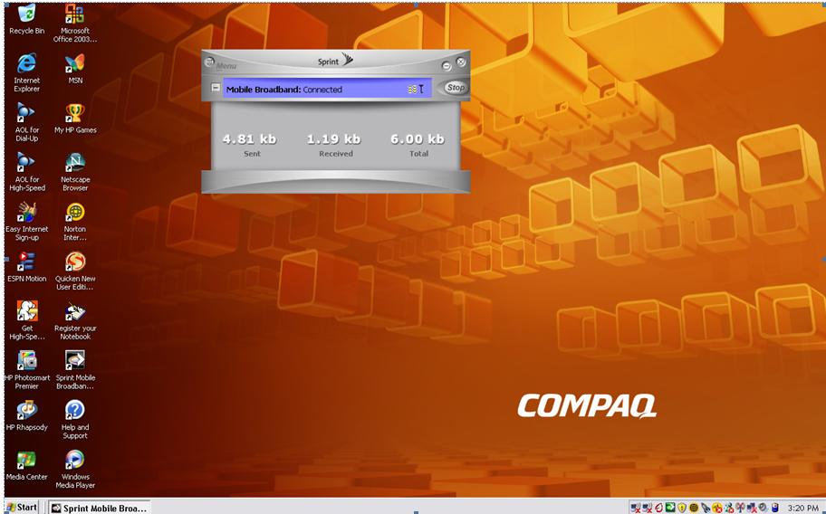
Sprint EV-DO/DV

Slide 122
Sprint EV-DO/DV

Slide 123
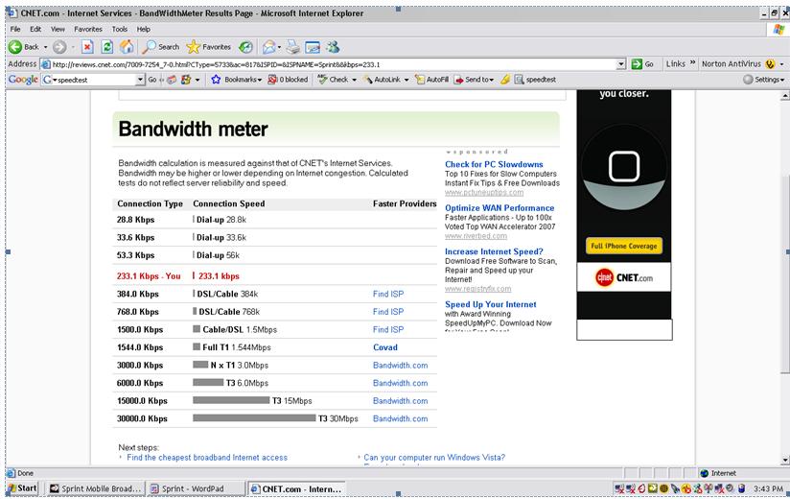
Sprint EV-DO/DV

Slide 124
4G
Despite the lack of widespread 3G deployments there is already discussion of 4G systems
As Network World says about 4G
Several technologies available today may play a roll in 4G as it develops
Here are five of them

Slide 125
4G
Orthogonal Frequency Division Multiplexing (OFDM) and OFD Multiple Access (OFDMA)
OFDM transmits data by splitting radio signals that are broadcast simultaneously over different frequencies
OFDMA, used in mobile WiMax, also provides signals that are immune to interference and can support high data rates
It is said to use power more efficiently than 3G systems while using smaller amplifiers and antennas
This all translates to expected lower equipment costs for wireless carriers

Slide 126
4G
Mobile WiMAX is an IEEE specification also known as 802.16e and designed to support as high as 12Mbps data-transmission speeds
It uses OFDMA and is the next-generation technology of choice for Sprint Nextel and Clearwire Communications

Slide 127
4G
Ultra Mobile Broadband (UMB), also known as CDMA2000 EV-DO, is an expected path to 4G for legacy CDMA network providers
It’s an IP-based technology that is said to support 100Mbps through 1Gbps data-transmission speeds
Also key for business users, it is supposed to be able to support QoS

Slide 128
4G
Multiple-input multiple-output (MIMO) wireless LAN technology supports two or more radio signals in a single radio channel, increasing bandwidth
MIMO does this by using multiplexing
MIMO was developed by Airgo, which has been acquired by Qualcomm
MIMO is expected to support data rates as high as 315Mbps in 36MHz of spectrum

Slide 129
4G
Long Term Evolution (LTE) is a modulation technique designed for GSM/UMTS-based technology that uses OFDM and MIMO
It’s being developed by the Third Generation Partnership Project (3GPP) and is said to support 45M to 144Mbps in test networks today

Slide 130
4G
Most observers do not expect 4G to appear until 2012 to 2015

Slide 131
Cellular Frequencies
Here is a nice summary of the frequencies used by various wireless MAN systems from a presentation by Commscope as used in a BICSI webinar in April 2011

Slide 132
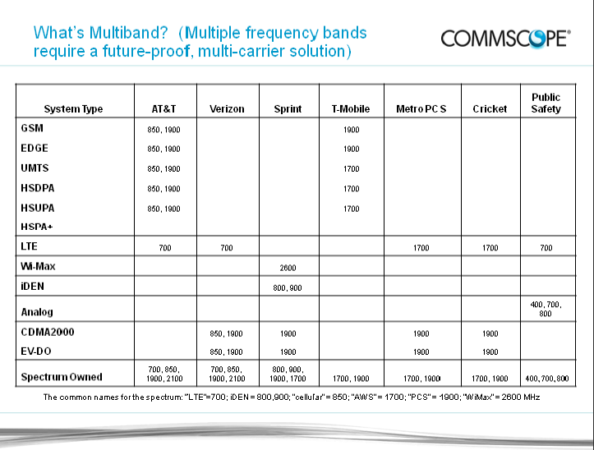
Cellular Frequencies

Slide 133
What is SCADA
A SCADA system is used to receive reports from and control industrial sites that normally do not have anyone on site
SCADA stands for Supervisory Control and Data Acquisition
These systems send data to a remote site where an operator sees the data displayed typically on a representation of the site

Slide 134
What is SCADA
The acronym is pronounced as SCA DA similar to Skate without the t, then the duh
So skAAA - duh

Slide 135
SCADA Operation
For example, a site made up of pumps and pipelines might have a board on the wall that showed each pump and pipeline or a display on a computer monitor
The flow through and settings of these devices would be displayed based on the information received over the SCADA system

Slide 136
SCADA Operation
At the site the local control of the devices is through RTUs – Remote Terminal Units or PLCs – Programmable Logic Controllers
The RTU is used to convert the data from the sensors to be sent to the supervisory system for display

Slide 137
SCADA Operation
The PLC is used to control the devices at the site such as valves, pumps, and sensors
There is no security on these systems, which is a major problem considering the types of systems they control
Let’s look at an example of a typical use

Slide 138
SCADA Site

Slide 139
SCADA Site

Slide 140
SCADA Site

Slide 141
SCADA Site

Slide 142
SCADA Site

Slide 143
SCADA Frequencies
A large number of licensed and unlicensed frequencies are used for SCADA including

Slide 144
SCADA Frequencies
Licensed from 1 to 35 watts
150-175MHz
220-225MHz
400-420MHz
435-470MHz
757-788MHz
928-960MHz
1427-1432MHz
3400-3500MHz

Slide 145
SCADA Frequencies
Unlicensed at 1 watt
902-928MHz
2400-2483.5MHz
3Ghz
5GHz

Slide 146
Method of Connection
The interface to the equipment is usually serial
Some use Ethernet

Slide 147
SCADA Use
Another example is the SCADA system used by the City of Burleson Texas
They monitor the water levels in nine water tanks around the city
They also control five pumps in the water distribution system
All of the information is displayed and controlled on a single computer monitor

Slide 148
SCADA Use
Burleson uses a licensed frequency
They would not say what frequency, but I suspect something in the 400 MHz range
There is no explicit security on the signals which is common with SCADA

