Slide 1
Installing Equipment for Outside Wireless Networks
Last Update 2014.07.29
1.4.0

Slide 2
Objectives
Learn how to install wireless equipment outside

Slide 3
Introduction
This is a continuation of the presentation on towers used to install outside wireless networks

Slide 4
Tower to Equipment Building
Some, especially PolyPhaser, express a concern about the height of the cables that connect the tower to the equipment building
In many cases this is 3 to 5 meters high

Slide 5
Tower to Equipment Building
It is believed that having the coax cable leave the tower to go to the equipment building at any height above ground level sends a significant amount of energy through the cable’s shield to the equipment
If the entry is made higher up, then all of the grounding connections inside the building should be there as well

Slide 6
Tower to Equipment Building
This also means the equipment racks must be isolated from the floor
Regardless of the height of these cables a drip loop must be in the cables before they enter the building

Slide 7
The Equipment Building
The location of the building where the inside equipment is placed is important to mitigate the effect of the magnetic field created by a lightning strike on the tower
In general the recommended distance for the equipment building is at least 10 meters or thirty feet from the tower

Slide 8
The Equipment Building
If this is not possible, then some will use a Faraday cage around the inside of the building, but this is a very high cost method of protection
As a Faraday case is basically a thick-walled, highly conductive metal box with no holes, slots or apertures of any kind

Slide 9
The Equipment Building
This not being very practical, a metal mesh is sometime used instead
The 10 meter distance will also keep the energy from the lightning from saturating the building

Slide 10
Inside the Equipment Building
Once inside the building all of the equipment there must connected to a common interior ground, then this interior system is connected to the outside grounding system, which is a single point ground were all ground fields are bonded to each other

Slide 11
Inside the Equipment Building
The connection should be made with a low impedance copper strap similar to the connection from the bulkhead to the ground
Any bends in this common cable must be very gradual

Slide 12
Inside the Equipment Building
All metal devices inside the building must be connected to this ground such as the metal door and frame, equipment cabinets, air conditioner, and desk
If the flooring of the building is conductive, then the equipment must be isolated from the floor

Slide 13
LAN Connections
Inside the building additional protection can be provided to the equipment that attaches to the outside and the inside networks
Devices such as the following from Tripp-Lite can be inserted in any UTP line

Slide 14
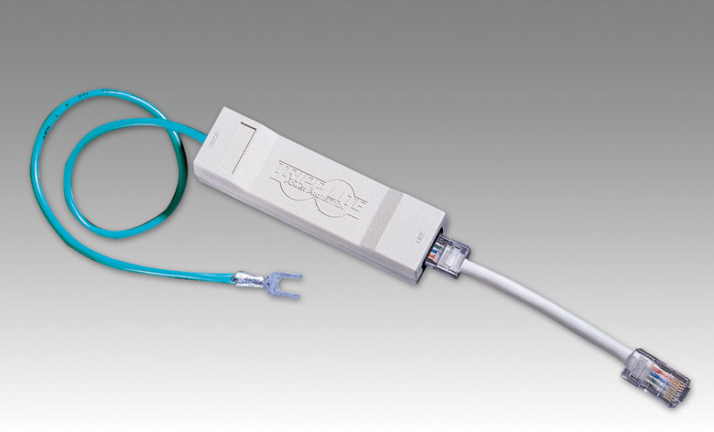
Tripp-Lite DNET1

Slide 15
Telephone Lines Protection
The protection for the telephone lines at the site is provided by the telephone company
Additional protection can be accomplished by using a surge protector device between the telephone company’s demarc and the customer end equipment
For example, this unit from PolyPhaser will provide some additional protection

Slide 16
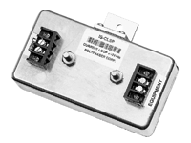
PolyPhaser IS-CLSP Protector

Slide 17
Electrical Supply Protection
The protection for the main AC electrical power connection from the utility company is beyond the scope of this work
The utility company that provides the service and the licensed electrician should handle this aspect
Be certain this ground is bonded to the rest of the ground field

Slide 18
Electrical Supply Protection
Additional protection for the AC power can be provided by devices such as the following from PolyPhaser

Slide 19
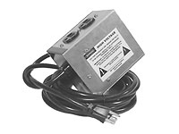
Electrical Supply Protection

Slide 20
Everything Else on the Site
Any additional metal structures
Such as
Fence
Fence gates
Tower guy wires
Must be connected back to the same common ground point

Slide 21
Sometimes Nothing Helps
Then again, some times no matter what you do it doesn’t help
Read this message that appeared on a wireless related mailing list
My 120 foot tower sits on one of the highest hills in the area and lightning struck, and lightning struck, and lightning struck
The neighbors living next to the tower for 20 years said they had never seen anything like it

Slide 22
Sometimes Nothing Helps
Some thought it was eight direct hits, others said at least five
I appear to have lost all five Breeze DS-11 and four Raylink AP's as well as the A/C unit and all computers inside the building
Even the APC Battery Backups are blown
I can see burn marks on my APC CAT5 protectors and the RJ45 ports on the Cisco Routers and Cisco Catalyst switches

Slide 23
Sometimes Nothing Helps
ps
The tower had halo grounding
Nothing will protect a site and the equipment there from a direct strike

Slide 24
Small Site Lightning Protection
At a smaller site, the antenna is typically mounted directly to the structure or on a short pole
Then a cable attaches the antenna to a box which may be mounted inside or outside

Slide 25
Small Site Lightning Protection
At these sites the pole, the antenna, the cables, and any outside equipment needs to be protected
There are two basic ways to do this
One is to replicate, but on a smaller scale, the methods used for a tower as discussed above

Slide 26
Small Site Lightning Protection
In this case an air terminal is mounted to the top to providing the zone of coverage for the equipment
This type of arrangement is called for when an ODU is mounted to the pole rather than being mounted inside the building

Slide 27
Small Site Lightning Protection
The pole is protected by being attached to the single point ground at the site
This single point ground at a small site is typically the electrical service entrance panel location

Slide 28
Small Site Lightning Protection

Slide 29
Small Site Lightning Protection
In the case where the only equipment mounted outside is an antenna, the antenna protection is afforded by its attachment to the pole, which is itself grounded
In this case there is no need for the air terminal device
Although the antenna will still be subject to damage from a direct lightning hit

Slide 30
Small Site Lightning Protection

Slide 31
Transmission Cable Protection
At the small site the cable connecting the antenna to the box may be a coax cable or an outdoor Ethernet cable
The protection for this cable in either case is provided where the cable enters the structure

Slide 32
Transmission Cable Protection
Many will not install this type of device, but it is called for by the National Electrical Code in Article 810 which covers proper installation and grounding of radio and television receiving equipment
Devices used for this purpose include

Slide 33
Coax Lightning Arrestor
Coax Connector
Coax Connector
Ground Wire Connection

Slide 34
Ethernet Lightning Arrestor
Ground Wire Connection
Outdoor Ethernet Cable - In
Outdoor Ethernet Cable - In

Slide 35
Transmission Cable Protection
The connection to ground should be as close to the point of cable entry into the building as is practical
The connection should also be to the same ground used for the rest of the building
As discussed above, avoid ground loops

Slide 36
Weather Protection Devices
Some devices are made to exist outside
Other devices will need additional protection for the environment
This additional protection is typically in the form of a NEMA – National Electrical Manufacturers Association enclosure
There are many types of NEMA boxes for indoor or outdoor use

Slide 37
Weather Protection Devices
Each one is rated by how much of the environment they keep out or filter out
The NEMA Type 4 or 4x is a common type for outdoor use

Slide 38
Weather Protection Devices
It is described by NEMA as
“Enclosures constructed for either indoor or outdoor use to provide a degree of protection to personnel against incidental contact with the enclosed equipment; to provide a degree of protection against falling dirt, rain, sleet, and snow; and that will be undamaged by the external formation of ice on the enclosure”

Slide 39
Typical NEMA Enclosure
This box is
18” X 16” X 8”
On the outside

Slide 40
Typical NEMA Enclosure
This box is
16” X 14” X 5”
On the inside

Slide 41
NEMA Enclosures
These boxes can have heaters, fans, air filters and so on
The boxes are mounted on towers, poles, or the side of a building
NEMA4X boxes are also common

Slide 42
NEMA Enclosures
These boxes provide some protection against contact with the enclosed equipment, falling dirt, rain, sleet, snow and windblown dust, splashing water hose-directed water and corrosion
They are also undamaged by external formation of ice on enclosure

Slide 43
Hooking Things Together
Once all these devices are mounted on something or the other, the bits and pieces must be hooked together
There are many ways to send signals around from place to place
Of course in a wireless system we are mostly interested in the methods that do not use wires

Slide 44
Hooking Things Together
Before we get to that point or after these waves are recaptured, they must travel on physical things
In an RF system these physical things are
Cables
Connectors
Waveguides

Slide 45
Cables
In an RF system the cables are coaxial cables
As in

Slide 46
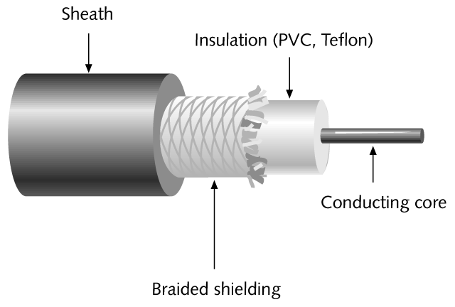
Coax Cable

Slide 47
Coax Cable

Slide 48
Coax Cable

Slide 49
Coax Cable
The inner conductor carries the RF signal
The outer shield or conductor keeps it from leaking out
All cables attempt to get the signal from one place to another with the minimum amount of insertion loss

Slide 50
Coax Cable
In general as the cable gets larger, heavier, and more expensive the lower is the loss; but the harder the cable is to handle
As cables introduce loss, use the shortest length possible
This may call for the placement of devices based on the resulting cable length required

Slide 51
Cables
Use premade cables whenever possible
Machines are better than you in this case
Use cable that matches the frequency of the signal

Slide 52
RG
These coax cables are designated by RG – Radio Grade numbers
RG-58 is commonly used in RF systems

Slide 53
LMR Cable
LMR is a special type, read more expensive, coaxial cable for wireless equipment
As the manufacturer says
“TimesLMR cables are high performance, flexible, low loss, 50 ohm coaxial communication cables designed for use in wireless systems…

Slide 54
LMR Cable
“LMR cables are actually a complete system of cables, connectors, installation tools, and accessories”
Although more costly, they are worthwhile as the cable is a common source of problems

Slide 55
LMR Cable

Slide 56
Heliax Cable
Some users believe for long runs from an antenna at the top of a tower to the radio at the bottom even LMR cable is not sufficient
They recommend the use of Heliax by Andrews Corporation

Slide 57
Heliax Cable

Slide 58
Amplifiers
The use or some would say misuse of external amplifiers that are added to a basic wireless system is a constant source of argument in this industry
In general those that design and manufacture these systems believe they function best as designed
That is with only the amplifiers that are built into the system being used

Slide 59
Amplifiers
Others, especially those that grew up as Ham radio operators, believe that external third party amplifiers have a place
There is no solution to this argument so let me just present both sides for consideration

Slide 60
Amplifiers
Reasons to not use an amplifier
Systems are designed and tuned as a single system that includes all components from design through deployment
Buying and installing an external amplifier is like dropping a huge, high performance engine in the family sedan
The entire car is not designed to support that engine, even if room can be made for it in the engine compartment
Increased cost for the amplifier

Slide 61
Amplifiers
Increased receiver side noise
Another point of failure
Reasons to use an amplifier
Overcome cable loss from radio to antenna
Gain the maximum transmit power at the antenna
Increase sensitivity for devices with weak receive sensitivity

Slide 62
Amplifiers
The main reasons advanced for the use of the external amplifier are to overcome cable loss from a radio mounted at the bottom of a tower to the antenna at the top of a tower

Slide 63
Amplifiers
On the other hand this loss can also be overcome by using low loss, read more expensive, cable between these two locations or by using an outdoor rated radio that is also mounted at the top of the tower
This top of the tower mounted radio can then be connected with lower cost, easier to handle outdoor UTP cable

Slide 64
Amplifiers
Then again if the radio mounted up on the top of the tower fails, someone has to climb up there to replace it
Another reason advanced for the use of amplifiers, even when cable lengths are short, is to allow the use of lower gain antennas while still being able to cover a wide area

Slide 65
Amplifiers
The feeling is that a lower gain antenna has a fatter beamwidth when viewed from the side
As gain goes up, this pattern flattens out, just like when the air is let out of a tire inner tube

Slide 66
Amplifiers
By using an amplifier the lower gain and taller beamwidth antenna can be used, but by increasing receive sensitivity by using an amplifier the area of coverage can be maintained

Slide 67
Connectors
There are a number of connector types used in RF systems
To begin this discussion two points need to be made concerning them
First, at least in the United States the FCC – Federal Communications Commission Part 15 rules call for all wireless parts manufacturers to use proprietary connectors on their equipment

Slide 68
Connectors
This is to make it difficult for users to create non standard combinations of parts
Recall that all systems must be certified by the FCC to work with each other
Second, do not convert from one type to another if at all possible as such a conversion increases insertion loss

Slide 69
Connectors in General
Beyond these considerations there are several factors that will determine the choice of connector series and style
Cable type and frequency range are the primary factors
It is good practice to try and match the connector size and cable diameter as closely as possible in order to minimize reflections

Slide 70
Connectors in General
The larger the difference between cable diameter and connector diameter, the worse the performance will be
Reflections will generally increase as a function of frequency, and smaller connectors will generally perform well at higher frequencies

Slide 71
Connectors in General
Frequency will determine the connector series used
In general, it is best to use push-on or bayonet style connectors at low frequencies, typically below 6 GHz
Threaded connectors should be used for high performance, low noise applications

Slide 72
Connectors in General
The cable that is specified will generally determine the impedance of the connector used
50 and 75 ohms are the standard impedances used for these types of systems

Slide 73
Connectors in General
Aside from trying to match the cable and connector as closely as possible in size to minimize reflections, connector interface and dielectric materials are also important considerations

Slide 74
Connectors in General
Line to line and air interfaces such as the SMA and Type N give good high frequency, low reflection performance
Overlapping dielectric type connections, such as the BNC and the SMB, are usually more limited in relation to performance and frequency over which they are useful
The measure of a connector’s performance is its Reflection Coefficient

Slide 75
Connectors in General
This is a measure of how much signal is reflected back from the connector down the wire
It can be expressed in terms of Reflection Coefficient, VSWR, and Return Loss

Slide 76
Connectors in General
Due to Federal Communications Commission Part 15 regulations that require non-standard interfaces on spread spectrum wireless devices, connections are made with common connector types such as BNC and TNC, but with reverse polarity or reverse threaded interfaces

Slide 77
Connectors in General
Power or voltage requirements are also a factor determining the connector to be used in a particular application

Slide 78
Types of Connectors
Common connector types include
N
SMA
BNC
TNC

Slide 79
N Connector
The N connector, at least according to Amphenol, is named for Paul Neill of Bell Labs
It was developed in the 1940's
This connector was the first for microwave signals

Slide 80
N Connector
The Type N connector was developed to meet the need for a durable, weatherproof, medium-size RF connector for use up to 20 GHz
There are two families of Type N connectors
Standard N for coaxial cable
Corrugated N for helical and annular cable

Slide 81
N Connector
N connectors are used for medium to miniature coaxial cable, such as RG-8, RG-58, RG-141, and RG-225
N connectors are designed to be tightened by hand
Over-tightening the connector can cause the signal quality to be reduced

Slide 82
N Connector

Slide 83
N Connector

Slide 84
SMA Connector
SMA stands for SubMiniature version A
It was developed in the 1960's
The SMA uses a threaded connection
50 ohm SMA connectors provide excellent electrical performance from DC up to 40 GHz
These connectors are compact in size and have good durability

Slide 85
SMA Connector

Slide 86
SMA Connector

Slide 87
BNC Connector
BNC connectors were developed in the late 1940’s as a smaller version of the Type C connector
According to Amphenol BNC stands for Bayonet Neill Concelman and is named after Amphenol engineer Carl Concelman
The BNC product line is a miniature quick connect/disconnect RF connector

Slide 88
BNC Connector
It features two bayonet lugs on one side of the connector and slots on the other side
Mating is achieved by sliding the lugs into the slots on the other side of the connector
Then it is locked with only a quarter turn

Slide 89
BNC Connector
BNC’s are commonly used for small coax cables, such as RG-58, 59, and RG-179
BNC connectors are designed to operate up to 1 GHz

Slide 90
BNC Connector

Slide 91
TNC Connector
Developed in the late 1950's, TNC stands for Threaded Neill Concelman and is named after Carl Concelman, according to Amphenol
The TNC is a threaded version of the BNC
It uses screw threads for mating
TNC are small and weatherproof with a constant 75 ohm impedance that operate from 0 - 12 GHz

Slide 92
TNC Connector

Slide 93
TNC Connector

Slide 94
Waveguide
Waveguides are used for special applications, such as high power transmission
These are rectangular pipes that guide waves
These pipes carry the RF signal itself, not an electrical current as a cable does
Waveguides produce almost no insertion loss

Slide 95
Waveguide

Slide 96
Sealing Connections
Moisture is very, very bad for connections carrying RF signals
You must keep moisture out of the connections
If water gets in, forget getting it out, just replace the part
To keep it out in the first place seal connections using one of the methods discussed below

Slide 97
Sealing Connections
Recheck these connections on a regular basis
No one can agree on the best way to keep moisture out
Everyone does agree that it must be done
Listed next are some of the methods that have been suggested

Slide 98
Sealing Connections
No one method is any better than any other
Try them and use the one that works for you
The first suggestion is to spray the inside of the connector with non-dielectric Bull Frog protectant
Use 3M Scotch 33+ tape on the bottom
Then 3M Scotch 2210 vinyl mastic tape

Slide 99
Sealing Connections
Another layer of 3M Scotch 33+ tape
Finally a liberal - about 3mm - coat of Scotch Coat liquid, not spray
Others say forget the sprays and liquids, as they just make a mess
Do this instead

Slide 100
Sealing Connections
3M Scotch 33+ electrical tape
3M Scotch 2210 vinyl mastic tape
3M Scotch 33+ electrical tape
The first layer of electrical tape adds a protective layer between the connector and the mastic, which is sticky

Slide 101
Sealing Connections
The next layer of the vinyl tape covers the mastic and keeps the gooey stuff from sticking to something it should not, as well as keeping out the water
Time Microwave, who makes LMR cable, calls for not one wrap over the mastic, but three

Slide 102
Sealing Connections
The first is wrapped from bottom to top, then from top to bottom, and finally a last one from bottom to top
When wrapping any of the mastic or tape, start at the bottom and wrap upward
This creates a shingling effect to help keep water out
Also be sure the tape lays down nice and flat with no bubbles or bulges

Slide 103
Sealing Connections
The mastic discussed above is basically a thick sticky tape, much like the Coax-Seal
It is sticky on one side
The stick is covered with a peel off cover
This substance is about 1/8” thick
The electrical tape is any high quality tape, with 3M Scotch 33+ being a commonly mentioned brand

Slide 104
Sealing Connections
To remove these layers, all you need do is score a line with a utility knife and peel the buytl and outer electrical tape layer off of the inner electrical taper layer

Slide 105
Coax-Seal
Another idea is Coax-Seal
This solution is recommended by Cisco
It is wrapped around a connection such as this one

Slide 106
Coax-Seal

Slide 107
Coax-Seal
Coax-Seal is a putty like material in tape form
The white waxed paper keeps it from sticking to its self

Slide 108
Coax-Seal

Slide 109
Coax-Seal
Note that the first wrap comes back on itself exactly and the second turn starts the diagonal wrap
Wrap from the coax cover toward the fitting with one half overlap with each winding

Slide 110
Coax-Seal

Slide 111
Coax-Seal
The last wrap again comes straight back over the previous wrap without a diagonal
The seal is slightly sticky and should be molded by hand to remove any gaps and to ensure that all the wraps are blended together
Overtime the wraps will almost fuse together

Slide 112
Coax-Seal

Slide 113
Cold Shrink Tubing
Another method that can be used is cold shrink tubing
After cold shrink tubing is placed around the joint, a string is pulled and the tubing shrinks around the connection

Slide 114
Cold Shrink Tubing

Slide 115
Heat Shrink Tubing
With heat shrink tubing the tube is placed around the joint
After it is heated, the tubing shrinks and forms around the joint

Slide 116
Heat Shrink Tubing

Slide 117
Sealing Precautions
Regardless of the sealing method used be sure to leave any drain or vent holes uncovered
For example, many omnidirectional antennas have drain holes in the bottom near the connector
If the hole is covered, water will collect inside the antenna

Slide 118
Sealing Precautions
This will cause corrosion and reduced performance

Slide 119
Drip Loop
Besides sealing the connectors drip loops should be used before all connecting points where the cable connects to a box or wall
This is to keep the water running down away from the connection point
Such as

Slide 120
Drip Loop

Slide 121
Delivering Power
Active devices require an electrical power supply
If these devices are mounted outside there are three ways to deliver this power
Exterior electrical outlet
Over the coax conductor
PoE

Slide 122
Exterior Electrical Outlet
Unless the equipment is mounted on a rooftop or some similar location, the voltage drop that would occur is generally too much to allow a standard electrical circuit to be used to deliver power to an outdoor device
Further, the devices do not require this type of power
They use low voltage DC

Slide 123
Exterior Electrical Outlet
Even with a nearby outdoor connection, standard power will have to be converted anyway
In most installations then, one of the next two methods is used instead

Slide 124
Power Over Coax
A common way to deliver electrical power to an outside unit is to send it along with the signal over the same coax cable
This requires that any lightning arrestor installed on the line be a gas capsule type, as the quarter wave stub type of arrestor will not pass this current

Slide 125
Power Over Coax
The advantage to this method is that it requires no other change to the normal installation practices

Slide 126
Power Over Ethernet
The third way to deliver electrical power is to use PoE – Power Over Ethernet
This method sends DC power over some of the unused wires in a UTP Ethernet cable
There are several ways to setup PoE as there is no standard for this yet, but keep an eye on the IEEE’s 802.3af

Slide 127
Power Over Ethernet
As there is no standard be careful as one manufacturer may use one wire, whereas another uses another wire
The current ways to provide PoE include
Single port injector
Multi port injector
Switch with PoE built-in

Slide 128
Power Over Ethernet
A single port injector supplies power to a single device
A multiport injector supplies power to as many devices as the injector has ports, usually from 4 to 12 ports
A switch with PoE built-in is the best choice
Of course the device must be able to accept power over Ethernet

Slide 129
Power Over Ethernet
Many newer devices can
For those that cannot, a splitter is used to break the power out of the Ethernet cable and deliver it to the standard power port of the device

Slide 130
Outdoor Ethernet Cable
When providing PoE to devices installed outside or just sending an Ethernet signal outside, such as up on a tower or a rooftop, special cable must be used
At present this is Category 5 cable, but in this case it is shielded cable

Slide 131
Outdoor Ethernet Cable
This cabled is shielded in several ways including
UV shielding from the sun
Physical shielding from water
Electrical shielding from radio frequency interference and lightning

Slide 132
Outdoor Ethernet Cable

Slide 133
Outdoor Ethernet Cable
UV protection comes from the type of material used in the outer jacket
This is pretty standard in outdoor cables
Radio frequency interference and lightning protection are afforded, to some extent, by the metal shield on the inside of the jacket
This shield should be grounded were it enters the structure
There are several ways to do this

Slide 134
Outdoor Ethernet Cable
We will look at one method here that uses a 3M Scotchlok 4460-D connector is used
The instructions shown are straight from the manual for this device

Slide 135
Grounding Ethernet Cable

Slide 136
Grounding Ethernet Cable

Slide 137
Grounding Ethernet Cable

Slide 138
Grounding Ethernet Cable

Slide 139
Grounding Ethernet Cable
In this application this type of cable is grounded only at the end where the cable enters the structure

Slide 140
Outdoor Ethernet Cable
The outermost jacket provides some protection from water penetration due to its thicker outer jacket
For more protection, cable similar to loose tube fiber optic cable can be used
Here the water protection is afforded by a gel that is between the outside jacket and the inner twisted pair

Slide 141
Outdoor Ethernet Cable
As this type of cable has a jacket that is quite a bit larger than the standard indoor Cat5 cable, special RJ-45 style connectors are required for it
These connectors can also be used to terminate the metal shield and attach it to ground
For example

Slide 142
Outdoor Shielded Connector
Larger opening for the larger outdoor cable and metal covering to use to terminate the shielding

Slide 143
Outdoor Shielded Connector

Slide 144
Outdoor Ethernet Cable
The connection, whether grounded by using a shield grounding kit or relying on the connection to the RJ-45 connector, should attach to a ground block at the building entrance
For example

Slide 145
Outdoor Ethernet Cable
Ground Wire Connection
Outdoor Ethernet Cable - In
Outdoor Ethernet Cable - In

Slide 146
Outdoor Ethernet Cable
A better, although more expensive, solution is to use fiber optic cable outside
Fiber optic cable avoids most of these problems
Unfortunately except for FSO – Free Space Optics equipment, outdoor devices used in wireless data networks do not use fiber optic connections yet

Slide 147
Delivering Power to the Site
Regardless of how power ultimately reaches the equipment, it must first be delivered to the site
This can be by
Standard AC power
Solar Power

Slide 148
Standard AC Power
The main considerations when extending a standard source of electrical power to a site are safe installation and voltage drop
The longer the distance from the breaker box to the site, the lower the voltage level on arrival
The NEC - National Electrical Code does not have any requirement for this, but it does include recommended values

Slide 149
Standard AC Power
NEC 210-19 and 215-2 recommend 5% maximum drop for feeder circuits and 3% maximum drop for branch circuits
A formula for this is

Slide 150
Standard AC Power
Voltage Drop = (Factor X Amps X Feet)/100
This formula is used along with a table from the NEC that shows the value to use for the factor above based on the size of the wire
Here are the values for common copper wire sizes

Slide 151
Standard AC Power
AWG Wire Size | Factor
14 | .4762
12 | .3125
10 | .1961
8 | .1250
6 | .0833
4 | .0538

Slide 152
Standard AC Power
Let’s compute a sample to illustrate this
One site I looked at has the equipment cabinet 396 feet from the breaker box
If the maximum drop is 5%, what size wire is needed for the equipment in the equipment cabinet

Slide 153
Standard AC Power
The equipment cabinet contains the following
Access Point
Router
PC
Hub
Refrigerator
A PoE adaptor provides power to the access point on top of a tower

Slide 154
Standard AC Power
The refrigerator in a small building on the site is used to keep the router, PC, and hub cool
This site is used as an example due to the high electrical load requirements, mostly due to the PC, router, and refrigerator

Slide 155
Standard AC Power
Consult the specifications for each device to find out how many amps each draws
Access Point – 0.35 amps
PC – 6 amps
Router – 1.5 amps
Hub – 0.0625 amps
Refrigerator – 0.9 amps
The total is 8.8125 or rounded up, 9 amps

Slide 156
Standard AC Power
Plug these values into the formula
Adjust the size of the wire to produce no more than 5% voltage drop
In this example that is AWG 8 size wire
This calculation assumes copper wire and a single phase circuit
AWG 8 is large wire

Slide 157
Standard AC Power
Each wire is .128 inches or 3.26 mm in diameter
There will be two or three conductors, the bare ground wire, plus the covering around all of them

Slide 158
Solar Power
To avoid all of these issues a solar power source can be used instead
Using solar power the source of the power and the equipment to be powered are all at a single location
Voltage drop is not an issue
Neither are ditches from the site to the electrical power source and conduit to go in the ditch

Slide 159
Solar Power
For this application a DC-AC solar power system is required, unless the equipment can accept DC
A typical solar panel system consists of
Solar Panel – Charge Controller - Battery Bank - Inverter
In this system the photovoltaic cells in the solar panel charge a set of batteries during the daylight hours

Slide 160
Solar Power
The charge controller protects both the batteries and the solar panels from damage due to excessive power being applied to either one
The batteries supply power to the system through the inverter
The inverter converts the DC power produced by the panels into the AC required by the network equipment

Slide 161
Solar Power
Fuses or other protection devices prevent problems from affecting all the equipment
Let’s look at the details of the main parts of the system

Slide 162
Solar Power Panels
A solar panel consists of silicon elements that when exposed to sunlight produce electricity
This is the photovoltaic principle
The electricity produced by these panels is DC
DC power flows in one directional only
It can be stored in a battery

Slide 163
Solar Power Panels
Panels used for this type of application are typically 30 inches by 15 inches or so
Each one weighs around 10 pounds

Slide 164
Solar Power Batteries
All solar power systems require batteries
The batteries are used to store all of the energy to be provided by the system to the equipment that requires electrical power to operate
The batteries used must be able to tolerate repeated discharging from 50 to 80 percent of their capacity

Slide 165
Solar Power Batteries
For higher voltages the batteries are wired in series, for more amps of current the batteries are wired in parallel
The batteries used will depend on the storage capacity required, the discharge rate, the charge rate, and the temperature at which the batteries will operate

Slide 166
Solar Power Batteries
The storage capacity of a battery is expressed as amp-hours
These amp-hours are used up as electricity is supplied to the load, the wireless equipment in this case

Slide 167
Solar Power Batteries
The number of amp-hours available should be sufficient to supply the required power for a period of time equal to the longest stretch of bad weather that can be expected, without discharging the batteries more than 80 percent
This combination of amp-hours and time produces the last key battery parameter the discharge rate

Slide 168
Solar Power Batteries
This is the number of hours the battery can deliver its full capacity
A battery with a 100 amp-hour rating and a 25 hour discharge rate can deliver 4 hours of power before complete discharge
This rating is stated at a certain temperature
If the temperature of the battery is lower, then the capacity is lower

Slide 169
Solar Power Batteries
The table shown next contains the factors to use
High temperatures are also hard on batteries
Anything above 110 degrees F will shorten battery life

Slide 170
Solar Power Batteries
Temperature in F | Factor
80 | 1.00
70 | 1.04
60 | 1.11
50 | 1.19
40 | 1.30
30 | 1.40
20 | 1.59

Slide 171
Solar Power Batteries
There are several types of batteries used in solar power systems
The most common are
Flooded Lead-Antimony Acid
Gelled Electrolyte Sealed Lead Acid
AGM - Absorbed Glass Mat Sealed Lead Acid

Slide 172
Solar Power Batteries
Flooded lead acid batteries have been used for a long time, but the need to add water to them make them unsuitable for this application
Gelled electrolyte batteries have been the choice for these types of solar power systems as they are maintenance free

Slide 173
Solar Power Batteries
But gelled batteries do not handle rapid charging as well as the last type AGM
Rapid charging must be done as the number of hours of peak sun are limited
AGM batteries are also maintenance free
These batteries can be charged at a rapid rate

Slide 174
Solar Power Batteries
They do not produce fumes, so corrosion is not a problem
As their cost comes down these are the batteries coming into common use
Batteries used in these system vary in size and weight

Slide 175
Solar Power Batteries
A typical size is 13 by 7 by 10 inches or larger
Weight varies from 50 to 70 pounds each and higher
Multiple batteries are commonly required

Slide 176
Solar Power Charge Controller
The charge controller is connected to both the solar panels and the batteries
It serves to protect the solar panels from flow out of the batteries back to the panels when the panels are not producing electricity, such as at night
It also prevents overcharging of the batteries

Slide 177
Solar Power Charge Controller
Most of these incorporate one or more disconnects to isolate parts of the system from one another
These units are only a few inches long and wide
Each one weighs a few pounds
A specific unit is selected based on the number of amps the solar power system will produce

Slide 178
Solar Power Charge Controller
For example, if each solar panel produces 6.4 amps and two panels are required for the 12 volt system, then 12.8 amps are produced
Adjust this number up for the a safety margin of 25 percent
Then 12.8 times 1.25 is 16 amps
A controller with at least this rating is required

Slide 179
Solar Power Charge Controller
Using one with a higher rating is acceptable
It only costs more

Slide 180
Solar Power Inverter
The last major part is the inverter
Depending on the equipment to be powered an inverter may or may not be needed
Many devices used in a wireless system come with a electrical power connection for standard 120 VAC
The inverter turns the DC into AC

Slide 181
Solar Power Inverter
The inverter must be able to deliver more watts than the maximum load placed on the system
This power must have a appropriately shaped sine wave
The equipment used for wireless radio frequency systems will function fine with the lower priced inverters that produce a modified sine wave

Slide 182
Solar Power Inverter
The inverter is usually the size of a shoe box
It weighs only a few pounds
These systems really use lower voltage DC
If possible power the devices directly from the batteries using DC, with the appropriate disconnects between the batteries and the load

Slide 183
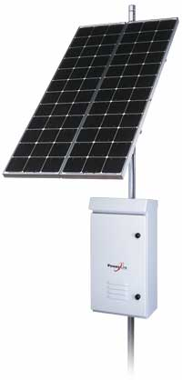
Typical Solar Power System
Solar Panel
Box Containing the Rest of the Components

Slide 184
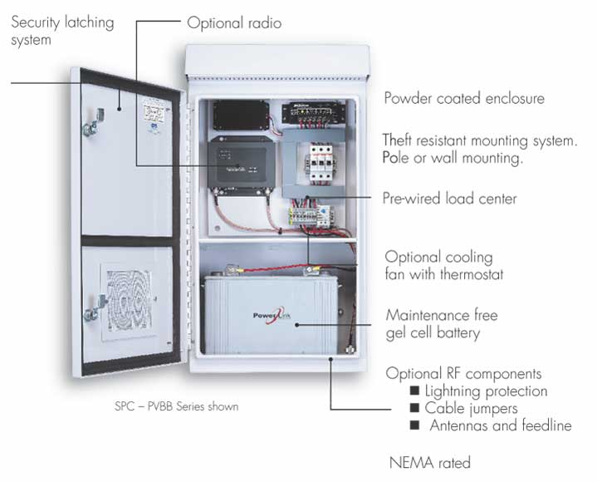
Typical Solar Power System

Slide 185
Solar Equipment Selection
There are four steps required to determine the exact equipment needed for a solar power installation
This discussion will be limited to 12 volt systems
Telecommunications sites are unlikely to require either so much power or so much distance between the components that a higher voltage system would be required

Slide 186
Solar Equipment Selection
First, compute the electrical load in watts that must be powered by the system
List every device that will consume power from this system
Add up the watts of continuous power consumption that will be used by all of the equipment on this list

Slide 187
Solar Equipment Selection
This is on a tag on the device or on the device’s specification sheet
Multiply the watts consumed by 24, since this type of equipment must work all the time
This is the watts per day of power required
Adjust the number to account for the average peak sun value for the location
This value is to account for the changes in the intensity of the Sun’s radiation as the hours of the day and the days in the year go by

Slide 188
Solar Equipment Selection
This will be a lower number than the total hours of sunlight as we are concerned with the average peak sun, not total sun hours
A Solar This is the number of hours per day that the solar panels produce their maximum electrical power of 1000 watts per meter²
Insolation Table yields this number

Slide 189
Solar Equipment Selection
This computation raises the power production requirement for the solar power system as the maximum sun is not always available to the solar panels
Finally, adjust this number to account for the inefficiencies in the system
This yields the number of watts of power that must be produced by the solar panels

Slide 190
Solar Equipment Selection
Second, determine the manufacturer, model, and number of solar panels to use
Compare the number of watts required to the peak power output in watts of the model of solar panel that will be used
If the specifications for the panel do not show the peak power production, multiply the amps the panel produces by the charging voltage, typically 13 volts

Slide 191
Solar Equipment Selection
This tells you the number of solar panels required
Round up to the next highest whole number
Third, determine the manufacturer, model, and number of batteries to use
Using the total watts required as computed above, adjust this number for the number of rainy days in a row that can be expected
Seven to 14 days are commonly used for this application

Slide 192
Solar Equipment Selection
Adjust this number to allow for the draw down or discharging of the batteries that can be tolerated
A maximum of .80 is commonly used, but .50 is better for longer battery life
Adjust this number once more to account for the loss in efficiency of batteries when they are exposed to cold weather
This computation yields the maximum watt-hours that must be provided by the batteries

Slide 193
Solar Equipment Selection
Divide this number by the watt-hour capacity of the battery to be used
This number, rounded up to the next highest number, is the number of batteries required
Fourth, determine the amp capacity required for the charge controller

Slide 194
Solar Equipment Selection
The charge controller must be able to handle the current produced by the solar panels
This is computed by taking the peak power output of the solar panels in relation to the system voltage
You may have noticed that a single value, watts, are used for all of this computation whenever possible
This is to keep things easy to compute and compare

Slide 195
Solar Equipment Selection
Unfortunately the equipment manufacturers do not always provide the required values in watts or watt-hours
Some common conversions that may be needed
To convert amp-hours to watts-hours
Watts-hours = amp-hours x volts
Amp-hours = watt-hours/volts

Slide 196
Example of Solar Equipment
Let’s do an example to illustrate all of this
Compute the load on the system
Let’s say we have a wireless access point mounted on a tower
The access point is the only device that needs power
In this example the access point consumes 13.4 watts

Slide 197
Example of Solar Equipment
With the access point in operation 24 hours a day, 321.6 watt-hours per day are used, which is 13.4 times 24
To adjust for the limited amount of time per day the solar panels are able to produce their peak power output divide 321.6 by the figure for your locality from the solar insolation table
To be safest use the smallest number

Slide 198
Example of Solar Equipment
In my case this is 321.6 divided by 4.8 or 67 watt-hours
One more adjustment is needed
This is to increase the watt-hours that must be produced by the system to account for system inefficiencies
Multiply 67 by 1.3
This number gives us the final value for step one

Slide 199
Example of Solar Equipment
The amount of power the solar panel or panels must produce in this example is 87.1 watts
In step two we need to know how many solar panels to buy
To calculate this divide the amount of power required, 87.1 watts by the peak power output of the selected solar panel in watts
For example, the panel I selected produces 55 watts
87.1 divided by 55 and rounded up is 2

Slide 200
Example of Solar Power Sizing
Go buy two of these panels
For step three, the number of batteries is determined
Take the watt-hours per day from above of 321.6 and multiply it times the number of rainy days in a row that can happen in the area
Keep in mind we always need to be pessimistic
Seven to 14 days are commonly used for industrial applications and four to seven days for consumer installations

Slide 201
Example of Solar Power Sizing
321.6 times 7 is 2251.2 watt-hours
Batteries cannot be totally discharged
The watt-hours required, 2251.2, is divided by the amount of discharge that can be tolerated
This number is either .80 or .50
If .80 is used then fewer batteries are required, but they will have to be replaced sooner
2251.2 divided by .80 is 2814.0
One last adjustment must be made

Slide 202
Example of Solar Power Sizing
This is to adjust for the detrimental effect of low temperatures on batteries
If the worst case figure of 1.59 for 20 degrees F is used, then 2814.0 times 1.59 is 4474.26 watt-hours required
With this number in hand find a battery
Divide 4474.26 by the watt-hour capacity of the selected battery
This is the number of batteries of this type required

Slide 203
Example of Solar Power Sizing
Be sure to round up
In this example divide 4474.26 by 1056
Four batteries are needed for this installation
In the last step the current handling capacity of the charge controller is computed

Slide 204
Example of Solar Power Sizing
Using the peak power rating of the solar panel times the number of panels, multiply this number by the system voltage
For example, four 55 watt panels is 220 watts
220 divided by 12 is 18.33
Adjust his number up by 25 percent to allow for a safety factor
18.33 times 1.25 is 22.92 or rounded up to 23 amps

Slide 205
Solar Power System Installation
When selecting a location for the solar power system the solar panels cannot be shaded at all, at any time of the day
All the cells in the panel are connected in series
In most cases if even one cell on a panel is shaded, the others in the panel will reduce their power output to that of the weakest cell in the panel

Slide 206
Solar Power System Installation
Other than properly locating the panels, common things to account for include
Meet the grounding requirements of NEC Articles 690 and 250
Keep the panels covered during installation, as they produce electricity when exposed to sunlight

Slide 207
Aiming the Solar Panel
The solar panels themselves are aimed toward the sun, which in the northern hemisphere is to the south
This is true south, which is the magnetic compass derived south adjusted for the magnetic correction, so that the panels align with the earth’s rotation axis
The correction value changes over time
Look for the latest information

Slide 208
Aiming the Solar Panel
The correction value can be obtained from a map
Here is a map Kyocera includes in their current catalog
For W values, those to the east of the 0 degree line on the map, subtract the value from the compass heading
For E values, add the value to the compass heading

Slide 209
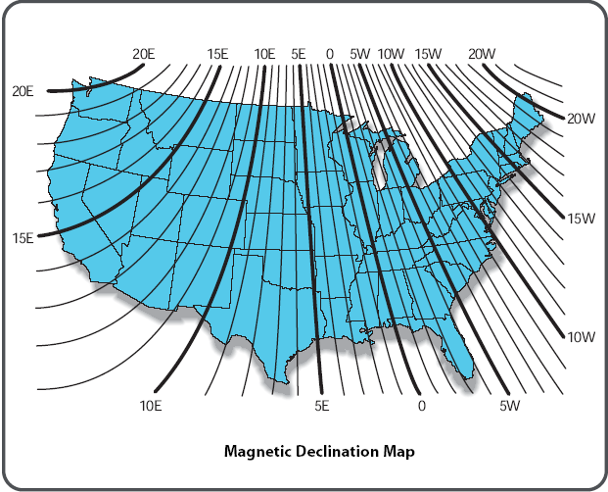
Aiming the Solar Panel

Slide 210
Aiming the Solar Panel
An exact value can be determined by using one of the many online calculators
For example in the United States the National Oceanic and Atmospheric Administration, National Geophysical Data Center has one available as of the date of this publication at
http://www.ngdc.noaa.gov/cgi-bin/seg/gmag/fldsnth1.pl

Slide 211
Aiming the Solar Panel
The angle of the panel in relation to level is also important
In general for a fixed mount system such as would be used for this application the latitude of the system’s location is a good approximation of the angle to horizontal to use
Most solar panel manufacturers recommend a bias toward the optimum winter setting

Slide 212
Aiming the Solar Panel
This setting depends on the latitude
Kyocera for example recommends the following values for their panels
Other manufacturers use similar figures

Slide 213
Aiming the Solar Panel
Site Latitude in Degrees | Fixed Tilt Angle
0 to 15 | 15 degrees
15 to 25 | Same as latitude
25 to 30 | Latitude plus 5 degrees
30 to 35 | Latitude plus 10 degrees
35 to 40 | Latitude plus 15 degrees
40 and higher | Latitude plus 20

Slide 214
Solar Power Maintenance
Maintenance requirements are minimal
If the solar panels are tilted, then normal rainfall should keep them clean
Batteries will only last from two to four years

Slide 215
What Power System to Use
Assuming it is possible to provide either type of power to a site the relative costs and scalability of the two power delivery systems will decide which one to use
How do the costs for a solar power setup compare to running electrical cable
Let’s use the sample site discussed before that is 396 feet from the circuit breaker box

Slide 216
What Power System to Use
To simplify things we will assume the only equipment at the site is the access point as discussed above

Slide 217
Cost of Standard AC Power
Item | Amount | Cost
8/3 Underground Feed Cable | 396 Feet | 601.92
20 amp Single Pole Circuit Breaker | 1 | 4.20
GFCI Weatherproof Outlet and Mount | 1 | 20.00
Labor including trenching 24” ditch |  | 648.88
Total |  | $1,275.00

Slide 218
Cost of Solar Power System
Item | Amount | Cost
Solar Panels | 2 | 670.00
Charger Controller | 1 | 76.00
Batteries | 3 | 420.00
Inverter | 1 | 76.00
Box | 1 | 208.00
Solar Panel Mount | 1 | 270.00
Other Parts | Various | 15.00
Total |  | $1,735.00

Slide 219
What Power System to Use
As this example shows the solar power system is more expensive than the underground electrical cable
This is usually the case
In addition, a 20 amp circuit at 120 volts AC as the standard underground circuit delivers can power quite a bit more equipment than the selected solar power equipment

Slide 220
What Power System to Use
To increase the capacity of the solar power system significantly, the majority of the parts would have to be replaced
A final consideration is placement of the solar power equipment
Solar panels, the batteries, the other parts, and the cabinets they all go in have both size and weight

Slide 221
What Power System to Use
If the equipment is mounted on a tower, then the weight and wind loading has to be accounted for to prevent tower failure
In some areas nice big solar panels make attractive targets for some target shooters with little sense
But then in some cases a normal electrical circuit just cannot be provided to a site
In that case solar is the best choice

Slide 222
Painting
In general the bits and pieces of a wireless system can be painted
But do not use any paint that contains a metallic substance, such as graphite, carbon, red oxide, or metallic flakes
This is especially true of the antenna

Slide 223
Affect of Ice on Patterns
Once again we need to discuss the affects of ice on wireless equipment as ice on an antenna can change the radiation pattern
Ice always degrades the antenna’s performance, which is one reason for a fade margin
The higher the frequency, the worse the problem

Slide 224
Affect of Ice on Patterns
This is because the dipole elements of an antenna radiate radio waves into free space
The impedance of free space is 377 ohms
If the air surrounding the elements is replaced by ice, which has a lower impedance, then the impedance match and radiation pattern of the antenna will change

Slide 225
Affect of Ice on Patterns
For example for a 10 element yagi antenna at 502 MHz

Slide 226
Radiation Pattern No Ice

Slide 227
Radiation Pattern .20” of Ice

Slide 228
Affect of Ice on Patterns
There is an omnidirectional antenna somewhere under that ice

Slide 229
Affect of Ice on Patterns
To prevent this problem antenna elements are usually encased in a plastic protective housing or radome
This provides space between the elements and the ice, which serves to decrease the effect
Ice on the elements has the same effect as if the directors were lengthened

Slide 230
Affect of Ice on Patterns
As the electrical length of the directors become greater than one-half wavelength, they stop being directors and start acting like reflectors
This changes the radiation pattern of the antenna
Here is an example of why grid design antennas have problems in icy areas

Slide 231
Affect of Ice on Patterns

Slide 232
Affect of Ice on Patterns
In areas where severe icing and wet snow are common, it is good practice to install a full radome over any solid parabolic antennas or yagi antennas, and to avoid using grid antennas
In extreme cases a heater can be added that will keep the radome warm enough to prevent excessive buildup

Slide 233
Affect of Ice on Patterns
Here is an example of the mounting for such a unit as provided by RFS
This unit surrounds the radome covering the antenna

Slide 234
Antenna Heater
The heater is the band surrounding the edge of the radome
Thermostat to control the heater

Slide 235
Antenna Heater

Slide 236
Radiation Safety
To ensure microwave radiation is not harmful to those working with the equipment or who happen to pass by, the FCC has set minimum safe distances
These differ depending on whether the people around the source are aware they are near an antenna or not
For example, for a 2.4 GHz system the distances are

Slide 237
Radiation Safety
EIRP of Antenna | Distance Aware Feet | Distance Unaware Feet
36 | .31 | .63
40 | .46 | .98
42 | .57 | 1.22
44 | .71 | 1.52
46 | .88 | 1.90
48 | 1.09 | 2.37

Slide 238
Radiation Safety
General radiation safety precautions include
Turn off the equipment when working around and especially in front of the antenna
Never point an antenna at anyone
Mount equipment so that people who are unaware of its existence will not be affected by it, such as placing it up in the air

Slide 239
Radiation Safety
If other equipment, especially high power licensed equipment, is nearby ask that it be turned off
There are also radiation protection suits that can be worn along with radiation monitors whenever work is performed around high power sites that cannot be turned off

Slide 240
Radiation Safety Suit

Slide 241
Radiation Monitor

Slide 242
Radiation Safety
For more information try one of these two web sites

Slide 243
FCC Radiation Safety

Slide 244
OSHA Radiation Safety

