Slide 1
Wireless Equipment Installation Inside
Last Update 2013.10.31
1.7.0

Slide 2
Objectives
Learn how to install wireless equipments indoors

Slide 3
Access Point Mounting
The typical mounting method is to place the AP in the ceiling area where there is a plenum space between a false ceiling and the structural ceiling
Such as

Slide 4
Access Point Mounting

Slide 5
Access Point Mounting
There are several ways an access point can be mounted
Here are several examples from an October 2013 webinar by Commscope

Slide 6
Access Point Mounting

Slide 7
Access Point Mounting

Slide 8
Access Point Mounting

Slide 9
Access Point Mounting
A common way of mounting an access point in the ceiling area is to use zip ties to attach them to beams or columns in this space
Another way is to mount the AP to a board and then attach this structure to the ceiling or just lay it across the ceiling grid
A more secure method is to use a lockable box that replaces a ceiling tile

Slide 10
DeVry Mounting Method
Here for example is the way DeVry mounts access points

Slide 11
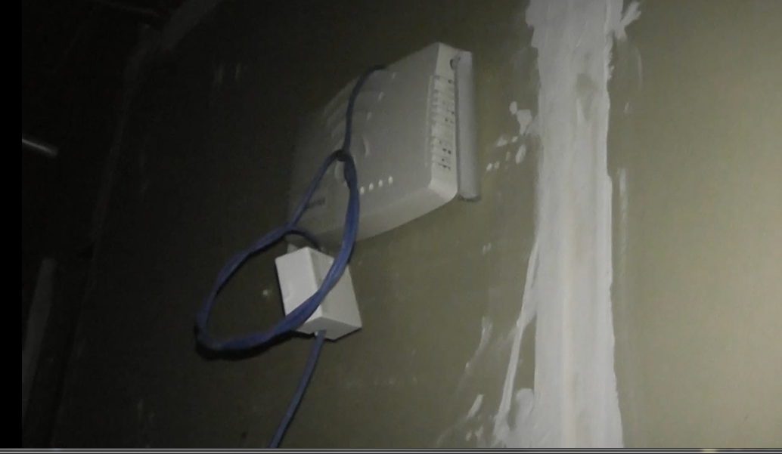
DeVry Mounting Method

Slide 12
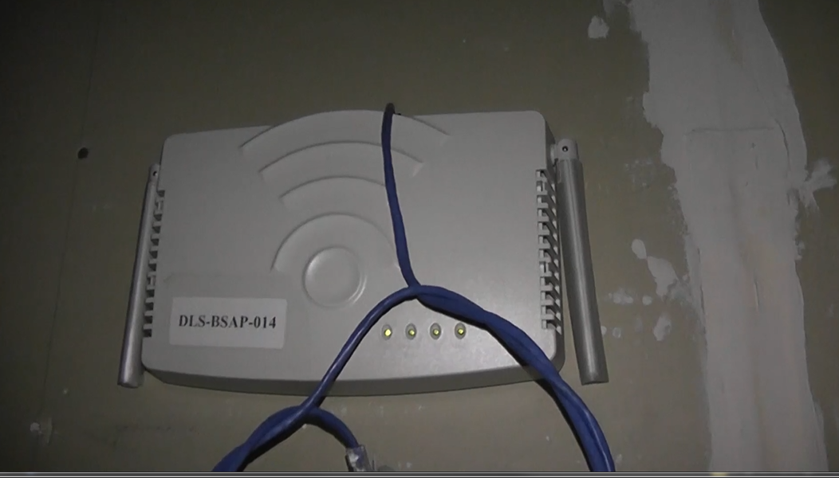
DeVry Mounting Method

Slide 13
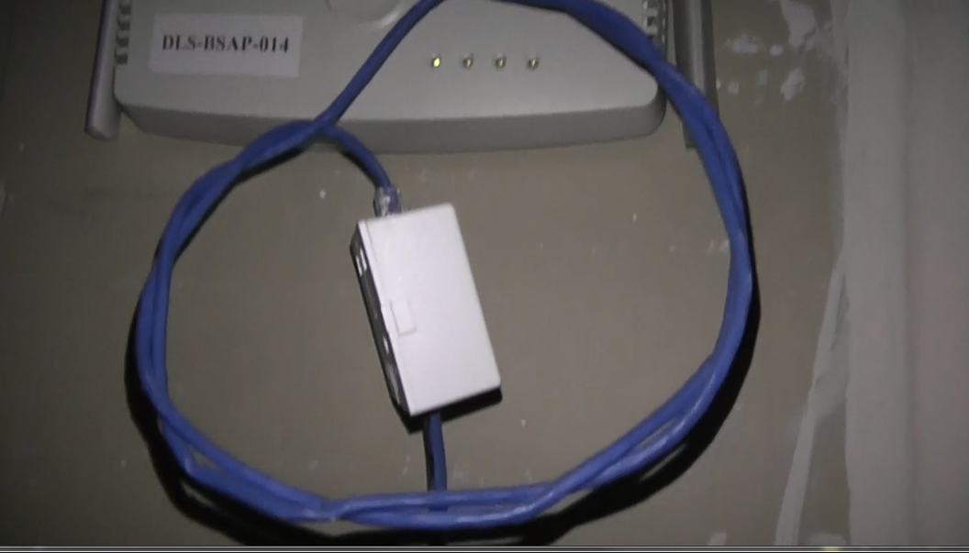
DeVry Mounting Method

Slide 14
Access Point Mounting
In this example the box is 2 feet by 2 feet
After the example of the ceiling mount a secure wall mount box is shown as well

Slide 15
Secure Ceiling Mount

Slide 16
Secure Ceiling Mount Closed

Slide 17
Secure Ceiling Mount Open

Slide 18
Secure Wall Mount

Slide 19
Access Point Mounting
Here is some detail on this from a webinar by Panduit from April 2013

Slide 20
Access Point Mounting

Slide 21
Access Point Mounting

Slide 22
Access Point Mounting

Slide 23
Access Point Mounting

Slide 24
Access Point Mounting

Slide 25
Access Point Mounting

Slide 26
Access Point Mounting

Slide 27
Access Point Mounting

Slide 28
Access Point Mounting

Slide 29
Access Point Mounting

Slide 30
Network Connection
Even though the end user’s network connection will be wireless, each access point must connect back to the wired network through the distribution system
The distribution system is a system of cables from the wired network out to the location for each access point

Slide 31
Network Connection
These are no different from the cables run from the LAN room to a wired user’s computer
These cables just terminate in the space where the access point will be
All of the usual structured cabling system requirements still apply

Slide 32
Network Connection
To ease the rearrangement or addition of access points in an area run the cable from the LAN room to a standard UTP cable surface mount box
Then attach the access point to the outlet box with a patch cable

Slide 33
Network Connection
As long as the limits on cable length are adhered to the access point can be relocated by changing the patch cable length, rather than running a new cable
So an additional access point can be added to increase availability or throughput, run two cables to each location

Slide 34
Network Connection
In 2006 some work was begun on a set of specifications for the cabling for access points
ISO/IEC 24704-2004 and TIA TSB-162 both address this
They both suggest overlaying the site with a series of 12 meter radius honeycomb cells for the ISO/IEC standard and a square for the TIA version

Slide 35
Network Connection
One cable for an access point is to be run to each of these

Slide 36
Bandwidth Considerations
As the speeds of wireless systems increase so must the cabling system connecting the access points back to the main wired infrastructure
Some of the proposed standards such as 802.11ac and 802.11ad will require gigabit or higher links
This is even true of 802.11n systems using multiple radios in a single access point

Slide 37
Bandwidth Considerations
Here are several slides that summarize this quite well
They were prepared by Oberon for a BICSI webinar from April 2011

Slide 38
Bandwidth Considerations

Slide 39
Bandwidth Considerations

Slide 40
Bandwidth Considerations

Slide 41
Bandwidth Considerations

Slide 42
Bandwidth Considerations

Slide 43
Electrical Power Connection
Every access point must be supplied with electrical power
There are two basic ways to do this for those APs mounted inside a building
Standard Electrical Outlet
PoE

Slide 44
Standard Electrical Power
In general, electrical connections for computer equipment should be made using a dedicated, isolated, and grounded circuit
This means each circuit goes from its own breaker in the breaker panel to a single outlet

Slide 45
Standard Electrical Power
The circuit should also have an isolated ground, which is one that is attached directly to the ground for the building using a ground wire in the same bundle with the other wires for the circuit
This type of circuit is designated by an orange outlet with a small green triangle

Slide 46
Dedicated Isolated Grounded

Slide 47
Standard Electrical Power
Such a circuit is more costly to install than a standard shared circuit
As an access point is not a heavy user of electrical power, a normal shared circuit may suffice

Slide 48
Power Over Ethernet
When no electrical power is near, a PoE – Power Over Ethernet electrical connection can be used
This method sends DC power over wires 5 and 6 for the positive, and 7 and 8 for the negative
This is a low power connection at 12.95 watts and 48 volts
The PoE standard is the IEEE’s 802.3af

Slide 49
Power Over Ethernet
The current ways to provide PoE include
Single port injector
Multi port injector
Switch with PoE built-in
A single port injector supplies power to a single device

Slide 50
Power Over Ethernet
A multiport injector supplies power to as many devices as the injector has ports, usually from 4 to 12 ports
A switch with PoE built-in is the best choice
Of course the device must be able to accept power over Ethernet
Many newer devices can

Slide 51
Power Over Ethernet
For those that cannot, a splitter is used to break the power out of the Ethernet cable and deliver it to the standard power port of the device
For example, here is a diagram from Cisco showing the use of these three options with one of their access points

Slide 52
Power Over Ethernet

Slide 53
Antenna
Typically the antennas used for interior wireless networks are those included with the access points
But in some cases these will not suffice as the coverage provided by them is not adequate

Slide 54
Antenna
Each antenna type has a different radiation pattern
Regardless of the antenna’s predicted radiation pattern, elements in the environment will change this pattern
For example, metal near the antenna, such as sprinkler heads, light fixtures, and the metal structure of the building itself, will alter the expected pattern

Slide 55
Antenna
This is why, as discussed below, a post installation test must be done
What sort of patterns can we expect to start with
Let’s briefly review these

Slide 56
Vertical Pattern

Slide 57
Dipole Pattern

Slide 58
Yagi Pattern

Slide 59
Patch Panel Microstrip Pattern

Slide 60
Beamwidth
Another aspect to keep in mind when setting up an antenna is the beamwidth it produces
The beamwidth has two dimensions
Vertical
Horizontal
The vertical beamwidth is perpendicular to the Earth’s surface and the horizontal beamwidth is parallel to the Earth’s surface

Slide 61
Beamwidth
Antenna design determines beamwidth
Common ranges for different types of antennas are

Slide 62
Beamwidth
Antenna Type | Vertical Beamwidth | Horizontal Beamwidth
Omni | 7 – 80 Degrees | 360 Degrees
Patch or Panel | 6 - 90 | 30 - 180
Yagi | 14 - 64 | 30 -78

Slide 63
Antenna Usage Guidelines
Remember, that with a wireless network you must learn to work in a three dimensional environment
The site survey done both before and after the installation will determine what antenna is actually used, but some general guidelines can be provided
For an open office or meeting room environment, use an omnidirectional vertical or dipole antenna

Slide 64
Antenna Usage Guidelines
This will provide general coverage for a wide area
For a hallway, a patch antenna is a better choice
When a highly directional signal is required inside, a yagi style can be used

Slide 65
Polarization
Besides the pattern of the beam, for maximum signal strength the polarization of the access point and the receiving stations must match
Recall that polarization is related to the two planes that exist in a radio frequency signal

Slide 66
Polarization
E Field – Electric Field
Exists in a plane parallel to the antenna
H Field – Magnetic Field
Exists in a plane perpendicular to the antenna
The E field lines up with the antenna
For example

Slide 67
Planes
Antenna Vertical | E Field Orientation

Slide 68
Planes
Antenna Horizontal | E Field Orientation

Slide 69
Polarization
The polarization aligns with the E field
In that the direction plane of the electric field lines determines the polarization of an electromagnetic wave
If the electric field lines are parallel with the surface, then the polarization is horizontal

Slide 70
Polarization
When those electrical field lines are perpendicular to the surface, the polarization is vertical
The antenna construction and type determine the polarization of the radio wave

Slide 71
Polarization

Slide 72
Signal Attenuation
Even if the correct antenna radiation pattern is selected and the polarization is correctly aligned, attenuation of the predicted signal is still likely
There are too many unpredictable and uncontrollable variables out there
Recall what causes loss or attenuation of radio frequency signals

Slide 73
Materials Effect on Signal Loss
The materials in the site have a major impact on the received signal strength and therefore on the coverage area
Different materials have different effects on the radio waves in order of most to least
Metal in walls
Tinted or coated windows
Metal in ceilings or floors

Slide 74
Materials Effect on Signal Loss
Wood
Glass
Brick and concrete
In an office environment the furniture itself may also have an effect, for example
Metal filing cabinets
Metal mesh furniture

Slide 75
Materials Effect on Signal Loss
In a warehouse environment other elements may come into play, such as
Metal racks
The products themselves as
Anything with a high water content will block the signal
This is true of both the product and the packaging
Paper and cardboard can have a high water content

Slide 76
Materials Effect on Signal Loss
Obstruction | Additional Loss dB | Effective Range Feet
Open Space | 0 | Up to 100
Window – Glass | 3 | 70
Window – Metal Tint | 5-8 | 50
Drywall | 5-8 | 50
Woodwall | 10 | 30
6” Wall | 15-20 | 15
12” Wall | 20-25 | 10
Floor/Ceiling | 15-20 | 15
Floor/Ceiling – Thick | 20-25 | 10

Slide 77
Materials Effect on Signal Loss
Water, regardless of how it appears or where it is found including inside people, attenuates the signal
Human beings are basically large bags of water
The more humans in a space, the less coverage that can be expected, according to a study by Obayashi and Zander, as well as reports from actual installations

Slide 78
Materials Effect on Signal Loss
The affect can vary depending on the exact environment
For example, here are the results of an informal study performed at DeVry University – Dallas on the effect of humans on a wireless LAN signal

Slide 79
Effect of Humans on Signals
In this study the following equipment was used
Cisco 350 Access Point
Cisco 350 Series PCMCIA Wireless LAN Adapter
Here is the layout of the study area

Slide 80
Effect of Humans on Signals
Access Point Location
Client Location

Slide 81
Effect of Humans on Signals
The room with the access point is 10 feet by 16 feet
The table on which the access point was placed is 34 inches high
The shelving is floor to ceiling along the wall to the side of the room where the wireless client is
The shelves contain books
The walls are metal studs with sheetrock covering

Slide 82
Effect of Humans on Signals
There is carpet on the floor
The room with the wireless client is the same, except that it is 10 feet by 10 feet
The intervening room is also 10 feet by 10 feet, and the same as the other two with the walls covered by shelving holding books

Slide 83
Effect of Humans on Signals
Signal dBm | Noise dBm | Signal to Noise Ratio dBm | Number of Humans
-50 | -87 | -37 | 0
-51 | -87 | -36 | 1
-54 | -87 | -33 | 2
-53 | -87 | -34 | 3
-54 | -87 | -33 | 4
-57 | -87 | -30 | 5
-53 | -87 | -34 | 6
-51 | -87 | -36 | 7
-53 | -87 | -34 | 8

Slide 84
Material Effect on Signal Loss
As seen in the table the signal was attenuated up to five people
Then it began to improve
Changing the location of the humans had no effect on the readings
All of this is why a realistic site survey must be done, the emphasis on realistic

Slide 85
Antenna Mounting
Once the type of antenna has been selected it must be mounted to something
In many cases the antenna is part of the access point
In that case mounting the AP takes care of the antenna mounting as well
When it is not and the décor of the facility is an issue, then some compromises may have to be made

Slide 86
Antenna Mounting
This may call for the antenna to be hidden or disguised
This is sometimes done by using a microstrip antenna
For example this antenna is 4 inches in diameter and ½ inch thick

Slide 87
Microstrip Design

Slide 88
Antenna Mounting
An interesting use of a microstrip antenna is the i-ceilings antenna system from Armstrong
Armstrong is usually seen as being a company that makes floor and ceiling parts
In this case the antenna is part of the ceiling
It is a ceiling tile replacement

Slide 89
Antenna Mounting
They are designed to look exactly like a typical ceiling panel
But behind the panel are connectors for a set of microstrip antennas

Slide 90
Armstrong i-ceilings Antenna
2.4 GHz antenna connectors
850/1900 MHz dual band connector
1900 MHz antenna connector

Slide 91
Armstrong i-ceilings Antenna
The 2.4 GHz connections are for attachment to a wireless LAN access point
The other connectors and antennas are for cellular phone systems
Reports from the field indicate that this is a suitable antenna for covering large areas with a small number of users

Slide 92
Painting Antennas
You can paint an antenna so that it will blend in with décor
However, do not use any paint with metal in it, such as iron oxide
This metal may distort the radiation pattern

Slide 93
Device Configuration Issues
Since the devices, such as the access point, used for an inside wireless network will be in inaccessible places for the most part, it is a good idea to configure and test each one before it is deployed
This is required even if a centralized management system will be used, as most access points are managed through a built-in http connection

Slide 94
Device Configuration Issues
Each access point from the manufacturer will come with the same default IP address
At a minimum these need to be changed before the AP is installed

Slide 95
Fire Safety Considerations
Anytime something is placed in the space between the false ceiling and the structural ceiling, and this space is used for return air for the ventilation system the device must be plenum rated
A plenum rating means that if the device burns, it will not give off toxic fumes in excess of certain limits

Slide 96
Fire Safety Considerations
These limits are set by the NEC and any other local standards that may apply
The material the device is made of has the most effect on this rating
This can make the installation of wireless LAN equipment quite problematic

Slide 97
Fire Safety Considerations
For example, Cisco states
“The access point uses a metal enclosure having adequate fire resistance and low smoke-producing characteristics suitable for operation in a building’s environmental air space (such as above suspended ceilings) in accordance with Section 300-220 of the NEC”

Slide 98
Fire Safety Considerations
However, just below this statement Cisco says
“Cisco Aironet power injectors are not tested to UL 2043 and should not be placed in a building’s environmental air space, such as above suspended ceilings”
The point is to check this before the installation and read the installation instructions

Slide 99
Test the Installation
Regardless of what the site survey suggested and the plans called for, with a wireless network a post install test must be done
There are simply too many unmeasurable factors present in the radio frequency microclimate the wireless network will operate in

Slide 100
Test the Installation
Just like the atmospheric microclimate, this environment can change constantly
So this test must measure real usage patterns as well as possible, including the time of day and the number of people typically seen

Slide 101
Post Install Adjustment
This test may, and likely will, call for adjustments to be made in the location and number of devices in the wireless network
There is nothing unusual about this
In fact, depend on it

