Slide 1
Wireless CAN
Last Update 2011.02.02
1.2.0

Slide 2
Use of Wireless
Wireless links can be used to create a CAN where the use of a cable connection is too costly or the ground between points does not allow it, such as not controlling the right of way
We will see an example of each

Slide 3
Useable Frequencies
For use in a CAN the frequencies that are useable are
Unlicensed
900 MHz
2.4 GHz
5 GHZ
24 GHz
60 GHz
Semi-Licensed
3.65 GHz

Slide 4
Useable Frequencies
Licensed
6 GHz
11 GHz
18 GHz
23 GHz

Slide 5
Which Frequency to Use
The lowest cost way to create a short range point-to-point link such as is used in a CAN is to use a 5 GHz link
There is less interference in this band than there is in the 2.4 GHz band
900 MHz does not have enough bandwidth for it to be useable
Higher in cost are 24 GHz unlicensed links

Slide 6
Which Frequency to Use
These are short range, low speed solutions right now
A semi-licensed solution when 5 GHz is too busy in an area is the 3.5 GHz band
The license cost is lower than the traditional licensed frequencies
The protection from interference is less than licensed frequencies

Slide 7
Which Frequency to Use
The licensed solutions typically connect at 800 mbps to 1 Gig
Companies that offer these solutions include
Dragonwave
Nera
Motorola Canopy
Ligowave
Ubiquiti

Slide 8
Deployment
The actual deployment of this equipment, such as how to mount it outside or design the network to use it, are covered in separate presentations
It does not matter what frequency is deployed, the techniques concerning installation and management are the same

Slide 9
Example Connection
In this first example a tower is located over 400 feet from the network operations center
The right of way between the two is accessible
However for this application the cost of running a cable is prohibitive
Here is the path

Slide 10
Relationship of Facilities

Slide 11
Obstructions
Notice that the line of sight between the two points is obstructed by trees as the antennas are mounted at the height of the middle of the trees
This was done to avoid the need to hire a tower climber
Normally this would be a problem

Slide 12
Obstructions
In this case the short distance along with the high gain of the antennas allows this connection to be made

Slide 13
Obstructions

Slide 14
Obstructions

Slide 15
Tower

Slide 16
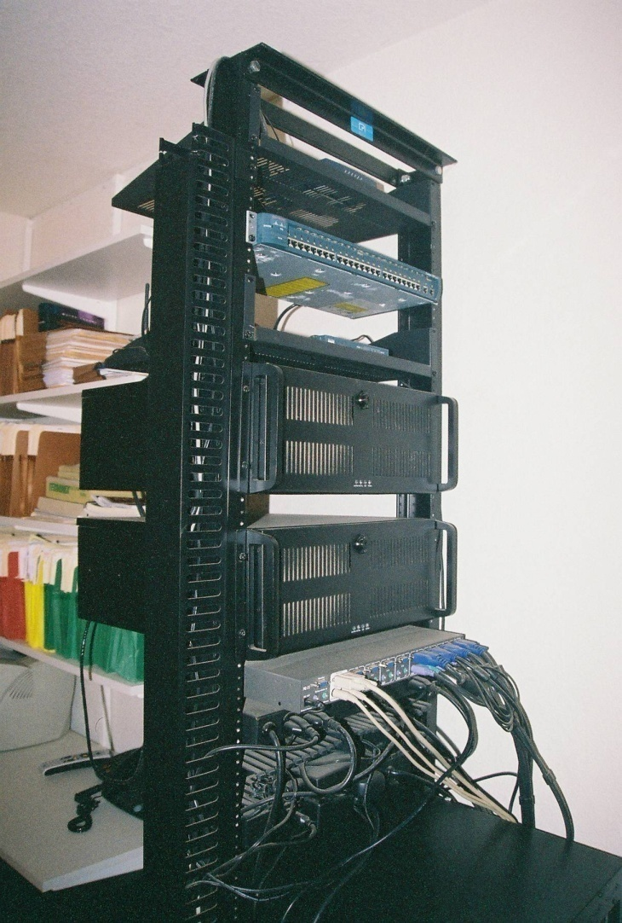
Network Operations Center

Slide 17
Method of Connection

Slide 18
Method of Connection

Slide 19
Example Connection
The system illustrated here is used by the City of Joshua Texas to interconnect several of their facilities that are separated by a road and a railroad
In this case the right of way is not accessible
Here is the overhead view of the area

Slide 20
Relationship of Facilities

Slide 21
City Administration

Slide 22
Public Works

Slide 23
Fire Station

Slide 24
Animal Control

Slide 25
Typical Distance

Slide 26
Method of Connection

