Slide 1
Site Survey for a Wireless Local Area Network
Last Update 2012.07.11
1.3.0

Slide 2
Purpose of a Site Survey
A site survey for a local area network is done to determine the number of and location of the access points required to provide access to the network at the desired data rate
The data rate should always be the maximum rate

Slide 3
Steps in a Site Survey
There are two basic steps in this process
Measure the radio frequency environment without the access points
Determine the number and location of the access points

Slide 4
Types of Site Surveys
There are two types of site surveys
Measured
Predicted

Slide 5
Measured
A measured site survey is done manually onsite

Slide 6
Predicted
A predictive site survey is done by a program from anywhere

Slide 7
Measured Site Survey
The measured site survey procedure uses one or more access points and laptops
This is done by placing an access point in a likely location
Then walking around the area of the access point with a laptop running a site survey program

Slide 8
Advantages and Disadvantages
This method takes longer to do, but yields more accurate results
The reason they are more accurate is the survey is done in the actual building while measuring the actual environment

Slide 9
Predictive Site Survey
This process uses a program to simulate the nature of the building
Doing this requires a plan of the building loaded into the program
After this the characteristics of the walls and structure of the building must be entered so the attenuation of the signal can be predicted

Slide 10
Predictive Site Survey
From this information the program will indicate the number and location of the access points

Slide 11
Advantages and Disadvantages
This method takes less time
It can be done from anywhere
However, it is difficult to accurately model the building
This can be overcome to some extent by the use of thin access points that are centrally managed

Slide 12
Advantages and Disadvantages
The output of these can be adjusted, within legal limits, to overcome any misses in the prediction
802.11n presents new problems for this method as it makes use of multipath signals, which cannot be modeled

Slide 13
Measure the RF Environment
Regardless of the method used to select the location of the access points a spectrum analysis must first be done of the premises as the site survey procedure only deals with the 802.11 signals
These methods do not take non-802.11 signals such as Bluetooth headsets, portable phones, and microwaves into account

Slide 14
Measure the RF Environment
Many articles on the site survey process just casually toss off this advice to examine the environment with a spectrum analyzer
They fail to tell you how to do this
Using a spectrum analyzer is easy, once you learn how

Slide 15
Measure the RF Environment
Interpreting the results when the signal is a spread spectrum waveform is not
Let's look at the output of a spectrum analyzer
This first screenshot shows the FM radio band from 88 to 108 MHz in my area

Slide 16
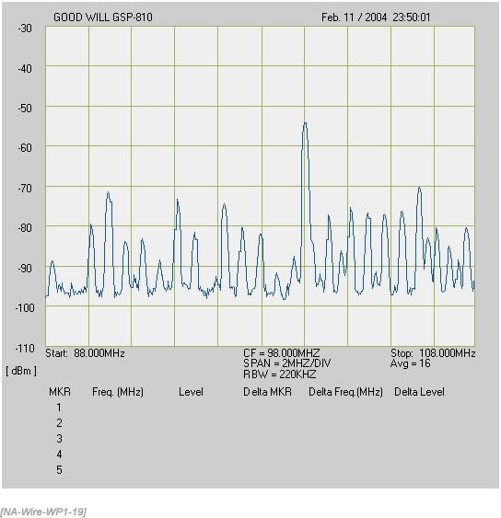
Measure the RF Environment

Slide 17
Measure the RF Environment
Each of the peaks on the graph represents a FM radio station
This result was easy to obtain
The spectrum analyzer was tuned to the frequency at the center of the band of interest by entering the frequency 98.000 MHz using a keypad
The span each vertical line was to represent was selected the same way

Slide 18
Measure the RF Environment
Here the span is 2 MHz
The result is a graph showing quite a few FM radio stations in the area
As the graph shows, FM radio uses a high power signal at a single frequency

Slide 19
Measure the RF Environment
The problem in using a spectrum analyzer for a site survey, when the user has little experience with its use, is the nature of the spread spectrum signal
The spread spectrum, in this case DSSS, signal uses low power to spread the signal over a wide range

Slide 20
Measure the RF Environment
This is to prevent any strong signal in the same band from overwhelming the entire spread spectrum signal
Here is a theoretical DSSS signal in relation to a high power signal at a single frequency

Slide 21
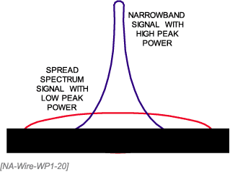
Measure the RF Environment

Slide 22
Measure the RF Environment
Here is an actual spread spectrum signal in the 802.11b band as captured by a spectrum analyzer

Slide 23
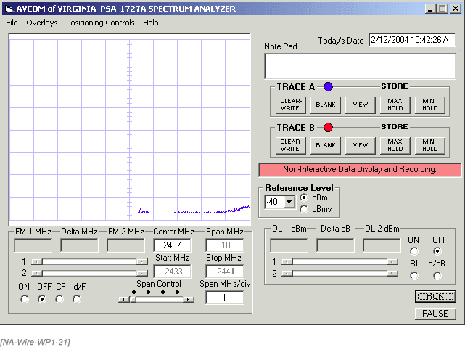
Measure the RF Environment

Slide 24
Measure the RF Environment
Not very useful
This is the nature of spread spectrum signals
DSSS uses low power spread over a wide area
The signal peaks briefly at different points across the band
Here is a shot that captured a single peak

Slide 25
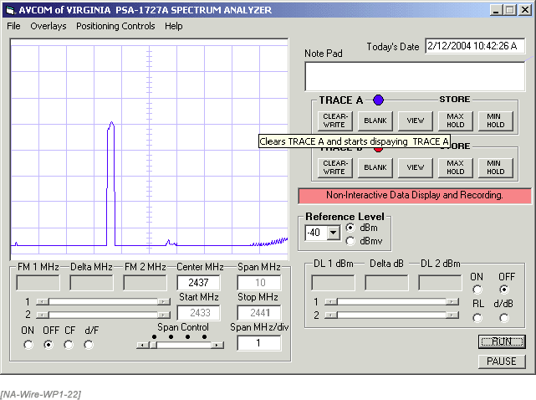
Measure the RF Environment

Slide 26
Measure the RF Environment
The only way to capture the true DSSS waveform is to use the peak hold function of the spectrum analyzer
This function captures and holds the signal at each point
Over time, the total waveform is seen
Here is a captured DSSS signal using peak hold for 2 minutes on a low activity network

Slide 27
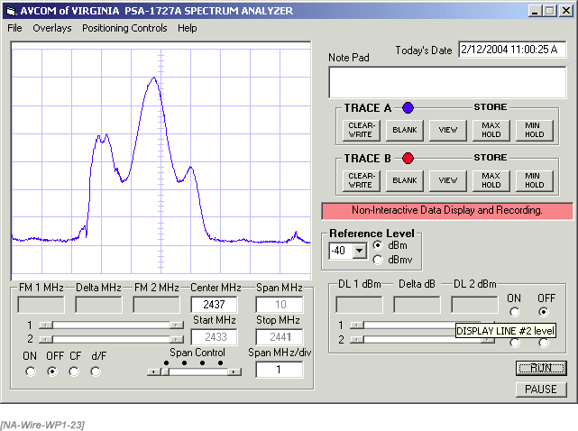
Measure the RF Environment

Slide 28
Measure the RF Environment
Adding a second access point overlays an additional signal onto the waveform seen just above

Slide 29
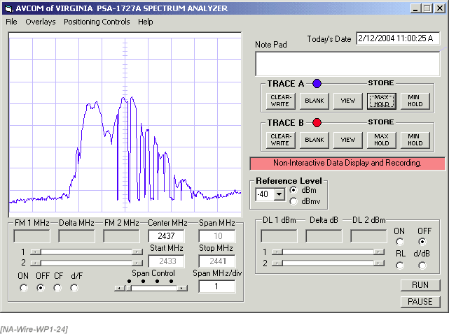
Measure the RF Environment

Slide 30
Measure the RF Environment
Taking out the second access point and putting a microwave oven in its place generates this type of waveform

Slide 31
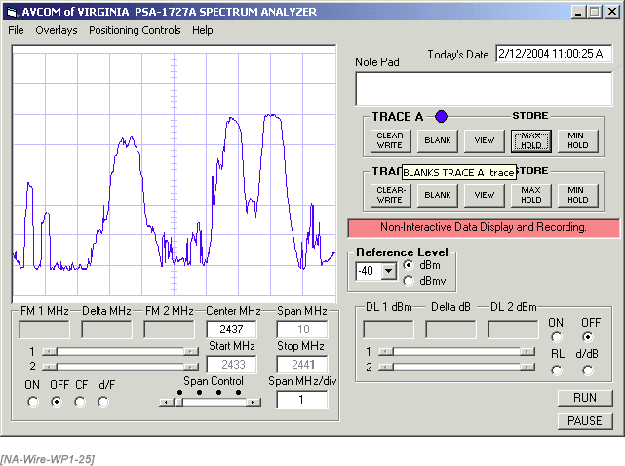
Measure the RF Environment

Slide 32
Measure the RF Environment
Sources of interference from devices such as a microwave oven, a cordless phone, or a frequency-hopping access point can be identified with a little practice with a spectrum analyzer
What cannot be easily detected are other spread spectrum signals
A spectrum analyzer is a very useful device if you know what you are doing

Slide 33
Measure the RF Environment
If you haven't had a lot of practice with a spectrum analyzer, you will find it easier to find other DSSS signals by using a device that identifies 802.11 networks by channel, such as NetStumbler
Then use the noise floor figure or signal-to-noise ratio to discover non-DSSS signals within the radio frequency environment

Slide 34
Measure the RF Environment
When these non-DSSS sources are turned off, the noise floor should drop and the signal-to-noise ratio improve

Slide 35
Measure the RF Environment
Another method that is lower in cost than using a standard spectrum analyzer is to use the USB based analyzer form Metageek
For example

Slide 36
Measure the RF Environment

Slide 37
Measure the RF Environment
It produces a display like this

Slide 38
Measure the RF Environment

Slide 39
Measuring the RF Environment
When doing the spectrum analysis be sure to use the style of antenna that the access points will use
That is omnidirectional or directional

Slide 40
Locating the Access Points
Once the ambient RF environment is identified, the installer can start to lay out the wireless network extension
There are four aspects to consider when locating the access points
Data Rate
Signal
Noise
Signal to Noise Ratio

Slide 41
Locating the Access Points
The data rate is very important because 802.11 networks make poor use of the network capacity
Because it is a shared environment using a collision avoidance mechanism, overhead chews up about half of the capacity
For an 802.11b network, this capacity is not the theoretical 11 Mbps, but 5.5 Mbps

Slide 42
Locating the Access Points
Dynamic rate shifting can allow a device to maintain a link at a lower data rate, but this is not very useful
Design the network to maintain the maximum data rate

Slide 43
Locating the Access Points
The number of users supported by each access point is also an issue in this shared media
A common guideline for 802.11b networks serving a typical business is 30 to 50 users per access point

Slide 44
Locating the Access Points
If the business is a graphics firm or the area is a classroom filled with students working on database administration, then this guideline may not be appropriate
This is the reason to test the network before putting it into operation
The wireless LAN equipment we are installing creates the signal

Slide 45
Locating the Access Points
The noise is what everyone else is creating
Of course, once we finish and the next person begins a nearby installation, then our signal becomes noise to them

Slide 46
Locating the Access Points
The desirable signal level must remain above the receive sensitivity of the worst receiving unit that will be used in the wireless network
The receive sensitivity of wireless NICs ranges from -80 to -91 dBm at the maximum data rate for 802.11b equipment

Slide 47
Locating the Access Points
Users might have almost any device to receive the signal, so the worst receive sensitivity should be assumed
The receiver sensitivity is the lowest signal level that a radio can receive with a certain bit error rate that allows the transfer of data at the specified data rate

Slide 48
Locating the Access Points
What the site survey device reports as noise is everything that the device cannot identify as a signal
In other words, what it cannot demodulate

Slide 49
Tools to Use
For the manual site survey process the best tool to use is a wireless NIC along with a program that will show the following as received from the NIC
MAC address of the connected access point
The channel
The data rate
The signal, noise, and signal to noise ratio in dBms

Slide 50
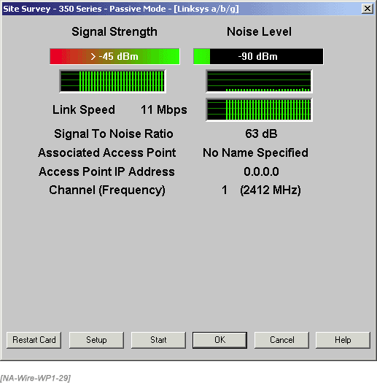
Tools to Use

Slide 51
Tools to Use
To use this tool, just walk away from the access point in different directions like the spokes of a wheel while recording the readings on a copy of the floor plan
The idea is to see where the 20 dB signal-to-noise ratio point is
This point, where the SNR drops below 20 dB, is the edge to mark for the coverage area in that direction

Slide 52
Tools to Use
This requires two people, one to hold the laptop and another to record
Some of the automatic units will do the recording for you
Record these readings on all floors and outside the building
Be sure the site survey device does not change association to another access point while performing the survey

Slide 53
Tools to Use
When finished, connect the dots
The result is an irregular coverage pattern surrounding each proposed access point location
This pattern is not circular as described in most publications, but highly irregular
Examine the plots for dead spots where no signal penetrated

Slide 54
Tools to Use
Let's look at the results of a site survey
A two-story building is being surveyed for installation of one or more 802.11b access points to provide wireless Internet access to the students in the building
Here is what the second floor looks like

Slide 55
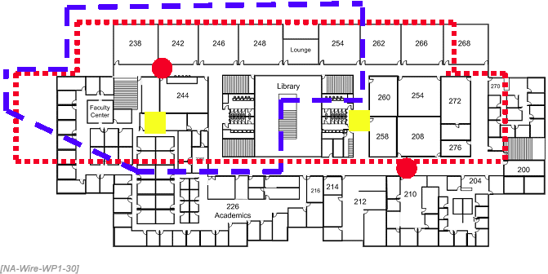
Tools to Use

Slide 56
Tools to Use
The first idea for coverage was to place an access point in the ceiling at opposite ends of the two long halls
These are the red circles
The expected coverage area is the red box using the small square dots for the line
This pattern ignores the spillover to the outside for now

Slide 57
Tools to Use
With this pattern, four access points can cover the entire building using two per floor
The problem with this plan was both too little coverage and too much coverage
There was much less coverage than expected inside the building and much more outside of the building

Slide 58
Tools to Use
The actual signal coverage inside the building is shown as the blue dashed line
The signal also extended outside the building over 400 meters away
This coverage area was measured with the laptop-style NIC
Imagine how far away this signal could be received outside using a highly directional antenna

Slide 59
Tools to Use
The revised plan places the access points further into the building where the yellow boxes are
With a reduced power setting on each access point, this covers the building and helps to keep the signal inside
Some signal still penetrates outside, but not as far
The first floor uses a similar pattern

Slide 60
Tools to Use
Cell overlap is needed in the layout to ensure that a user walking around the building maintains a connection and to prevent dead spots
An overlap of 20 to 30 percent is adequate

Slide 61
Tools to Use
A channel assignment plan for the access points is needed as part of the site survey
The channels to use depend on the 802.11 standard used, the number of access points required, their location, and the purpose of the coverage
The 802.11b standard allows for only three non-overlapping channels

Slide 62
Tools to Use
The channel plan for a multistory building has to be three dimensional
When performing a site survey using this method a question arose about where to place the access point as it was moved around the building
A plastic cart was being used
This placed the access point at waist level instead of at the ceiling level

Slide 63
Tools to Use
What affect would this have on the signal used for the site survey

Slide 64
Tools to Use
After testing, it was found that the signal was the same near the access point's location, but worse by an average of 5 dB as the site survey device went beyond 60 feet from the access point
So there is no need to place the access points in their planned physical location above the false ceiling, at least in this building

Slide 65
Tools to Use
Rolling them around on a cart doesn't provide a better signal, as would be expected, but a lower signal level
In this instance, that merely provides a higher level of fade margin
There are several ways to power the access point
For example, the Cisco Aironet 1200 access point draws 8 Watts RMS

Slide 66
Tools to Use
A low cost 500 W UPS will power these units for four hours or more once the UPS batteries are fully charged
Be sure to fully charge the UPS and configure it to not sound an alarm when it is unplugged from the wall before using it this way
A battery pack and DC-to-AC converter can also be used

Slide 67
Tools to Use
If the access point is placed in the ceiling, it can be secured with wire ties or duct tape
I dislike duct tape for this because it never completely comes off
Do not lay it on the ceiling tiles because the antennas will point up instead of down

Slide 68
Tools to Use
If you are going to the trouble of placing the access points in the ceiling you might as well point them the right direction
Wire ties or anything else placed in the ceiling must meet the fire code standards

Slide 69
Predicted Site Survey
There are a number of companies that offer predictive tools for site surveys
For example, here are some screenshots from a June 2011 Webinar by Ekahau
First, the building layout is imported into the program
An outline is drawn in the program around the area to cover

Slide 70
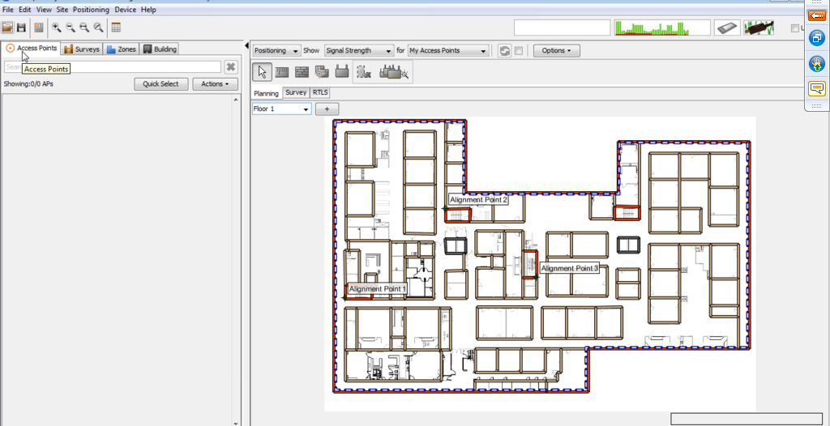
Predicted Site Survey

Slide 71
Predicted Site Survey
Multiple floors can be used as the left side panel shows

Slide 72
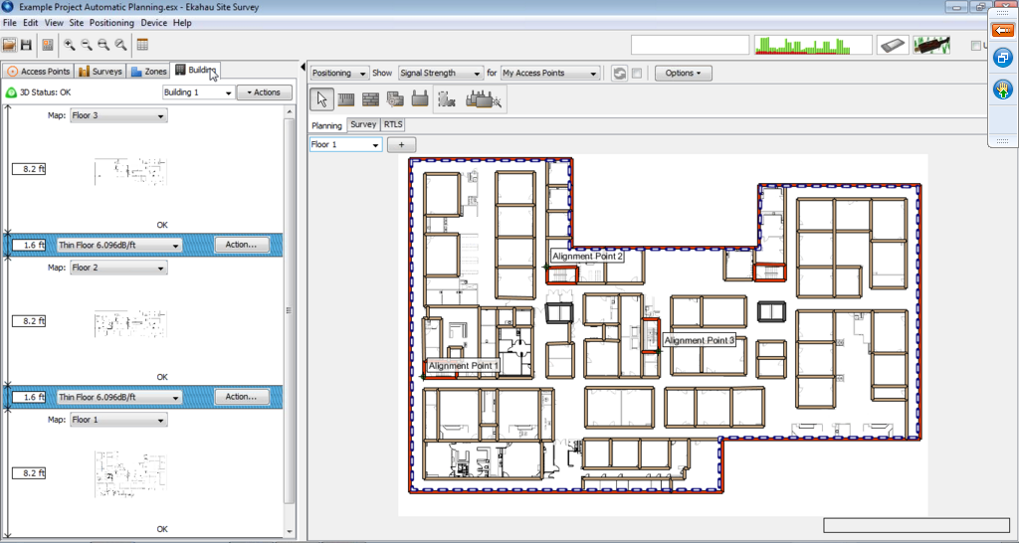
Predicted Site Survey

Slide 73
Predicted Site Survey
Requirements such as coverage or capacity is indicated

Slide 74
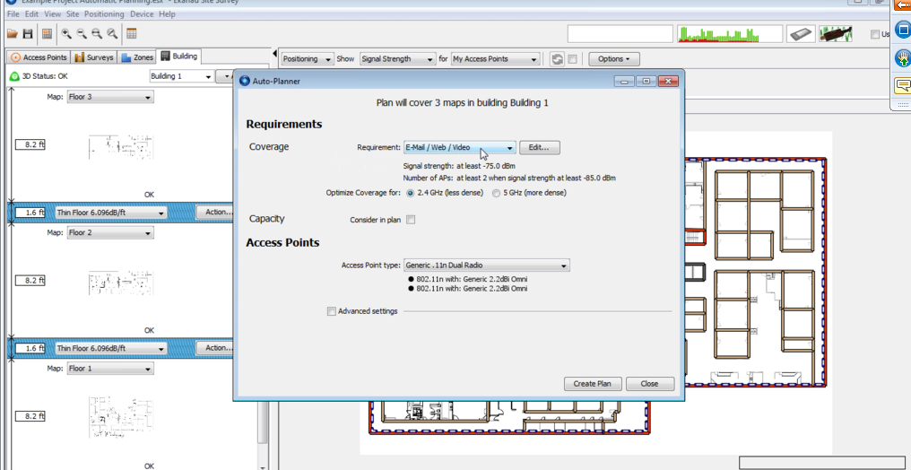
Predicted Site Survey

Slide 75
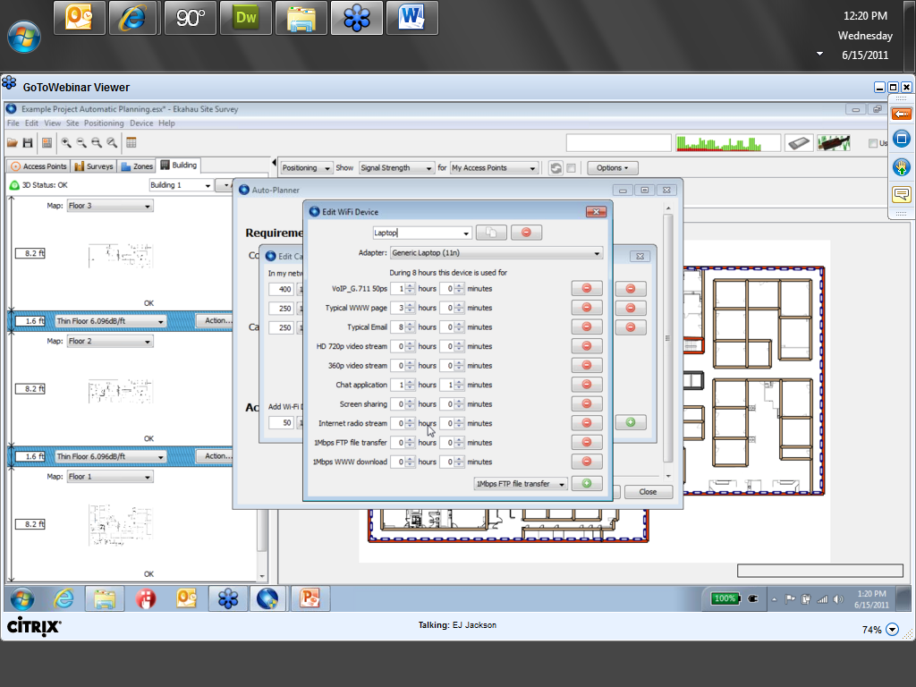
Predicted Site Survey

Slide 76
Predicted Site Survey
Then the coverage is predicted

Slide 77
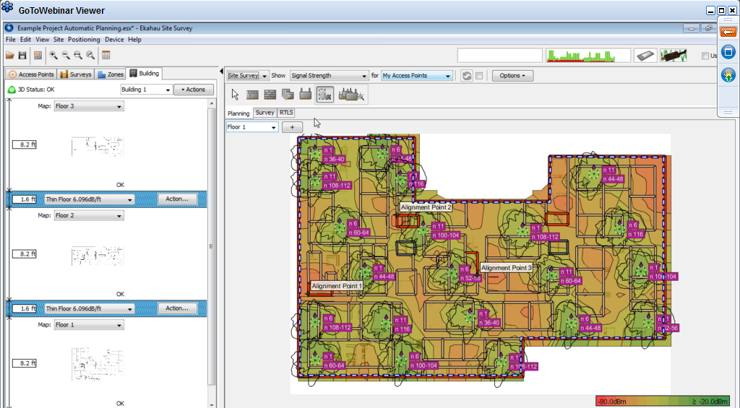
Predicted Site Survey

