Slide 1
Regulation of Wireless Systems
Last Update 2008.12.06
1.2.0

Slide 2
Regulatory Authorities
As might be expected when dealing with governmental bodies and their regulations there are many with a hand in it, including
International
ITU-R
International Telecommunication Union - Radiocommunication Sector
Europe
CEPT
European Conference of Postal and Telecommunications Administrations

Slide 3
Regulatory Authorities
ETSI
European Telecommunications Standards Institute
ECC
Electronic Communications Committee
ERO
European Radiocommunications Office
Western Hemisphere
CITEL
Inter-American Telecommunication Commission

Slide 4
Regulatory Authorities
Asia-Pacific
APT
Asia-Pacific Telecommunity
ARIB
Japan
ACA
Australian Communications Authority
Ministry of Commerce
New Zealand

Slide 5
Regulatory Authorities
Canada
Industry Canada
Spectrum Management and Telecommunications Sector
United States of America
FCC
Federal Communications Commission
Next we will see what each is responsible for beginning with the ITU-R as it has some international impact

Slide 6
Regulatory Authorities
Then the major regional and country specific bodies will be covered

Slide 7
ITU-R
As the web site says the ITU-R
“plays a vital role in the management of the radio-frequency spectrum and satellite orbits, finite natural resources which are increasingly in demand from a large number of services such as fixed, mobile, broadcasting, amateur, space research, meteorology, global positioning systems, environmental monitoring and, last but not least, those communication services that ensure safety of life at sea and in the skies”

Slide 8
CEPT
According to CEPT
“CEPT's activities have included co-operation on commercial, operational, regulatory and technical standardization issues”
“In 1988 CEPT decided to create ETSI, The European Telecommunications Standards Institute, to which all its telecommunication standardization activities were transferred”

Slide 9
CEPT
“The role and purpose of CEPT was redefined at its plenary assembly on 5-6 September 1995 in Weimar as follows”
“CEPT offers its members the chance of establishing a European forum for discussions on sovereign and regulatory issues in the field of post and telecommunications issues …”

Slide 10
CEPT
Members of CEPT and most other European telecommunications related bodies include as of early 2003
Albania
Andorra
Austria
Azerbaijan
Belgium
Bosnia and Herzegovina
Bulgaria

Slide 11
CEPT
Croatia
Cyprus
Czech Republic
Denmark
Estonia
Finland
France
Germany
Great Britain
Greece

Slide 12
CEPT
Hungary
Iceland
Ireland
Italy
Latvia
Liechtenstein
Lithuania
Luxembourg
Macedonia
Malta

Slide 13
CEPT
Moldova
Monaco
Netherlands
Norway
Poland
Portugal
Romania
Russian Federation
San Marino
Slovakia

Slide 14
CEPT
Slovenia
Spain
Sweden
Switzerland
Turkey
Ukraine
Vatican
Yugoslavia

Slide 15
CEPT
CEPT regulations that relate to wireless networks include
CEPT/ERC/REC 70-03
ERC Report 072
ERC Report 067
CEPT/ERC/DEC(96)03
CEPT/ERC/DEC(99)23
CEPT/ERC/DEC(99)24

Slide 16
ETSI
As the ETSI says
“ETSI (the European Telecommunications Standards Institute) is a not for profit organization whose mission is to produce the telecommunications standards that will be used for decades to come throughout Europe and beyond”

Slide 17
ETSI
“ETSI unites 768 members from 55 countries inside and outside Europe, and represents administrations, network operators, manufacturers, service providers, research bodies and users”
“ETSI plays a major role in developing a wide range of standards and other technical documentation as Europe's contribution to world-wide standardization in telecommunications, broadcasting and information technology”

Slide 18
ETSI
ETSI regulations include
ETSI EN 300 328-1
ETSI EN 300 328-2
ETSI EN 301 893

Slide 19
ECC
The ECC is the committee that brings together the radio and telecommunications regulatory authorities of the 45 CEPT member countries

Slide 20
ERO
The ERO is the permanent office supporting the ECC arm of the CEPT
In addition to supporting the ECC, according to the website of the ERO, the ERO has the following functions
“To provide a centre of expertise which shall act as a focal point, identifying problem areas and new possibilities in the radio and telecommunications fields and to advise the ECC accordingly”

Slide 21
ERO
“To draft long-term plans for future use of the radio frequency spectrum at a European level”

Slide 22
CITEL
CITEL – Inter-American Telecommunications Commission does some radio frequency related work in the Western Hemisphere
According to the CITEL website

Slide 23
CITEL
“The Inter-American Telecommunication Commission endeavors to make telecommunications a catalyst for the dynamic development of the Americas by working with governments and the private sector”
“CITEL works under the auspices of the Organization of American States”

Slide 24
APT
In the Asia-Pacific area the APT - The Asia-Pacific Telecommunity was established in May, 1979 as a Regional Telecommunication Organization
Its role is to coordinate, among other things, radio frequency usage in that area

Slide 25
ARIB
In addition to the general coverage of radio frequency communication standardization and regulation provided in the Asia by APT, many countries have there own specific regulations
In Japan this is ARIB – Association of Radio Industries and Businesses

Slide 26
ARIB
As the English language web site for this organization says
“ARIB conducts the following activities in its capacity as a Minister of Public Management, Home Affairs, Posts and Telecommunications
Investigation, research and development on utilization of radio waves in the field of telecommunications and broadcasting
Consultation, education for popularization, collections and publications of information on utilization of radio waves in the field of telecommunications and broadcasting

Slide 27
ARIB
Establishment of technical standards for radio systems in the field of telecommunications and broadcasting
Correspondence, coordination and cooperation with overseas organizations regarding utilization of radio waves in the field of telecommunications and broad-casting
Specific Frequency Change Support Service as defined in Article 71-2 of the Radio Law”

Slide 28
Industry Canada
In Canada, Industry Canada is responsible for radio frequency related issues
More specifically as the web site says
“…facilitates access to the radiofrequency spectrum by issuing authorities for its use, securing Canada's access to it through international negotiations and by ensuring its continued health, in Canada, through the preparation and enforcement of standards”

Slide 29
Industry Canada
For unlicensed frequencies the Canadian regulation is RSS-210, which is basically the same as the FCC Part 15 requirements

Slide 30
FCC
In the United States of America most of the regulation related to radio frequency systems is by the FCC
The FCC was created as part of the Communications Act of 1934
Preceding the creation of the FCC, the first use of radio to broadcast speech and music was in 1906

Slide 31
FCC
Also at this time the first international conference was held because of the need to coordinate and control the use of the spectrum between 500 and 1500 kHz
In the United States, the call for regulation resulted from interference caused by numerous uncoordinated transmissions in that frequency range

Slide 32
FCC
The result was the Radio Act of 1912
This legislation required the registration of transmitters with the Department of Commerce
But it did not provide for the control of their frequencies, operating times, or station transmitting power
With no power to enforce anything, the 1912 law was unsuccessful

Slide 33
FCC
As time went on this problem only became worse
In 1922 United States government users of radio spectrum formed the Interdepartment Radio Advisory Committee to coordinate their use of the spectrum

Slide 34
FCC
Next the Radio Act of 1927 established the Federal Radio Commission, and the Communications Act of 1934 which established the FCC were passed
Finally in the 1934 Act Congress gave the FCC broad regulatory powers in both wire-line based communications, such as telephone and telegraph systems and radio based communications

Slide 35
FCC
At present the use of the electromagnetic spectrum in the United States is managed using a dual organizational structure
NTIA manages the Federal Government's use
The FCC manages all other uses

Slide 36
FCC Rule Parts
The FCC rules and regulations are in Title 47 of the Code of Federal Regulations
All codes are initially published in the Federal Register
After final approval, the GPO - Government Printing Office maintains these rules and regulations in publishable form

Slide 37
FCC Rule Parts
After October 1 of each year, the GPO compiles all the changes, additions, and deletions to the FCC rules and publishes an updated CFR - Code of Federal Regulations
As of the date of this publication Title 47 includes these parts

Slide 38
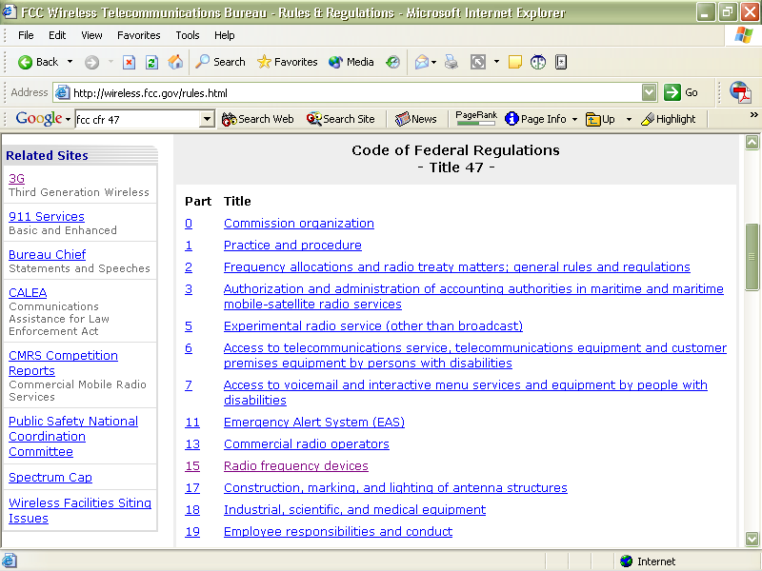
FCC Rule Parts

Slide 39
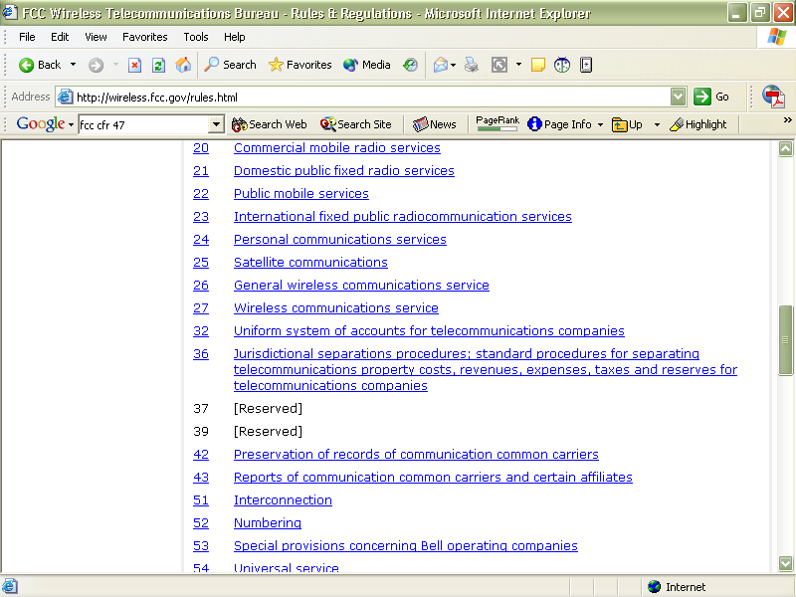
FCC Rule Parts

Slide 40
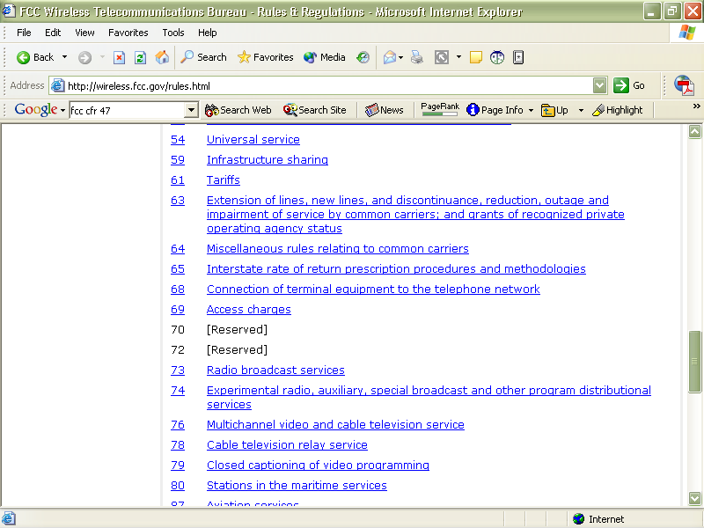
FCC Rule Parts

Slide 41
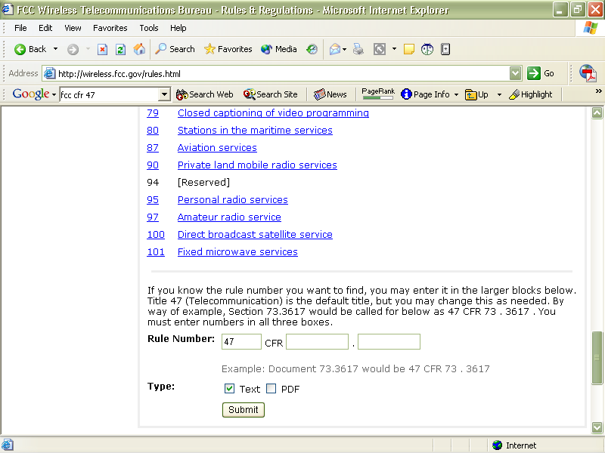
FCC Rule Parts

Slide 42
FCC Rule Parts
Each part of Title 47 of the CFR has information relevant to those that would produce or use wireless data networks
However, two parts are of particular interest
Part 15
Part 101

Slide 43
Part 15
As part of the FCC’s function and directly related to the use of wireless communications systems is Part 15 of the CFR
Part 15 covers equipment used with the unlicensed frequencies
Among other things, it states that every system used must be certified as a complete system

Slide 44
Part 15
Each of these systems is then given a certification number
A system is the transmitting device, cabling, connectors, amplifiers, attenuators, antennas, and so on
In other words, all the bits and pieces

Slide 45
Part 15
This does not mean you cannot mix parts from different manufacturers
It does mean that this mixture of parts, this exact mixture of parts, must itself be certified

Slide 46
Part 101
For the most part licensed wireless networks are covered under Part 101 of the CFR
These are the FCC rules for the use of microwave transmitters in the bands above 3 GHz for common carriers and private

Slide 47
Nongovernmental Bodies
Outside of the government are the voluntary organizations that work to produce standards for the equipment to be used to transmit over the approved frequencies
These organizations include
IEEE
WiFi-Alliance
ETSI

Slide 48
IEEE
The IEEE – Institute of Electrical and Electronics Engineers is one of the main hardware related standards creation organizations
In the wireless area they are responsible for the
802.11
802.16
standards

Slide 49
Wi-Fi Alliance
The Wi-Fi Alliance, which used to be known as WECA, tests equipment to ensure interoperability among 802.11a, 802.11b, and 802.11g equipment
This is the Wi-Fi logo

Slide 50
ETSI
As discussed above under the regulatory section the ETSI is a non profit organization whose mission to create telecommunications standards
This is similar to the IEEE, but it operates in Europe
For example, their standard for the unlicensed bands is ETS 300 328

Slide 51
Regulatory Harmony
For the unlicensed bands most countries will use the requirements of either the FCC Part 15 or the ETSI EN 300 328
Harmony in all of the rules worldwide is desirable for equipment manufacturers in particular
It is an advantage to users as well, as wider usage always brings lower costs

Slide 52
Regulatory Harmony
For the unlicensed 2.4 GHz frequency range most of the restrictions have been lifted worldwide, except for a few channel restrictions and limitations to indoor use only
France, Israel, parts of Latin America, Asia, and the Middle East are the remaining problem areas

Slide 53
Regulatory Harmony
For the 5 GHz ranges some part is available everywhere
The differences being what parts can be used where, such as indoors or outdoors

