Slide 1
Radio Frequency Concepts
Last Update 2009.05.10
1.12.0

Slide 2
Radio Waves
To start we need to cover some basic concepts that relate to radio frequency systems beginning with what radio waves are, as they are the medium used to carry the signals in a wireless network
Radio waves are electromagnetic radiations

Slide 3
Radio Waves
Electromagnetic radiations can be characterized by both frequency and wavelength
For the frequencies of interest here, the ones used to create wireless data networks, the range is in or near the gigahertz frequencies
This is just under 1 GHz to just under 100 GHz, specifically 700 MHz to 95 GHz

Slide 4
Radio Waves
Frequency being the number of complete oscillations per second of energy in the form of waves
In terms of the length of these waves, they range from 428.6 mm to 3.2 mm
The wavelength is the distance a radio wave will travel during one cycle
That is the distance between identical points in the adjacent cycles of a waveform

Slide 5
Radio Waves
There are formulas to compute wavelength or frequency
Note
The actual speed of radio waves is the speed of light, which is 299,792,458 meters per second, but rounding to 300,000,000 is sufficient for this purpose

Slide 6
Wavelength
Wavelength

Slide 7
Radio Wave Formulas
For frequency in megahertz
f = frequency in megahertz
v = velocity of the radio wave, which is the speed of light in meters per second, in this case divided by 1000
w = wavelength in mm

Slide 8
Radio Wave Formulas
For frequency in gigahertz
f = frequency in gigahertz
v = velocity of the radio wave, which is the speed of light in meters per second, in this case divided by 100
w = wavelength in mm

Slide 9
Radio Wave Formulas
For wavelength in mm for megahertz frequencies
w = wavelength in mm
v = velocity of the radio wave, which is the speed of light in meters per second, in this case divided by 1000
f = frequency in megahertz

Slide 10
Radio Wave Formulas
For wavelength in mm for gigahertz frequencies
w = wavelength in mm
v = velocity of the radio wave, which is the speed of light in meters per second, in this case divided by 100
f = frequency in gigahertz

Slide 11
Radio Wave Propagation Speed
Since radio waves move really fast, their speed of propagation is not an issue when discussing wireless data networks such as these
It is safe to ignore the effect of the speed of the radio wave

Slide 12
Planes
Electromagnetic radiation fields consist of two planes
It is necessary to understand what a plane is in relation to a wave front as it has an effect on the ability of two ends of a wireless radio link to communicate

Slide 13
Planes
These planes are
E Field – Electric Field
Exists in a plane parallel to the antenna
H Field – Magnetic Field
Exists in a plane perpendicular to the antenna
In other words the E field lines up with the antenna
Using a dipole antenna for example

Slide 14
Planes
Antenna Vertical | E Field Orientation

Slide 15
Planes
Antenna Horizontal | E Field Orientation

Slide 16
Polarization
Radio frequency signals are said to be polarized
The polarization aligns with the E field
In that the direction plane of the electric field lines determines the polarization of an electromagnetic wave
If the electric field lines are parallel with the surface, then the polarization is horizontal

Slide 17
Polarization
When those electrical field lines are perpendicular to the surface, the polarization is vertical
With circularization polarization the electrical field wave circles as it moves forward away from the antenna
The antenna construction and type determine the polarization of the radio wave

Slide 18
Polarization

Slide 19
Polarization
For frequencies below 1 GHz, vertically polarized radio waves propagate better near the earth than horizontally polarized ones
Horizontal polarized radio waves will be canceled out by reflections from the earth
Above 1 GHz it makes little difference

Slide 20
Polarization
It is important that the sending and receiving antennas in a wireless communication system both use the same polarization
Failure to do so will cause a reduction in the useable signal
For example

Slide 21
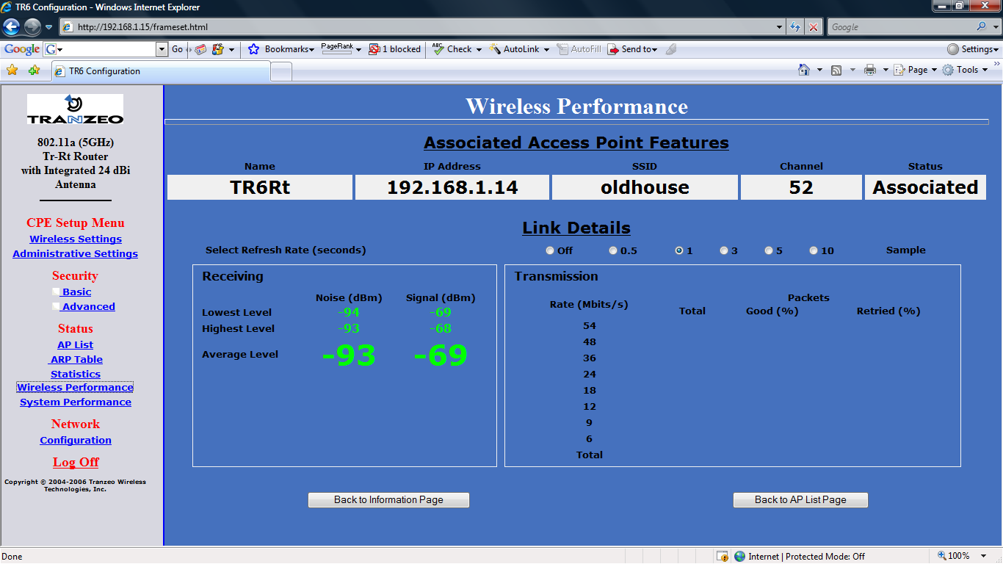
Incorrect Polarization

Slide 22
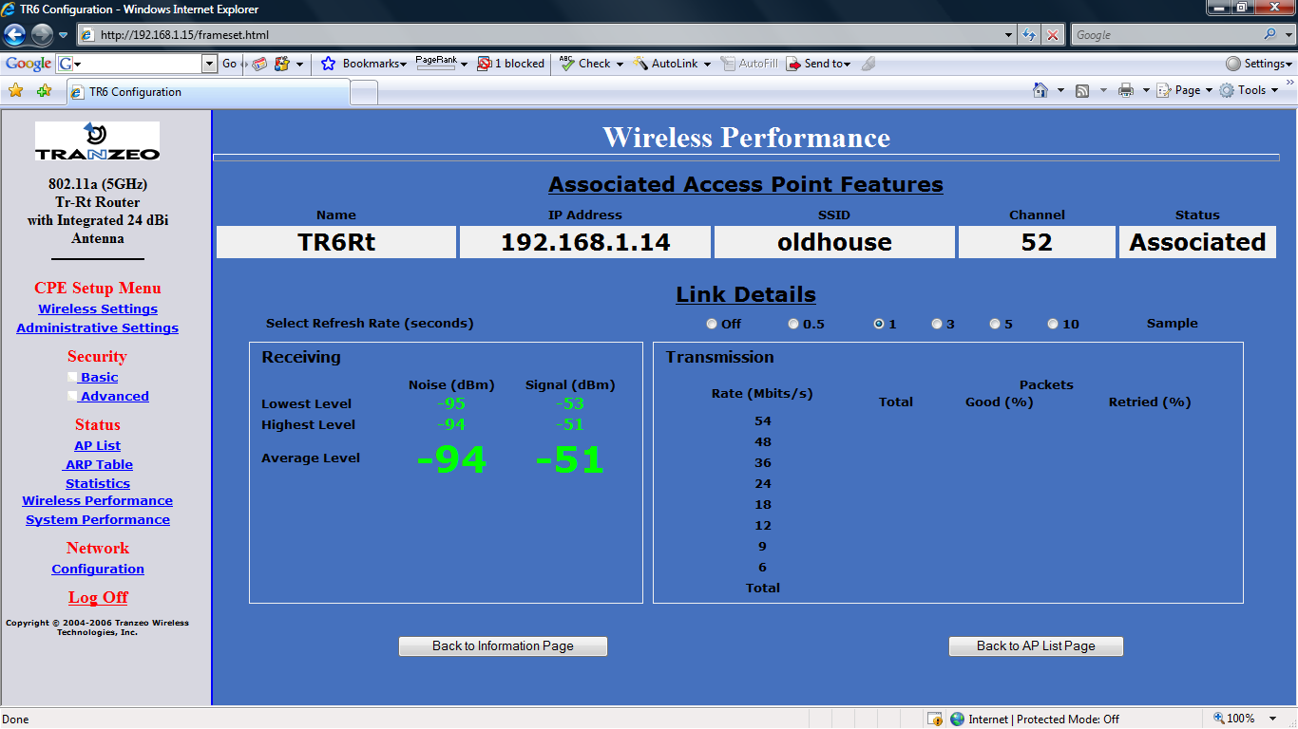
Correct Polarization

Slide 23
Lab
Polarization Demonstration

Slide 24
Signals
A signal in a RF or radio frequency system is produced by an electrical current flowing through a conductor
The antenna turns this current into invisible waves moving through the air from the transmitting end
Then at the receiving end the invisible waves are turned back into electrical current on a conductor

Slide 25
Signals
The invisible airborne waves are signals
Signals can be
Analog
Digital

Slide 26
Analog Signal
An analog signal is one that varies continuously from one value to another in the form of a sine wave, which is a waveform that represents periodic oscillations in which the amplitude of displacement at each point is proportional to the sine of the phase angle of the displacement

Slide 27
Analog Signal
Sine itself being the trigonometric function that for an acute angle is the ratio between the leg opposite the angle when it is considered part of a right triangle and the hypotenuse
In other words, the current or voltage varies with the sine of the elapsed time

Slide 28
Analog Signal

Slide 29
Digital Signal
A digital signal in contrast goes instantly from one value to another

Slide 30
Carrier and Information Signals
In radio frequency systems an analog signal is always used as the main airborne signal
This is the carrier signal
On top of this signal another signal, analog or digital, is added that carries the information
This is the information signal

Slide 31
Carrier and Information Signals
This combination of signals is called the modulation

Slide 32
Modulation
Modulation is how an information signal is added to a carrier signal
This is the superimposing of the information onto the carrier
In an RF system a modulator generates this information signal
Then it is passed to the transmitter and out the antenna

Slide 33
Modulation
In other words it is modulated
Then at the other end the signal is demodulated
The way to think of this is like a letter
The envelope is the carrier and the letter is the information
The envelope is only needed during transmission

Slide 34
Modulation
Modulation is why a perfect sine wave is desired
Modulators superimpose the information onto the sine wave by making tiny modifications to the sine wave
If the sine wave is not perfect, these small changes may be lost by the time the signal gets to the other end of the link

Slide 35
Types of Modulation
There are three forms of modulation
AM – Amplitude Modulation
FM – Frequency Modulation
PM – Phase Modulation

Slide 36
AM
AM changes the height of the sine wave as time goes by
For example

Slide 37
FM
FM changes the frequency of the sine wave as time goes by, without changing the height
For example

Slide 38
PM
PM changes the phase of successive sine waves
A
B
C
A LEADS B BY 30 DEGREES
B LEADS C BY 30 DEGREES
A LEADS C BY 60 DEGREES

Slide 39
PM
In general when you see phase modulation schemes explained B stands for binary, which is only 2 points
Q stands for quadrature, which is 4 points and 16 and 64 represent the higher number of points in the modulation schemes

Slide 40
PM
Every time the number of points is increased the speed is increased, but interference tolerance is reduced
This is one of the reasons for automatic speed reduction in the face of interference
Going from binary - 2 to 64 requires a really clean signal

Slide 41
PM Types

Slide 42
PM Types
Some encoding methods used with phase modulation methods are
MSK – Minimum Shift Keying
BPSK – Bi-Phase Shift Keying
QPSK – Quadrature Phase Shift Keying
DQPSK – Differential OPSK
GMSK – Gaussian Minimum Shift Keying

Slide 43
Signal to Noise Ratio
All communication systems generate noise and pickup noise that is naturally occurring
The signal to noise ratio is a ratio of the signal power divided by the noise power
It is measured in decibels

Slide 44
Sources of Noise
Noise consists of all undesired radio signals, whether manmade or natural
Noise makes the reception of useful information difficult
The radio signal’s strength is of little use, if the noise power is greater than the received signal power
This is why the signal to noise ratio is important

Slide 45
Sources of Noise
Increasing receiver amplification cannot improve the signal to noise ratio since both signal and noise will be amplified equally and the ratio will remain the same

Slide 46
Natural Noise
Naturally occurring noise has two main sources
Atmospheric noise, such as thunderstorms, from 0 to 5 MHz
Galactic noise, such as stars, at all higher frequencies
Both of these sources generate sharp pulses of electromagnetic energy over all frequencies

Slide 47
Natural Noise
The pulses are propagated according to the same laws as the desirable signals being generated by the radio frequency equipment
The receiving systems must accept them along with the desired signal

Slide 48
Manmade Noise
Manmade noise is part of modern life
It is generated almost anywhere that there is electrical activity, such as automobile ignition systems, power lines, motors, arc welders, fluorescent lights, and so on
Each occurrence is small, but there are so many that together they can completely hide a weak signal that would be above the natural noise in a less populated area

Slide 49
Manmade Noise
The most common sources of noise in the urban environment are automotive noise, power generating noise, and industrial noise
A Comparative Investigation on Urban Radio Noise…
Ming-Hui Chang and Ken-Huang Lin
IEEE Transactions on Broadcasting Vol. 50 Number 3 9-2004

Slide 50
Lab
Measure Noise Level

Slide 51
Active or Passive
There are a number of components that are used in RF systems
All of these are either
Active
or
Passive
An active device requires a power supply
A passive device does not

Slide 52
Loss
All components exhibit one of two properties
Loss
or
Gain
If the signal coming out is smaller than the signal going in, it is loss
Attenuators produce loss

Slide 53
Loss
Well everything else produces loss as well, but this loss is not by design
Loss is a passive process that appears as heat
This passive loss is called insertion loss

Slide 54
Attenuation
Causes of loss or attenuation in RF systems and the environments through which they transmit include
Water, regardless of how it appears or where it is found including inside connections
When water is encountered in the air as the signal passes through, the form of the moisture matters

Slide 55
Attenuation
At frequencies above 10 GHz attenuation from rain becomes significant
When the raindrop’s size matches the wavelength attenuation occurs
Raindrops vary in size from colloidal to about 6 to 8 mm equivalent spherical diameter
Limits to the size of raindrops are due to the drag that occurs as the raindrops fall through the atmosphere

Slide 56
Attenuation
At the maximum size the surface tension of the raindrop can no longer overcome the force placed on the raindrop by the atmospheric drag
Keep in mind that the determining factor in rain produced attenuation is not the total amount of rain that has fallen, but the instantaneous rainfall rate

Slide 57
Attenuation
Examples of the affect outside include
Rain causes about .08 dB of loss per mile for 2.4 GHz and 5.8 GHz
Fog causes about .03 dB per mile for 2.4 GHz
For 5.8 GHz the loss is about .11 dB per mile
Ice changes the effective design of an antenna, therefore changing its performance

Slide 58
Attenuation
Inside a structure
The packaging material, such as cardboard, has a water content
This will affect the signal in a warehouse or manufacturing location
The products themselves in many cases have a significant water content
In an office, hospital, or meeting environment the human beings attenuate the signal, as humans are basically large bags of water

Slide 59
Attenuation
As the frequency increases so does the affect of water on the signal
Below 10 GHz rain attenuation is not a major factor
A document from the International Telecommunications Union, ITU-R P.838-1 has a formula for computing the effect based on frequency and polarization

Slide 60
Attenuation
As the ITU formula shows a vertically polarized antenna is less susceptible to rain fade
All of this is why a realistic site survey must be done, the emphasis on realistic

Slide 61
Gain
If the signal gets larger before it exits the device, it is gain
RF amplifiers produce gain
Gain is an active process in most cases, in other words it requires a power source
Gain can also be the combination of signals from different directions appearing together, such as the main signal and a reflected signal

Slide 62
Gain
However, the total gain cannot exceed the original level transmitted from the antenna in such a case

Slide 63
dBm
This uses 1 mW or milliwatt as the standard
1 mW = 0 dBm
So 10 dBm means a signal that is 10 dB above 1 mW

Slide 64
dBi
The dBi refers to the gain of an antenna in relation to a theoretical isotropic radiator
This measure is used for antennas used for frequencies above 1 GHz

Slide 65
Lab
Lookup dBi ratings

Slide 66
dBd
This is the gain in decibels in relation to a standard half-wave dipole antenna
1 dBd = 2.15 dBi
The dBd is used for antennas for systems transmitting below 1 GHz

Slide 67
Bandwidth
Bandwidth is the difference between the highest and the lowest frequencies
There is a relationship between bandwidth and carrying capacity in terms of the amount of data that can be transmitted
Although significant, bandwidth is not as important as actual throughput, which is the amount of data pushed through a real network

Slide 68
Propagation Factors
The propagation of the radio waves through the atmosphere is how the information travels from one point to another in a wireless data network
For the types of networks of interest here, this propagation occurs entirely within the atmosphere near the Earth
The Earth’s atmosphere is divided into layers

Slide 69
Propagation Factors
The troposphere is the first layer
It starts at the Earth’s surface and goes up to about 10 kilometers
Air in this layer decreases in temperature at a rate of about 2.5° C for every 300 meters of altitude gained
The second layer of the atmosphere is the stratosphere

Slide 70
Propagation Factors
It extends from about 10 km to 50 km
The air in this layer maintains a nearly constant temperature of about -65° C
Above about 50 km and extending upward to more than 500 km is the ionosphere
The ionosphere gets its name because the molecules in it are ionized

Slide 71
Propagation Factors
Electrons have been stripped from the atoms by the bombardment of the Sun’s rays and other high energy particles from the Sun
These ionized particles with large quantities of free electrons act on any radio waves that pass through the ionosphere

Slide 72
Propagation Factors
Radio waves move from the transmitter to the receiver using sky waves or ground waves
Sky waves bounce the signal off of the ionosphere, where it is refracted back to the Earth
The other method, and the one of interest here, is by ground wave

Slide 73
Propagation Factors
Sky waves operate in the 2 to 30 MHz range
A ground wave propagates directly from the transmitter to the receiver
Ground wave propagation is affected by several factors which determine how much of the radio wave is readable when it arrives at the other end, including

Slide 74
Propagation Factors
The transmitter’s power output
The frequency being transmitted
The effect of the Earth’s shape in between the points
The conductivity of the Earth along the transmission path
The microclimate through which the signal passes

Slide 75
Propagation Factors
The ground wave has three components
Direct wave
Ground reflected wave
Surface wave
The direct wave travels directly from the transmitting antenna to the receiving antenna

Slide 76
Propagation Factors
This wave is limited to the line of sight distance between the transmitting antenna and the receiving antenna
The distance can be extended by atmospheric refraction and diffraction of the wave around the Earth’s curvature

Slide 77
Propagation Factors
Raising the antenna at one or both ends helps to extend this distance
The ground reflected wave bounces off of the surface and then to the receiving antenna
Multipath as discussed later, is a result of the ground reflected component and the direct wave component arriving at the receiving antenna at different times

Slide 78
Propagation Factors
The surface wave follows the Earth’s curvature
It is most affected by the Earth’s conductivity and dielectric constant

Slide 79
Ground Waves
The frequency mainly determines which wave component will carry the information signal
For example, when the Earth’s conductivity is high and the frequency of a radiated signal is low, the surface wave is the predominant component
For the lowest radio frequency signals the surface wave is usually the main method of propagation

Slide 80
Ground Waves
Above 10 MHz, radio waves begin to be absorbed more by the ground or other surface, so the direct becomes the most important
In the 30 to 300 kHz range, ground losses are very small, so the radio wave follows the Earth’s surface or curvature quite well

Slide 81
Ground Waves
These frequencies can be used for long distance communication with sufficient transmitter power
The next set of frequencies, those from 300 kHz to 3 MHz, are used for long distance communications over sea water and for medium distance communication over land

Slide 82
Ground Waves
Above 3 MHz in the 3 to 30 MHz range, the ground’s conductivity is a significant factor
Especially above 10 MHz, the conductivity of the Earth’s surface determines how much signal absorption occurs

Slide 83
Ground Waves
Both the frequency and the characteristics of the surface over which the signal travels determines how much of that signal is lost to absorption by the surface
The best transmission occurs when the signal is at a low frequency and the surface is highly conductive

Slide 84
Effect of Earth’s Conductivity
In general the Earth’s surface has poor conductivity
But some surfaces are better than others
For example a commonly used table shows

Slide 85
Effect of Earth’s Conductivity
Surface Type | Relative Conductivity
Large body fresh water | Very good
Ocean or sea water | Good
Flat or hilly loam | Fair
Rocky terrain | Poor
Desert | Poor
Jungle | Very Poor

Slide 86
Effect of Earth’s Conductivity
Keep in mind that the various factors that act on propagation as discussed here interact or one factor may help in relation to one thing and be an impediment in relation to another
For example, as seen just above water has good conductivity in relation to other surfaces

Slide 87
Effect of Earth’s Conductivity
However, water makes problems from reflections of the signal much worse
The exact interaction of all of these various factors and their permutations is quite difficult to characterize

Slide 88
Ducting
At the frequencies of interest here sky wave propagation is not much of a factor so the ionosphere can be ignored
The only sky wave phenomena of interest is the ducting phenomena
Ducting is a form of refraction
It is the bending of a wave as it passes through air layers of different density

Slide 89
Ducting
Ducting occurs in semitropical regions, when a layer of air 5 to 100 meters thick with abnormal characteristics forms
This is normally the result of a temperature inversion
For example, on a warm day after a rainy period, the Sun may heat up the ground and create a layer of warm, moist air

Slide 90
Ducting
As the sun goes down, the air a few meters above the ground will cool very quickly, while the moisture in the air near the ground holds the remaining heat there
A large difference in temperature occurs between the air near the ground and the air at a height of 10 to 20 meters, resulting in a difference in air pressure

Slide 91
Ducting
When a radio wave in the VHF or UHF range is transmitted into this air mass, it may bend along the temperature or inversion layer
This layer then acts as a channel or duct between the transmitting antenna and an unusually distant receiving antenna that normally would not be able to receive the signal

Slide 92
Ducting
Ducting is measured by the k-factor or refractivity gradient
The k-factor can change frequently and different regions have different values
A k-factor higher than 1 means a microwave signal will tend to bend downward toward the earth

Slide 93
Ducting
The result is the radio horizon is now much further away than would normally be the case
In other words the signal will curve around the earth when in more typical weather conditions, it would not
Moreover, if the k-factor is less than one, then the microwave signal will not travel as far as expected

Slide 94
General Atmospheric Factors
In addition to the ducting phenomena, temperature changes in general along with other atmospheric factors will commonly produce a daily variance in signal strength
As the day goes by the temperature may go up and the humidity down, then as the sun goes down the reverse happens
Air density as expressed by atmospheric pressure also affects propagation

Slide 95
General Atmospheric Factors
For example, here is a report from a wireless related mailing list concerning these effects
I have watched my links long enough now to observe signal strength patterns and have noticed a very repeatable pattern
My strongest signals usually occur near midnight

Slide 96
General Atmospheric Factors
Then they will fade slightly until around 8 AM, where they come back up a bit until around 2 PM, when they again, slowly fade, until they are the worst around 6-7 pm, where they stay until around 9 pm, where they slowly start back up until around midnight

Slide 97
Environmental Factors
As radio waves move along in their journey from here to there, they are acted upon by many things
Most of these many things are not good
Everything an RF signal encounters on its journey has an effect on the signal
The effect is usually to make the signal smaller or to changes its direction in some way

Slide 98
Environmental Factors
These things that have an effect include
Free Space Loss
Absorption
Reflection
Refraction
Diffraction
Scattering

Slide 99
Free Space Loss
The free space loss is the widening out of the signal as it moves away from the antenna
The effect is a loss of signal strength at the receiving end of the link
Just think of water coming out of a water hose, it can only go so far
Propagation loss increases with respect to both distance and frequency

Slide 100
Free Space Loss
In other words, higher frequency signals loose more than lower frequency signals, because the short wavelengths of the higher frequencies cannot bend around objects as can longer wavelengths

Slide 101
Free Space Path Loss
The result being systems that use the short wavelengths must be line of site
The formula is
L = C + (20 * Log(D)) + (20 * Log(F))
For both measuring systems
D = Distance
F = Frequency
For kilometers C = 32.4
For miles C = 36.6

Slide 102
Lab
Free Space Loss
In the hall move further down the hall

Slide 103
Absorption
Free space loss is only the beginning of the losses suffered by the signal as it goes from here to there
Absorption is insertion loss caused by things the signals run into

Slide 104
Absorption
For the wavelengths of interest here the amount of loss experienced by a radio wave from absorption depends on the materials the wave encounters on its journey and the effects of the Earth’s surface over which it travels

Slide 105
Absorption
These high frequencies with their short wavelengths are absorbed by the Earth at points relatively close to the point of transmission
In general as the frequency goes up, the more rapidly will the wave be absorbed by the Earth

Slide 106
Absorption
So straight line, long distance transmission at heights close to the Earth’s surface is impractical above 2 MHz
Further the size of the obstacle in comparison to the size of the wavelength is important
When short wavelengths as are used in these wireless systems hit large obstacles, such as a tree, the signal is blocked

Slide 107
Absorption
Lower frequency signals are desired for this type of non line of sight penetration
In the types of systems used to create data and multimedia networks for deployment outside, the main absorption problem encountered is vegetation
There are no firm numbers for this problem, but some general statements can be made

Slide 108
Absorption
This absorption is due to the water content of the vegetation and the frequency of the signal
For full foliage trees in the Northern Hemisphere research suggests these values for the absorption effect of vegetation

Slide 109
Absorption
870 MHz
.2 to 1.3 dB per meter of foliage or 11 dB per tree
1.6 GHz
.5 to 1.3 dB per meter of foliage or 11 dB per tree
5 GHz
1.2 to 2 dB per meter or 20 dB per tree
20 GHz
2 to 4 dB per meter of foliage or 23 dB per tree

Slide 110
Absorption
Studies suggest that the wood part of the tree is the major factor in tree related attenuation at frequencies from 870 MHz to 4 GHz
With the leaves adding from 35% additional attenuation at 870 MHz to 15% additional at 1.6 GHz
At 20 GHz the wood and leaves are both important

Slide 111
Absorption
An ITU - International Telecommunication Union study on this subject also states that the attenuation caused by vegetation varies widely due to the irregular shape of vegetation, as well as the wide range of sizes, shapes, densities, and water content of the various species

Slide 112
Absorption
In addition to the attenuation caused by absorption, foliage also causes scattering as discussed below, especially at the lower frequencies around 900 MHz

Slide 113
Absorption

Slide 114
Lab
Measure Absorption
Both units in the hall
Both units in classrooms

Slide 115
Reflection
Reflection is a change in direction of the signal caused by something the signal cannot penetrate
The amount of reflection depends on the wavelength and the material the object is made of
Reflection occurs when the object has a very large dimension compared to the wavelength

Slide 116
Reflection
As most of the wavelengths used in wireless systems are very short in comparison to the objects they encounter on their journey, most things in the environment cause reflection
If the material does not absorb all of the signal, some must bounce off or be reflected in another direction

Slide 117
Reflection
A smooth metal surface with good electrical conductivity does this
Reflection appears as multipath
Surfaces made of metal or water exhibit severe reflection
Antenna diversity or modulation techniques are used to help with this multipath problem

Slide 118
Reflection

Slide 119
Refraction
Refraction is the bending of a wave as it passes through an object
It is not reflected off, but mostly passes through the object
The signal that passes through goes off in a direction different from that which it entered the object
The obstruction that causes the refraction is not always obvious

Slide 120
Refraction
Atmospheric refraction is an example of this
In atmospheric refraction when the wave front reaches a area of less dense air it starts to travel faster than the part of the wave front still in the more dense air
This causes the part of the wave front to bend

Slide 121
Refraction
Ducting as discussed earlier is the common effect see from this type of refraction
Usually refraction and reflection both occur at the same time

Slide 122
Refraction

Slide 123
Diffraction
Diffraction occurs when a RF wave is obstructed by a surface that has sharp edges or a rough surface, such as the edge of a building or a hill
The signal moves around the object and back to the other side
But a shadowed area appears behind the object

Slide 124
Diffraction

Slide 125
Diffraction

Slide 126
Scattering
Scattering occurs when the radio waves hit a large number of objects whose dimensions are smaller than the wavelength of the wave
In the frequencies of interest here, common causes of this are foliage, street signs, and other such things found in the environment

Slide 127
Scattering
In addition to the scattering caused by the leaves Pelet, Salt, and Wells report that the swaying of the tree branches due to wind whether the leaves are present or not introduces additional loss due to scattering
Effect of Wind on Foliage Obstructed Line-of-Sight…
Eric R. Pelet, J. Eric Salt, and Garth Wells
IEEE Transactions on Broadcasting, Vol. 50 Number 3 9-2004

Slide 128
Scattering

Slide 129
Link Budget
To account for all of these various impediments to the successful transmission of a radio frequency signal from one end of a link to the other we need to compute a link budget
To do this we compute the transmitted power from one end of the link, then also compute the received power at the other end of the link

Slide 130
Link Budget
By computing this for one end point we can assume it is the same at both ends for this simple case
Once this number is computed it must be compared to the sensitivity of a radio at the desired data rate and an acceptable bit error rate

Slide 131
Link Budget
The difference between these two numbers must be large enough so that changes in the dynamic environment in which wireless networks operate will not take the link down
Therefore, the number to compute is the received power at one end point

Slide 132
Link Budget
It would be nice if this number was exactly the same as the power generated at the transmitter on the originating end
It will never be so
Let’s next examine what things will cause the received power to be lower than the transmitted power

Slide 133
Link Budget
The formula for this computation is
Ps – L = Pr
or
Power Sent Minus Losses Equals Power Received

Slide 134
Link Budget
What determines the power sent
Power sent is made up of two components
First, is the power output of the radio
This is typically expressed for the equipment we use in milliwatts or mW
This number must be converted to dBm
The formula for this is
dBm = 10xLog(Power in mW)

Slide 135
Link Budget
Second, is the gain of the antenna
This is expressed as a dBi rating
Recall that dBs in any form can be added and subtracted without conversion
For example, a Cisco Aironet 1300 radio has a maximum power output of 100 mW or 20 dBm
The antenna built-in to the unit has a gain of 13 dBi
This makes the maximum transmitted power 33 dBm

Slide 136
Link Budget
So now we have the power generated at the originating point
What then is the power received
The difference between the power generated and the power received is due to signal loss in the environment between the originating radio and the receiving radio

Slide 137
Link Budget
Loss takes many forms
Some of these can be measured, some computed, and some merely inferred
One form of loss that will always be encountered is free space loss
Recall the free space loss is due to the spreading of the signal as it moves away from originating radio

Slide 138
Link Budget
The total power is still there, but the receiving antenna will only be able to receive a small portion of that total power
Free space loss is dependent on the frequency of the signal and the distance between the two antennas
The formula is
Free Space Loss = 32.4+20xLogFinMHz+20xLogRinKilometers
FinMHz is the frequency in MHz
RinKilometers is the distance in kilometers

Slide 139
Link Budget
The additional loss factors may or may not apply to a particular link
The line of sight between the two points must be examined to see what if any of these factors exist
To determine this make an onsite examination or at least consult a recent photograph

Slide 140
Link Budget
Here are some common loss factors to look for
Obstructions
Fresnel Zone
Earth Bulge
Absorption
Water in all its forms, such as leaves in trees, rain, and fog
This can be computed based on the size and composition of the obstacle or a climate or terrain factor can be used for a generalized estimate

Slide 141
Link Budget
Multipath
Connection Losses
Connectors
Cables
Antenna Movement
Due to wind
Due to vibration

Slide 142
Link Budget
The loss due to absorption is particularly difficult to account far as it can vary so much depending on the exact nature of the obstruction
Multipath is impossible to measure in the real world
It is mostly inferred

Slide 143
Link Budget
To overcome this power loss the obvious answer is to just turn the power up
But you cannot do this as there are regulations that limit the maximum power that may be generated
This is expressed as the EIRP – Effective Isotropically Radiated Power
Once you are at maximum power, the only thing that can be done is to

Slide 144
Link Budget
Shorten the distance
Change the frequency
Use equipment with better sensitivity

Slide 145
Link Budget
Power received then is the power generated minus the various losses that occur from one end of the link to the other
Some of this loss is overcome by the gain of the receiving antenna
So in more detail the link budget formula is
Radio Power at the Sending Radio + Antenna Gain at the Sending End – Losses of All Types + Antenna Gain at the Receiving End

Slide 146
Link Budget
For more information on this examine the following
NBS Technical Note 101 from 1967
Epstien-Peterson method discussions
Okumura-Hara model discussions
Longley-Rice model discussions

Slide 147
Lab
Compute Link Budget

Slide 148
Interference Temperature
Interference among radio frequency systems is currently minimized by coordinating frequency usage or by limiting the power of a transmitter
In contrast the interference temperature model sets a maximum noise level for an entire band

Slide 149
Interference Temperature
New systems can be placed in service beside existing systems, if it is anticipated that the interference temperature limit would not be exceeded
For this to work the interference temperature would have to be monitored by the systems that would share the spectrum

Slide 150
Interference Temperature
This requires that cognitive radios be developed that can sense the interference temperature and adjust themselves accordingly

