Slide 1
Radio Frequency Systems Basic Parts
Last Update 2012.03.27
1.4.0

Slide 2
The Basic Parts
There are just five basic parts in a radio frequency based communication system
  Antenna
  Amplifier
  Filter
  Mixer
  Source

Slide 3
The Basic Parts
These five parts are then put together to do one of two basic functions
  Transmit
  Receive
The name of the resulting device is a radio

Slide 4
A Radio
The radio may also go by many other names based on marketing considerations or its specific role in the wireless network
A radio is used to send and receive a signal that flows through the air as a series of electromagnetic waves
Radios can take on many different forms, as such it is not always easy to identify them

Slide 5
The Transmitter
When transmitting or receiving the goal is to produce a perfect sine wave, of the exact size required, at only one frequency
A block diagram of the basic parts looks like this
For a transmitter

Slide 6
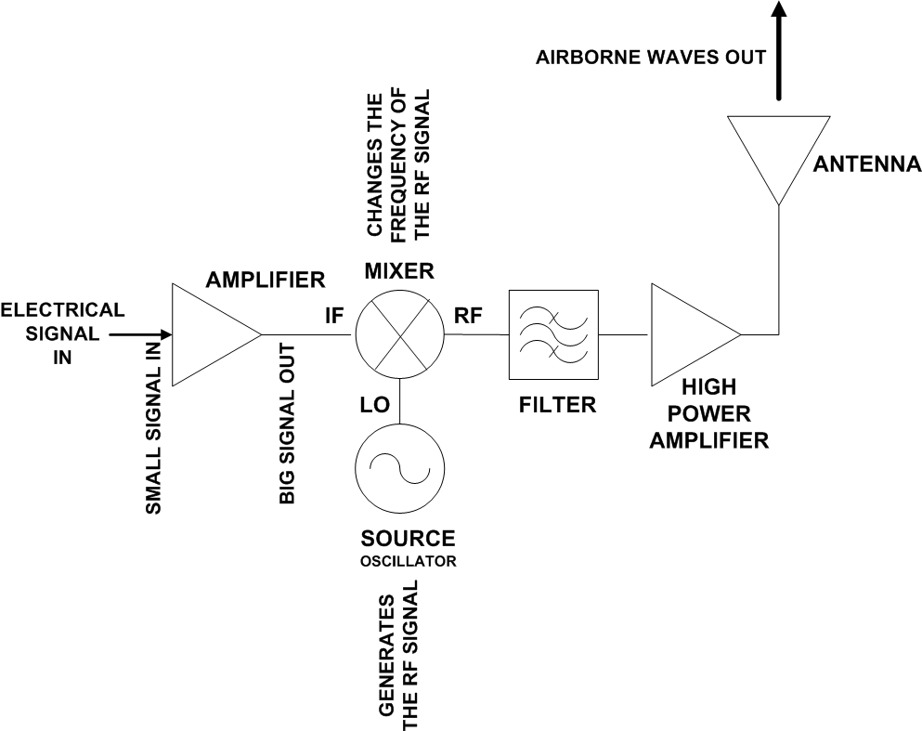
Transmitter Block Diagram

Slide 7
The Receiver
A block diagram of the basic parts looks like this
For a receiver

Slide 8
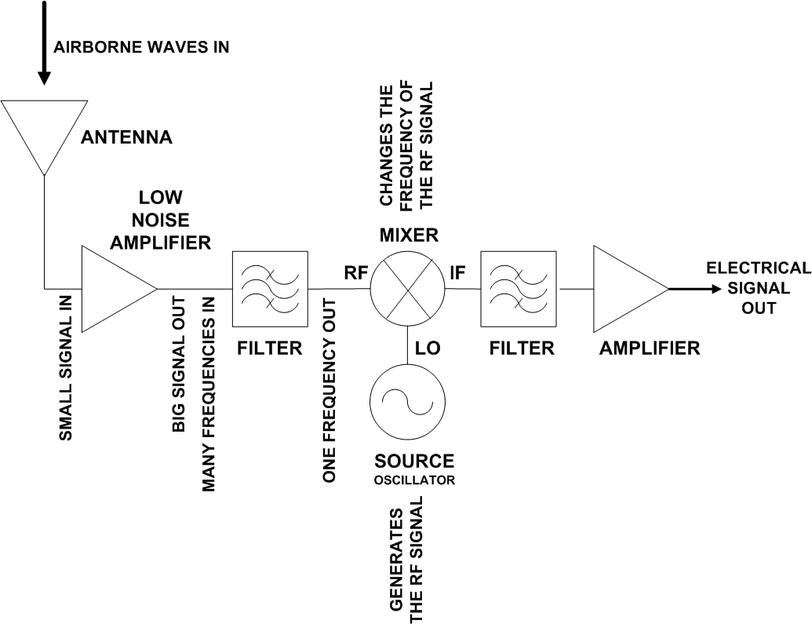
Receiver Block Diagram

Slide 9
The Basic Parts
The main job of the manufacturers of these basic parts is to attempt to make them
  Smaller
  Lighter
  More energy efficient
  Lower in cost
Now on to some details on each of these parts

Slide 10
What is an Antenna
Every radio frequency wireless system must have an antenna
You may not see it
You may not recognize it, if you do see it
But it must be there somewhere

Slide 11
What is an Antenna
The antenna does only one thing, it converts electrical signals coming from a conductor into airborne waves or it converts airborne waves into electrical signals to be sent down a conductor
Being a resonant device it operates efficiently over a narrow frequency band

Slide 12
How an Antenna Works
The real way an antenna does its work is somewhat complex
But for this level of discussion lets say it this way
An antenna begins to radiate energy, in the form of radio frequency waves, whenever the length of the antenna becomes close to the wavelength of the signal

Slide 13
How an Antenna Works
When an alternating electric current flows through a conductor, electric and magnetic fields are created around the conductor
If the length of the conductor is very short compared to a wavelength, the electric and magnetic fields will generally fade out within one or two wavelengths

Slide 14
How an Antenna Works
But as the conductor is lengthened, the intensity of the fields around it grow bigger
As such, an ever increasing amount of energy escapes into space

Slide 15
Why Are Antennas So Short
It seems in the real world that antennas are always shorter than basic theory would suggest they must be
This is because when the length of the wire approaches one-half a wavelength at the frequency of the applied alternating current, most of the energy will escape as electromagnetic radiation

Slide 16
Why Are Antennas So Short
So an antenna starts work early
Further, the ground itself is a good conductor for medium and low frequencies and acts as a large mirror for the radiated energy
The ground reflects a large amount of energy that is radiated downward from an antenna mounted over it

Slide 17
Why Are Antennas So Short
Using this characteristic of the ground, an antenna only a quarter-wavelength long can be made into the equivalent of a half-wavelength antenna
All of this means that a quarter-wavelength antenna standing vertically, with its lower end connected electrically to the ground acts just like a half-wave antenna

Slide 18
Why Are Antennas So Short
The ground takes the place of the missing quarter-wavelength
The reflections supply that part of the radiated energy that normally would be supplied by the lower half of an ungrounded half-wavelength antenna

Slide 19
Why Are Antennas So Short
At the low and medium frequencies, the ground acts as a good conductor
At the higher frequencies, artificial grounds constructed of large metal surfaces can be used to achieve this effect
Another factor is that the antenna length of a half-wave dipole is somewhat less than a half-wavelength due to end effect

Slide 20
Why Are Antennas So Short
Lastly, the speed of propagation in coaxial cable is slower than in air, so the wavelength in the cable is shorter

Slide 21
Antenna Radiation Pattern
When selecting an antenna the width of the area to be covered and the distance of each link must be considered
These considerations will then determine the type of antenna to use based on each antenna’s signal pattern
Every antenna has a pattern to the signal
This pattern applies to both sending and receiving

Slide 22
Antenna Radiation Pattern
By convention the radiation line used to draw this pattern is drawn wherever the power radiating out drops to one half the power at the antenna surface
For example, for a dipole antenna

Slide 23
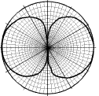
Antenna Radiation Pattern

Slide 24
Antenna Radiation Pattern
As opposed to a directional antenna

Slide 25
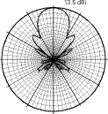
Antenna Radiation Pattern

Slide 26
Antenna Radiation Pattern
Note in the diagram above that the radiation pattern does not have an even outline
In that there is a large main lobe, which is desired, and one or more side lobes, which are undesirable
These side lobes are also called the minor lobes

Slide 27
Antenna Radiation Pattern
Antennas also have a front to back ratio that is measured in dBs
The forward gain is the peak gain on the main lobe of the antenna
The rear gain is measured as either the gain at exactly 180 degrees from the main lobe, or from 90 degrees to 270 degrees from the main lobe

Slide 28
Antenna Radiation Pattern
Using the wider sector is the better way to measure this
These back lobes are also undesirable
A front to back ratio of 10-15 dB is considered fair to poor, 15-20 dB is good, 20-30 dB is very good, and above 30 dB is excellent

Slide 29
Antenna Radiation Pattern
The regions in between the main and minor lobes are areas of weak signals called nulls

Slide 30
Antenna Radiation Pattern
Main
or
Major Front Lobe
Null
Side or Minor Lobe
Back Lobe

Slide 31
Antenna Radiation Pattern
The pattern provided by the manufacturer can be a rectangular grid or the more popular polar coordinate system just shown
The plotting scales used range from linear to linear logarithmic to modified logarithmic
The linear logarithmic and modified logarithmic are the ones most commonly used

Slide 32
Antenna Radiation Pattern
These scales show the side and back lobes as well as the main lobe
For antennas in the frequencies of interest here these patterns are for the far field of the antenna
The far field region is the area in which wave propagation occurs
This field starts basically 10 wavelengths from the antenna

Slide 33
Antenna Radiation Pattern
The radiation pattern of an antenna is adjusted in most cases by adding reflectors and directors
The reflector adds gain to the antenna, in relation to the isotropic antenna, by redirecting the signal
The director then concentrates the beam into an even tighter pattern

Slide 34
Lab
Find Radiation Patterns

Slide 35
Reflector
In general the directivity of the antenna is changed by adding a reflector behind the main antenna transmitting element
There are several types of reflectors
  Corner reflector
  Trough reflector
  Panel reflector

Slide 36
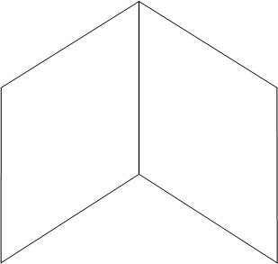
Corner Reflector Style

Slide 37
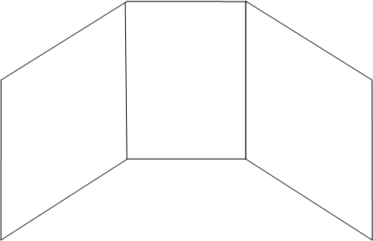
Trough Reflector Style

Slide 38
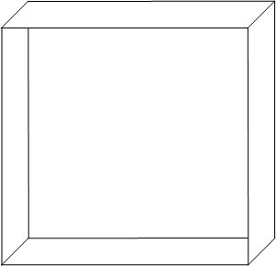
Panel Reflector Style

Slide 39
Reflector
The reflector is about 5 percent longer than the driven element
The driven element being the basic antenna
It is placed parallel to the driven element about ¼ quarter wavelength from it
There is no electrical connection between these two elements

Slide 40
Reflector
The reflector works because the radio waves leave the driven element, then encounter the reflector
Since the reflector is longer, both physically and electrically, than the driven element the signal is bounced back toward the antenna element itself

Slide 41
Reflector
These reflected waves then join up with the radiated waves to increase the signal that leaves the antenna
This stronger signal is sent off in a direction opposite to the location of the reflector

Slide 42
Reflector
Reflector
Driven Element

Slide 43
Director
For even more directivity a director can be added to the antenna as well
The director is an antenna element that is 5 percent shorter than the driven element
The director is placed parallel and ¼ wavelength in front of the driven element
There is no electrical connection between these elements

Slide 44
Director
The effect of the director, being shorter than the driven element, is to draw the radio waves to it
This serves to force the waves into a tighter beam

Slide 45
Director
Driven Element
Director

Slide 46
Passive or Active Antenna
An antenna can be a passive device or it can be an active device
In other words, it either has a power supply attached or it does not
The passive antenna is just a shape, a piece of metal configured into whatever form is required for the specific application

Slide 47
Passive and Active Antenna
The active antenna is just a shape, a piece of metal configured into whatever form is required for the specific application and with a power supply

Slide 48
Active Antenna
The power supply for an active antenna can be a separate device or more likely the power comes in on the same connection as the RF signal

Slide 49
Antenna Size and Shape
The size and shape of an antenna depends on three things
  Frequency
  Direction
  Power
In general the lower the frequency the larger the antenna

Slide 50
Antenna Size and Shape
So even though we would get better coverage if cell phone cells were the size of AM broadcast areas, the antenna would be somewhat too large for the average size pocket

Slide 51
Antenna Gain
All antennas have gain
However this may or may not be real gain
Real gain is that produced by applying a power supply directly to the antenna
Yet even passive antennas have gain
How is this possible
It is so because antenna gain is measured in relation to a theoretical antenna called an isotropic antenna

Slide 52
Antenna Gain
There is no such real thing as an isotropic antenna
If there was it would show a radiation pattern where the signal radiated out from a single point in space equally in all directions
In other words a radiation ball
As in

Slide 53
Antenna Gain
Go get a balloon

Slide 54
Antenna Gain

Slide 55
Antenna Gain
Well not exactly a basketball, but you get the idea
The energy then goes equally in all directions
Since an isotropic radiator cannot be produced, any real antenna will have some gain when compared to it
So antenna gain is a combination of directional gain and power gain

Slide 56
Antenna Gain
There is always directional gain, in relation to the isotropic radiator’s radiation pattern
There is also power gain, if the antenna is an active antenna
This directional gain is expressed in relation to the isotropic radiator by using decibels
In this case a special decibel, the dBi

Slide 57
Antenna Gain
A second measure that is important to antenna gain is the power coming out of the antenna
The output power of the antenna is named the EIRP – Equivalent Isotropically Radiated Power as discussed below

Slide 58
Lab
Find Gain of Antennas

Slide 59
Beamwidth
Another aspect to keep in mind when setting up an antenna is the beamwidth it produces
The beamwidth has two aspects
  Vertical
  Horizontal
The vertical beamwidth is perpendicular to the Earth’s surface and the horizontal beamwidth is parallel to the Earth’s surface

Slide 60
Beamwidth
Antenna design determines beamwidth
Common ranges for different types of antennas are

Slide 61
Beamwidth
Antenna Type | Vertical | Horizontal
Omni | 7 - 80 | 360
Patch or Panel | 6 – 90 | 30 – 180
Yagi | 14 – 64 | 30 – 78
Parabolic Dish | 4 – 21 | 4 - 25

Slide 62
Lab
Find Beamwidth of Antennas

Slide 63
The 6 dB Rule
A useful rule for estimating range of an antenna is the 6 dB rule
In this relationship a 6 dB increase in EIRP doubles the range, whereas a 6 dB decrease in EIRP halves the range
For example

Slide 64
The 6 dB Rule
Distance in Meters | Loss in dB
100 | 80.23
200 | 86.25
500 | 94.21
1,000 | 100.23
2,000 | 106.25
5,000 | 114.21
10,000 | 120.23

Slide 65
Antenna Shapes
Antennas come in all sorts of shapes and sizes
However, in general there are two basic shapes
  One dimensional
  Two dimensional

Slide 66
One Dimensional Antennas
A one dimensional antenna is a piece of wire
It is either straight or in some shape
A common one dimensional antenna is the monopole
This is straight wire that is approximately one quarter of the wavelength of the radio frequency signal

Slide 67
One Dimensional Antennas
Another common type is the dipole, which is two monopoles connected together
Dipoles are commonly used, since a half wavelength antenna radiates radio frequency energy really well
A monopole stuck in the ground acts like a dipole
Therefore, it only needs to be half as long as the dipole

Slide 68
Two Dimensional Antennas
When antennas use two dimensions they may look like almost anything from a patch to a dish as detailed below

Slide 69
Deploying Antennas
When deploying an antenna there are several factors to consider including
  Line of Site
  Fresnel Zone

Slide 70
Line of Site
LOS – Line of Sight means the ability of one antenna to see the other antenna
As in

Slide 71
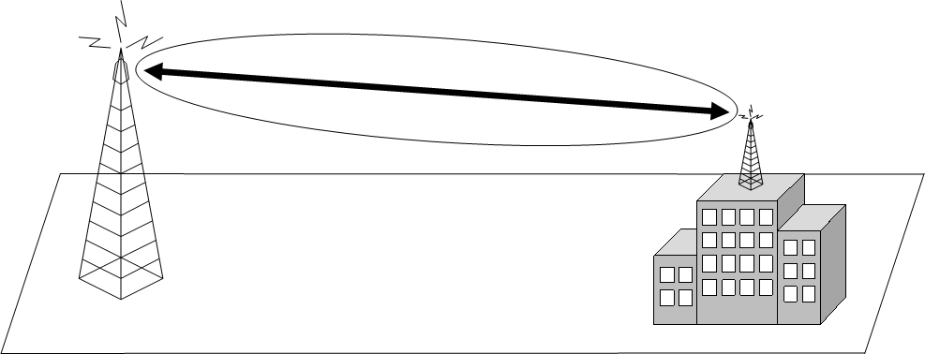
Line of Site

Slide 72
Fresnel Zone
The Fresnel Zone is an ellipsoid around the direct line of sight between two antennas
The first Fresnel zone is a surface containing all points for which the sum of the distances from that point to the ends is exactly ½ wavelength longer than the direct path

Slide 73
Fresnel Zone
Each subsequent Fresnel zone surrounding this first zone is some multiple of ½ wavelength either in phase out of phase with the direct wave, thereby producing constructive or destructive multipath signals
Anything that extends into the first Fresnel zone, such as trees, hills, buildings, can diffract or reflect or degrade the signal

Slide 74
Fresnel Zone
This zone is three dimensional
Therefore account for objects that protrude in from the sides as well as those that stick up
The higher the frequency, the shorter the Fresnel Zone
Also the longer the path, the broader the zone

Slide 75
Fresnel Zone
Usually up to 20% to 40% blockage of the Fresnel Zone will not cause a problem
Envision this as a slightly elongated football with a string running through the middle of it connecting the two points
The football is the Fresnel Zone and the string is the visual line of sight

Slide 76
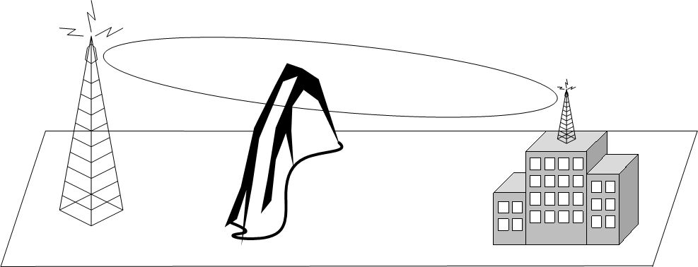
Fresnel Zone

Slide 77
Fresnel Zone
To calculate the height of the Fresnel zone use this formula for meters
  h = height of the Fresnel zone in meters
  dFirstEnd = distance between the first antenna and the tip of the obstacle in kilometers
  dSecondEnd = distance from the second antenna to the tip of the obstacle in kilometers
  f = frequency in GHz

Slide 78
Fresnel Zone
To calculate the height of the Fresnel zone use this formula for feet
  h = height of the Fresnel zone in feet
  dFirstEnd = distance between the first antenna and the tip of the obstacle in miles
  dSecondEnd = distance from the second antenna to the tip of the obstacle in miles
  f = frequency in GHz

Slide 79
Fresnel Zone
The two formulas just shown assume the obstacle has a fairly sharp point at the top, such as a single tower
If the obstacle is more like a wide, flat top, hill; then the loss is much higher
Further, this also assumes there is just one thing in the way
Many times there are several obstacles along the way

Slide 80
Fresnel Zone
It is very difficult to model such a thing
This is why a fade margin is used
It attempts to account for all of these things for which exact calculations cannot be done

Slide 81
Lab
Compute Fresnel Zone

Slide 82
Earth Bulge
For distances over seven miles the curvature of the earth must be considered
The formula for this is
  h = additional height required in feet
  D = distance between the antennas in miles
This formula yields the additional antenna height required to account for the bulge

Slide 83
Intentional Radiator
An intentional radiator is the entire RF system, except for the antenna itself
As in

Slide 84
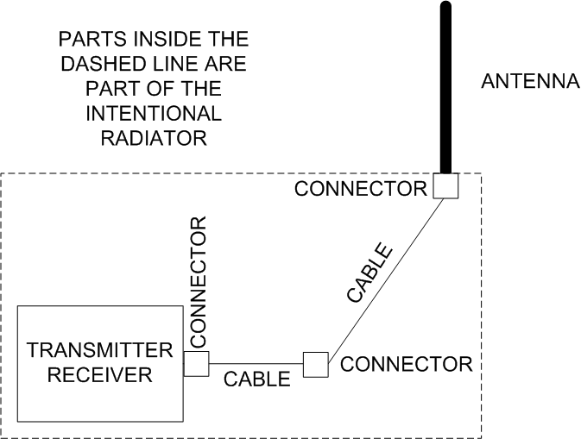
Intentional Radiator

Slide 85
Intentional Radiator
The power output of the intentional radiator is the power output at the end of the last connection before the antenna

Slide 86
EIRP
EIRP – Equivalent Isotropically Radiated Power is the power actually radiated by the antenna itself
It includes the gain added by the antenna
This power level is regulated by the FCC
EIRP = Transmit Power + Antenna Gain
or
EIRP = dBW/dBm+dBi-Line Loss

Slide 87
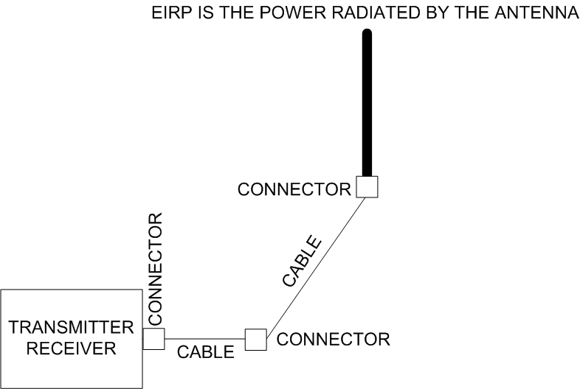
EIRP

Slide 88
Lab
Computer EIRP of Various Radio and Antenna Combinations

Slide 89
Other Radiators
There are two other types of radiators
  Unintentional Radiator
    These devices generate radio frequency emissions inside themselves incidental to their normal operation
    But they are not intended to emit these
    Such as computers, printers, and disk drives

Slide 90
Other Radiators
  Incidental Radiator
    These devices generate radio frequency energy as part of their normal operation
    But they are not intended to emit these
    Such as motors and generators

Slide 91
Power Output Rules
One of the ways various regulatory bodies ensure everyone can share the same unlicensed spectrum is to impose rules concerning the maximum power output
This is expressed as the maximum EIRP that may be radiated from the antenna

Slide 92
Power Output Rules
The rules that apply depend on two factors
  Is this an experienced or any inexperienced person installing the equipment
  Is this a Point to multipoint or a point-to-point link
Here are the rules

Slide 93
Power Output Rules
Point to Multipoint Rules
Type of User | Radio Power | Antenna Gain | EIRP
Consumer | 30 dBm | 6 dBm | 36 dBm
Experienced Installer | 20 dBm | 36 dBm | 36 dBm

Slide 94
Power Output Rules
Point to Point Rules
Type of User | Radio Power | Antenna Gain | EIRP
Consumer | 30 dBm | 6 dBm | 36 dBm
Experienced Installer | 20 dBm | 36 dBm | 56 dBm

Slide 95
Power Output Rules
In addition for the 5 GHz UNII bands there are power output limits depending on which UNII band is being used

Slide 96
Power Output Rules
UNII Band | Maximum Radio Power | EIRP
UNII-1 | 50 mW | 22 dBm
UNII-2 | 250 mW | 29 dBm
UNII-2 Extended | 1 W | 36 dBm
UNII-3 | 1 W | 36 dB,

Slide 97
Antenna Forms
The basic types of antennas are
  Dipole
  Vertical
  Parabolic Dish or Grid
  Yagi
  Sector
  Patch or Panel
  Adaptive

Slide 98
Antenna Forms
These different types of antennas fall into three basic types depending on the direction the radiation field emitted from the antenna goes off in
  All directions – omnidirectional
  A limited direction – semidirectional
  One single direction – highly directional
These fields are called beams or lobes

Slide 99
Dipole Antenna
A dipole is a bidirectional antenna, and its radiation pattern extends in two directions outward
It generally consists of a base with two antenna spokes going in opposite directions
The radiation pattern looks like a figure eight

Slide 100
Dipole Design

Slide 101
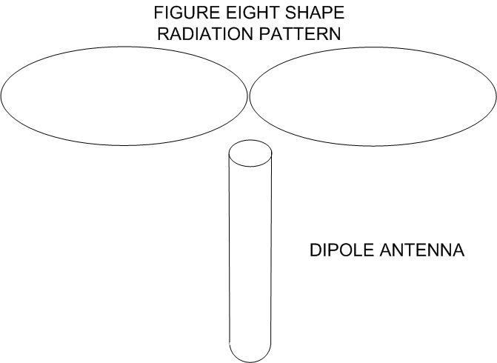
Dipole Radiation Pattern

Slide 102
Vertical Antenna
A vertical antenna looks like the name sounds
It sticks up in the air
A vertical antenna’s radiation pattern extends in all directions from the unit
It looks very much like a donut, in that there is little radiation directly above or below the antenna

Slide 103
Vertical Antenna
The power drops as the distance from the antenna increases
As the omnidirectional antenna’s gain goes up, the pattern height goes down into more of a pancake shape
This is a very common type of antenna
Internally a vertical antenna is a series of stacked dipoles

Slide 104
Vertical Antenna
As more dipole elements are added the gain of the antenna increases

Slide 105
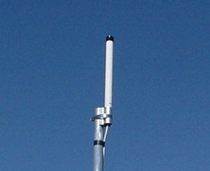
Vertical Design – Outside

Slide 106
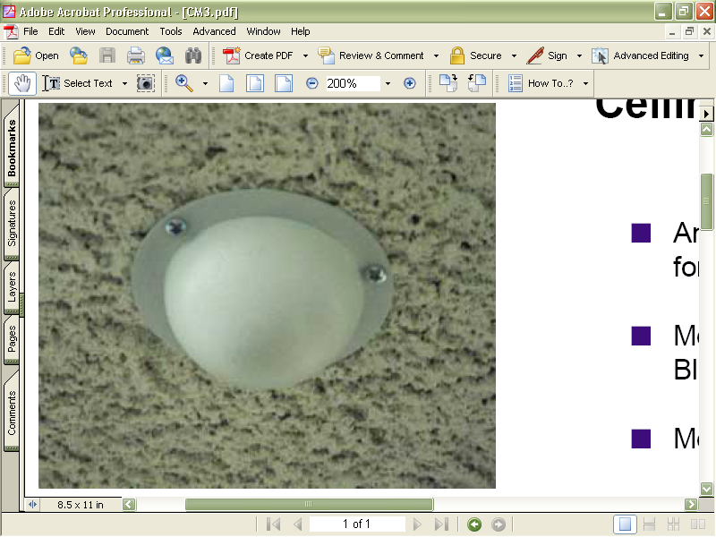
Vertical Design - Indoor
Antenna diameter is 88 mm or 3.5 inches
Antenna is mounted to a ceiling tile

Slide 107
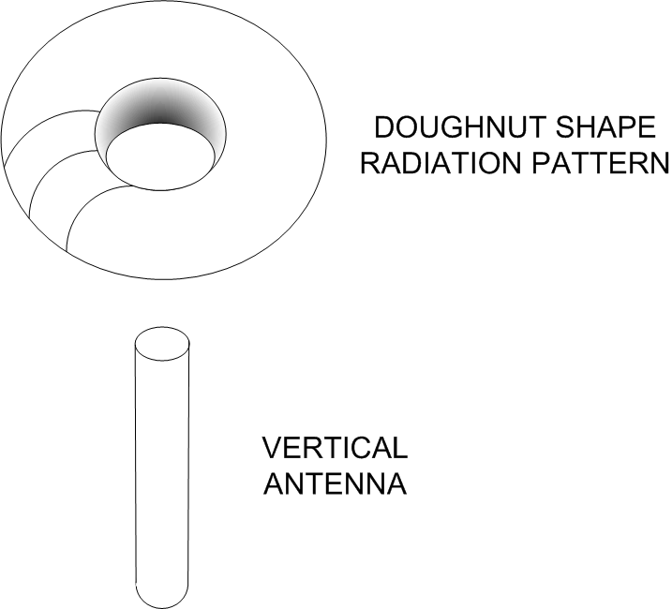
Vertical Radiation Pattern

Slide 108
Parabolic Dish or Grid Antenna
Not used in LANs, but widely used in CANs and MANs, is the parabolic dish or grid antenna
A parabolic antenna can take several forms
In general they are circular or square
If circular, they look like a small satellite dish

Slide 109
Parabolic Dish or Grid Antenna
If square, they look like a wire grid
For even more gain and directivity a shield can be placed around the dish
This is a short cylinder on to the front
This type of antenna is a unidirectional antenna, meaning that it transmits in one specific direction
Which is the direction at which the antenna is pointed

Slide 110
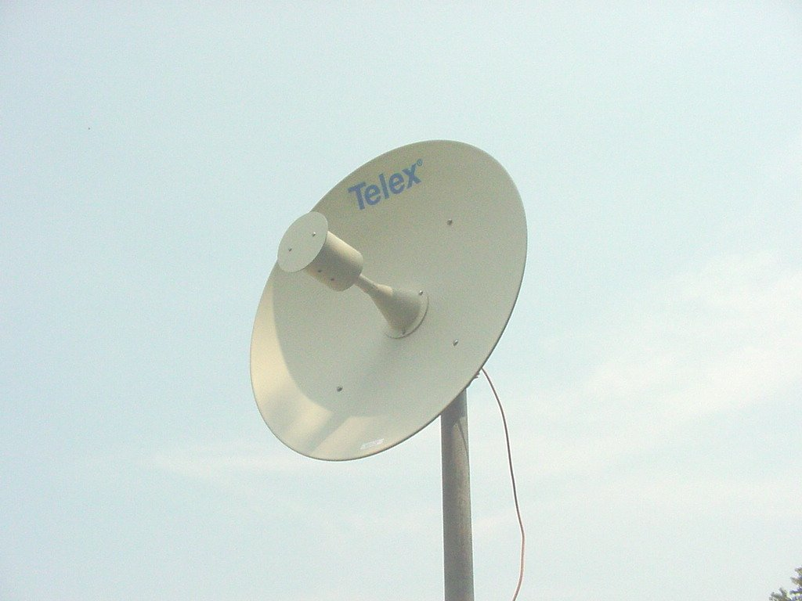
Parabolic Dish Design

Slide 111
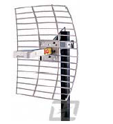
Parabolic Grid Design

Slide 112
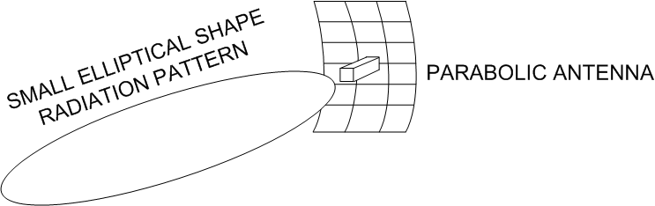
Parabolic Radiation Pattern

Slide 113
Yagi Antenna
A yagi antenna is slightly less powerful than a parabolic antenna
It too is mostly used in a CAN environment
Like the parabolic, the yagi is also unidirectional
A yagi antenna consists of a series of metal spokes radiating from a central core

Slide 114
Yagi Design
These spokes are often covered, so they are not apparent when looking at the antenna
This cover is called a radome
The yagi antenna has many variations
It normally consists of two or three elements

Slide 115
Yagi Design
The basic elements of the three-element yagi are a radiator, a reflector, and a director
The radiator is the main element
To add gain and change the radiation pattern so that it is directional, a director element is added in front of the radiator, while the reflector element is behind the radiator

Slide 116
Yagi Design
As discussed above in more detail, the director element is slightly shorter than the radiator while the reflector element is slightly longer
For really high gain both of these methods are used
To increase the gain even more directors are added in front of the main director

Slide 117
Yagi Design
Generally, each additional director is shorter than the previous one and spaced such that the overall length of the antenna is increased

Slide 118
Yagi Design - Internal
REFLECTOR
DIRECTOR
DIRECTION
OF
BEAM
RADIATOR

Slide 119
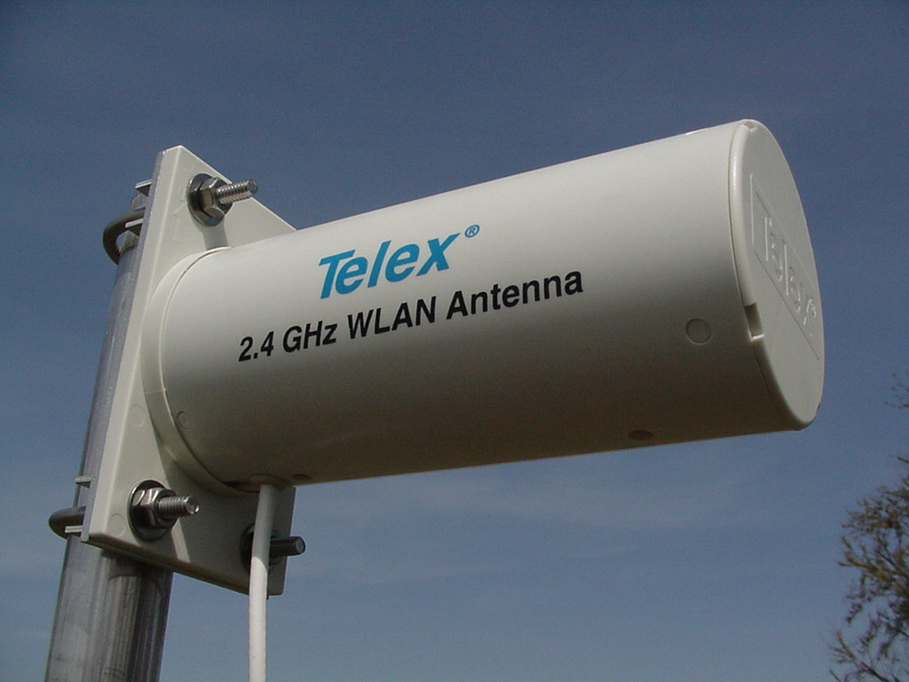
Yagi Design - External

Slide 120
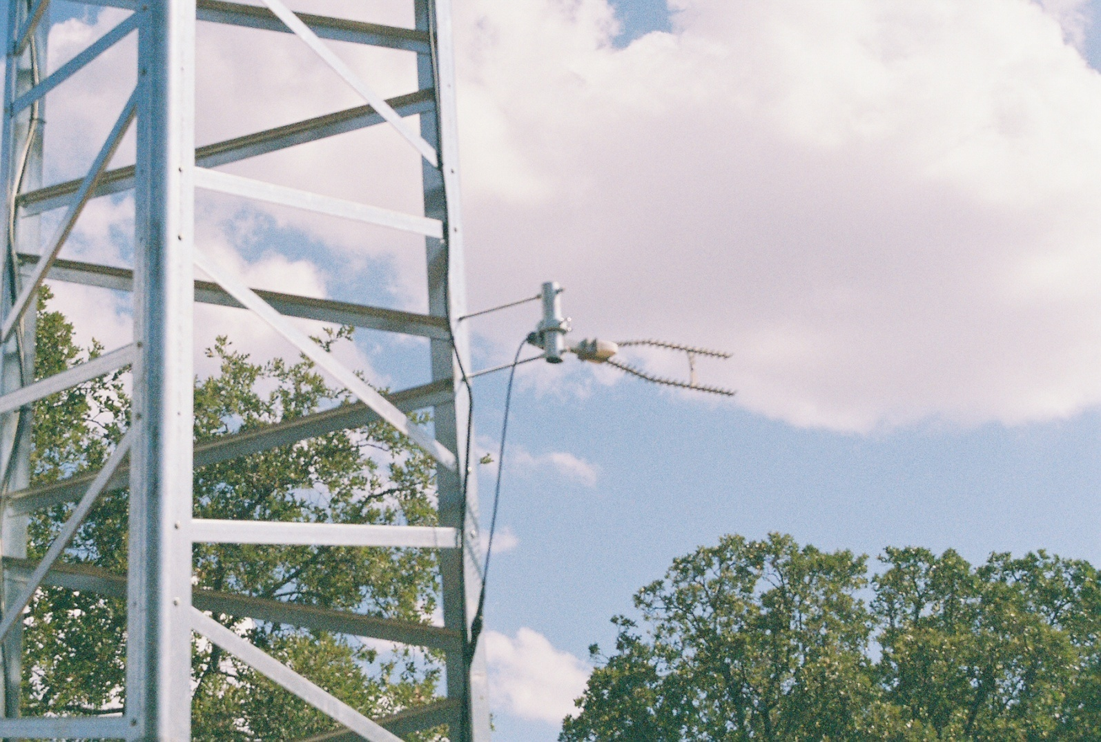
Yagi Design - External

Slide 121
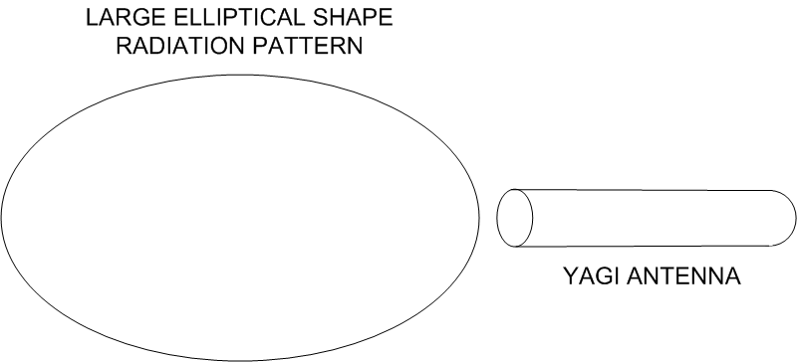
Yagi Radiation Pattern

Slide 122
Sector Antenna
Sector antennas are generally used to provide wide bands of coverage from a central point, such as an outside wireless base station
Sector antennas provide the ability to aim the signal where it is needed
It is possible to increase coverage by using multiple sector antennas all mounted on the same tower

Slide 123
Sector Antenna
Sector antennas generally offer greater gain than omni-directional antennas and offer better flexibility and noise rejection
Most sector antennas are designed to be down-tilted for better coverage
This tilt redirects the beam down toward the surface

Slide 124
Sector Antenna
This is required when a narrow vertical beamwidth, present in a high gain antenna, cannot reach the areas that need the signal or to limit co-channel interference
The downtilt can be mechanical or electrical
Mechanical downtilt is shown below

Slide 125
Sector Antenna
Electrical tilting, sometimes called null fill, is created by controlling the current phase in the antenna as part of the antenna’s design

Slide 126
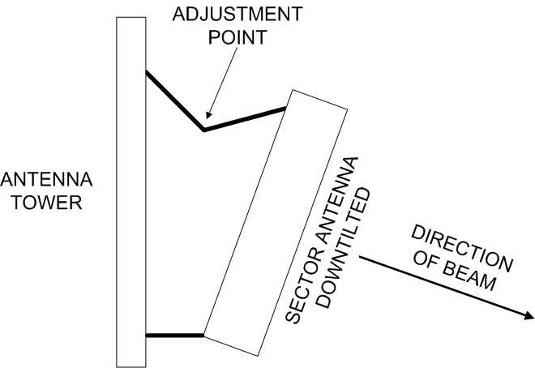
Sector Mechanical Downtilt

Slide 127
Sector Downtilt
The degree of downtilt must be accurately calculated so that the desired area is covered
As in

Slide 128
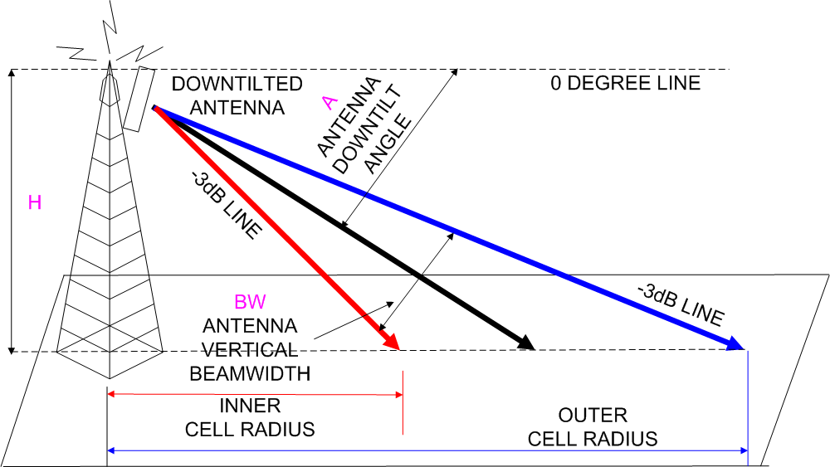
Sector Downtilt

Slide 129
Sector Downtilt
Two calculations must be made
One is for the inner radius of the coverage
  ID = Inner radius distance
  H = Antenna height
  A = Downtilt angle
  BW = The antenna’s beamwidth

Slide 130
Sector Downtilt
The other is for the outer radius of coverage
  OD = Outer radius distance

Slide 131
Sector Downtilt
For example with the following
  H = 100 feet
  A = 8 degrees
  BW = 8 degrees
The calculated coverage is from .09 miles to .27 miles
However this is not an absolute limit as the power does not abruptly quit, rather it falls off gradually

Slide 132
Sector Downtilt
The point is this is the area of maximum signal strength, not the only signal strength
The point to downtiling an antenna is to deliver the maximum power to the far off sites

Slide 133
Sector Antenna
In the frequency ranges used for wireless MANs, a sector antenna can provide coverage up to ten miles if used in conjunction with highly directional end-station antennas, such as a parabolic style

Slide 134
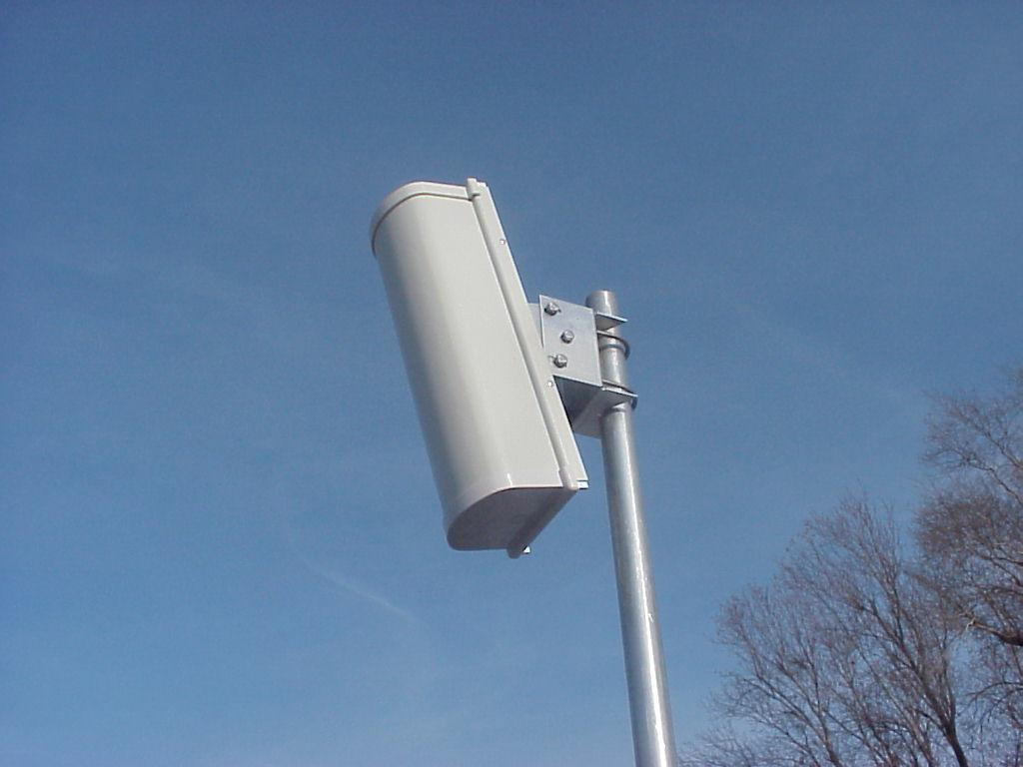
Sector Design

Slide 135
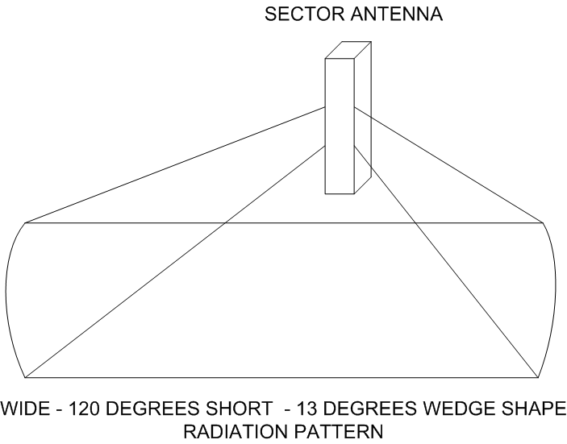
Sector Radiation Pattern

Slide 136
Patch Panel Microstrip Antenna
This type of antenna goes by several names from patch to panel to microstrip
All of these are basically flat, totally enclosed antennas
These antennas are generally used for short-distance point-to-point links, such as building-to-building, or short-distance end-station customer premises equipment, less than 1 mile

Slide 137
Patch or Panel Design
The panel antenna uses a trough reflector, where the sides are folded in so that they are at right angles to the back plane
Ends are then added to complete the box
A cover or radome is added to over the elements

Slide 138
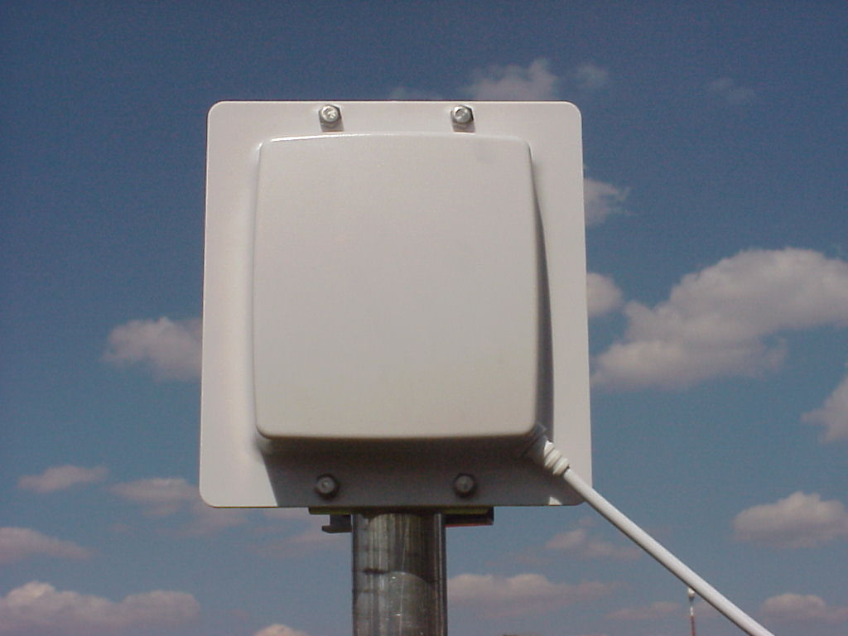
Patch or Panel Design
Photograph courtesy of Telex

Slide 139
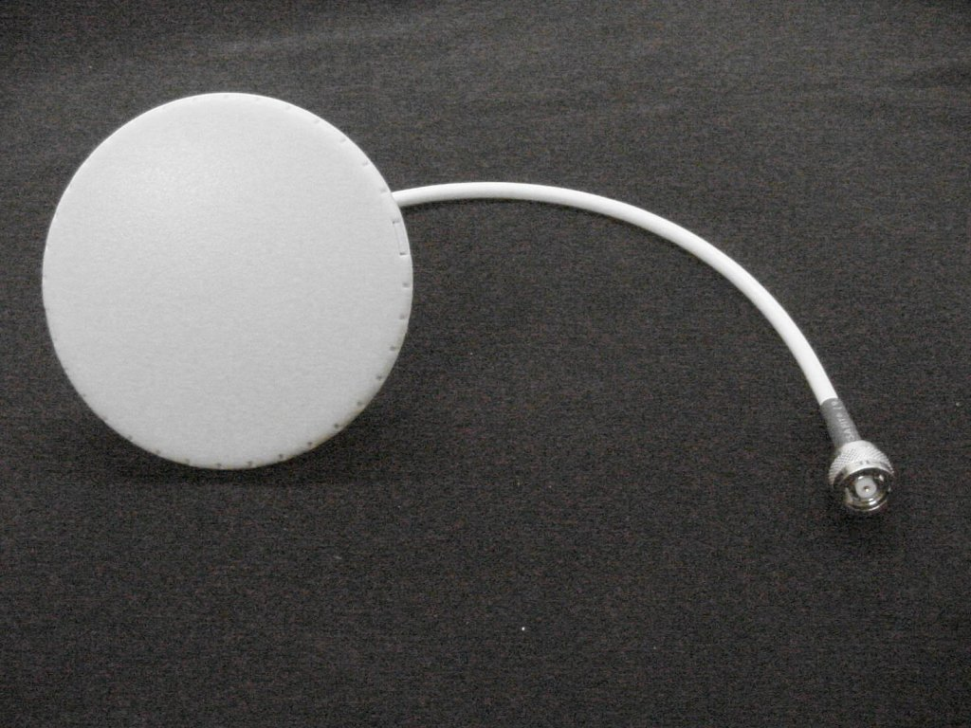
Microstrip Design
Photograph courtesy of Telex

Slide 140
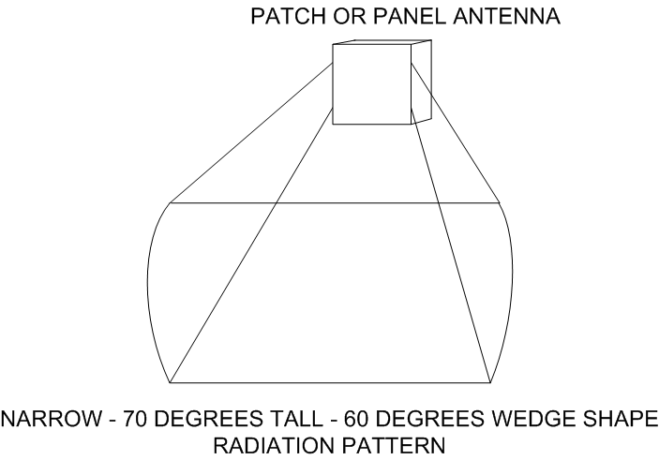
Patch Panel Radiation Pattern

Slide 141
Adaptive Antenna Systems
Adaptive antennas dynamically change the form of their beam or in this case beams to match the conditions
Here is some detail on this from a March 2012 webinar presented by Douglas Morais

Slide 142
Adaptive Antenna Systems
  In an Adaptive Antenna System (AAS),also called an Adaptive Beamforming system, an array of antennas is used adaptively for reception, transmission, or both, in a way that seeks to optimize transmission over the channel
  In a PMP system, array usually at BS, and forms beams adaptively that target individual remote, not a sector or an entire cell

Slide 143
Adaptive Antenna Systems
  Able to do this by creating multiple beams simultaneously, each beam directed to a specific remote
  Shape of each beam can be dynamically controlled so that signal strength to and from a remote is maximized
  Does this by directing main lobe in direction of strongest signal component, and sidelobes in the direction of multipath components

Slide 144
Adaptive Antenna Systems
  Further, it can simultaneously minimize interference of signals that arrive at a different direction from the desired by locating nulls in direction of interference, thus maximizing SINR
  Beams from adaptive beamforming antenna array communicating with two remote stations

Slide 145
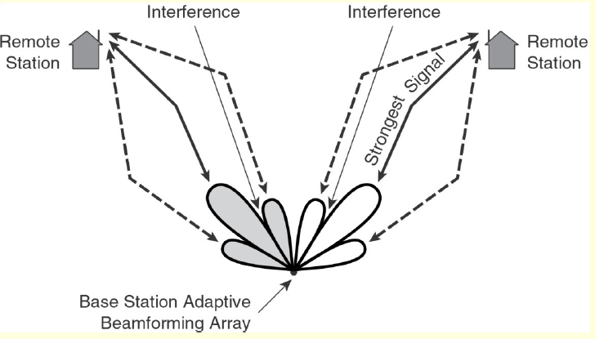
Adaptive Antenna Systems

Slide 146
Lab
Find One of Each Type of Antenna

Slide 147
Antenna Diversity
Most access points come with either a single dipole antenna or diversity antennas
A diversity antenna is simply multiple antennas connected to a single receiver
This helps to overcome multipath reception problems when the access point cannot be moved

Slide 148
Antenna Diversity
For diversity to be effective the two antennas should be placed at least 15 cm or six inches apart
Separation greater than 250 cm or eight feet is not generally required for the diversity function to be effective

Slide 149
MIMO Antenna
MIMO - Multiple Input Multiple Output antennas use multiple transmit and receive antennas in a single unit
The MIMO algorithm in the radio chipset sends the data out two or more antennas
These signals reflect off objects, in other words multipath interference

Slide 150
MIMO Antenna
But the MIMO algorithm uses these multiple paths to send not the same data but additional data
At the other end these signals are recombined
MIMO also allows an access point to grab multiple different radio-frequency streams and choose the best one for better performance

Slide 151
Selecting an Antenna
There are several parameters to consider when selecting an antenna
These parameters are
  Antenna Gain
  Beamwidth
  Loss
  Radiation Pattern

Slide 152
Antenna Gain
Antenna gain is an indicator of how well the antenna focuses a signal
This is measured in dBi - decibels relative to isotropic radiator, which is a theoretically perfect antenna
The dBi is computed by comparing the output of the antenna to the theoretically perfect antenna

Slide 153
Antenna Gain
The higher the dBi measurement, the higher the power level of the antenna

Slide 154
Beamwidth
The beamwidth of the antenna is the area radiating outward from the antenna, where the signal within a specified angular distance is still higher than the half power of the peak intensity of the antenna
This suggests the antenna type to use

Slide 155
Beamwidth
For example, the parabolic antenna is a unidirectional antenna with a very low beamwidth, which means that it needs to be very carefully aimed in order to work properly
A vertical antenna, being omnidirectional has a very high horizontal beamwidth, which is why it’s suitable for covering a large circular area

Slide 156
Beamwidth
In general, there’s an inverse relationship between beamwidth and antenna gain
So as gain increases the beamwidth decreases
Therefore the antenna must be more carefully aimed
For example

Slide 157
Beamwidth
Horizontal Beamwidth | Vertical Beamwidth | Maximum Gain dBi
360 | 8 | 11.6
360 | 15 | 8.8
150 | 15 | 12.6
150 | 30 | 9.6
120 | 30 | 10.6
120 | 60 | 7.6
90 | 15 | 14.9
90 | 30 | 11.9
60 | 30 | 13.6
60 | 60 | 10.6

Slide 158
Loss
Loss affects a wireless deployment, especially at higher power levels
Loss is a result of the signal having to travel from the access point to the antenna
Since these parts are always connected by a cable, there will always be loss
To minimize the loss use the correct cable, usually coax, and the minimum length possible

Slide 159
Radiation Pattern
As shown above every type of antenna has a different radiation pattern based on its construction
This is a three-dimensional field
It reflects the output of the antenna at any point in space

Slide 160
Radiation Pattern
If it is available from the manufacturer, get a copy of the radiation pattern for the antenna you will be using to see what the coverage area will look like

Slide 161
Antenna Parameters in General
You can use the parameters just discussed to determine where access points need to be placed
In particular how far the signal from a particular antenna can travel before becoming unusable

Slide 162
Antenna Parameters in General
As a rule of thumb, a directional antenna has a pattern of coverage shaped like a cone that radiates in the direction that the antenna is pointed, while an omnidirectional antenna’s area of coverage is shaped like a doughnut

Slide 163
What is an Amplifier
Things often need to get bigger
In radio frequency systems an amplifier does this

Slide 164
Amplifier Properties
There are three basic properties of amplifiers
  Gain
  Noise figure or output power
  Linearity

Slide 165
Amplifier Gain
Gain is a measure of how much larger the output is over the input
It is measured in dB
In a radio frequency system a lot of gain is 40 to 50 dBs and a little is 5 to 10 dBs

Slide 166
Noise or Power
Amplifiers are categorized as
  Low noise
  High power
  Other

Slide 167
Noise or Power
In radio frequency systems a low noise amplifier is the first amplifier after the signal comes through the antenna in a receiver and a high power amplifier is the last amplifier it goes through when going out a transmitter
Everything else is an other

Slide 168
Low Noise Amplifier
A LNA - Low Noise Amplifier is used to take the very small radio frequency signal and make it into something that is useable
As the signal is small, if a bunch of noise is added to it, that would drown out the signal
So a LNA is very useful in such a case
Noise is measured as an NF figure, the lower the better

Slide 169
High Power Amplifier
A HPA - High Power Amplifier is used to boost the signal up to the allowable limit just before it is launched into the air
HPAs are measured in watts more or less
These watts are expressed as the dBs above one milliwatt of dBm
In other words 30 dBm is a signal 30 dB above 1 mW or 1000 times larger than 1 mW or 1 watt

Slide 170
Linearity
When sending digital signals linearity is important
Linearity refers to how much the signal’s shape is distorted
What is desired is a signal coming out of the amplifier that is larger than what went in and of the same shape
This is shown as a transfer curve

Slide 171
Linearity
A transfer curve is a graph of the output power versus the input power of an amplifier
A characteristic of an amplifier is that as the input power to an amplifier increases the output power also increases by a like amount up to a point
This portion of the curve is the linear portion

Slide 172
Linearity
The end of this part of the curve is called the P₁dB, pronounced as the “p wun’ db” point
This point is the highest at which an amplifier can put out linear power
Above the P₁dB point the power increases, but not in a linear fashion

Slide 173
Special Types of Amplifiers
There are three special types of amplifiers encountered in radio frequency systems
  Limiting
  Balanced
  Variable Gain

Slide 174
Limiting Amplifier
A limiting amplifier limits the output power
This type is used when the component that follows the amplifier would be damaged by too much power coming into it from the amplifier

Slide 175
Balanced Amplifier
An amplifier using a balanced design is really two amplifiers in one
The radio frequency signal enters one side of the amplifier
Once inside the signal is split into two parts
Half goes to one amplifier and the other half to the other amplifier

Slide 176
Balanced Amplifier
The two signals are then added back together before leaving the amplifier
The advantage to this design is that if one amplifier inside fails, the other can keep working
This design leaks less, which means less VSWR

Slide 177
Variable Gain Amplifier
A variable gain amplifier merely has a control that can be used to adjust the gain

Slide 178
What is a Filter
A filter filters signals
Such as a bunch of signals all at different frequencies coming in and just one, the desired one, going back out
In essence a filter is the door bouncer at a trendy club
Some get in and some are kept out

Slide 179
Use of Filters
Filters are used at the receive side as the antenna will pick up signals at and near the desired frequency
The filter removes the undesired ones
Governmental regulatory authorities say you may only transmit on the authorized frequency
The filter is designed to ensure this is the case

Slide 180
Types of Filters
There are four types of filters
  Low pass
    Letting all frequencies below a certain frequency to pass
  High pass
    Letting all frequencies above a certain frequency to pass
  Bandpass
    Allows all frequencies between two frequencies to pass
  Band reject – notch filter
    Prevents all frequencies between two frequencies from passing

Slide 181
Filter Operation
Filters do their work by varying their insertion loss as a function of the frequency they see
This is the frequency response of the filter

Slide 182
What is a Mixer
A mixer seeks to change the frequency of a signal while keeping everything else about the signal the same
But why would you want to do this
One reason would be that your voice creates sound in the area of 2,000 Hertz, but a cell phone operates at 900,000,000 Hertz

Slide 183
Mixer Operation
Mixers have three ports, two input and one output
  The RF port is the higher frequency signal port
  The IF port is the lower frequency port
  The LO port connects to a source or oscillator
Mixers are not perfect things
This is why a filter always follows a mixer

Slide 184
Mixer Operation
It gets rid of what is produced, but not needed
A mixer also produces other problems
Being a passive component the mixer exhibits loss as it does its work
This is the conversion loss or CL
The lower the CL figure the better

Slide 185
Mixer Operation
A mixer also produces noise
The lower the noise figure or NF the better

Slide 186
Two Stage Mixer
A two stage mixer is not really a type but rather a way of using mixers
In this setup there are two mixers, one after the other
The signal between the two is called the baseband signal

Slide 187
What is a Source
The source or oscillator is what generates the radio frequency
The desire is to produce a perfect sine wave at the desired frequency
Of course this never happens

Slide 188
Other Components
Besides the five main components used in radio frequency systems
  Antenna
  Amplifier
  Mixer
  Filter
  Source

Slide 189
Other Components
There are several more you will encounter from time to time
These include
Switch
Attenuator
Divider and Combiner
Coupler
Circulator and Isolator

Slide 190
Other Components
Transformer
Detector
Phase Shifter
Phase Detector

Slide 191
Other Components
In general all of these other devices do one of two things
  They send the radio frequency signal in a different direction or multiple directions
  or
  They change the size or shape of the signal

Slide 192
Switch
Switches change the path of a radio frequency signal
Switch performance is based on
  Amount of loss
  Switching speed
In a switch there are two kinds of loss
  Insertion loss
  Isolation loss

Slide 193
Switch
Insertion loss is the reduction in the signal just because it went through the switch
Isolation loss is produced by the gap created when the switch is open
Of course insertion loss should be kept low
Isolation loss should be kept high

Slide 194
Switch
Switches are commonly used in radio frequency systems so that a single antenna can be used for both transmitting and receiving

Slide 195
Attenuator
An attenuator creates loss
The key point here is that an attenuator is used to insert a known amount of loss for some reason related to a circuit’s design
Attenuators can be
  Fixed
  Variable
A fixed attenuator is sometimes called a pad

Slide 196
Divider or Combiner
Dividers divide a signal into two or more parts, usually two or four
The division is always equal in size
These are also called power dividers
Combiners combine signals
As with most devices low insertion loss is desired

Slide 197
Coupler
A coupler is used to draw a sample of a radio frequency signal off for some use, such as feedback to a circuit so that it can correct the signal before it is sent out
Performance measures of couplers include
  Insertion loss
  Coupling accuracy
    Which is that the signal that is sampled is accurate

Slide 198
Circulator
In a circulator a signal that comes in travels around in a circle until it encounters an exit, then it must get off
A circulator is a form of a switch
For example

Slide 199
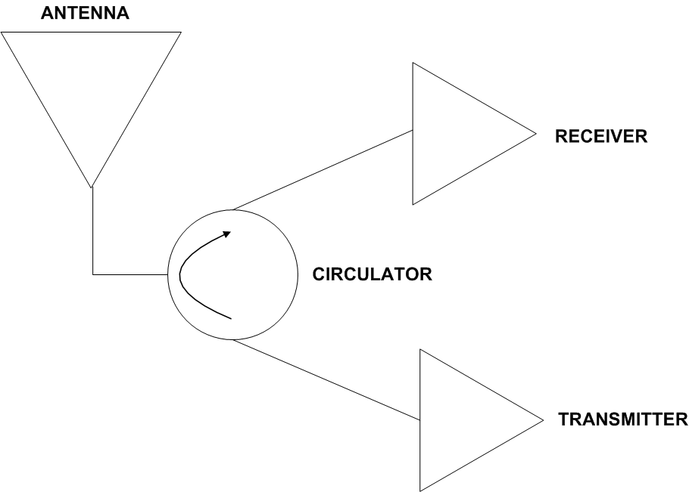
Circulator

Slide 200
Circulator
Any signal coming in from the antenna must get off at the receiver
Any signal coming from the transmitter must get off at the antenna
So we have a simple, but smart switch
Low insertion loss is desirable

Slide 201
Isolator
A special type of circulator that only uses two of the three ports is called an isolator
The isolator is used to draw off reflected power as heat so that this reflected power does not go back down the line and damage something
Low insertion loss is desirable

Slide 202
Transformer
A transformer, transforms
In the radio frequency world the thing being transformed is impedance
In other words it takes one thing, like an impedance of 100 ohms, and changes it to another thing, like an impedance of 50 ohms
The main performance measure is the impedance ratio

Slide 203
Detector
The detector is a power to voltage converter
Radio frequency power enters it at one side, it comes out the other side as a voltage that is proportional to the radio frequency power

Slide 204
Detector
The use of this device is to convert a radio frequency signal into a voltage, as there are devices that cannot handle a radio frequency signal, but they can handle a voltage
An example is a piece of test equipment

Slide 205
Phase Shifter
A phase shifter is used to control the phase of one signal in relation to another signal
These are used when optimizing a circuit or as a means to provide feedback to a circuit

Slide 206
Phase Detector
Once the phase shifter imparts a shift in phase, to be useful this shift must be detected
This is what the phase detector does

Slide 207
Let’s Summarize
Antenna
  Active or Passive
  Converts signals to and from airborne waves
Amplifier
  Active
  Makes a signal larger

Slide 208
Let’s Summarize
Filter
  Passive
  Separates a signal by frequency
Mixer
  Active or Passive
  Increase or decrease a signal’s frequency

Slide 209
Let’s Summarize
Oscillator
  Active
  Create a perfect sine wave
Switch
  Active
  Change the direction a signal travels

Slide 210
Let’s Summarize
Attenuator
  Active or Passive
  Make signal smaller
Divider
  Passive
  Split a signal

Slide 211
Let’s Summarize
Combiner
  Passive
  Add signals together
Coupler
  Passive
  Split up or add two signals in unequal proportion

Slide 212
Let’s Summarize
Circulator
  Passive
  Create a smart switch
Isolator
  Passive
  Protect components from signal reflection

Slide 213
Let’s Summarize
Transformer
  Passive
  Change impedance
Detector
  Passive
  Convert an RF signal to voltage

Slide 214
Let’s Summarize
Phase Shifter
  Active or Passive
  Change the phase of one sine wave with respect to another
Phase Detector
  Passive
  Produce a voltage proportional to the difference in phases

Slide 215
The Result – A Radio
What is the result of putting all of these bits and pieces together
The creation of a radio of course
A radio is used to send and receive a signal that flows through the air as a series of electromagnetic waves
The way these parts are put together to form the radio, as well as the quality of the parts, determines how well the radio works

Slide 216
Radio Quality
There are several important measures used to differentiate the ability of a radio to do its work
The main measure used to determine the ability of a radio to function is its receive sensitivity
This is a measure of the lowest quality signal a radio can hear and decipher

Slide 217
Radio Quality
Just because the radio can hear something means nothing
It must be able to understand what the signal is trying to say
The receive sensitivity is expressed as a minus dBm number

Slide 218
Radio Quality
The larger the number the better
In other words the further away from zero the better

Slide 219
Receive Sensitivity
dBm Value | 0 Point | -dBm Value The further the number is from the 0 point the better
 |  | Worse -1 to -95 Better

Slide 220
Radio Quality
Once the radio is in the operation it not only receives the desired signal, but all signals in the area
The desired signal will have a value in dBm as well
This is the signal strength level
The signal strength level is determined by the radio based on the signal it can receive and decipher

Slide 221
Radio Quality
The closer to the zero point the louder the signal
Some of the signals received by the radio cannot be deciphered
These are the undesirable signals or noise

Slide 222
Radio Quality
Some of this noise will be from galactic noise, some from manmade noises, and some are valid signals from other radio networks
All of this is noise or undesired signal to the radio in our network
These signals create the noise floor

Slide 223
Radio Quality
If the noise floor is further from the zero point than the desired signal, then we are in business
A functioning radio communication link exists
But keep in mind that the radio environment is unbounded
It is subject to almost unlimited change on a second by second basis

Slide 224
Radio Quality
To provide some margin for these varying conditions a certain SNR – Signal to Noise Ratio is desired
The SNR is the signal strength level seen by the radio minus the noise level seen by the radio
This noise level is also called the noise floor

Slide 225
Radio Quality
For example with a received signal strength of -65 dBm and a noise reading of -85 dBm, then the signal to noise ratio is 20 db
This allows a fade margin to account for the varying conditions while still maintaining a reliable radio link

Slide 226
Radio Quality
Let’s look at an example
The Cisco PCMCIA 350 wireless NIC has a published receive sensitivity of -85 dBm at 11 Mbps
It also can receive at -95 dBm if the data rate is only 1 Mbps
This is always the case

Slide 227
Radio Quality
The lower the data rate the better the ability of the receiver to decipher the desired signal
What values are typically seen in the field
Following is a screen shot for the client utility that comes with the Cisco 350 PCMCIA 350 card

Slide 228
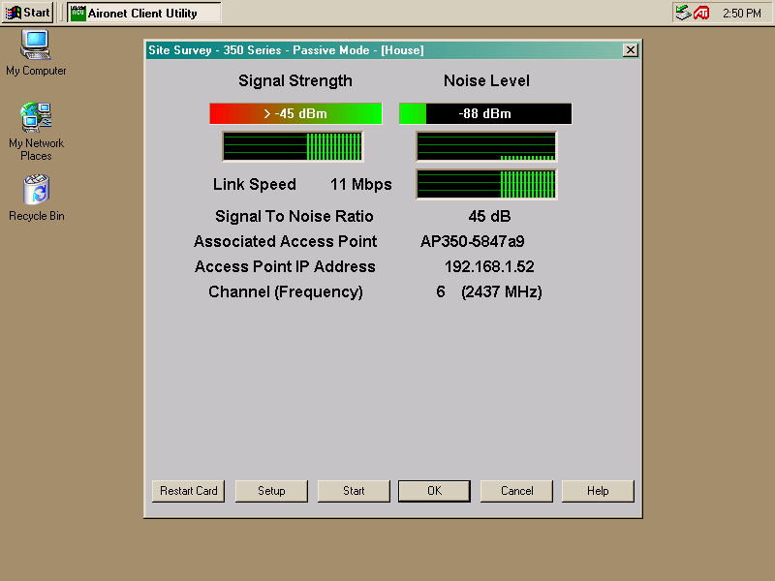
Radio Quality

Slide 229
Radio Quality
As seen in the screenshot the signal strength is around -45 dBm and the noise level is around -88 dBm
This produces a SNR of 45 dB
What's good and what's bad
Signal strength is determined by the factors between the sending and receiving radios, such as distance and propagation factors

Slide 230
Radio Quality
Noise levels vary, but -85 to -97 is commonly seen
So this value of -88 dBm is quite normal
The worst I have heard of is -55 dBm
A desired SNR is 20 dB on a point-to-point link
For a point-multipoint link 12 to 14 dB SNR is adequate

Slide 231
Radio Quality
Links will work, but not well, down to 6 dB or so
In this example a SNR of 45 dBm is quite good
It should be because the NIC is only 12 inches from the access point

Slide 232
Lab
Find the Sensitivity Ratings for a Radio

Slide 233
Review
What is a radio
What determines radio quality

