Slide 1
Introduction to Wireless Networks
Last Update 2013.01.07
1.3.0

Slide 2
Purpose of a Network
What is a data network for
A network is used to share things
If there is nothing to share, there is no need for a network
Wireless networks are used to share the same things that wired networks do, such as
Applications
Printers

Slide 3
Network Types
For our purposes the types of networks are by geographic size
When classified by the size there are four types of networks
LAN – Local Area Network
CAN – Campus Area Network
MAN – Metropolitan Area Network
WAN – Wide Area Network

Slide 4
LAN
The LAN covers a small area
This is usually just a single building or a few floors in a single building
The LAN contains devices such as workstations, servers, and printers
It is used to share these things among the users of the LAN

Slide 5
LAN
This is the Environmental Education, Science, and Technology Building as shown in the virtual tour of the campus
A single LAN could cover this entire building

Slide 6
CAN
A CAN typically connects LANs that are located in separate buildings that are near to each other
By near I mean you can walk to each building and back without much trouble
A CAN may also connect LANs on several floors in a tall building

Slide 7
CAN
This distance is 1.3 kilometers or .8 miles
This distance is 1.8 kilometers or 1.1 miles

Slide 8
MAN
In a MAN size network you cannot easily walk there
But you can drive there and back in a short while
If we blowup the top corner of the map, we can see that UNT has a research facility 7.5 km or 4.5 miles from the main campus
Now this is too far to walk, but you could drive there and back without any trouble

Slide 9
MAN

Slide 10
WAN
A WAN covers a very large area or connects sites together that are far apart
You could drive there, but it would be hard to do so and return in the same day
For example, as a news release from the University of North Texas says
“Dr. Timothy Montler, …has been working for over two decades to preserve the languages of Pacific Northwest Native American tribes”

Slide 11
WAN
Washington
This distance is 2500 kilometers 1500 miles
Texas

Slide 12
Network Types
The point to this discussion of network types is that different frequencies and techniques are used depending on the size of the network
Besides the distances used to define the different types of networks the terrain makes a difference

Slide 13
Network Types
For example the UNT campus map does not show that the middle of the campus when going east to west is on quite a rise
You cannot see the stadium on the west side from the buildings on the east side

Slide 14
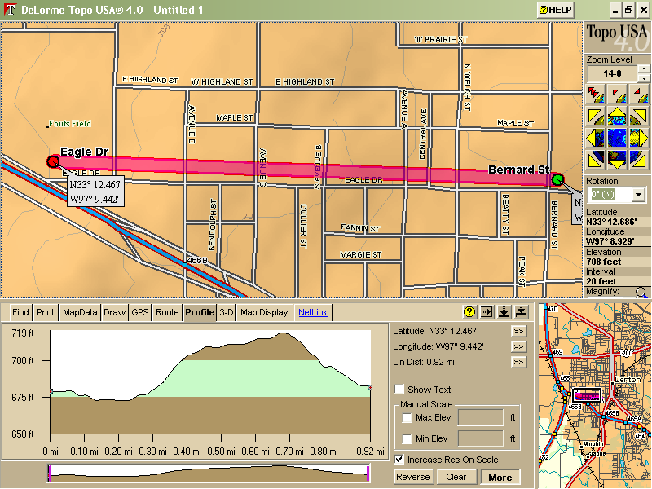
Network Types

Slide 15
Network Types
The map also does not show that the campus is covered in trees
None of these definitions are set in stone
They are just offered as guidelines to use when judging the size of a network

Slide 16
Network Types

Slide 17
What About a Wireless Network
Wireless networks can be used in any of these four types of networks
One note here, many wireless networks that are used to connect end users to a central site as in a last mile solution are called wide area networks by some
This is not the case

Slide 18
What About a Wireless Network
Any network of that type is clearly a CAN or a MAN
The only case where a wireless network is truly used as part of a WAN, are the long range point-to-point microwave connections used to span long distances

Slide 19
Nature of Wireless Networks
It must be kept in mind that wireless networks are fundamentally different from those that use wires
Wireless signals are unbounded and dynamic
A wireless signal’s environment is quite similar to a microclimate as used when discussing the weather

Slide 20
Nature of Wireless Networks
In fact, the weather and wireless networks are very similar
They both suffer from the same problem
For the weather we know about the behavior of large weather systems and climate in general
We can then predict that in the summer the weather will be hot

Slide 21
Nature of Wireless Networks
During the monsoon, it will rain often
What we do not know is exactly where it will rain and exactly how much
Even if rain can be predicted for an area, will it rain on my house
This is the microclimate problem
There are simply too many variables, engaging in too many interactions

Slide 22
Nature of Wireless Networks
Let’s look at an example of this problem related to forecasting exactly where it will rain
The forecast was for a 100 percent chance of rain for the DFW area
But where exactly did it actually rain and how much at each location

Slide 23
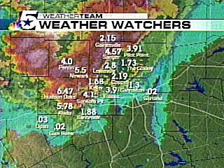
Nature of Wireless Networks

Slide 24
Nature of Wireless Networks
As the map shows it poured in some places and did not rain at all in others
We have the same problem with radio frequency networks as we have with the weather network
Much is known, in general, about how radio frequency signals traverse the environment

Slide 25
Nature of Wireless Networks
But we cannot accurately predict what they will do or not do from a base station antenna to an end user’s location
The usual way of handling this problem for both the weather and radio frequency networks is a fudge factor or fade margin

Slide 26
Capacity of Wireless Networks
In addition to the variability of wireless signals just discussed there is also the issue of the load a wireless network can handle
For example

Slide 27
Capacity of Wireless Networks

Slide 28
Capacity of Wireless Networks
What happened
The introduction of the device was marred by a glitch with Mr. Jobs initially having difficulty getting web pages to load and causing the largely enthusiastic crowd to go silent
"I'm afraid we have a problem and I'm not going to be able to show you much today," said Mr. Jobs, who tried switching devices and also asked the audience to disconnect from the Wi-Fi network, before managing to connect

Slide 29
Capacity of Wireless Networks
In the unlicensed environment wireless cannot replace wired

