Slide 1
Examine Wireless Frames Lab
Last Update 2011.06.01
1.0.0

Slide 2
Capturing Wireless Frames
In order to capture wireless frames for examination a network analyzer must be used
There are several commercial versions of these, as well as the open source Wireshark program
Wireshark by itself will not read in wireless frames in most cases

Slide 3
Capturing Wireless Frames
It requires a wireless NIC that can be set to promiscuous mode and that will read in damaged frames
The AirPcap USB adaptor from Cace technology is the common way of doing this

Slide 4
Radiotap Header
In addition, the Radiotap header in the frame must be displayed as this is where you see most of the wireless information
You must tell Wireshark to include it, as it does not do so by default
You set this in the AirPcap adaptor settings

Slide 5
AirPcap Adaptor
The AirPcap USB adapter looks like this

Slide 6
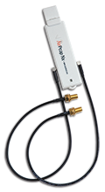
AirPcap Adapter

Slide 7
AirPcap Adapter
A capture of wireless frames in Wireshark using the AirPcap device looks like this

Slide 8
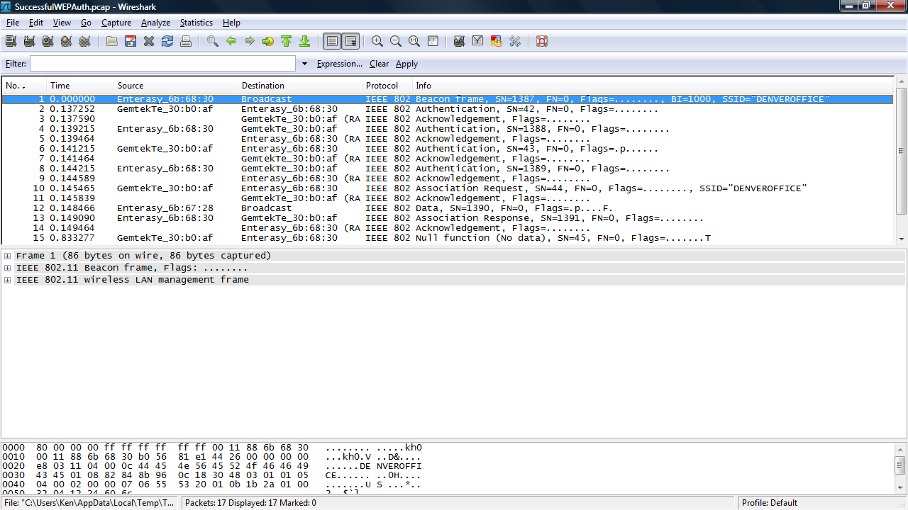
Wireless Frames

Slide 9
AirPcap Adapter
To use the AirPcap adapter with Wireshark it must be set based on the network under study
Here are the common elements to set as illustrated by Laura Chappell

Slide 10
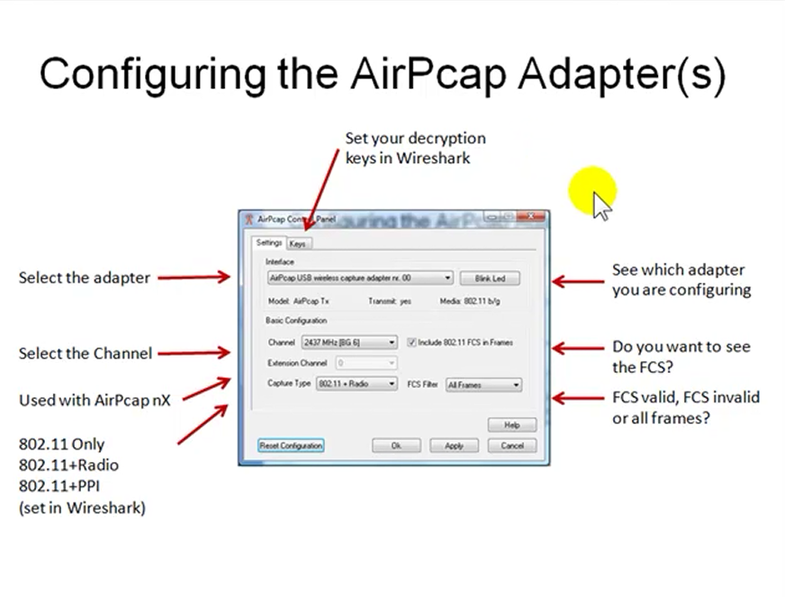
AirPcap Adapter Setup

Slide 11
AirPcap Adapter Setup
And a closer look at the main things to set

Slide 12
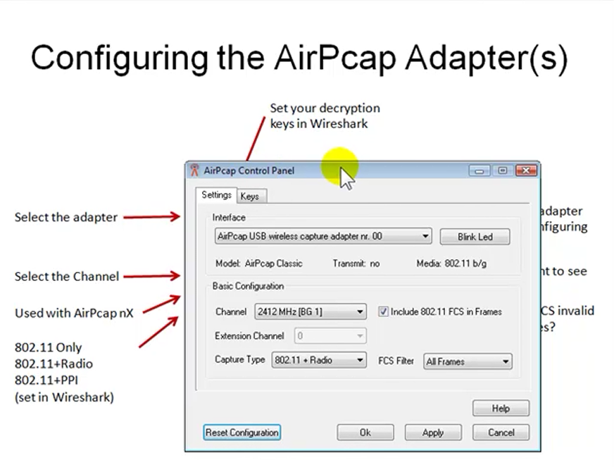
AirPcap Adapter Setup

Slide 13
AirPcap Adapter Setup
The first thing to do is to select the adapter as there can be up to three installed at one time
This is done in the dropdown section under Interface
Next the selected adapter is set to a channel in the dropdown section under Basic Configuration – Channel

Slide 14
AirPcap Adapter Setup
If channel bonding is being used the Extension Channel dropdown can select the channel just before the one specified above by using -1 or the one just after by using +1
The Capture Type dropdown selection tells the adapter what types of frames to capture
These include as the documentation says

Slide 15
AirPcap Adapter Setup
Capture Type
  802.11 frames only
  802.11 frames plus radio information by using radiotap
  802.11 frames plus the Per-Packet Information (PPI) header

Slide 16
AirPcap Adapter Setup
PPI and radio information includes additional information not contained in the 802.11 frame, such as transmit rate, signal power, signal quality, channel, and (for PPI) multiple antenna information
The radio information comes from the radiotap addition
It is defined as

Slide 17
AirPcap Adapter Setup
  The ieee80211_radiotap definitions provide a device-independent bpf(4) attachment for the capture of information about 802.11 traffic which is not part of the 802.11 frame structure
For example as mentioned above
  Transmit rate, signal power, signal quality, channel
The PPI information is defined as

Slide 18
AirPcap Adapter Setup
  When capturing live network data, it is often useful to collect out-of-band information and provide it along with in-band packet data
  The traditional method of doing this is to prefix each PDU with a meta-information header (often called a pseudoheader)
  Current implementations include such information as 802.11 radio information, access server user IDs, and point-to-point link direction

Slide 19
AirPcap Adapter Setup
  The Per-Packet Information (PPI) Header is a general and extensible meta-information header format originally developed to provide 802.11n radio information, but can handle other information as well
  PPI is intended to supplement individual packets received from a hardware or software engine with interesting data in a light-weight fashion

Slide 20
AirPcap Adapter Setup
  Often such data of interest pertains to the PHY layer, but this need not always be the case
  Whatever the carried information may be, the intent is that the information contained is only added to data captured in real-time, not stored packets

Slide 21
AirPcap Adapter Setup
The last main setting is whether to capture the FCS or not
This is done by selecting
  Include 802.11 FCS Frames
And then the types to capture under the FCS Filter dropdown selection
The possibilities include

Slide 22
AirPcap Adapter Setup
  All Frames: the adapter will capture all the frames regardless of whether the FCS is valid or not
  Valid Frames: the adapter will only capture frames that have a valid FCS
  Invalid Frames: the adapter will only capture frames that have an invalid FCS

Slide 23
AirPcap Adapter Setup
If required the next step is to enter a WEP key if you want to do this in AirPcap
This key along with WPA and WPA2 settings can also be done directly in Wireshark if they are needed

Slide 24
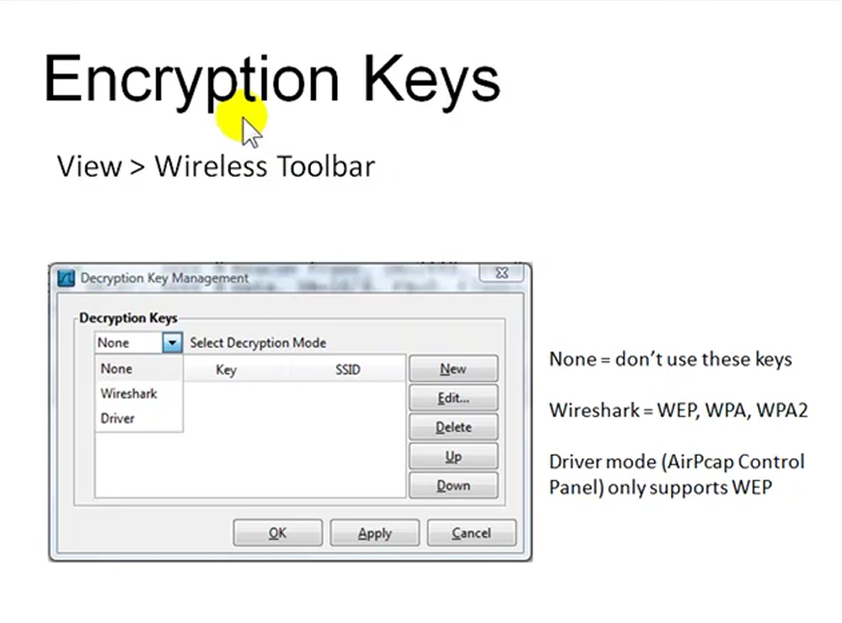
AirPcap Adapter Setup

Slide 25
Radiotap Header
Let’s look at a Radiotap header
Open this file from the file set zip file
  wlan-radiotap.pcap file
Select frame 1
Expand all of the fields under the Radiotap layer

Slide 26
Radiotap Header
This provides the
  Data Rate
  Frequency
  Channel
  Signal Strength
  Noise Floor
  Signal to Noise Ratio
Do not put a lot of faith in the signal values
They are extrapolated

Slide 27
Wireless Frame Types
There are several types of frames used in an 802.11 network including
  Management Frame
    Used to exchange management information
  Control Frame
    Used to control access to the media
  Data Frame
    Used to send the important stuff

Slide 28
Management Frame Types
The management frames are
  Association request
  Association response
  Reassociation request
  Reassociation response
  Probe request
  Probe response
  Beacon

Slide 29
Management Frame Types
  ATIM
  Disassociation
  Authentication
  Deauthentication

Slide 30
Management Frame Types
Association request
  This frame carries information about the NIC – Network Interface Card, such as the supported data rates and the SSID of the network it wishes to associate with
  After receiving the association request, the access point considers associating with the NIC, and if accepted reserves memory space and establishes an association ID for the NIC

Slide 31
Management Frame Types
Association response
  An access point sends an association response frame containing an acceptance or rejection notice to the wireless NIC requesting association
  If the access point accepts the wireless station, the frame includes information regarding the association, such as the association ID and the supported data rates

Slide 32
Management Frame Types
Reassociation request
  If the wireless station moves away from the access point to which it is currently associated and finds another access point with a stronger beacon signal, the wireless NIC will send a reassociation frame to the new access point
  The new access point then coordinates the forwarding of data frames that may still be in the buffer of the previous access point waiting for transmission to the station

Slide 33
Management Frame Types
Reassociation response
  An access point sends a reassociation response frame containing an acceptance or rejection notice to the station requesting reassociation
  Similar to the association process, the frame includes information regarding the association, such as the association ID and the supported data rates

Slide 34
Management Frame Types
Probe request
  A station sends a probe request frame when it needs to obtain information from another device
  For example, a wireless NIC would send a probe request to determine which access points are within range

Slide 35
Management Frame Types
Probe response
  A station will respond to a probe request frame with a probe response frame
  This frame contains capability information, such as supported data rates

Slide 36
Management Frame Types
Beacon
  The access point periodically sends a beacon frame to announce its presence and send network related information, such as the timestamp and SSID
  Stations continually scan all 802.11b radio channels and listen to beacons, which they use as the basis for choosing which access point is best to associate with

Slide 37
Management Frame Types
ATIM
  Battery powered stations will turn off their transceivers periodically to save battery power
  This is called Power Saving Mode or sleep mode
  All sleeping stations wake up at the same time which is during the ATIM - Announcement Traffic Indication Map window, which corresponds with each beacon transmission

Slide 38
Management Frame Types
ATIM
  If an access point is holding packets for a sleeping station, the access point will send an ATIM frame to the sleeping station indicating that packets are awaiting transmission to it
  The station that had been asleep then knows to stay awake through the next beacon interval in order to receive those frames

Slide 39
Management Frame Types
Disassociation
  A station sends a disassociation frame to an access point if it wishes to terminate the association
  For example, a station that is shutting down gracefully can send a disassociation frame to alert the access point that it is powering off
  The access point can then relinquish memory allocations and remove the station from the association table

Slide 40
Management Frame Types
Authentication
  An access point must accept or reject any stations that ask to authenticate with it
  The station begins the authentication process by sending an authentication frame containing its identity to the access point

Slide 41
Management Frame Types
  With open system authentication, the wireless NIC sends only one authentication frame, and the access point responds with an authentication frame as a response indicating acceptance

Slide 42
Management Frame Types
  With shared key authentication, the wireless NIC sends an authentication frame, and the access point responds with an authentication frame containing challenge text
  The wireless station must send an encrypted version of the challenge text, using its WEP key, in an authentication frame back to the access point

Slide 43
Management Frame Types
  The access point ensures that the station has the correct WEP key by seeing whether the challenge text recovered after decryption is the same as was sent
  Based on the results of this comparison, the access point replies to the wireless NIC with an authentication frame signifying the result of authentication

Slide 44
Management Frame Types
Deauthentication
  A station or access point sends a deauthentication frame to a station if it wishes to terminate secure communications

Slide 45
Control Frame Types
The basic control frame types are
  RTS
  CTS
  ACK
  PS Pool
  CF End
  CF End + CF ACK

Slide 46
Control Frame Types
RTS - Request to Send
  A station sends a RTS frame to another station as the first phase of a two-way handshake necessary before sending a data frame on a network that is heavily loaded
  This is not required in normal operation

Slide 47
Control Frame Types
CTS - Clear to Send
  The station sends back the CTS telling the requesting station to go ahead
  The CTS includes a time value that causes all other stations to hold off transmission of frames for the time period necessary for the requesting station to send its frame

Slide 48
Control Frame Types
ACK - Acknowledgement
  After receiving a data frame, the receiving station checks for errors in the frame
  Then the receiving station will send an ACK frame to the sending station if no errors are found
  If the sending station doesn't receive an ACK after a period of time, the sending station will retransmit the frame

Slide 49
Control Frame Types
PS Poll - Power Save Poll
  A station awakening from Power Saving Mode transmits this frame to retrieve any frames that have been buffered by the access point for the station

Slide 50
Control Frame Types
CF End
  This frame marks the end of the contention free period, which is part of the PCF mode of operation

Slide 51
Control Frame Types
CF End + CF ACK
  This is the same as the CF End alone, but it adds an ACK for the last frame received during the contention free period, which is part of the PCF mode of operation

Slide 52
Data Frame Types
There is only one type of data frame
This frame has a maximum size of 2348 bytes
Of these 2348 bytes
  30 bytes are used by the header
  6 bytes are used by the CRC trailer
  This leaves up to 2312 bytes of data
The data frame contains the following major fields

Slide 53
Data Frame Format
Frame Control
Duration ID
Address 1
Address 2
Address 3
Sequence Control
Address 4
Frame Body
CRC

Slide 54
Frame Control Subfields
The first field, the frame control field, actually consists of eleven subfields
These are

Slide 55
Frame Control Subfields
Protocol Version
Type
Subtype
To DS
From DS
Move Frag
Retry
Power Management
More Data
WEP
Reserved

Slide 56
Sequence Control Subfields
Further down in the list of data frame fields the sequence control field is seen to contain two subfields
These are

Slide 57
Sequence Control Subfields
Protocol Version
Sequence Number

Slide 58
Data Frame Fields
Let’s look at each of these fields in more detail
As we encounter a field with subfields, these subfields will be detailed as well

Slide 59
Frame Control Field
16 bits
11 subfields
This field does just what its name implies
It contains in its subfields the control information for the frame

Slide 60
Protocol Version Subfield
2 bits
This is the version of 802.11b being used
Right now there is only one version
This first and only version is indicated by a protocol number of 0

Slide 61
Type Subfield
2 bits
Along with the subtype field this field identifies the type of frame this is such as management, control, or data
There are 30 possibilities

Slide 62
Subtype Subfield
4 bits
This field works in combination with the type subfield to identify the type of frame as discussed just above

Slide 63
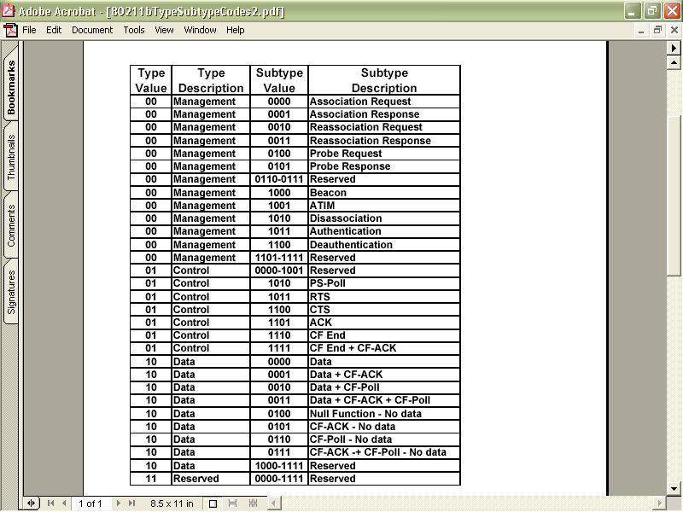
Type and Subtype Codes

Slide 64
To DS Subfield
1 bit
This is set to 1 when the frame is going to a distribution system
Recall that a distribution system is a wired connection among access points
This is set also whenever the frame is being sent to or as indicated by the next field being sent from a device that is connected to the network using a wire

Slide 65
From DS Subfield
1 bit
This is set to 1 when the frame is from a distribution system or wired device

Slide 66
More Fragments Subfield
1 bit
This is set to 1 when there are more fragments to come

Slide 67
Retry Subfield
1 bit
This says that the frame is a retransmission of a fragmented frame so that a frame is not duplicated

Slide 68
Power Management Subfield
1 bit
This field indicates whether the station is in
  Power Save Mode
  or
  Active Mode
The access point uses this field so that it will know which stations are in sleep mode

Slide 69
Power Management Subfield
Such a station requires the access point to hold transmissions for that station until it awakens

Slide 70
More Data Subfield
1 bit
This is to let the receiver know that more frames will follow this frame for a station that has been in sleep mode

Slide 71
WEP Subfield
1 bit
This is set when WEP – Wireless Equivalent Privacy is used

Slide 72
Order Subfield
1 bit
This field indicates that the DEC LAT protocol is in use
This is a protocol designed to allow LAN devices to connect to a DEC VAX minicomputer
For the most part, no one uses this protocol anymore

Slide 73
Duration or ID Field
16 bits
The meaning of this field depends on the type of frame this is
It can be used to
  Set the NAV value, which is the number of microseconds the medium is expected to be busy for a transmission

Slide 74
Duration or ID Field
  Set the NAV for stations that missed the beacon that announced the NAV value as just described
  Transmit a PS - Poll frame by stations awakening from power saving mode

Slide 75
Address Field 1
48 bits
A frame can have up to four addresses in it
This is the first of the four
This is the recipient address
The actual value of this field depends on the values in the To DS and From DS fields

Slide 76
Address Field 1
This recipient can be
  Broadcast address
  Access point address
  Station address

Slide 77
Address Field 2
48 bits
This is the second of the four address fields
This address is the unit transmitting the frame, either the access point or whichever station it might be
If the original transmitter of this frame is a wired device, then the address here is the access point that is retransmitting the data

Slide 78
Address Field 3
48 bits
This is the third of the four addresses
Depending again on the To DS and From DS this can be either the original source address or the destination address

Slide 79
Sequence Control Field
16 bits
This field is used to reorder the fragments back into a complete and correct frame and to discard duplicate frames

Slide 80
Address Field 4
48 bits
This is the fourth of the four addresses
This field is used when a frame is going from one AP – Access Point to another AP

Slide 81
Initialization Vector Header
This is an extension to the normal header
It exists only if WEP is being used
It is 4 bytes long
This header along with the Integrity Value Check shown below constitute the WEP information that is added

Slide 82
Initialization Vector Subfields
If the initialization vector header is used, there are three subfields in this header
  Initialization Vector
    This subfield carries the 24 bit initialization vector
  Pad
    This is to adjust the size, if required
  Key ID
    This identifies the default key that was used to encrypt the frame

Slide 83
Frame Body Field
Finally the important stuff, the data
This is the point to all of this discussed here
To get data from one place to another
Up to 2304 bytes of data is provided for
  Out of this 2304 bytes 8 bytes are used for the 802.2 LLC headers
  So the actual maximum real data that can be passed up to the next layer is 2296 bytes

Slide 84
Frame Body Field
  However a maximum payload of up to 2312 bytes must be supported to accommodate WEP overhead if WEP is used

Slide 85
Integrity Value Check
This addition to the trailer exists only if WEP is being used
It is 4 bytes long
This trailer along with the IV header shown above constitutes the information that is added if WEP is used

Slide 86
CRC Field
32 bits
The checksum
This is used as always to be sure the frame got to its destination intact

Slide 87
Management Frame Format
Let’s switch from the data frame to the format of a management frame
This frame has fewer fields
For example

Slide 88
Management Frame Format
Frame Control
Duration
DA
SA
BSSID
Sequence Control
Frame Body
CRC

Slide 89
Management Frame Format
Frame Control
  This is the same as the data frame
Duration
  The time period required for the frame
  The exact time specified depends on the type of management frame being sent
  For example if this is an ACK the duration is set to 0, for others it is set to several microseconds

Slide 90
Management Frame Format
DA
  The destination address
SA
  The source address
BSSID
  The MAC address of the access point
Sequence Control
  Used to place the frames in the correct order

Slide 91
Management Frame Format
Frame Body
  This field carries whatever management information is being sent by the management frame
  This will vary depending on the function of the management frame
CRC
  Error checking

Slide 92
Control Frame Format
The format of control frames differ slightly depending on what type of control frame it is
We will look at the common ones

Slide 93
Control Frame Format – RTS
Frame Control
Duration
RA
DA
CRC

Slide 94
Control Frame Format – RTS
Frame Control
  This is the same as the data frame
Duration
  This is the time in microseconds to transmit the frame, plus one CTS frame, one ACK frame, and three SIFS intervals
RA
  The destination station address

Slide 95
Control Frame Format – RTS
DA
  The address of the station transmitting the frame
CRC
  Error checking

Slide 96
Control Frame Format – CTS
Frame Control
Duration
RA
CRC

Slide 97
Control Frame Format – CTS
Frame Control
  This is the same as the data frame
Duration
  This is the time in microseconds required to transmit the frame
  This value is copied from the previous RTS frame, minus the time in microseconds required to transmit the CTS frame and its SIFS interval

Slide 98
Control Frame Format – CTS
RA
  This is the destination station address, which is copied from the previous RTS frame to which this frame is a response
CRC
  Error checking

Slide 99
Control Frame Format – ACK
Frame Control
Duration
RA
CRC

Slide 100
Control Frame Format – ACK
Frame Control
  This is the same as the data frame
Duration
  If the fragment field of the data frame to which this is a response is set to 0, this field is 0
  Otherwise the value is obtained from the duration field of the previous frame, minus the time in microseconds required to transmit the ACK and the SIFS interval

Slide 101
Control Frame Format – ACK
RA
  This is the destination station address, which is copied from the previous data frame this CTS frame is a response to
CRC
  Error checking

Slide 102
Control Frame Format – PS Poll
Frame Control
AID
BSSID
TA
CRC

Slide 103
Control Frame Format – PS Poll
Frame Control
  This is the same as the data frame
AID
  This is the Association ID
  This is how the AP knows which station it is talking to
BSSID
  The name of the access point

Slide 104
Control Frame Format – PS Poll
  The MAC address of the station sending the frame
CRC
  Error checking

Slide 105
Common Wireless Frames
Now let’s look at some typical frames as seen on an 802.11b network
We will look at
  Management Frames
    Beacon Frame
    Probe Request Frame
    Probe Response Frame
    RTS
    CTS

Slide 106
Common Wireless Frames
  Control Frame
    Acknowledgement
  Data Frame

Slide 107
Common Wireless Frames
Open this file from the file set
  Wireless Common Frames Seen.pcap

Slide 108
Beacon Frame
First a Beacon Frame
Select frame 1
Expand all except the top layer named Frame 1
In the Radiotap header we see
  The data rate is just 1 Mbps, which is common for management frames such as this one no matter how strong the signal is

Slide 109
Beacon Frame
  The frequency is 2437, which is the 802.11b/g channel 6
  This is a 802.11b connection
  The signal strength is fair at
    81 signal
    100 noise floor
    19 SNR
  Thus connectivity and speed for this client will be ok, but it might drop lower which will be a problem

Slide 110
Beacon Frame
In the IEEE 802.11 Beacon Frame layer we see
  That this is a beacon frame
  It is sent to the broadcast address

Slide 111
Beacon Frame
In the IEEE 802.11 wireless management frame layer we see
  The beaconing interval is 102.4 seconds
  The SSID is mtndsi
  It can send data at rates from 1 to 54 Mbps
  It is talking on channel 6
  It is a Cisco Aironet access point

Slide 112
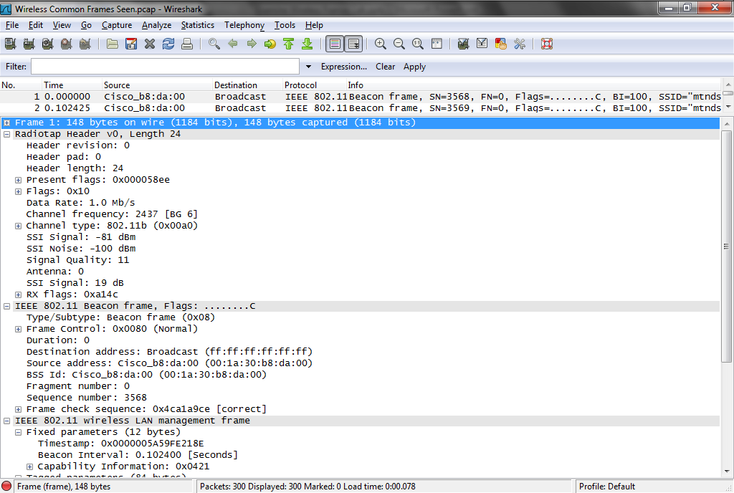
Beacon Frame

Slide 113
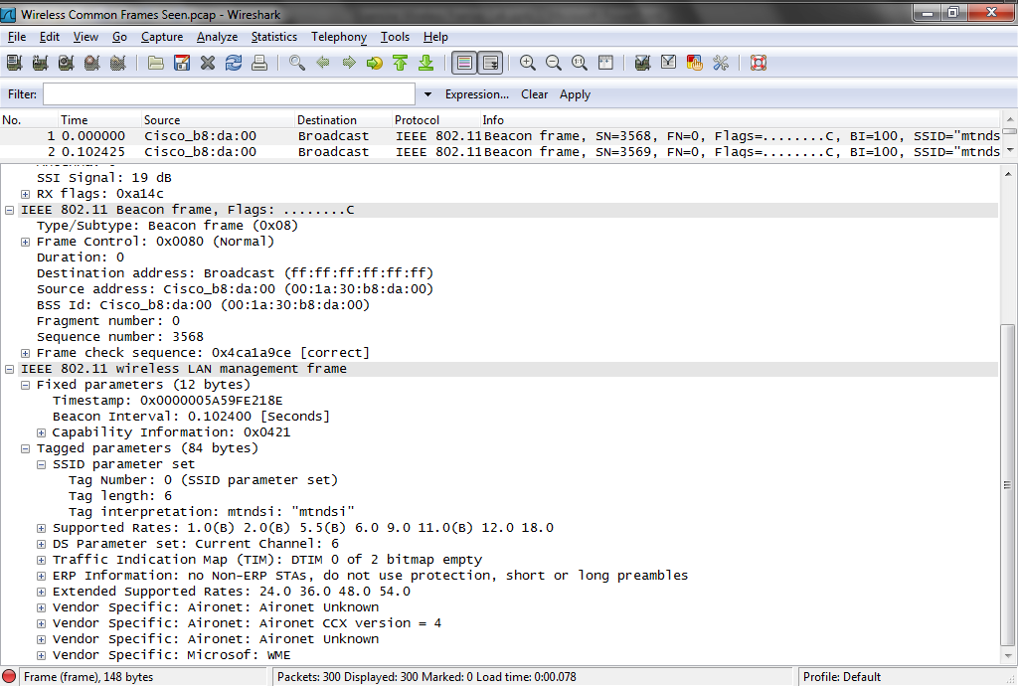
Beacon Frame

Slide 114
Probe Request
Select frame 124
This is a Probe Request
This device has not heard a beacon it wants to hear, so it is asking what access points are out there
It will not receive a Probe Response as it was damaged as discussed below

Slide 115
Probe Request
This is maybe why it is having trouble communicating on the wireless network if it is sending out malformed frames
It could also be the result of a normal collision

Slide 116
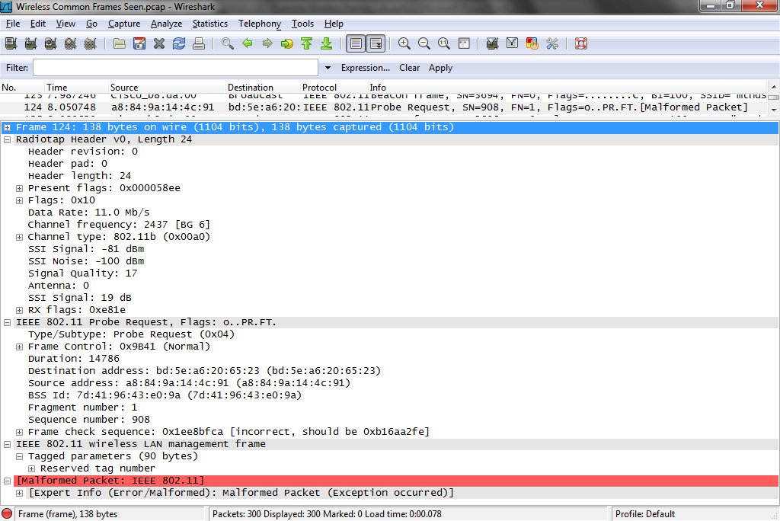
Probe Request

Slide 117
RTS Frame
Select frame 78
The is a Request to Send frame
This is used when the network is too busy for normal operation
This sender is saying to everyone else – shut-up for a few microseconds – the duration field says 9849 - while I send something

Slide 118
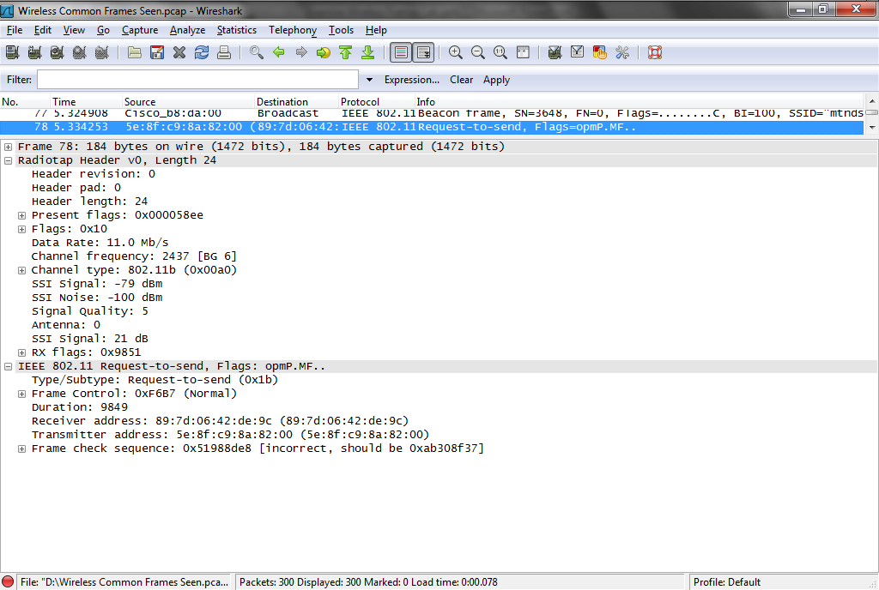
RTS Frame

Slide 119
CTS Frame
Select frame 95
This is a CTS - Clear to Send
The other side has heard a RTS sent to it
It answers back, ok send
All the other devices that hear this exchange will remain quiet for the NAV value listed in the Duration field, in this case 32285 microseconds or .032285 seconds

Slide 120
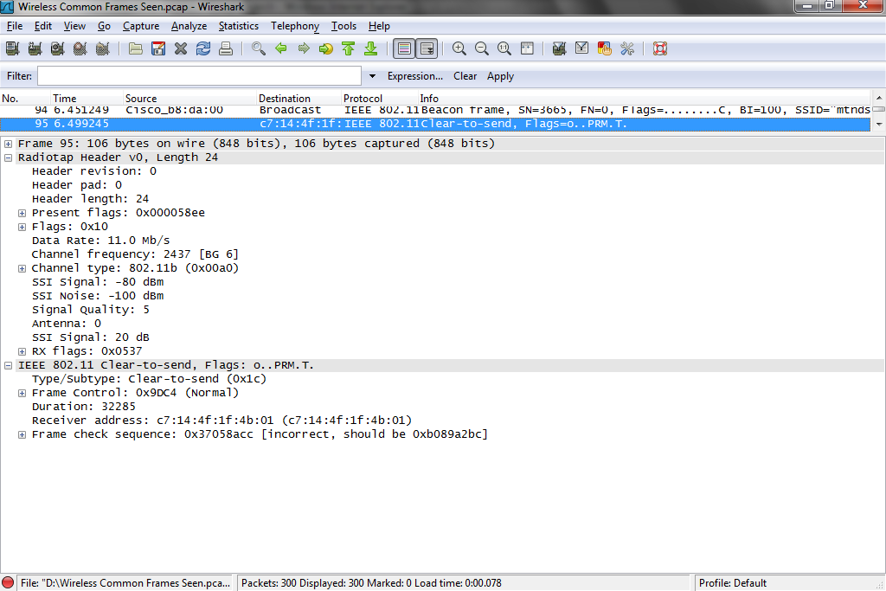
CTS Frame

Slide 121
Acknowledgement Frame
Select frame 38
This is an acknowledgement frame
Only the destination address is used for these

Slide 122
Data Frame
Open the file named
  wlan-videodownload.pcap
Select frame 2
This is a data frame
One of many in a sequence as this client downloaded a video file

Slide 123
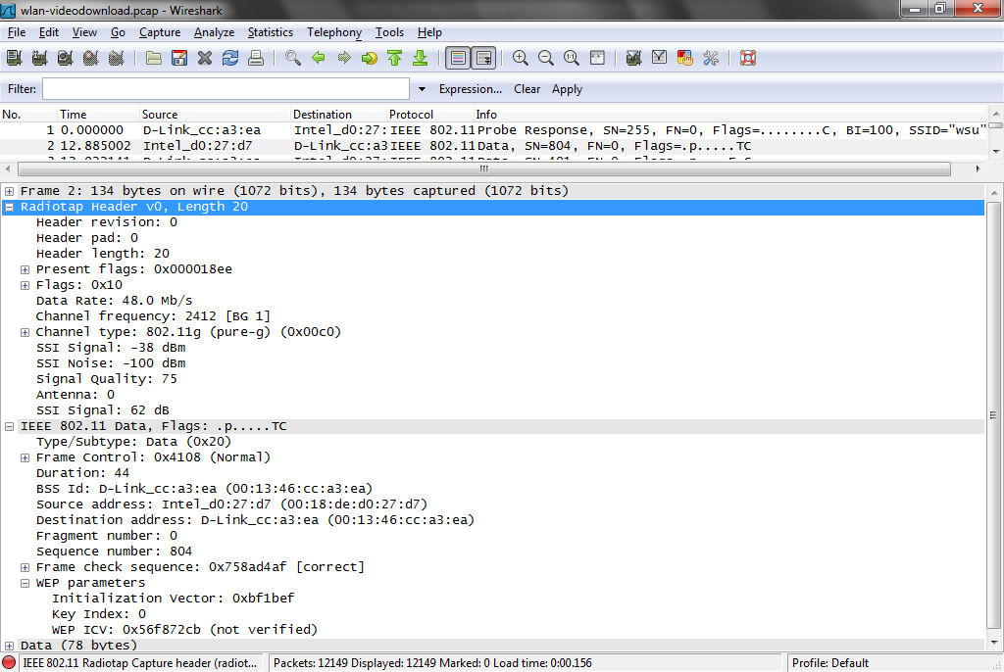
Data Frame

Slide 124
Data Frame
In the first layer we see the usual Radiotap header information
Then in the IEEE 802.11 Data layer we see
  Source and Destination MAC addresses
  The sequence number
  It is using WEP to protect the data
  And the data

Slide 125
Frames Showing Problems
Next let’s look at a common problem seen in wireless frames
  Malformed Frame

Slide 126
Malformed Frame
Select frame 124 in
  Wireless Common Frames Seen.pcap
Look at the last layer in it
It says
  Malformed Packet
In other words, it was damaged in transit by running into something
It will need to be resent

Slide 127
Malformed Frame

Slide 128
Wireless Security Frames
Let’s look at some common wireless security frames including
  WEP Authentication
    Failed
    Successful
  WPA-PSK
  WPA2-PSK
  No Security

Slide 129
PSK Authentication
The most common way of securing a wireless network is to use a PSK – Pre-Shared Key
This is basically a password entered at both ends of the connection, that is the client and the access point
For the client to be allowed through the access point onto the network these must match

Slide 130
PSK Authentication
WEP, WPA-PSK, and WPA2-PSK all use this basic approach to security
The process proceeds this way
  This authentication method works by using a challenge/response system
  When the client attempts to connect to the access point, the access point sends a challenge text to the client
  This challenge frame is acknowledged

Slide 131
PSK Authentication
  Then the client takes the challenge text, decrypts it with the WEP key provided by the client, and transmits the resultant string back to the access point
  Once the access point verifies that the response text is what it should be, it transmits a message back to the client to notify it that the authentication process was successful

Slide 132
Failed WEP Authentication
Let’s look at a failed attempt at this type of authentication from a wireless client to an access point due to the wrong pre-shared key being entered in the client
Open this file in Wireshark
  FailedWEPAuth.pcap
Select frame 1
Expand the 802.11 layers

Slide 133
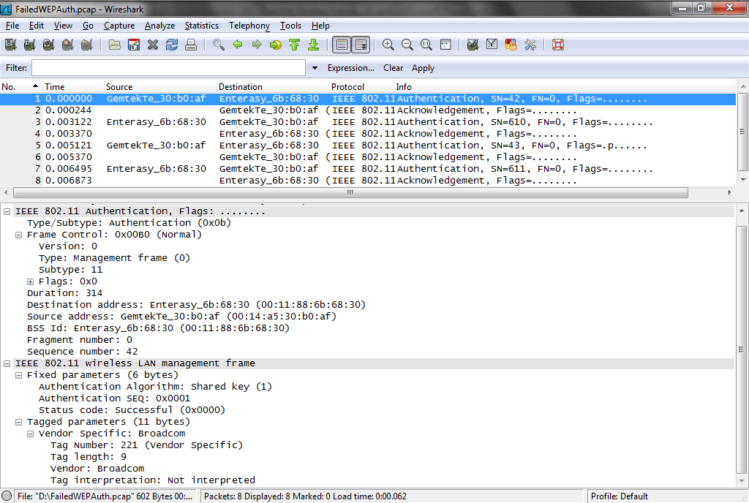
Failed WEP Authentication

Slide 134
Failed WEP Authentication
Look at the first 802.11 layer
  This is an authentication frame
  It is from the client to the access point
  The access point BSS ID is the company name
Look at the second 802.11 layer
  The authentication proposed is PSK

Slide 135
Failed WEP Authentication
Select frame 2
Here the access point says ok I received this authentication request
Keep in mind the authentication as the first phase is always successful
It is the second step of association where the connection fails

Slide 136
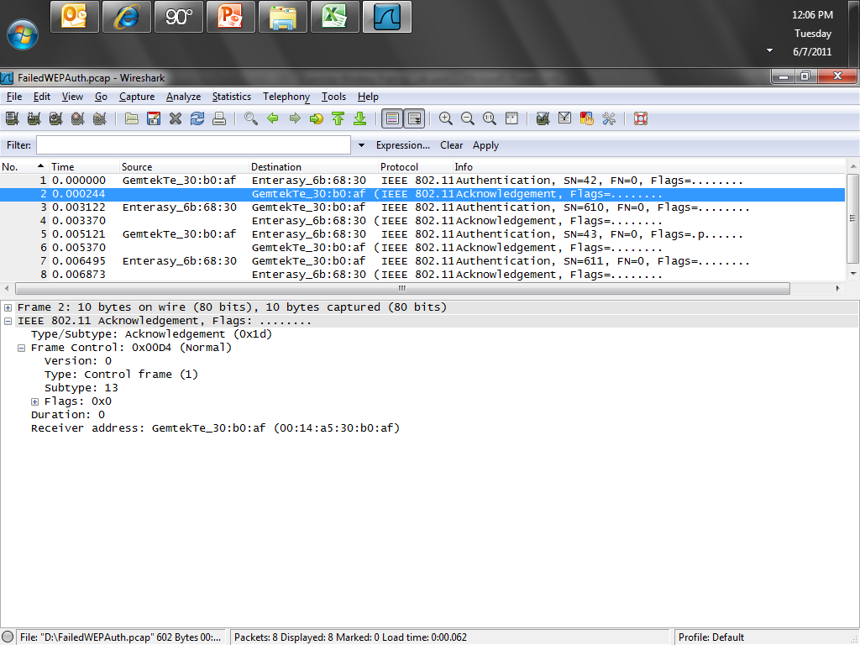
Failed WEP Authentication

Slide 137
Failed WEP Authentication
Select frame 3
The access point sends the challenge text to the client
Select frame 4
The client says I received the frame with the challenge text

Slide 138
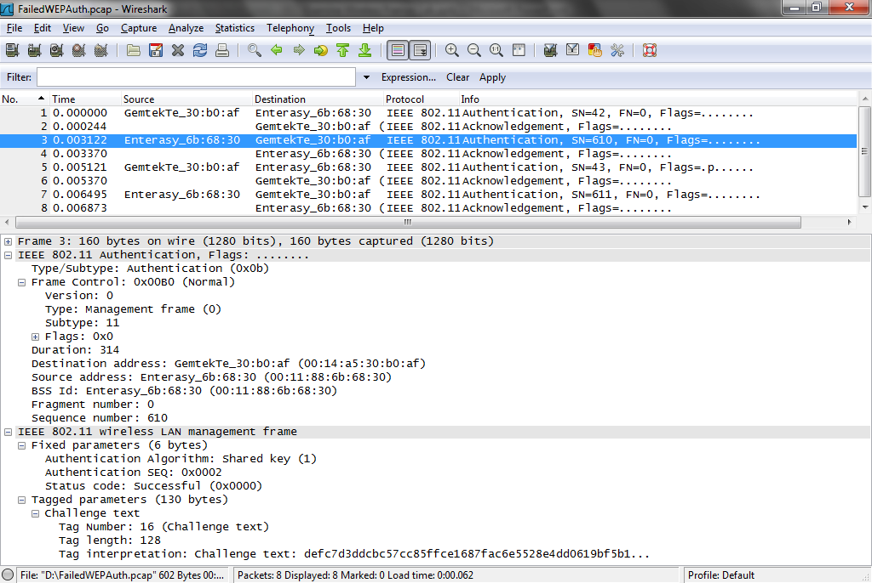
Failed WEP Authentication

Slide 139
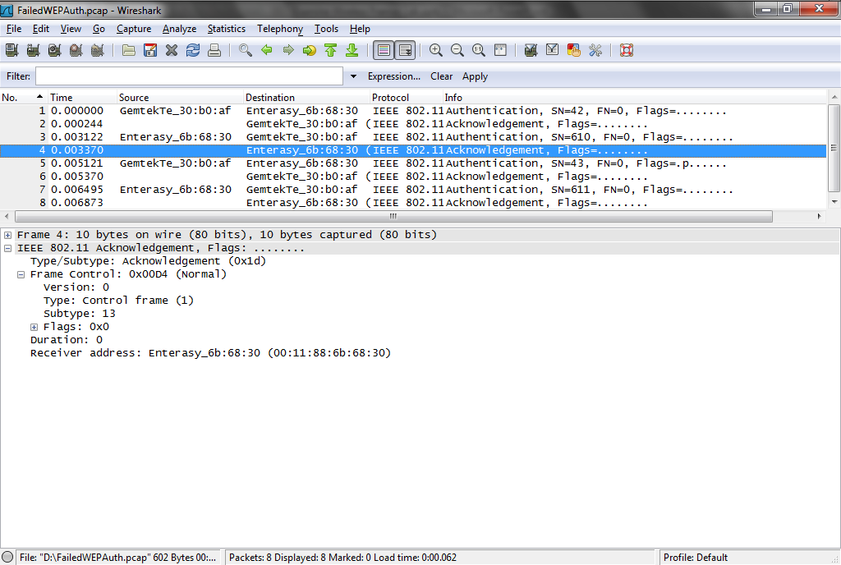
Failed WEP Authentication

Slide 140
Failed WEP Authentication
Select frame 5
The client acts on the challenge text and sends the result back to the access point

Slide 141
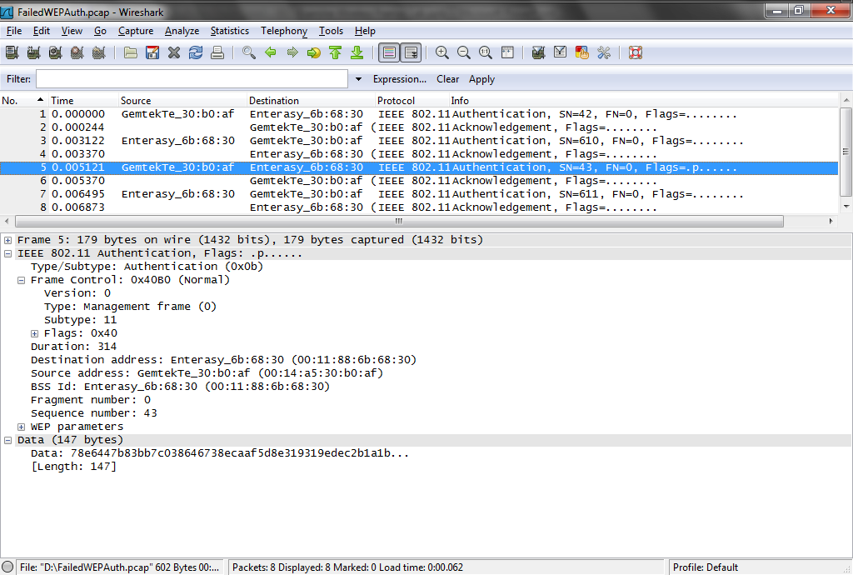
Failed WEP Authentication

Slide 142
Failed WEP Authentication
Select frame 6
The access point says, ok I have it

Slide 143
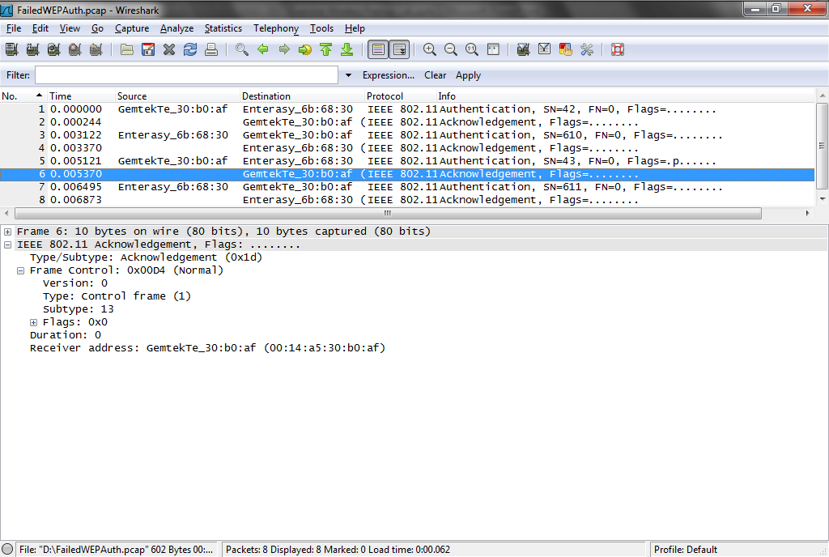
Failed WEP Authentication

Slide 144
Failed WEP Authentication
Select frame 7
The access point says, no that is incorrect
Go away and leave me alone
The key phrase here is
  Status code: Received an Authentication frame with authentication sequence transaction sequence number out of expected sequence (0x000e)

Slide 145
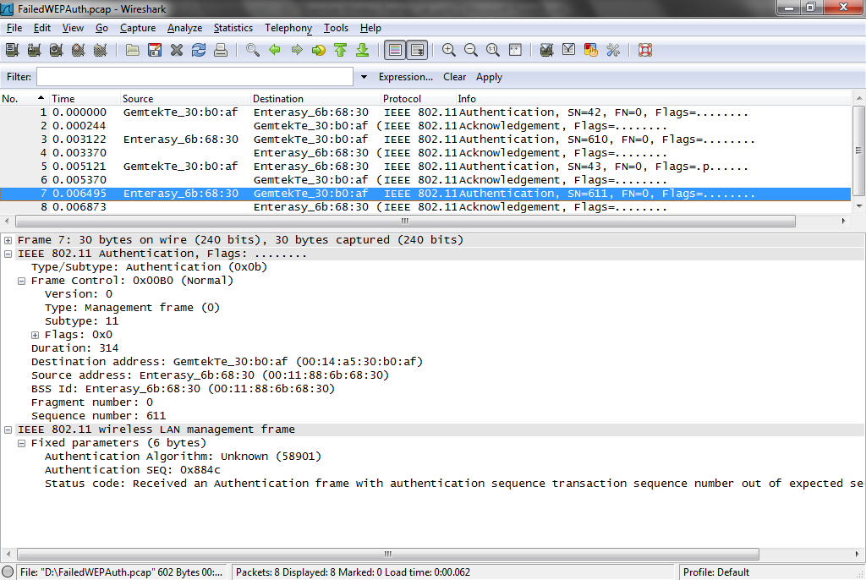
Failed WEP Authentication

Slide 146
Failed WEP Authentication
Finally in frame 8 the client says I received your response

Slide 147
Successful WEP Authentication
Now let’s look at a successful PSK authentication
Download and open this file
  WiFi-Shared-Authentication.pcap
The sequence of frames we are interested in are frames 4 to 15

Slide 148
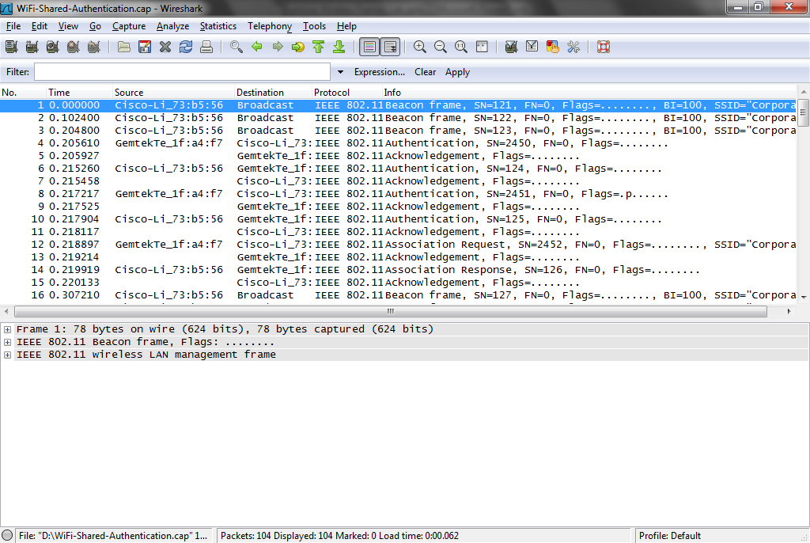
Successful WEP Authentication

Slide 149
Successful WEP Authentication
Select frame 4
Expand the IEEE 802.11 Wireless LAN management frame layer
The authentication method desired is
  Shared key

Slide 150
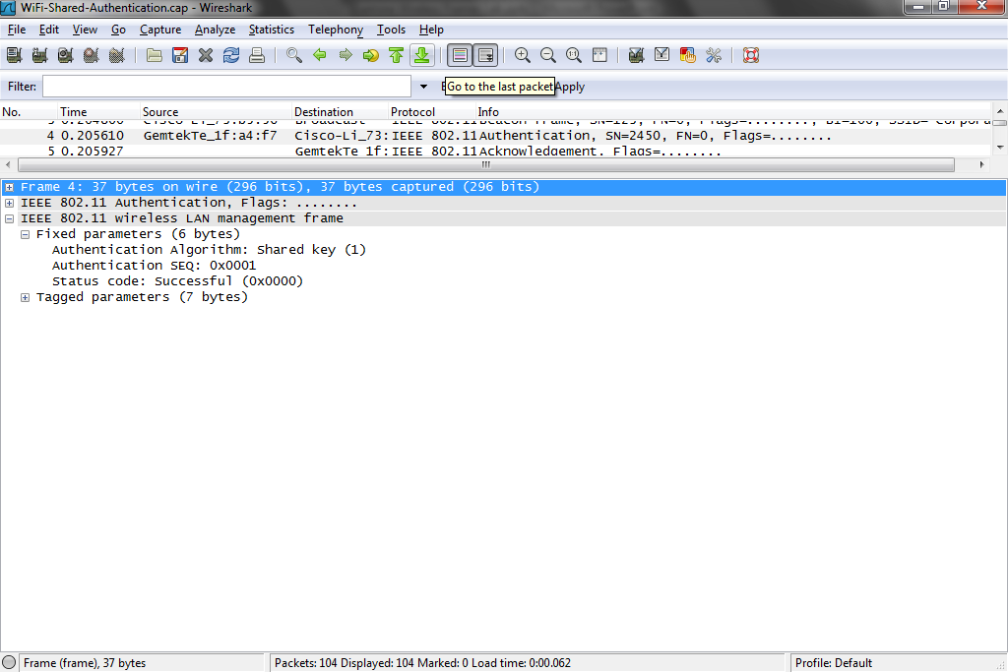
Successful WEP Authentication

Slide 151
Successful WEP Authentication
In frame 5 the access point says got it with an ACK
In frame 6 the access point says Shared Key works for me

Slide 152
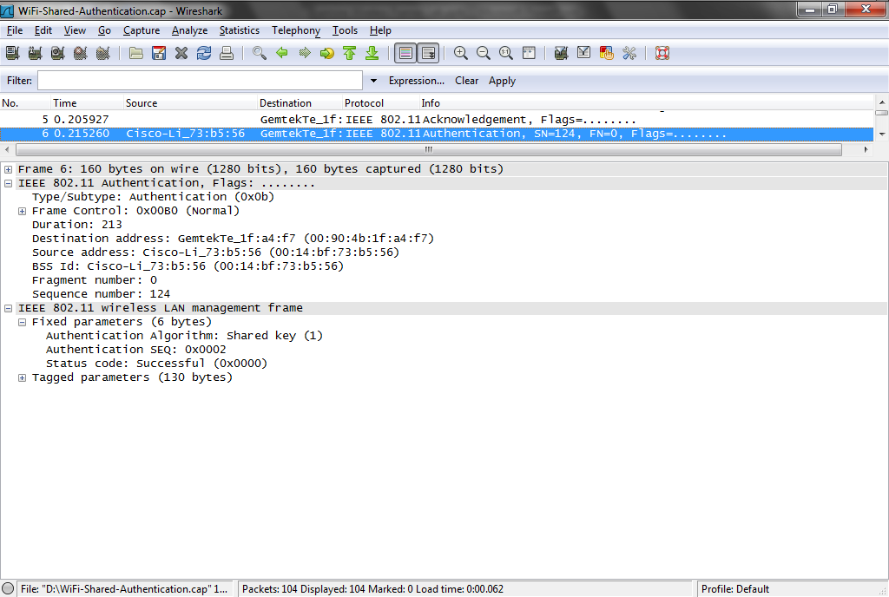
Successful WEP Authentication

Slide 153
Successful WEP Authentication
In frame 7 the client ACKs frame 6
In frame 8 the client says here is my WEP key

Slide 154
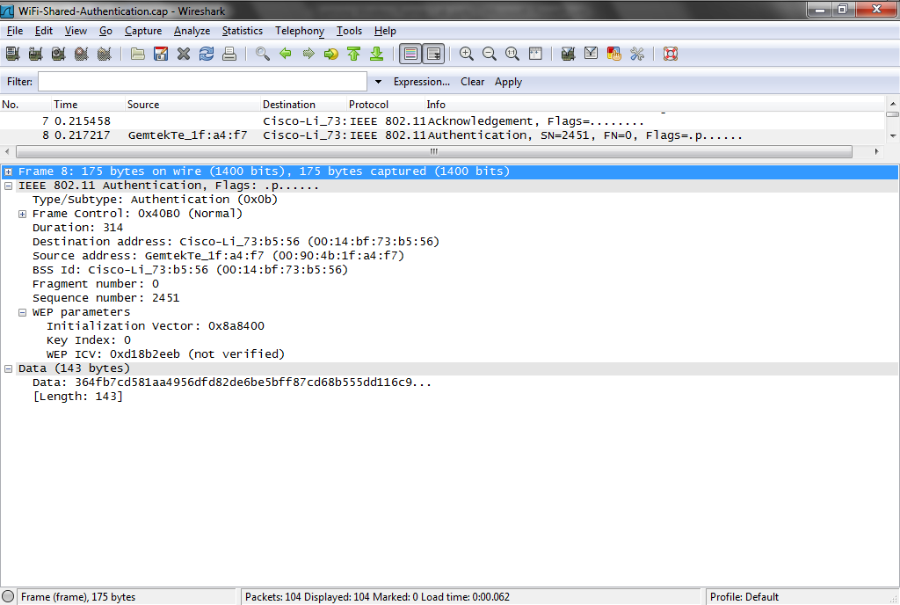
Successful WEP Authentication

Slide 155
Successful WEP Authentication
In frame 9 the access point ACKs that
In frame 10 the access point says ok, I know who you are now

Slide 156

Successful WEP Authentication

Slide 157
Successful WEP Authentication
In frame 11 the client ACKs that
In frame 12 the client says ok since we authenticated, let’s now associate so I can pass data through you
Here is what I can do in terms of data rates and so forth

Slide 158
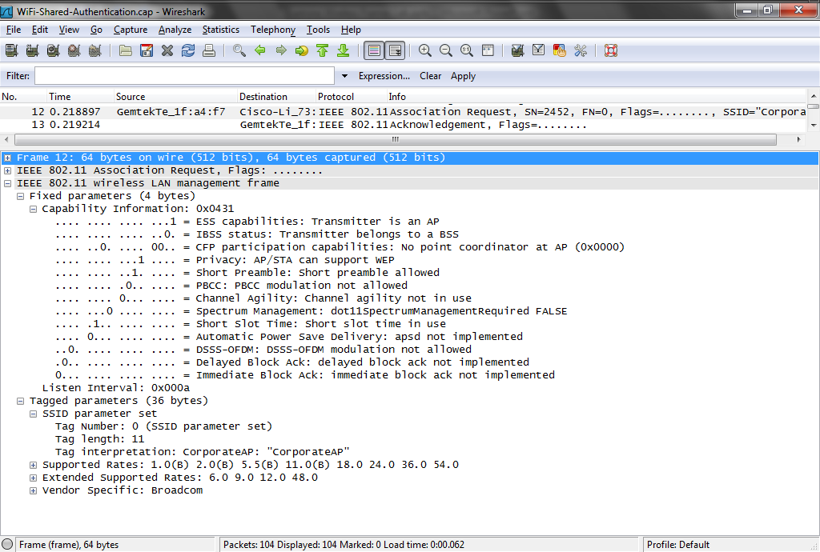
Successful WEP Authentication

Slide 159
Successful WEP Authentication
In frame 13 the access point ACKs that
In frame 14 the access point says ok here is what I can do
In frame 15 the client ACKs that

Slide 160
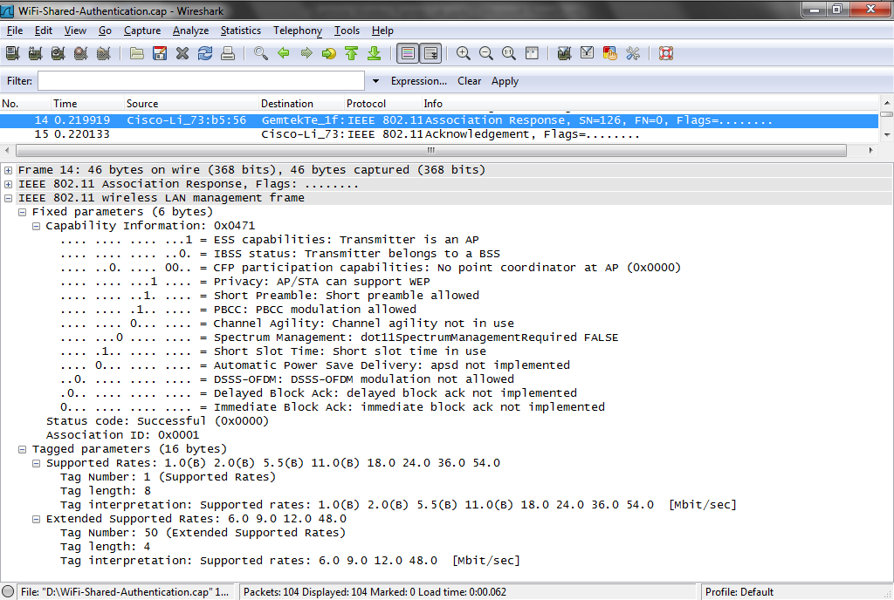
Successful WEP Authentication

Slide 161
Successful WEP Authentication
Finally in frame 55 the client sends some data through the access point

Slide 162
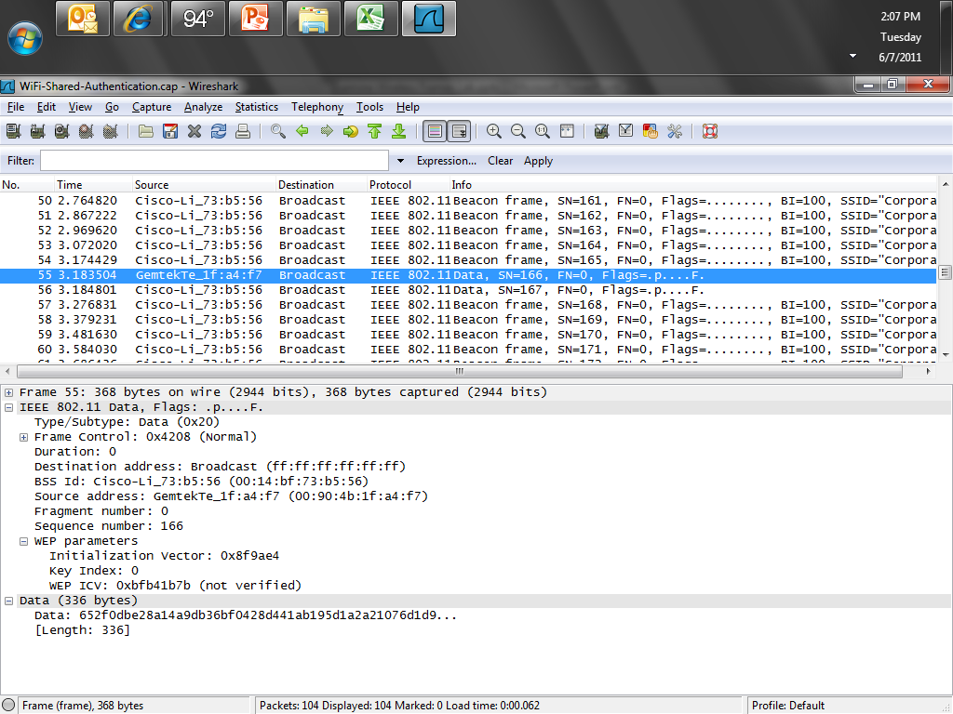
Successful WEP Authentication

Slide 163
WPA Authentication
Now let’s look at a successful WPA-PSK authentication using TKIP
Download and open this file
  WPA-PSK-TKIP.pcap
Select frame 665
Here we see the access point busily beaconing away

Slide 164
WPA Authentication
Select the next frame
A client pops up when it sends a Probe Request

Slide 165
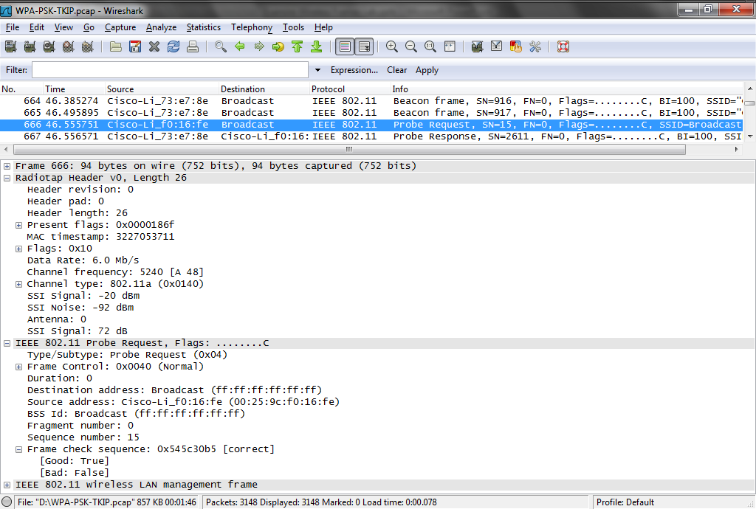
WPA Authentication

Slide 166
WPA Authentication
As we can see the signal is quite good at 20 dBm
The noise floor is ok at 92 dBm
So the SNR is 72 dBs
This transmission is on channel 48 at 5240 MHz
In the next frame the access point comes right back with Probe Response

Slide 167
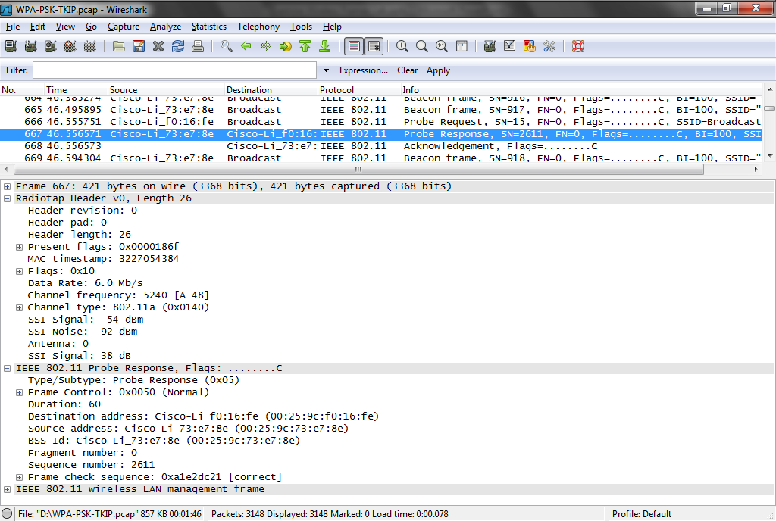
WPA Authentication

Slide 168
WPA Authentication
This signal is not quite as good at 54, 92, and 38
In the response the access point tells the client all it needs to know, such as
  SSID of Chipps5GHz
  Data rates up to 54 Mbps
  Channel 48 is fine with it
  Security is WPA using TKIP

Slide 169
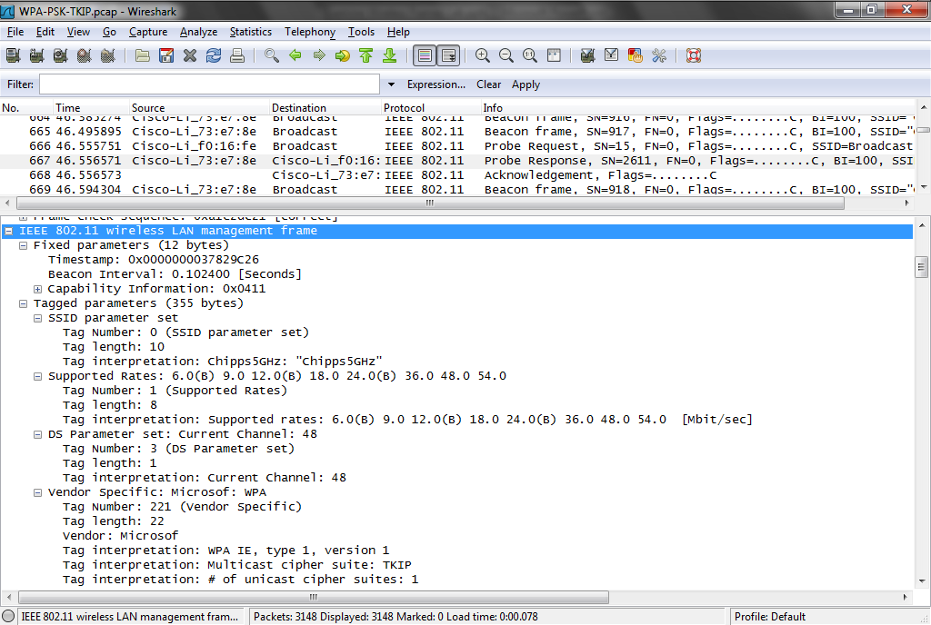
WPA Authentication

Slide 170
WPA Authentication
The client ACKs the Probe Response in frame 668
Select frame 703
The client says let’s connect up by sending an Authentication frame
The access point ACKs that in frame 704
Next the access point sends back its Authentication frame in frame 705

Slide 171
WPA Authentication
The client ACKs it

Slide 172
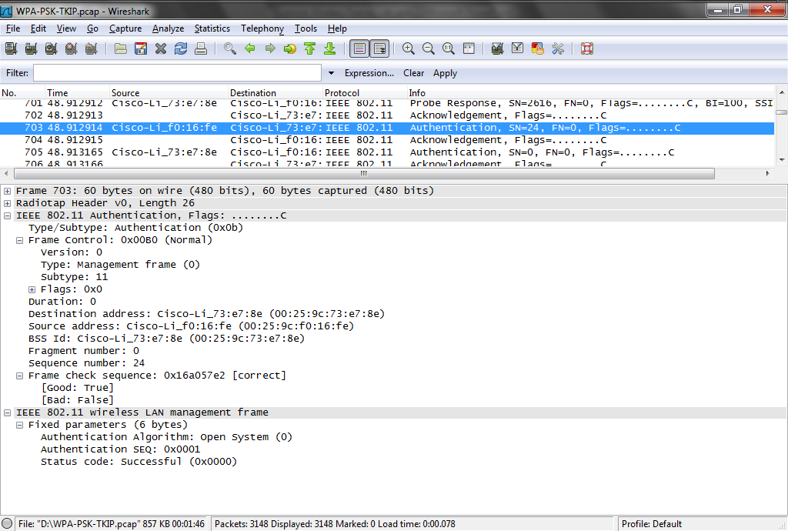
WPA Authentication

Slide 173
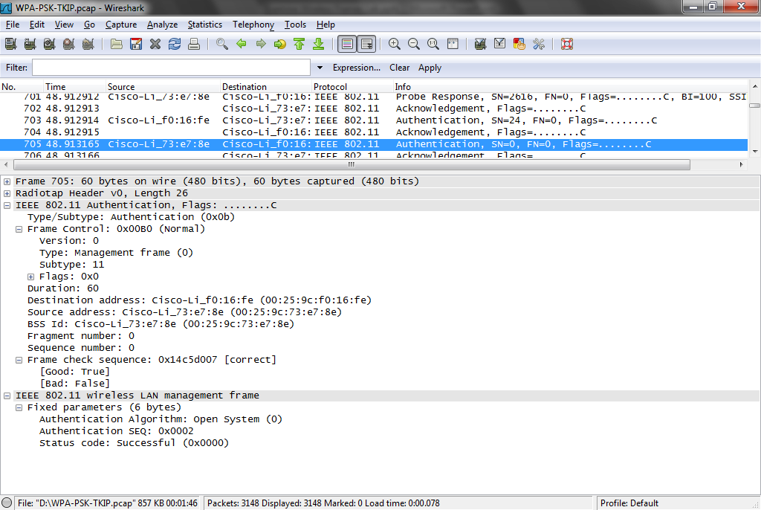
WPA Authentication

Slide 174
WPA Authentication
Select frame 707
The client now says let’s Associate
I can speak WPA-PSK using TKIP
The access point ACKs that

Slide 175
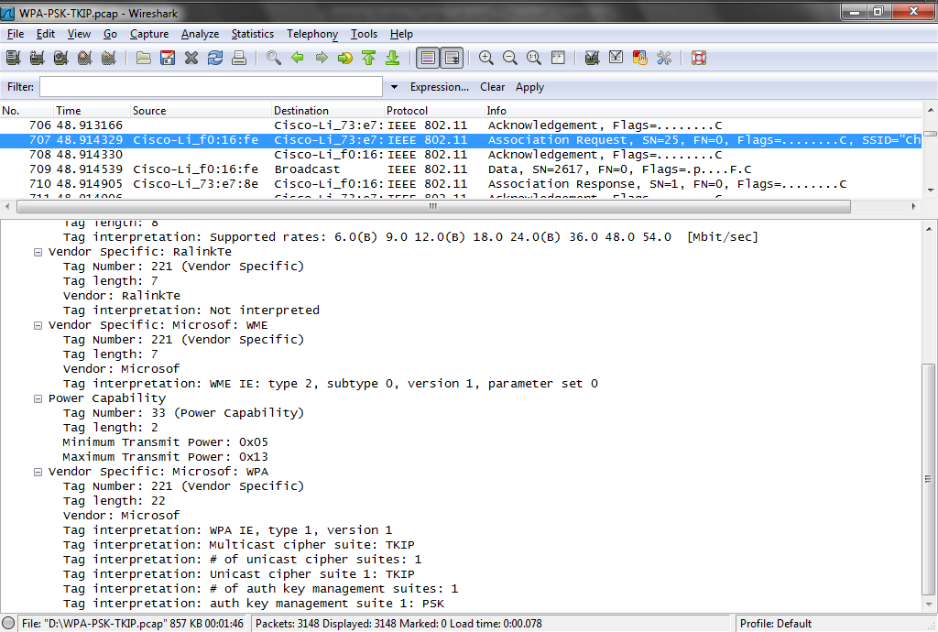
WPA Authentication

Slide 176
WPA Authentication
Select frame 709
In the data section the client sends the PSK
Select frame 710
The access point says fine
In frame 711 the client ACKs that

Slide 177
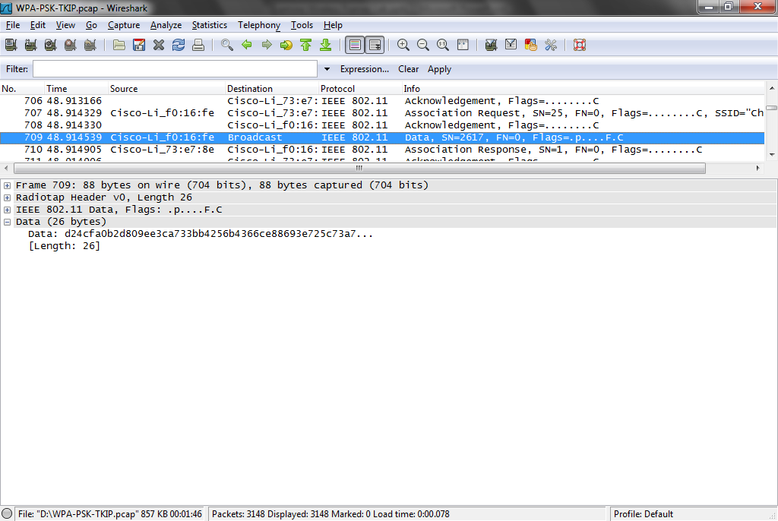
WPA Authentication

Slide 178
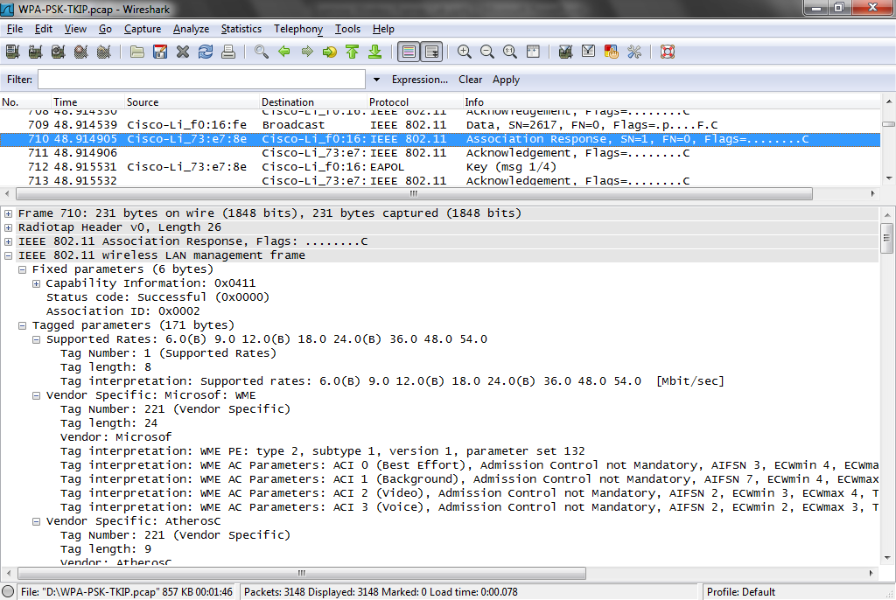
WPA Authentication

Slide 179
WPA Authentication
Now WPA begins the four way handshake as they exchange keys in frames 712 to 720

Slide 180
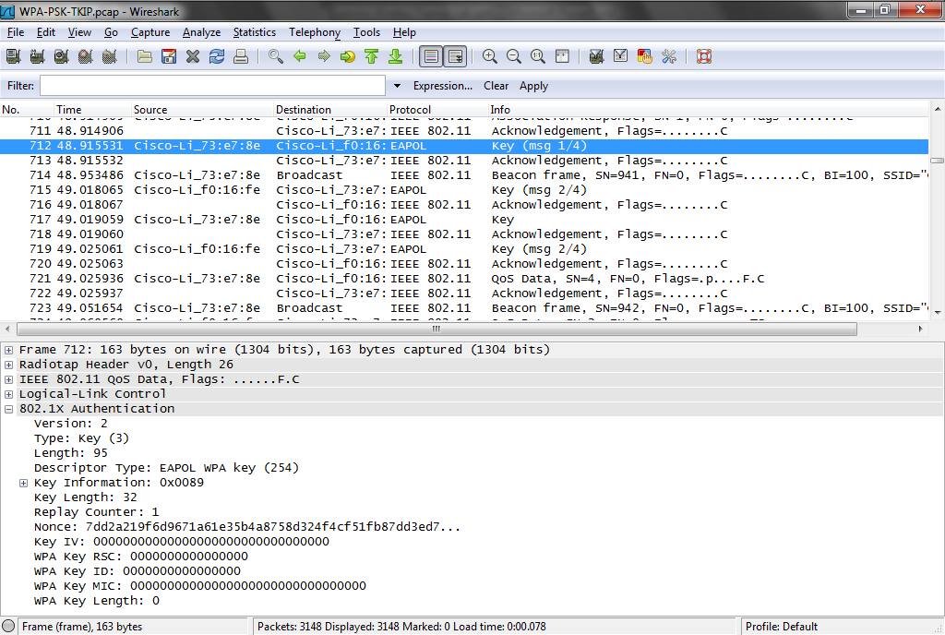
WPA Authentication

Slide 181
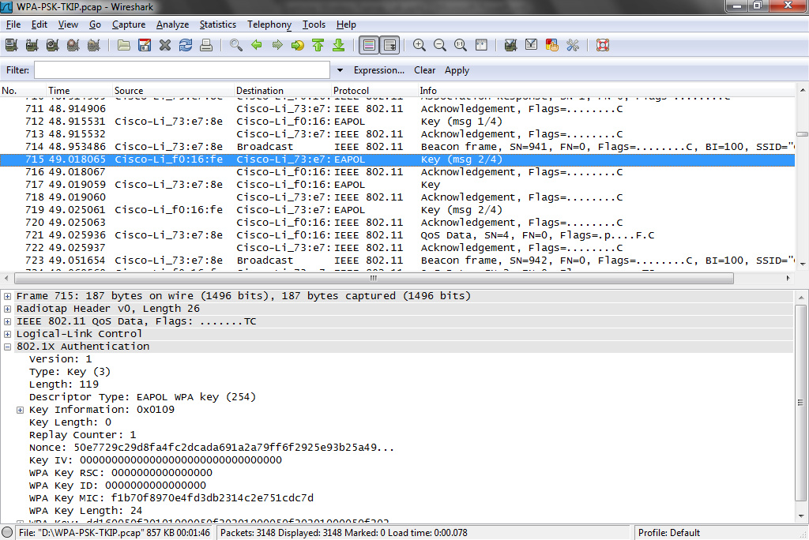
WPA Authentication

Slide 182
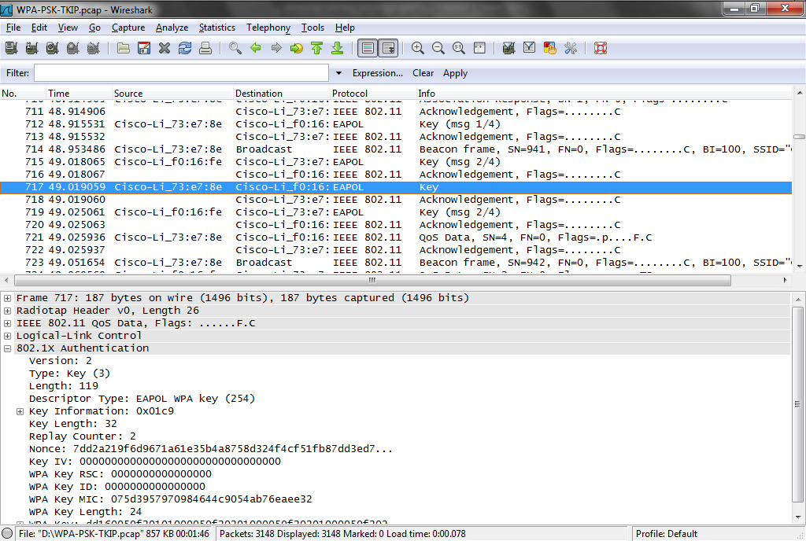
WPA Authentication

Slide 183
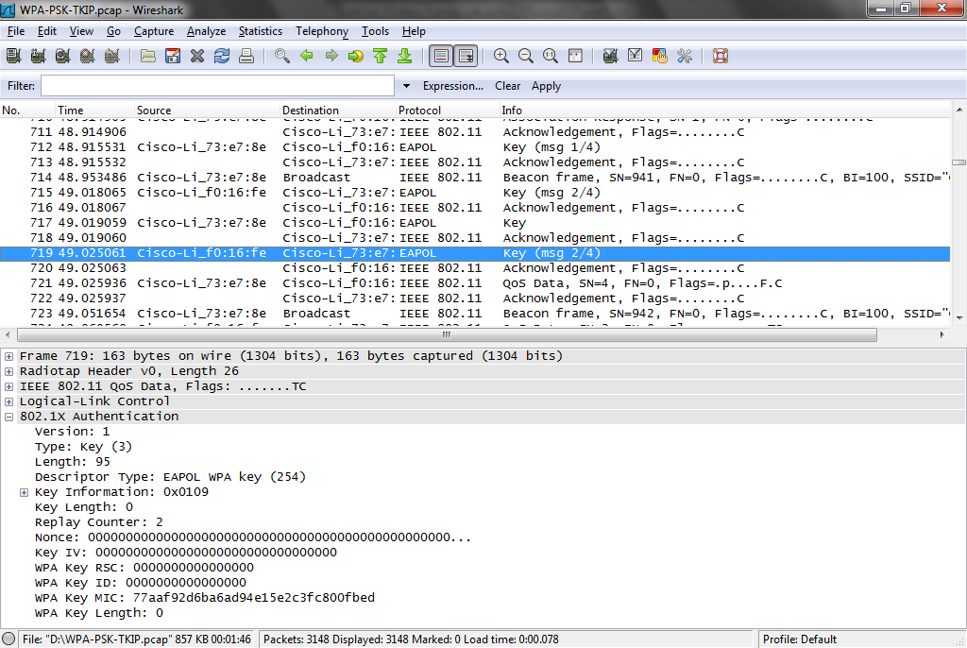
WPA Authentication

Slide 184
WPA Authentication
You can isolate this handshake by entering
  eapol
In the display filter field

Slide 185
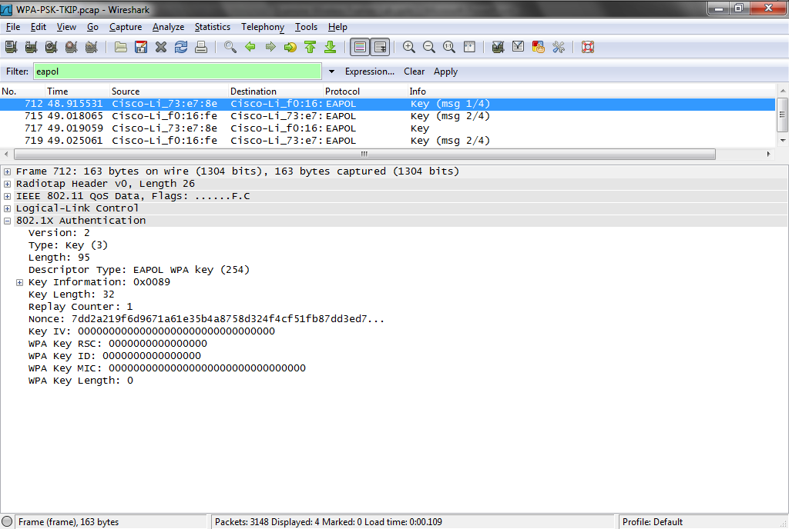
WPA Authentication

Slide 186
WPA Authentication
Now the client has authenticated and associated with the access point
So data transmission can commence as we see in frame 721

Slide 187
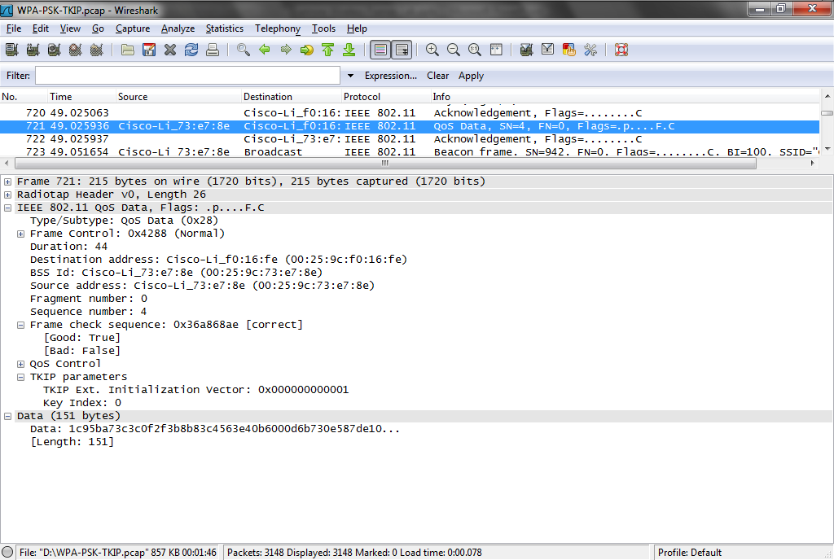
WPA Authentication

Slide 188
WPA2 Authentication
Now let’s look at a successful WPA2-PSK authentication using AES
Download and open this file
  WPA2-PSK-AES.pcap
Select frame 366

Slide 189
WPA2 Authentication
Here we see the access point busily beaconing away
Then below the authentication and association process begins

Slide 190
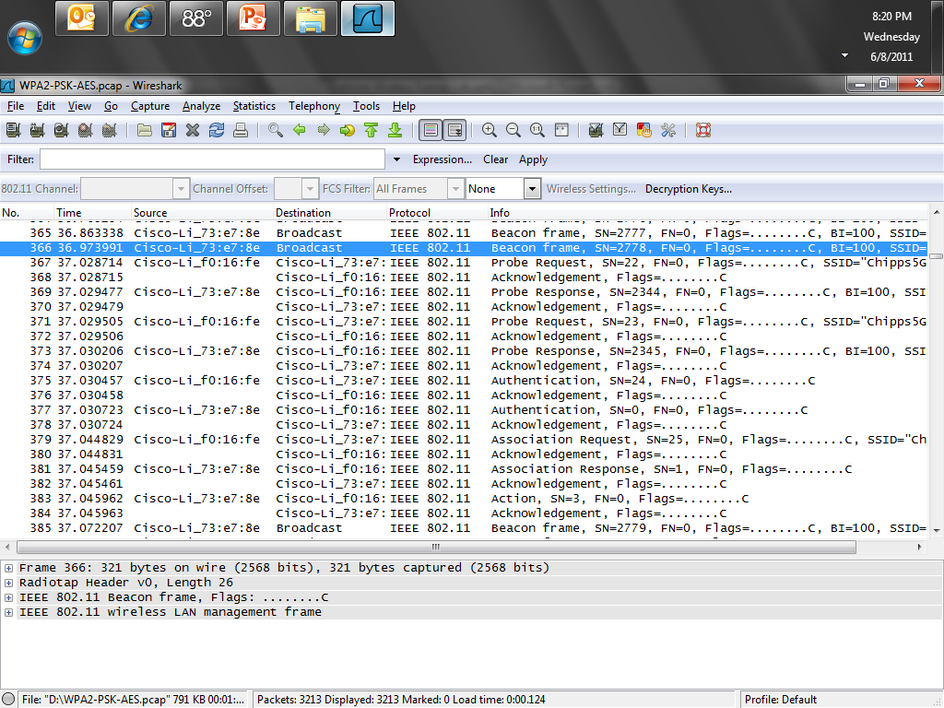
WPA2 Authentication

Slide 191
WPA2 Authentication
Select frame 371
The client looks for an access point by sending a Probe Request
The access point ACKs this
Select frame 373
The access point responses with a Probe Response
The client ACKs this

Slide 192
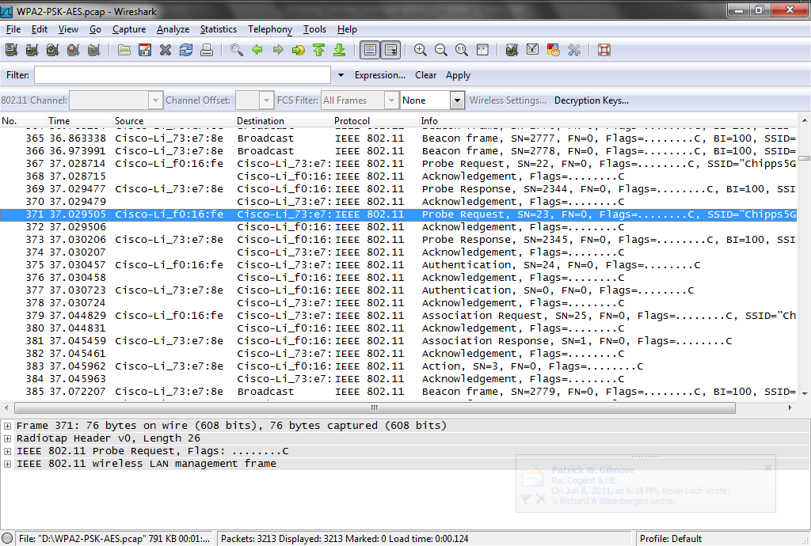
WPA2 Authentication

Slide 193
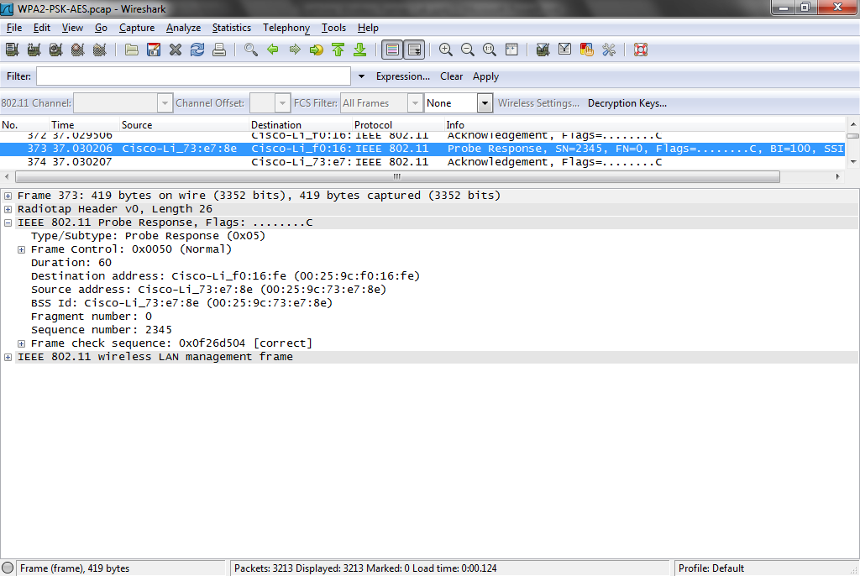
WPA2 Authentication

Slide 194
WPA2 Authentication
Select frame 375
The client sends an Authentication frame to say let’s talk
Select frame 377
The access points says fine

Slide 195
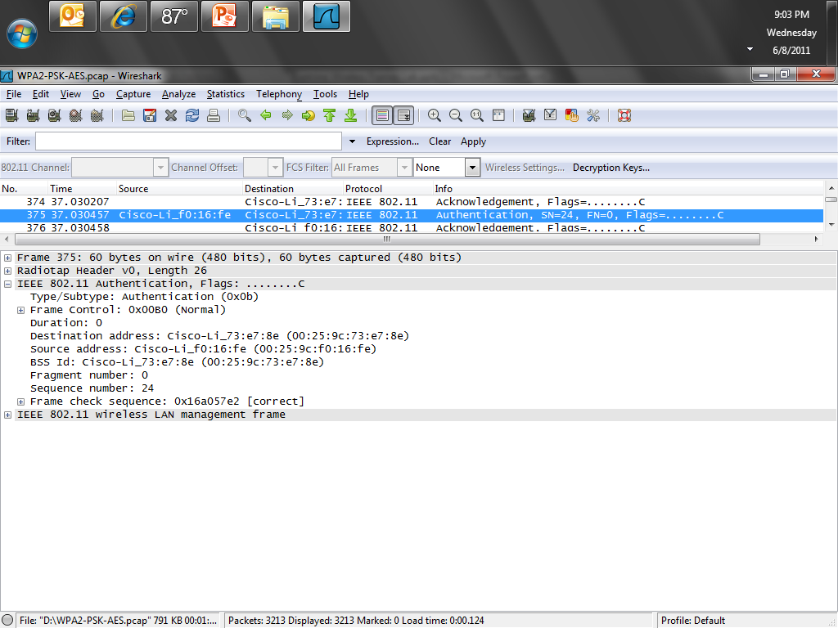
WPA2 Authentication

Slide 196
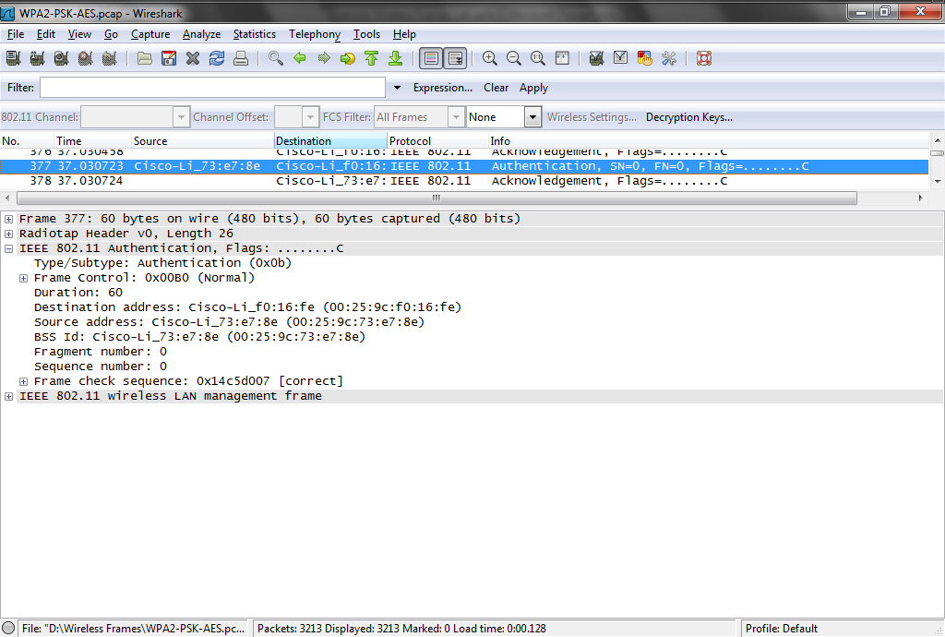
WPA2 Authentication

Slide 197
WPA2 Authentication
The client says in that case let’s associate in frame 379
It proposes WPA2-PSK using AES
The access point ACKs this
Then says in frame 381 WPA2-PSK using AES will be fine
The client ACKs that

Slide 198
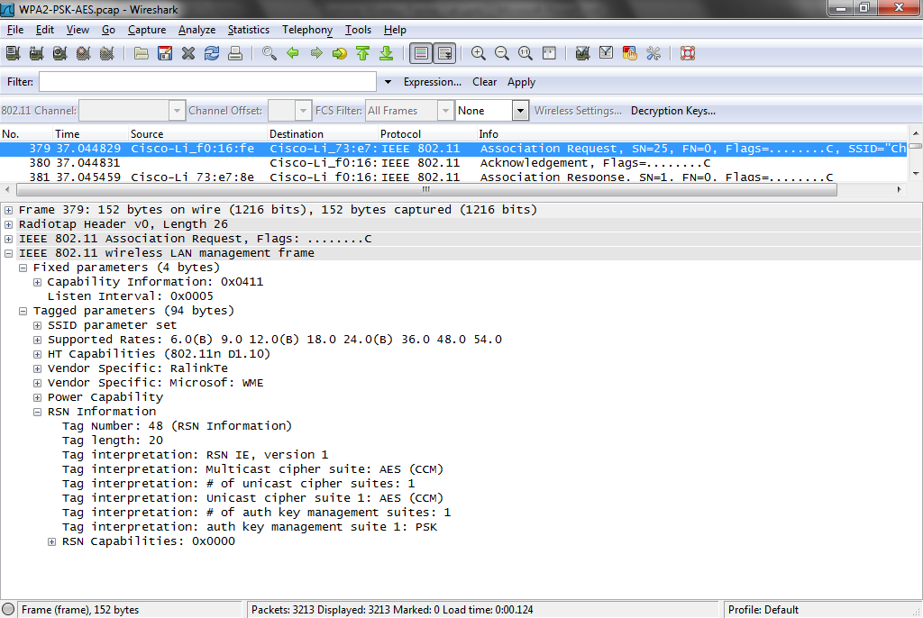
WPA2 Authentication

Slide 199
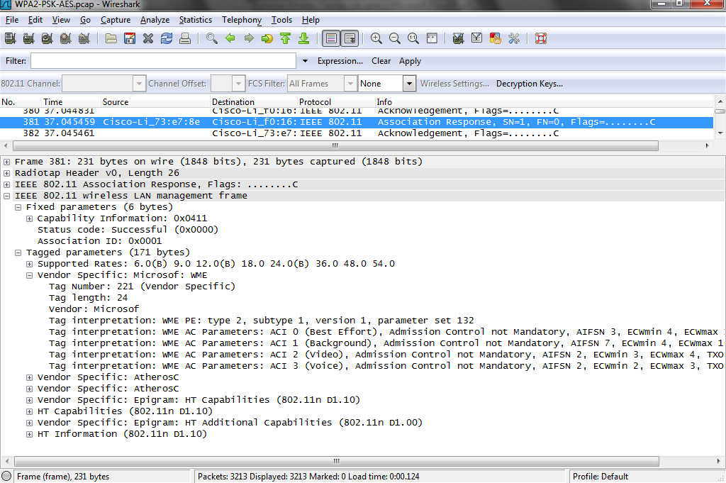
WPA2 Authentication

Slide 200
WPA2 Authentication
In frames 387 to 398 the WPA2 handshake process proceeds through the four steps

Slide 201
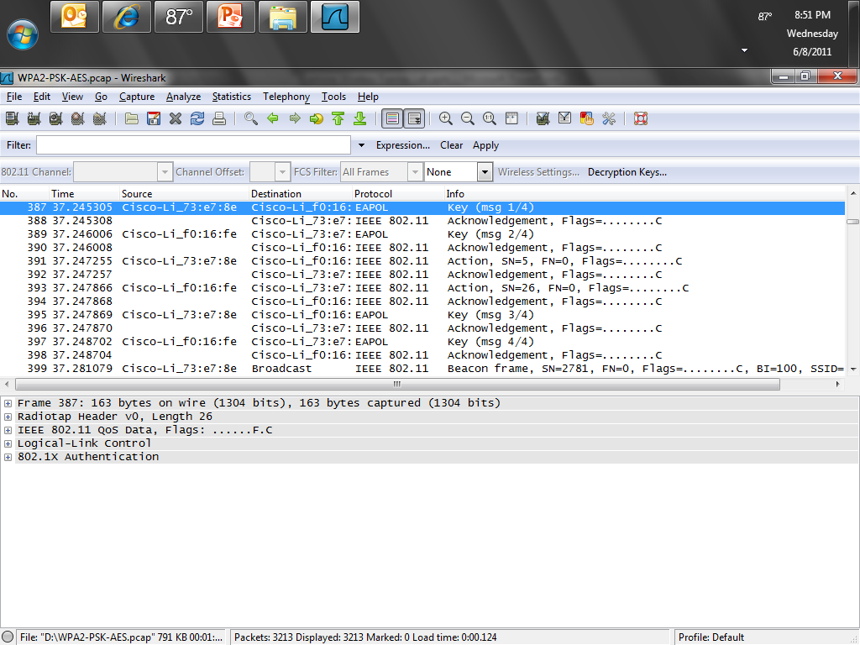
WPA2 Authentication

Slide 202
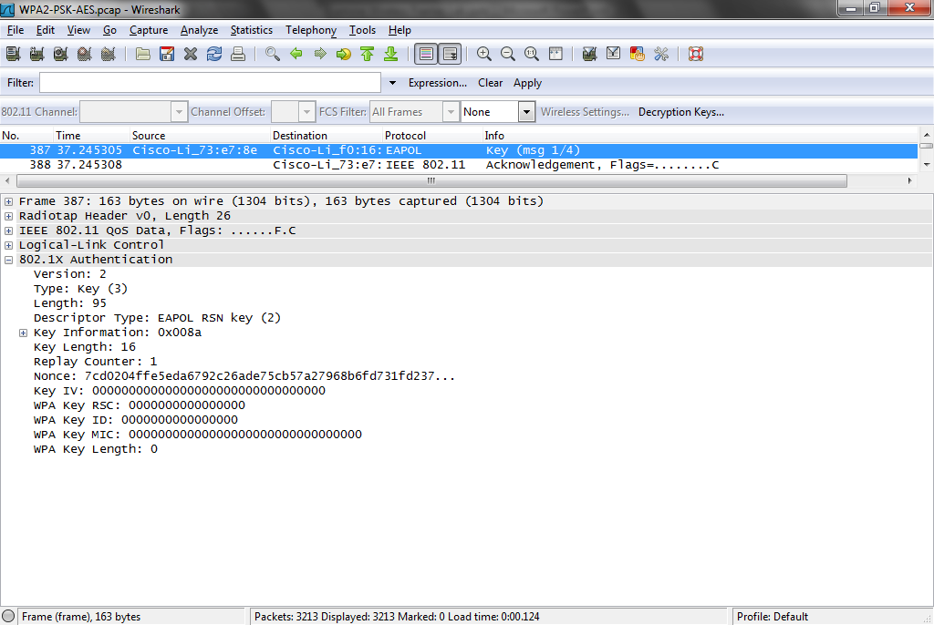
WPA2 Authentication

Slide 203
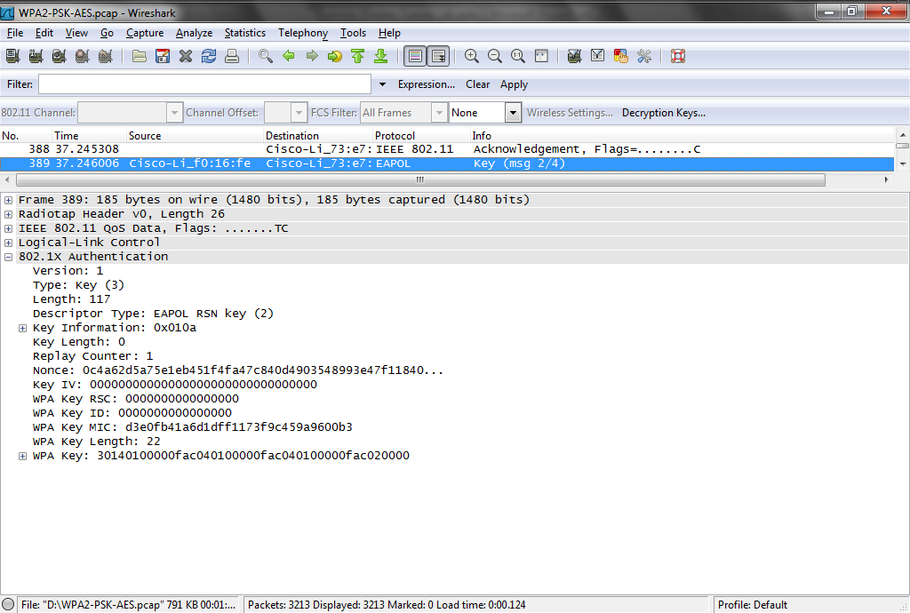
WPA2 Authentication

Slide 204

WPA2 Authentication

Slide 205

WPA2 Authentication

Slide 206
WPA2 Authentication
During this four way handshake the RSN – Robust Security Network process conducts the key generation and exchange that establishes the secured connection
These keys are the PTK – Pairwise Transient Key and the GTK - Group Transient Key

Slide 207
WPA2 Authentication
Here is a graphic of the process from a paper on the www.hakin9.org web site
This paper has a nice discussion of wireless security in general

Slide 208

WPA2 Authentication

Slide 209
WPA2 Authentication
Finally in frame 401 the client sends some data

Slide 210

WPA2 Authentication

Slide 211
No Security
Download and open this file
  WiFi-Open-Authentication.pcap
Here is an example of a wireless network without any security
Look at the frames from 4 to 11
The same authentication and association process proceeds just as it did above where a WEP key was used

Slide 212
No Security
But the Type/Subtype field under the IEEE 802.11 Authentication layer shows a value of 0b in hex
As both the client and the access point agree on no security data is passed

Slide 213

No Security

