Slide 1
Capturing Wireless Frames With A NIC
Last Update 2012.04.30
1.0.0

Slide 2
Capturing Wireless Frames
Normally to capture wireless frames you need an adaptor designed for this purpose
The one commonly used is the AirPcap adaptor from Cace Technology now part of Rivebed Technology
But in a video from MetaGeek another method was reported

Slide 3
Capturing With A NIC
In this method Microsoft Network Monitor 3.4 available free from Microsoft is used to capture wireless frames that can then be saved in a cap format for later analysis using Wireshark or any other tool that will read cap files
The only other thing required for this is a NIC that will work with Microsoft Network Monitor

Slide 4
Capturing With A NIC
As is common with MetaGeek they leave out the details
It appears in their video on this posted to YouTube that they are using an Engenius EUB9801, but who knows
I tested this procedure using a Cisco AE2500 dual band adaptor
It worked just fine with it

Slide 5
Microsoft Network Monitor
All that needs to be done in Microsoft Network Monitor is to
  Deselect all NICs except the wireless NIC to be used to capture with
  Set that NIC to Monitor Mode
  Leave the window where the NIC was set to Monitor Mode open
  Start the capture
Let’s see how this is done

Slide 6
Microsoft Network Monitor
Go to www.microsoft.com
Search for Microsoft Network Monitor

Slide 7
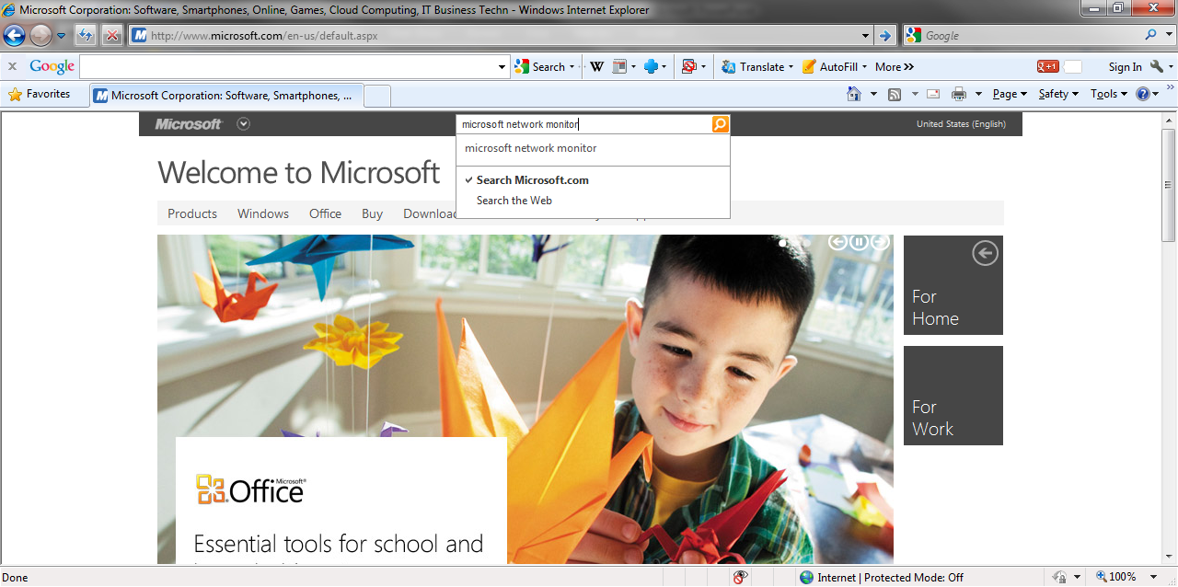
Microsoft Network Monitor

Slide 8
Microsoft Network Monitor
On the search results page select the download

Slide 9
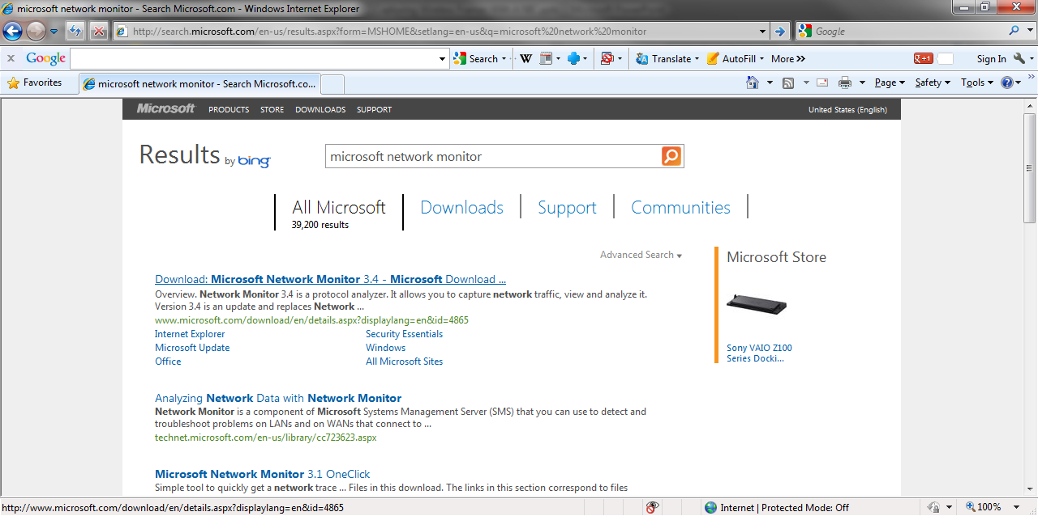
Microsoft Network Monitor

Slide 10
Microsoft Network Monitor
On its page select Download

Slide 11
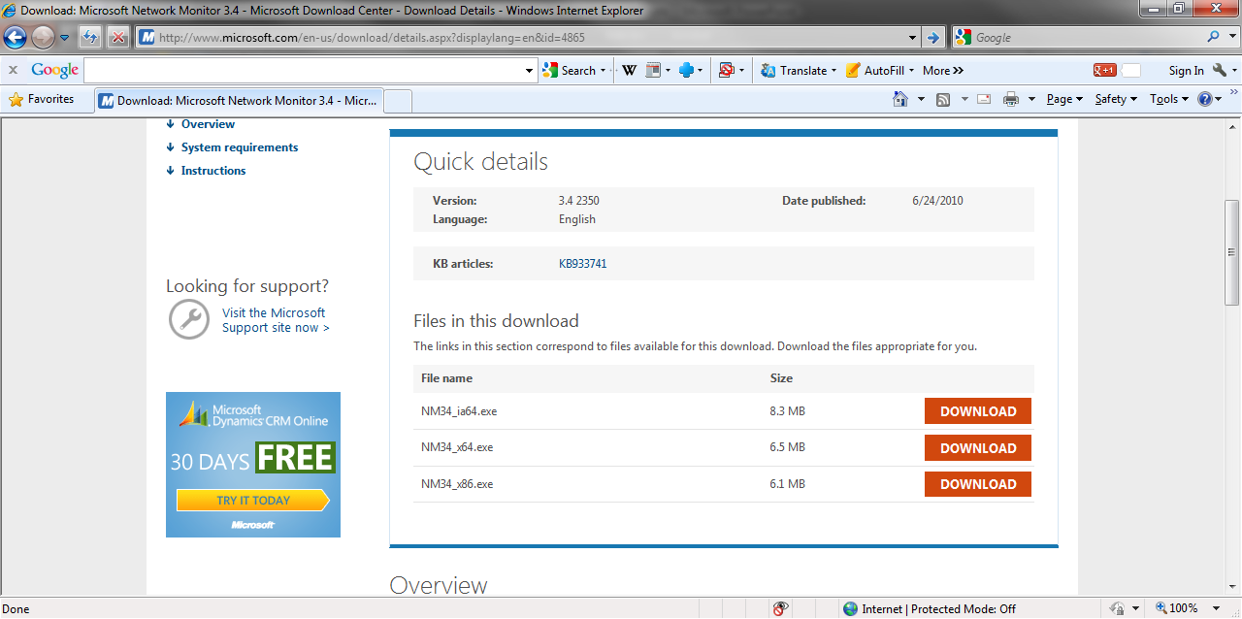
Microsoft Network Monitor

Slide 12
Microsoft Network Monitor
Once the program is downloaded and installed run it
It looks like this
Notice that several adaptors are already checked
Deselect all of these except the wireless adaptor that will be used to capture frames with

Slide 13
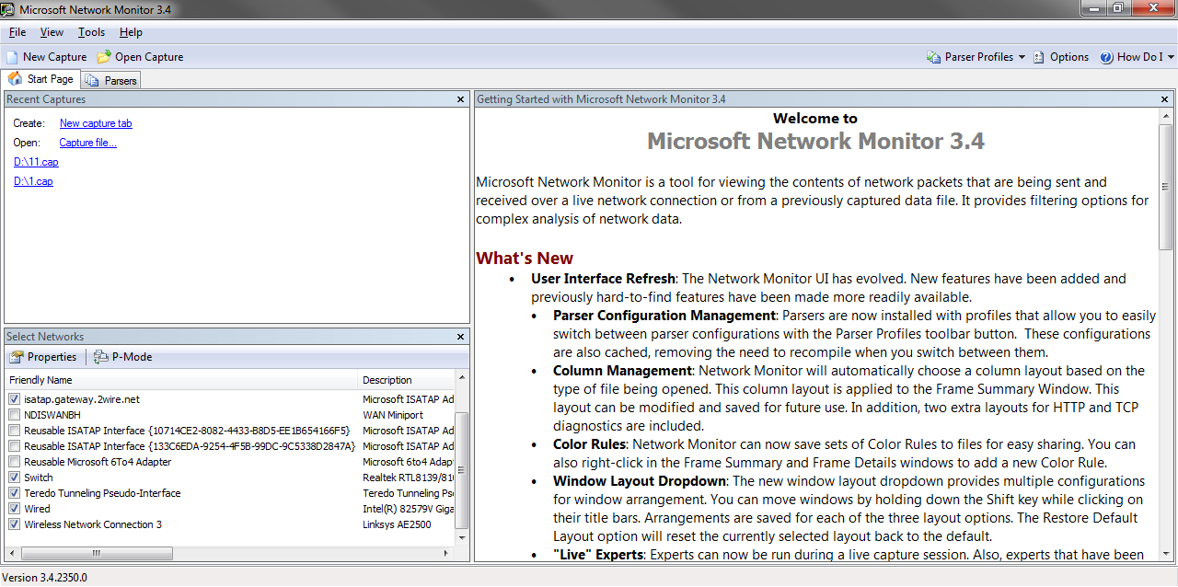
Microsoft Network Monitor

Slide 14
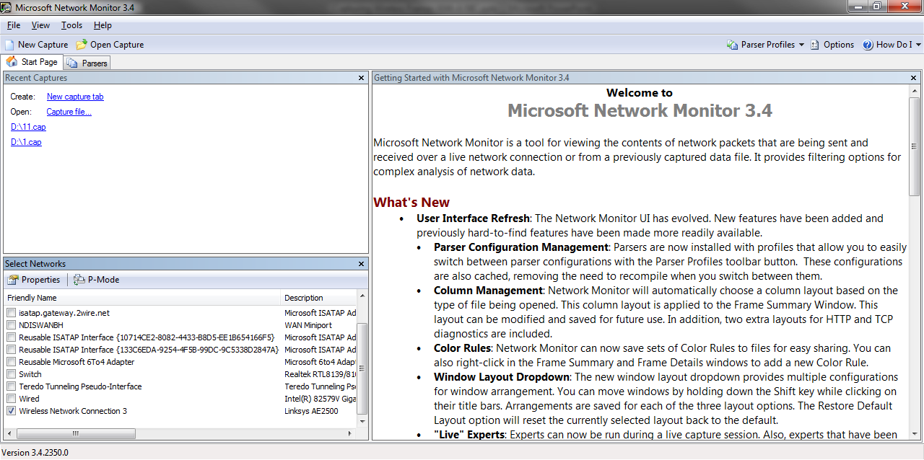
Microsoft Network Monitor

Slide 15
Microsoft Network Monitor
Double Click on it
A small window will pop-up
Click on Scanning Options

Slide 16
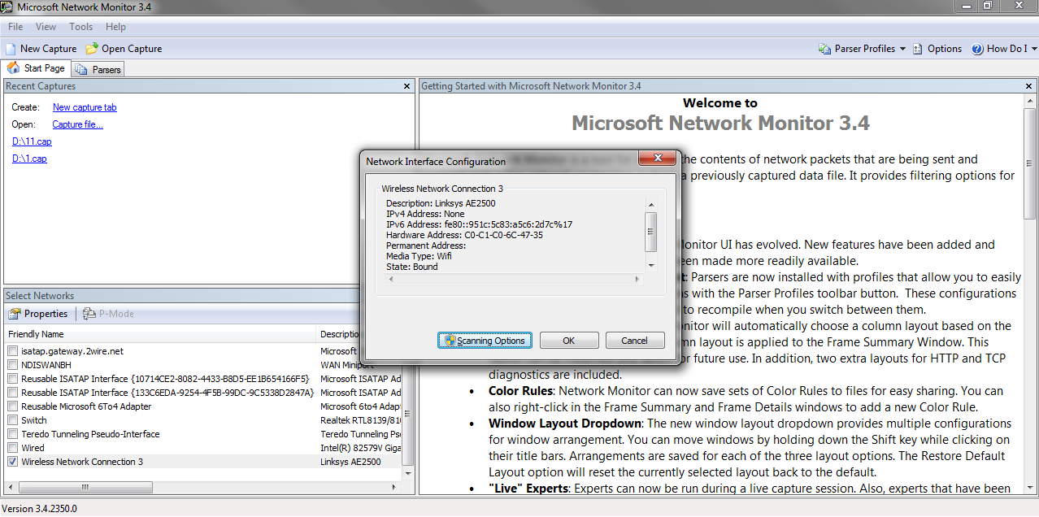
Microsoft Network Monitor

Slide 17
Microsoft Network Monitor
On the window that appears select Switch to Monitor Mode
Click on Apply
Do not click on Close and Return to Local Mode
Just leave this window open

Slide 18
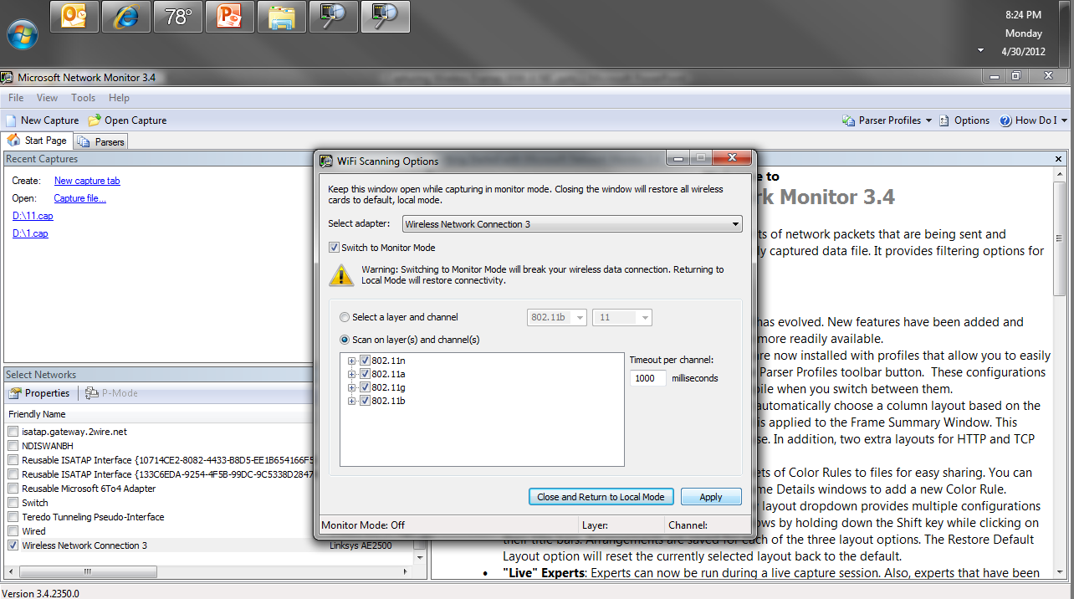
Microsoft Network Monitor

Slide 19
Microsoft Network Monitor
Click back to the other window and close the first small window that appeared
We should see this
We are ready to capture

Slide 20
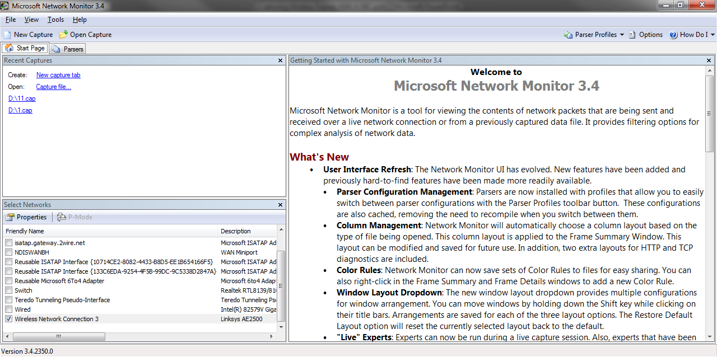
Microsoft Network Monitor

Slide 21
Microsoft Network Monitor
Click on New Capture
Then Start

Slide 22
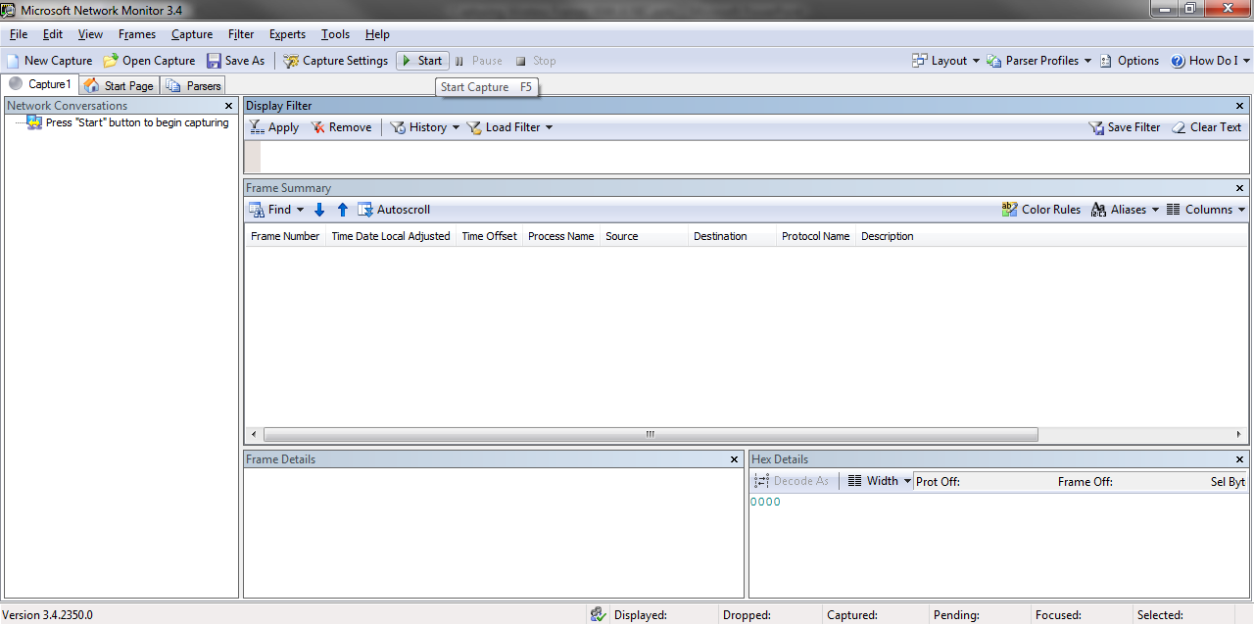
Microsoft Network Monitor

Slide 23
Microsoft Network Monitor
When you have enough traffic captured click on Stop
This is what you will have

Slide 24
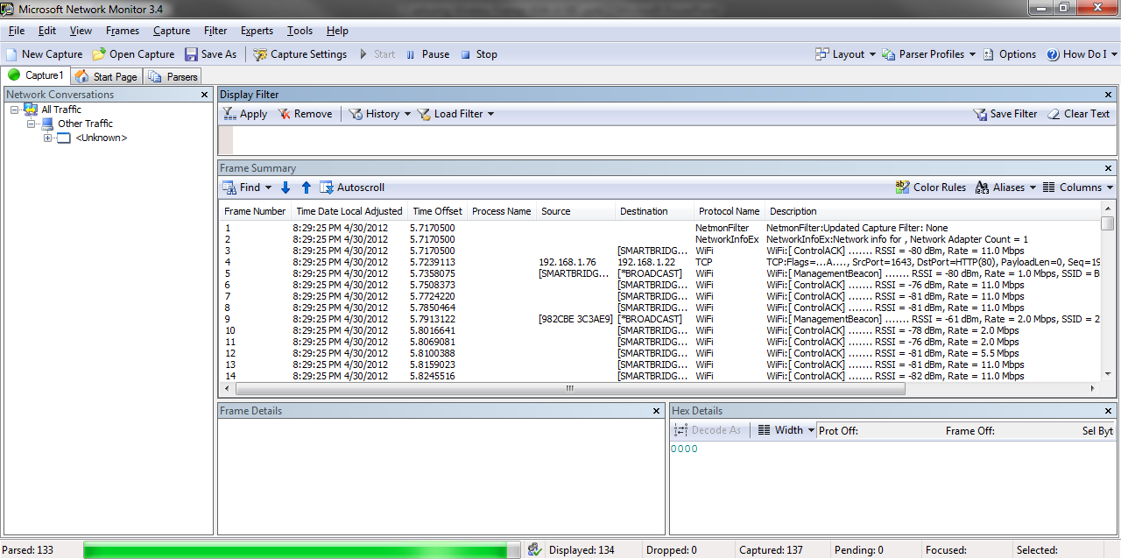
Microsoft Network Monitor

Slide 25
Capturing With A NIC
Just save this file as a cap file
It can then be opened in any program that can display cap files
If you have a NIC that this works with or buy one that will, you have just saved yourself a bunch of money as the AirPcap adaptor costs from 200 to 600 dollars

