Slide 1
802.11 Equipment
Last Update 2008.12.09
1.2.0

Slide 2
The Basic 802.11 Equipment
Only two parts are needed to create a 802.11b network
The parts are
Access Point
NIC
Such a network looks like this

Slide 3
The Basic 802.11 Equipment

Slide 4
What is an Access Point
An access point or AP provides a means to connect a wireless device to a wired network
It is the intermediary in the connection between the wired and wireless networks

Slide 5
Access Point Operating Modes
An AP can operate in one of three modes
Root Mode
Repeater Mode
Bridge Mode

Slide 6
Root Mode
In root mode the AP is connected directly to the wired network by attaching a cable to the Ethernet port in the AP and to a hub or switch on the wired network
This is the default configuration for most access points
In root mode one access point can talk to another one by going through the wires they both share

Slide 7
Root Mode
This type of conversation is required when a device communicating with one AP needs to talk to a device that is attached to another AP on the same wired network
APs also use this connection to coordinate roaming among access points similarly configured
In this mode an AP is operating as a bridge at layer 2 of the OSI model

Slide 8
Communication in Root Mode

Slide 9
Bridge Mode
In this mode the AP operates like a bridge
A bridge is a way to connect two physical parts of the same network together
Devices do not connect to bridges

Slide 10
Bridge Mode

Slide 11
Repeater Mode
In repeater mode an additional access point is used to wirelessly extend the range of an existing access point
This is done by having the clients at the extended distance connect wirelessly to the AP that is located away from the main access point
This extended access point then connects wirelessly back to the main AP

Slide 12
Repeater Mode
The cell of the extended AP must overlap the cell of the main AP by 50 percent for this to work effectively
The throughput of the wireless LAN – Local Area Network is cut significantly as the repeater must receive and retransmit each frame on the channel
This basically doubles the traffic on the wireless media

Slide 13
Repeater Mode
In general, to setup an AP for this role all that is required is to switch the AP to repeater mode, then set the SSID, which is the name of the wireless network, to match the SSID of the root mode AP
Not all APs have a repeater mode

Slide 14
Repeater Mode

Slide 15
Access Point Management
There is an ongoing argument concerning the way to manage an increasing number of access points
As organizations add more and more access points there is a need to limit the amount of time required to manage these
The suggested method is to use limited access points and wireless switches

Slide 16
Access Point Management
The term wireless switch is an unfortunate marketing term for taking all of the intelligence out of the access points, which is fine, and placing it in a single box at the junction point between the wireless and wired networks

Slide 17
Access Point Management
Here is a discussion on this from Ortronics
Centralized wireless LANs use a wireless controller to manage, process, and configure your radio frequency (RF) environment
The access points, sometimes called "thin APs", communicate directly with the central controller located at the edge of the wired network

Slide 18
Access Point Management
Unlike a traditional more costly access point, all the functionality and intelligence is offloaded to the controller
This provides a single point of administration for various policies relating to security, intrusion detection, user roles, and software upgrade

Slide 19
Access Point Management
A traditional wireless LAN uses decentralized "fat" access points that perform all the network processing and functionality in each unit
Manual configuration of each access point consumes valuable network administrator time to manually set power levels, channel, security, and many other configurable parameters

Slide 20
Access Point Management
In larger deployments, this could lead to configuration mistakes that go unnoticed causing performance problems or network security risks
Firmware upgrades, to fix or add functionality, can be a painstaking process with as few as six access points
Each AP will most likely have to be individually updated and touched by the administrator if remote upgrade tools are not available

Slide 21
Access Point Management
New standards, such as 802.11i for robust security, may require hardware replacement due to a lack of processing power or incompatibility with your existing access points
Centralized deployment lowers total cost of ownership and solves many of the problems associated with older architectures

Slide 22
Access Point Management
Enhanced integrated functionality i.e. VPN, Secure VoIP fast roaming support, intrusion detection, stateful firewall, and auto calibration redundancy, are typically unsupported by distributed access points

Slide 23
Access Point Management
Wireless controllers inspect all wireless traffic prior to being sent to the wired network. Ortronics wireless controllers are able to automatically download minimal configuration parameters and are aware of surrounding access points so that calibration of power and channel settings occur

Slide 24
Antenna Types
Most APs come with either a single dipole antenna or diversity antennas
A diversity antenna is simply multiple antennas connected to a single receiver
This helps to overcome multipath reception problems

Slide 25
Access Point Options
Depending on price and manufacturer an access point may have some of the following options available
Detachable Antenna
Filtering
Radio Cards
Variable Power Output
Wired Network Connection

Slide 26
Detachable Antenna
With a detachable antenna it is possible to
Mount the AP away from the antenna, such as the antenna outside and the AP inside
Allow a higher gain antenna to be exchanged for the standard dipole

Slide 27
Filtering
Filtering that is possible on an AP is usually
MAC filtering
Protocol filtering
In MAC filtering a table of those devices that are allowed on the network is kept based on the MAC address of each device

Slide 28
Filtering
Protocol filtering allows the restriction of what type of network access is allowed through the wireless portion of the network

Slide 29
Radio Cards
Most APs have a radio that is fixed in place
To change the radio requires a fork lift upgrade
In other words, throw out the existing AP and buy another one
Radio cards, added through PCMCIA slots, allow the radio portion of the AP to be upgraded

Slide 30
Radio Cards
Another use of a radio card slot is to allow a single AP to perform two functions, such as standard access point and bridge in a single unit
A last use is to use the slot to add capacity without buying another AP

Slide 31
Variable Power Output
Variable power output allows the power, in milliwatts, can be adjusted
Normally this is used to control the cell size the AP serves

Slide 32
Wired Network Connection
The standard way of connecting an access point to the wired network is either a 10BaseT or 100BaseT connection
But this limits the distance the AP can be from the wired network to 100 meters
A fiber port, such as 100BaseFX, allows a more distant connection

Slide 33
Example Access Point
Let’s look at an example of a typical access point
In this case a DLink DWL-900AP+
On the front of the unit are three lights
Power
LAN activity
WAN activity

Slide 34
Example Access Point
On the back
Reset button
Wired LAN connection
Power supply connection

Slide 35
DLink DWL-900AP+ Front
Power Wired LAN Activity Wireless LAN Activity

Slide 36
DLink DWL-900AP+ Back
Reset
LAN Connection
Power Supply

Slide 37
Setup
Once the physical connections are made the access point must be configured
In this example the DLink DWL-900AP+ is setup using the built-in setup program as seen in the pages that follow
In the first few screenshots the setup wizard is being used

Slide 38
Setup
Then the normal method is shown where the individual setup pages are selected
Typical configuration steps include
Login
Set a password
Select the SSID and channel

Slide 39
Setup
Enable WEP
Set an IP address and subnet mask for the AP
Setup the built-in DHCP server
Set the operating mode
Adjust the performance
Setup MAC filtering

Slide 40
Setup
After the AP is in operation the status of the network can be checked through the AP’s management program

Slide 41
Login

Slide 42
Setup Opening Menu

Slide 43
Setup Wizard

Slide 44
Password Setup

Slide 45
SSID and Channel Setup

Slide 46
WEP Setup

Slide 47
Setup Wizard Finish

Slide 48
Setup Wizard Finish

Slide 49
WEP Setup

Slide 50
IP Address Setup

Slide 51
DHCP Server Setup

Slide 52
Mode Setup

Slide 53
Performance Adjustment

Slide 54
MAC Filtering Setup

Slide 55
Setup Saving and Recovery

Slide 56
Password Setup

Slide 57
Firmware Upgrade

Slide 58
Activity

Slide 59
Activity

Slide 60
Activity

Slide 61
Wireless Status

Slide 62
Help Topics

Slide 63
Wireless NIC
The next piece of equipment needed when creating a wireless network based on the 802.11 standards is a NIC – Network Interface Card
Recall that as in a wired network the NIC is used to allow a device to connect to the network
This is the link between a device and the network

Slide 64
Wireless NIC
It puts information onto the network
It takes information off of the network

Slide 65
NIC Forms
Wireless NICs come in several forms including these typical ones
PCMCIA
Adaptor Card
USB Port Adaptor
Compact Flash
Wired to Wireless Bridge

Slide 66
PCMCIA Form
PCMCIA is the format designed for laptop computers
As in

Slide 67
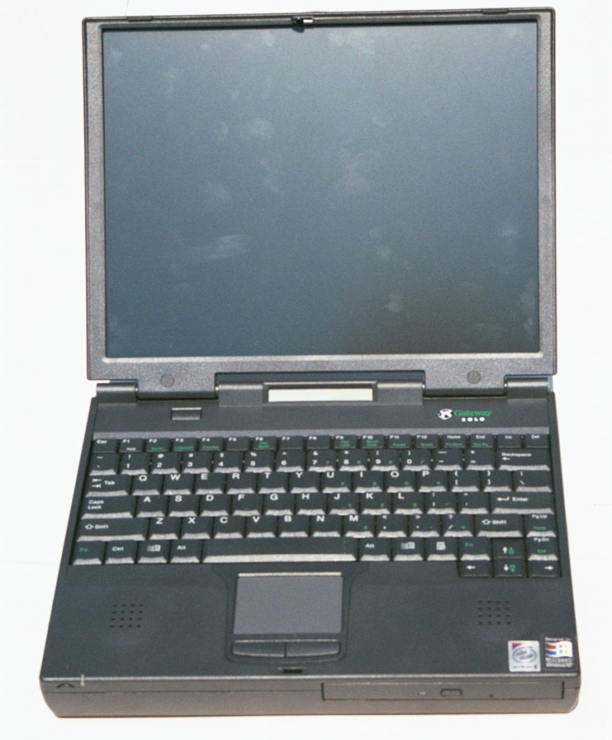
PCMCIA NIC

Slide 68
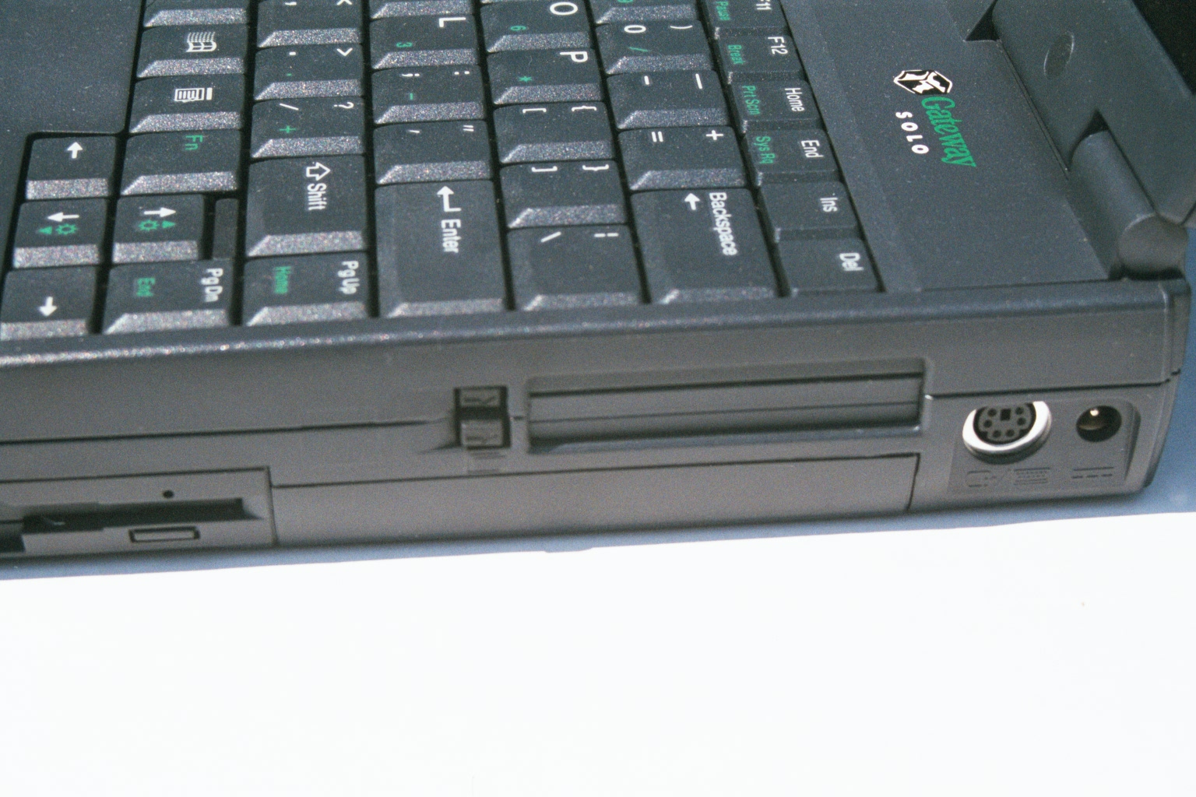
PCMCIA NIC

Slide 69
PCMCIA NIC

Slide 70
PCMCIA NIC

Slide 71
CardBus v PC Card
There are two types of PCMCIA interfaces used in laptops
PC Card
This is a 16 bit 3.3 or 5 volt interface
CardBus
This is a 32 bit 3.3 volt interface
PC Card is the older one
It has not been used much since 1999

Slide 72
CardBus v PC Card
This style of NIC an also be used in a desktop system by using an adaptor

Slide 73
Desktop Wireless NIC
The PCMCIA form is sometimes used to make a NIC for use in a desktop computer
When used this way the PCMCIA card is inserted into a carrier that will attach to the bus in a desktop computer, such as the PCI bus
For example

Slide 74
Wireless NIC – PCI

Slide 75
Compact Flash Form
The CF - Compact Flash form of the NIC is used for PDAs and other handheld devices smaller than a laptop computer
These look like

Slide 76
CF NIC

Slide 77
CF NIC
CF NIC

Slide 78
USB Port Form
A new form for a NIC is using the USB port to attach the NIC to the computer
As in

Slide 79
USB Port Form

Slide 80
Wired to Wireless Adaptor
Another new form for a NIC of sorts is the wired to wireless adaptor, also called a wireless bridge
This device functions like a bridge to allow a device with a built in wired NIC to attach to a wireless network without altering the built in NIC
As in

Slide 81
Wired to Wireless Adaptor

Slide 82
Wireless NIC Setup
The setup for a wireless NIC mirrors that of the access point for the most part
In this example, after the two opening screens the following is seen
System parameters
Radio frequency setup
Performance setup
Security setup

Slide 83
NIC Utility Program

Slide 84
NIC Setup Screen

Slide 85
NIC System Parameters

Slide 86
NIC RF Setup

Slide 87
NIC Performance Setup

Slide 88
NIC Security Setup

Slide 89
Review
What are the major parts of a wireless LAN

