Slide 1
Which Method Should I Select To Connect Point A to Point B
Last Update 2012.04.20
1.0.0

Slide 2
Objectives of This Section
Learn why in a monopolistic environment telecommunications cost will never make sense
Learn some guidelines as to how to select the right way to connect Point A to Point

Slide 3
The Monopoly
First you must realize that the price you pay for a data line will bear no resemblance to its true cost in terms of the price the provider paid to create the network, capex, and their cost to operate it, opex
This is because the last mile in the overwhelming majority of cases is under the control of a single company

Slide 4
The Monopoly
In the absence of competition, they will charge whatever they can get away with
We will use my house as a perfect example of this
Over the years I have had a number of different WAN connections
These have included

Slide 5
The WAN Connection
Analog Line
  14 kbps
  $16
IDSL
  144 kbps
  $150
ISDN
  128 kbps
  $200
T1
  1.5 mbps
  $400
DSL
  6.0 mbps
  $40

Slide 6
The WAN
All of these lines have gone down the exact same two 24 gauge copper wires of the eight that go to my house from the road
Here is the path they all follow
First a overall look at the last mile or in my case the last 34,000 wire feet

Slide 7
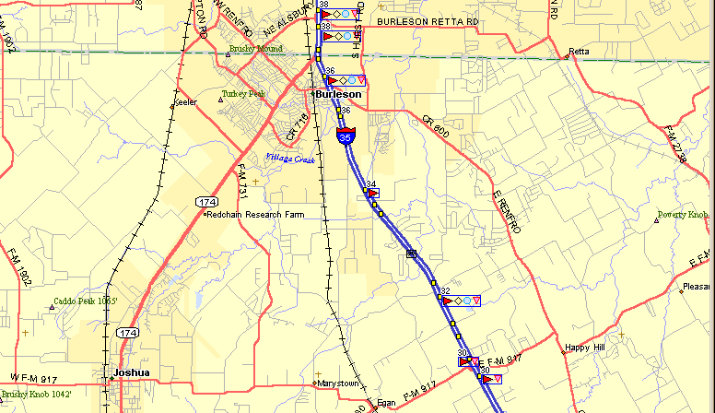
The Path of the WAN
The service provider’s central office is here
I am here

Slide 8
The Path of the WAN
Here are all of the demarcs that have been installed over the years

Slide 9
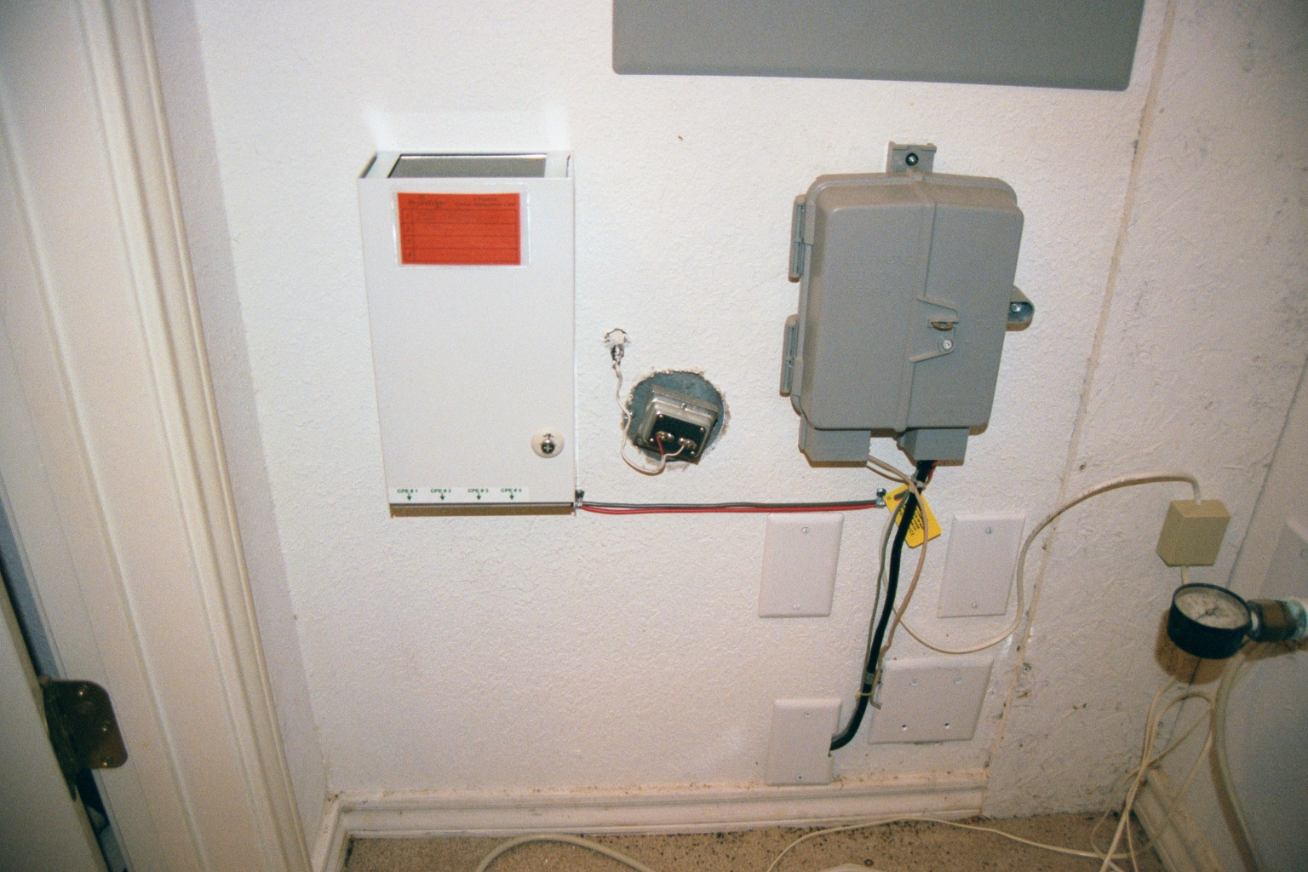
The Path of the WAN
T1 Demarc
All of the copper lines from the telco to the house come in here

Slide 10
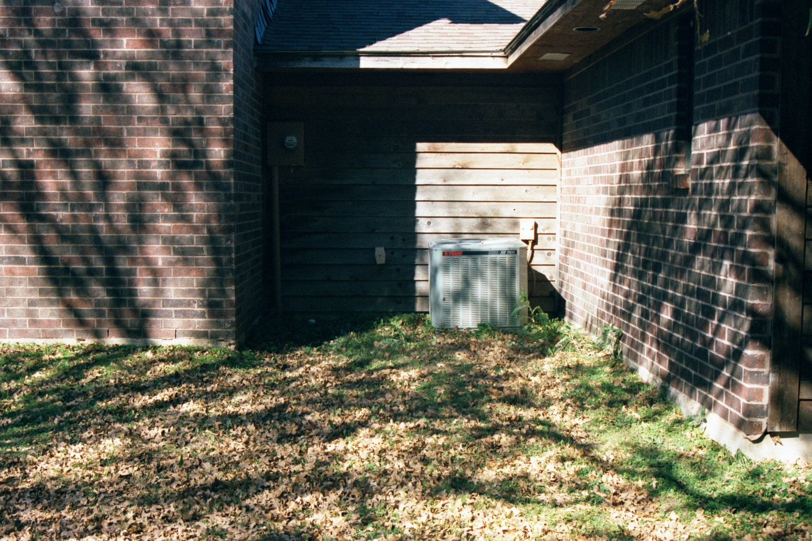
The Path of the WAN
The copper wires leave the house and cross the yard

Slide 11

The Path of the WAN
The lines go across the yard underground

Slide 12

The Path of the WAN
Down the side of the road

Slide 13
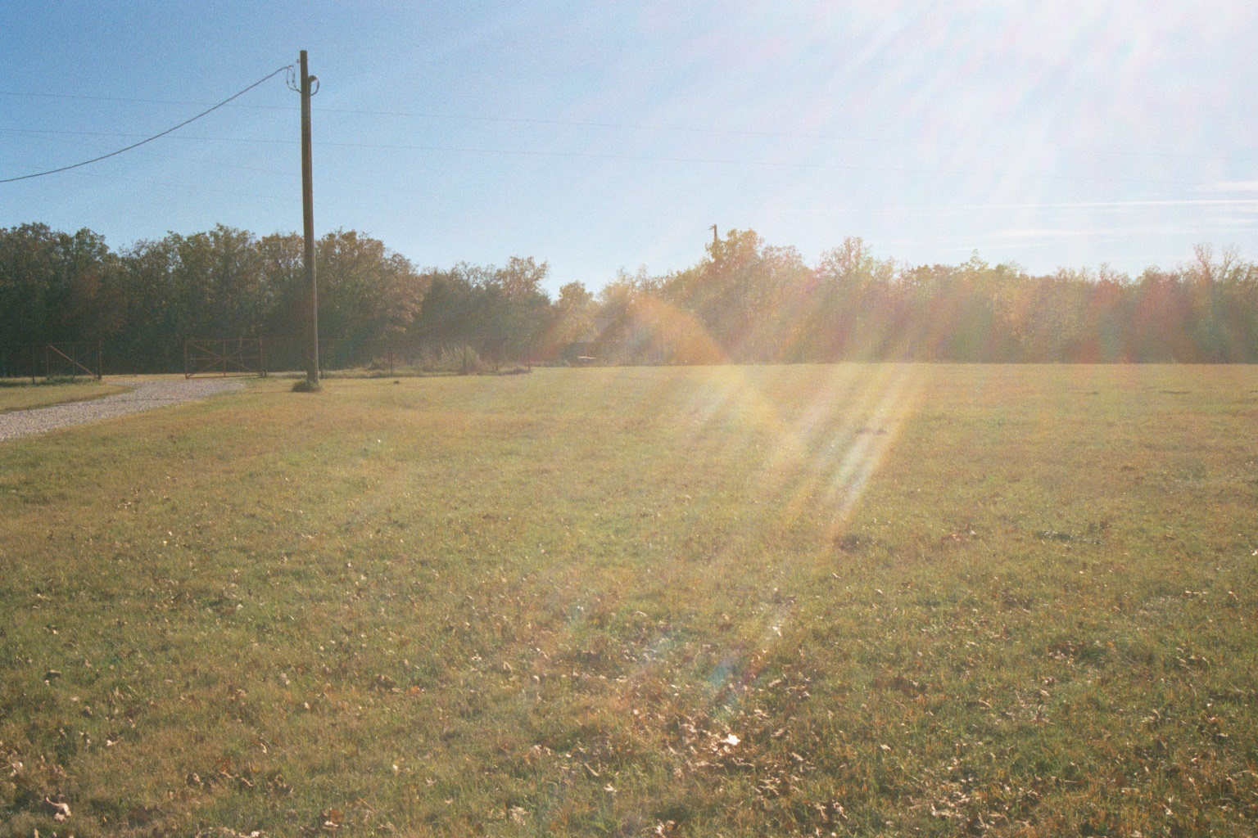
The Path of the WAN
Across the hay field

Slide 14
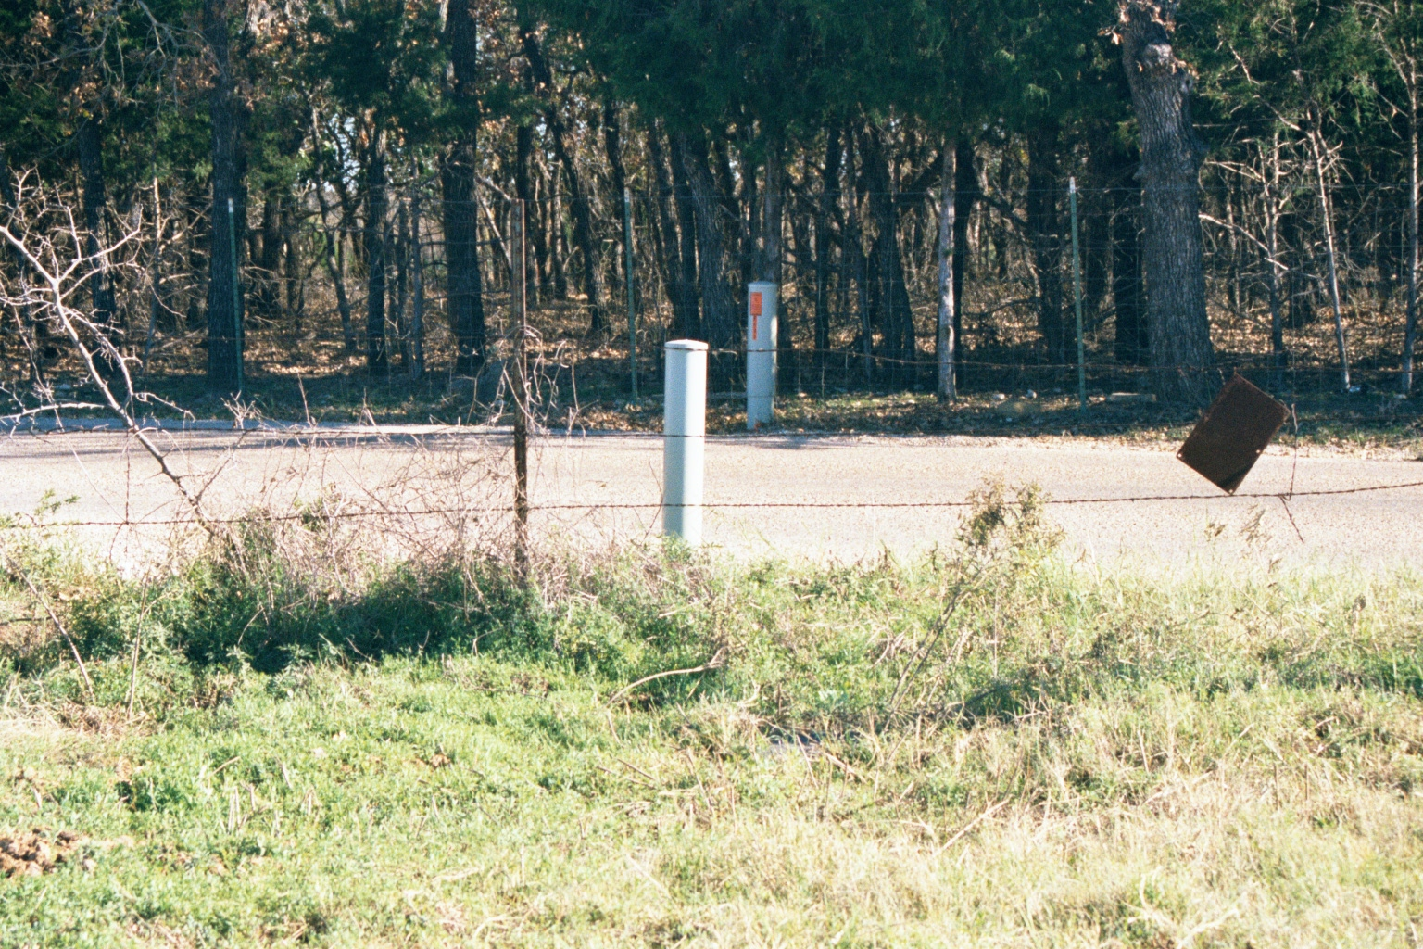
The Path of the WAN
To the connection box

Slide 15
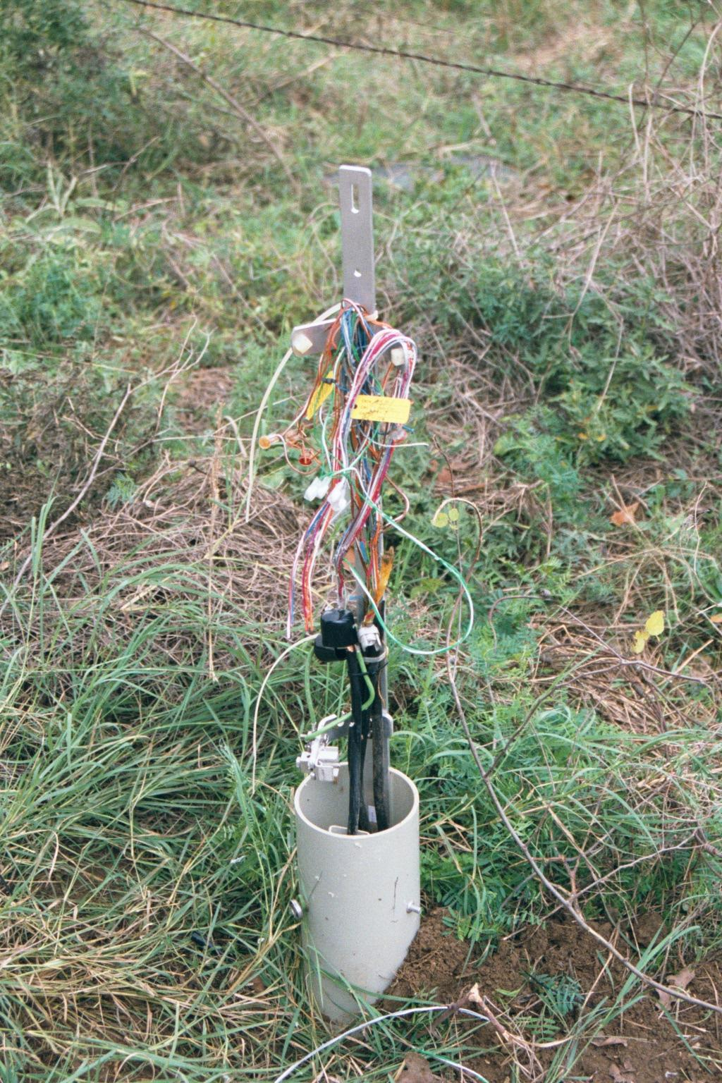
The Path of the WAN
The data circuit is just a set of copper wires like all the others that serve the house

Slide 16
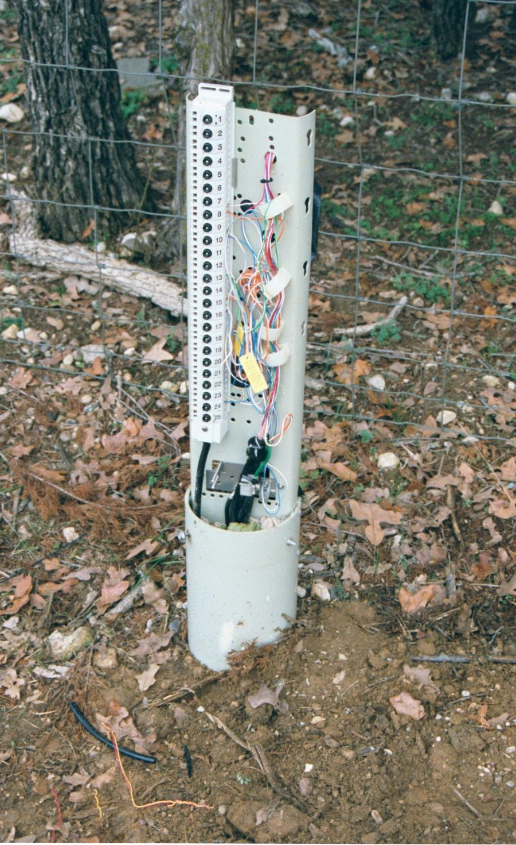
The Path of the WAN
The circuit goes across the road to another copper connection post

Slide 17
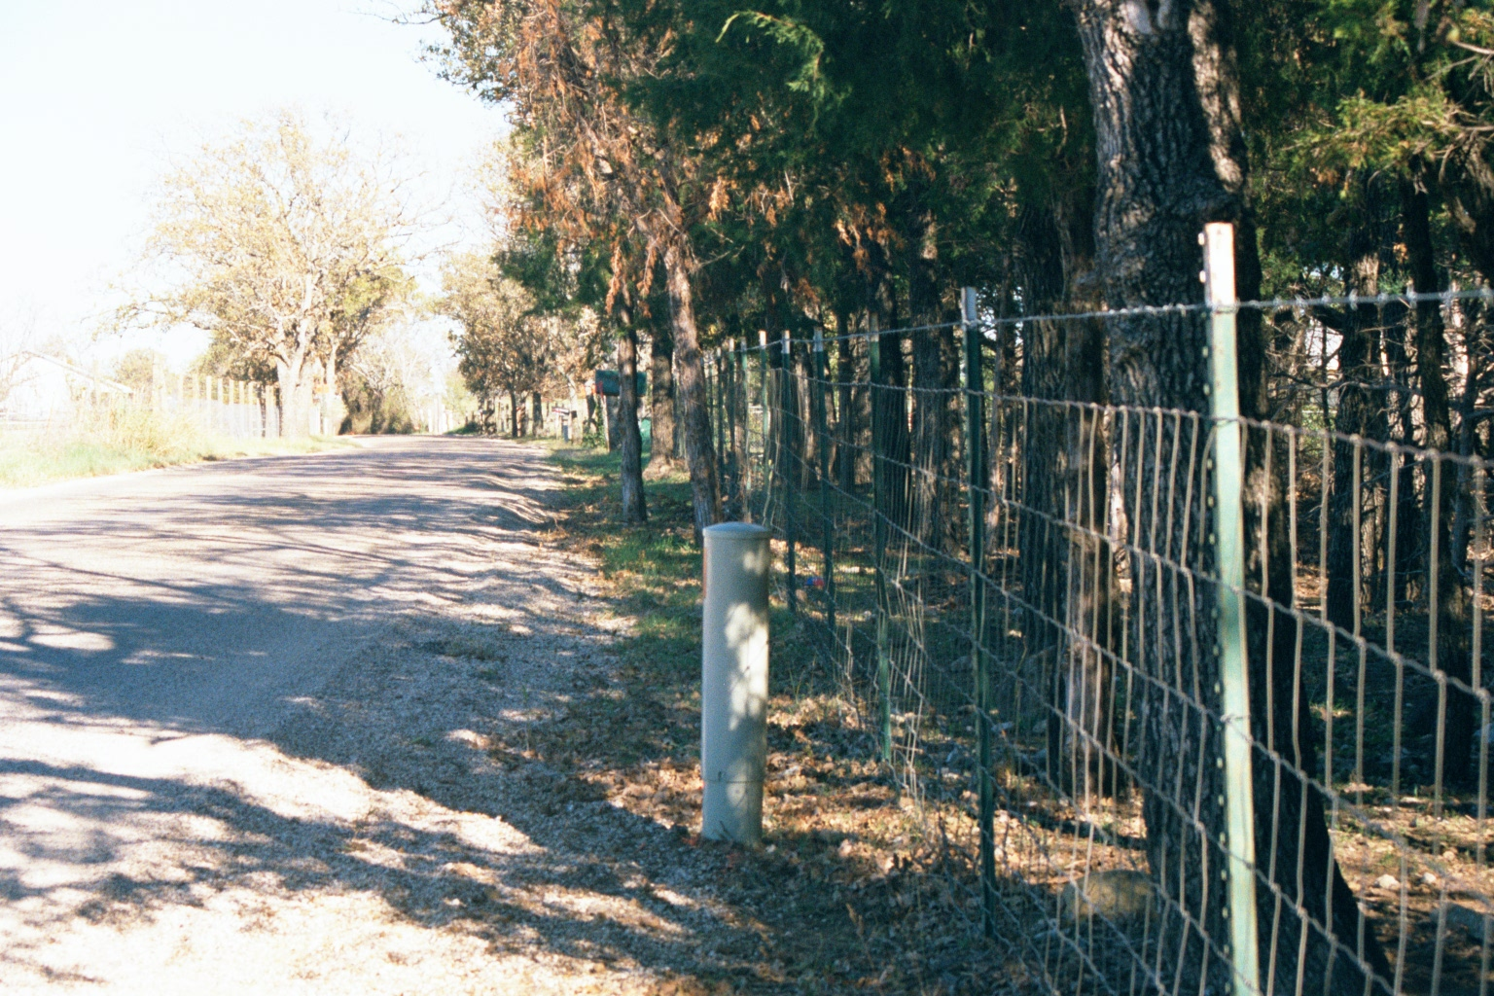
The Path of the WAN
The copper lines go down the road toward the highway

Slide 18
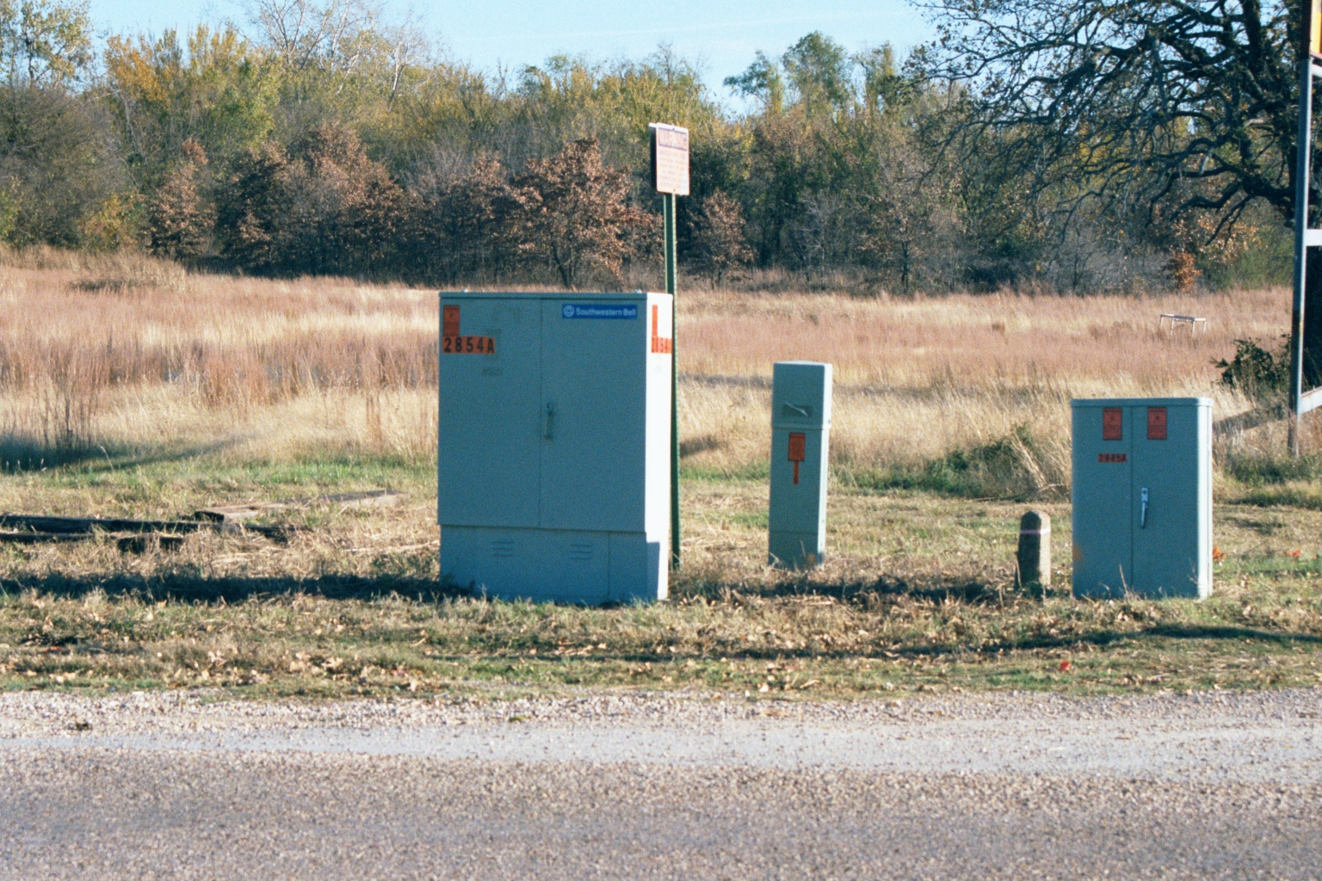
The Path of the WAN
All of the copper lines are terminated here in this box

Slide 19
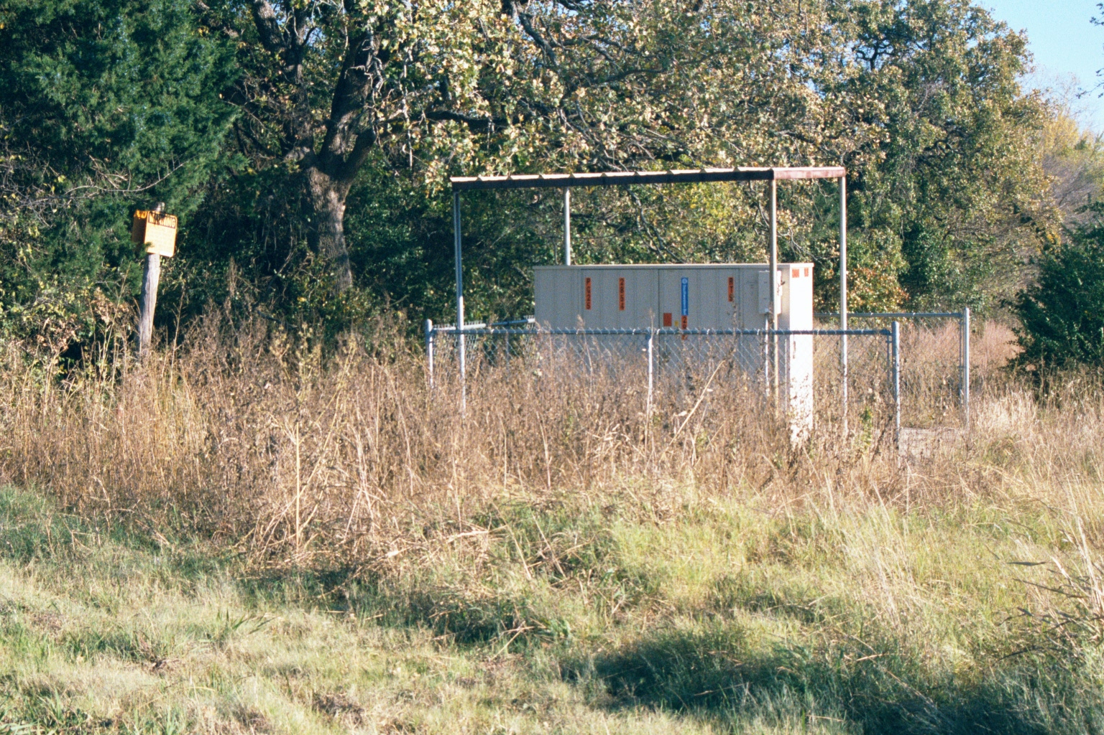
The Path of the WAN
The copper lines are combined and converted to fiber optic cables in this box

Slide 20
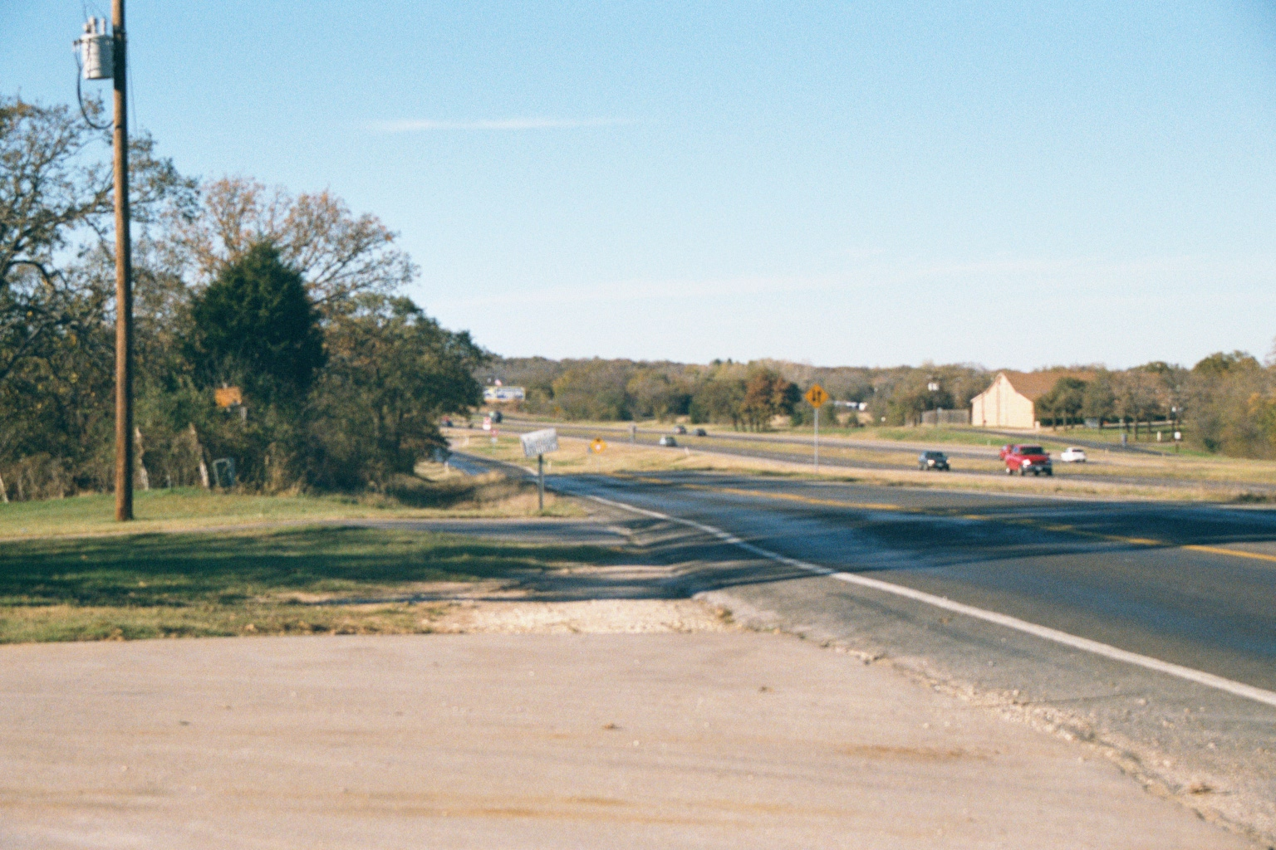
The Path of the WAN
The fiber goes down the highway

Slide 21
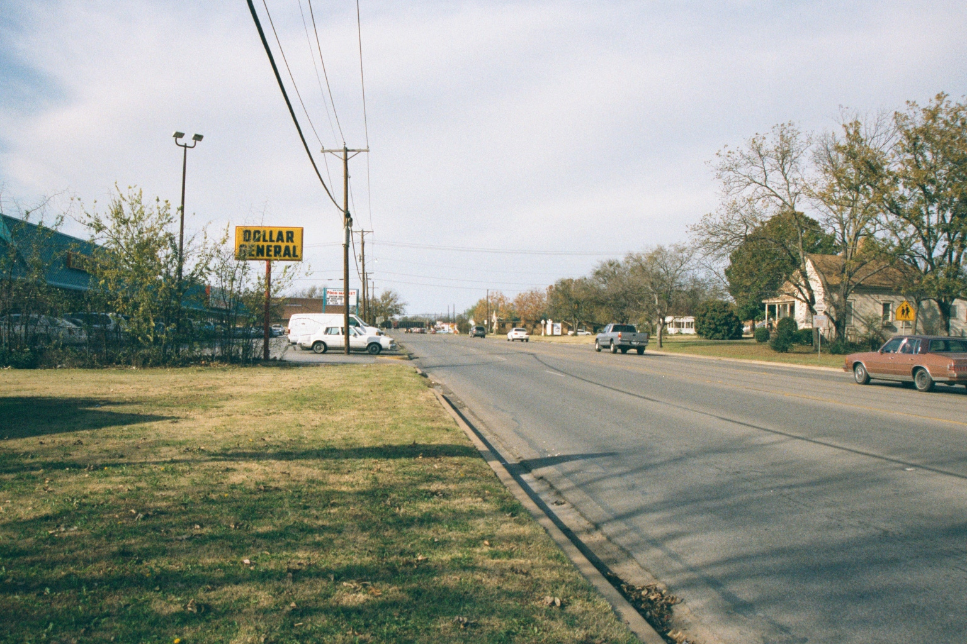
The Path of the WAN
In town the fiber leaves the highway and proceeds down the street

Slide 22
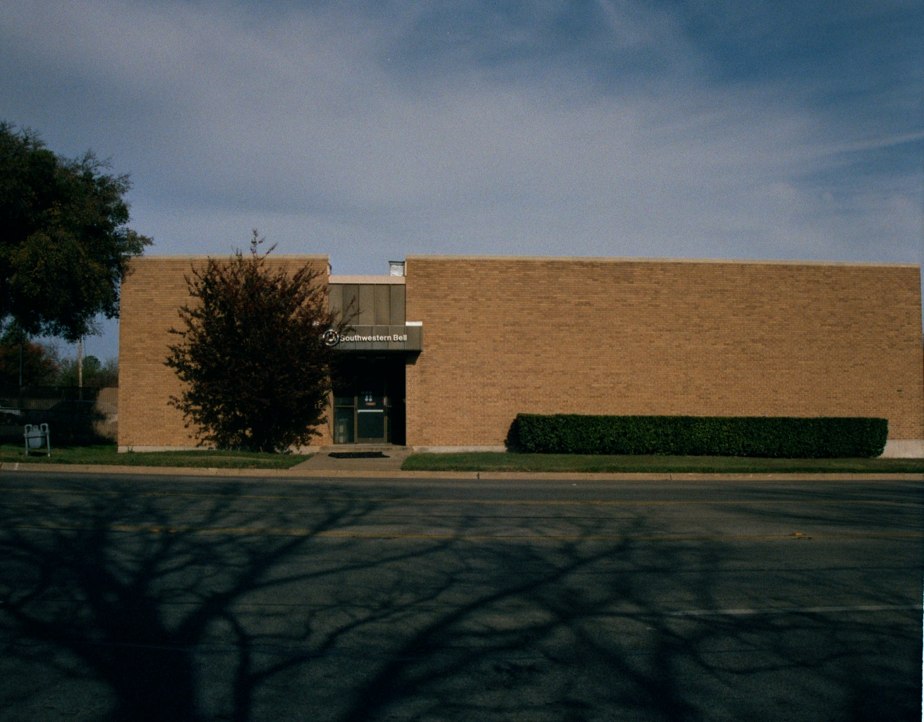
The Path of the WAN
To the service provider’s central office

Slide 23
The Last Mile
Notice that the exact same path has been taken by a data line that achieved 14 kbps and one that achieved 6 Mbps
How is this possible
The equipment attached to the end of the line at my house and at the end of the line at the central office
Now this part makes perfect sense

Slide 24
The Last Mile
Better technology, yields higher speeds
What does not make sense is the cost differential
Let’s look at it again keeping in mind that all each of these connections has ever done is provide an onramp to the Internet
The only difference here is the speed limit of the onramp

Slide 25
Cost Differential
Analog Line
  14 kbps
  $16
IDSL
  144 kbps
  $150
ISDN
  128 kbps
  $200
T1
  1.5 mbps
  $400
DSL
  6.0 mbps
  $40

Slide 26
Cost Differential
Look at the cost of the IDSL v the ISDN and their speeds
Why did the ISDN line cost more than the IDSL line even though the speed was lower
AT&T ran the provider of the IDSL line out of business in order to regain their monopoly control over the last mile connection to my house

Slide 27
Cost Differential
Once they did that, they could charge whatever they wished
Where else would I turn
As more speed was needed the only other option available was a T1 line
Notice in that case that the speed increases dramatically, but the cost did not increase at the same rate

Slide 28
Cost Differential
This is due to the existence of resellers of T1 lines
AT&T allowed them to remain in business unlike the DSL competitors
The next jump is more dramatic
After a few years AT&T decided the population density in my rural area was finally enough to justify deploying DSL into the neighborhood

Slide 29
Cost Differential
As the price of DSL had been set not by AT&T, but by their competitors the cable companies inside the larger cities, when AT&T deployed DSL into their monopoly controlled areas such as my rural neighborhood, they could not justify either raising the price or lowering the speeds over what they were forced to do in the urban areas

Slide 30
Cost Differential
This is dramatic decrease in cost and increase in speed of the DSL line in contrast to the T1 line that preceded it
Now it is true that the repair response time of AT&T for a T1 failure as opposed to a DSL line failure is very different at 4 hours for the T1 versus 24 hours for a business grade DSL line

Slide 31
Cost Differential
Still the cost and speed differentials cannot be reconciled except within the scope for arbitrary pricing a monopolistic environment provides to AT&T

Slide 32
Which One To Select
Let’s now look at a very nice discussion of why things are as they are and how you might work around this problem of monopolies in telecommunications while you attempt to select the correct type of data line for your connection from Point A to Point B by reading an article from Network World’s Cisco Subnet section by Andy Gottleib from April 2012

Slide 33
Which One To Select
Click here to open the article
  www.chipps.com/4/Gottlieb.pdf

