Slide 1
VPN Last Update 2010.11.29 1.3.0

Slide 2
Objective
Learn what a VPN is and why you would use one

Slide 3
What is a VPN
A VPN – Virtual Private Network is a method used to add security to a WAN link
This added security is especially important for those methods of linking Point A to Point B that make the link through the Internet

Slide 4
Types of VPNs
A VPN can be purchased as a service from a service provider or it can be setup by the end user
If a service provider is used, this service provider can be the same one that provided the data line or a provider that just adds a VPN on top of the data line

Slide 5
Types of VPNs
Service provider offerings are typically one of two methods
IPSec-encrypted tunnel VPN
MPLS VPN
IPSec tunnel-based VPNs are sometimes referred to as client-premises equipment-based VPNs because the service provider typically places equipment at the client site

Slide 6
Types of VPNs
This device handles encryption and decryption of traffic before it goes out over the service providers' network
Traffic within the service provider network is routed the same as any other IP traffic, and the service provider has no visibility into the IP tunnel

Slide 7
Types of VPNs
Nor does the service provider network need to be configured in any special manner to support IPSec VPNs
Because traffic in an IPSec-based VPN is encrypted, it is generally considered secure to use IPSec to transport sensitive traffic over a public IP network

Slide 8
Types of VPNs
An IPSec-based VPN can also be offered by a service provider as a managed service
With this type of VPN, the service provider deploys and manages the customer premises equipment, and all traffic is carried over that provider's network
This lets the provider offer service-level guarantees for assured performance

Slide 9
Types of VPNs
These are also called Private IP Networks sometimes
A end user can also deploy their own VPN devices
This approach is recommended for connecting branch offices that only have one Internet connection

Slide 10
Types of VPNs
The disadvantages to the do it yourself method is that you are responsible for managing VPN configurations, and because traffic is transversing the Internet, there are no performance guarantees
However, a do it yourself approach lets corporations establish a VPN to any site that has access to the Internet regardless of whose network they must use to do this

Slide 11
Types of VPNs
The second type of service provider based VPN operates at either layer 2 or layer 3
Layer 2 VPNs based on the IETF - Internet Engineering Task Force's Martini draft or Kompella draft simply emulate layer 2 services such as Frame Relay, ATM or Ethernet

Slide 12
Types of VPNs
Typically, layer 2 MPLS VPNs are invisible to the end user, much in the same way the underlying ATM infrastructure is invisible to Frame Relay users
The customer is still buying Frame Relay or ATM, regardless of how the provider provisions the service

Slide 13
Types of VPNs
With layer 3 MPLS VPNs, also known as IP enabled or Private IP VPNs, service providers assign labels to IP traffic flows
These labels represent unique identifiers and allow for the creation of virtual IP circuits or LSP - Label Switched Paths within an IP network

Slide 14
Types of VPNs
By using labels, a service provider can create closed paths that are isolated from other traffic within the service provider's network, providing the same level of security as other PVC - Private Virtual Circuit type of services such as Frame Relay or ATM

Slide 15
Types of VPNs
Because MPLS VPNs require the service provider to modify its network, they are considered network-based VPNs
MPLS-based VPNs require no client devices, and tunnels usually terminate at the service provider edge-router
Layer 3 VPNs offer significant advantages to traditional Layer 2 services

Slide 16
Types of VPNs
Because they rely on IP routing to build paths, they easily can be used to create fully or partially meshed networks within a service provider cloud, with only one entry point into the cloud from each location

Slide 17
Sources
The preceding is from a discussion from April 2002 in Network Fusion by Irwin Lazar

Slide 18
Types of VPNs
When an organization sets up their own VPN connections they can also use a IPSec based VPN
Considering the difficulty in distributing the required certificates, many have begun switching to SSL instead
This is the same Secure Sockets Layer that is used for online web purchases

Slide 19
Types of VPNs
By using SSL the need to load special software on each workstation is avoided
At present SSL is limited to just a few applications as they must be browser based

Slide 20
How to Create a VPN
To create a VPN – Virtual Private Network connection two things are required
A tunnel
An encryption method

Slide 21
The Tunnel
The tunnel is the VPN connection

Slide 22
An Encryption Method
The encryption method makes the data unreadable

Slide 23
Type of VPNs
Remote Access
Site to Site

Slide 24
Remote Access
A single computer connecting to a centralized VPN server is remote access

Slide 25
Site to Site
A site to site or gateway to gateway VPN uses devices at each end to allow to LANs to connect to each other

Slide 26
IPSec Process
An IPSec VPN relies on three things to ensure the data is safe
Encryption
Authentiction
Message Integrity

Slide 27
Encryption
IPSec encryption uses two pairs of encryption algorithms to
Hide the data
Recover the data
Here is the process as shown in Wendell Odom’s ICDN2 book

Slide 28
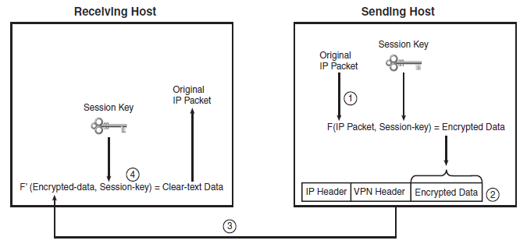
Encryption

Slide 29
Encryption
There are several algorithms of increasing security but increasing load on the devices using them
As shown in Wendell Odom’s ICDN2 book

Slide 30
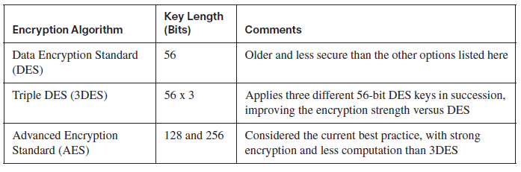
Encryption

Slide 31
Encryption
As discussed above the process requires a key
How is the key to be exchanged before the VPN is established
This can be through a phone call, a letter, or unsecured email
This is simply the PSK – Pre Shared Key process

Slide 32
Encryption
The other problem is once the PSK is distributed it is rarely changed

Slide 33
Authentication
Authentication is part of the PSK process

Slide 34
Message Integrity
Message integrity is part of this basic process as well

Slide 35
Common VPN Alternatives
Here is table showing the common VPN alternatives as of May 2006
This is copied from Cisco’s Packet magazine

Slide 36
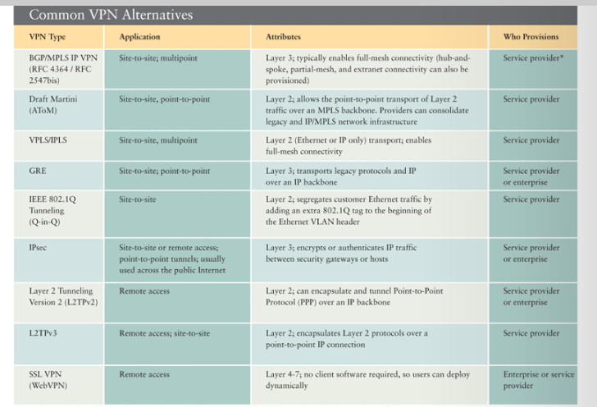
Common VPN Alternatives

