Slide 1
T Carrier Circuits
Last Update 2010.01.17
1.16.0

Slide 2
Objectives of This Section
Learn
What a T Carrier circuit is
Where a T Carrier circuit is used

Slide 3
Context
Layer | 1
Network Type | WAN

Slide 4
Layers
As a layer 1 technology a T Carrier circuit requires something at layers 2 through 7 in order to operate
Typically this is
Layer 2
PPP or HDLC
Layer 3 through 7
TCP/IP

Slide 5
What is a T Carrier Circuit
This circuit is called by many names
T Carrier
T1 Line
Private Line
Leased Line
Point-to-Point Circuit
It is a high speed circuit
It is a digital connection end-to-end
It is always on

Slide 6
Background
This circuit was developed in 1957
It was first used in 1962 to carry voice as a digital rather than as an analog signal
This is where the channel sizes come from
It is based on the size of voice circuits
This type of circuit was first offered to the public in 1977 by AT&T as a special circuit
It was offered as a standard circuit in 1983

Slide 7
Background
The T in the name, according to some, comes from the trunk side as opposed to the user side of a circuit
In other words this circuit was first developed for use solely by the phone company
Only later was its use extended to the end user
Others say it is irrelevant, it is just a letter

Slide 8
Operation
At the customer site regardless of the way the circuit comes into the site it must be broken down into a copper circuit before it connects to the customer equipment at the demarc
In the original way of delivering this circuit it terminated in 4 copper wires in full duplex operation with one pair sending data and one pair receiving data

Slide 9
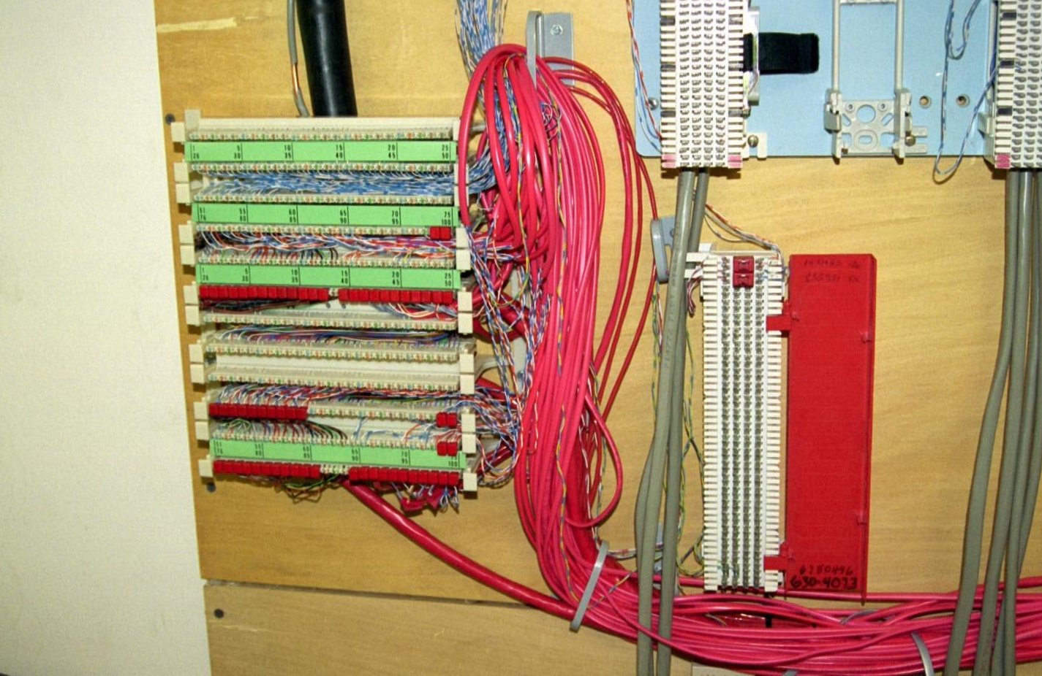
Operation
T1 circuits being delivered to the end user as a copper line

Slide 10
Operation
In many new service provider deployments this circuit is actually engineered as a HDSL or even a HDSL2 circuit
In the case of HDSL it is still 4 copper wires at the end
In the case of a HDSL2 it is only 2 copper wires

Slide 11
Operation
How does one of these lines get from here to there
This sequence of photographs shows my T1 line from the house back to the service provider’s central office

Slide 12
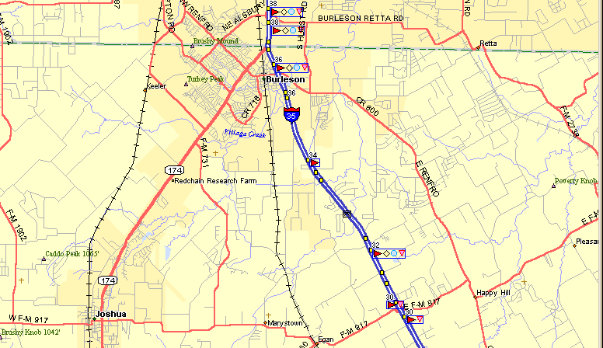
Operation
The service provider’s central office is here
I am here

Slide 13
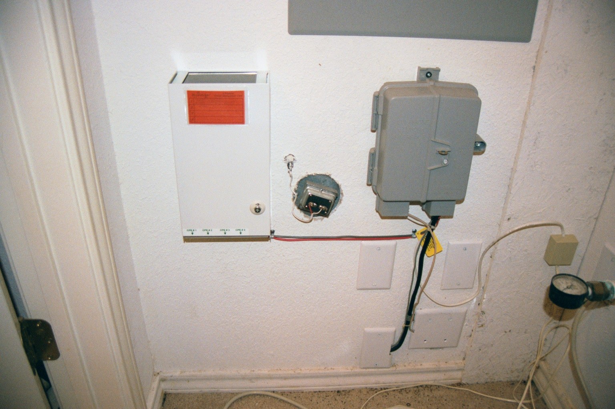
Operation
T1 Demarc
All of the copper line from the telco to the house come in here

Slide 14
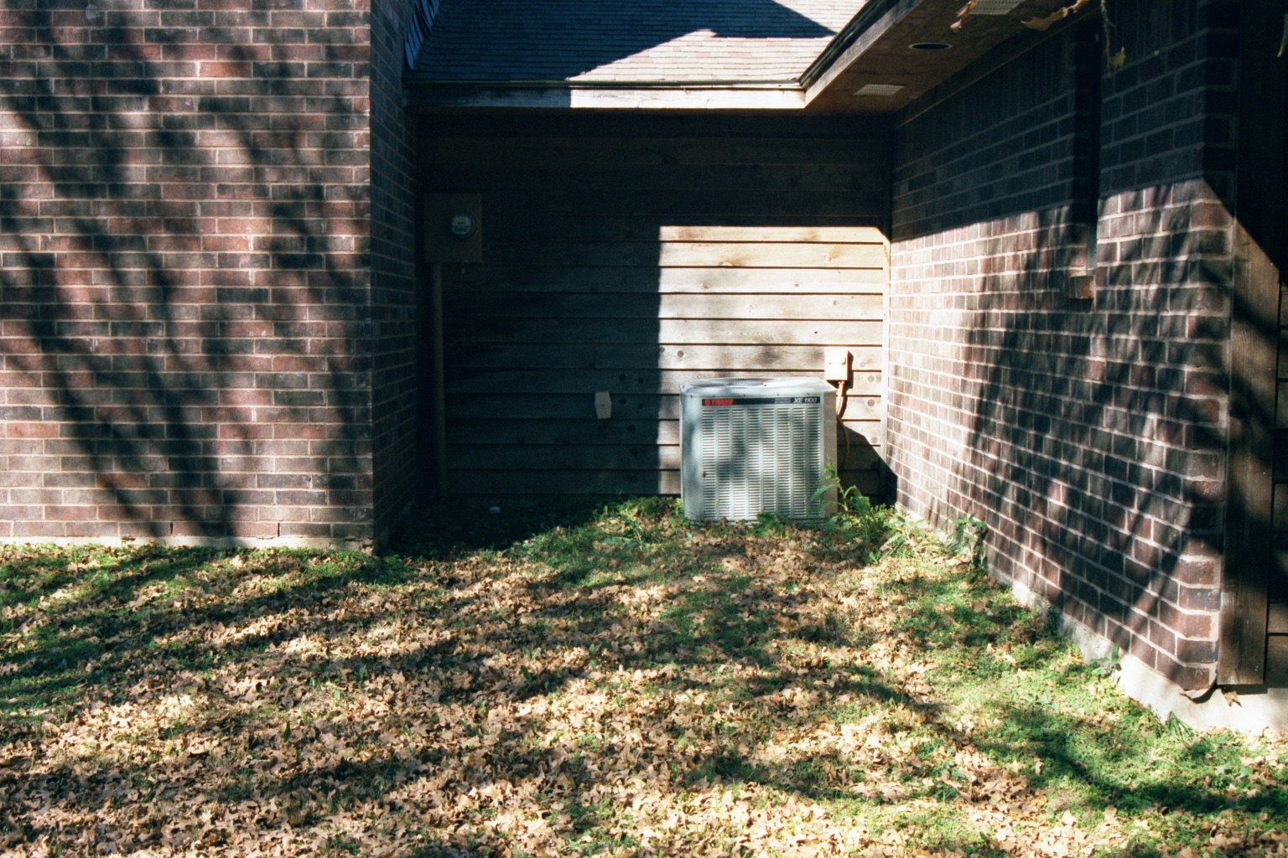
Operation
The copper wires leave the house and cross the yard

Slide 15
Operation
The lines go across the yard underground

Slide 16
Operation
Down the side of the road

Slide 17
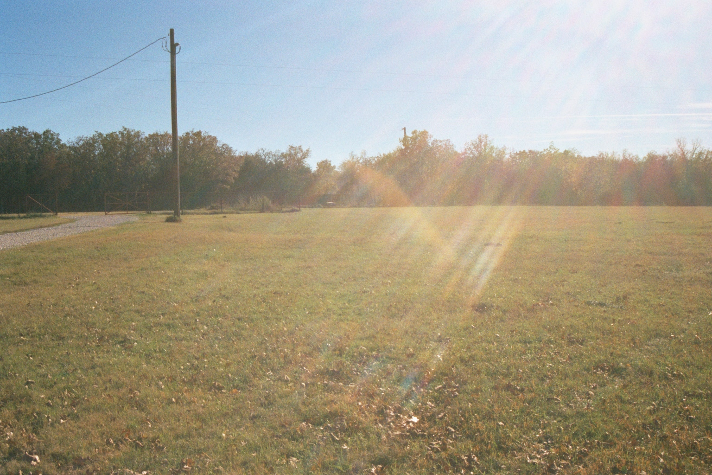
Operation
Across the hay field

Slide 18
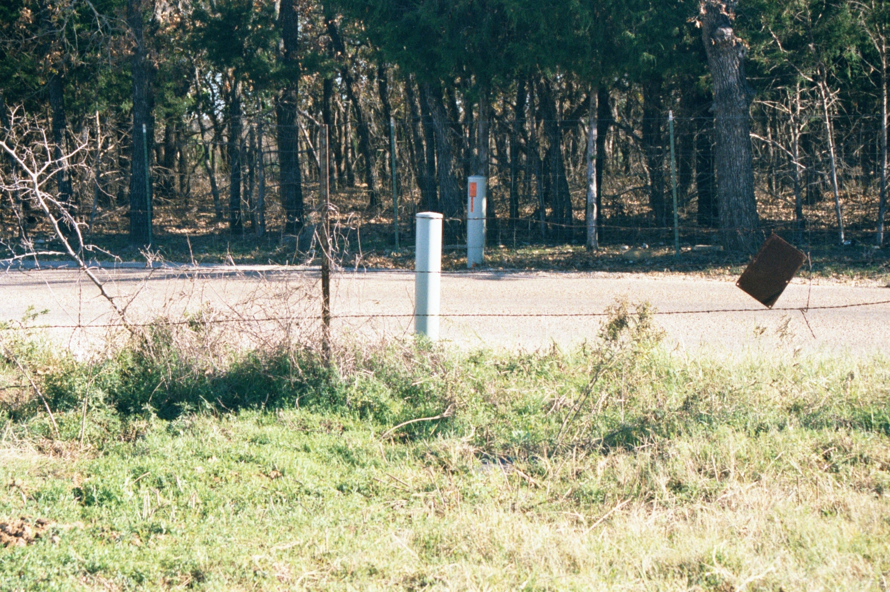
Operation
To the connection box

Slide 19
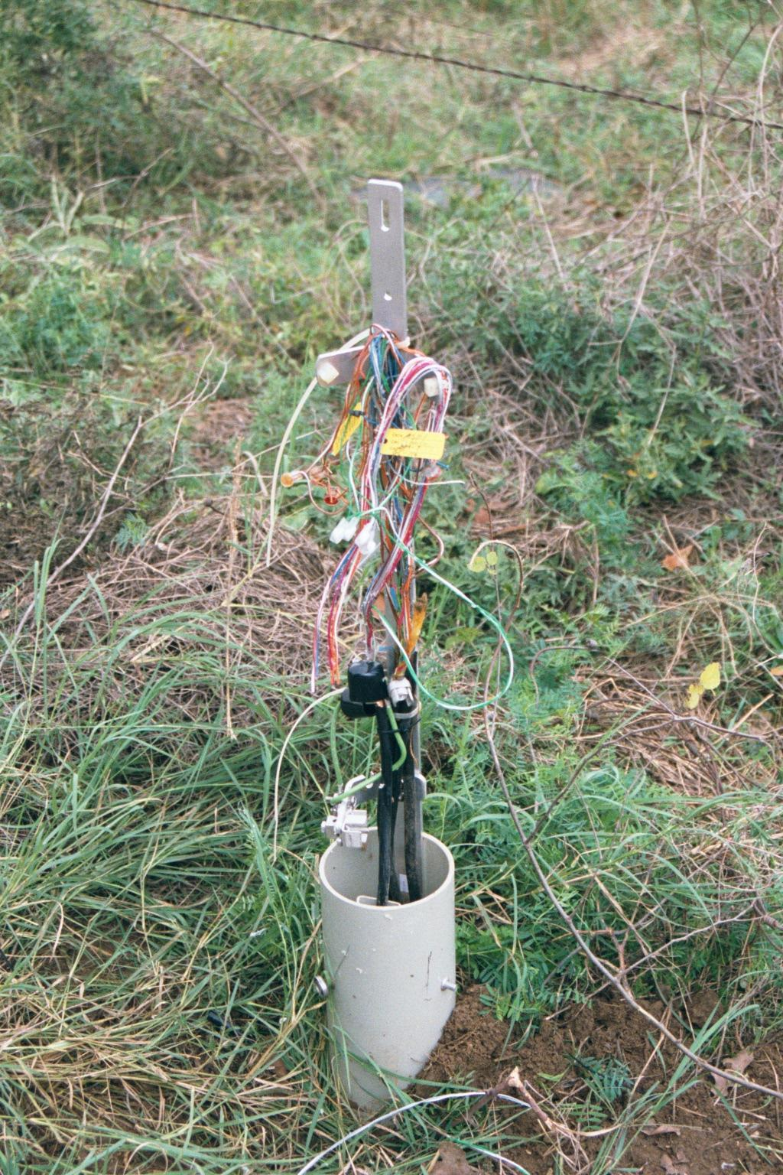
Operation
The T1 circuit is just a set of copper wires like all the others that serve the house

Slide 20
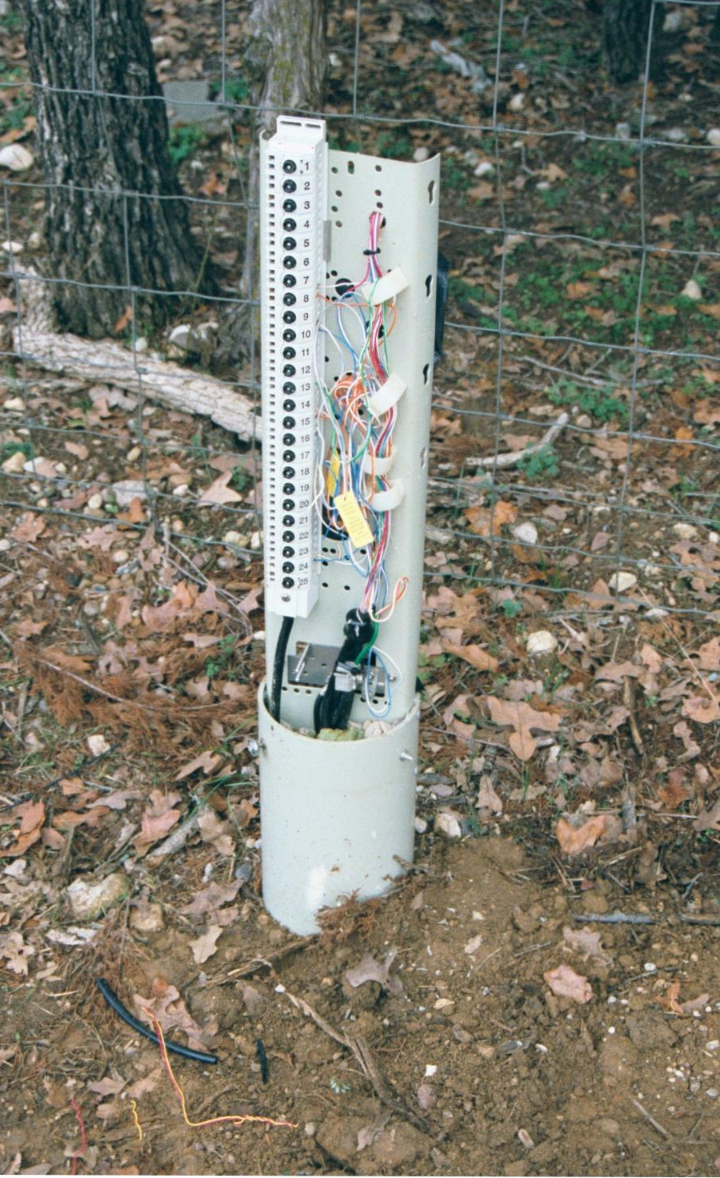
Operation
The circuit goes across the road to another copper connection post

Slide 21
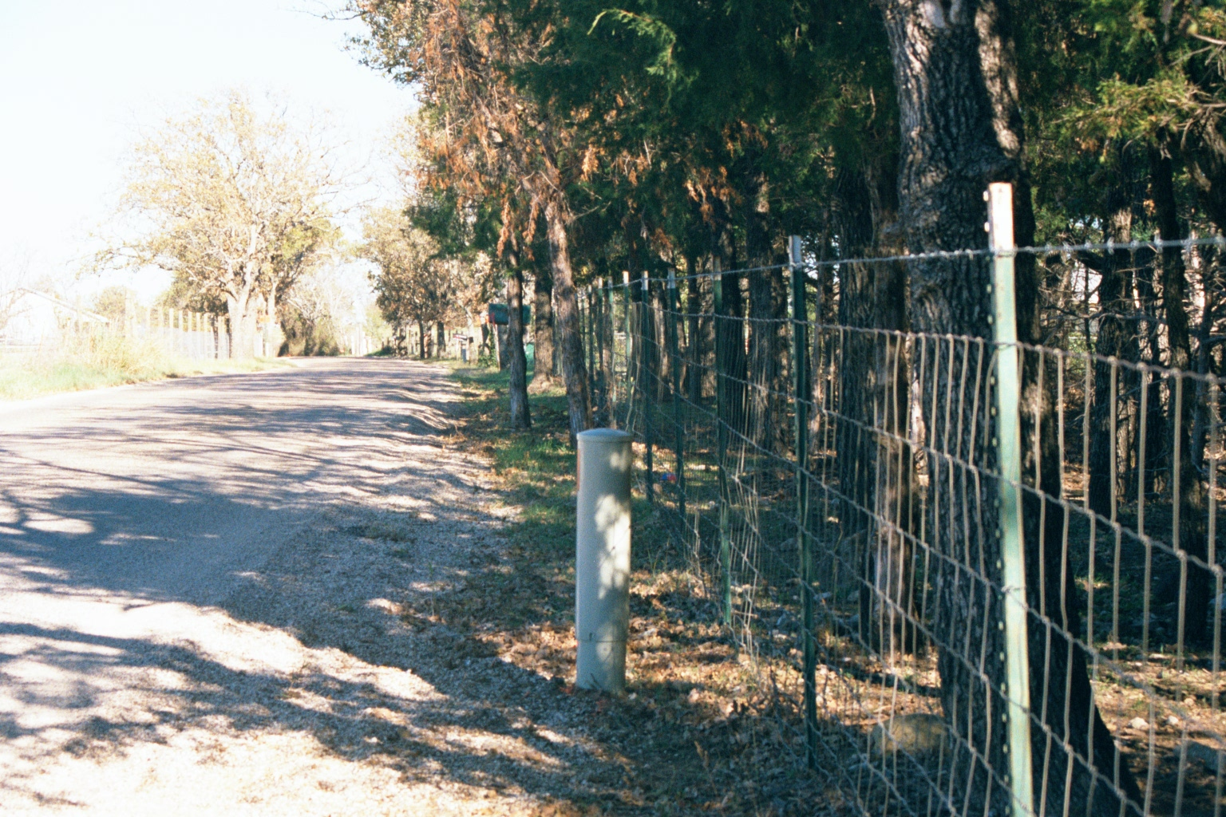
Operation
The copper lines go down the road toward the highway

Slide 22
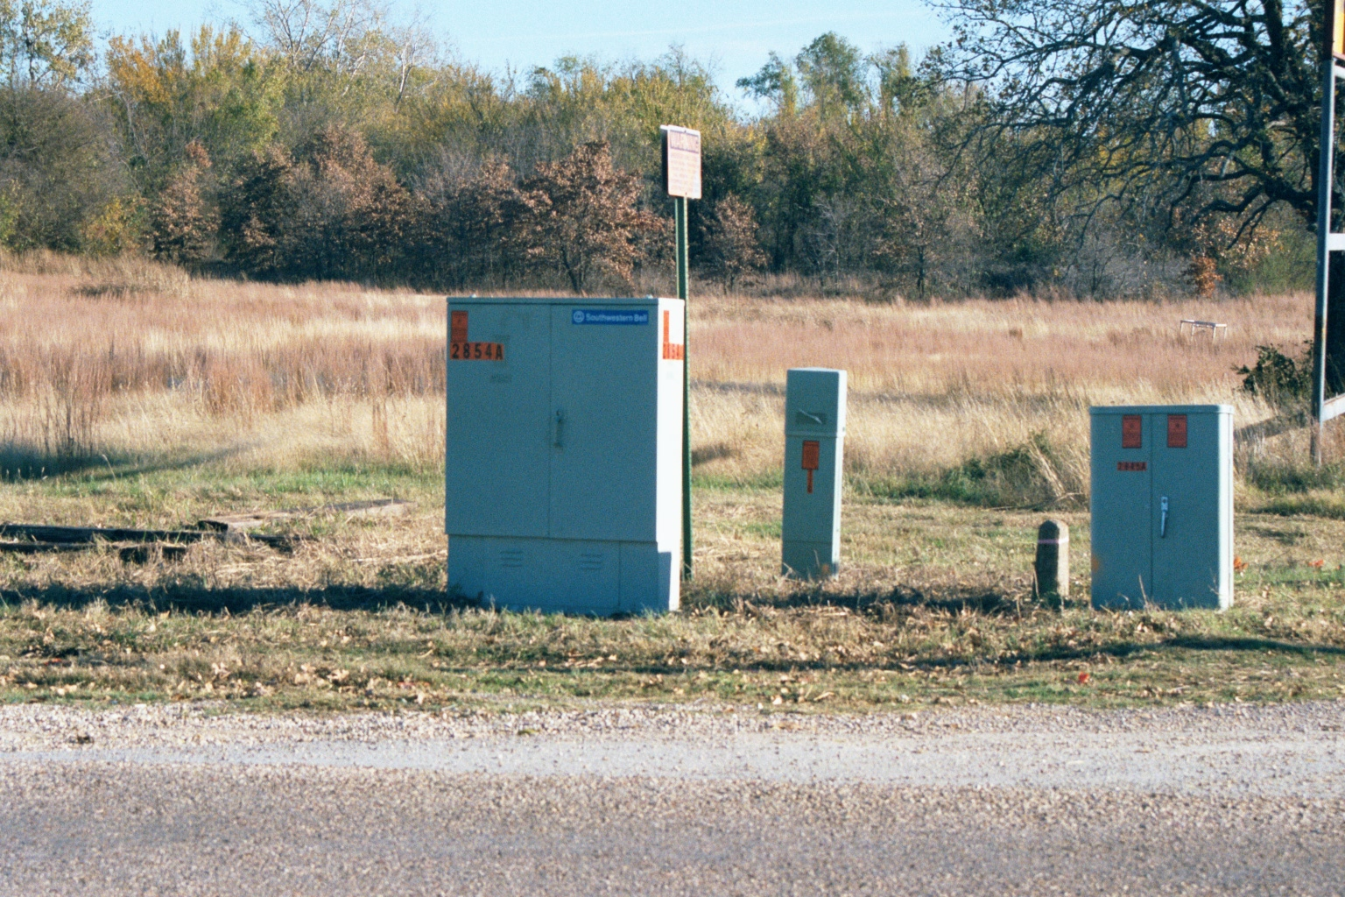
Operation
All of the copper lines are terminated here in this box

Slide 23
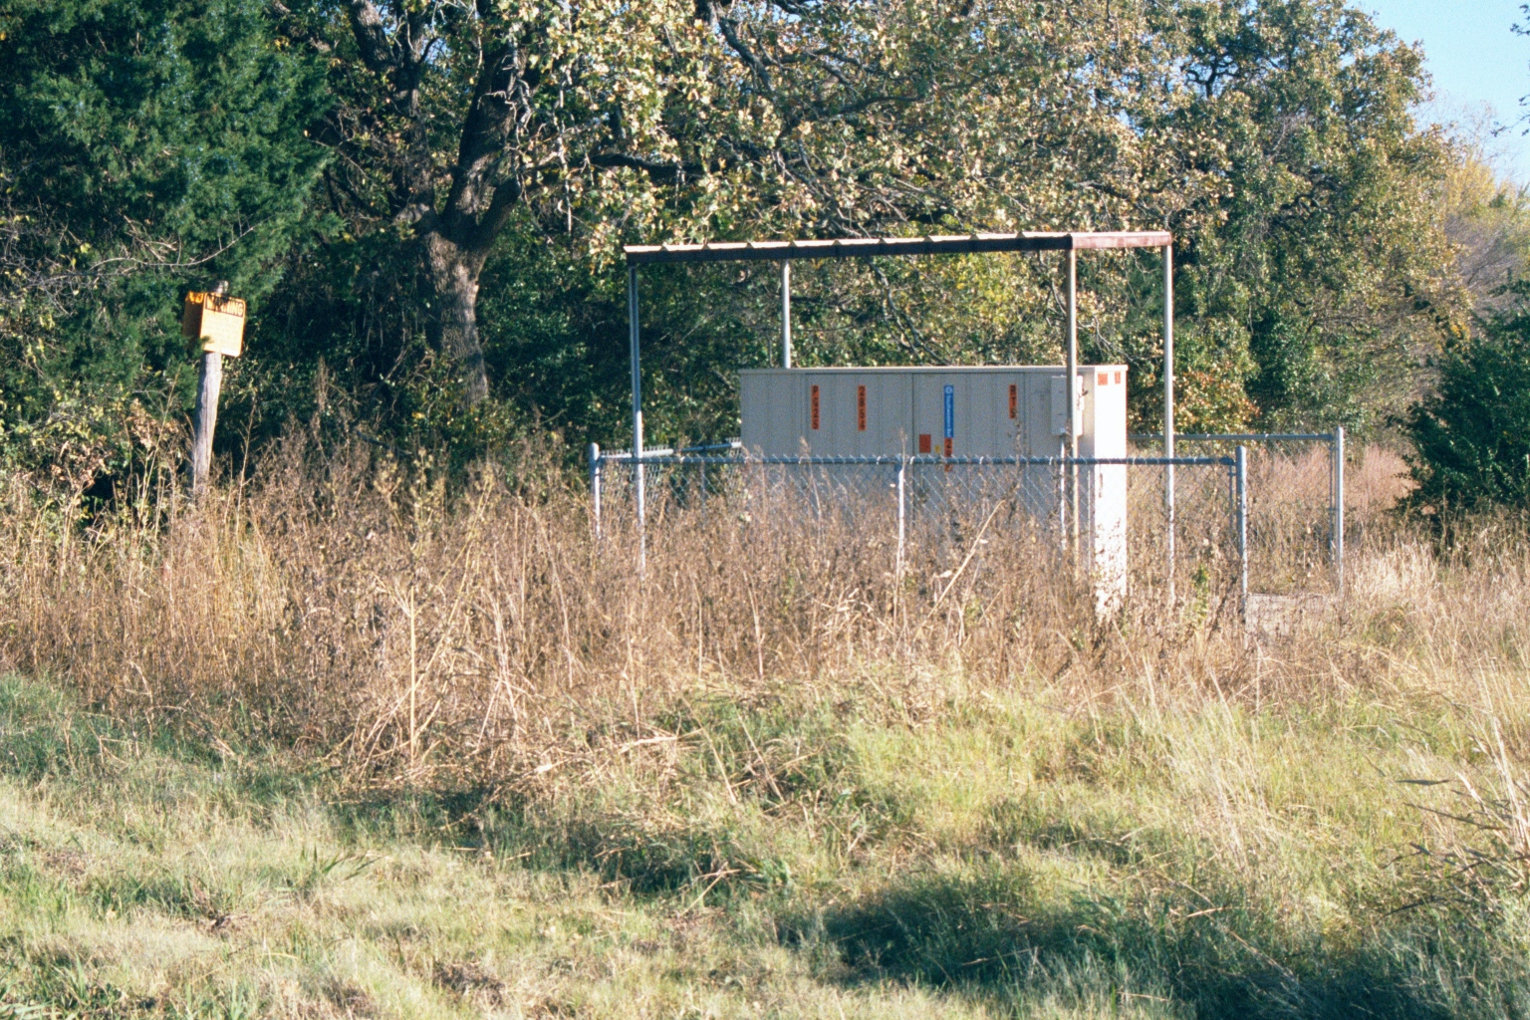
Operation
The copper lines are combined and converted to fiber optic cables in this box

Slide 24
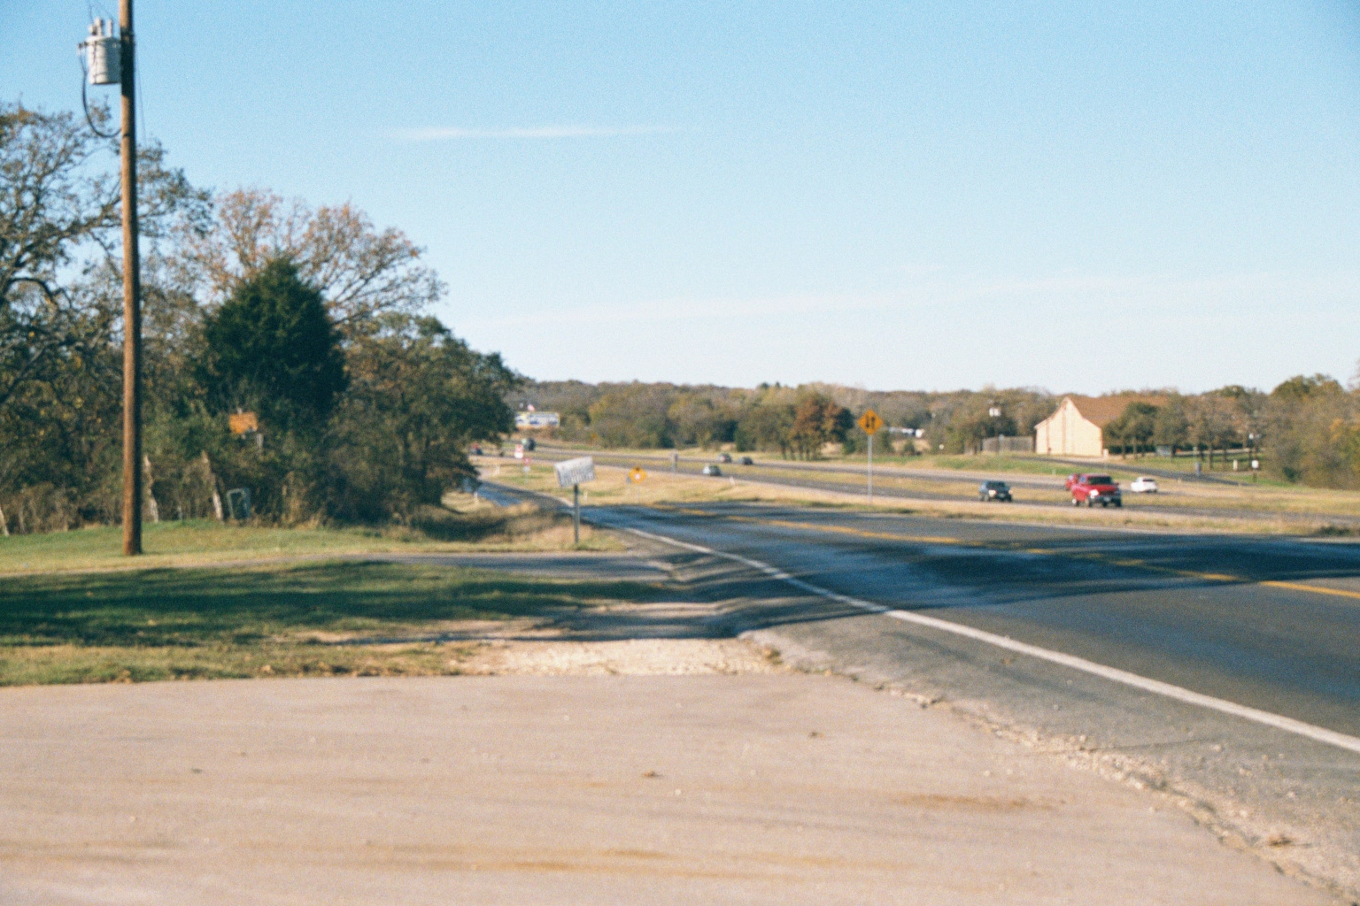
Operation
The fiber goes down the highway

Slide 25
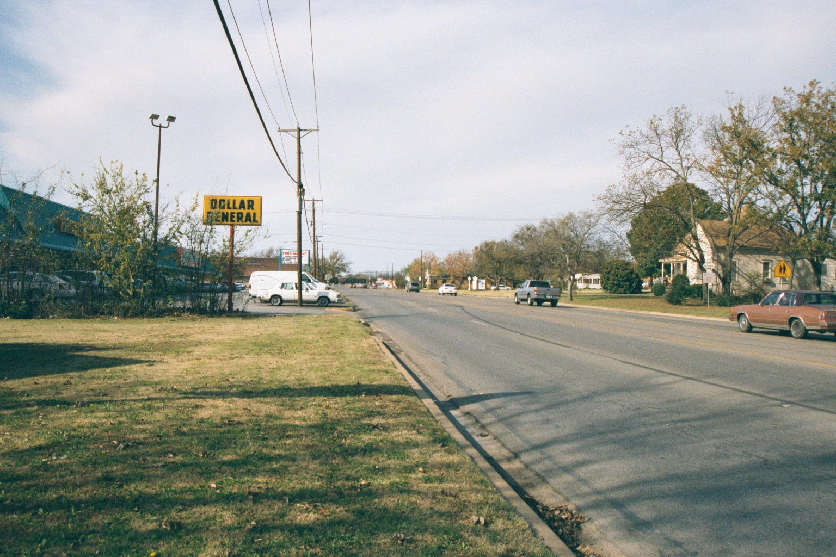
Operation
In town the fiber leaves the highway and proceeds down the street

Slide 26
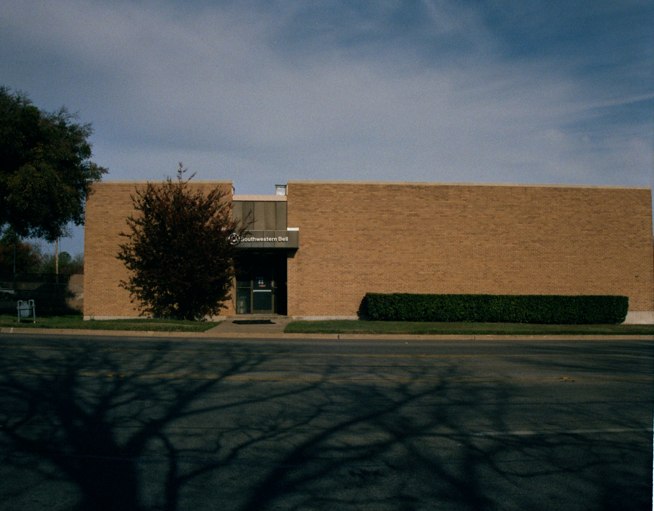
Operation
To the service provider’s central office

Slide 27
Operation
T Carrier circuits are a layer 1 and 2 technology, operating primarily at layer 1
Due to its roots in the voice world a full T1 is divided into 24 channels of 64 Kbps each for a total of 1.544 Mbps
Transmission is multiplexed using TDM

Slide 28
Operation
The term Clear Channel is commonly used in relation to T Carrier circuits
There are two common uses of this term
You have to pay attention to the context to know which definition is meant

Slide 29
Operation
When referring to the entire circuit as a Clear Channel circuit
There is only a single data source
In a channelized setup each channel has its own data source
It does not use TDM
The entire circuit can carry any type of traffic
Many will send ATM over this type of circuit using an IAD to mix traffic types

Slide 30
Operation
When referring to a single channel in a circuit Clear Channel means
The channel is using B8ZS and ESF as opposed to AMI and SF
The difference is that when using B8ZS and ESF the entire 64 Kbps of the circuit can carry data
Where as the AMI and SF combination circuit can only carry 56 Kbps of data, with the rest being used for management of the circuit

Slide 31
Usage
These circuits are often used to mix data, voice, and video traffic on the same circuit by using different channels for each
There is basically no limit to the distance over which a T1 circuit can be from the phone company central office
But this requires circuit conditioning and repeaters on the line
As such a T1 is expensive to install

Slide 32
Speeds
From 64 Kbps to 274 Mbps
The most common speeds are
Fractional T1 at 64, 128, 256 Kbps
Full T1 at 1.544 Mbps
T3 at 45 Mbps
These are called DS circuits to further confuse things as seen in this table

Slide 33
Speeds
Circuit | Speed | Channels | Use
DS0 | 64 Kbps | 1 | A single channel
DS1 | 1.544 Mbps | 24 | Full T1
DS1C | 3.152 Mbps | 48 | Used by carriers
DS2 | 6.312 Mbps | 96 | AT&T Picturephone service
DS3 | 44.736 Mbps | 672 | Full T3
DS3C | 89.472 Mbps | 1,344 | Defined, but not used
DS4 | 274.176 Mbps | 4,032 | Used by carriers for aggregation

Slide 34
Operation
The difference between DS or T is one of usage
A DS circuit is how the basic circuit is defined
A DS circuit is an isochronous circuit
That is bits have to fall into time slots, remember TDM
There are no time markers, as in asynchronous

Slide 35
Operation
There is no external timing signal, as in synchronous
TDM is used so that a single physical circuit can carry more than one signal
Without TDM a T1 circuit of 24 channels would require 24 separate wires
Or actually in the case of T Carrier circuits 96 wires since each circuit requires 4 wires usually

Slide 36
Operation
So a DS1 just defines a circuit that runs at a particular data rate
In this case 1.544 Mbps in total
Of which 1,536 Mbps is available for data
This odd speed comes from its roots in the voice world
The human voice occupies 3,200 Hz of sound waves
To cover some area on the outside of this it was rounded up to a 4,000 Hz

Slide 37
Operation
The Nyquist Theorem says that to adequately sample and represent any signal, it should be sampled at twice the frequency rate
That means if the sound waves cycle through 4,000 cycles per second, then it should be sampled at twice that, or 8,000 times per second
In addition, each sample is represented on an 8-bit scale
So we have eight bits of information in each of 8,000 times

Slide 38
Operation
This is 8,000 frames transmitted per second
8 bits per frame
Over 24 channels
The rest is overhead in the form of the framing bit
A T1 is a DS1 circuit that is running over copper
But recall that all of this really runs over fiber optic cable outside of the customer site

Slide 39
Operation
A DS1 could be delivered over a wireless connection or anything else
A copper circuit is by far the most common
That is why people always call a circuit which is technically a DS1 a T1

Slide 40
Operation
The basic bit stream or the line coding describes the way the signal bits, the 0s and 1s, are represented on the wire
For example, T Carrier uses the lack of voltage on the line to indicate a 0
As will be seen below this can cause problems in equipment thinking a long string of 0s is a loss of signal

Slide 41
Operation
At the next level up there are constraints on the basic bit stream defined by the DS hierarchy
These constraints are required to maintain signal quality and limited control functions
These bit framing methods include

Slide 42
Operation
AMI – Alternate Mark Inversion
This method is rarely used anymore since it produces a 56 Kbps channel
Some people use it when they want to use the remaining 8 Kbps for a PBX
It is used along with SF also called D4
B8ZS – Bipolar with 8-zero substitution
This is the most common as it allows the entire 64 bps to be used for data
It is used along with ESF

Slide 43
AMI
AMI is a way of varying a continuous pattern of 1's or 0's so that the receiving device can separate out the data from no signal or a clock signal
The problem occurs if a bunch of 1's comes across, represented by a long period of positive voltages
Say like
++++++++++

Slide 44
AMI
Devices have a hard time figuring out where to break the data bits out of that signal
What AMI does is vary the polarity of every other 1, for instance
+-+-+-+-+-+-+-
That allows discrete 1's to be picked out of the signal

Slide 45
B8ZS
This problem can also be fixed by B8ZS
It works by replacing a long string of data bits, which happen to contain a series of eight zeros, with a known pattern of voltage
Such as
+-0-+
The other device recognizes this, and says
Oh, you must be sending eight zeroes

Slide 46
B8ZS
This technique is called maintaining the 1's density

Slide 47
Signaling Problems
The specific problem these two techniques are designed to fix relate to how circuits are timed
The voltage level of the bipolar, return-to-zero T1 signal conveys the data
Absence of a voltage pulse indicates a 0, and a positive or negative pulse indicates a 1

Slide 48
Signaling Problems
So, if a long sequence of 0s is transmitted, two problems arise
First, an extended sequence of 0s is indistinguishable from a LOS – loss of signal condition
Second, the sampling clock can get out of sync, and the T1 receiver can misinterpret the incoming bit stream

Slide 49
Signaling Problems
The use of B8ZS or AMI circumvents this problem

Slide 50
Framing
At the next level up the bit stream is formed into frames
One of two frame types can be used
ESF - Extended SuperFrame is the most common
SF – SuperFrame is also used
T1 sends a frame every 125 microseconds
Which translates to 8000 frames per second

Slide 51
Framing
Then with 24 channels and 8 bits per channel, plus 1 framing bit we have a circuit of 1.544 Mbps
In the SF 12 frames are sent in a pack
In the ESF 24 frames are sent together

Slide 52
Encapsulation
Finally to send this data between routers an encapsulation method is required
HDLC and PPP are normally used for a T carrier circuit
As we will see later other encapsulation methods can be applied to a T carrier circuit, such as frame relay

Slide 53
Usage
In general a T Carrier circuit is recommend for constant rate traffic
A T Carrier circuit is used to connect large sites together
They are also used to connect a collection node to a central site in a hub and spoke arrangement

Slide 54
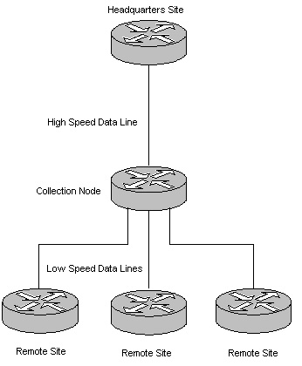
Usage

Slide 55
Uptime
Why use an expensive, in comparison to DSL or Cable, T1 line
Reliability and uptime is the main reason
For example, when the phone company takes down a DSL line, they just take it down without notice
If the line fails, there is no guaranteed repair time

Slide 56
Uptime
In contrast, the T1 line has a guaranteed repair window
Further, if they have to take the line down for a time you get a call like this one I received
This is Mark the SBC technician
I am giving a courtesy call for tomorrow
About 2:30 we will be working on the cables outside

Slide 57
Uptime
It will affect your T1 line for about five to ten minutes
The phone number and name of the customer I have is a Ken Chipps 817-447-6637
Again about 2:00 or 2:30 we will have the T1 down for about ten minutes at the most
Any questions please call me at …
The normal guaranteed repair time is 4 hours or less

Slide 58
Cost
The cost of a T1 line has dropped over the years
For example Covad offers one in my area as of 2008 for $369 per month
They will bond of these together to provide a 3 Mbps data line

Slide 59
For More Information
T1: Survival Guide
Michael S. Gast
ISBN 0596001274

