Slide 1
Satellite Equipment
Last Update 2010.01.17
1.1.0

Slide 2
Objectives of This Section
Learn
What equipment is required for a satellite network connection

Slide 3
Satellite Equipment
For a satellite system there will be equipment both outside and inside
The is called the ODU – Outside Data Unit and IDU – Inside Data Unit
Either may consist of one or more boxes and cables
This is true of the equipment at both ends of the link

Slide 4
Satellite Equipment

Slide 5
Satellite Equipment
At the other end of the link in most cases where this type of connection is used there will be one central site called a teleport
The teleport connects the terrestrial circuits to the satellite circuits
Most companies will lease access from a teleport provider, rather than build their own

Slide 6
Teleport

Slide 7
End User Equipment
At the end user side of the connection the ODU is further comprised of antenna, LNB, transceiver - if it's bi-directional, and some sort of power amplifier
If they are receive only systems like DirecTV, they would only have an antenna and LNB and not include a transceiver nor power amplifier

Slide 8
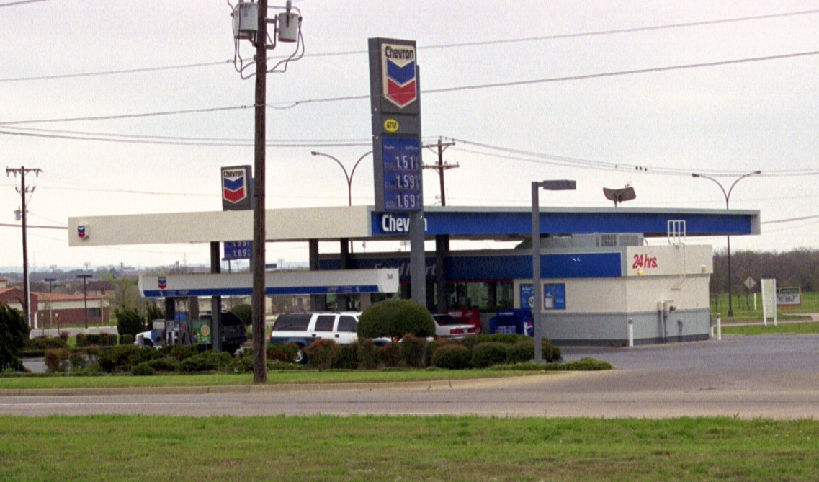
End User ODU
Antenna

Slide 9
End User Antenna

Slide 10
End User LNB

Slide 11
End User Equipment
The frequency of the signals from and to the ODU are downconverted or upcoverted to and from the IDU
The IDU receives the signal from the ODU and converts it for use on the LAN

Slide 12
End User IDU

Slide 13
End User IDU

