Slide 1
SMDS
Last Update 2010.01.17
1.1.0

Slide 2
Objectives of This Section
Learn
What SMDS is
Where SMDS is used

Slide 3
Context
Layer | 2
Network Type | MAN WAN

Slide 4
What is SMDS
SMDS – Switched Multimegabit Data Service is a packet switched service
This is not a technology, just a service
This service may or may not be offered by any particular telecommunications provider
This service was designed to send large volumes of bursty data over a MAN

Slide 5
What is SMDS
It was offered by RBOCs
Bell Atlantic now Verizon appears to have been the last company to offer it
As far as I know they have dropped it now
Here is what they used to say about it

Slide 6
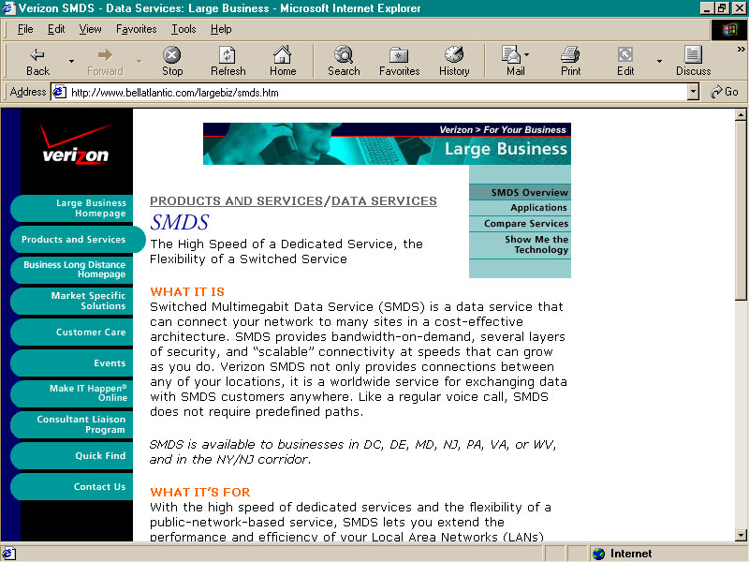
What is SMDS

Slide 7
What is SMDS
SMDS is a data service that can connect your network to many sites in a cost-effective architecture
SMDS provides bandwidth-on-demand, several layers of security, and “scalable” connectivity at speeds that can grow as you do

Slide 8
What is SMDS
Verizon SMDS not only provides connections between any of your locations, it is a worldwide service for exchanging data with SMDS customers anywhere
Like a regular voice call, SMDS does not require predefined paths

Slide 9
What is SMDS
SMDS is available to businesses in DC, DE, MD, NJ, PA, VA, or WV, and in the NY/NJ corridor
With the high speed of dedicated services and the flexibility of a public-network-based service, SMDS lets you extend the performance and efficiency of your Local Area Networks (LANs) over a wide area

Slide 10
What is SMDS
Because SMDS provides “bandwidth on demand” for the bursty traffic typically found on LANs, SMDS is ideal for applications such as collaborative design and image retrieval, medical imaging, Internet access, and transaction services

Slide 11
What is SMDS
Using the high-speed switching and fiber-optic transmission facilities of the Verizon public network backbone, SMDS gives you multimegabit-per-second throughput at speeds of 1.17, 1.536, 4, 10, 16, 25 or 34 Mbps

Slide 12
Operation
Connectionless
Packet switched
But uses cells as the data unit
Same as ATM
53 bytes
48 bytes of data
Designed originally to operate over SONET
Maximum radius of 50 km

Slide 13
Operation
Each customer has a T1 to T3 access line to the provider
At each customer site there is a SAT – Subscriber Access Terminal
The SAT is typically just a router and a CSU/DSU setup to provide this service

