Slide 1
Radio Frequency Equipment
Last Update 2011.09.08
1.0.0

Slide 2
Objectives of This Section
Learn
What type of equipment is used for a radio frequency CAN connection

Slide 3
RF CAN Equipment
A radio frequency based campus area network connection could use low cost or higher cost equipment depending on the need
Let’s look at an example of each

Slide 4
Low Cost RF
Here is an example of a low cost solution that uses the Q-Bridge by Connex
At $400 this has proven to be a reliable low-speed, short-distance solution
Here is an example of how it is used

Slide 5
Front to Back CAN
In this case a set of cameras are located on a structure that is 900 feet from where the camera display needs to be seen
To carry this signal over these 900 feet the cameras are connected to a PoE switch
One end of the Q-Bridge is also connected to this switch

Slide 6
Front to Back CAN
At the other end a computer using a web browser connects to each camera using the IP address of the camera

Slide 7
Front to Back CAN

Slide 8
Front to Back CAN

Slide 9
Front to Back CAN

Slide 10
Front to Back CAN

Slide 11
Front to Back CAN
HERE IS THE TOWER
FROM THE ROOF OF THE
FRONT HOUSE
THE RADIO ON THE TOWER IS
JUST AT THE TREE LINE

Slide 12
Front to Back CAN
HERE IS THE TOWER
FROM THE ROOF OF THE
FRONT HOUSE
THE RADIO ON THE TOWER IS
JUST AT THE TREE LINE

Slide 13
Front to Back CAN
TO FRONT
ANTENNA

Slide 14
Front to Back CAN

Slide 15
Higher Cost RF
A higher cost version of this would be one that uses a licensed frequency, such as the BridgeWave 23 GHZ system
This system costs around $8,000

Slide 16
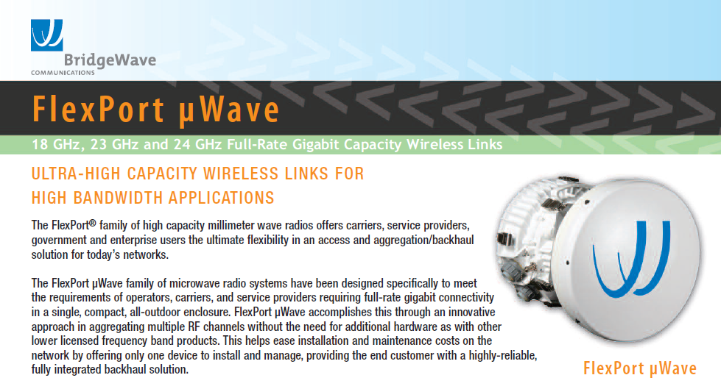
Higher Cost RF

