Slide 1
Powerline Distribution
Last Update 2010.01.17
1.2.0

Slide 2
Objectives of This Section
Learn
What Powerline distribution is

Slide 3
What is Powerline Distribution
The idea here is to use the existing electrical power grid as the telecommunications infrastructure as well
It goes by several names such as
Powerline Distribution
Powerline Communication
PLC
Broadband Over Powerline

Slide 4
Context
Layer | 1
Network Type | WAN

Slide 5
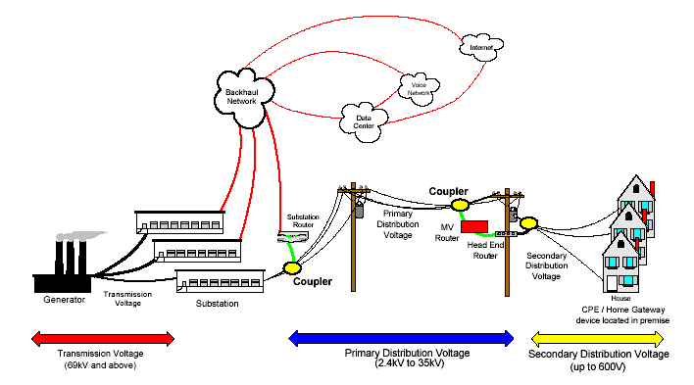
Operation

Slide 6
Operation
As seen in the diagram above in this method fiber optic cable is used to send the signal to a substation
Then the signal is sent along the existing electrical distribution lines to the customer’s house or business
The main problem with this idea is the cost

Slide 7
Operation
Such as laying the fiber optic cabling to the substations and the devices required to get the signal around transformers and the like, that will not let the signal through
This is what the couplers do in the diagram
A way around the cost and trouble of using couplers is to mount wireless access points on the power poles

Slide 8
Operation
Then normal wireless MAN techniques are used to deliver the signal to the customer
Still other providers think they have techniques that will allow them to just go through the transformers, rather than avoid them

Slide 9
Speeds
Speeds are expected to be from 500 Kbps to 3 Mbps, but no one really knows

Slide 10
Current Use
None

