Slide 1
Point A and Point B
Last Update 2010.01.10
1.0.0

Slide 2
Objectives of This Section
Learn
What a real life WAN looks like

Slide 3
What Does a WAN Look Like
A WAN connection can take many forms
It could be as simple as a DSL connection from your house to the Internet or as complex as a fully meshed MPLS network connecting an organization’s sites to each other
The example we will see here is one that connected remote offices to the headquarters

Slide 4
What Does a WAN Look Like
Regardless of the purpose of the network or the size of the network a WAN just like any other network is basically just a process of connecting Point A to Point B

Slide 5
Point A
In this example Point A is a typical remote site in a very large WAN that covered the State of Texas
Each of the over 550 sites looked much like this one
This particular location was the office on Jacksboro Highway in Fort Worth Texas

Slide 6
Point A

Slide 7
Point A

Slide 8
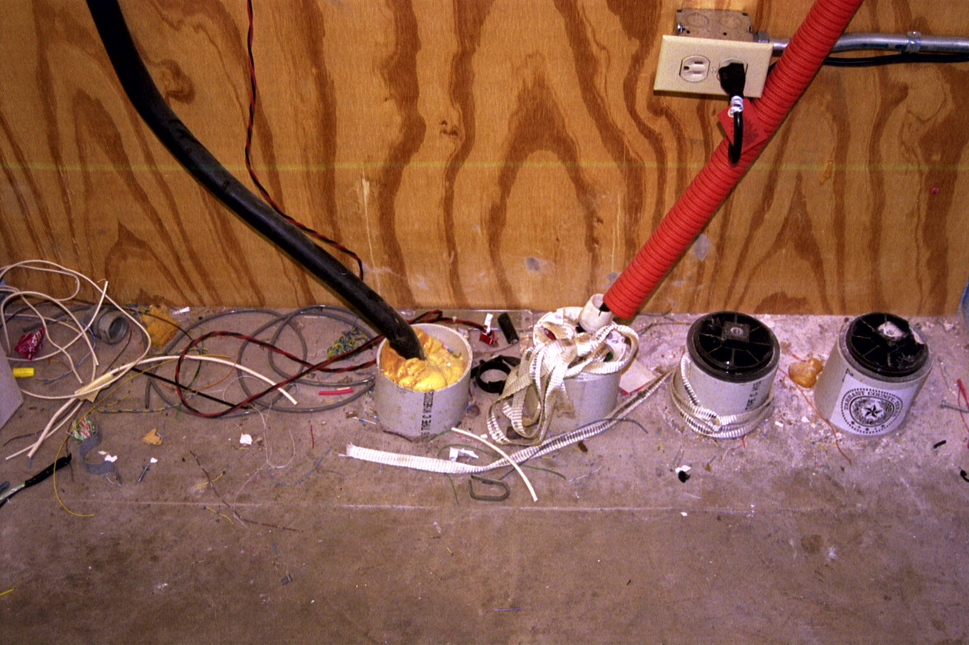
Bringing Fiber Into the Building

Slide 9
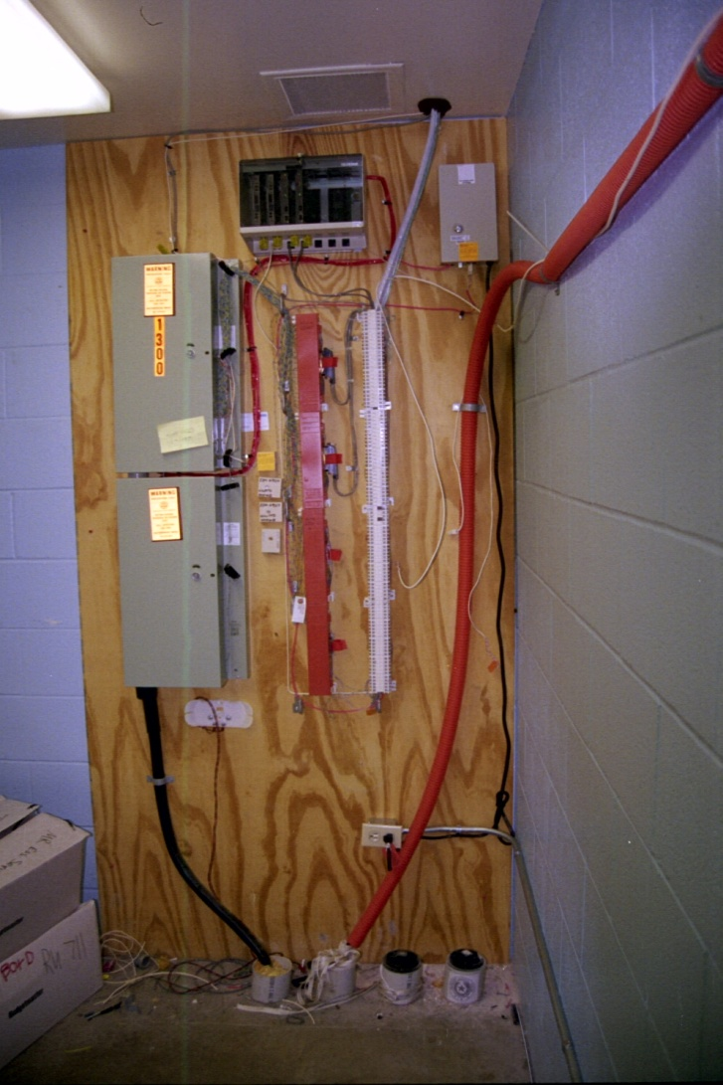
Changing the Fiber to Copper

Slide 10
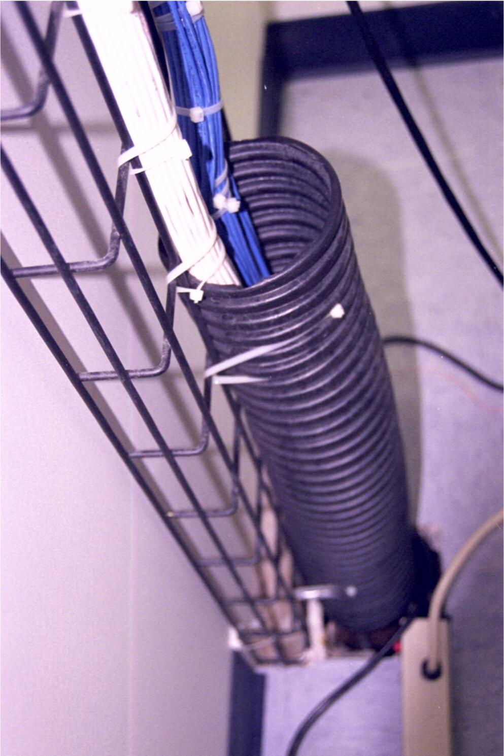
Extending to the LAN Room

Slide 11
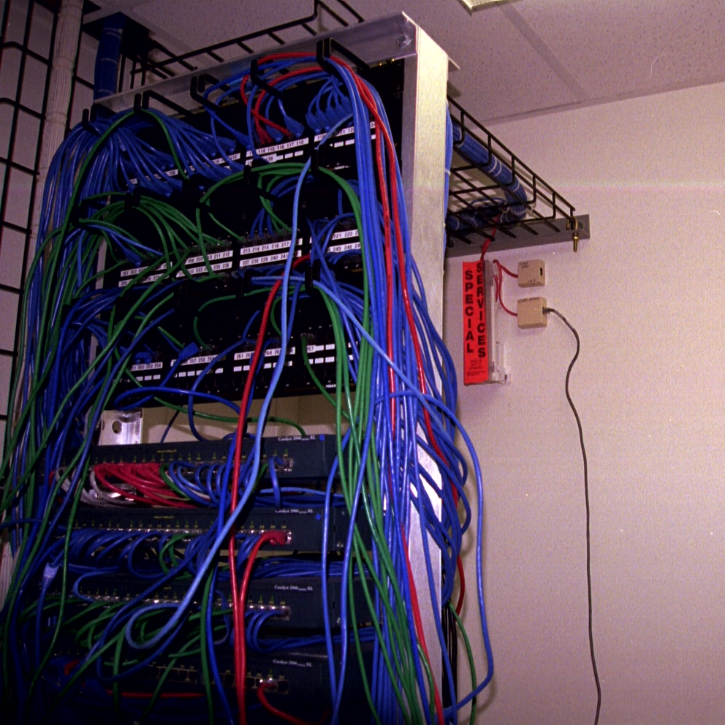
The Extended Demarc

Slide 12
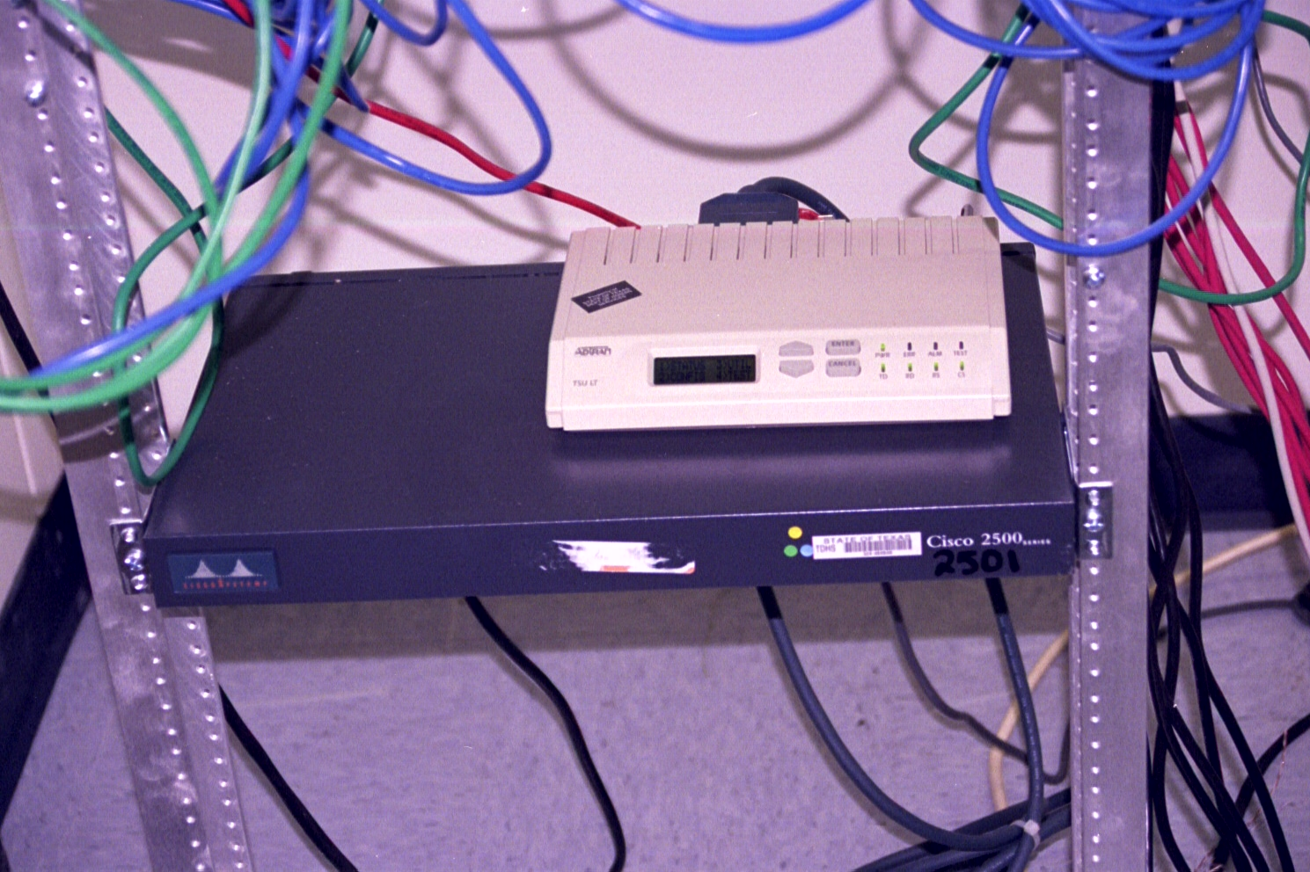
Connecting the Equipment

Slide 13
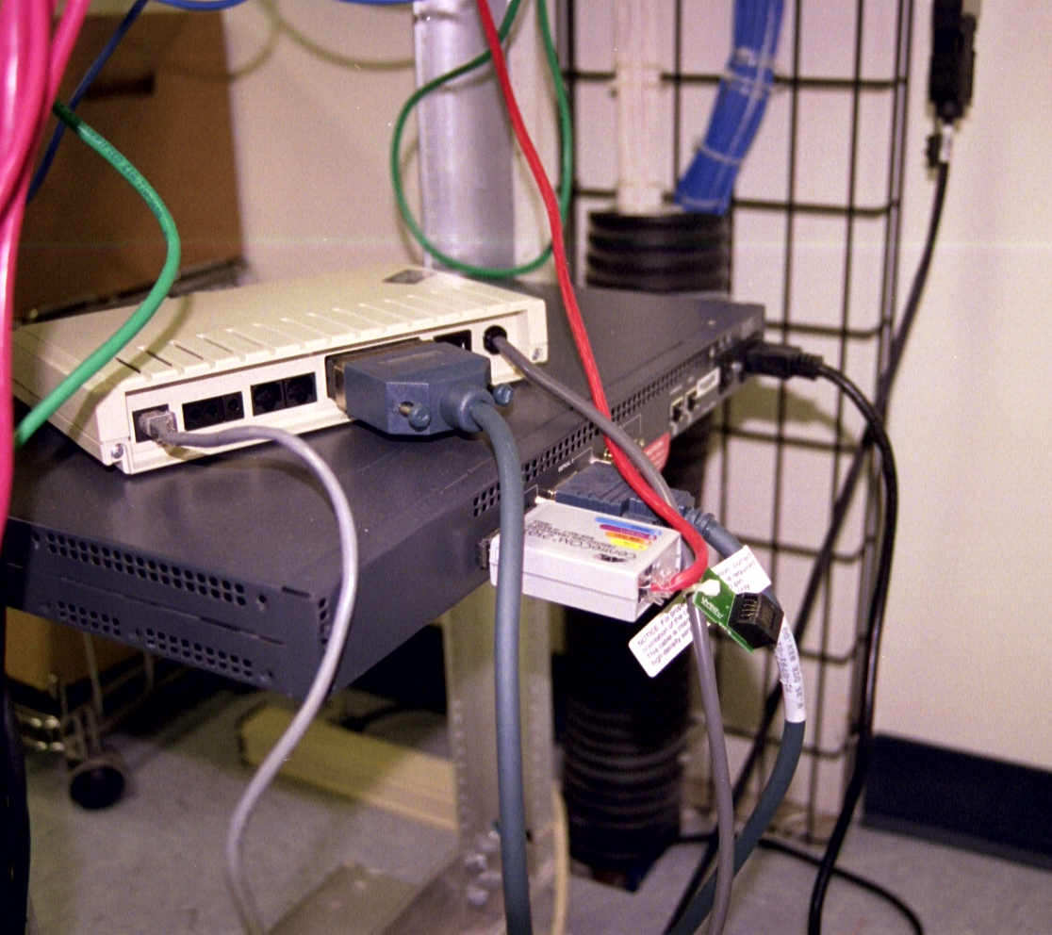
Connecting the Equipment

Slide 14
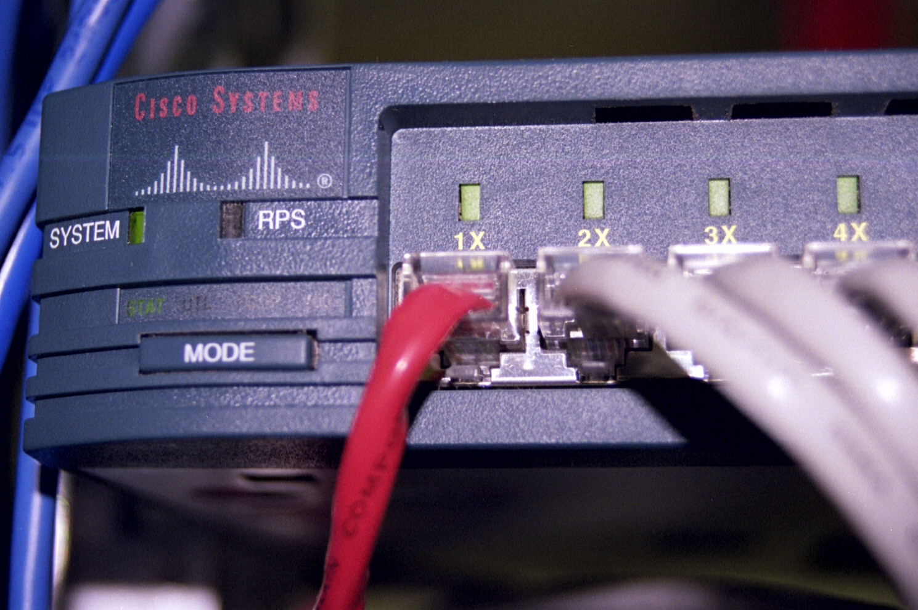
Connecting to the LAN

Slide 15
Point B
The Point A just seen connected to a Point B just north of downtown Dallas Texas
The Point B was called a Nodal Site
Its function was to collect the data from around 150 Point As then send this data to another Point B at the headquarters in Austin Texas

Slide 16
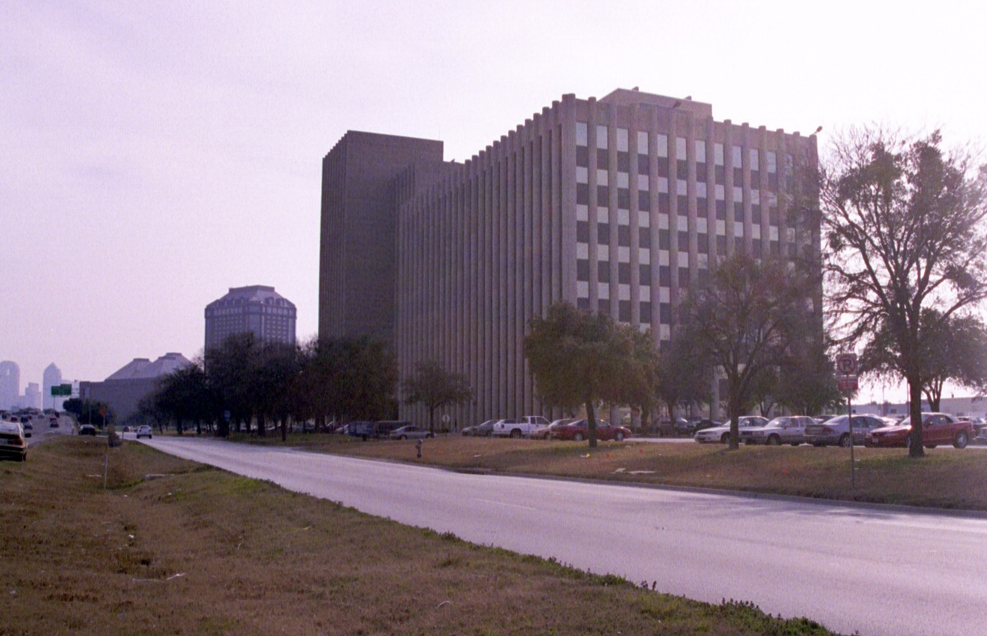
Point B

Slide 17
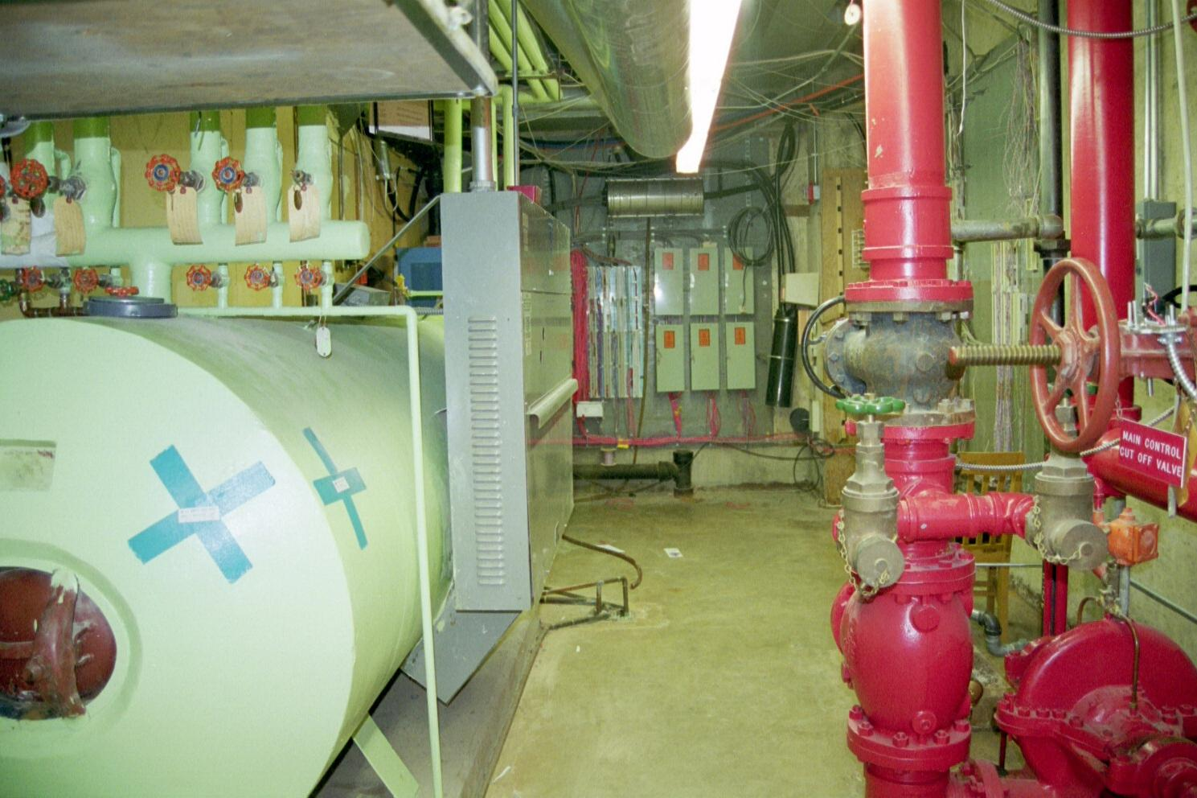
Typical Large Building Demarc

Slide 18
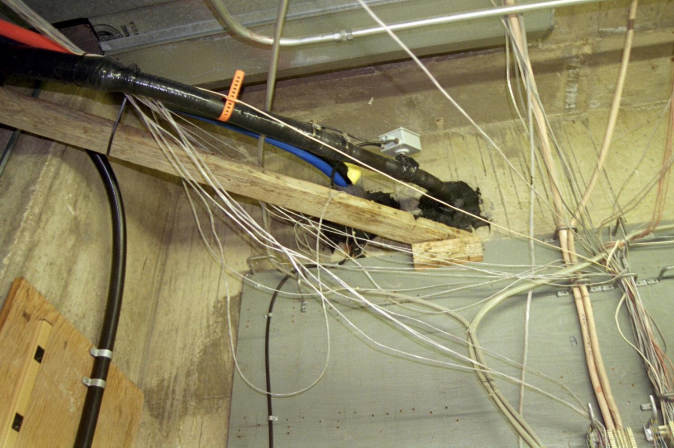
Cable in from Street

Slide 19
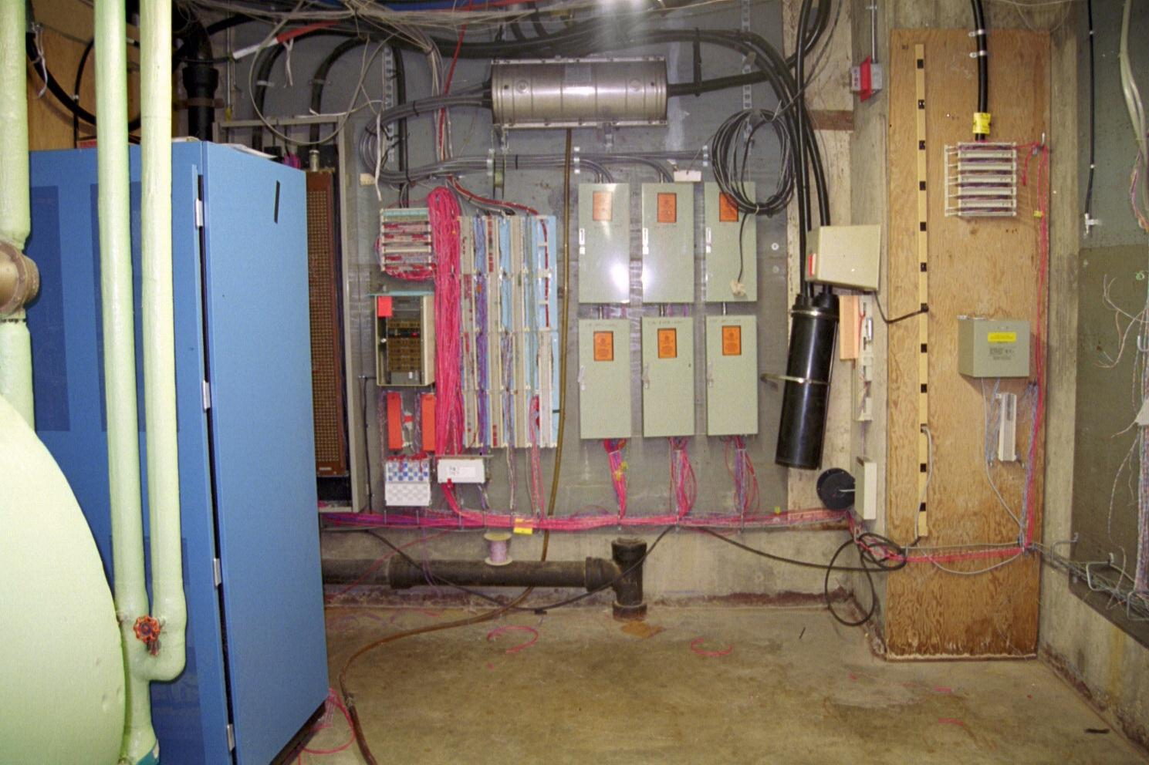
The Real Demarc

Slide 20
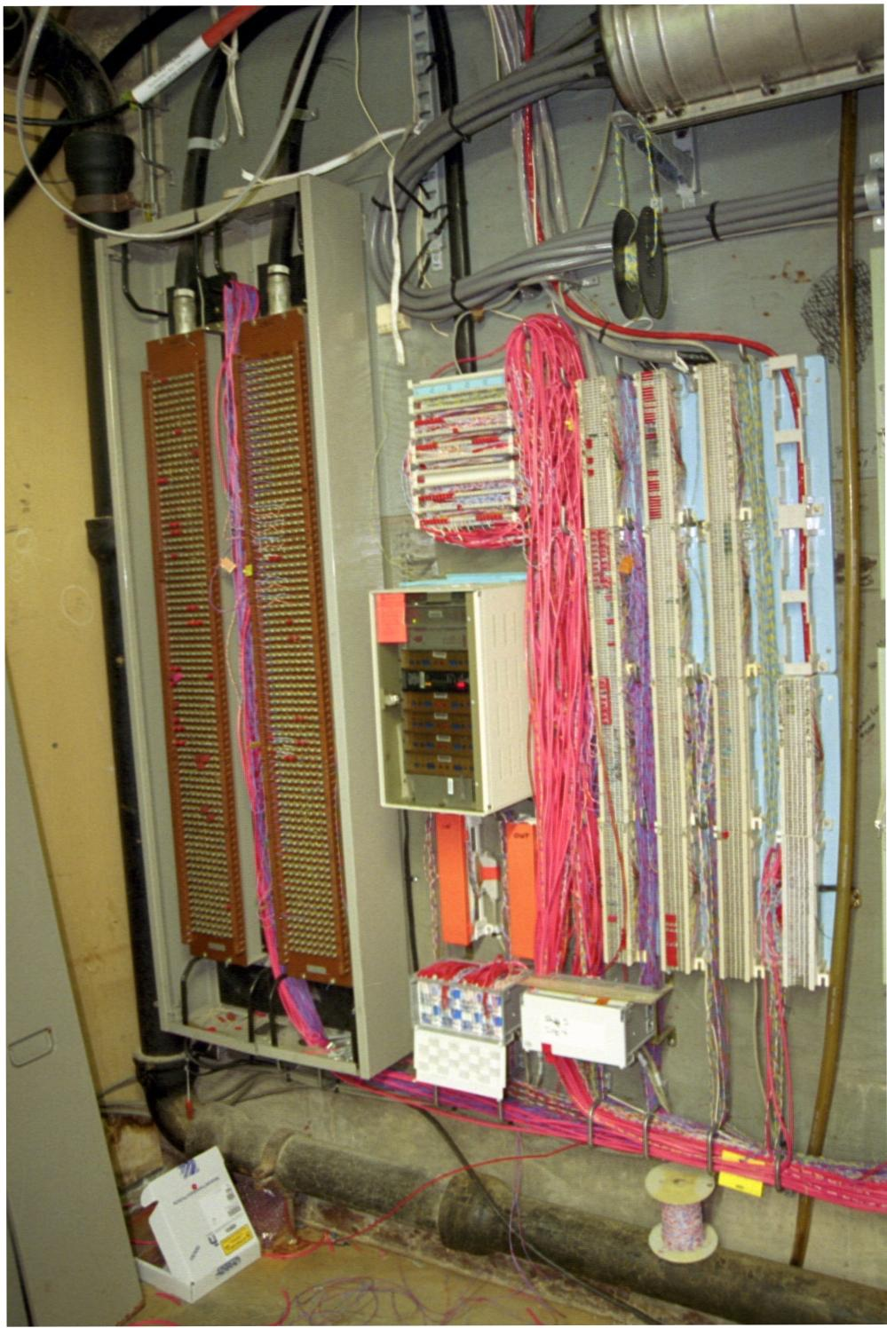
The Real Demarc

Slide 21
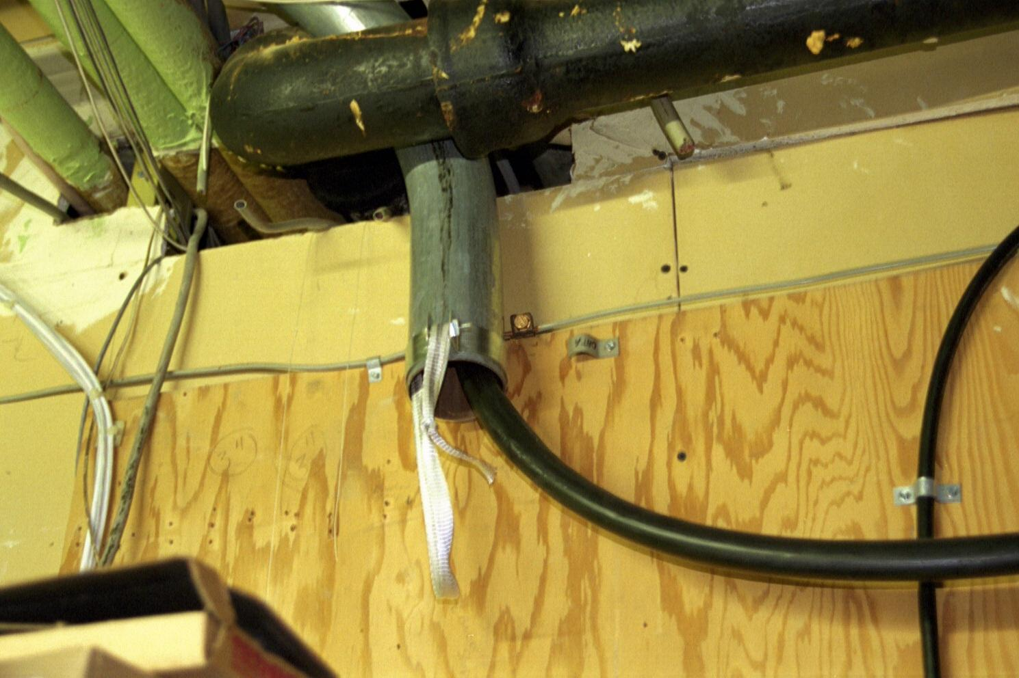
Conduit Out

Slide 22
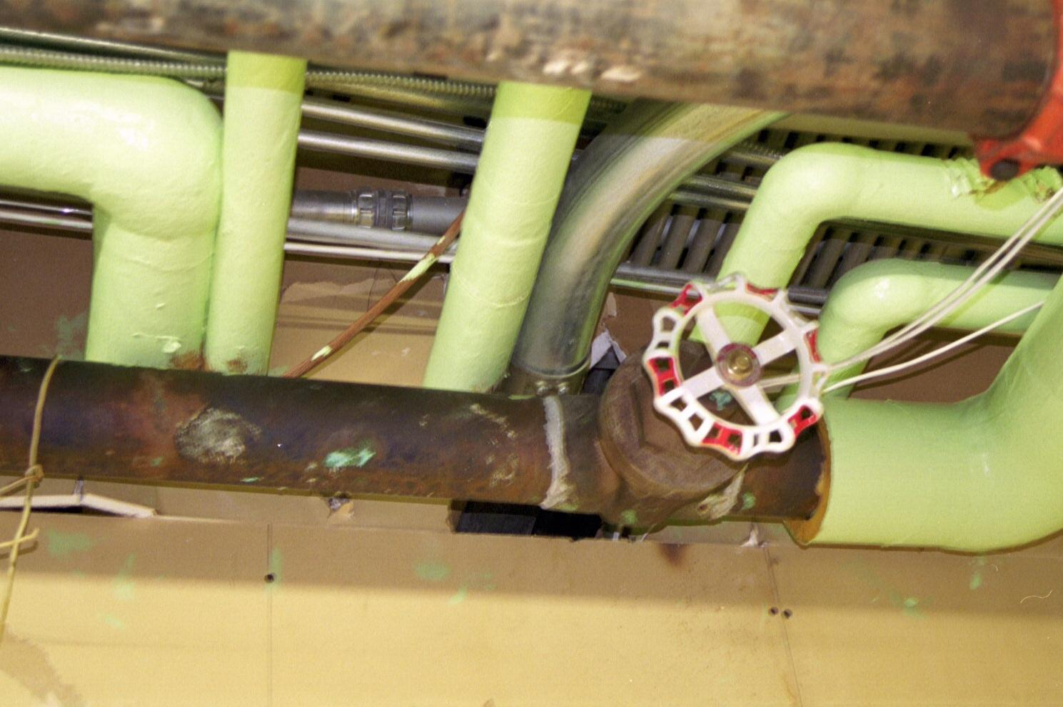
Conduit Out

Slide 23
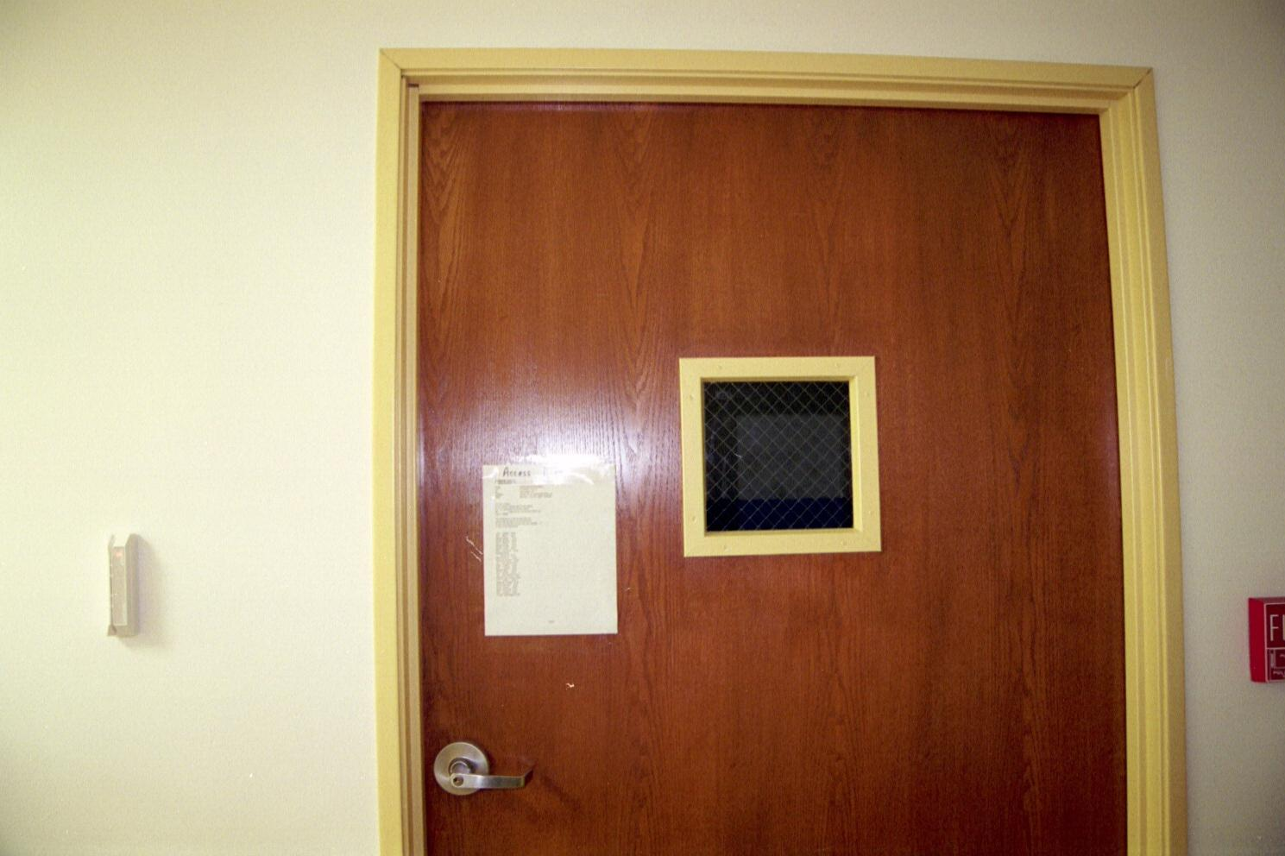
Door

Slide 24
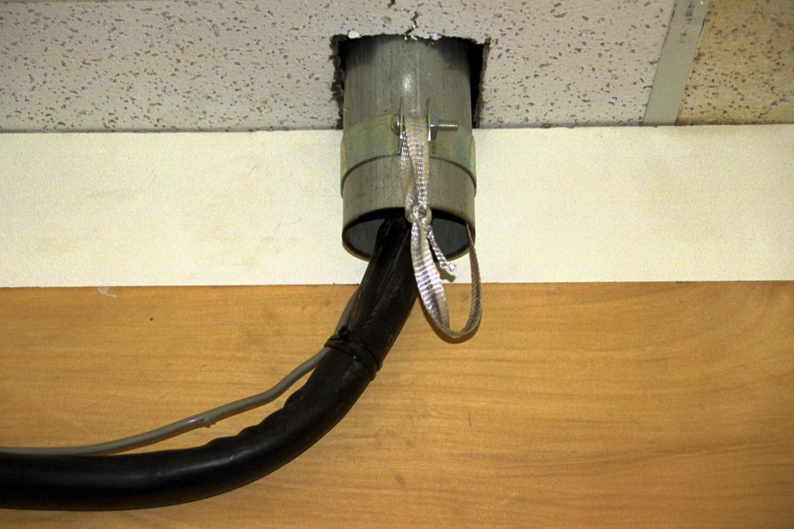
Conduit into Room

Slide 25
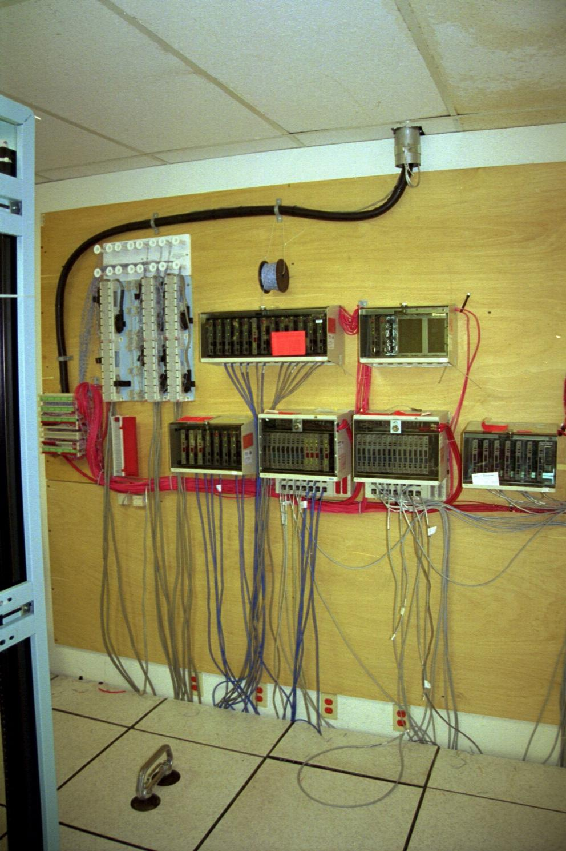
Phone Board in Room

Slide 26
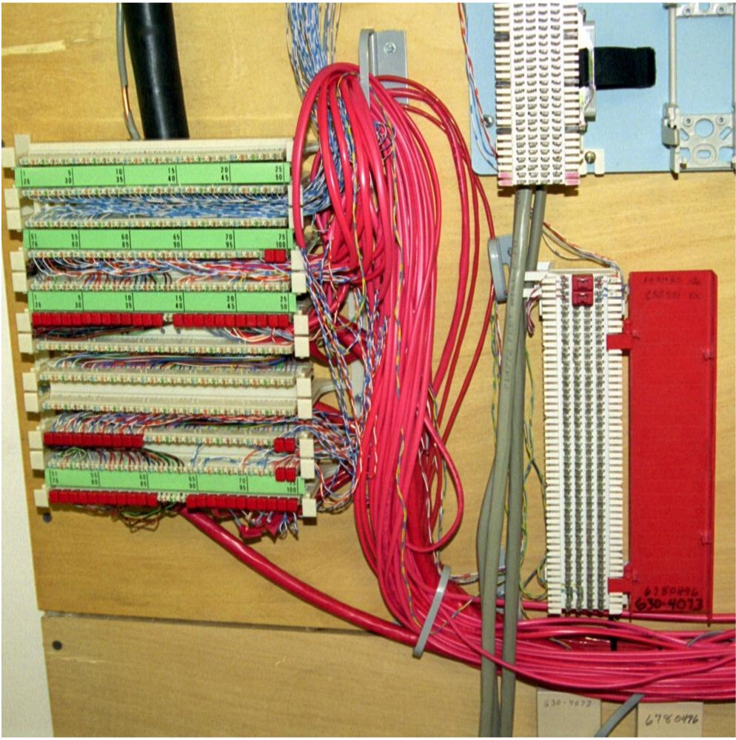
Change from Fiber to Copper

Slide 27
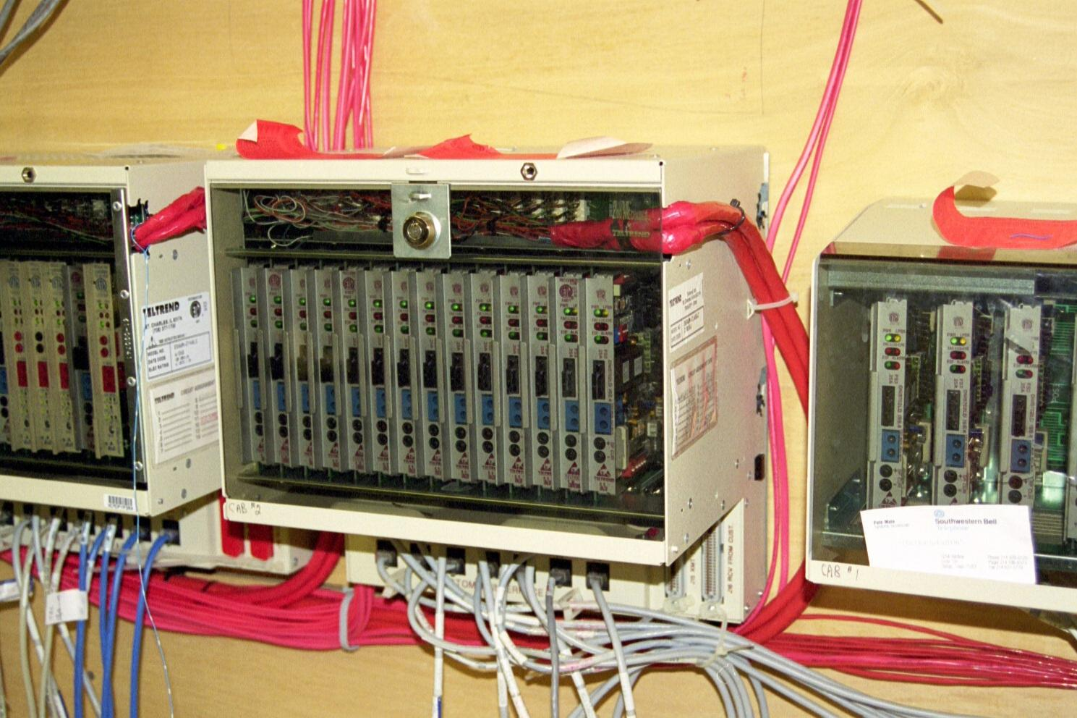
Smart Jack Cabinets

Slide 28
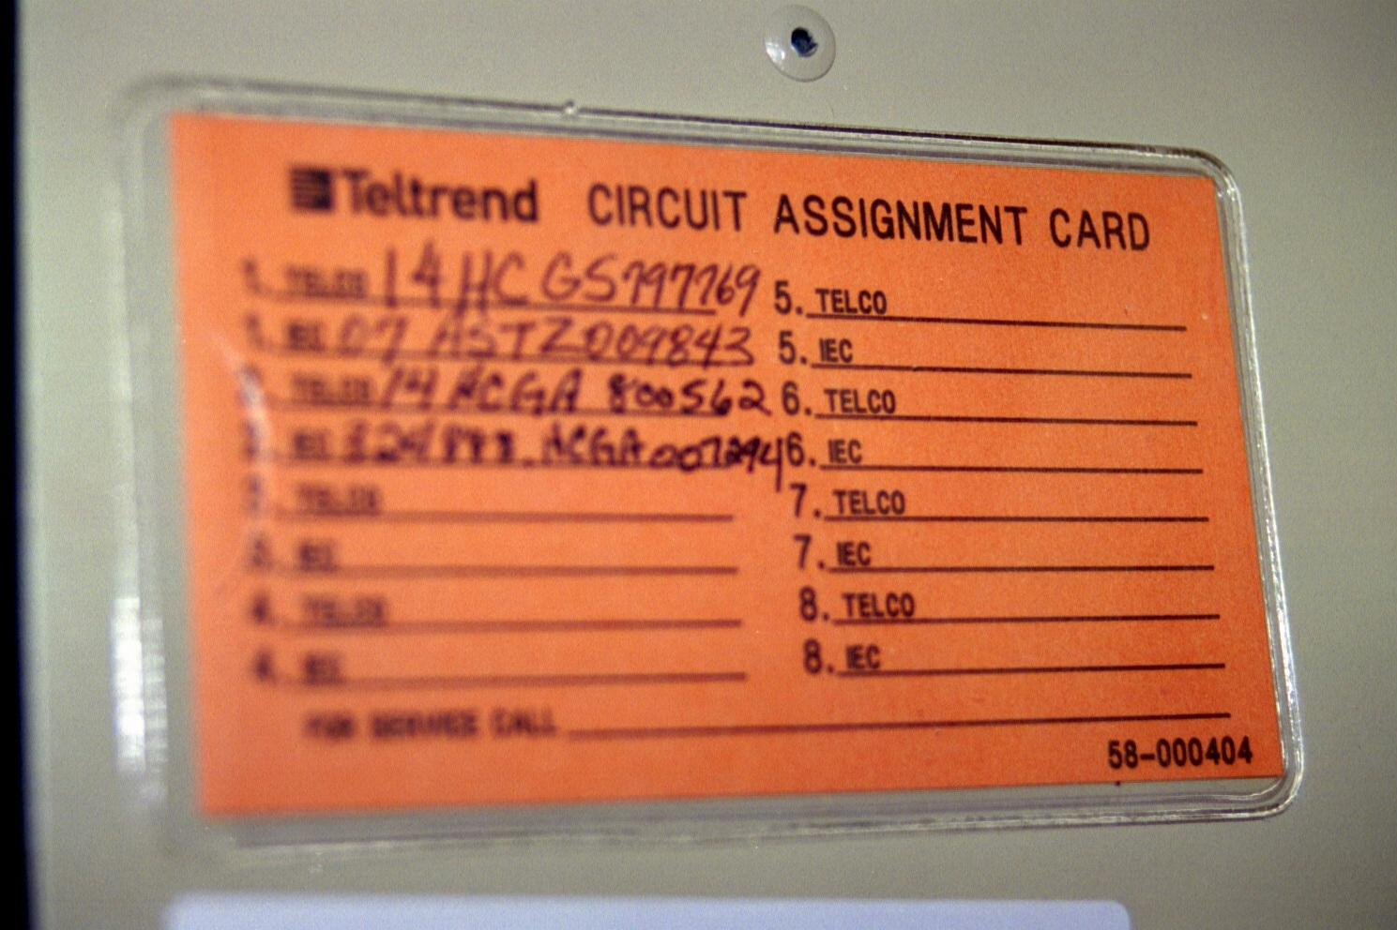
Circuit Label

Slide 29
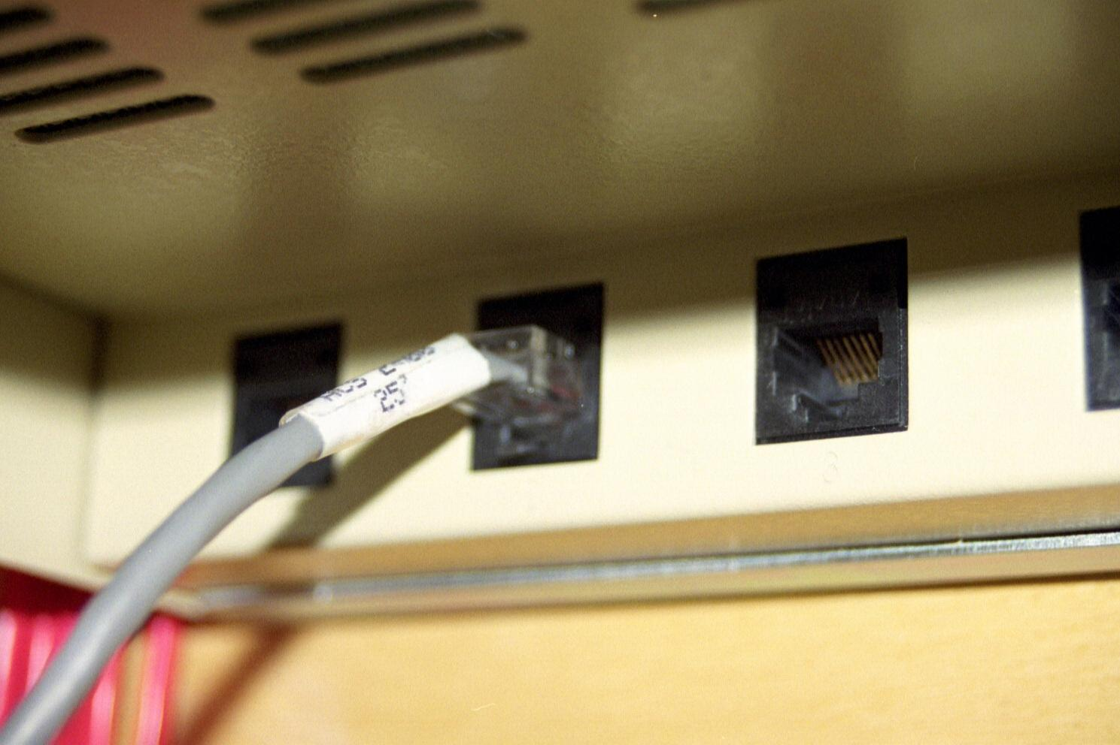
The Extended Demarc

Slide 30
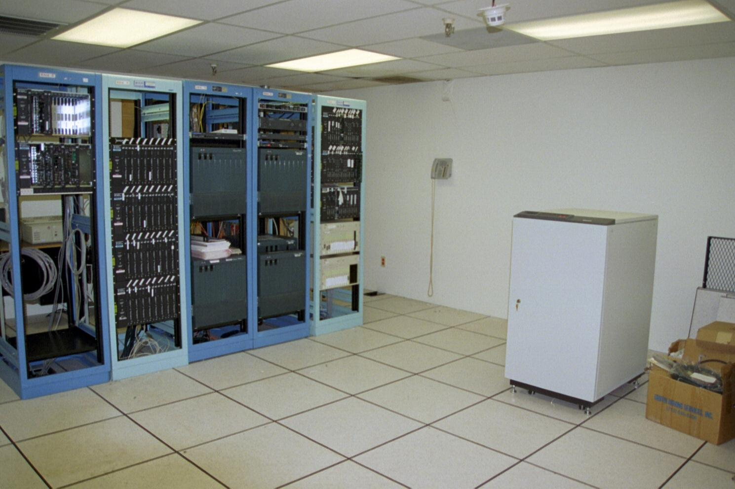
Overall Look at the Room

Slide 31
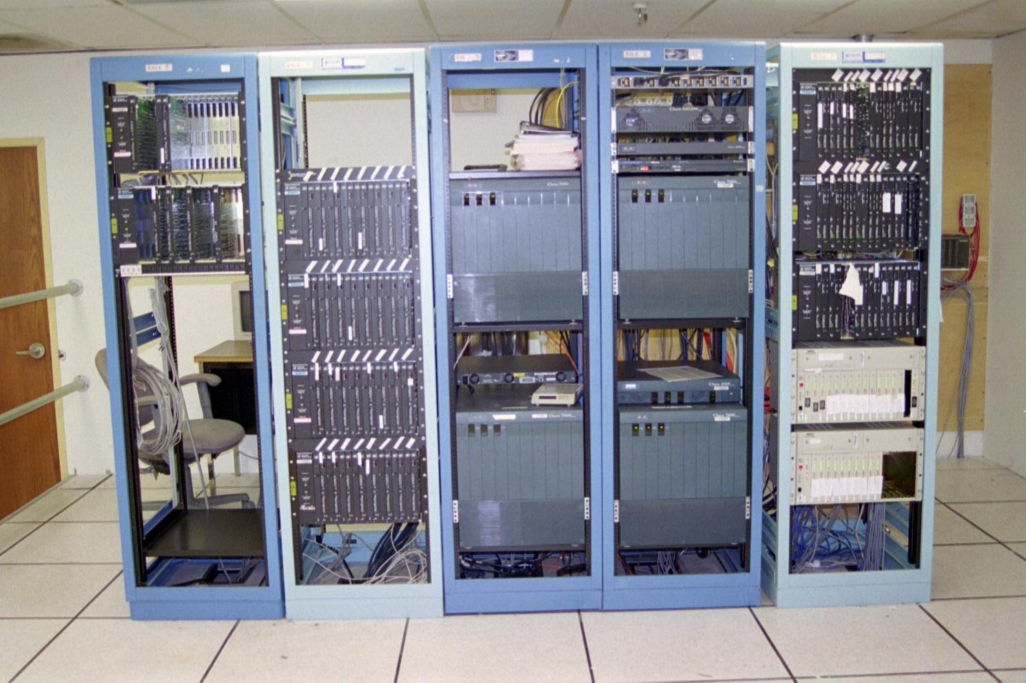
Equipment Racks

Slide 32
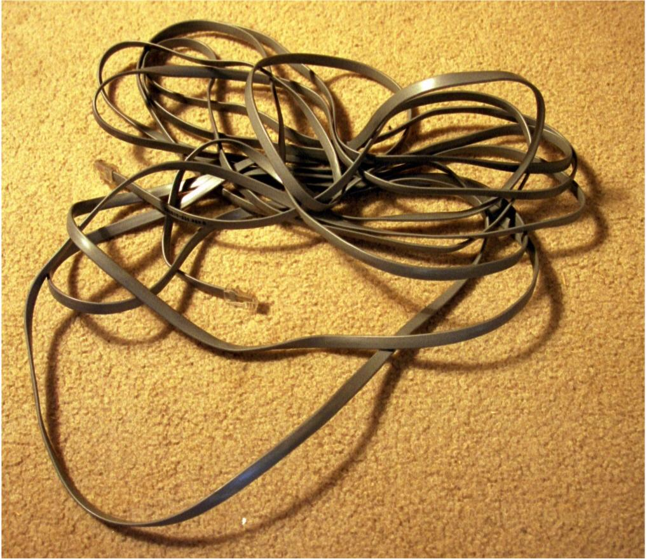
RTPC

Slide 33
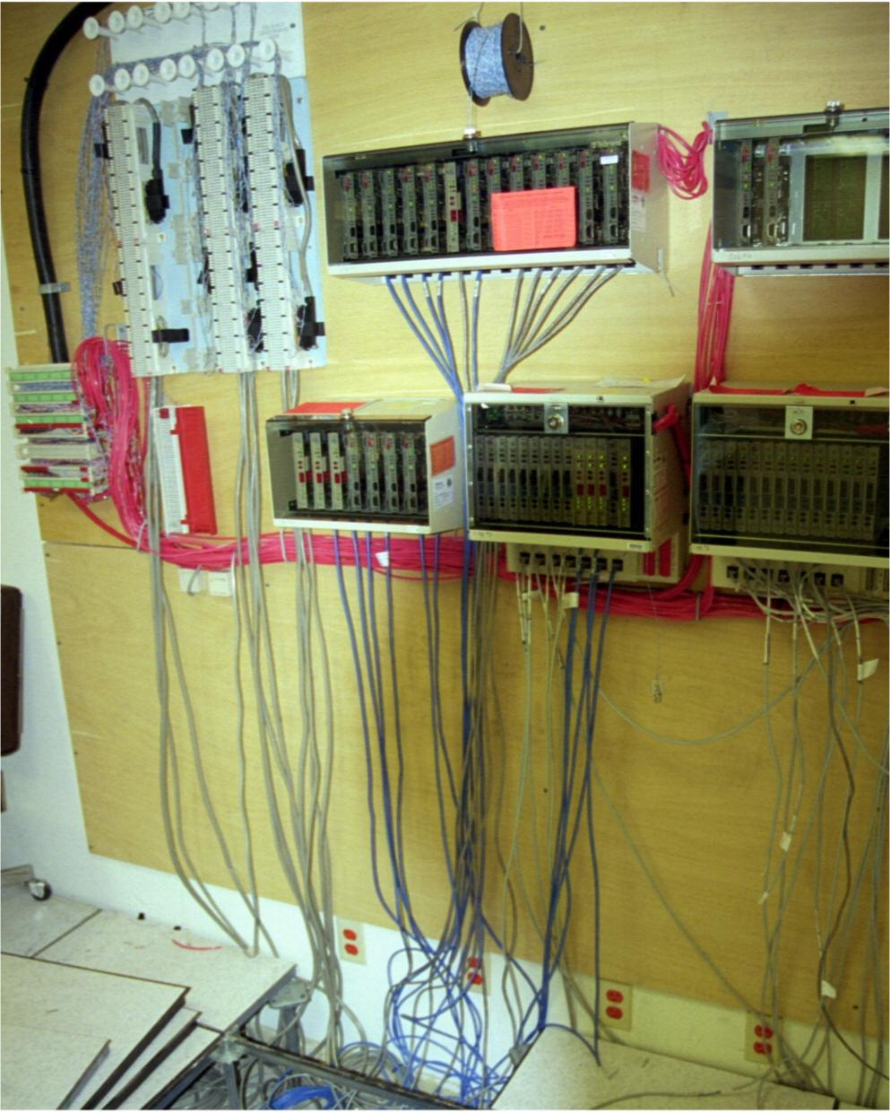
Down the Wall

Slide 34
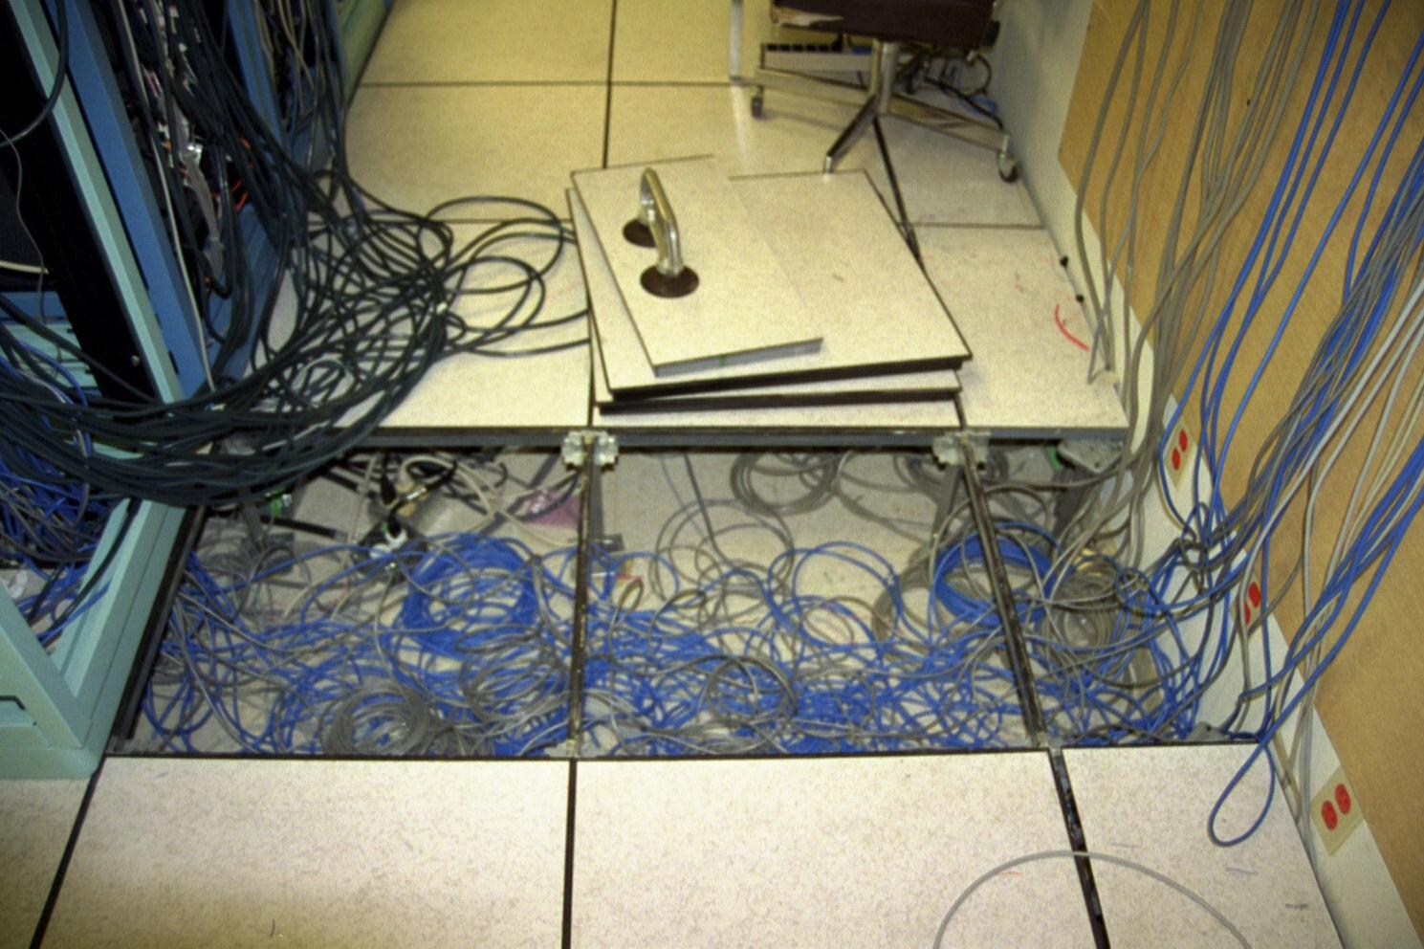
Under the Floor

Slide 35
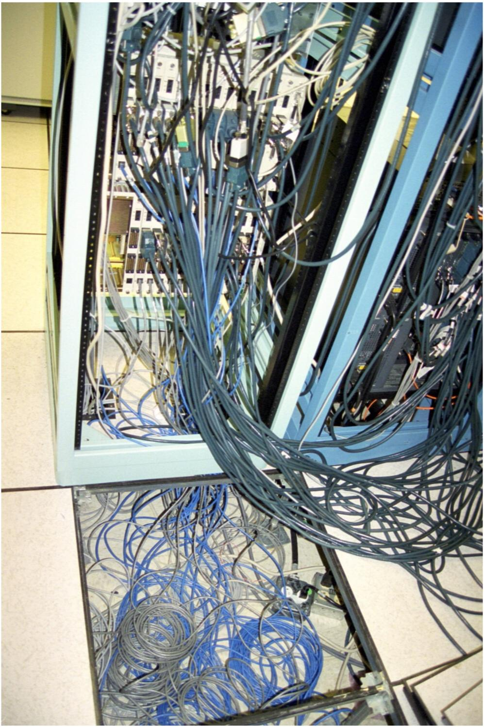
Through the Hole

Slide 36
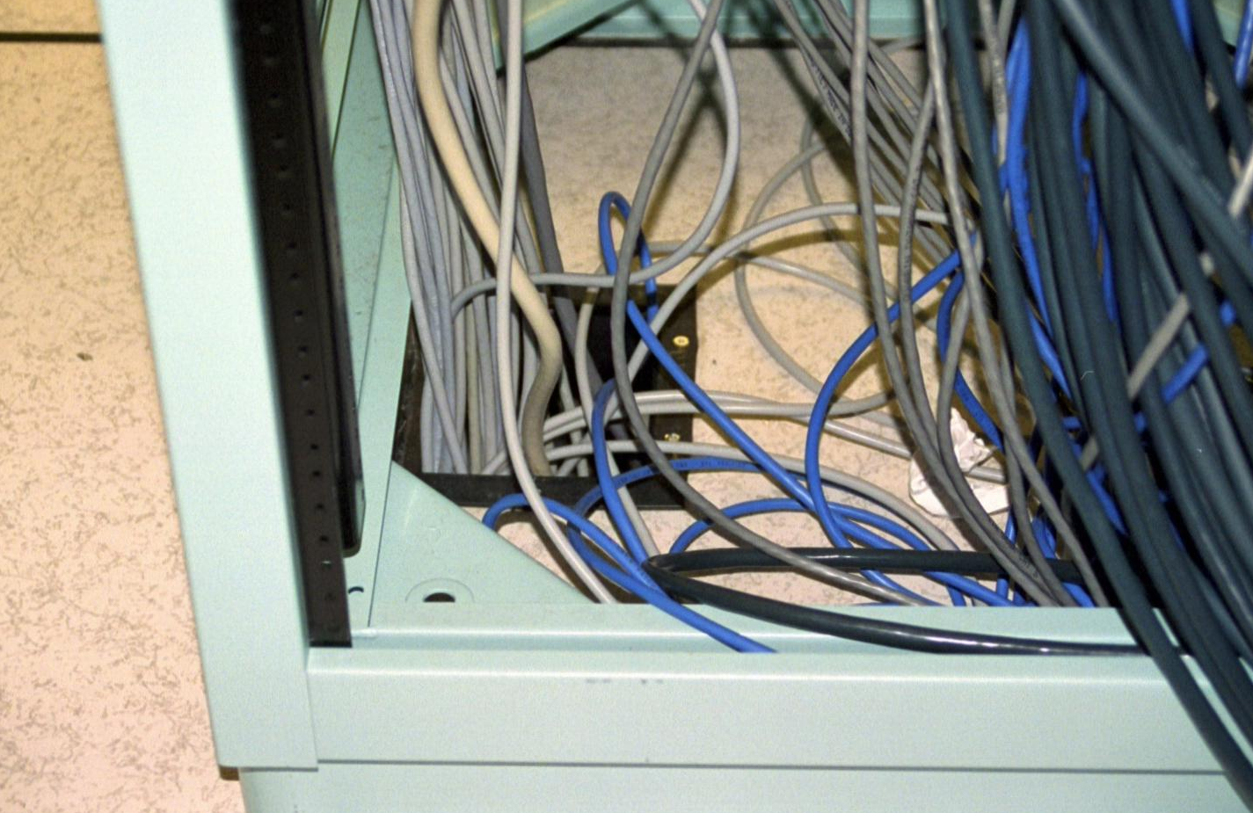
Through the Hole

Slide 37
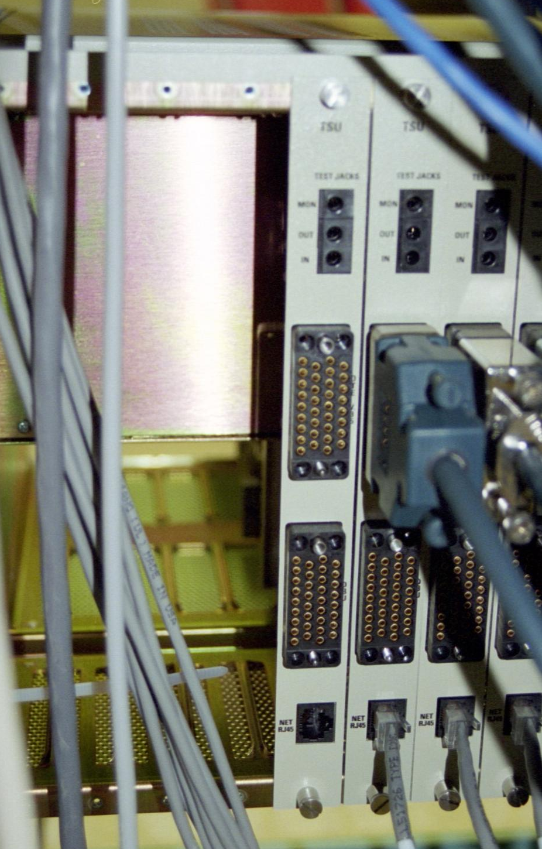
Into the Back of the CSU/DSU

Slide 38
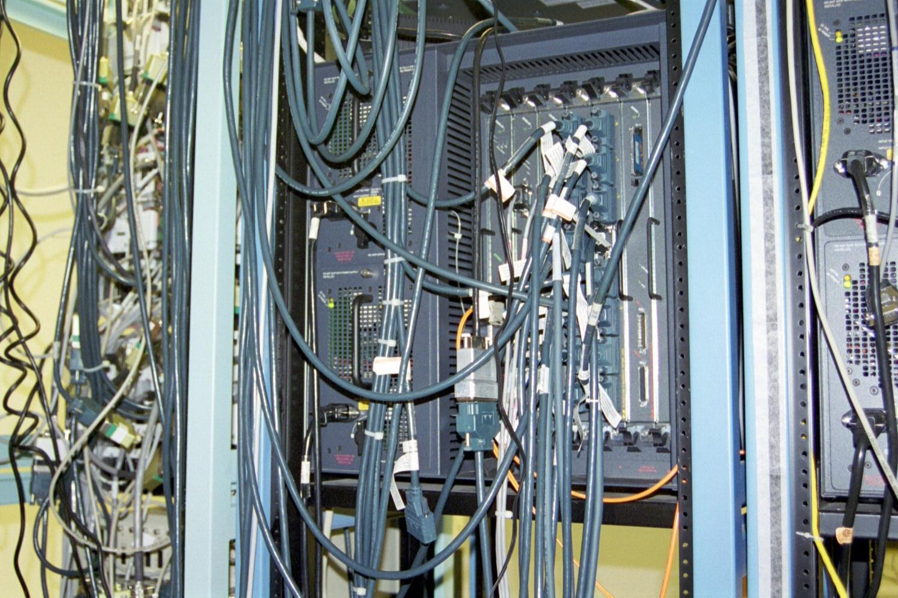
Over to the Router Port

Slide 39
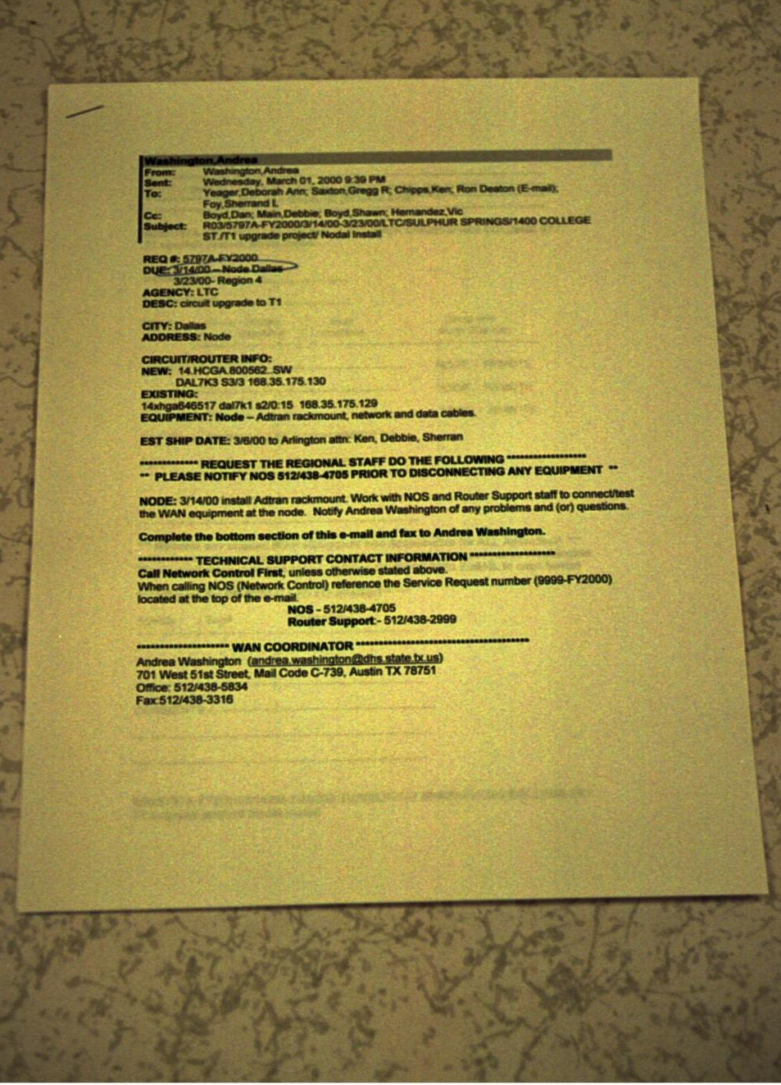
Work Order

Slide 40
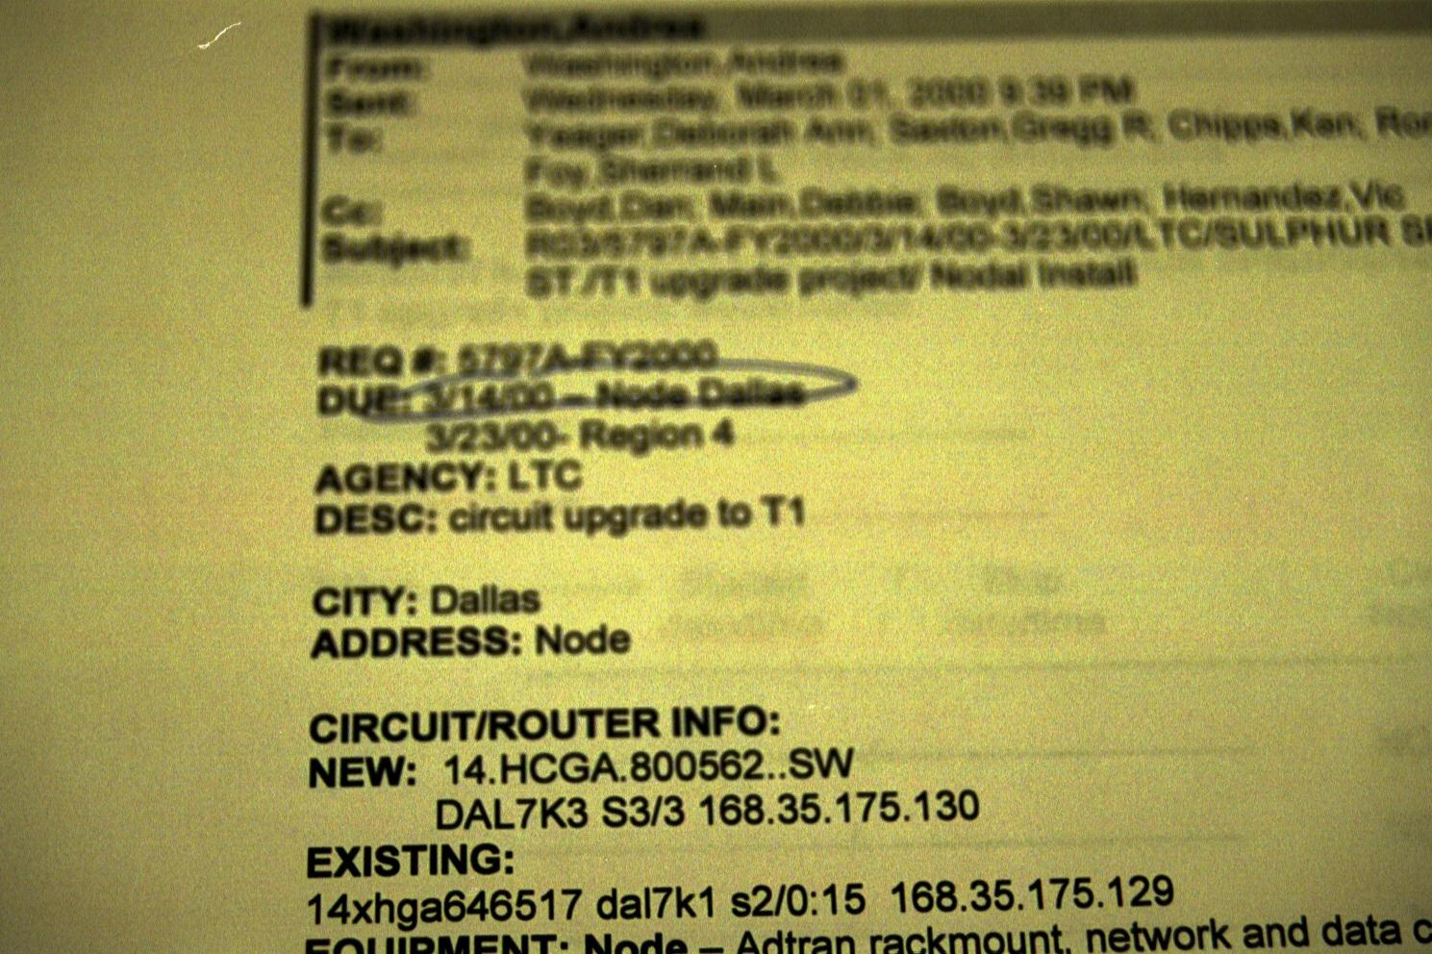
Work Order

Slide 41
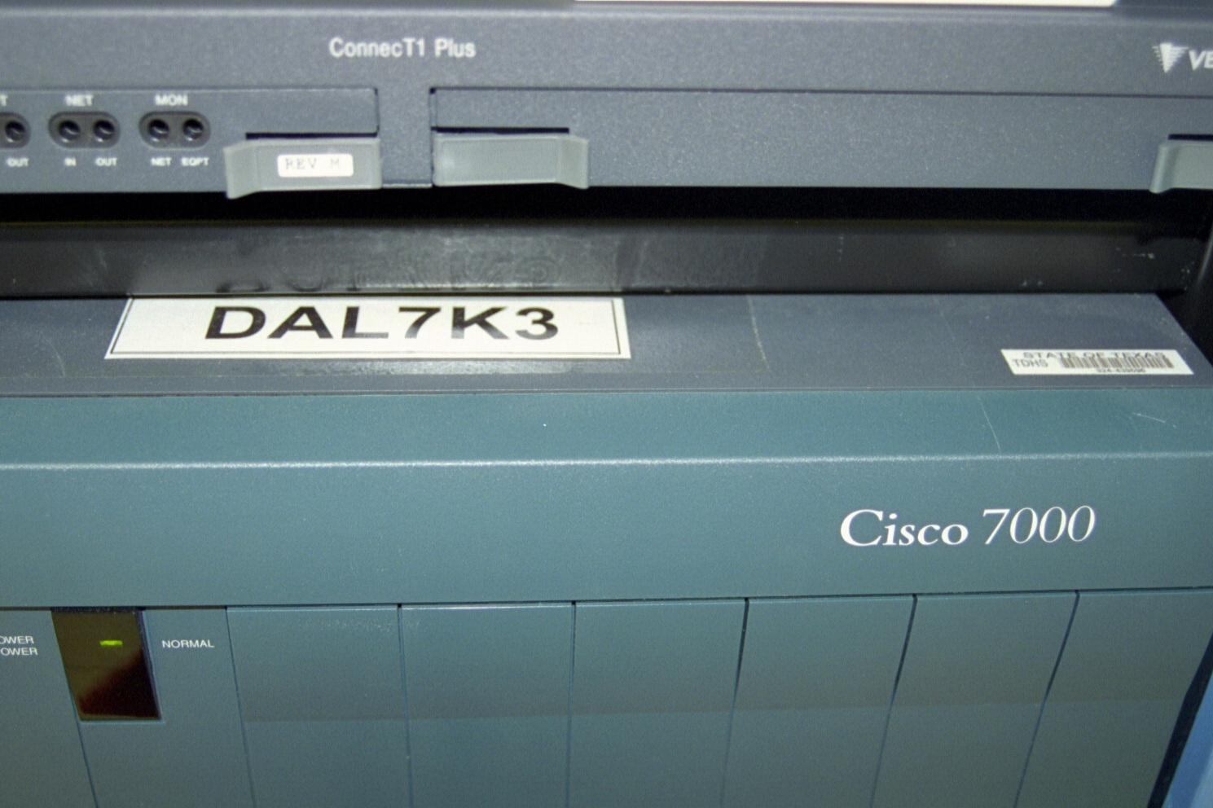
Label on the Router

Slide 42
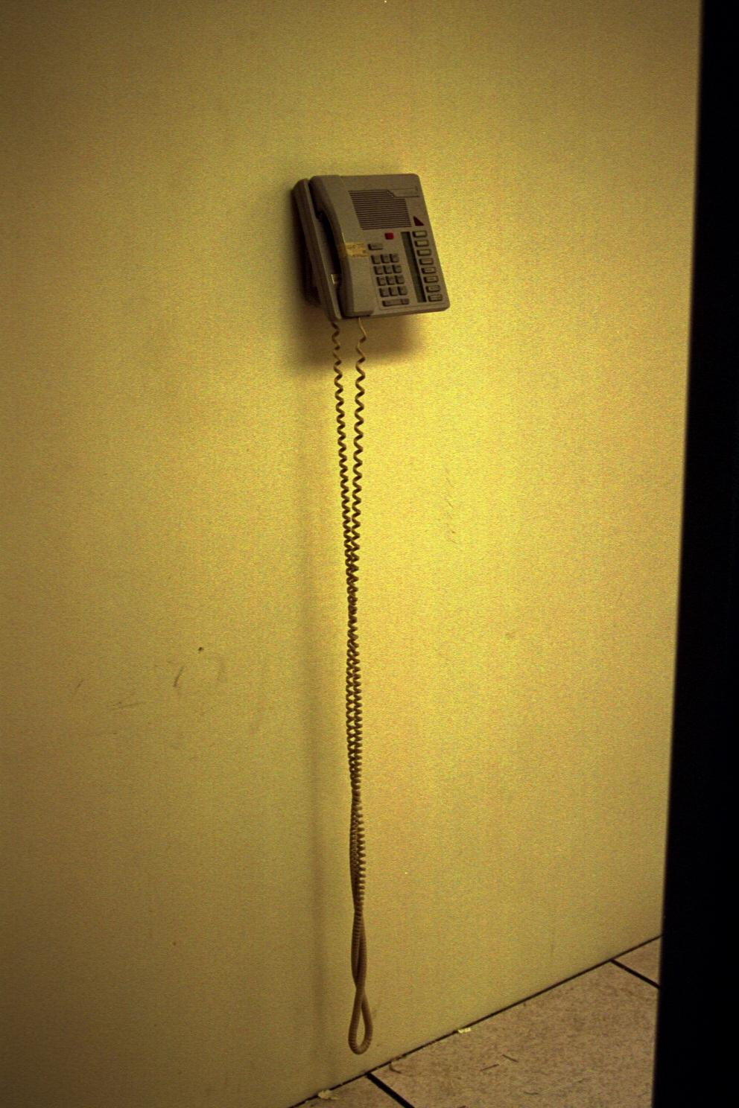
Phone

Slide 43
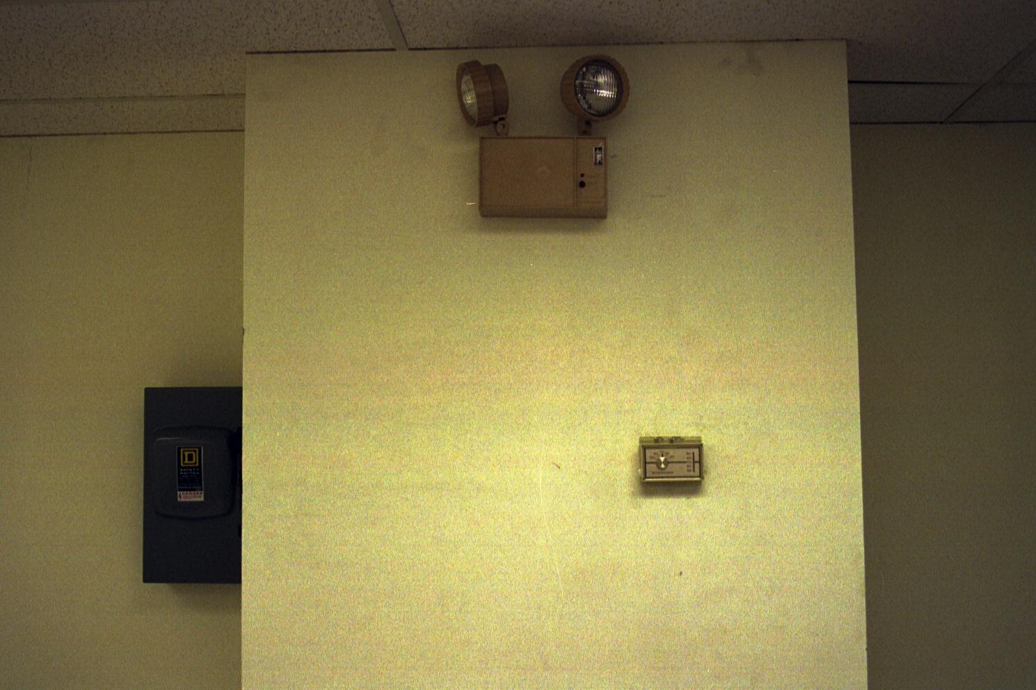
Thermostat

Slide 44
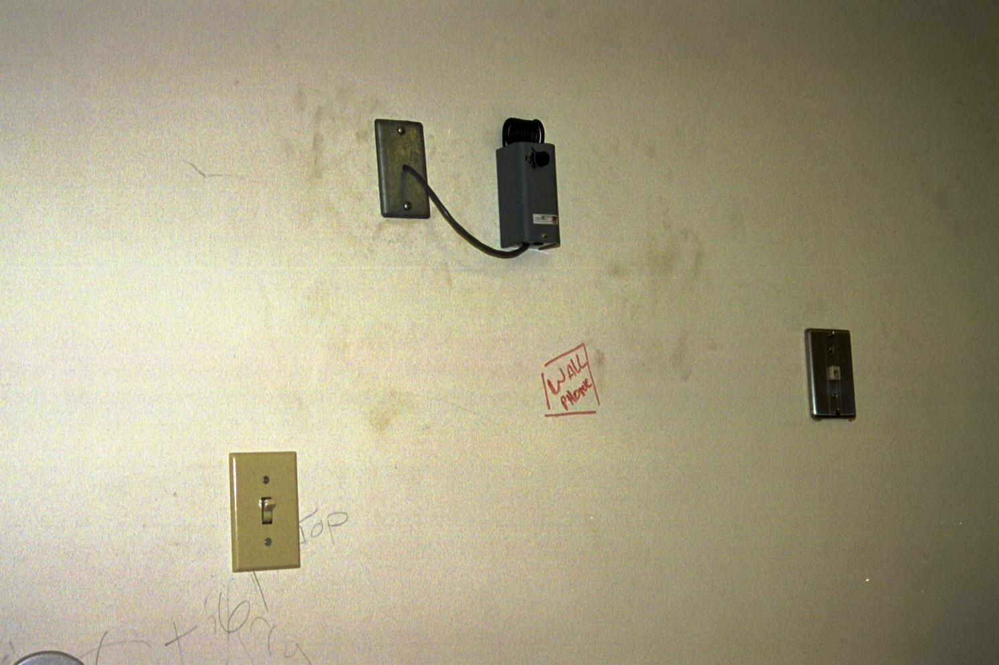
Sensor

Slide 45
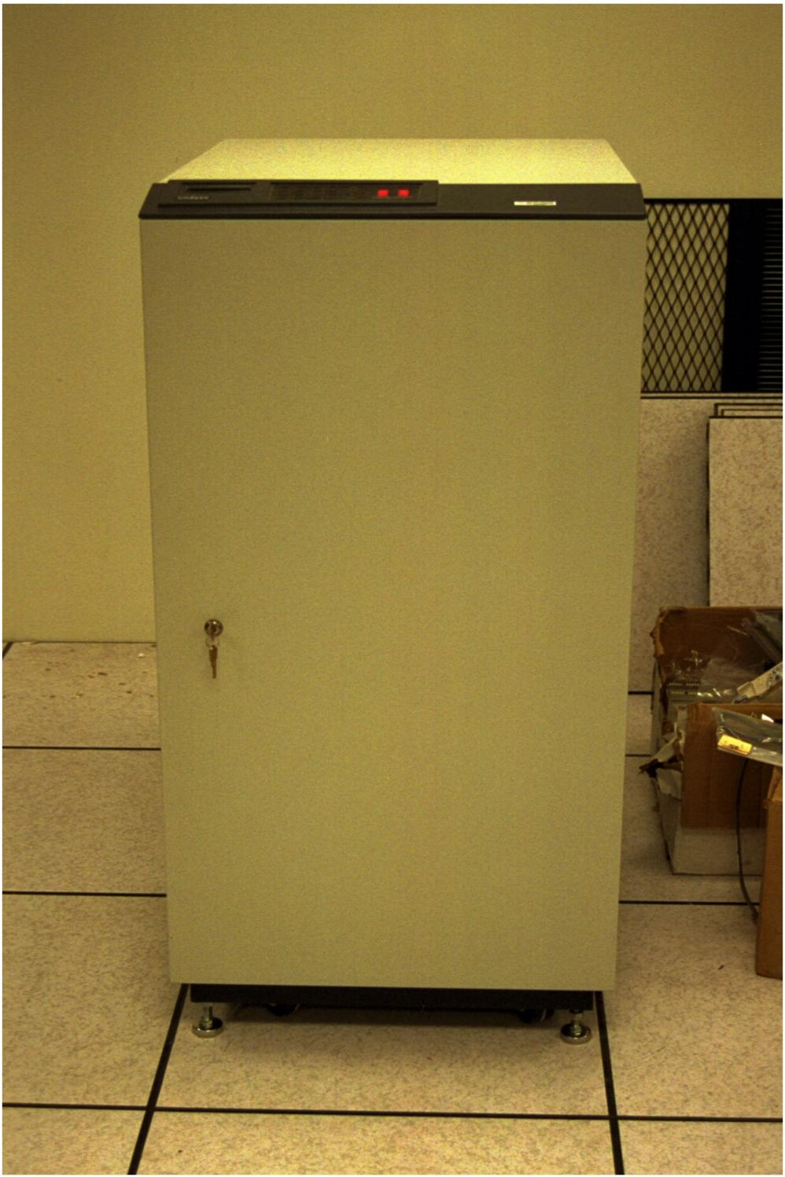
UPS

Slide 46
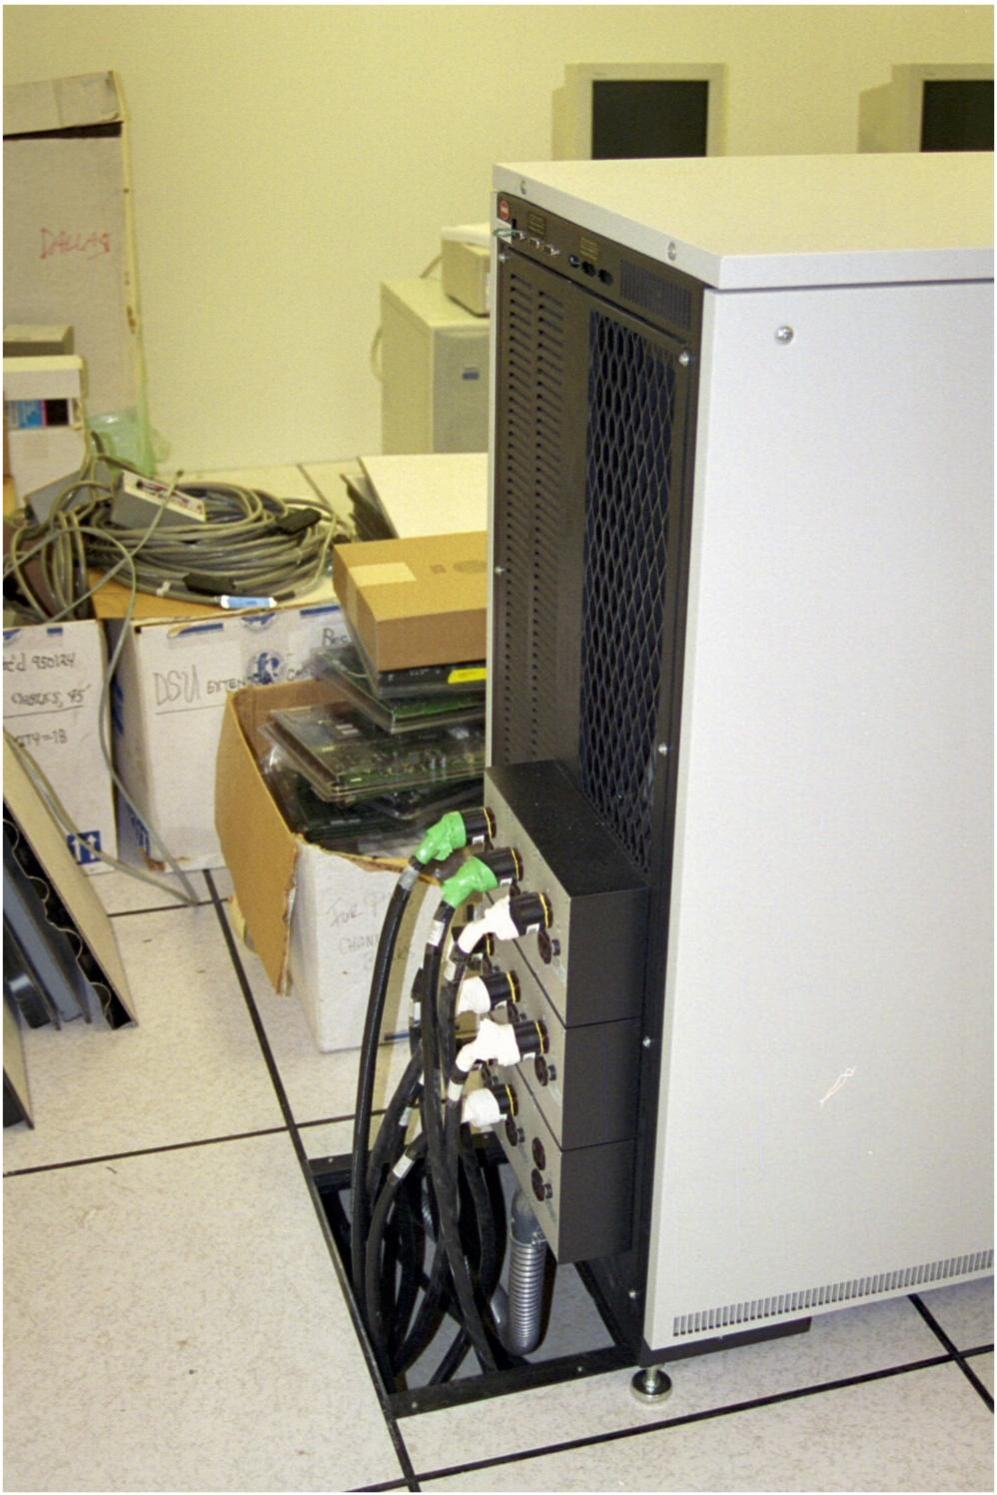
UPS

Slide 47
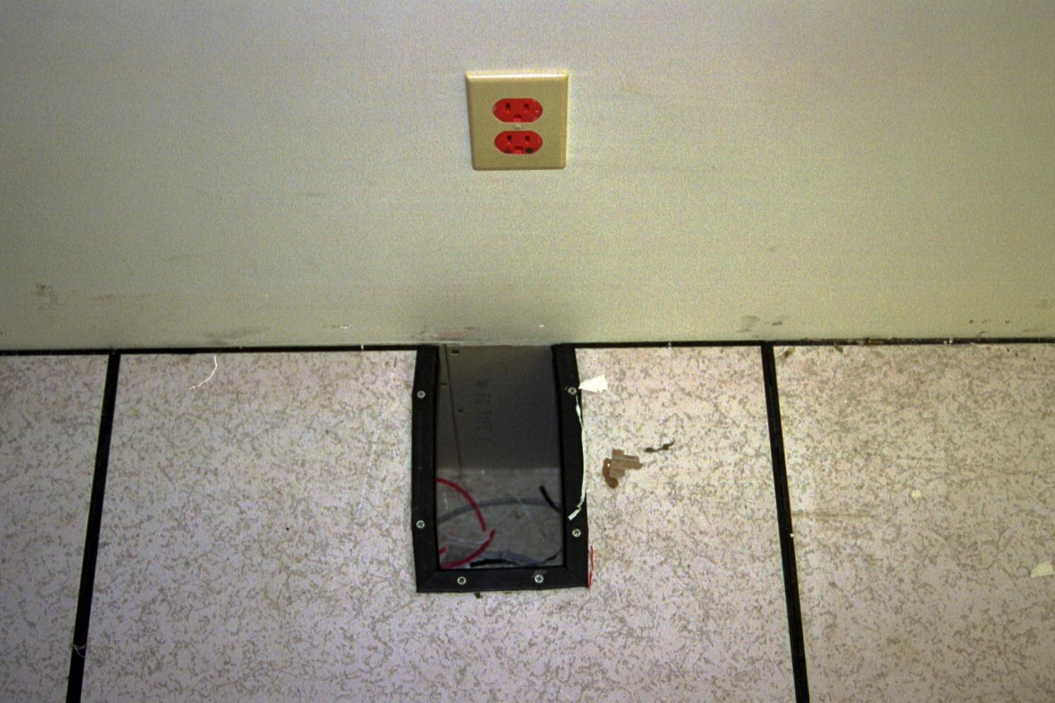
Hole for Trash

Slide 48
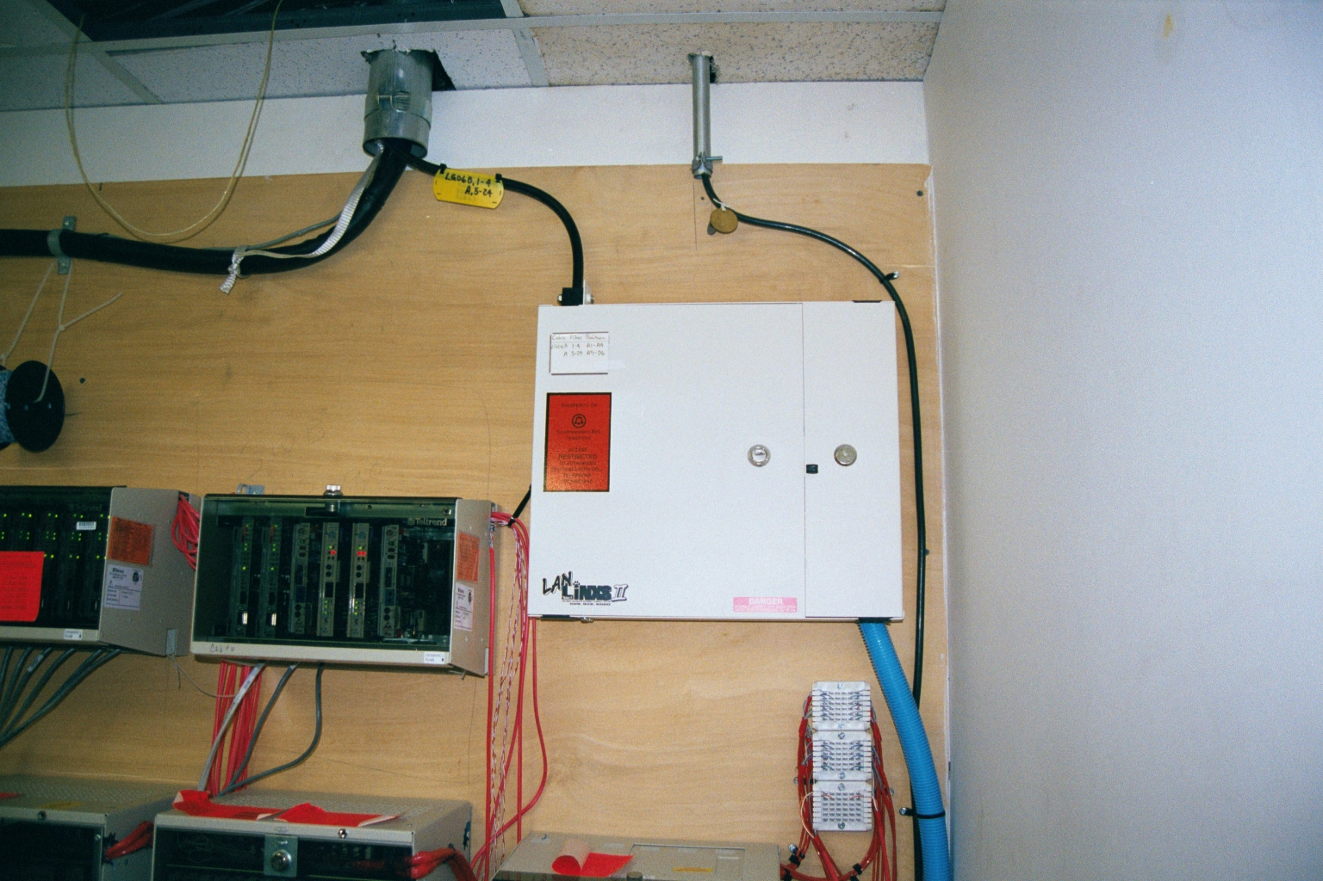
Change from T1 to DS3

Slide 49
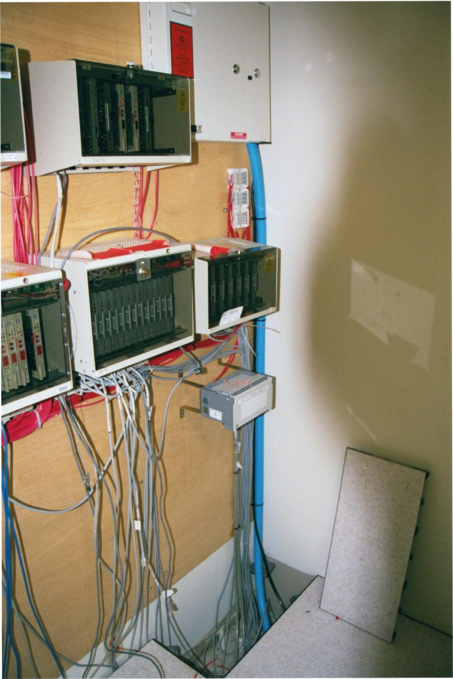
Change from T1 to DS3

Slide 50
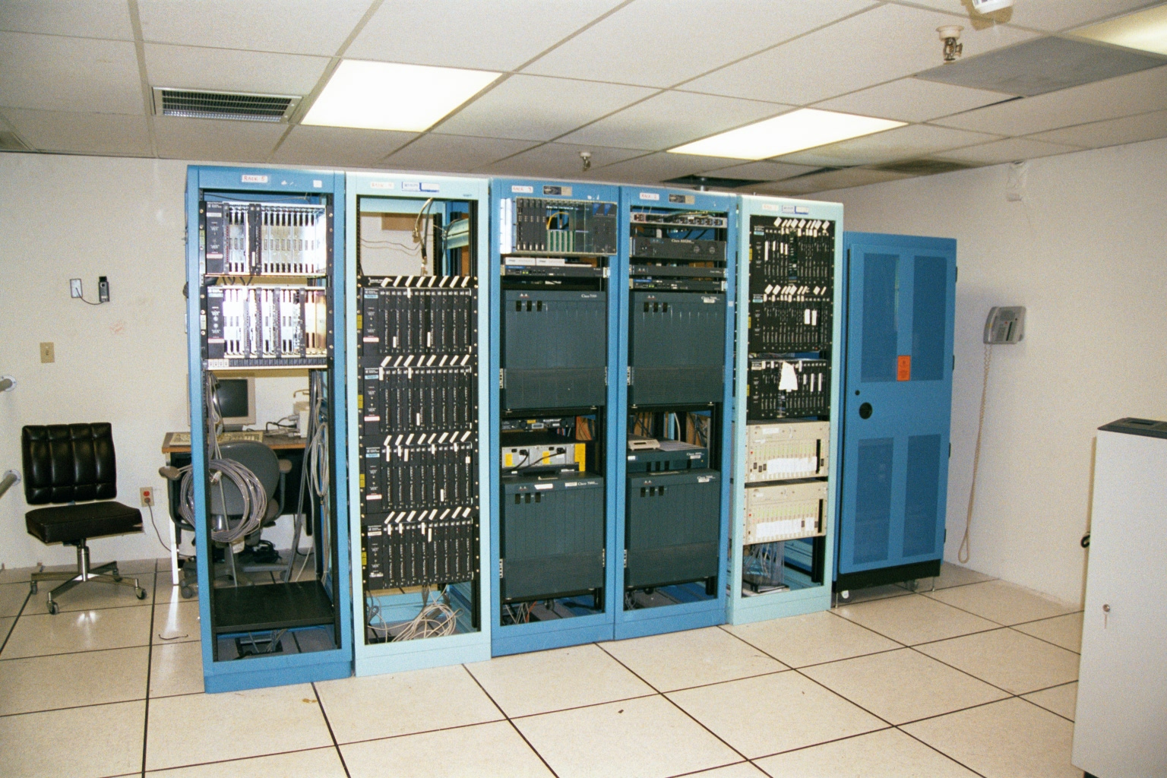
New Telco Cabinet

Slide 51
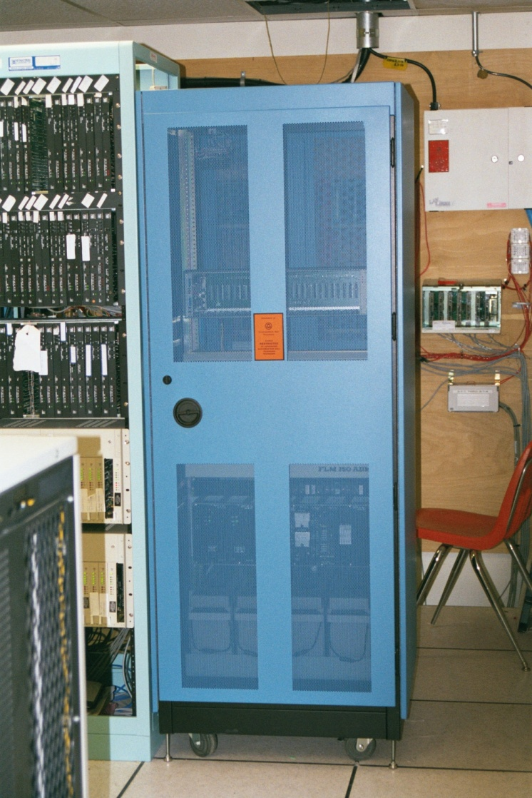
New Telco Cabinet

Slide 52
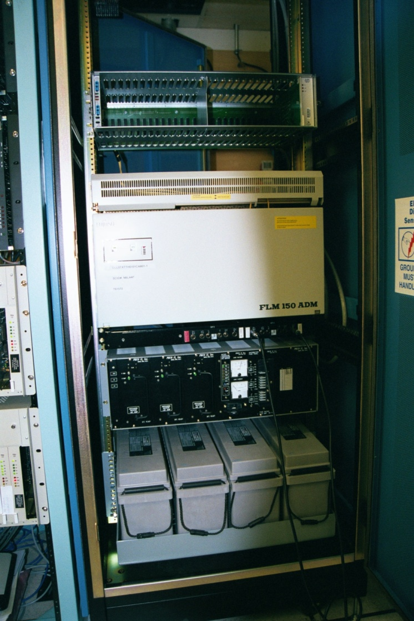
Change from T1 to DS3

Slide 53
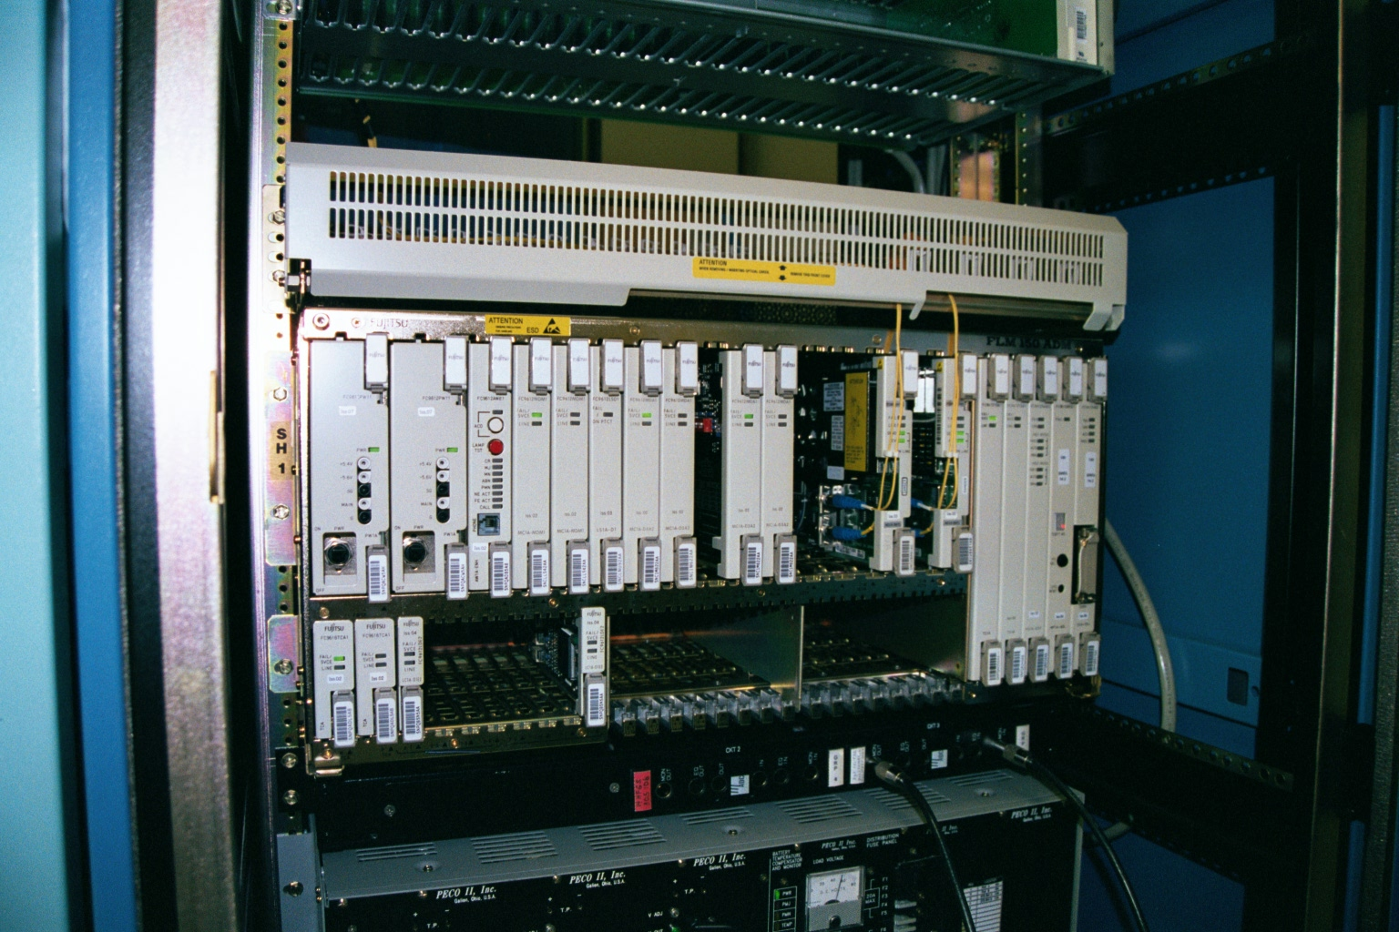
Change from T1 to DS3

Slide 54
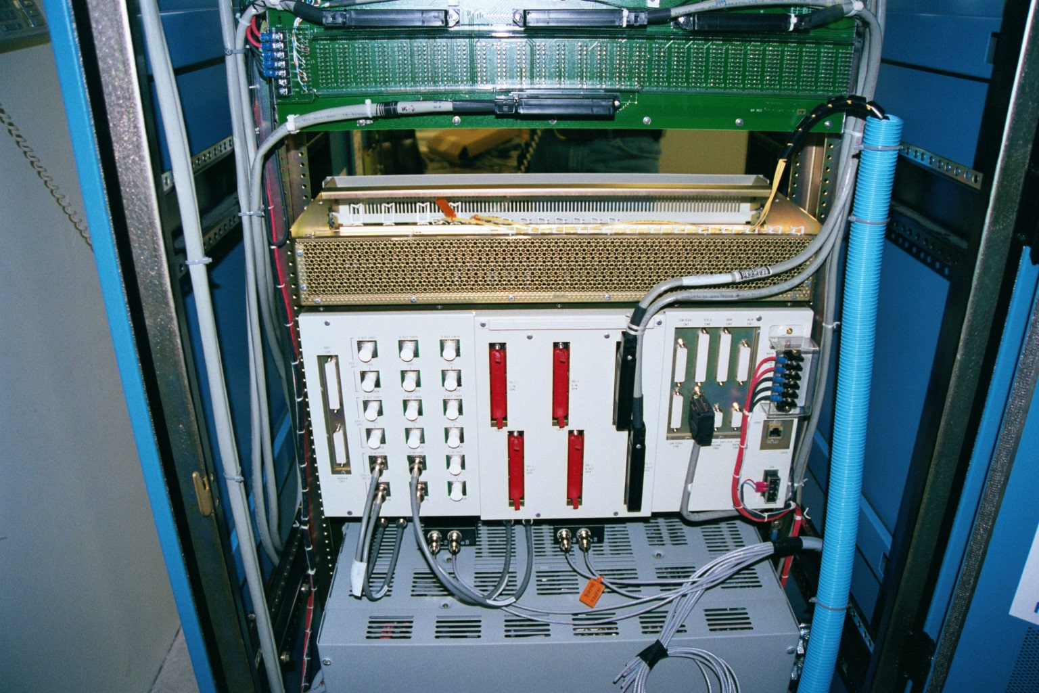
Change from T1 to DS3

Slide 55
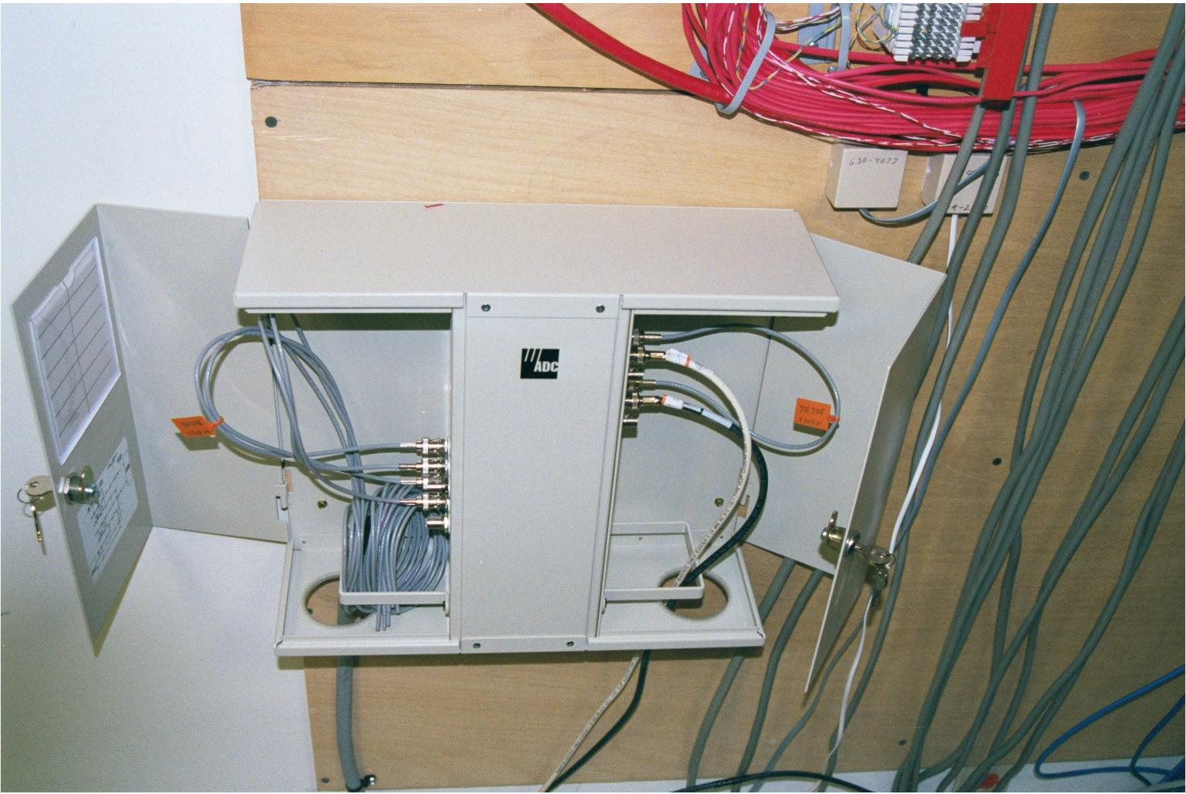
New Demarc

Slide 56
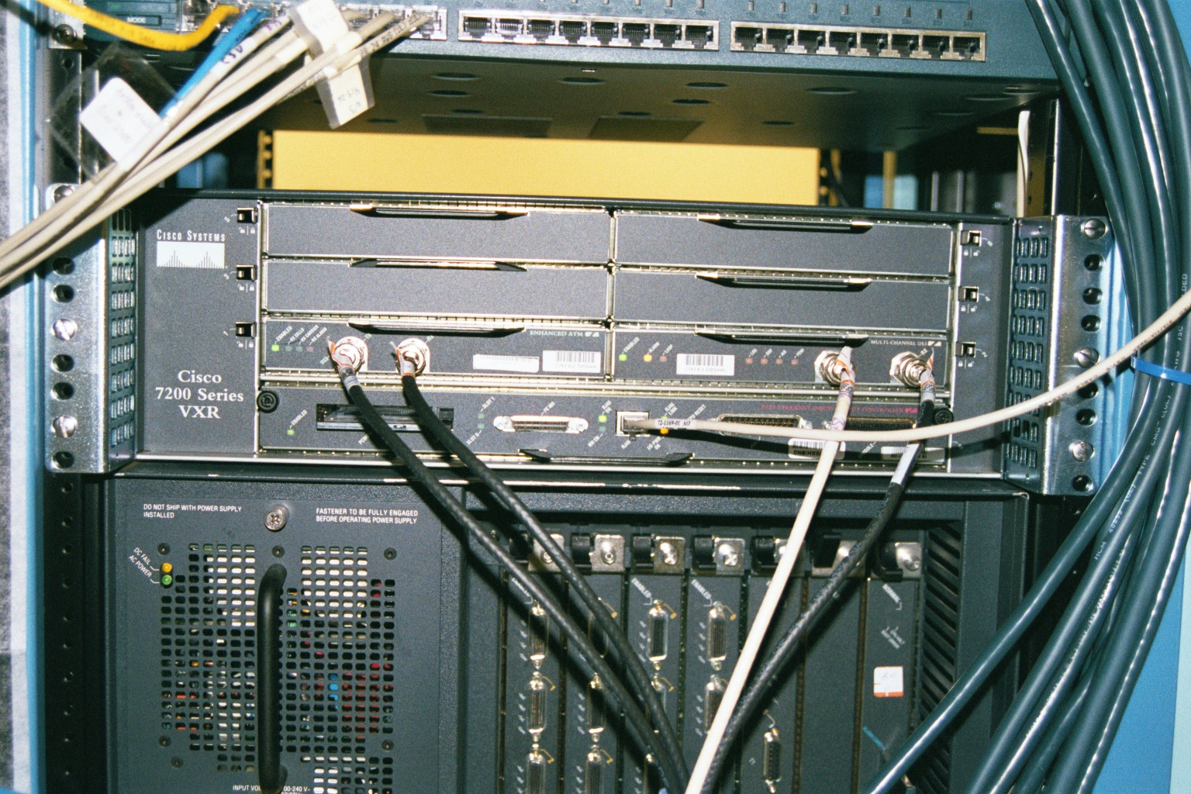
New Router

Slide 57
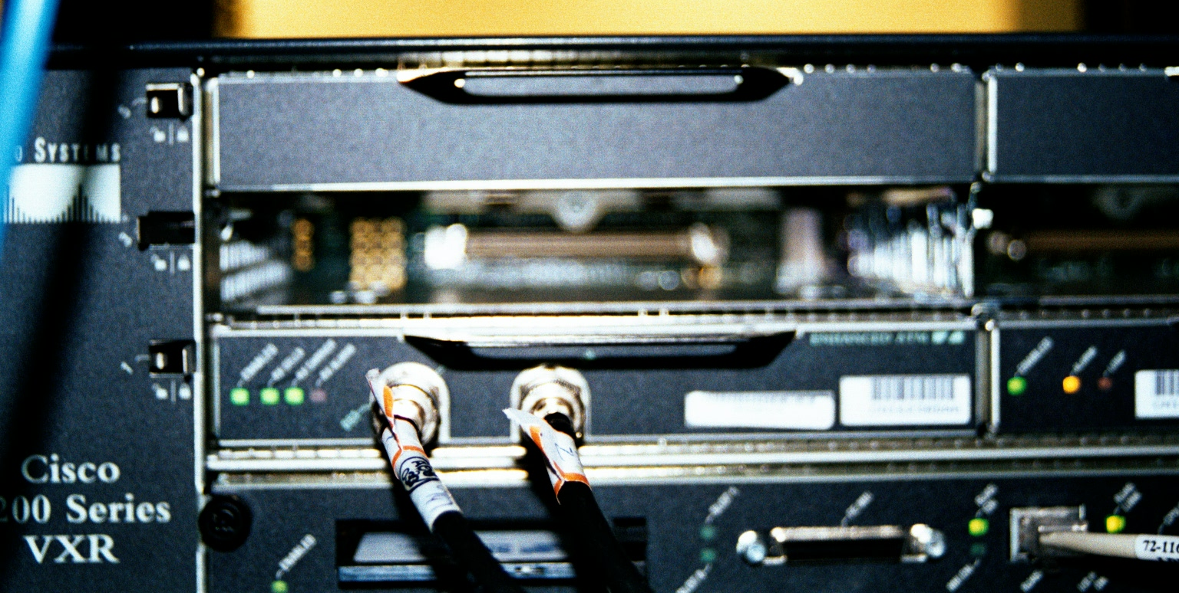
New Router

Slide 58
All of This Goes Away

Slide 59
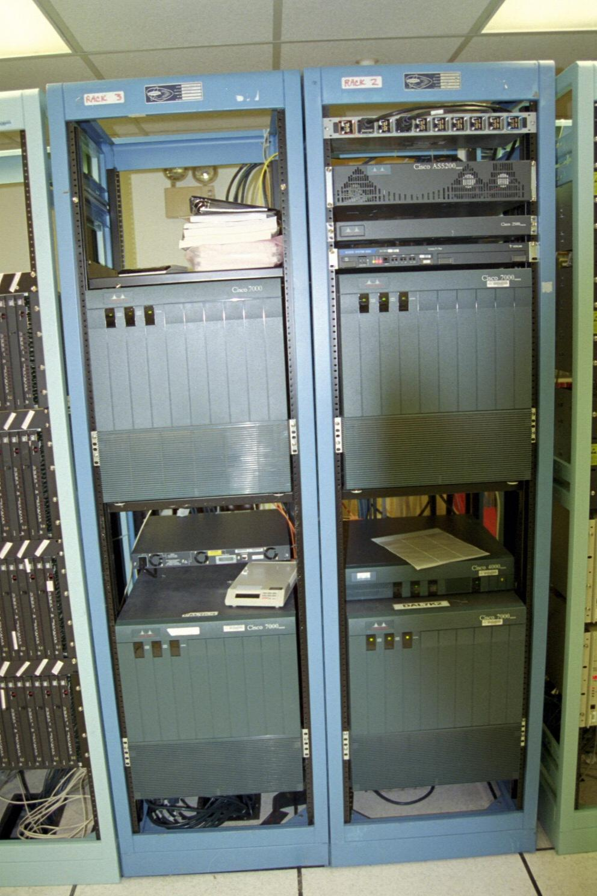
All of This Goes Away

Slide 60
All of This Goes Away

