Slide 1
PPPoE
Last Update 2011.07.21
1.4.0

Slide 2
Objectives Of This Section
Learn
What is PPPoE
What layer PPPoE operates in
Who is using PPPoE
Why are they using PPPoE
How PPPoE works

Slide 3
What is PPPoE
PPPoE is Point-to-Point Protocol over Ethernet
PPPoE relies on two widely accepted standards
PPP
Ethernet

Slide 4
What is PPPoE
PPPoE is a specification for connecting the users on an Ethernet network to the Internet through a common broadband medium, such as a single DSL line, wireless device, or cable modem
PPPoE uses tunneling to do this
Tunneling involves the embedding of messages in one format within the packets of another format

Slide 5
What is PPPoE
PPPoE functions similarly to virtual private networking tunneling protocols like PPTP - Point-to-Point Tunneling Protocol that are also derived from PPP
PPPoE operates at layer 2
Many home users do not even know if their connection to the Internet uses PPPoE

Slide 6
What is PPPoE
If one's cable or DSL setup requires logging in to the Internet, most likely this setup involves PPPoE

Slide 7
Why Are They Using PPPoE
PPPoE is used to allow Internet Service Providers to use their existing Radius authentication systems from their Dial-Up service over a broadband based connection
Dial-Up uses PPP, most broadband connections use Ethernet, hence Point to Point Protocol over Ethernet

Slide 8
Why Are They Using PPPoE
PPPoE mainly benefits the service provider
ISPs can manage IP addresses and track users in much the same way they manage their traditional dial-up service
Each customer receives one IP address and network usage can easily be tracked to individual user accounts

Slide 9
Why Are They Using PPPoE
PPPoE also theoretically benefits the home customer through ease of use
Internet users accustomed to traditional dial-up will already be familiar with the PPPoE connection model
Customers might be more comfortable entering their password each time they want to connect and having the ability to disconnect than they would with always on

Slide 10
Why Are They Using PPPoE
PPPoE offers better security and control for the home user than alternatives

Slide 11
How PPPoE Works
PPPoE has two distinct stages
There is a Discovery stage and a PPP Session stage
When a host wishes to initiate a PPPoE session, it must first perform Discovery to identify the Ethernet MAC address of the peer and establish a PPPoE Session_ID

Slide 12
How PPPoE Works
PPP defines a peer-to-peer relationship, Discovery is inherently a client-server relationship

Slide 13
How PPPoE Works
The PPPoE Discovery Stage is made up of four steps
Initiation
Offer
Request
Session Confirmation

Slide 14
PPPoE Frame Format
PPPoE uses a standard Ethernet II frame to carry its information
Let us recall when it looks like

Slide 15
Ethernet II Frame Format

Slide 16
Ethernet II Frame Format
Field | Bytes
Preamble | 8
Destination Address | 6
Source Address | 6
Type | 2
Data | 46-1500
Frame Check Sequence | 4

Slide 17
PPPoE Frame Format
A PPPoE frame is made-up of three parts
A PPP frame which is carried
Inside a PPPoE frame
Which is carried inside an Ethernet frame
As this nice graphics from www.h3c.com shows us

Slide 18
PPPoE Frame Format

Slide 19
PPPoE Frame Format
The PPPoE frame is placed in the Data field of the Ethernet frame
When this is done the Type code field contain one of these hexadecimal codes depending on which of two PPPoE messages are being sent
8863 for the Discovery Stage
8864 for the normal traffic flow stage

Slide 20
PPPoE Frame Format
According to RFC 2516 the PPPoE frame itself looks like this

Slide 21
PPPoE Frame Format

Slide 22
PPPoE Frame Format
The fields in this frame do the following
VER
This four bits field must be set to 0x1 for this version of the PPPoE specification
TYPE
This field is four bits and must be set to 0x1 for this version of the PPPoE specification

Slide 23
PPPoE Frame Format
CODE
An eight bit field
Code value 0x00 indicates session data; 0x09 indicates PADI packets; 0x07 indicates PADO or PADT packets; 0x19 indicates PADR packets; 0x65 indicates PADS packets

Slide 24
PPPoE Frame Format
SESSION_ID
This field is sixteen bits long
The value is fixed for a given PPP session and, in fact, defines a PPP session along with the Ethernet SOURCE_ADDR and DESTINATION_ADDR

Slide 25
PPPoE Frame Format
LENGTH
This field is sixteen bits long
The value, in network byte order, indicates the length of the PPPoE payload
It does not include the length of the Ethernet or PPPoE headers

Slide 26
Capture File for PPPoE
Let’s look at a capture file of some PPPoE traffic
Download this file
PPPoE.cap
Examine it using Wireshark by double-clicking on it
Frame 1 shows PPPoE looking for someone to talk to

Slide 27
Capture File for PPPoE
The fields should match those we just discussed
Let’s see if they do

Slide 28
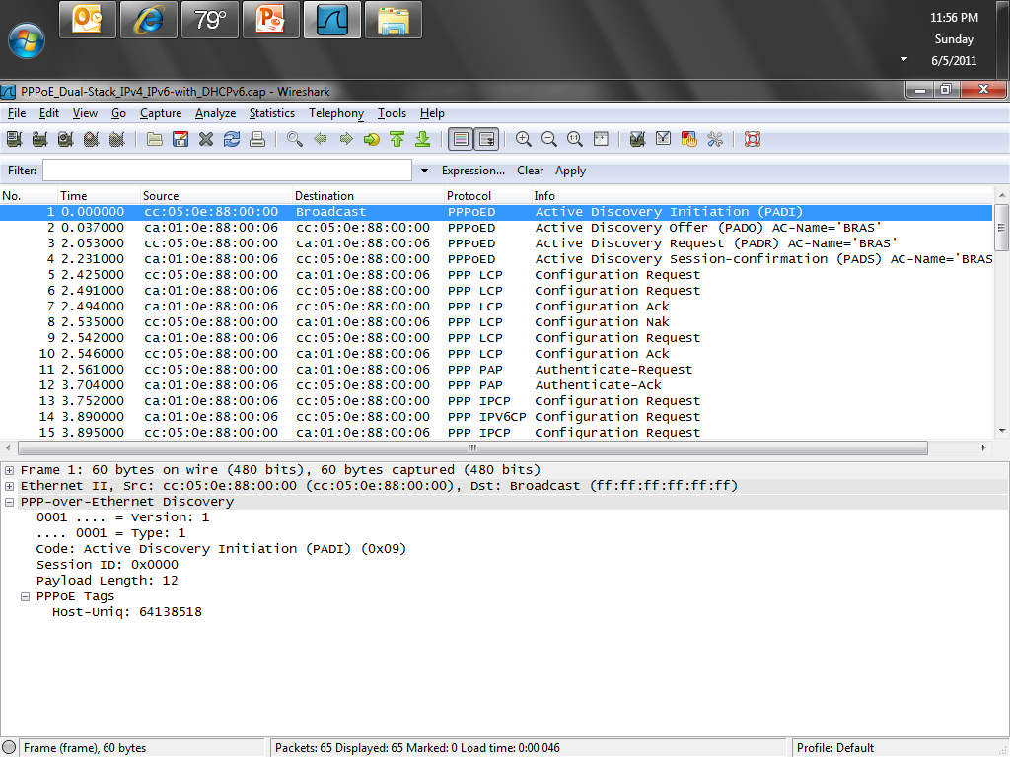
Capture File for PPPoE

Slide 29
Capture File for PPPoE
The device on the other end says hi, I will talk to you, who are you

Slide 30
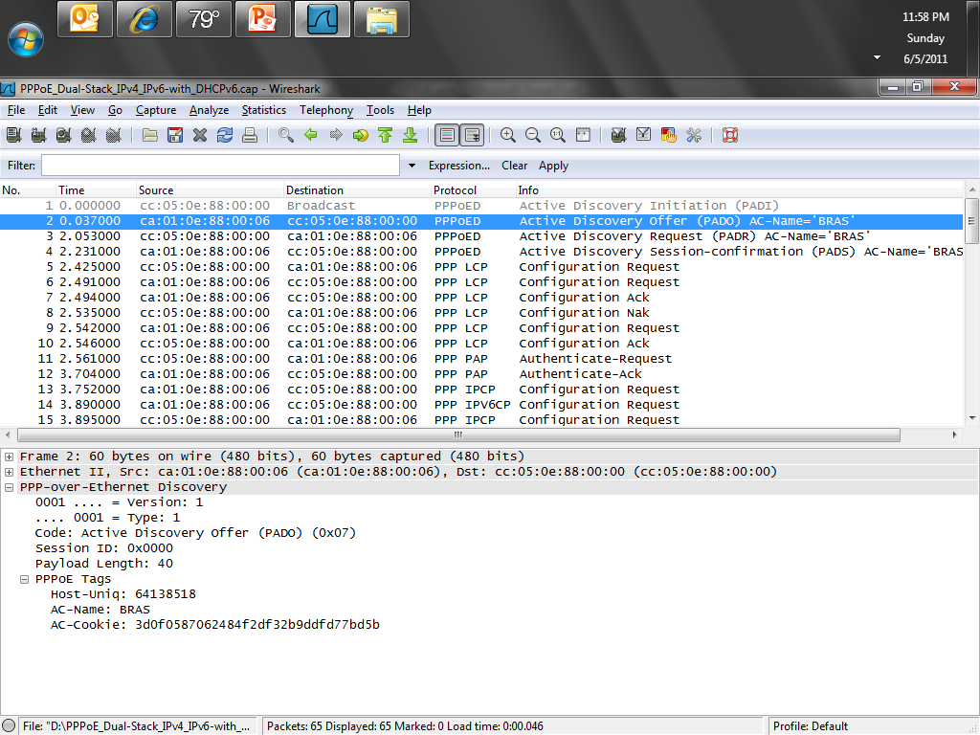
Capture File for PPPoE

Slide 31
Capture File for PPPoE
The next few frames continue the session establishment process

Slide 32
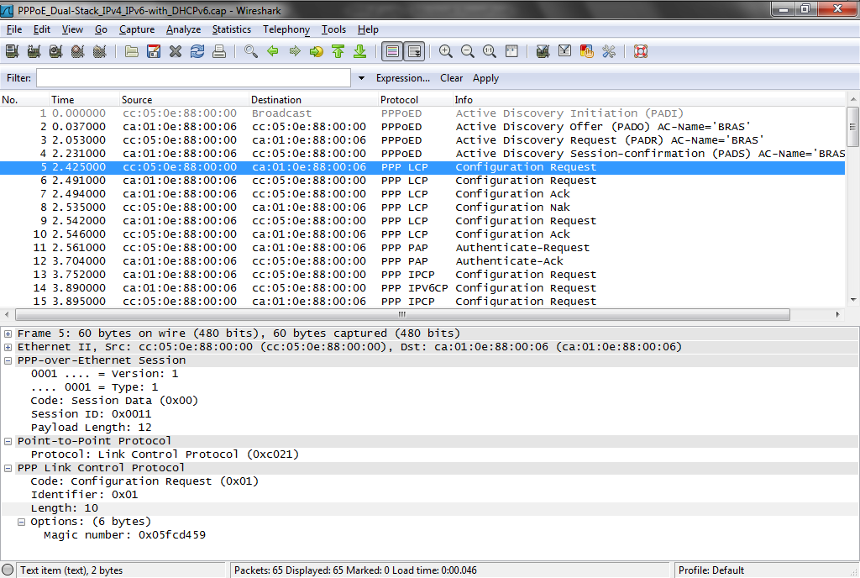
Capture File for PPPoE

Slide 33
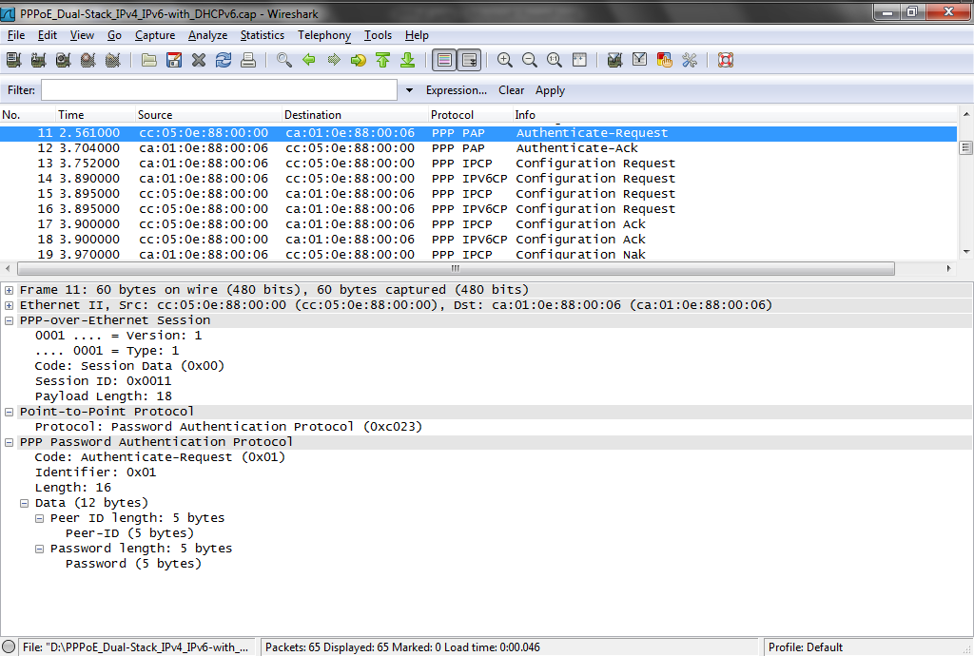
Capture File for PPPoE

Slide 34
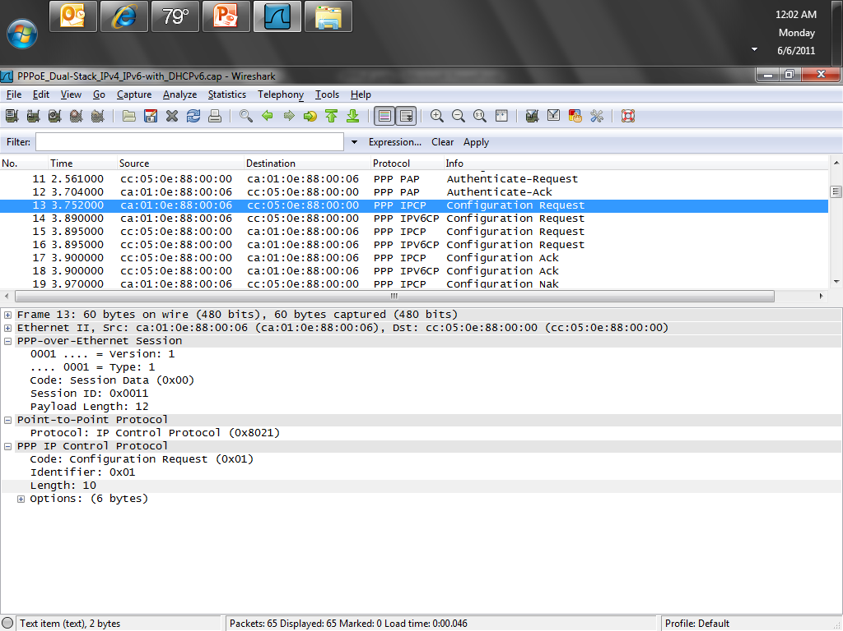
Capture File for PPPoE

Slide 35
Capture File for PPPoE
Here is a are you there, yes I am, process similar to pinging

Slide 36
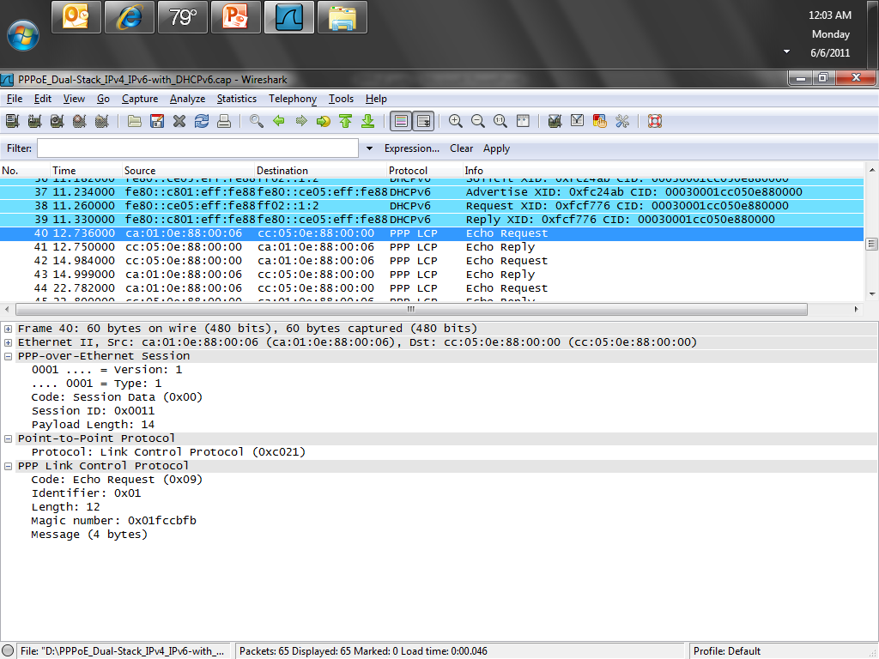
Capture File for PPPoE

Slide 37
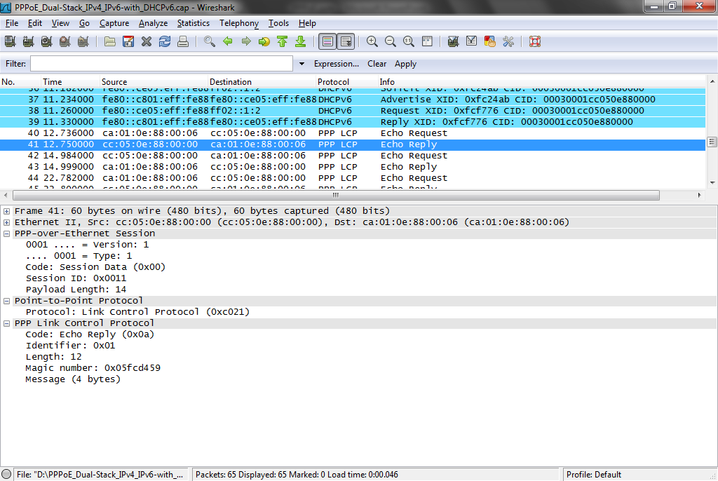
Capture File for PPPoE

Slide 38
Capture File for PPPoE
As you can see the PPPoE layer of the frames do not change much no matter what the higher layer protocols are up to

Slide 39
PPPoE in Operation
Here is an example of the setup for a ADSL circuit that uses PPPoE

Slide 40
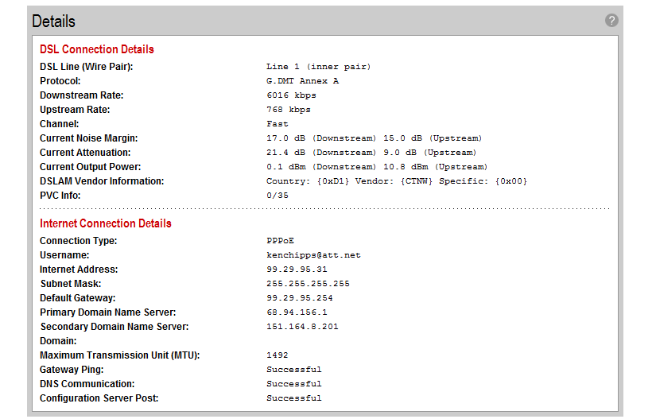
PPPoE Operation

Slide 41
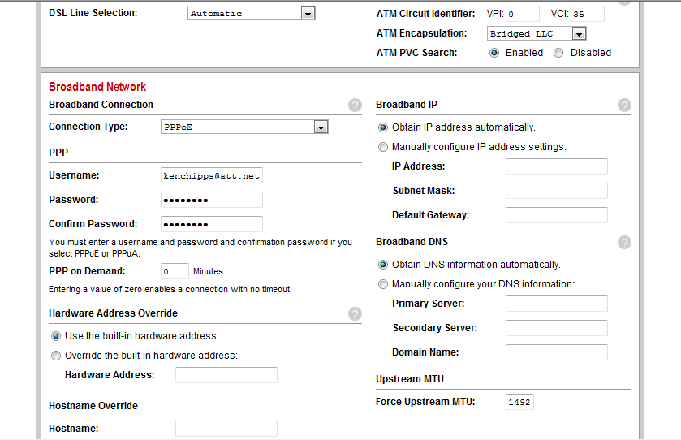
PPPoE Operation

Slide 42
Source
Some of this was copied from Newton’s Telecom Dictionary and RFC 2515

