Slide 1
PPP Last Update 2011.06.01 1.4.0

Slide 2
Objective
Learn what PPP is

Slide 3
What is PPP
PPP – Point-to-Point protocol is a layer 2 protocol that is used on either asynchronous, in other words dialup, or synchronous data lines as a simple way to transport packets between two peers
Its purpose is to get layer 3 packets across a serial point-to-point link that is full duplex
PPP was developed to replace SLIP – Serial Line Internet Protocol

Slide 4
What is PPP
SLIP does not
Support any layer 3 protocol but TCP/IP
Allow dynamic IP address assignment
Support authentication or encryption
Operate at high speeds
PPP also extends on HDLC as described elsewhere, but part of which is used in PPP itself
The main extension is the use of NCP

Slide 5
Operation
It is often said that PPP defines activity at both the physical and data link layers of the OSI model
In practice the only definition that PPP does concerning the physical layer is to say that there must be one, which is somewhat obvious, and to say that it must be a serial point-to-point link

Slide 6
Operation
This makes PPP primarily a layer 2 protocol
At layer 2, PPP defines three sublayers

Slide 7
PPP Layers
Layer 3
NCP
LCP
HDLC
Layer 1

Slide 8
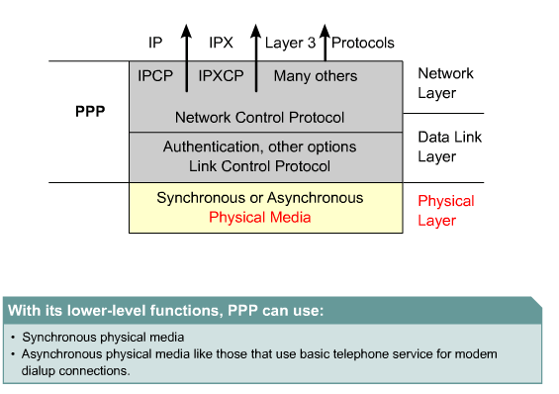
PPP Layered Architecture

Slide 9
PPP at Layer 1
As stated, the physical layer for PPP is specified to be a serial communication method including
EIA/TIA-232
EIA/TIA-422
V.35
The only requirement for this serial link is that circuit must be full duplex and asynchronous

Slide 10
PPP at Layer 2
At layer 2 PPP begins to do its work
To do this work of carrying data from one end of a point-to-point serial link to the other, PPP must transition between several states

Slide 11
PPP at Layer 2
Idle
Establishing
Authenticating
Networking
Terminating

Slide 12
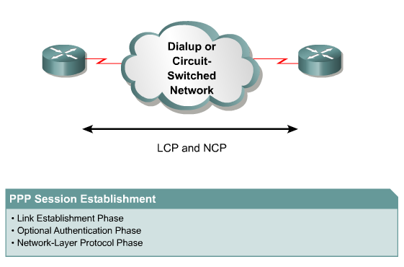
Establishing a PPP Session

Slide 13
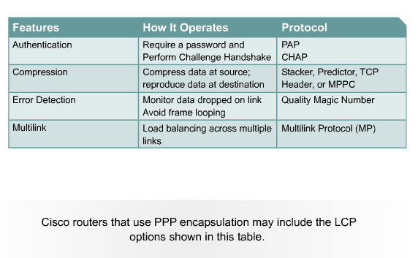
PPP Configuration Options

Slide 14
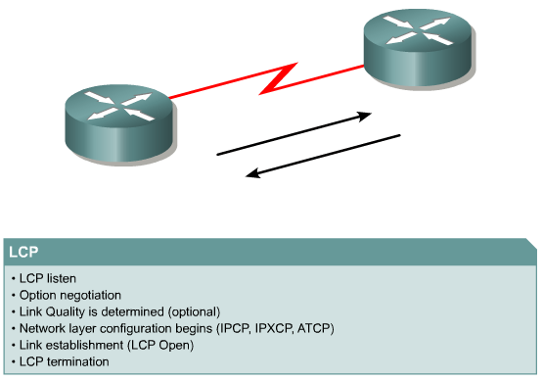
PPP Operation

Slide 15
Transition States
In the idle state the link is not being used
There is no active carrier on the line
In the establishing state the two end points have started communication
If any of the PPP options are to be used, they are negotiated here
During authentication, which is optional, the end points exchange information to establish they are who they say they are

Slide 16
Transition States
When the networking state is reached the real transfer of data begins
The connection remains in this state until communication is terminated
In the termination state one side closes the link

Slide 17
PPP Frame Format
To do its work PPP uses several different frames
The major PPP frame looks like this

Slide 18
PPP Frame Format
Flag
Address
Control
Protocol
Data and Padding
FCS
Flag

Slide 19
PPP Frame Format
These fields do the following
Flag
1 byte
This field marks the start of the frame
The value is always 0111110
Address
1 byte
No purpose as PPP does not support addressing
The address is always 11111111, which is the HDLC broadcast address

Slide 20
PPP Frame Format
Control
1 byte
This is used to indicate that transmission of the data will not be sequenced and is to be sent over a connectionless link
The value is always 00000011
Protocol
2 bytes
This field is used to direct whatever is in the data field to its proper location
It identifies the encapsulated protocol

Slide 21
PPP Frame Format
Data Field
Variable size, but 1500 bytes is the default
Larger sizes can be used, if both sides agree
This field contains the important stuff
FCS
2 bytes, but can be 4 bytes
The FCS – Frame Check Sequence is the CRC used to ensure everything arrived intact

Slide 22
PPP Frame Format
Flag
1 byte
This field marks the end of the frame
The value is always 0111110

Slide 23
Protocol Field
The value in the protocol field is typically expressed as a hexadecimal number
Common codes include
IP – 0021
IPX – 002b

Slide 24
HDLC in PPP
Although HDLC is discussed elsewhere as an alternative to PPP as a way to send data over a serial link, a form of HDLC is used to encapsulate the datagrams to be sent over the serial link

Slide 25
Link Control Protocol
The LCP - Link Control Protocol is a part of the PPP specification
LCP is used to establish, configure, maintain, and terminate links
LCP information is carried in the data field of the PPP frame

Slide 26
Link Control Protocol
The way a the device knows this data relates to LCP instead of data to be passed up the stack is by looking in the protocol field
LCP data is indicated by C021, a hexadecimal number, in that field
The LCP looks like this

Slide 27
Link Control Protocol Format
Code
Identifier
Length
Information

Slide 28
Link Control Protocol Format
The fields in this packet do the following
Code
1 byte
The code defines the type of LCP packet this is
Identifier
1 byte
This field is used to match a request to a reply
One end point places a value in this field
This value will be copied to the reply

Slide 29
Link Control Protocol Format
Length
2 bytes
Information
Variable in length
This field holds the extra information that is required by some types of LCP packets, such as whether authentication will be required

Slide 30
PPP Capture File
Let’s look at some PPP frames
Download
PPP with RIP.cap
Open it in Wireshark by double-clicking it
Select frame 1
This is a LCP PPP frame
In frame 13 we see a PPP ACK

Slide 31
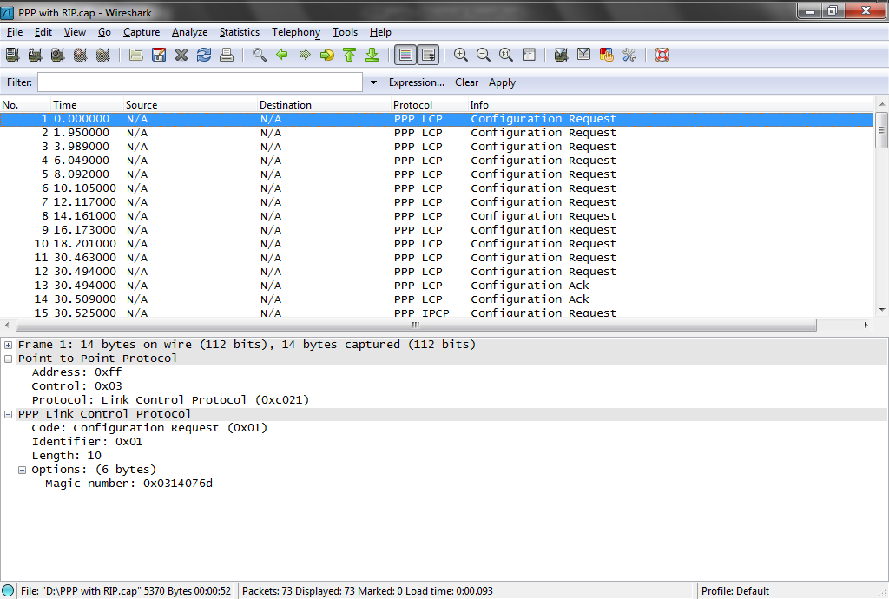
PPP Capture File

Slide 32
PPP Capture File
In frame 15 some IP traffic appears
Then in frame 16 some CDP traffic
Notice in frame 15 that an IP address appears as the links begin to come up

Slide 33
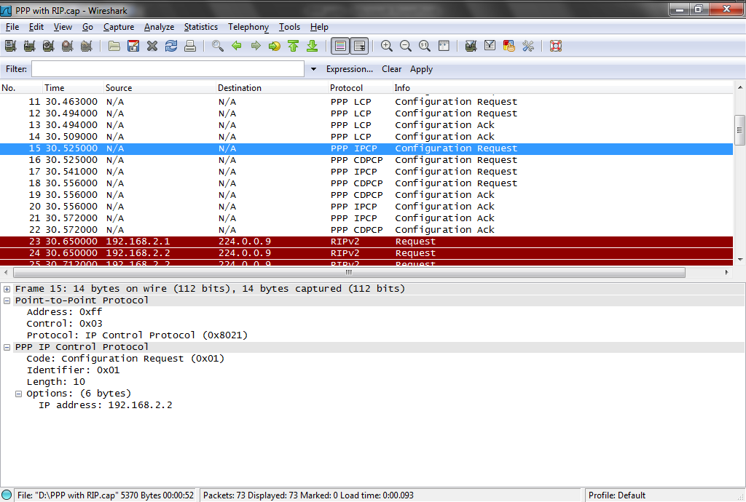
PPP Capture File

Slide 34
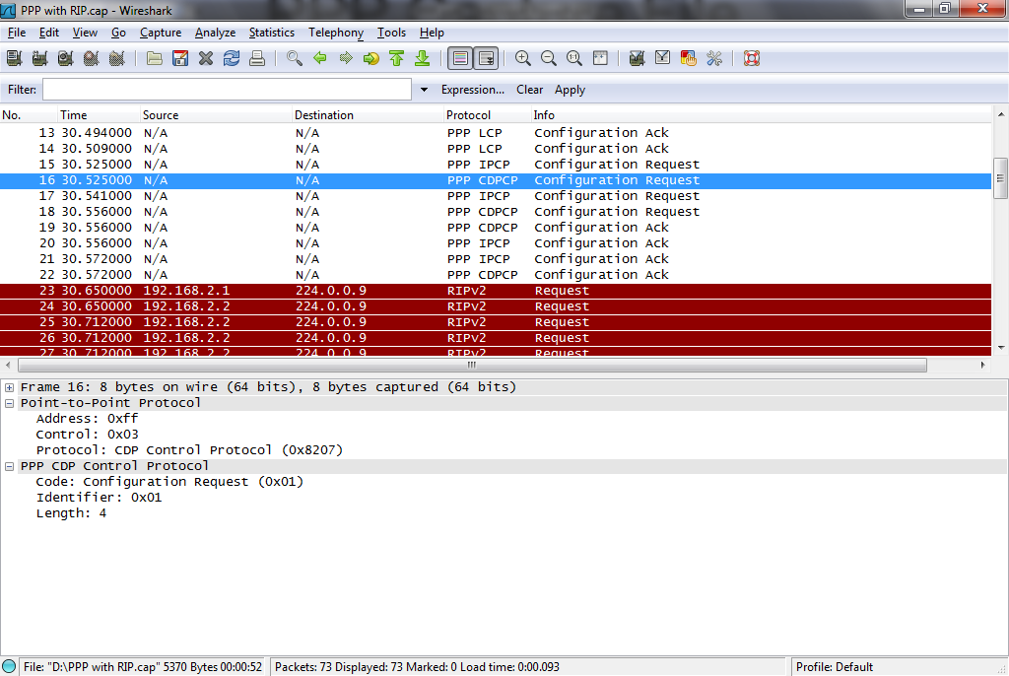
PPP Capture File

Slide 35
PPP Capture File
In frames 23 and 28 RIP begins to talk at both ends of the link

Slide 36
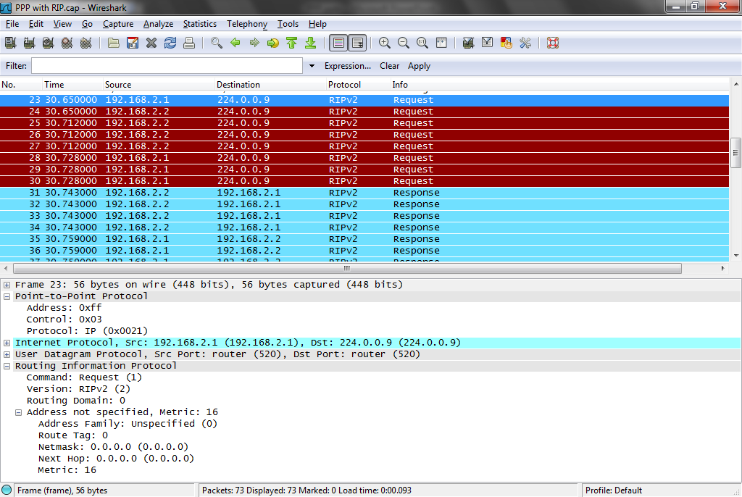
PPP Capture File

Slide 37
PPP Capture File
The RIP responses are in frames 31 and 35

Slide 38
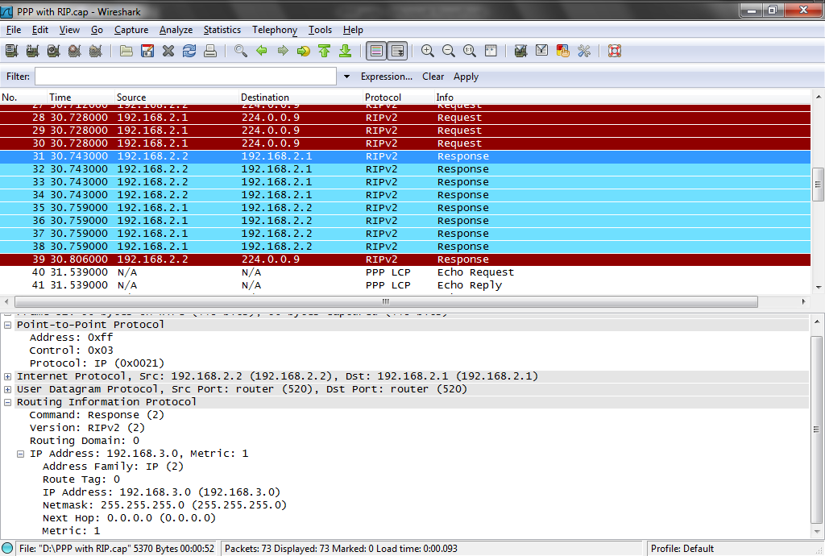
PPP Capture File

Slide 39
PPP Capture File
Beginning with frame 50 a series of ping requests and responses go back and forth all carried at layer 2 by PPP

Slide 40
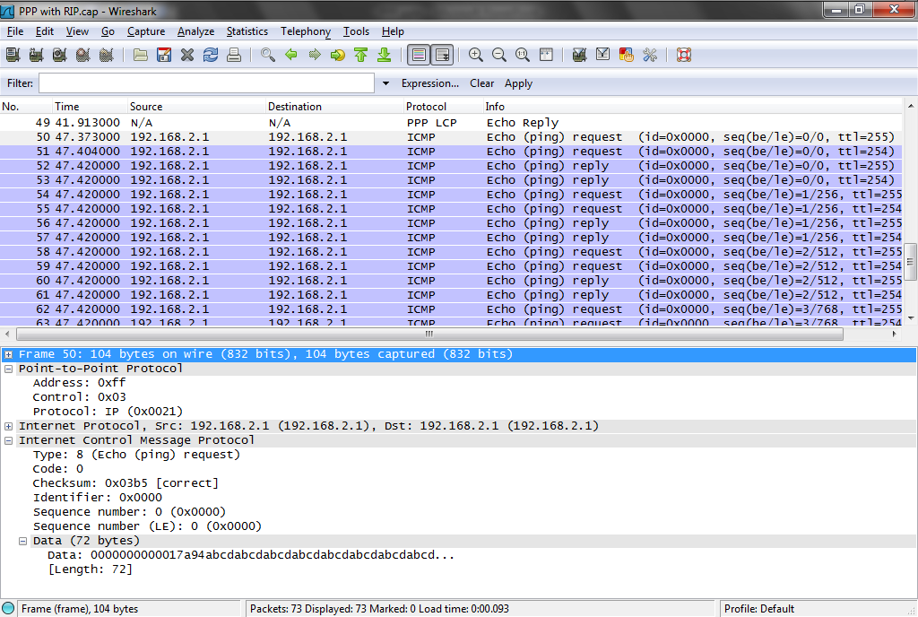
PPP Capture File

Slide 41
PPP Capture File
So we see here PPP hard at work carrying all types of information

Slide 42
Authentication
Authentication was an important addition to PPP compared to SLIP
Authentication is not needed in a point-to-point link over a T1 line, but it is needed for a dialup connection
You want to know who you are talking to whenever you cannot control both ends of the connection

Slide 43
Authentication
PPP can use either of two protocols for authentication
PAP
CHAP

Slide 44
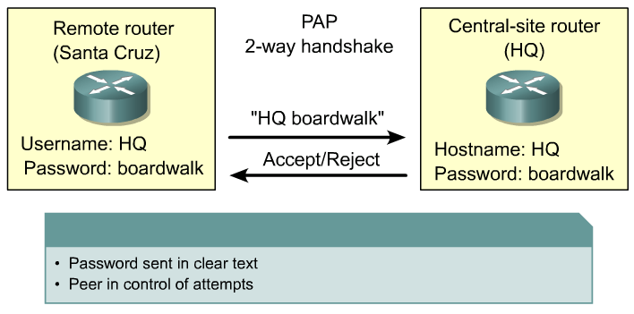
PPP Authentication Protocols

Slide 45
PAP

Slide 46
PAP
PAP – Password Authentication Protocol is very simple and basically useless
It works this way
The user wanting access to an end point sends an authentication request that includes the username and password
The end point either accepts or rejects the request

Slide 47
PAP
The problem is the password is sent in clear text
PAP packets can be identified by the code C023 in the protocol field

Slide 48
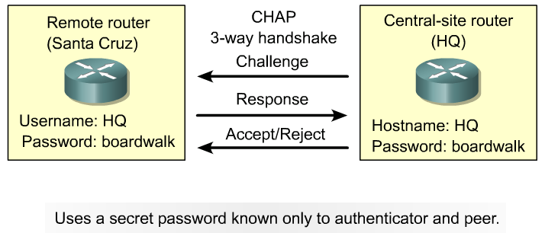
PPP Authentication Protocols

Slide 49
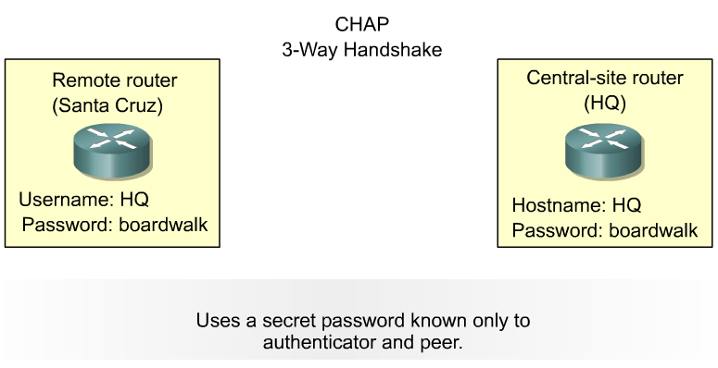
CHAP
CHAP provides protection against playback attack through the use of a variable challenge value that is unique and unpredictable

Slide 50
CHAP
CHAP – Challenge Handshake Authentication Protocol improves on PAP by keeping the password secret
CHAP will also recheck the authentication on a periodic basis
CHAP is indicated by C223 in the protocol field

Slide 51
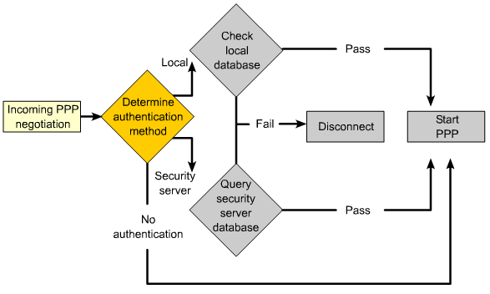
Encapsulation Authentication

Slide 52
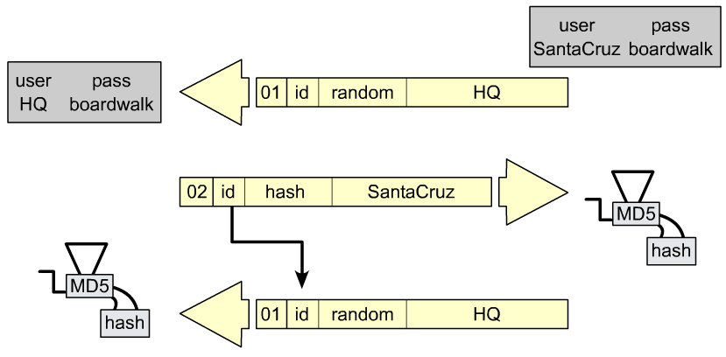
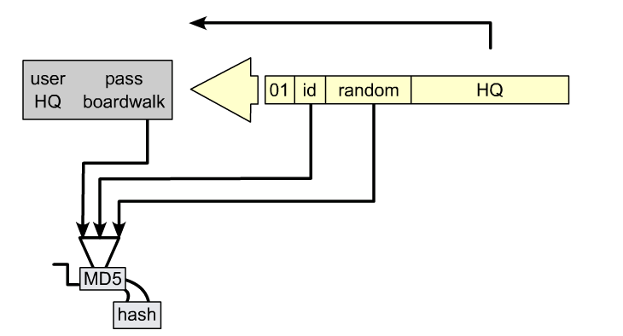
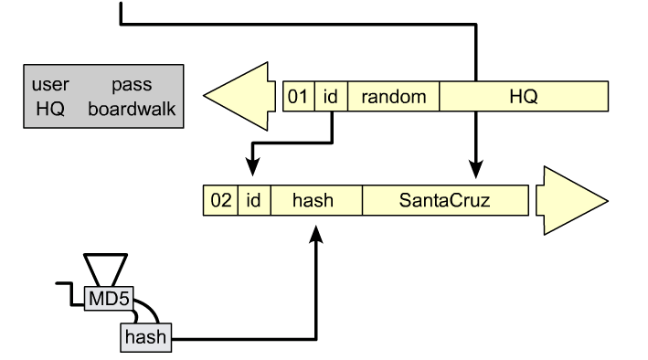
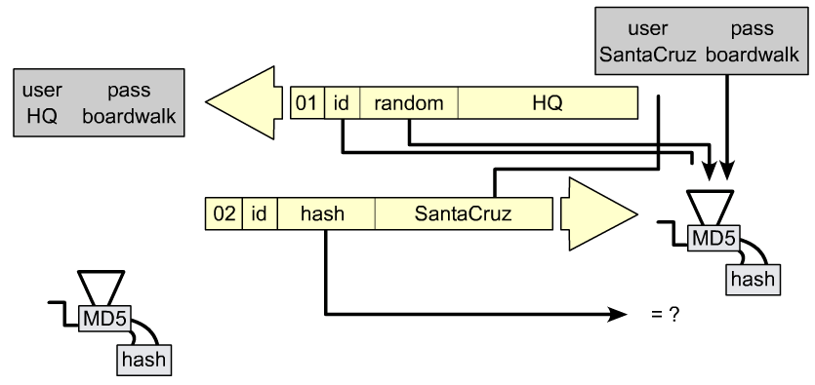
CHAP Authentication Process

Slide 53
Configuring PPP Authentication

Slide 54
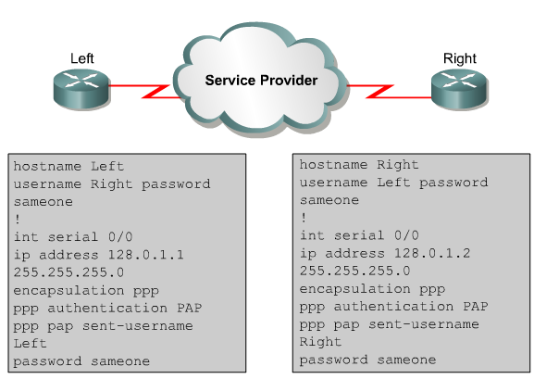
PAP Configuration

Slide 55
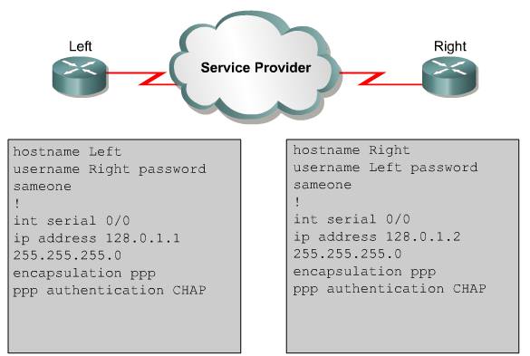
CHAP Configuration

Slide 56
Compression
In addition to authentication, compression is another optional service offered by PPP
Compression does not have to be used, but it is very useful for dial-up connections

Slide 57
PPP from Layer 2 to 3
At the top of PPP is the NCP – Network Control Protocol
NCP is used once LCP has established the connection and any authentication has taken place
At this stage NCP connects PPP to the higher level protocols that begin their work at layer 3

Slide 58
PPP from Layer 2 to 3
More specifically it encapsulates the IP, IPX, or whatever other traffic comes down into a form PPP can deal with at layer 2
For example, IPCP – Internetwork Protocol Control Protocol is used by NCP to create and then terminate a connection that will send TCP/IP packets
The protocol field 8021 indicates this

Slide 59
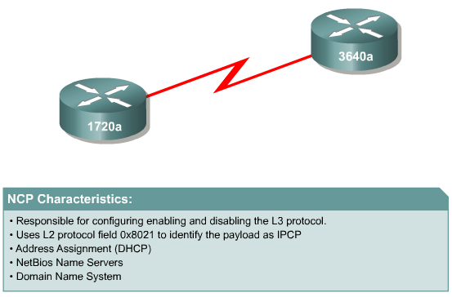
Network Control Protocol

Slide 60
Using PPP
Using PPP is quite easy on most devices
For example to use PPP encapsulation on a Cisco router, just type
encapsulation ppp
At the configure interface level

Slide 61
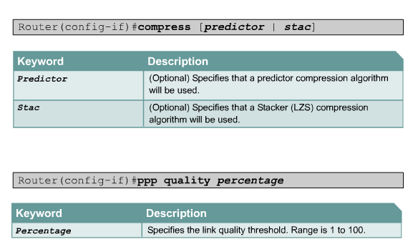
Configuring PPP

Slide 62
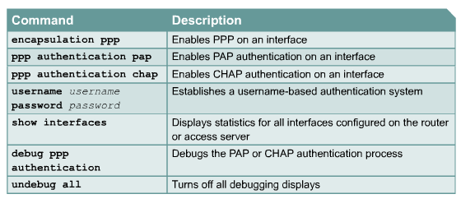
PPP Configuration Commands

Slide 63
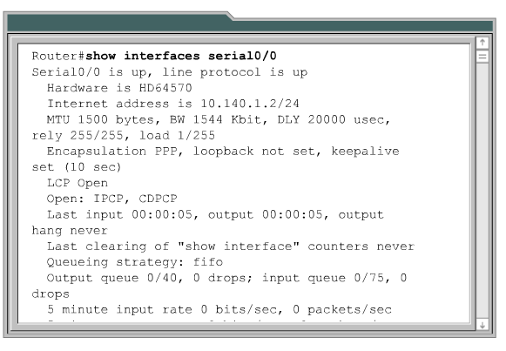
Verifying PPP

Slide 64
Troubleshooting PPP
The first thing to do when a problem arises on a link that uses PPP is to check the physical connection
Also check the configuration of physical layer devices, such as the CSU/DSU
This is by far the most common source of the trouble

Slide 65
Troubleshooting PPP
The next thing to check is the configuration of PPP in the router for a direct link or access server if a dial-up connection is being made
The most common error is when authentication is being used for the link
The username setting causes the most errors in this case

Slide 66
Troubleshooting PPP
When configuring the username on a router, it is the hostname of the router at the other end of the connection
Consult the Oppenheimer and Bardwell text for more details on this issue

Slide 67
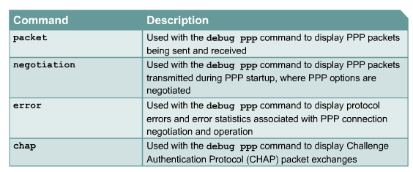
Debug PPP Authentication

Slide 68
For More Information
T1: A Survival Guide
Matthew S. Gast
ISBN 0-596-00127-4
Troubleshooting Campus Networks
Priscilla Oppenheimer and Joseph Bardwell
ISBN 0471210137

