Slide 1
Packet Over SONET Interface
Last Update 2011.09.08
1.0.0

Slide 2
Objectives of This Section
Learn
How to connect to a Packet Over SONET line

Slide 3
POS Interface
A POS – Packet Over SONET connection just requires an interface card for a router
This might be a router such as the Cisco 7200 series
The service provider would bring in a DS3 connection or similar coax based demarc that would then connect to this interface
For example

Slide 4
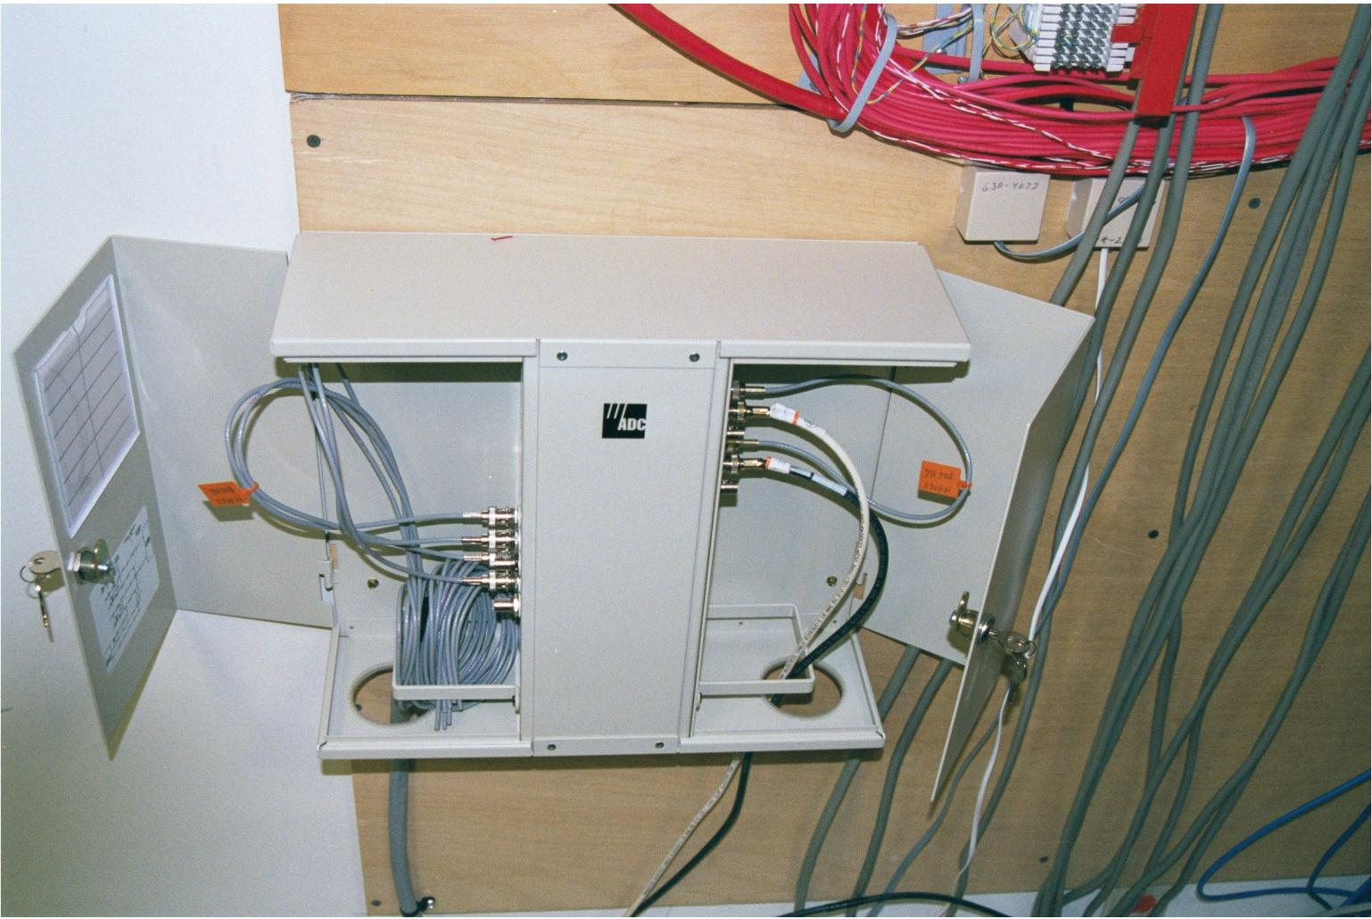
POS Demarc

Slide 5
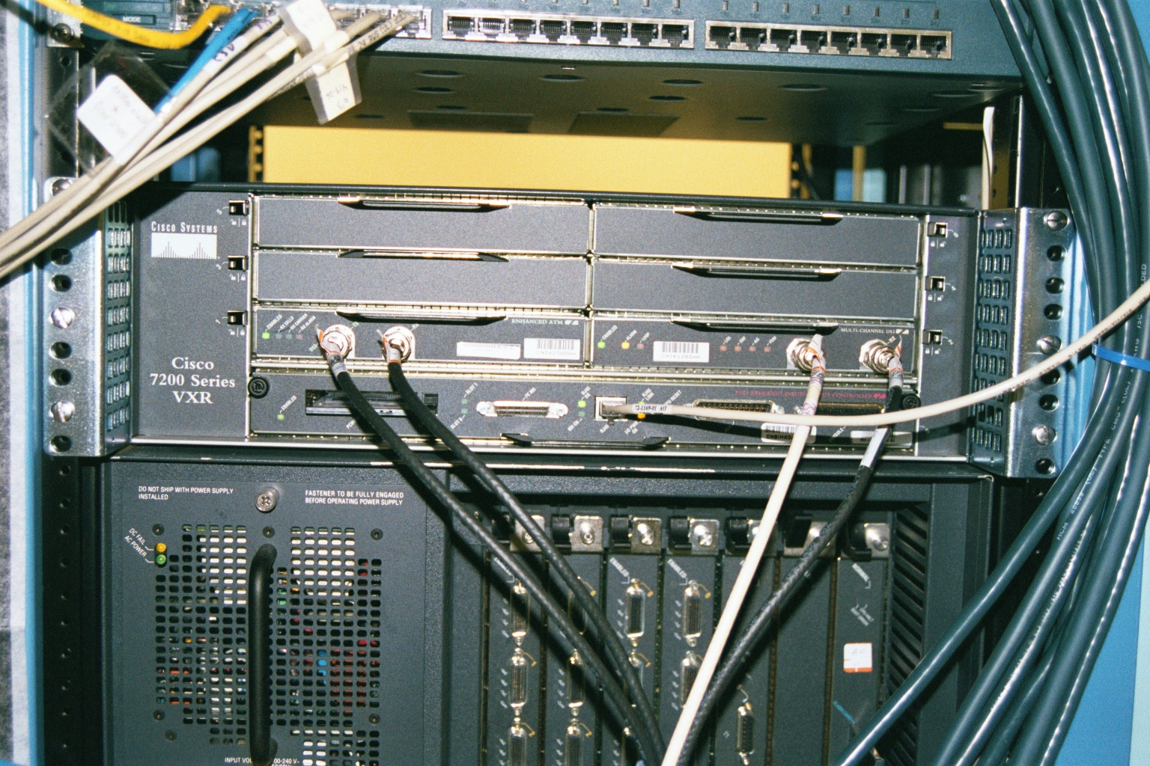
Router

Slide 6
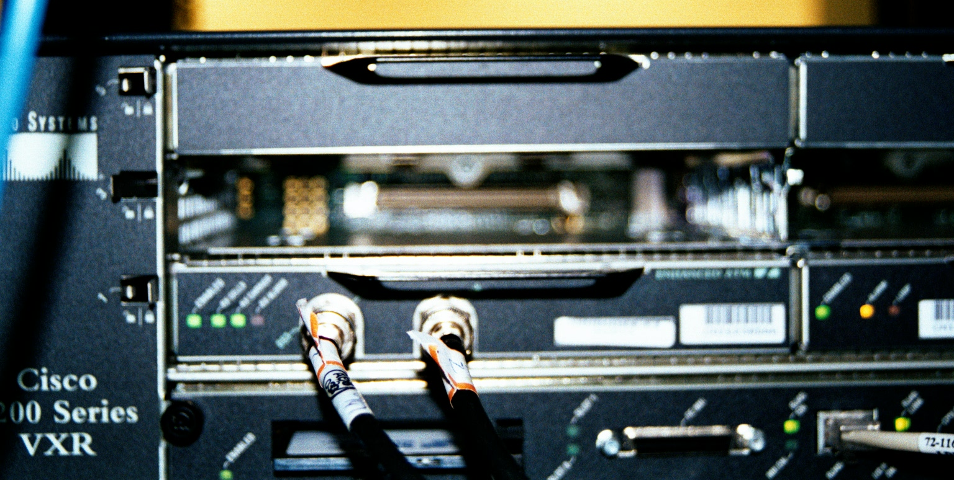
POS Router

Slide 7
POS Interface
The POS connection could also be directly to dark fiber such as in a MAN
This type of interface would be used for this

Slide 8
POS Interface

Slide 9
POS Interface
In either case this is a simple case of selecting the correct interface card for the router to be used

