Slide 1
Optical Interfaces
Last Update 2014.07.10
1.3.0

Slide 2
Objectives of This Section
Learn
What optical interfaces are
How to install and connect to them

Slide 3
Optical Interfaces
There are several types of optical interfaces
Modules that plug into an opening with an electrical connector at the back
Fast and Gigabit Ethernet
GBIC – Gigabit Interface Convertor
SFP – Small Form Factor Pluggable
10G Ethernet
XENPAK
XFP
SFP+

Slide 4
Optical Interfaces
Boards that go in a slot to connect to a backplane
Modular interface boards

Slide 5
GBIC and SFP
The older and slower types are the GBIC and the SFP
The SFP was designed to replace the GBIC in order to save front panel space
The SFP is close to the size of an RJ-45 port

Slide 6
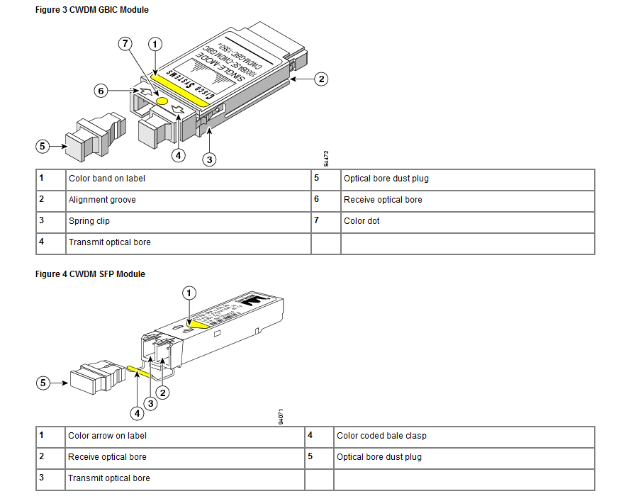
GBIC and SFP

Slide 7
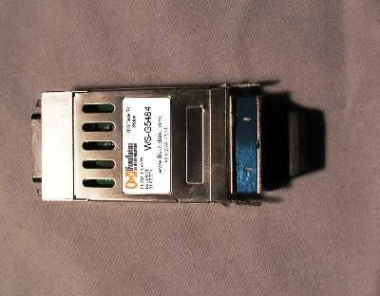
GBIC

Slide 8
GBIC Types
We will look at some Cisco GBIC models to illustrate the types that are commonly used
1000BASE-T GBIC WS-G5483
Connects a GBIC port to Category 5 UTP cable using a standard RJ-45 interface
The maximum distance is 328 feet or 100 meters

Slide 9
GBIC Types
1000BASE-SX GBIC WS-G5484
For a multimode fiber link up to 1815 feet or 550 m and on laser-optimized multimode fiber OM3 up to 3281 feet or 1 km
1000BASE-LX/LH WS-G5486
IEEE 802.3z 1000BASE-LX10 standard for up to 6.2 miles or 10 km over single-mode fiber and up to 550 meters over multimode fiber

Slide 10
GBIC Types
1000BASE-ZX GBIC WS-G5487
For single mode fiber optic link spans up to 43.4 miles or 70 km
Here is a summary table from Cisco

Slide 11
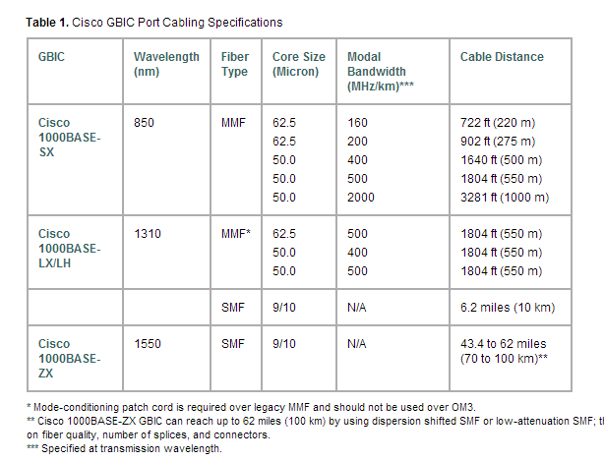
GBIC Types

Slide 12
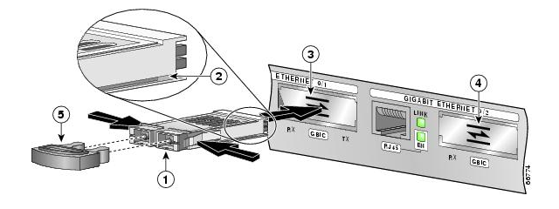
GBIC Slot

Slide 13
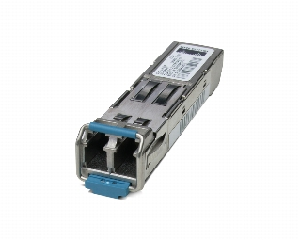
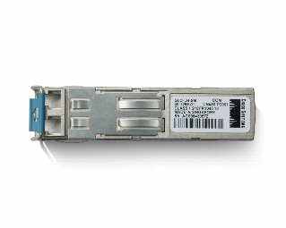
SFP

Slide 14
SFP Types
There are several types of SFPs
They differ based on the type of fiber optic cable they will connect to and the distance over which they will drive a single
For example

Slide 15
SFP Types
For 850 nm multimode fiber optic cable over Ethernet SX distances up to 550 m at 1.25 Gbps
For 850 nm multimode fiber optic cable over Ethernet SX distances up to 150 m at 4.25 Gbps
These have a black or beige extractor lever
For 1310 nm single mode fiber optic cable over Ethernet LX distances up to 10 km
These typically have a blue extraction lever

Slide 16
SFP Types
We will look at some Cisco SFP models to illustrate the types that are commonly used
1000BASE-T SFP GLC-T
Connects to standard UTP Category 5 up to 328 feet or 100m
1000BASE-SX SFP GLC-SX-MM
Connects to multimode fiber optic cable either 50 or 62.5 at distances up to 550 m and 220 m respectively
It can support up to 1km over laser-optimized 50 μm multimode fiber cable

Slide 17
SFP Types
1000BASE-LX/LH SFP GLC-LH-SM
Operates on standard single mode fiber-optic links up to 10 km and up to 550 m on any type of multimode fiber optic cable
A mode conditioning cable may be needed
1000BASE-EX SFP GLC-EX-SM
For standard single-mode fiber-optic link spans of up to 40 km in length
A 5 dB inline optical attenuator should be inserted between the fiber-optic cable and the receiving port on the SFP at each end of the link for back-to-back connectivity

Slide 18
SFP Types
1000BASE-ZX SFP GLC-ZX-SM
For standard single mode fiber optic links of approximately 70 km
The SFP provides an optical link budget of 21 dB, but the precise link span length depends on multiple factors such as fiber quality, number of splices, and connectors
When used over shorter distances with single mode fiber optic cable it might be necessary to insert an inline optical attenuator in the link to avoid overloading the receiver
A 10-dB inline optical attenuator should be inserted between the fiber-optic cable plant and the receiving port on the SFP at each end of the link whenever the fiber-optic cable span loss is less than 8 dB

Slide 19
SFP Types
Here is a summary table from Cisco

Slide 20
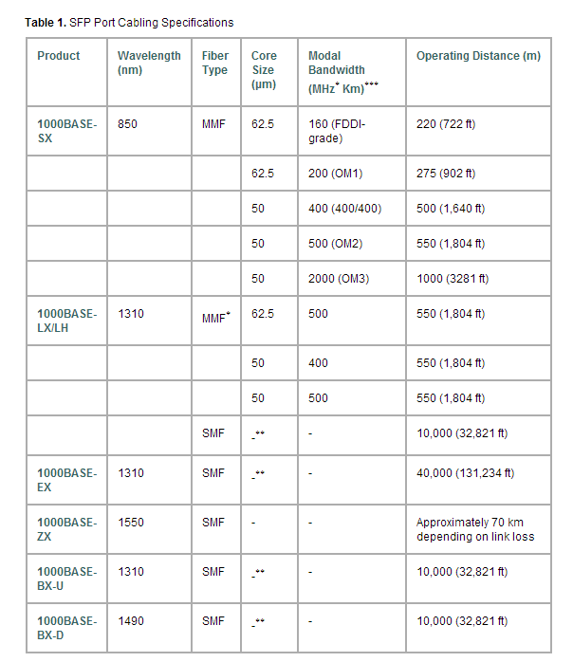
SFP Types

Slide 21
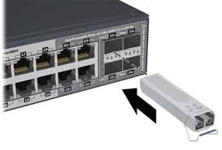
SFP Slot

Slide 22
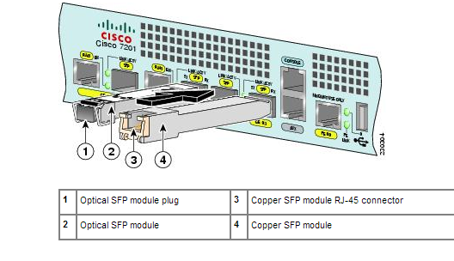
SFP Slot

Slide 23
XENPAK
With the development of 10G Ethernet new interfaces were developed
It first appeared in 2001

Slide 24
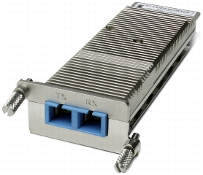
XENPAK

Slide 25
XFP
Announced in 2002 the XFP is another 10G plug in transceiver

Slide 26
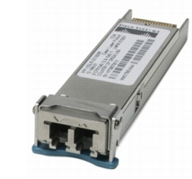
XFP

Slide 27
SFP+
The SFP+ is an enhanced version of the SFP designed for higher speeds such as 10G Ethernet

Slide 28
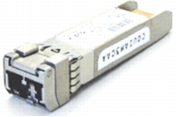
SFP+

Slide 29
Modular Board Based
Modular routers have a slot at the base of which is a connector to the device’s circuit board that allows the interfaces of the device to be changed without the need for an entirely new device
These modular connectors look like this

Slide 30
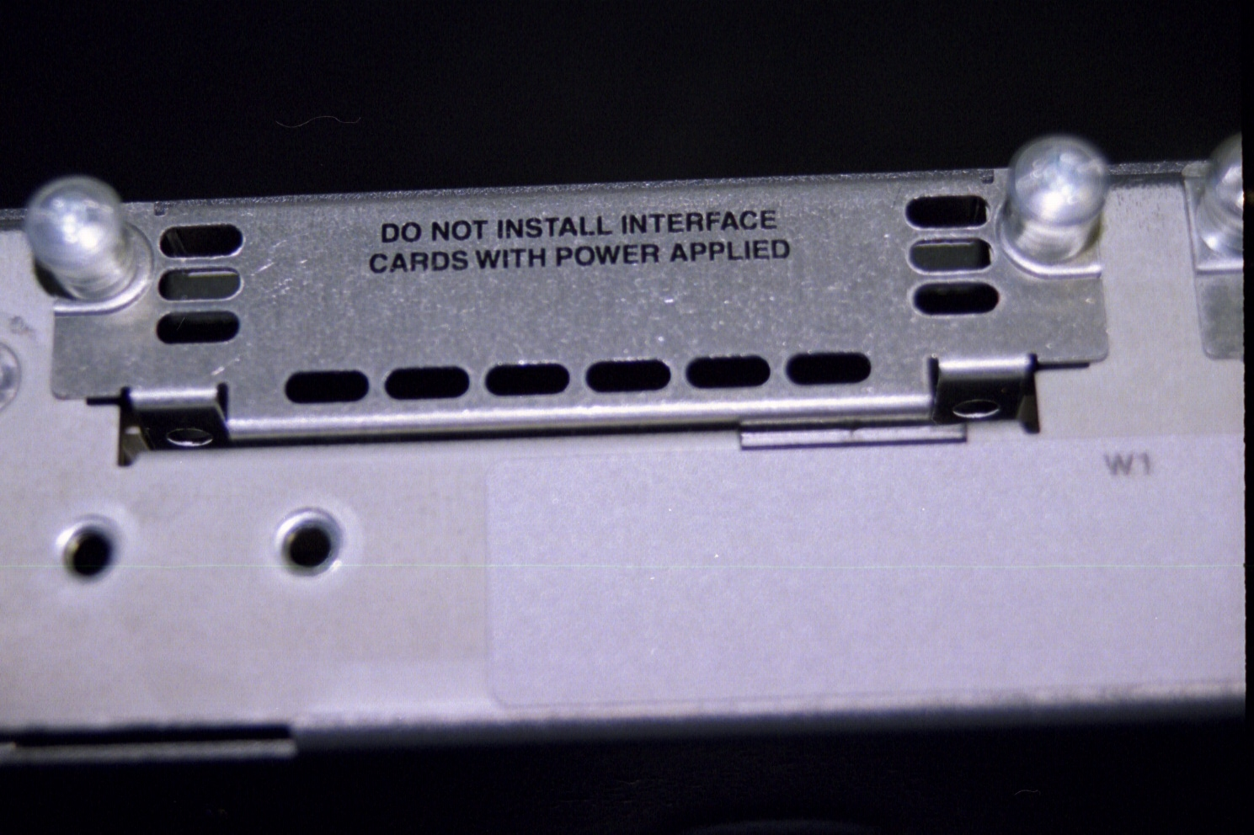
Modular Connector Slot Cover

Slide 31
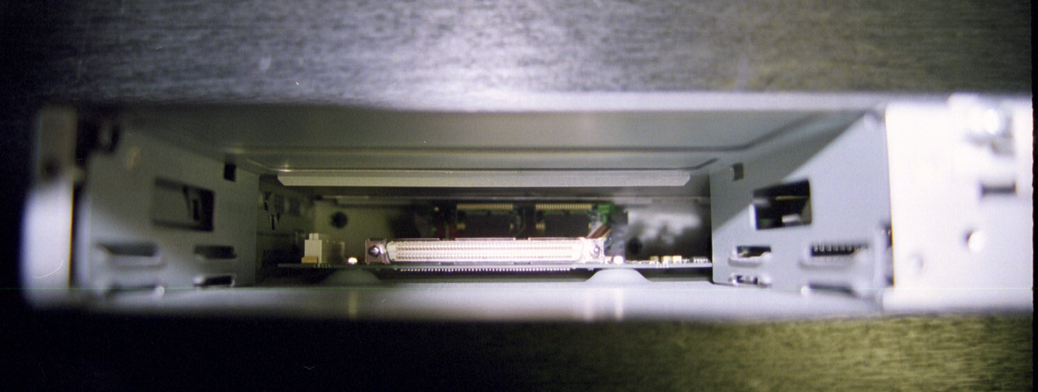
Modular Connector Slot

Slide 32
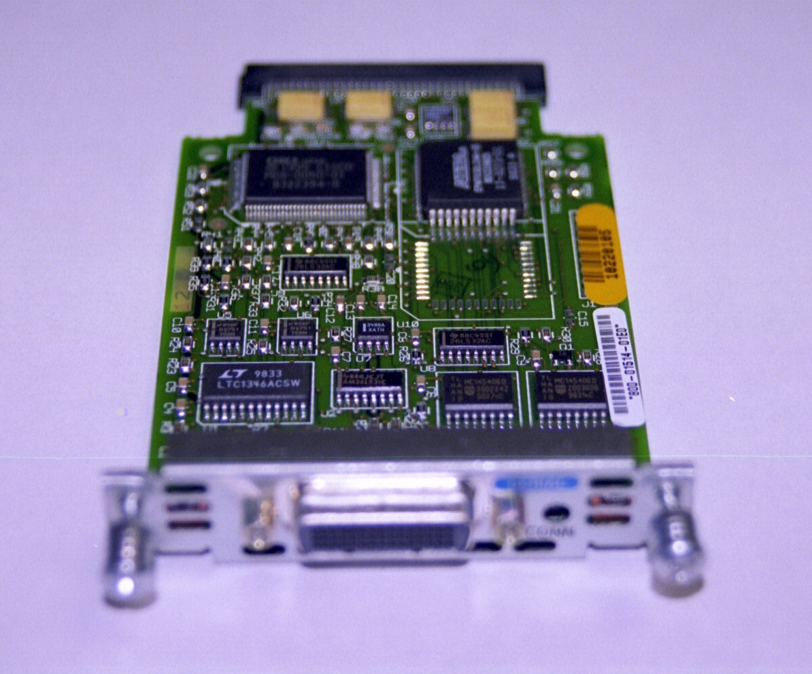
Modular Interface Board

Slide 33
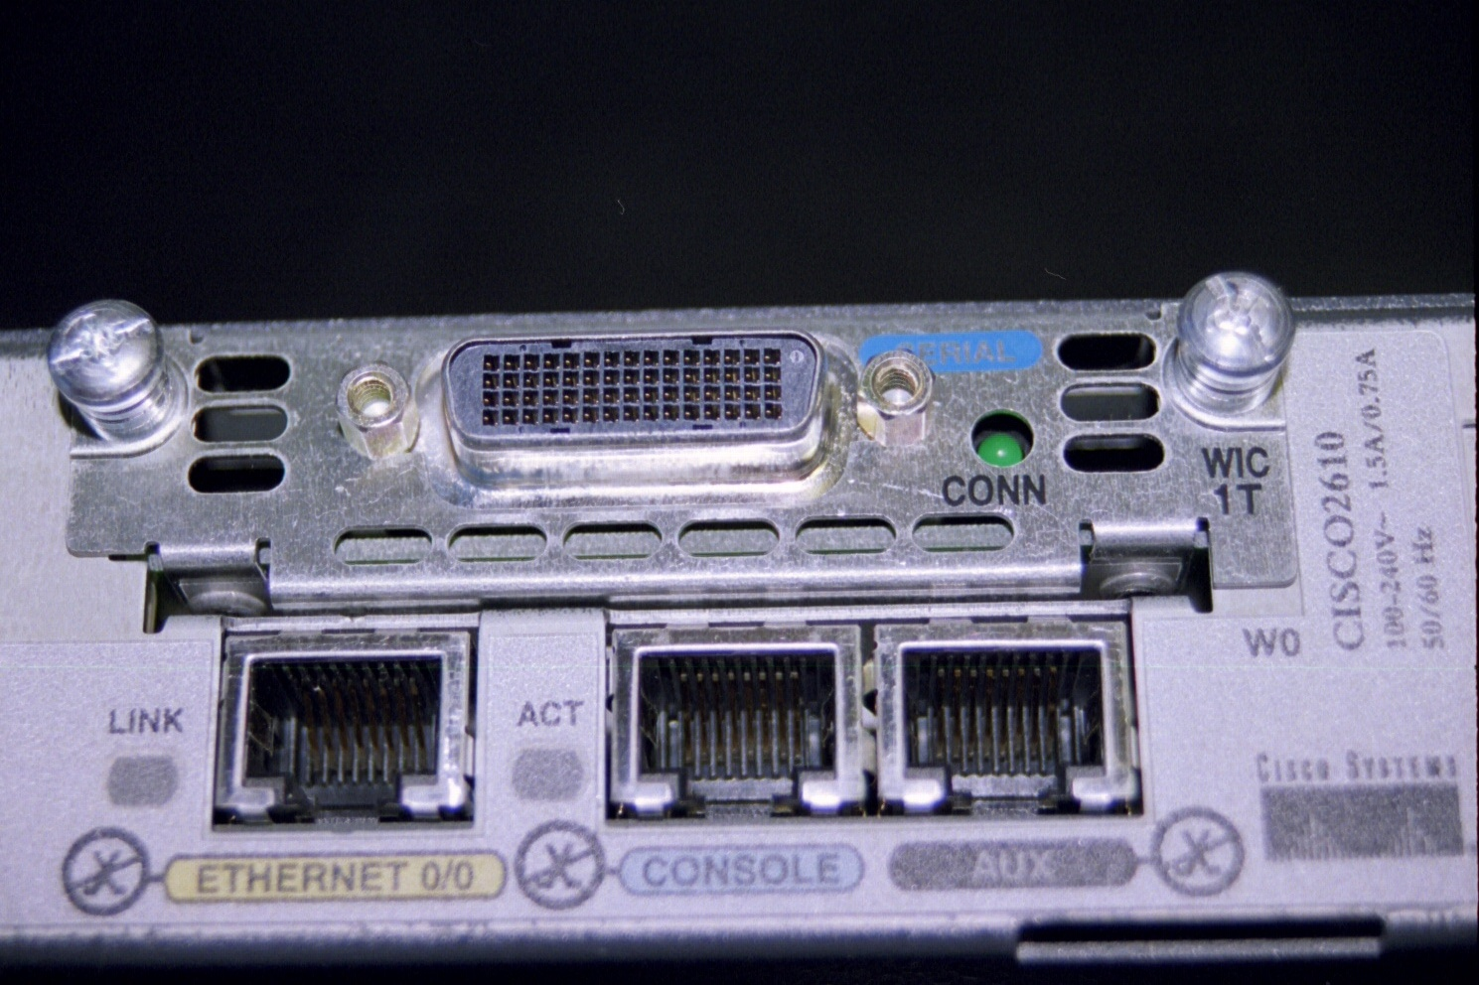
Modular Interface Board

Slide 34
Media Converter
Some times to save money fiber optic cable will be run from one point to another, but the devices at the ends, such as a switch, will have copper ports, since copper based boxes are cheaper than ones with fiber interfaces
To convert the copper port to the fiber optic cable a media converter is required
Such as

Slide 35
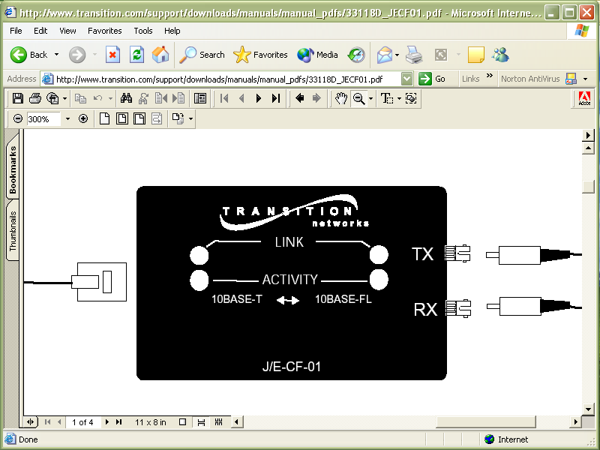
Media Converter

Slide 36
Connecting to Fiber Ports
To connect to a fiber optic cable port the correct type of fiber optic cable must be used
In addition the ends of the cable and the ports must be clean
Only an inspection scope can determine whether these ports and cable ends are clean enough

Slide 37
Handling Fiber Optic Media
Anytime you work with fiber optic cable it is important to keep everything clean
It is also important to protect yourself from injury from small pieces of fiber
These fiber pieces that are produced as a normal part of the termination process can get in your eyes or stick in your skin
They are difficult to remove

Slide 38
Keeping the Media Clean
It is critical that the ends of fiber optic cable be kept clean
Dirty connections are a common cause of link failures
According to Fluke 85% of link failures are due to contaminated ends

Slide 39
Inspection
The best way to check for dirt is an inspection scope
For multimode fiber 200 times magnification is used
For single mode cable 400 time is required

Slide 40

Inspection Scope

Slide 41
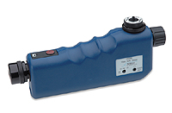
Inspection Scope

Slide 42
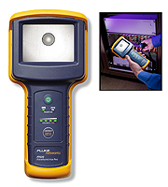
Inspection Scope

Slide 43
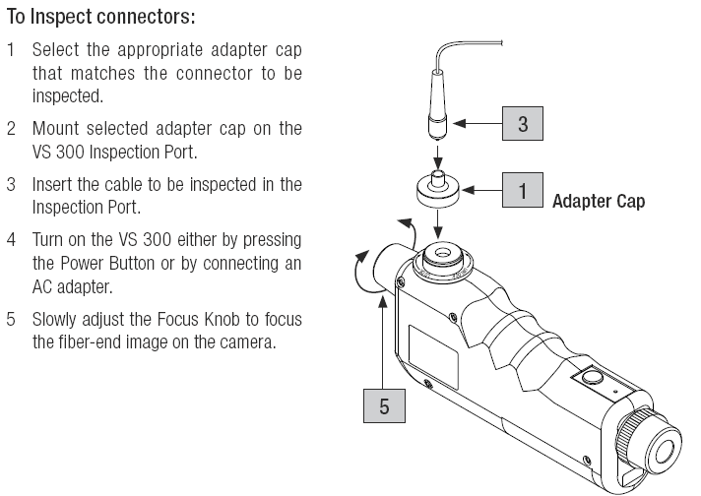
Inspection Process

Slide 44
Sources of Problems
The are two main sources of problems on fiber ends
Contamination
Dirt and Dust
Finger Prints
Cleaning Method Used
Skin Oils and Cable Gels
Damage
Pitting
Scratches

Slide 45
Contamination
There are many sources of contamination that leads to dirt particles on connections
Airborne dust and dirt
Improper or insufficient cleaning of tools and materials
Debris from poor quality components
Dirt from the technicians hands
Here are some examples of common problems from Fluke and others

Slide 46
Contamination
Even touching the end of a fiber will deposit excessive oil
Gel from used to pull cable will do the same thing
Dust caps do not necessarily help as they may transfer contamination

Slide 47
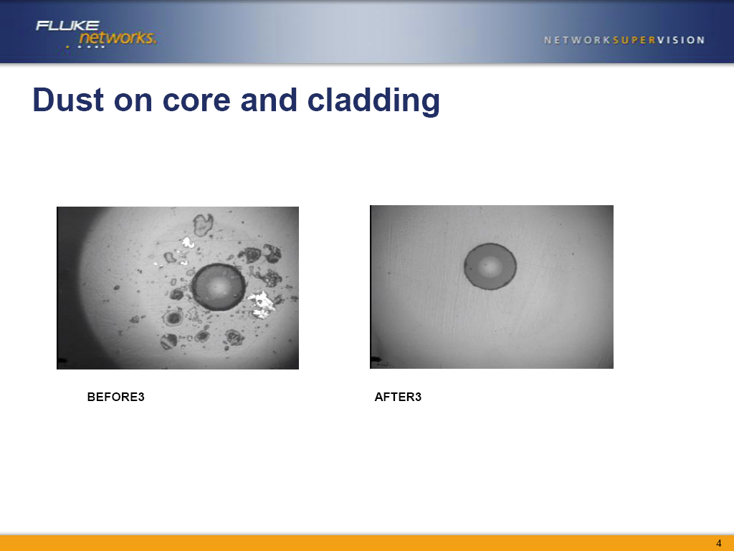
Dust

Slide 48
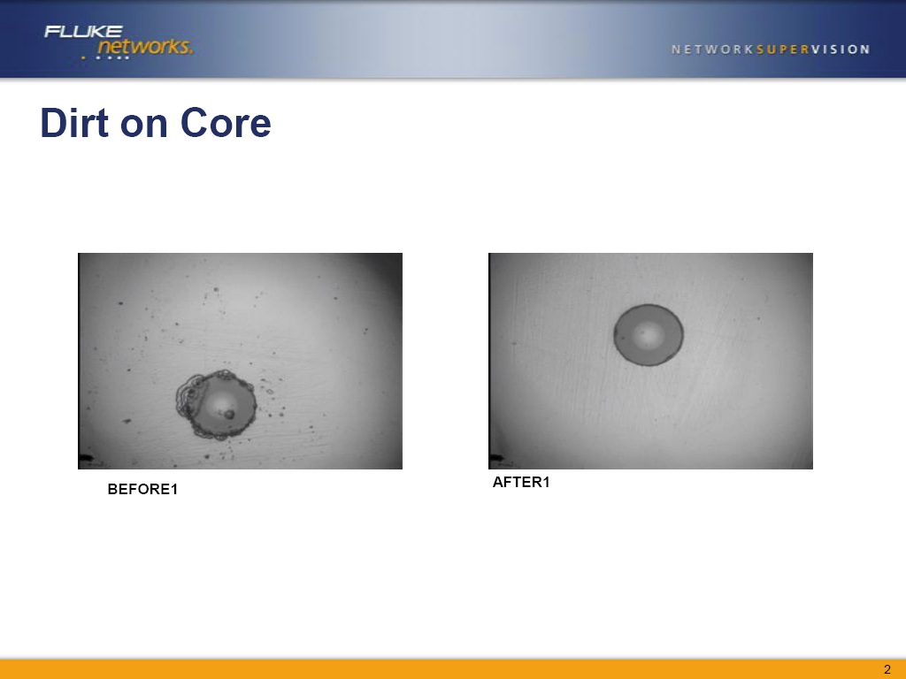
Dirt

Slide 49
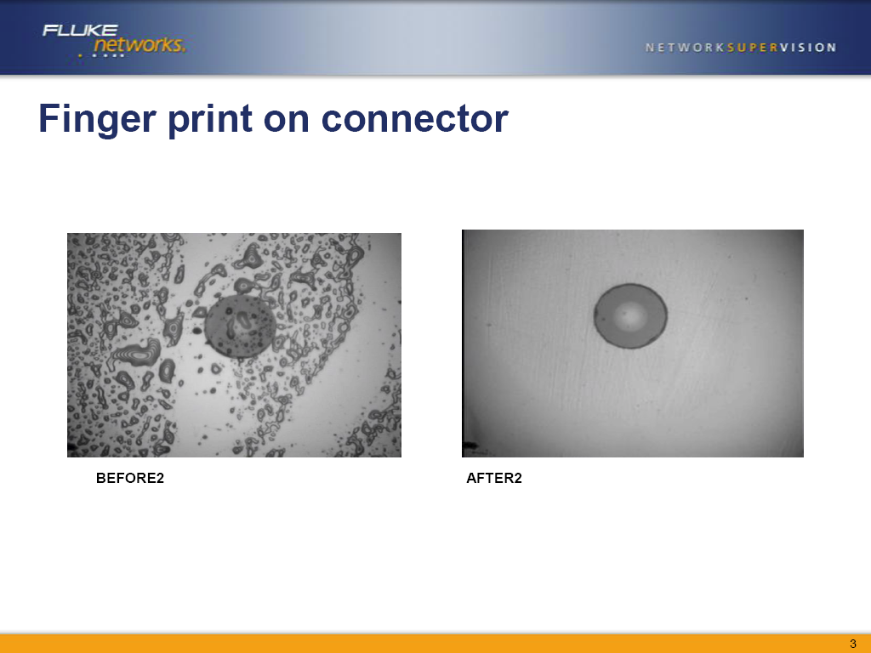
Finger Print

Slide 50
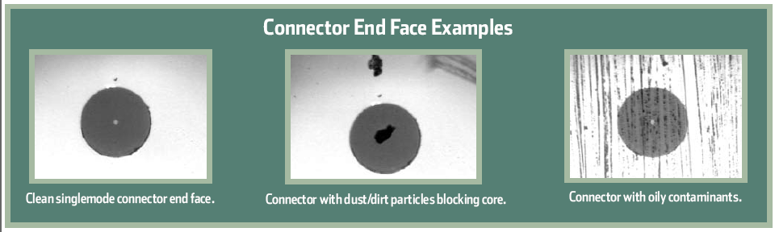
Dirt

Slide 51
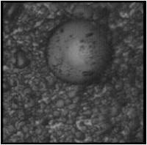
Dust and Skin

Slide 52
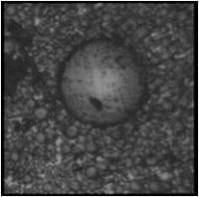
Dust and Skin

Slide 53
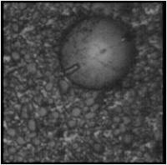
Dust and Skin

Slide 54
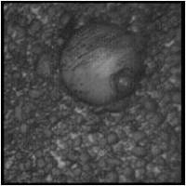
Dry Cleaned

Slide 55
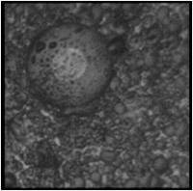
Too Much Solvent Cleaner

Slide 56
Pitting
In some cases the amount of dirt is so great that scratches, pits, and chips can be seen in the fiber ends

Slide 57
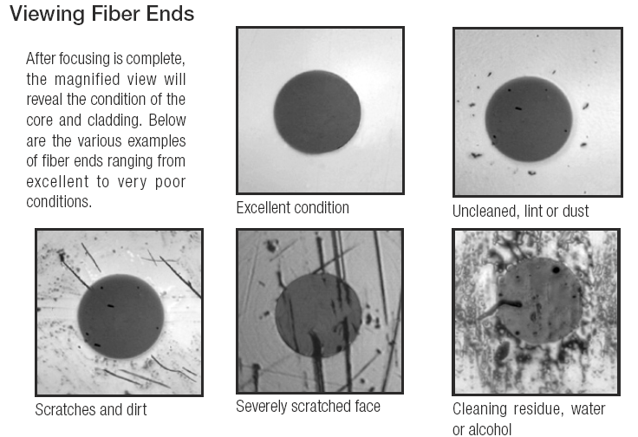
Scratches

Slide 58
Scope Resolution
In general scopes have one of three resolutions
Low – 60X
This does not show much detail, but it has a wide field of view
Medium – 200X
This will show dirt, oils, dust, and lint
High – 400X
This level will show pits and scratches as well

Slide 59
Scope Resolution
In the field the 200X is the most widely used

Slide 60
Cleaning
The solution to this problem is proper cleaning
This means the use of optical grade materials to do the cleaning
Cleaning can be done using dry or wet methods

Slide 61
Best Practice When Cleaning
As discussed below there are many suggested methods for cleaning fiber
To cut to the chase here is what Fluke says is the best way to do this regardless of whether it is a plug or jack

Slide 62
Best Practice When Cleaning
Dab the contaminated end-face with a solvent-dampened wipe or swab
The solvent dissolves and removes contaminants that have dried and firmly affixed to the end-face without producing a static charge that can attract dust from the air
It also evaporates quickly, making it preferable to isopropyl alcohol which takes much longer to disappear and can leave a staining residue in the process

Slide 63
Best Practice When Cleaning
Rub the fiber end-face perpendicularly against a dry wipe several times
Re-inspect the fiber end-face with an optical microscope to ensure that all the debris has been removed

Slide 64
Dry Cleaning
Dry cleaning is very common
However it can lead to static charges on the ends of the connectors
These charges then attract dust

Slide 65
Wet Cleaning
Although an extra step, wet cleaning is more effective
Isopropyl alcohol at 99 percent is commonly used for this purpose
While effective alcohol must be allowed time to dry, since alcohol will absorb water from the air
There are solutions designed for fiber optic cable that are a better choice

Slide 66
Cleaning Cable Ends
Let’s look at some common methods used to clean fiber optic media as provided by Fluke
Using Fluke Networks Fiber Optic Cleaning Card
Peel cover from an unused “N”– shaped cleaning zone
Apply a minimal amount of solvent from the Solvent Pen to the first corner of the “N”

Slide 67
Cleaning Cable Ends
Avoid isopropyl alcohol
Place the end-face perpendicular to the card in the first corner of the unused “N”
Swipe through the “N” shape using gentle pressure moving from wet to dry
Always check the end-face with a fiber microscope before insertion
If necessary, repeat the cleaning process from step #1 using another unused “N”
Never swipe over the same area twice

Slide 68
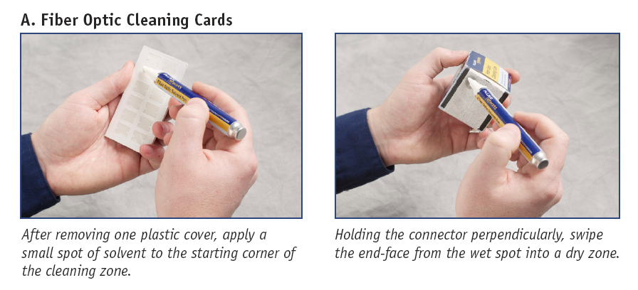
Cleaning Cards

Slide 69
Cleaning Cable Ends
Using Fluke Networks’ Fiber Optic Cleaning Cube
Pull out a clean wipe and lay it over the foam platen
For best results, apply a minimal amount of solvent from the Solvent Pen
A 1 cm diameter spot is sufficient
Avoid isopropyl alcohol

Slide 70
Cleaning Cable Ends
Place the end-face perpendicular to the cube in the wet spot
Swipe the end-face from the wet spot into a dry area using gentle pressure
Always check the end-face with a fiber microscope before insertion
If necessary, repeat the cleaning process on a clean portion of the wipe
Each wipe can clean up to four end-faces. Never swipe over the same area twice

Slide 71
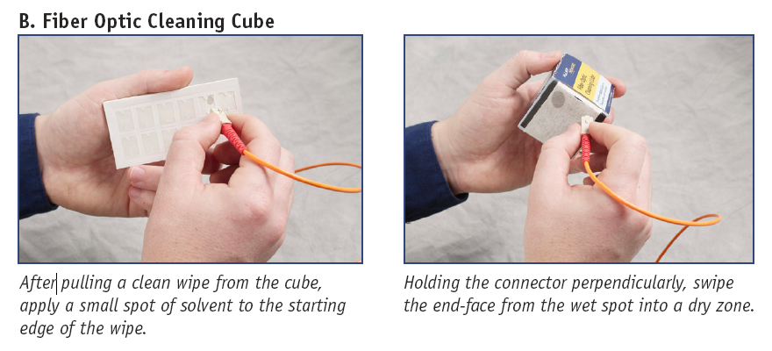
Cleaning Cube

Slide 72
Cleaning Cable Ends
Using Fluke Networks’ Fiber Optic Swabs
Select the swab with the correct diameter to fit inside the port to be cleaned. 2.5 mm Fiber Optic Swabs fit SC, ST, and all other 2.5 mm diameter ports. 1.25 mm Fiber Optic Swabs fit LC and MU ports
Using the Fiber Optic Cleaning Cube or Card, apply some solvent from the Solvent Pen to a wipe
Avoid isopropyl alcohol

Slide 73
Cleaning Cable Ends
Touch the swab to the wet spot on the wipe for 3 seconds to draw a minimal amount of solvent
Touching the swab directly to the Solvent Pen will likely result in excess solvent
Insert the damp swab into the port and turn several times, applying gentle pressure

Slide 74
Cleaning Cable Ends
Follow the damp swab with a dry one, using the same procedure to remove any remaining solvent from the end-face and alignment sleeve
Always check the end-face with a fiber microscope before insertion
If necessary, repeat the cleaning process with fresh swabs

Slide 75
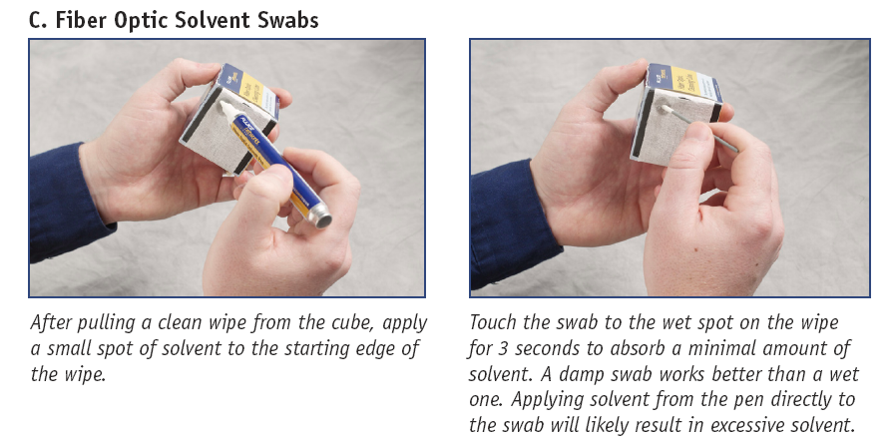
Cleaning Swabs

Slide 76
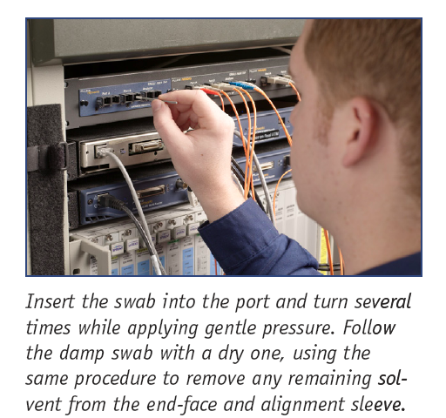
Cleaning Swabs

Slide 77
Area to Clean
It is important to clean not only the core area of the fiber end, but also the cladding area
In this photograph the core is the white dot the cladding is the dark circle

Slide 78
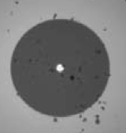
Area to Clean

Slide 79
Area to Clean
Failing to clean the cladding area as well as inside the connector itself will allow the debris there to migrate to the core, thus blocking the light based signal
Clean both the patch cord ends as well as the bulkhead connectors such as these

Slide 80
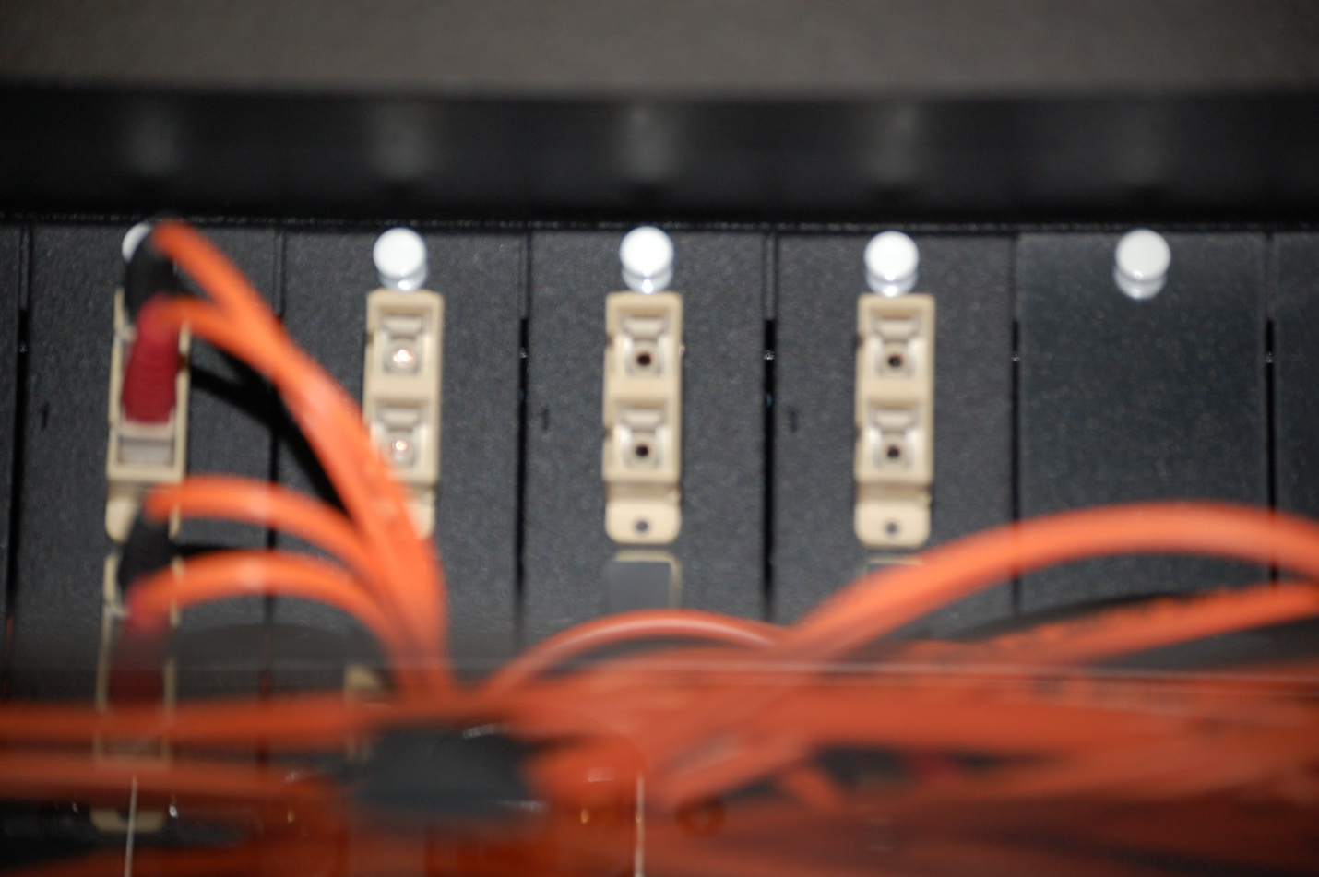
Area to Clean

Slide 81
Attenuators
Sometimes an optical interface generates too much, rather than too little power
In this case the interface can be replaced or an attenuator can be added
Let’s look at an excellent real world example of this from a blog post at the Tekcert website posted on 9 July 2014
Here is what it says

Slide 82
Attenuators
Once in a while I find myself doing some awesome work over long distances
In today's case, I've been working on some core and data center interconnects that span 5-35 miles (8-56km) using dark fiber
One of the connections was causing a warning message in the logs

Slide 83
Attenuators
%SFF8472-5-THRESHOLD_VIOLATION: Te1/1: Rx power high warning; Operating value: 0.3 dBm, Threshold value: -1.0 dBm
If you see a simple warning message like this, don't panic, it's a pretty easy fix
Start by doing some research on the connection
The show transceiver detail command says

Slide 84
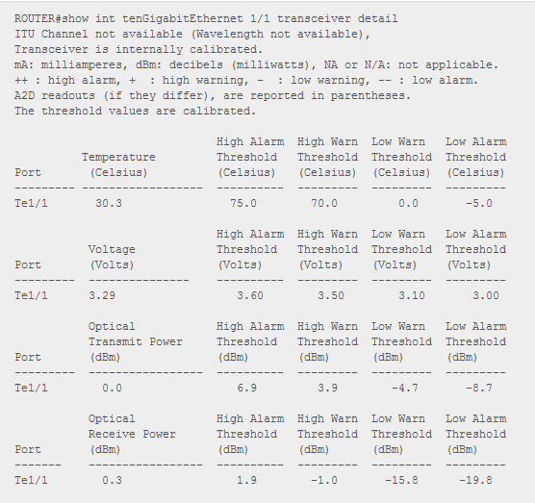
Attenuators

Slide 85
Attenuators
From this you can see the Rx power is over the warning threshold of -1.0
The low warning threshold is -15.8 dBm, so we want to attenuate the signal enough to land between -15.8 and -1.0
Once you've identified how much signal to attenuate, purchase an attenuator that matches your connection type

Slide 86
Attenuators
In my case, I have LC connections because I'm using SFP-10G-ER optics and I also needed at least 1.4 dB of attenuation
Since we had a 7dB attenuator on hand, that's what I used

Slide 87
Attenuators
If you don't have one on hand, a quick search turned up this Fiber Attenuator Singlemode Simplex LC/UPC Fixed 7db at Amazon

Slide 88
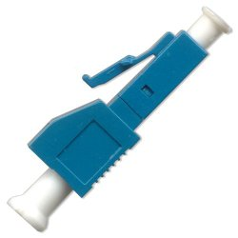
Attenuators

Slide 89
Attenuators
To install the attenuator, you need to place it on the fiber connecting to the receive side of the optic
If you aren't sure which side is receive, there is a Cisco doc with a diagram showing you which side is receive (it's the right side)

Slide 90
Attenuators
Here's a link to that doc
http://www.cisco.com/c/en/us/td/docs/interfaces_modules/transceiver_modules/installation/note/78_15160.html
After installing the attenuator, here's the results

Slide 91
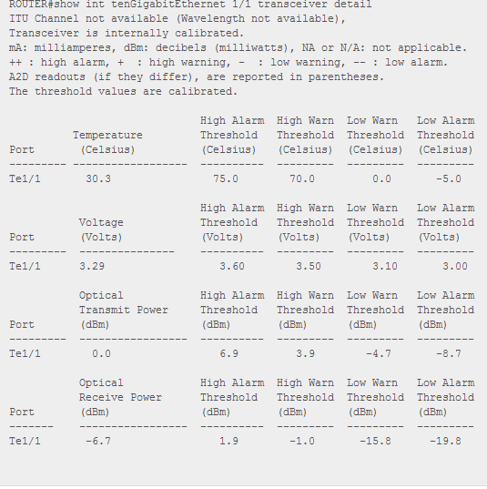
Attenuators

Slide 92
Attenuators
As you can see the Optical Receive Power is -6.7 dBm, or exactly 7 dBm lower
Isn't this stuff totally awesome
Ok, maybe not that much, but still pretty cool when things work
Hope this helps someone out there faced with long dark fiber runs and overpowering optics

