Slide 1
MPLS Label
Last Update 2011.06.01
1.0.0

Slide 2
Objectives of This Section
Learn
What a MPLS frame looks like

Slide 3
MPLS Frame Format
MPLS does not actually use a frame as it lives at layer 2.5
Instead it uses a label to direct either a frame when the MPLS connection is made at layer 2 or a packet if the MPLS connection is made at layer 3

Slide 4
MPLS Labels
The idea behind MPLS is very much like the way baggage is handled at the airport
A frame or packet, which is part of a related stream, enters a MPLS network at an edge router
This router examines the standard TCP/IP headers

Slide 5
MPLS
Using this information the router adds a tag to the packets coming from this stream
Then all of the routers inside of the MPLS enabled network know how to handle all of the packets in the stream without taking the time to examine each one, they just forward them onto a path predefined for this stream based on the tag
At the other edge of the MPLS network the tag is stripped off

Slide 6
MPLS
Just like at the airport at the ticket counter the agent examines the ticket, looks at the bags, and adds a tag to each bag with the destination indicated
All anyone else need do is just look at this tag
Then at the other end of trip the tag is ripped off as the bag is picked up by the owner

Slide 7
MPLS Label
The label looks like this

Slide 8
MPLS Label

Slide 9
MPLS Label
This label can be inserted in any type of frame
For example

Slide 10
MPLS Label

Slide 11
MPLS Label Stack
The labels, there can be more than one, are called the Label Stack
On PPP and LAN links, the label stack is a sequence of label stack entries
Each label stack entry is represented by 4 octets
Each octet is divided into four fields of varying length

Slide 12
MPLS Label
This label stack is placed after the data link layer headers and before any network layer headers
The top of the label stack appears first in the packet, and the bottom appears last
The network layer packet immediately follows the label stack entry

Slide 13
MPLS Label
Let’s look at the fields in this label
Label
COS/EXP
S
TTL

Slide 14
Label Field
The first field is the 20 bit label value
This is the information on the frame or packet used by the devices that receive it when they decide how to forward it
Here is what RFC 3032 says about this field
This 20-bit field carries the actual value of the Label

Slide 15
Label Field
When a labeled packet is received, the label value at the top of the stack is looked up
As a result of a successful lookup one learns
a) the next hop to which the packet is to be forwarded
b) the operation to be performed on the label stack before forwarding; this operation may be to replace the top label stack entry with another, or to pop an entry off the label stack, or to replace the top label stack entry and then to push one or more additional entries on the label stack

Slide 16
Label Field
In addition to learning the next hop and the label stack operation, one may also learn the outgoing data link encapsulation, and possibly other information which is needed in order to properly forward the packet

Slide 17
COS/EXP Field
The 3 bit class of service field is next
This field tells the device what priority or scheduling to give to the frame or packet as it is transmitted through the network
The service provider defines this field

Slide 18
S
A 1 bit field which if set indicates that this is the last label in a label stack
It is set to one for the last entry in the label stack and zero for all other label stack entries

Slide 19
TTL
The 8 bit time to live
RFC 3032 defines this field as
The incoming TTL of a labeled packet is defined to be the value of the TTL field of the top label stack entry when the packet is received
In general this is the value from the IPv4 TTL field

Slide 20
MPLS Label Capture File
Let’s look at some labels
Download this file
MPLS.cap
Open it in Wireshark by double-clicking it
Select frame 2
Here we see not yet a label but the LDP – Label Distribution Protocol that is used to handle the traffic in an MPLS network

Slide 21
MPLS Label Capture File
As Cisco says this protocol is used for
Cisco's MPLS label distribution protocol, as standardized by the Internet Engineering Task Force and as enabled by Cisco IOS software, allows the construction of highly scalable and flexible IP Virtual Private Networks that support multiple levels of services

Slide 22
MPLS Label Capture File
LDP provides a standard methodology for hop-by-hop, or dynamic label, distribution in an MPLS network by assigning labels to routes that have been chosen by the underlying Interior Gateway Protocol routing protocols
The resulting labeled paths, called label switch paths or LSPs, forward label traffic across an MPLS backbone to particular destinations

Slide 23
MPLS Label Capture File
LDP provides the means for label switching routers to request, distribute, and release label prefix binding information to peer routers in a network
LDP enables LSRs to discover potential peers and to establish LDP sessions with those peers for the purpose of exchanging label binding information

Slide 24
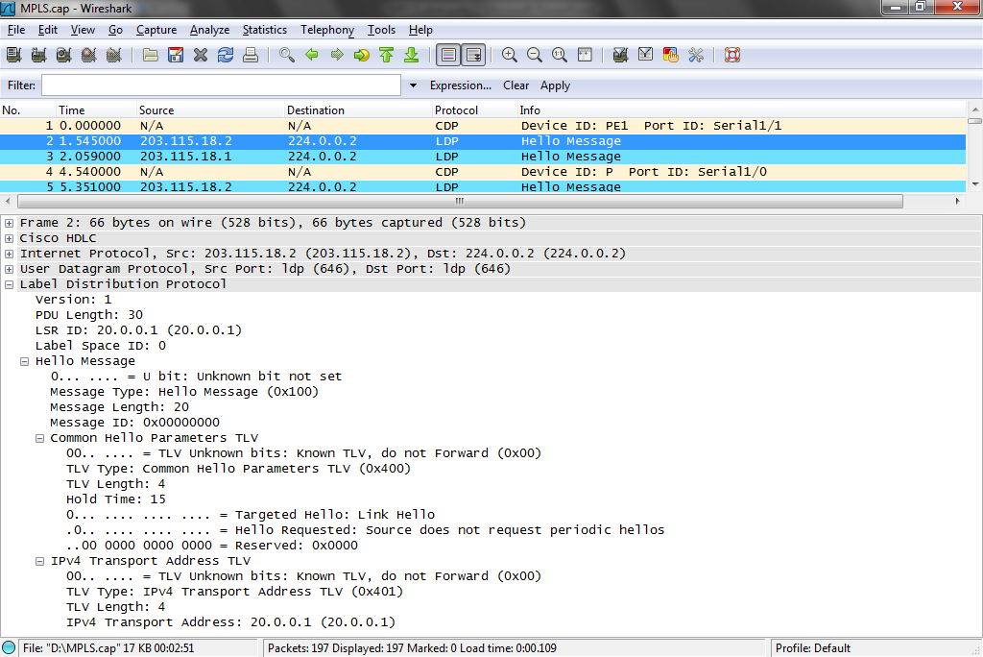
MPLS Label Capture File

Slide 25
MPLS Label Capture File
Let’s look at some labels next
Select frame 57
Starting here some ping traffic is going back and forth
Expand both of the Label layers
In frame 57 we see stacked labels
That is two labels in the same frame

Slide 26
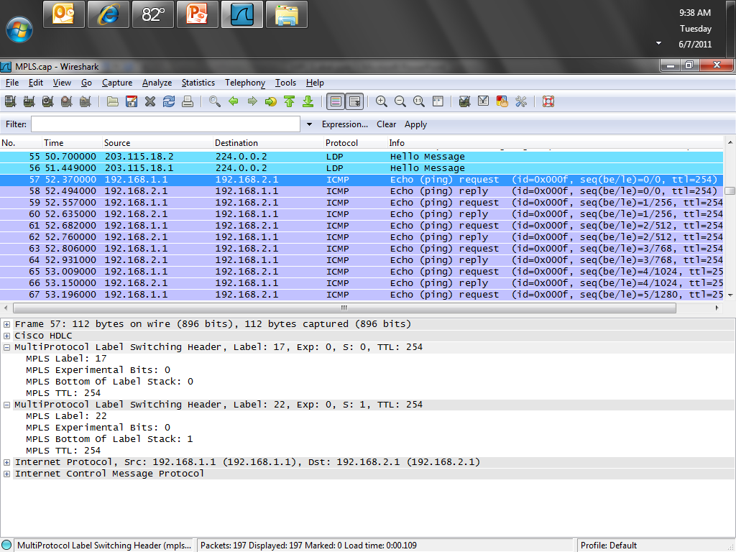
MPLS Label Capture File

Slide 27
MPLS Label Capture File
Select frame 58
Here there is just one label

Slide 28
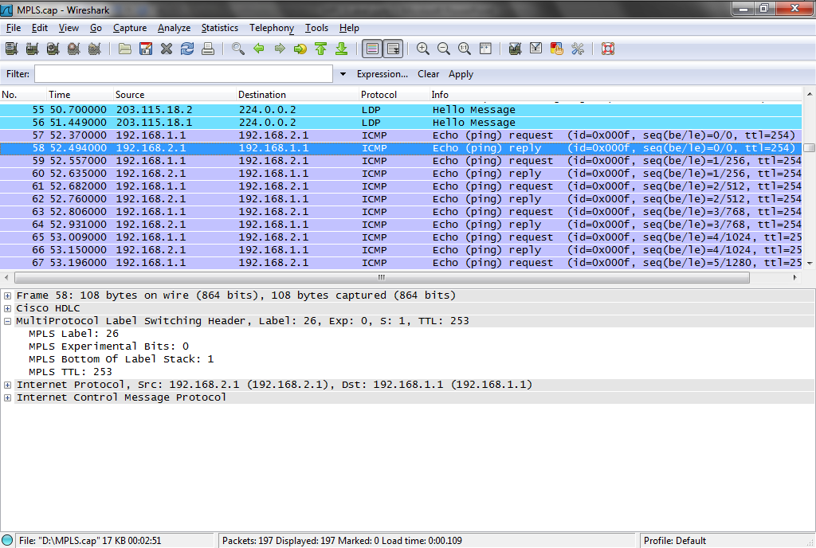
MPLS Label Capture File

Slide 29
MPLS Label Capture File
Notice that the labels are only used for standard data traffic, not for overhead traffic such as OSPF keep-alives

