Slide 1
ISDN Box
Last Update 2010.01.17
1.1.0

Slide 2
Objectives of This Section
Learn
  What ISDN equipment looks like

Slide 3
ISDN Equipment
At the end user site an ISDN line only requires a single box, but this box performs several functions
The type of box also depends on whether the box is ISDN aware or not
  Specialized ISDN terminals are referred to as TE1 - Terminal Equipment Type 1
  Non-ISDN devices are referred to as TE2 - Terminal Equipment Type 2

Slide 4
ISDN Equipment
TE1s connect directly to the ISDN network through a four wire, unshielded twisted pair cable
TE2s connect to the ISDN network through a TA – Terminal Adaptor
The ISDN TA can be either a standalone device or a board inside the TE2

Slide 5
ISDN Equipment
Beyond the TE1 and TE2 devices, the next connection point in the ISDN network is the NT1 - Network Termination Type 1 or NT2 - Network Termination Type 2 device
These are network-termination devices that connect the four-wire subscriber wiring to the conventional two-wire local loop

Slide 6
ISDN Equipment
In North America, the NT1 is a customer premises equipment device
The function of the NT1 is similar to the CSU/DSU
In most other parts of the world, the NT1 is part of the network provided by the carrier
The NT2 is a more complicated device that typically is found in PBXs

Slide 7
ISDN Equipment
The typical ISDN box looks like an external analog modem
It is usually provided by the carrier, but you could buy your own
For example

Slide 8
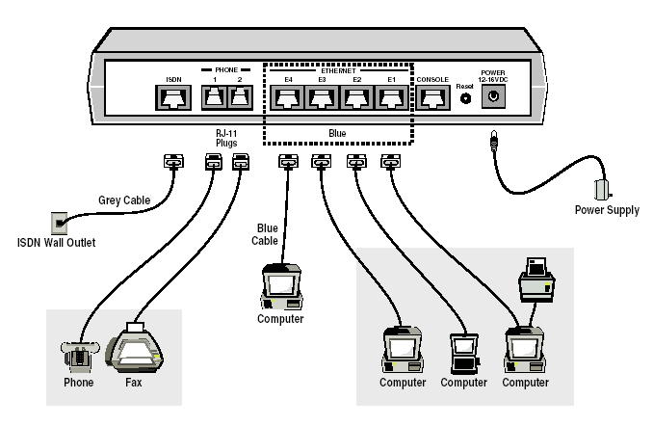
ISDN Equipment

Slide 9
ISDN Equipment
In the example above just four ports are shown for LAN connections
This is because ISDN is usually used for small offices or telecommuters with limited devices on site
Recall that BRI is just 128 Kbps

Slide 10
ISDN Equipment
If more devices than whatever the ISDN box has ports for are needed, a hub can be plugged into one port and more devices added that way, at least on the LAN side

Slide 11
Setup
As you can see the hardware hookup is pretty simple for ISDN
The cabling used is a standard UTP Category 5 cable with RJ-45 connectors
The specifications allow for quite a distance from the demarc to the ISDN equipment, up to a kilometer
But this is unwise, closer is always better, for troubleshooting if nothing else

Slide 12
Another Way
Another box that can be used is a standard router that has an ISDN port
If this is used instead of a single purpose ISDN box, then the router must be configured to talk ISDN of course

Slide 13
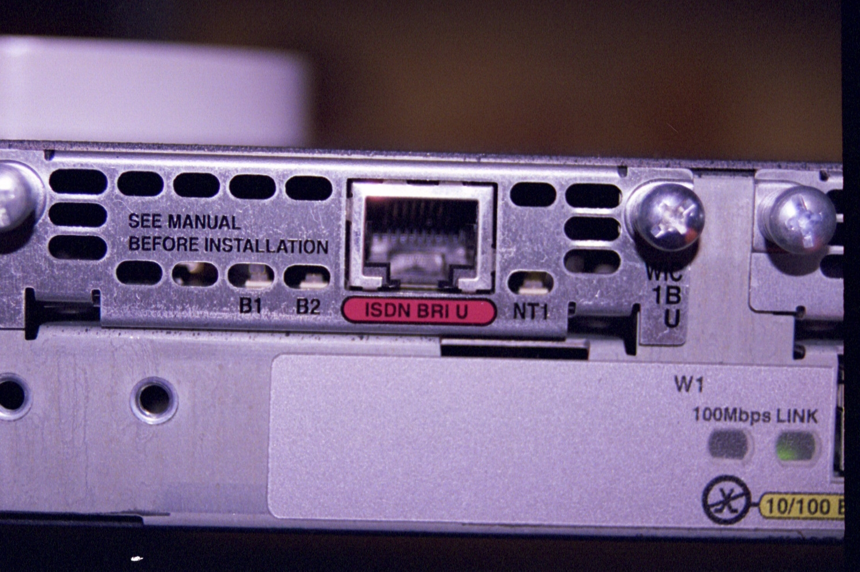
Another Way

