Slide 1
ISDN Last Update 2011.05.06 1.3.0

Slide 2
Objective
Learn what ISDN is and how it is used

Slide 3
What is ISDN
ISDN – Integrated Services Digital Network was meant to be the way to use the existing PSTN, copper, analog phone system to deliver voice, video, data, and music to any location over a single physical line as a digital instead of an analog circuit
It was the first attempt at convergence
Before ISDN a separate interface was required for each of those services

Slide 4
What is ISDN
ISDN was first deployed in the late 1980s
ISDN was defined by the ITU-T in 1984
Although it is still widely available and somewhat widely used, it never took off
The main problems were
Poor marketing by the phone companies
Poor implementation by the phone companies
Priced too high by the phone companies

Slide 5
What is ISDN
Too little bandwidth was defined by the BRI interface for the amount of information to be sent, as BRI was meant as the main deployment method for ISDN

Slide 6
Current Use
Currently ISBN is used to link a small office to the main office
It is also commonly used as a backup line for higher speed circuits
ISDN can be deployed as a switched circuit or an always on circuit

Slide 7
Speeds
ISDN is offered at two basic speeds
BRI – Basic Rate Interface or 2B+D
B Channel - 64 Kbps - Data
B Channel - 64 Kbps - Data
D Channel - 16 Kbps – Control
128 Kbps data rate
PRI – Primary Rate Interface or 24B+D
23 B Channels
1 D Channel
1.544 Mbps data rate

Slide 8
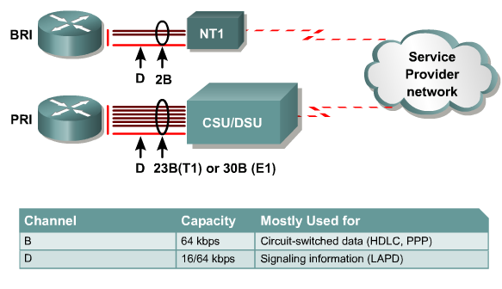
ISDN Access Options

Slide 9
Setup
The most difficult part of ISDN circuit setup is getting the service provider and the ISDN box talking the same language
In general there are six basic ways a service provider can setup an ISDN line
Try to find out what method they use and set the ISDN box on your end to match

Slide 10
Setup
As Eicon – a maker of ISDN equipment - says these are
EZ-ISDN 1 or IOC: U
Offers voice and data on both ISDN channels and supports advanced calling features such as call conference, call transfer, and caller ID on the first ISDN number
EZ-ISDN 1A or IOC: V
Same as EZ-ISDN 1, but adds voice mail

Slide 11
Setup
IOC: “S”
Offers voice and data on both ISDN channels, but without any advanced calling features
If you select this package, make sure to get Additional Call Offering (ACO), which is required for call bumping and call waiting to work correctly
EZ-ISDN 3 or 3A
Same as EZ-ISDN 1 (1A), plus adds support for Always On/Dynamic ISDN (AO/DI)

Slide 12
Setup
Capability Package AB
Same as IOC U, but with advanced calling support on both channels and support for AO/DI
Capability Package AC
Same as IOC V, but with advanced calling support on both channels and support for AO/DI

Slide 13
Setup
You will also need to find out the following from the service provider
At least the SPID
This is the line identification number
And maybe the ISDN switch type they use, which could be
National ISDN-1
AT&T 5ESS
AT&T 5ESS Point-to-Point

Slide 14
ISDN Switch Types

Slide 15
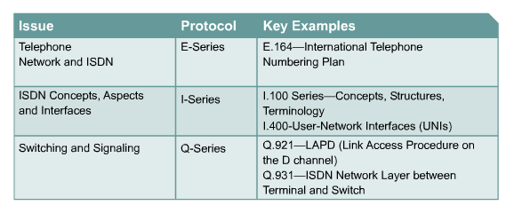
ISDN Standards

Slide 16
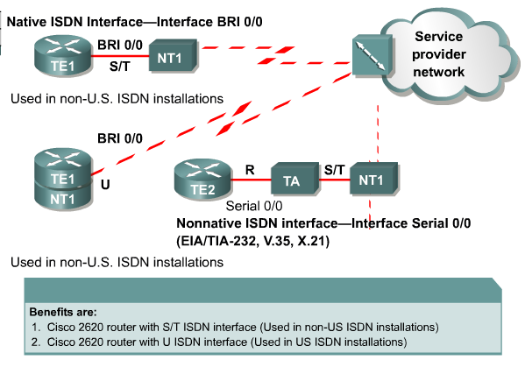
Cisco ISDN BRI Interfaces

Slide 17
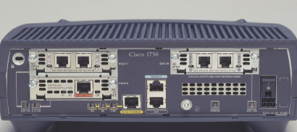
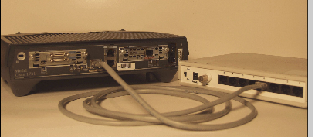
ISDN Interfaces
S/T ISDN Interface
U ISDN Interface

Slide 18
Reference Points
As seen in the literature and occasionally discussed during implementation of an ISDN circuit, there are reference points defined in an ISDN network
Each of these points is indicated by a letter
As in

Slide 19
Reference Points
CUSTOMER SITE |  |  |  |  |  |  | SERVICE PROVIDER
ISDN | TE1 |  |  | S | NT2 | T | NT1 | U | LT | V | ET
NON ISDN | TE2 | R | TA | S | NT2 | T | NT1 | U | LT | V | ET

Slide 20
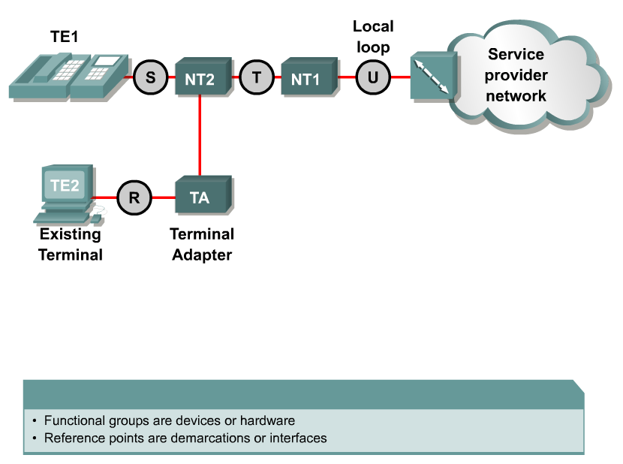
ISDN Reference Points
R: the connection between a non-ISDN Terminal Equipment (TE2) and a Terminal Adapter (TA), e.g. an RS-232 serial interface
S: references the points that connect into the customer switching device Network Termination type 2 (NT2) and enables calls between the various types of customer premises equipment
T: electrically identical to the S interface, it references the outbound connection from the NT2 to the ISDN network or Network Termination type 1 (NT1)
U: the connection between the NT1 and the ISDN network owned by the telephone company

Slide 21
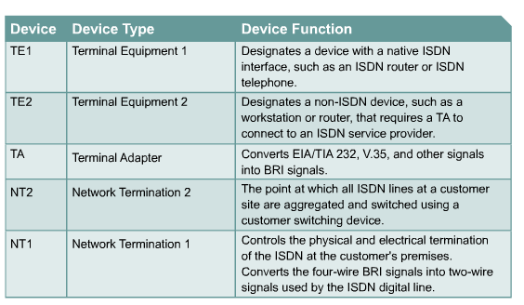
ISDN Functions

Slide 22
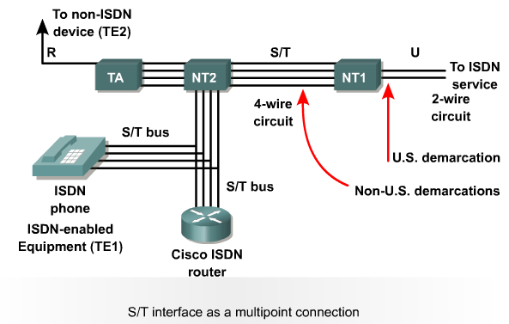
BRI Reference Points

Slide 23
Reference Points
In the diagram ISDN means equipment designed to connect to an ISDN network
TE1 is the ISDN designed equipment
By non ISDN is meant standard equipment
TE2 is the non ISDN equipment
The S and T points are one in most locations so this is referred to as the S/T reference point

Slide 24
Reference Points
It is the customer part of the network
U and V are the service provider reference points

Slide 25
ISDN and the OSI Model layers
ISDN uses two channels, one for the control information on the D channel and one for the useful data on the B channels
This means that different things happen on the same circuit depending on whether the transmission is control or data related
Let’s look at what happens on each channel in relation to the OSI model layers
BRI will be used for this purpose

Slide 26
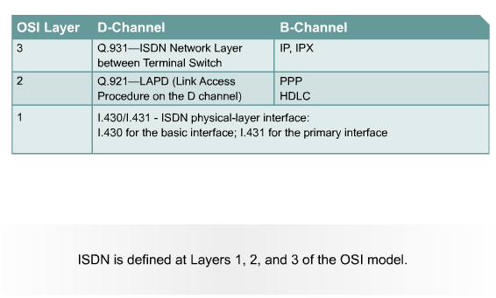
ISDN 3-Layer Model

Slide 27
ISDN at Layer 1
ISDN uses two different frame formats at layer 1 for the B channel
One is used for incoming data and one for outgoing
These frames are 48 bits long, with 36 bits of that being data
On both the D and B channels the I.430 protocol is used
Which channel is active is determined by TDM – Time Division Multiplexing

Slide 28
ISDN at Layer 2
At layer 2 the channels differ
On the D channel the protocol is LAPD – Link Access Procedure - D Channel for BRI
As the acronym indicates layer 2 is used on the D channel to ensure that the control and signaling information is sent and received properly
LAPD is similar to HDLC

Slide 29
LAPD Frame
FLAG
ADDRESS
CONTROL
DATA
FCS
FLAG

Slide 30
LAPD Frame
The flags mark the start and finish of the frame
The address tells us where it is going and where it has come from
There are two identifiers here
The SAPI – Service Access Point Identifier indicates what higher level protocol is being carried in the data field
The TE1 identifier points to the equipment on a multipoint line at the customer site

Slide 31
LAPD Frame
Control identifies the
frame type
The data is the important stuff
FCS is the error checking

Slide 32
ISDN at Layer 2
On the B channel at layer 2 the data is carried by PPP

Slide 33
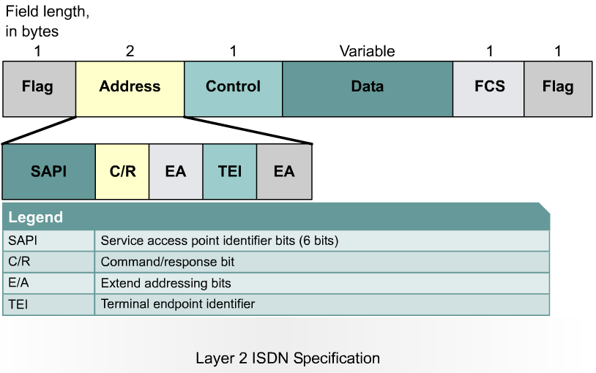
ISDN Data Link Layer

Slide 34
ISDN at Layer 3
ISDN layer 3 specifications are used for ISDN signaling on the D channel
Q.931 is commonly used here
On the B channel the data uses TCP/IP these days
Let’s look at an example of a B channel ISDN frame

Slide 35
ISDN at Layer 3

Slide 36
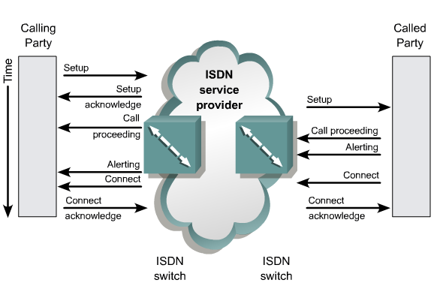
Q.931 Messaging-Call Setup

Slide 37
Call Processing
The D channel is used to send the called number to the local ISDN switch
The local switch uses the SS7 signaling protocol to set up a path and pass the called number to the remote ISDN switch
The remote ISDN switch signals the destination over the D channel
The destination ISDN NT-1 device sends the remote ISDN switch a call-connect message
The remote ISDN switch uses SS7 to send a call-connect message to the local switch
The local ISDN switch connects one B channel end-to-end, leaving the other B channel available for a new conversation or data transfer. Both B channels can be used simultaneously

Slide 38
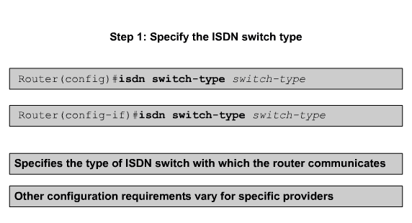
Configuring ISDN BRI

Slide 39
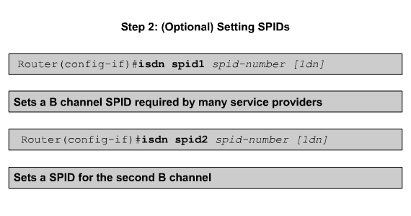
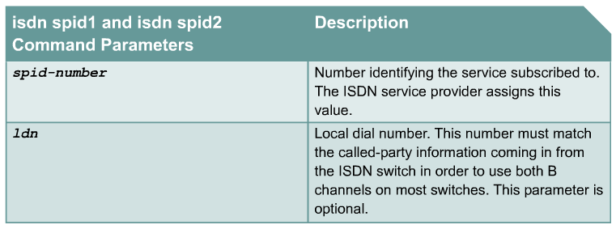
Configuring ISDN BRI

Slide 40
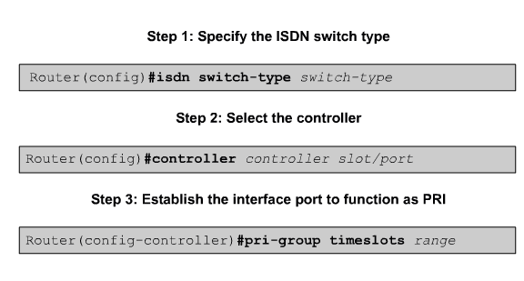
Configuring ISDN PRI

Slide 41
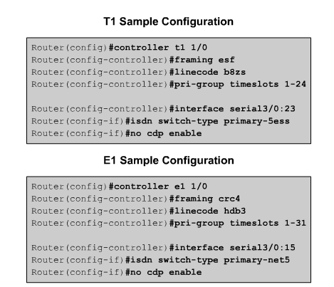
ISDN PRI Examples

Slide 42
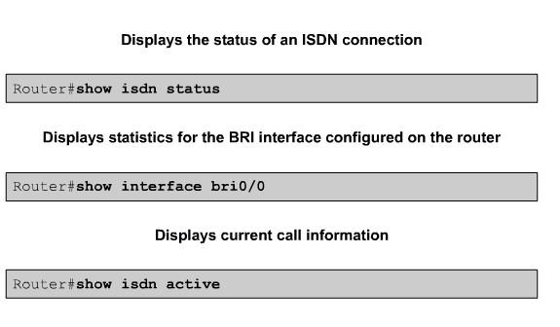
Verifying ISDN Configuration

Slide 43
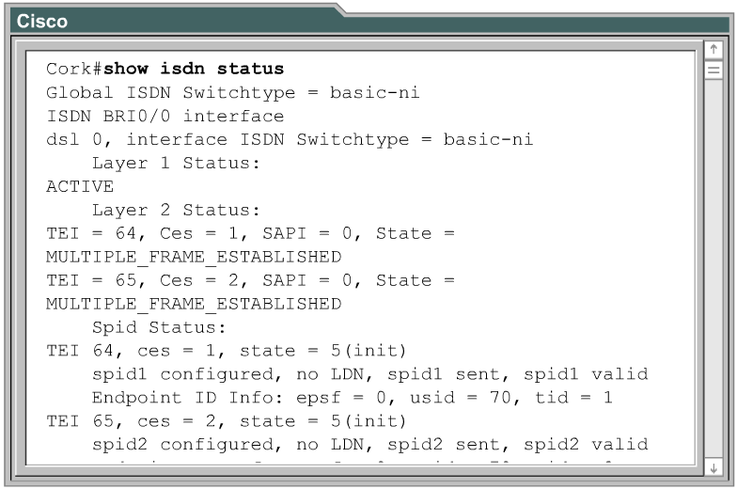
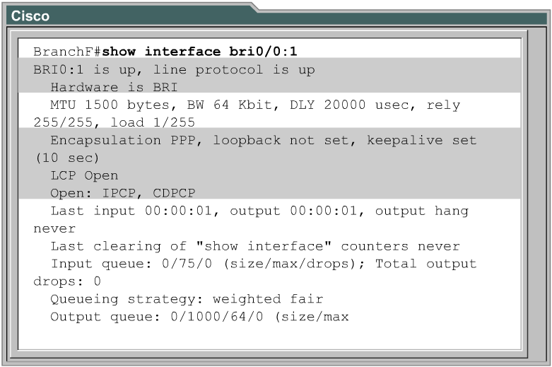
Verifying ISDN Configuration

Slide 44
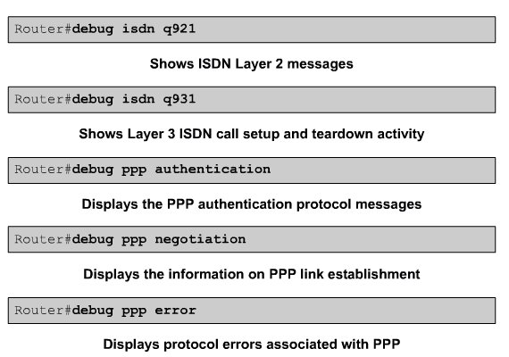
Troubleshooting ISDN

Slide 45
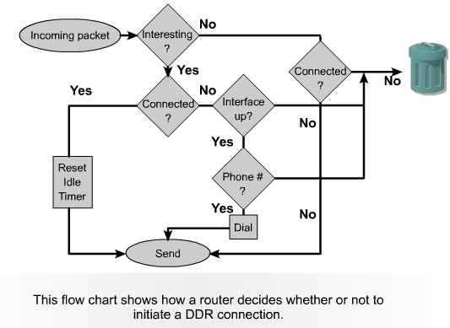
DDR Operation

Slide 46
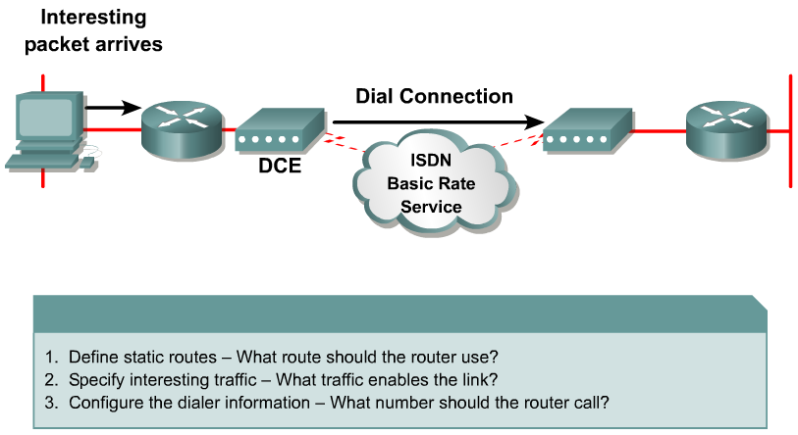
Configuring Legacy DDR

Slide 47
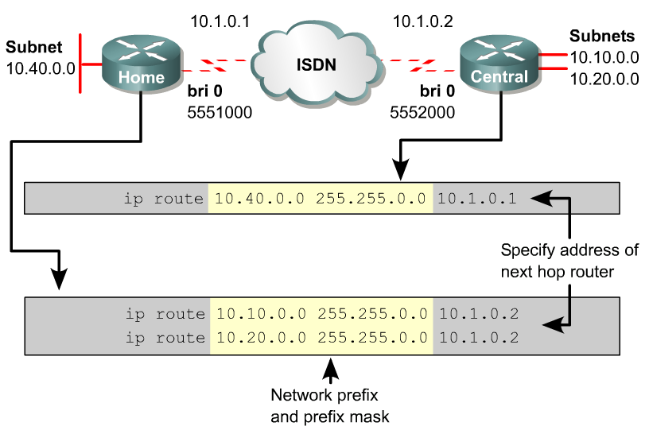
Defining Static Routes for DDR

Slide 48
Static Route Considerations
When configuring static routes, consider the following
By default, a static route will take precedence over a dynamic route because of its lower administrative distance
Without additional configuration, a dynamic route to a network will be ignored if a static route is present in the routing table for the same network.
To reduce the number of static route entries, define a summarized or default static route

Slide 49
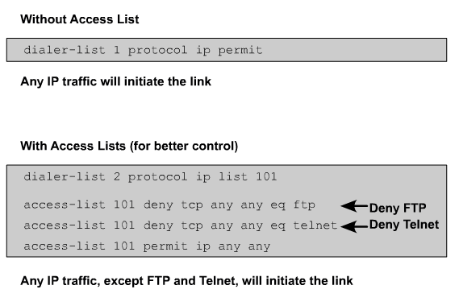
Specifying Interesting Traffic

Slide 50
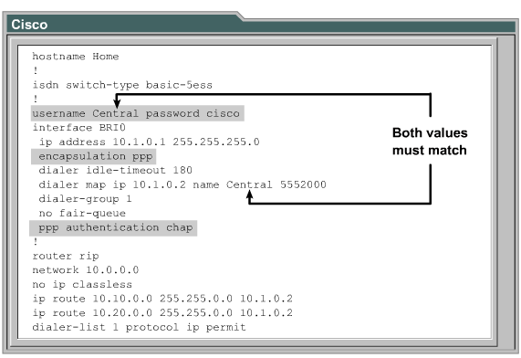
Configuring Dialer Information

Slide 51
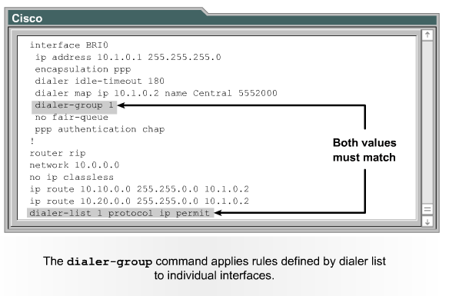
dialer-group

Slide 52
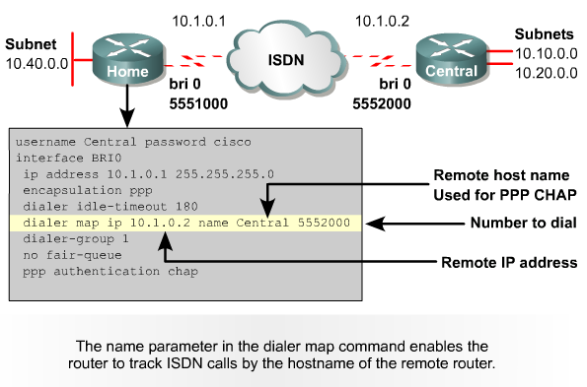
dialer-map

Slide 53
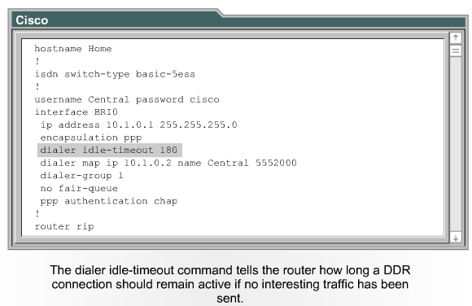
dialer idle-timeout

Slide 54
Dialer Profiles Overview
Define encapsulation and access control lists
Determine minimum or maximum calls
Turn features on or off

Slide 55
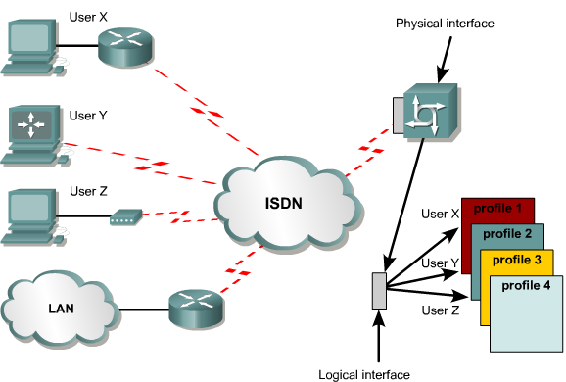
Dialer Profiles Overview

Slide 56
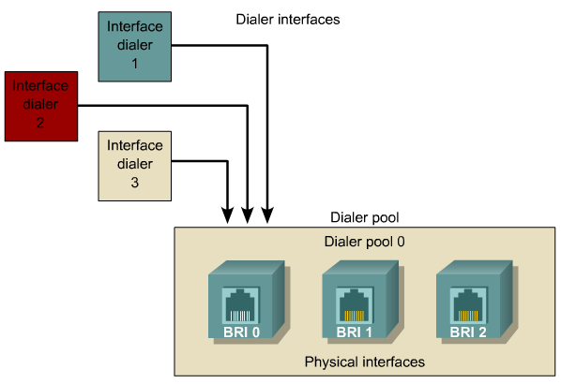
Dialer Profile Elements

Slide 57
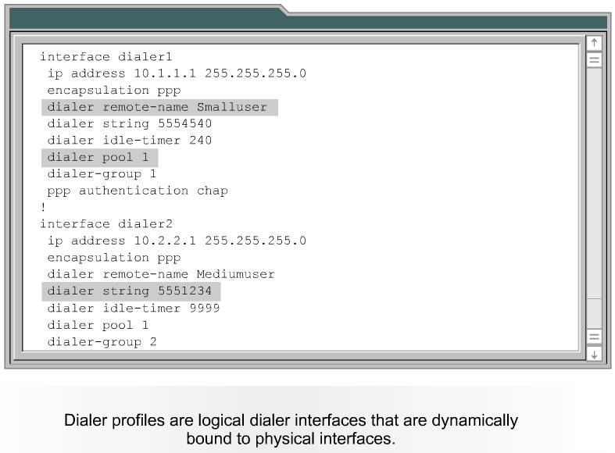
Configuring Dialer Interfaces

Slide 58
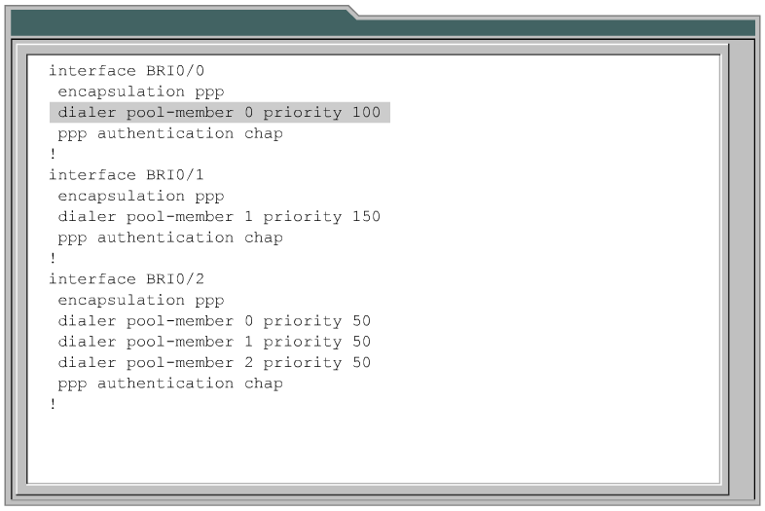
Configuring Physical Interfaces

Slide 59
Verifying DDR
show dialer
show dialer interface [BRI]
show isdn active
show isdn status

Slide 60
Troubleshooting DDR
debug isdn q921
debug isdn q931
debug dialer [events|packets]
isdn call interface
clear interface bri

