Slide 1
IAD
Last Update 2010.01.17
1.2.0

Slide 2
Objectives of This Section
Learn
What an IAD is

Slide 3
What is an IAD
Another way to connect to a WAN is to use an IAD - Integrated Access Device
This can be instead of or in addition to the router and CSU/DSU setup
The IAD provides a way to mix and usually compress traffic from many sources and types onto a single data line
This is used at the CAN, MAN, and WAN levels

Slide 4
What is an IAD
IADs are commonly used to mix data and voice on the same line
Video is sometimes added as well
The driver behind this is the desire to reduce the number of separate lines that must be maintained and paid for
Why have copper for voice, fiber for data, and coax for video; when a single line can do all three

Slide 5
What is an IAD
Another way these units function is by dynamically reallocating unused bandwidth from one use to another
The idea is to keep the pipe completely full at all times

Slide 6
How Does the IAD Work
This type of aggregation has typically been done at the phone company's central office
In this approach the aggregation is done on the customer premises
Devices like this are aimed primarily at small and medium size businesses

Slide 7
How Does the IAD Work
All traffic is combined by this device and then sent out of the building on a single line
This line can be a T1, Fractional T1, DSL, or dark fiber for ATM cell traffic
On the customer end the PBX, router, fax machine, video codec or like devices are plugged into the IAD

Slide 8
How Does the IAD Work
It then sends this traffic off to similar device operated by a service provider that breaks the traffic back out for distribution over the normal means
Unless the IAD is being used in a CAN or MAN solely controlled by the user, a service provider is required at the other end

Slide 9
How Does the IAD Work
In fact most of these devices are being sold to service providers, who are then turning around and selling the equipment and the service to the end user
At the CAN level these devices are used to reduce the number of fiber links required to connect buildings to each other

Slide 10
How Does the IAD Work
In this case the vendor performs a one time installation and setup of the devices at each end of the connection
Many of these boxes are ATM devices
This will help to keep ATM in the game for awhile
In the CAN area they are connected to clear channel T1 lines

Slide 11
Why Use an IAD
The ability of these devices to squeeze more useable bandwidth out of an existing line or to reduce the number of lines is the driving factor in the purchase of these devices for most folks

Slide 12
IAD
Next are a set of photographs showing a small IAD
It has a WAN and a LAN port as well as voice ports

Slide 13
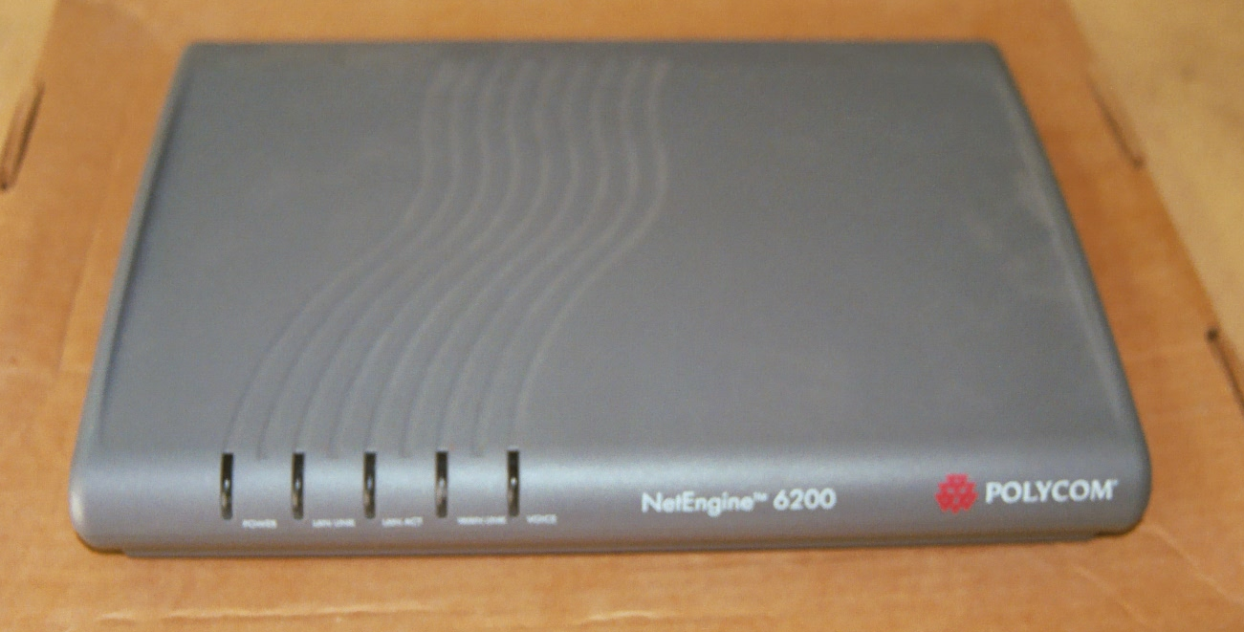
IAD Front

Slide 14
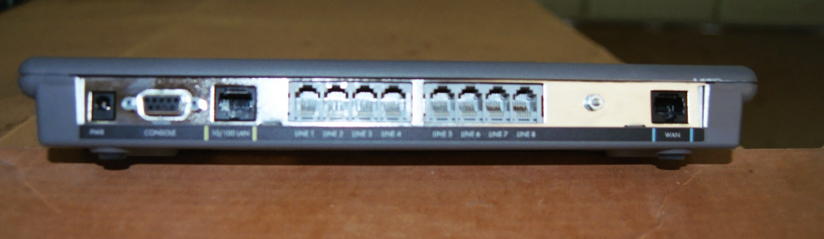
IAD Back

Slide 15
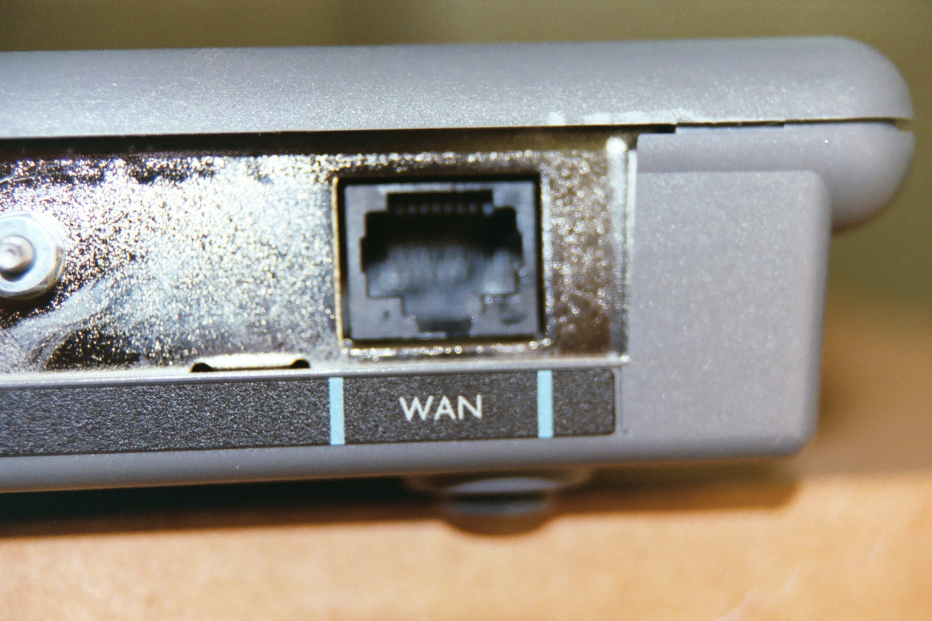
IAD Ports

Slide 16
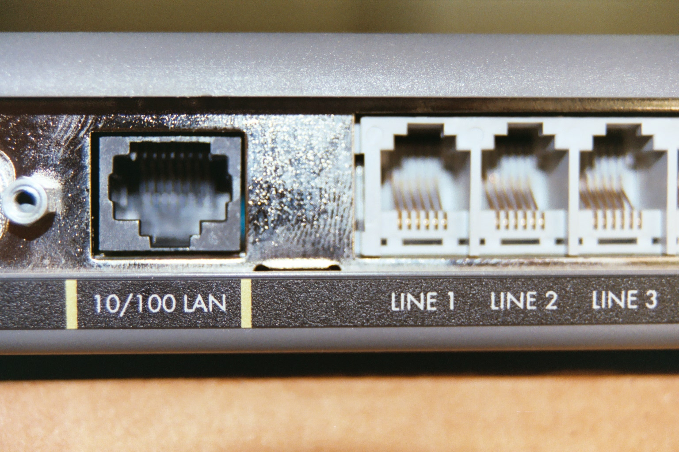
IAD Ports

