Slide 1
HDLC
Last Update 2012.04.30
1.5.0

Slide 2
Objectives of This Section
Learn
What HDLC is
Where HDLC is used
How HDLC operates

Slide 3
Context
Layer | 2
Network Type | WAN

Slide 4
Layers
As a layer 2 technology HDLC must have something below it at layer 1 to ride on, as well as something at layers 3 through 7 in order to operate
Typically this is
Layer 1
T Carrier
Layer 3 through 7
TCP/IP

Slide 5
What is HDLC
HDLC – High Level Data Link Control Protocol is a layer 2 encapsulation method used to send data over a point-to-point serial link, such as a T1 line
This is a bit oriented protocol that was developed by the ISO
It is based on IBM’s SDLC – Synchronous Data Link Control protocol
HDLC was released as a standard in 1979

Slide 6
Operation
Even though HDLC is a standard of sorts, every vendor’s implementation of HDLC is slightly different
This means one vendor’s router at one end of a line cannot talk HDLC to another vendor’s router at the other end of the line

Slide 7
Operation
Unlike most proprietary solutions, vendors will allow any other vendor to support their implementation of HDLC if the other vendor wants to
For example the Cisco version of HDLC, often called cHDLC, is also supported by Juniper Networks on some of their systems

Slide 8
Operation
An ancillary protocol used by HDLC is SLARP – Serial Line Address Resolution Protocol
SLARP is used for configuration and management of the link
For configuration it can be used to assign an IP address to the other end of the link, at least in the Cisco version of HDLC

Slide 9
Operation
For management it is responsible for sending out keepalives to ensure the other end of the connection is still talking

Slide 10
HDLC Frame Format
HDLC specifies three different frame formats
The only difference is what is in the control field
The types are
I – Information frame
S – Supervisory frame
U – Unnumbered frame

Slide 11
HDLC Frame Format
The I frame is used to carry data
The S frame is used for flow control
The U frame handles link initialization and disconnection

Slide 12
HDLC Frame Format
Flag
Address
Control
Data
FCS
Flag

Slide 13
HDLC Frame Format
These fields do the following
Flag
1 byte
This field marks the start of the frame
The value is always 0x7E, the 0x means the number is a hexadecimal number

Slide 14
HDLC Frame Format
Address
1 byte
This field serves no real purpose, as HDLC does not really use addressing
The address is always 0F or 8F, for either unicast or multicast
0F is used when the end point is known, such as data transfer
8F is used for keep alive frames

Slide 15
HDLC Frame Format
Control
1 byte
This field is used, as described above, to indicate the use of the data area
Data Field
Variable size
This field contains the important stuff

Slide 16
HDLC Frame Format
FCS
2 bytes, but can be 4 bytes
The FCS – Frame Check Sequence is the CRC used to ensure everything arrived intact
Flag
1 byte
This field marks the end of the frame
The value is always 0x7E

Slide 17
Cisco HDLC Frame Format
Flag
Address
Control
Type Code
Data
FCS
Flag

Slide 18
Cisco HDLC Frame Format
Cisco adds one additional field
Type Code
2 bytes
This is used as a protocol field to indicate the protocol at the next level
The EtherType codes are used in most cases, unless Ethernet does not have a corresponding function
For example, 0x800 means IP and 0x8137 means IPX

Slide 19
HDLC Capture File
Let’s look at some real HDLC frames
Download this file
HDLC with RIP.cap
Open it in Wireshark by double-clicking it

Slide 20
HDLC Capture File
Select frame 5
First we see some keep alive frames
Expand all of the fields
As mentioned above SLARP is used by Cisco for these keep alive frames

Slide 21
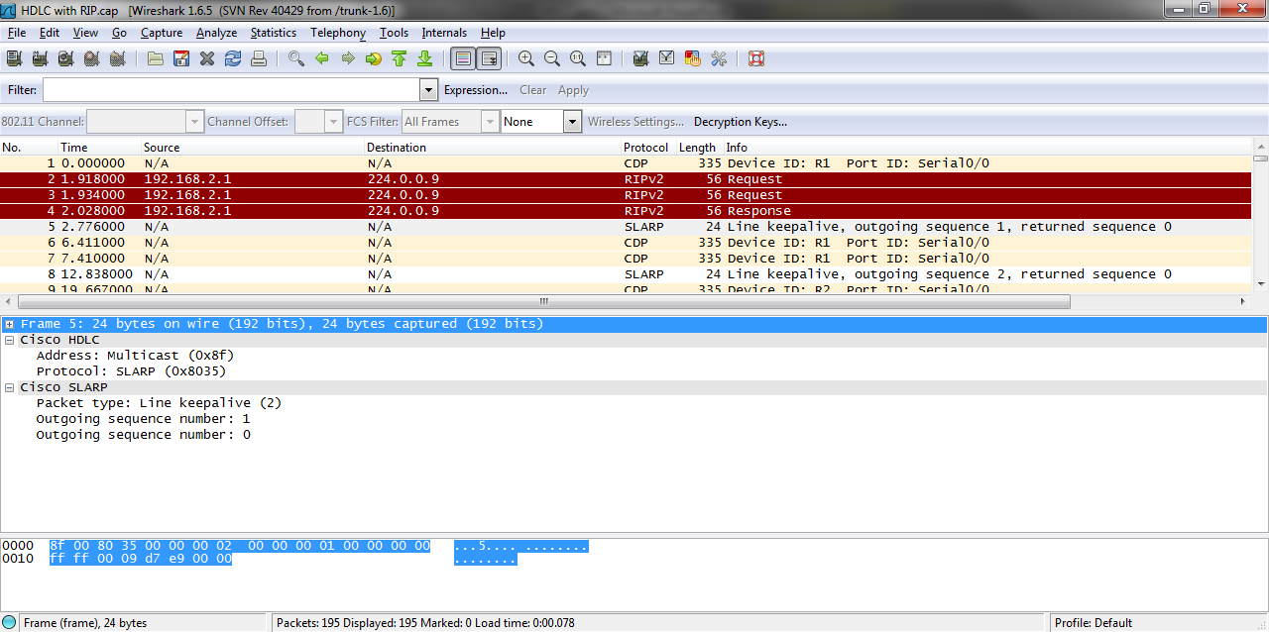
HDLC Capture File

Slide 22
HDLC Capture File
Down in frame 29 a ping packet is sent
Notice the address field changes from the multicast used for the keep alive frames to a unicast address as the ping goes to a specific end point
The protocol field holds the code for IP at the next layer

Slide 23
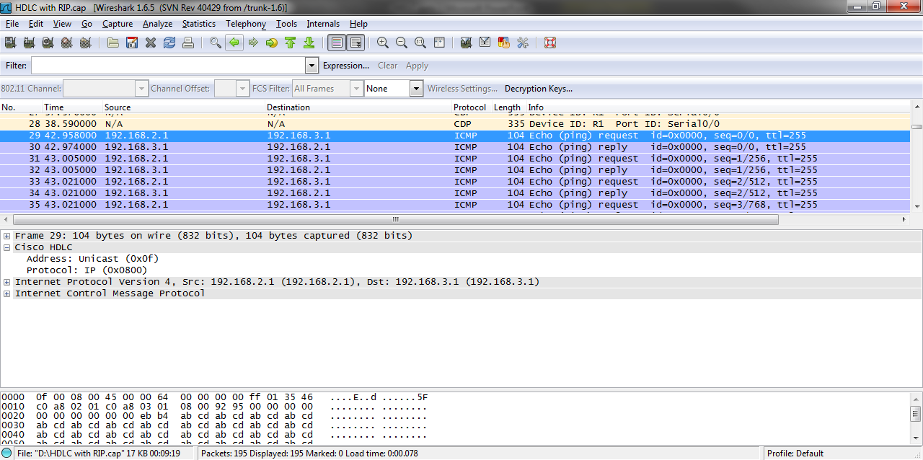
HDLC Capture File

Slide 24
SLARP
A SLARP – Serial Line Address Resolution Protocol frame is often seen along with cHDLC frames as these are used as keep alive messages for the link
SLARP is also used like a reverse ARP to receive an IP address over a serial line similar to receiving a address via DHCP on a LAN or to learn the IP address of the neighboring router

Slide 25
Troubleshooting HDLC
The first thing to do when a problem arises on a link that uses HDLC is to check the physical connection
Also check the configuration of physical layer devices, such as the CSU/DSU
This is by far the most common source of the trouble
There is little troubleshooting for HDLC

Slide 26
Troubleshooting HDLC
About the only thing to examine are the sequence numbers in the keepalive packets as discussed in Oppenheimer and Bardwell

Slide 27
For More Information
T1: A Survival Guide
Matthew S. Gast
ISBN 0-596-00127-4
Troubleshooting Campus Networks
Priscilla Oppenheimer and Joseph Bardwell
ISBN 0471210137

