Slide 1
Frame Relay Last Update 2011.06.01 1.5.0

Slide 2
Objective
Learn what Frame Relay is and how it is used

Slide 3
What is Frame Relay
Frame Relay is a service that you buy from a service provider
Frame Relay is quite ubiquitous
But is going away as MPLS works its way lower and lower down into other markets
However, Frame Relay will be around for a long, long time

Slide 4
What is Frame Relay
Frame Relay is a data transmission method that differs from those that preceded it such as X.25 and T Carrier
In contrast to X.25 it assumes that upper layer protocols will do all error checking and correction
In contrast to T Carrier it sends data over a shared network instead of dedicated lines

Slide 5
What is Frame Relay
Frame Relay was derived from X.25 and ISDN
Recall that X.25 was developed for use over unreliable data lines made of copper
Frame Relay recognizes that data lines are now highly reliable and run over fiber
Frame Relay removes the extensive error checking built into X.25

Slide 6
What is Frame Relay
The original Frame Relay standard was developed in the 70s and 80s as a service for ISDN
No one ever did anything with this idea at that time
Robert Gourley of WilTel is credited with the initial development of Frame Relay in 1991

Slide 7
What is Frame Relay
Gourley’s original intention was just to develop a new product for WilTel rather than change the world
It later developed that this was a good way to lower cost, since the data was going over a shared network rather than a private network

Slide 8
What is Frame Relay
Of course this was a hard sell to convince people to move off of what they saw as the safer and more secure private networks they had built to public networks
As in all cases, lower cost wins
Despite the lower cost a major problem with Frame Relay is a lack of QoS for time sensitive traffic

Slide 9
Frame Relay Operation
Frame Relay is a two part technology
It requires an underlying data line to carry traffic from the customer site to the Frame Relay Cloud
The data line typically used is a T Carrier circuit

Slide 10
Frame Relay Operation
But be aware of the downside
The Frame Relay Cloud as we will see is the carrier’s network
It is shown as being a series of Frame Relay switches
In practice it is the same ATM over SONET network that we have discussed before
This is a connection oriented circuit

Slide 11
Frame Relay Operation
These circuits are created as virtual circuits over the physical T carrier circuit
As discussed below these virtual circuits are software defined end points that connect Point A to Point B
These circuits do not represent fixed paths, but rather connections between these end points through the service provider’s internal network

Slide 12
Frame Relay Operation
The beginning and ending points of the circuit will never change, although the exact path through the service provider’s network may change
If it does, this change is transparent to the circuit

Slide 13
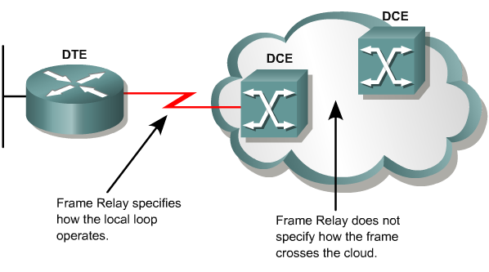
Frame Relay Operation

Slide 14
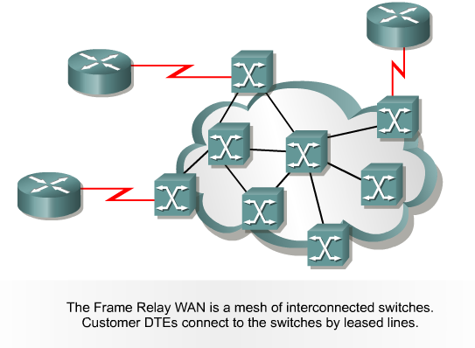
Frame Relay Switches

Slide 15
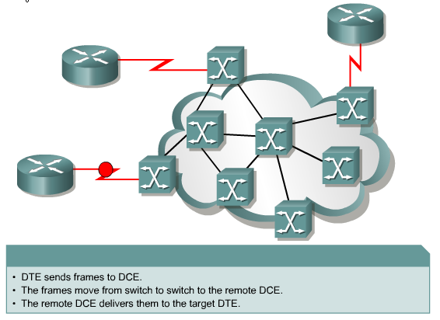
Frame Relay Concepts

Slide 16
DLCI
Each Frame Relay virtual circuit is labeled with an identification number called a DLCI – Data Link Connection Identifier
DLCIs are represented by 10 bits, so there are 1,024 total addresses, from 0 through 1023
Generally 16 through 991 are used
The others are reserved for various things like management information

Slide 17
DLCI
Such as, DLCO 0 which is used for signaling

Slide 18
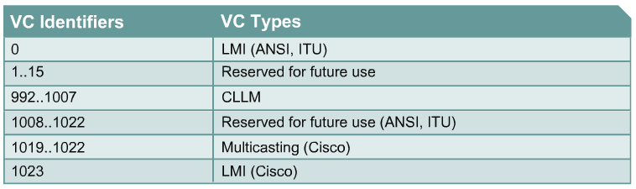
DLCI

Slide 19
DLCI
DLCIs have only local significance
That is the number used to identify a circuit at one switch may not be the number used at the next switch
The DLCI is used to keep track of the multiple virtual circuits that may exist over a single physical circuit
The DLCI is stored in the address field of every frame transmitted

Slide 20
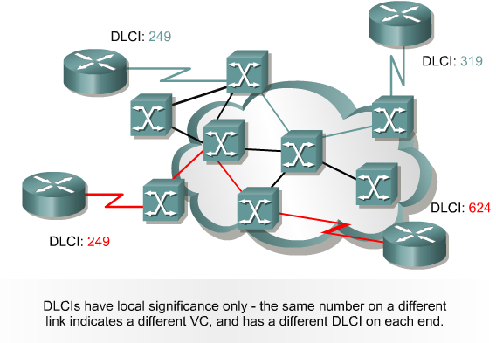
Local Significance of DLCIs

Slide 21
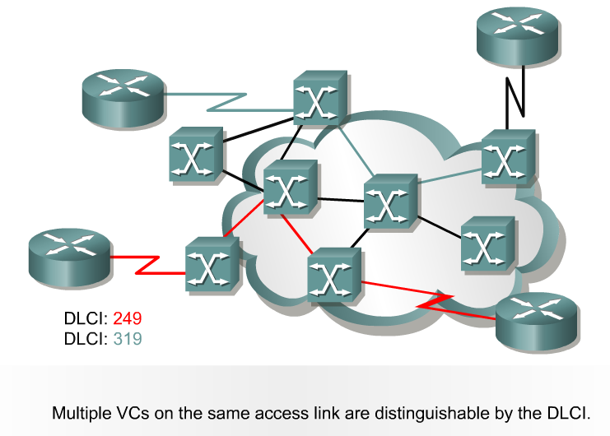
DLCI

Slide 22
Virtual Circuits
The connection through the Frame Relay network between two DTEs is called a VC - virtual circuit
Virtual circuits may be established dynamically by sending signaling messages to the network
In this case they are called SVC - switched virtual circuits

Slide 23
Virtual Circuits
Virtual circuits can be configured manually through the network
In this case they are called PVC - permanent virtual circuits

Slide 24
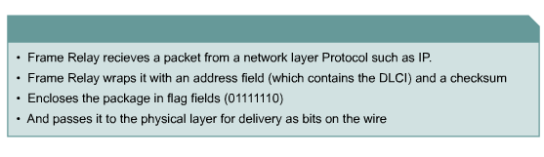
Frame Relay Functions

Slide 25
Congestion Control
Frame Relay networks use three methods for controlling congestion
Frame discarding
Explicit congestion notification
Implicit congestion notification

Slide 26
Congestion Control
The network starts by dropping frames that have the DE - discard-eligible bit set - those frames that are above and beyond the customer's CIR, which is the amount of data the customer can send
The carrier's network will automatically set a bit in any frame that is above the CIR as DE

Slide 27
Congestion Control
In addition, users can set certain traffic as DE to indicate that a given frame has a lower priority than another
DE can be set by any Frame Relay device including the router
If the network discards a frame, the higher-layer protocol will detect this and retransmit the frame

Slide 28
Congestion Control
These lost frames should also cause some of the inherent self-limiting flow control in TCP/IP to kick in
However, this process tends to fuel the congestion problem, as the volume of traffic increases each time retransmission occurs

Slide 29
Congestion Control
More efficient than discarding frames is slowing down the rate at which frames are delivered into the network
Slowing down the rate is the function of two mechanisms
FECN – Forward Explicit Congestion Notification
BECN - Backward Explicit Congestion Notification

Slide 30
Congestion Control
FECN sends a message to the router at the far end of the connection asking that router to tell the router at the originating end of the connection to slow down
It does this by setting the FECN bit to 1 on all packets it is sending on to the end point router

Slide 31
Congestion Control
Backward Explicit Congestion Notification sets the BECN bit to 1 on packets going through it back to the originating router
Most routers ignore FECN and a few respond to BECN

Slide 32
Congestion Control
These congestion control bits are not set by routers or FRADs
They are only set by the Frame Relay switches that make up the carrier's network
In practice most congestion control is just handled by the upper layer protocols

Slide 33
Congestion Control
In general Frame Relay networks just throw out the mail they cannot handle, much as the Post Office does with Bulk Mail

Slide 34
Frame Relay Frame Format
As described by www.protocols.com the Frame Relay frame looks like this

Slide 35
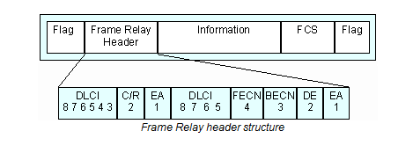
Frame Relay Frame Format

Slide 36
Frame Relay Frame Format
In it we find the following fields
DLCI
10-bit DLCI field represents the address of the frame and corresponds to a PVC
C/R
Designates whether the frame is a command or response

Slide 37
Frame Relay Frame Format
EA
Extended Address field signifies up to two additional bytes in the Frame Relay header, thus greatly expanding the number of possible addresses
FECN
Forward Explicit Congestion Notification
BECN
Backward Explicit Congestion Notification

Slide 38
Frame Relay Frame Format
DE
Discard Eligibility
Information
The Information field may include other protocols within it, such as an X.25, IP or SDLC (SNA) packet

Slide 39
Frame Relay Capture
Here is a Frame Relay frame as seen in a protocol analyzer

Slide 40
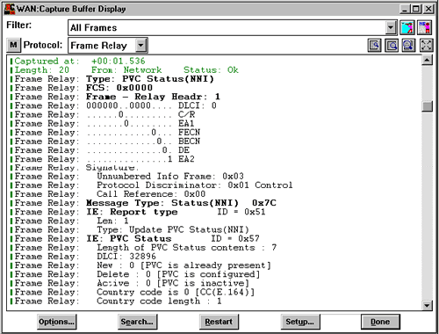
Frame Relay Capture

Slide 41
Lab
Let’s go look at these frames more closely
Start Wireshark by downloading and double-clicking on this file
Frame Relay with RIP.cap

Slide 42
Lab
Select the first frame
As this is just a signaling frame there is nothing in it except the Q.933 protocol
This is used to create the PVC connections

Slide 43
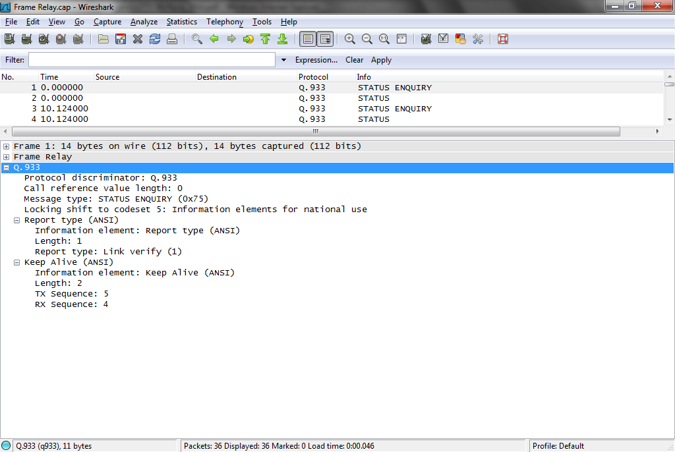
Lab

Slide 44
Lab
The first Frame Relay frame is 6 where we see DLCI 100 come up

Slide 45
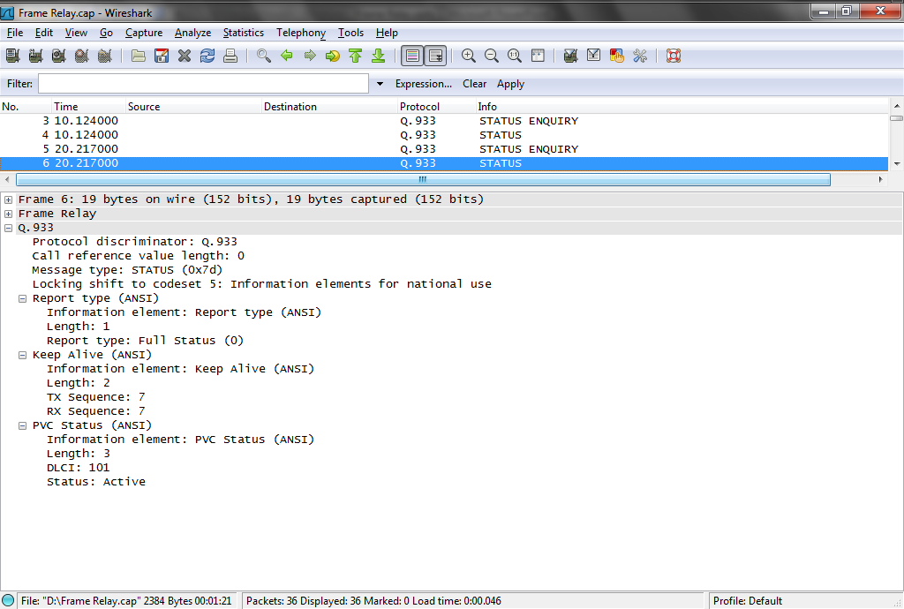
Lab

Slide 46
Lab
In frame 24 we see some real traffic when a ping request is sent
DLCI 101 is the PVC this time
Look at the BECN, FECN, and DE fields
None of these are set so the traffic load is within subscribed limits
Based on the Ethertype code the next protocol to receive the data is IP

Slide 47
Lab
Sure enough there it is at layer 3
Next we see ICMP message
Notice that it collapses the Transport and Application layers

Slide 48
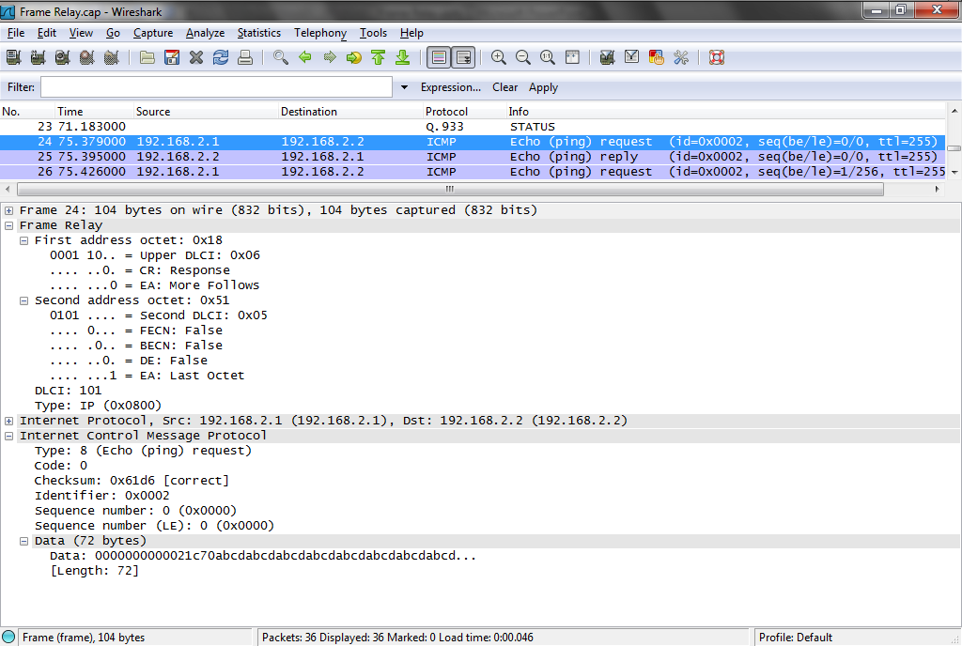
Lab

Slide 49
LMI
The main management tool for Frame Relay is LMI – Local Management Interface
When selecting equipment such as a router or an IAD be sure the device supports LMI
At first LMI was just used as a keep-alive signal between the router and the frame relay network

Slide 50
LMI
A second generation called ANSI T1.67 Annex D by ANSI and Annex A by the ITU-T provides additional information
LMI now provides basic management information about the physical access circuits and the DLCIs of the PVCs traversing the access circuit

Slide 51
LMI
When adding a PVC between two sites, for example, LMI-capable routers at the sites will automatically detect that the PVC is there
Without LMI routers must be updated manually as PVCs are added, deleted, or changed

Slide 52
LMI
LMI support enables CPE - Customer Premises Equipment and frame relay switches at the edge of a service provider’s network to communicate with one another about the following
Whether the physical access link is functioning
Which PVCs exist on the access link and which are active

Slide 53
LMI
Whether any new PVCs have been brought up on the access link and whether they are active

Slide 54
LMI
Three types of LMIs are supported by Cisco routers
Cisco
The original LMI extensions
Ansi
The ANSI standard T1.617 Annex D
q933a
The ITU standard Q933 Annex A

Slide 55
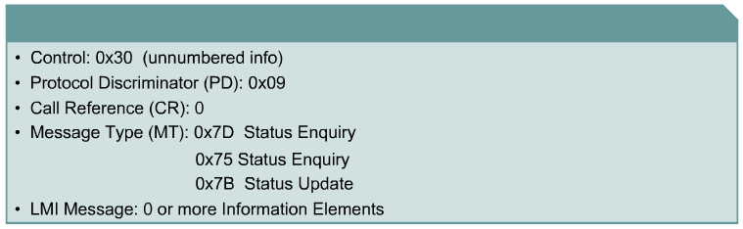
LMI Frame Format
1
2
1
1
1
1
2
1
Flag
Address
Control
PD
CR
MT
LMI Message
FCS
Flag
Notes:
Frame Relay Characteristics:
- Connection oriented protocol with a path defined between two end devices (PVC)
- Basic Error Detection w / no Recovery (Relies on upper layer protocols)
- Data Link Connection Identifier (DLCI) used to identify ‘conversations’ on link
- Each DLCI has local significance determined by provisioning
- LAPD packet encapsulation (ITU-T Q.922)
- Contains data and addressing information
Analogy: Phone cable has multiple pairs of wires (one for each conversation) a single Frame Relay interface can contain multiple ‘conversations’. Network Telephone switches cross-connect physical circuits until a complete connection is made through the network. Frame Relay is routed through the network based on the DLCI within each frame. The difference is multiple channels exist within a single physical circuit and the circuit is not tying up resources during idle times. (Unlike falling asleep on the phone..)

Slide 56
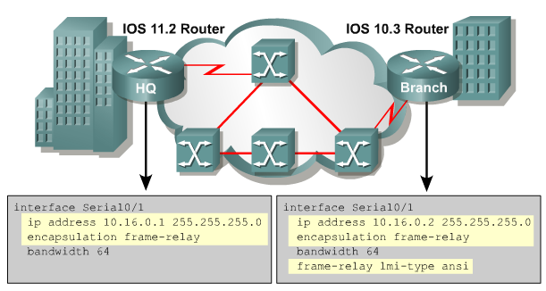
Configuring Basic Frame Relay

Slide 57
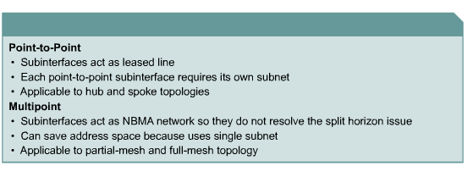
Frame Relay Subinterfaces

Slide 58
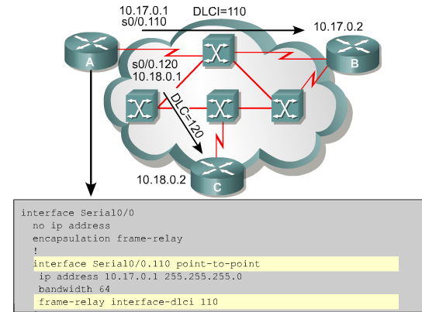
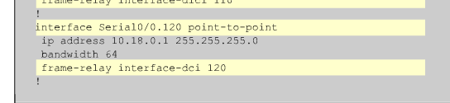
Configuring Subinterfaces

Slide 59
Frame Relay Mapping
Frame relay mapping is used to discover the layer 3 address of a layer 2 DLCI
This is needed in a multiaccess network
This will happen automatically with LMI that is enabled by default
You need do nothing for this to happen
Inverse ARP does this for you after LMI discovers the links

Slide 60
Frame Relay Mapping
If there is a need to do this manually, it is done with the frame relay map command
For example
interface s0/0/0/
no frame-relay inverse-arp
frame-relay map ip 199.1.1.2 52 broadcast

Slide 61
Verifying Frame Relay
The show interfaces command displays information regarding the encapsulation and Layer 1 and Layer 2 status
It also displays information about the following
The LMI type
The LMI DLCI
The Frame Relay DTE/DCE type

Slide 62
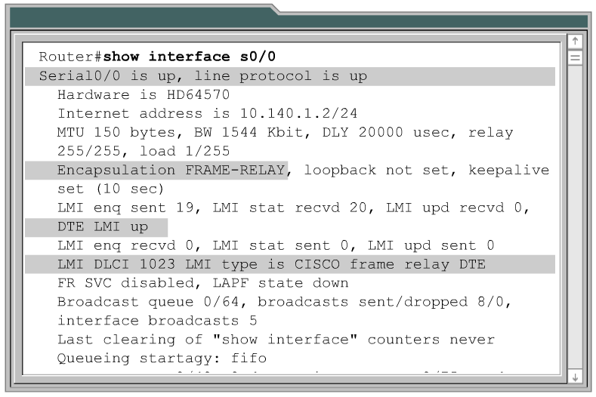
show interface
LMI Status
LMI DLCI
LMI Type

Slide 63
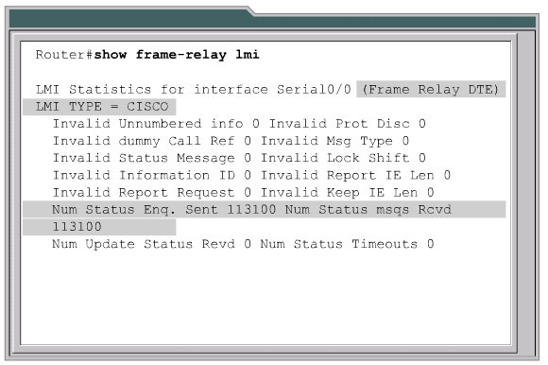
show frame-relay lmi

Slide 64
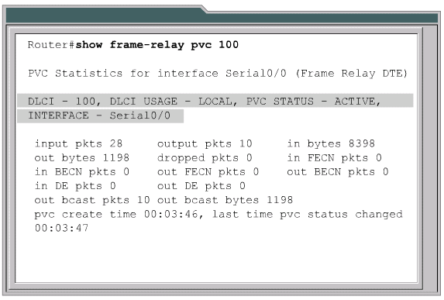
show frame-relay pvc

Slide 65
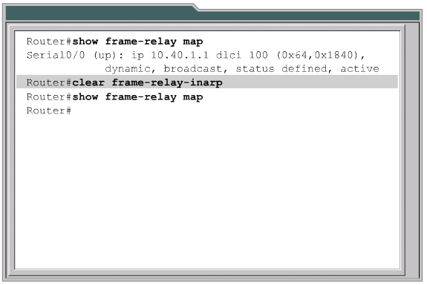
show frame-relay map

Slide 66
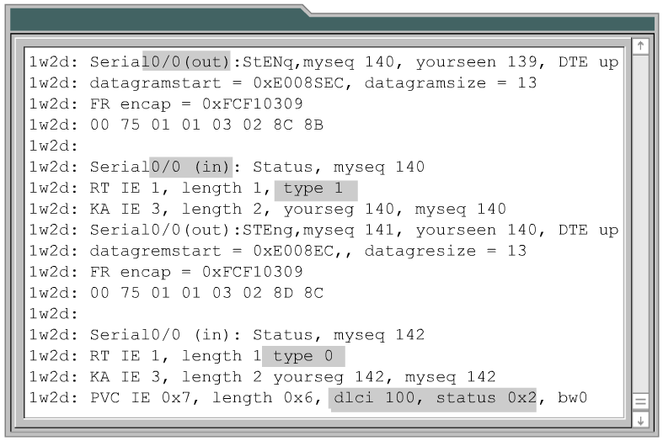
debug frame-relay lmi
PVC Status
0x2 – Active
0x0 – Inactive
0x4 – Deleted

