Slide 1
FTTP
Last Update 2010.01.17
1.1.0

Slide 2
Objectives of This Section
Learn
One example of how fiber to the premises is done

Slide 3
What is FTTP
FTTP – Fiber to the Premises is a general term for the replacement of the PSTN’s copper lines with some form of fiber optic cable
This is usually single mode fiber

Slide 4
FIOS
An example of FTTP is the Verizon FIOS system
This system is commonly deployed to residences to allow Verizon to sell three services over a single connection
These being
Voice
TV
Internet Access

Slide 5
FIOS
There is no reason Verizon could not offer the same thing to a business by connecting the circuit to a private network, rather than the Internet
So we will use the following photographs from an article that appeared on the ZDNet site on 15 July 2007 by Dan Farber
This article illustrated the FIOS installation to a house

Slide 6
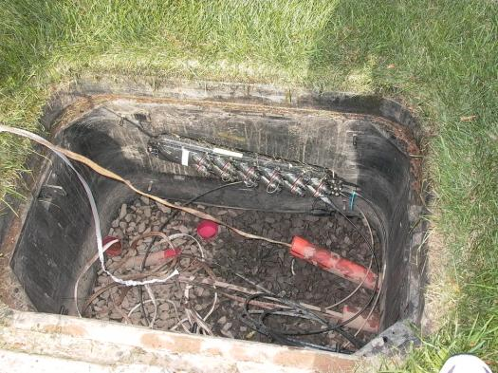
PON for the Area

Slide 7
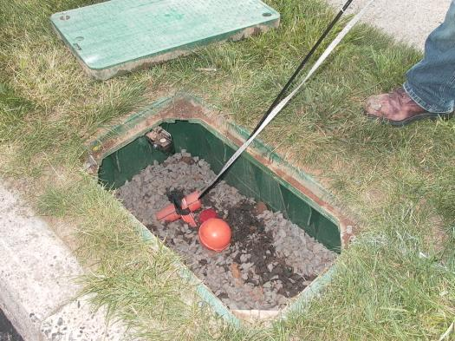
Box for the Neighborhood

Slide 8
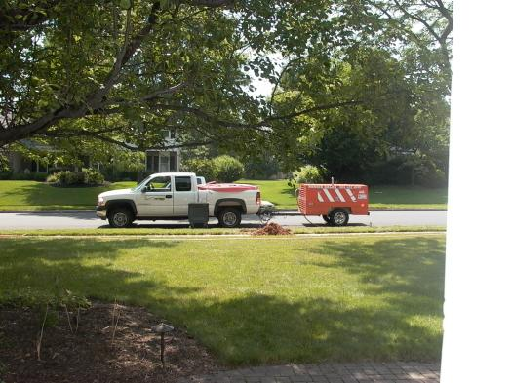
Conduit from Box Across Street

Slide 9
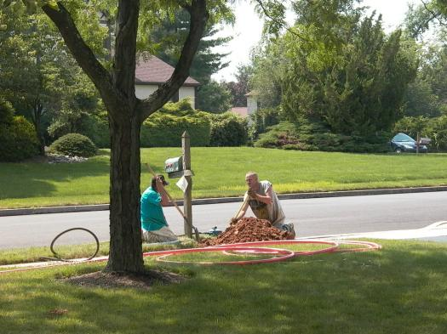
Conduit from Box Across Street

Slide 10
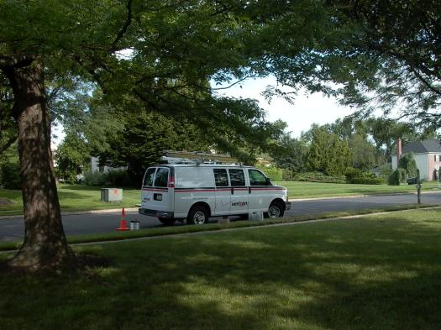
Cable from Street to House

Slide 11
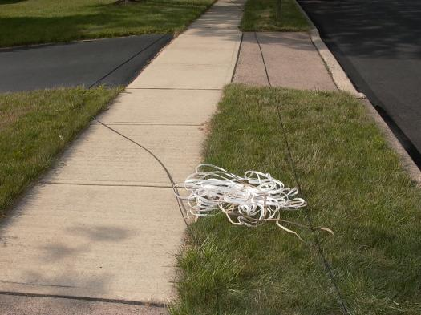
Cable from Street to House

Slide 12
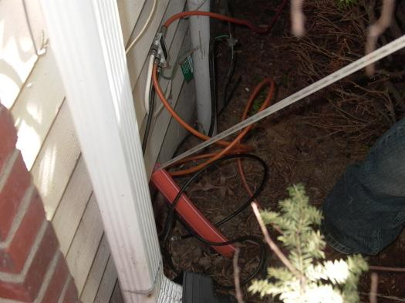
Cable from Street to House

Slide 13
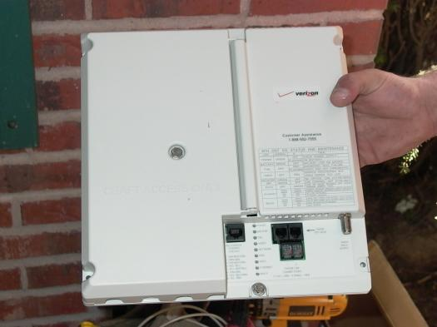
Box for Cable Termination

Slide 14
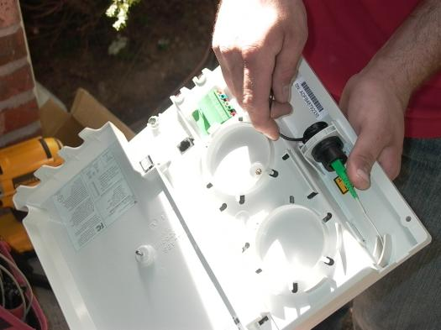
Terminating the Cable

Slide 15
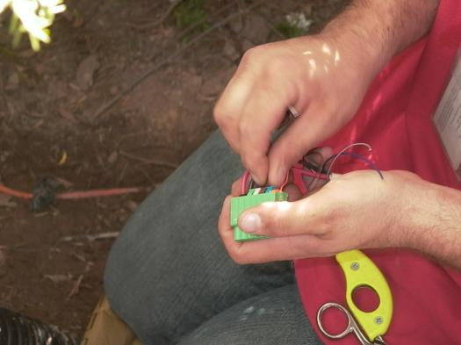
Power Connector to the Box

Slide 16
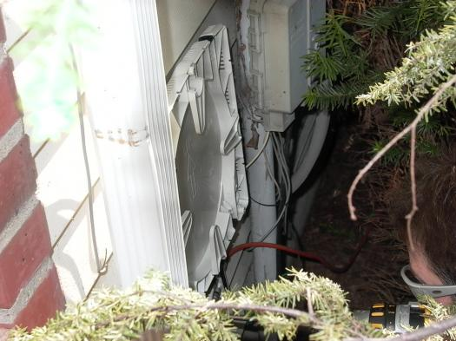
Box for Cable Termination

Slide 17
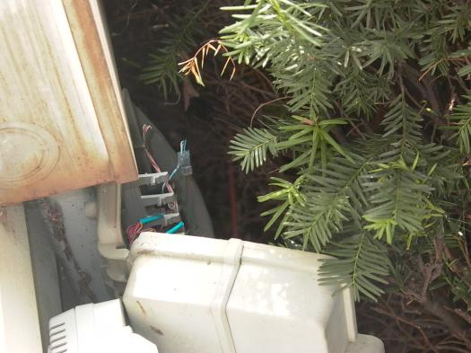
Box for Cable Termination

Slide 18
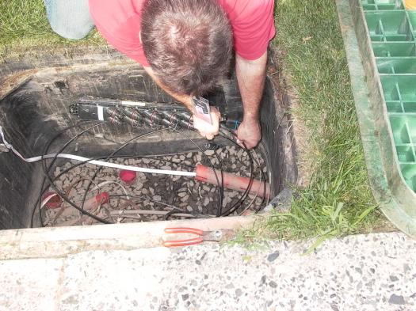
House to Neighborhood Box

Slide 19
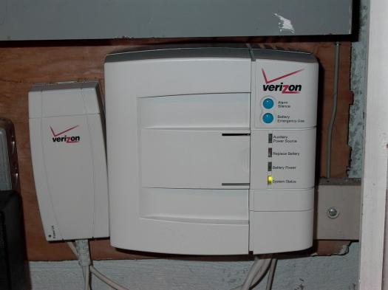
Battery Backup

Slide 20
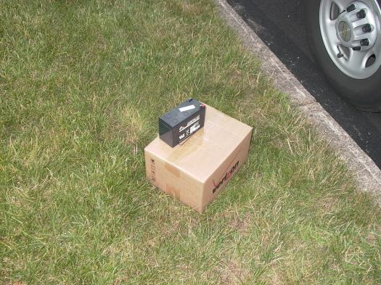
Battery

Slide 21
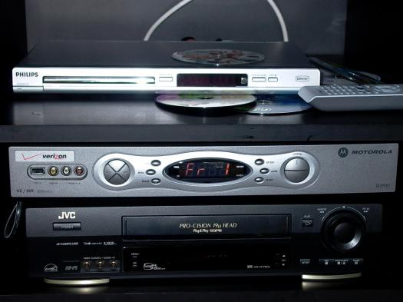
TV Box in House

Slide 22
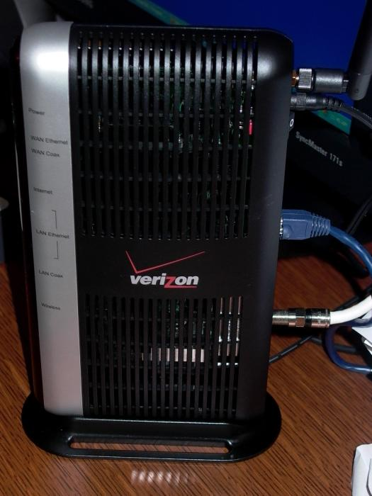
Internet Box in House

Slide 23
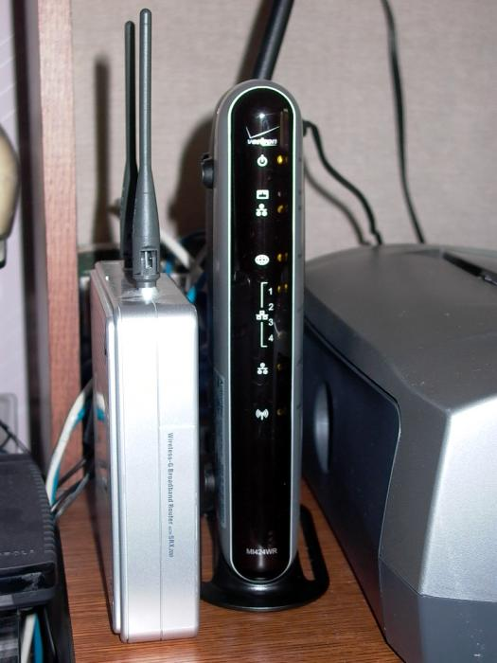
Internet Box in House

