Slide 1
Free Space Optics Equipment
Last Update 2011.09.08
1.0.0

Slide 2
Objectives of This Section
Learn
  What type of equipment is used for a Free Space Optics connection

Slide 3
FSO Equipment
A FSO – Free Space Optics link occurs at layer 1 as FSO is basically a fiber optic cable connection without the cable
The most common setup is to mount each end point unit to the parapet of the roof
For example

Slide 4
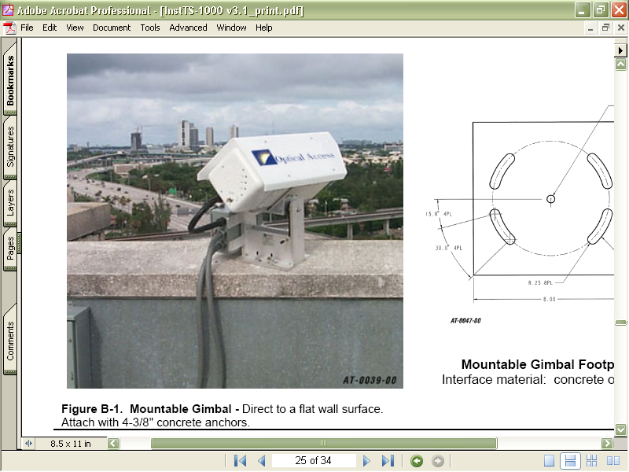
Roof Ledge Mount

Slide 5
Equipment Mounting Inside
The equipment can also be mounted inside

Slide 6
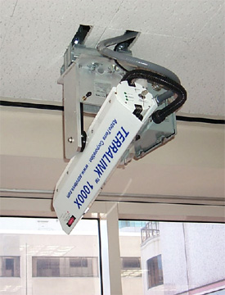
Equipment Mounting Inside

Slide 7
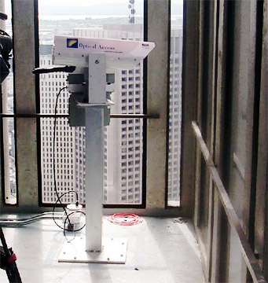
Equipment Mounting Inside

Slide 8
Equipment Connections
A FSO unit whether mounted outside or inside must be connected to the LAN - Local Area Network and electrical power
For outside mounting a junction box, such as a NEMA enclosure, is typically used
This box should be near the FSO unit
The LAN connection can be made with fiber optic or UTP cable

Slide 9
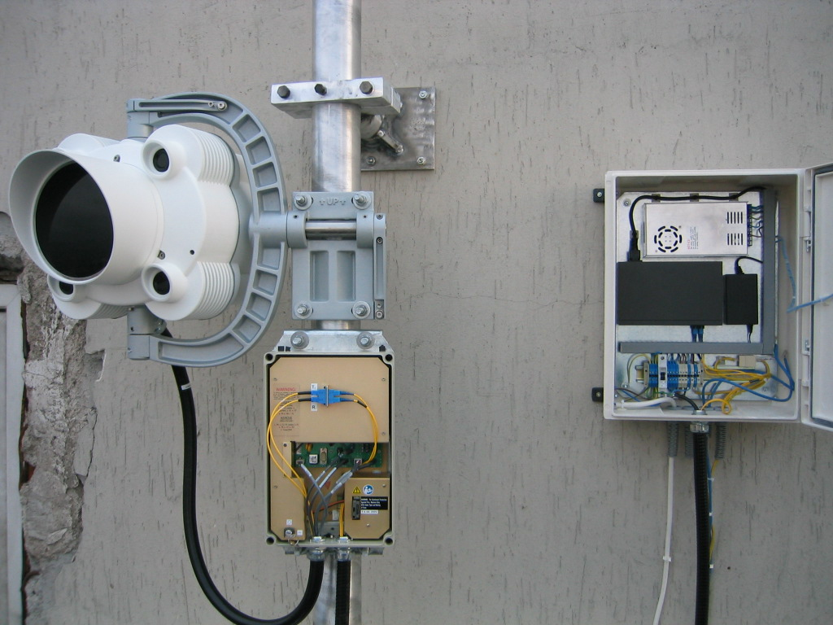
Equipment Connections

Slide 10
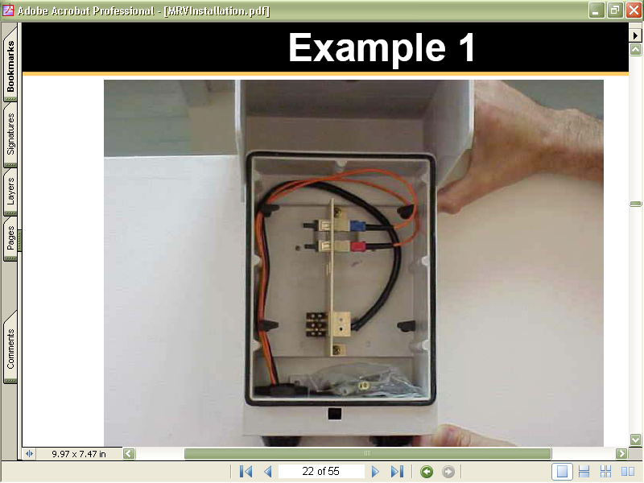
Equipment Connections

Slide 11
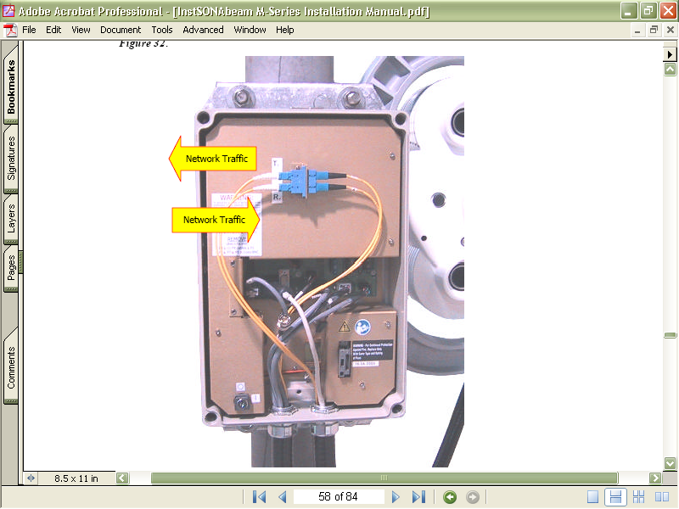
Equipment Connections
Fiber Optic
Data Connection
Electrical Power Connection

