Slide 1
FDDI
Last Update 2007.05.27
1.1.0

Slide 2
Objectives of This Section
Learn
What FDDI is
Where FDDI is used

Slide 3
Context
Layer | 1
Network Type | LAN CAN

Slide 4
What is FDDI
FDDI - Fiber Distributed Data Interface was pronounced dead on 13 December 1999 by Network World magazine
They based their assessment on the announcement by the companies that make FDDI chips that their last shipments would be made in early 2000

Slide 5
What is FDDI
FDDI was killed by faster methods such as Gigabit Ethernet and ATM and cheaper 100 Mbps technologies such as Fast Ethernet

Slide 6
What is FDDI
FDDI was used in three ways
To link devices such as routers so that they can talk to each other
To create LAN backbones because of its support for high bandwidth and greater distances than copper at one time
To create CANs

Slide 7
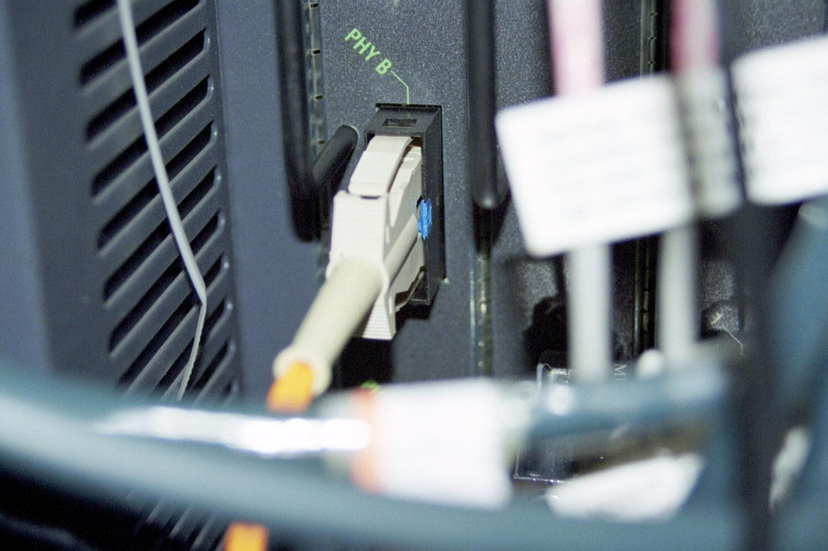
FDDI Connecting Routers
FDDI connector on a router

Slide 8
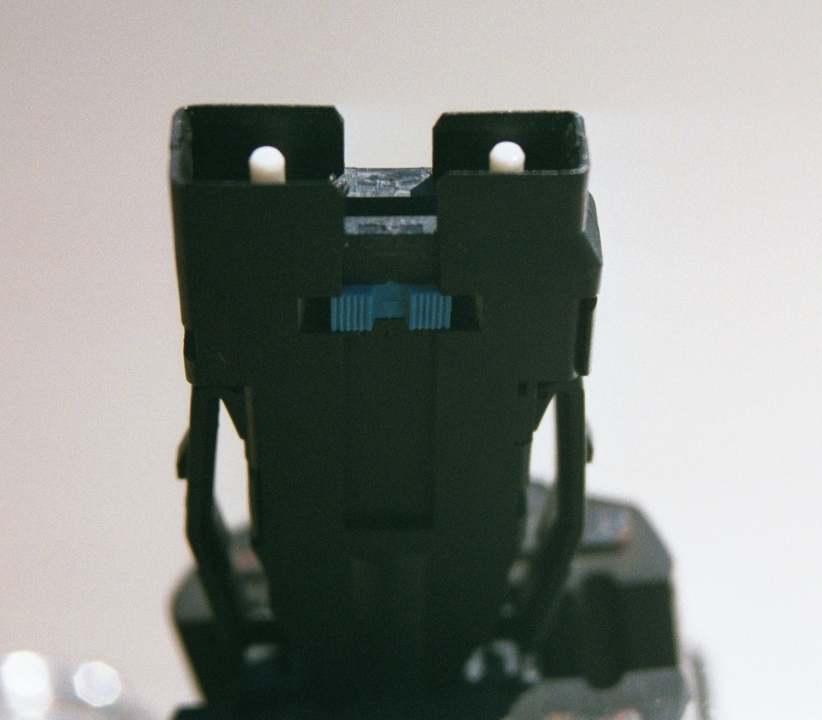
FDDI Connector

Slide 9
Operation
The FDDI specification describes a 100 Mbps token passing, dual-ring connection using fiber-optic cables
In FDDI’s dual-ring architecture traffic on each ring flows in opposite directions called counter-rotating rings
The dual-rings consist of a primary and a secondary ring

Slide 10
Operation
During normal operation, the primary ring is used for data transmission, and the secondary ring remains idle
FDDI can use either type of optical fiber: single-mode or multi-mode
FDDI allows two kilometers between stations using multi-mode fiber, and even longer distances using a single mode

Slide 11
Operation
FDDI only specifies the physical and media-access portions of the OSI reference model, layers 1 and 2
In this way it is similar to Ethernet and Token Ring
FDDI's primary fault-tolerant feature is the dual ring

Slide 12
Operation
If a station on the dual ring fails or is powered down, or if the cable is damaged, the dual ring is automatically wrapped - doubled back onto itself - into a single ring
When the ring is wrapped, the dual-ring topology becomes a single-ring topology

