Slide 1
Ethernet Frame Format
Last Update 2012.08.10
1.3.0

Slide 2
Ethernet Frame Format
Ethernet is used in LANs, CANs, MANs, and now WANs
It is the most common frame in LANs and CANs
In MANs and WANs it shares space with HDLC, PPP, ATM, Frame Relay, and MPLS frames

Slide 3
Ethernet Frame Format
What makes Carrier Ethernet service so attractive, besides the high-speeds and lower costs, if the ability to just take the standard Ethernet II frame off the LAN and send it onto the WAN link
No translation is required

Slide 4
Ethernet Frame Types
There are two types of Ethernet frames seen on local area networks
  Ethernet II
  Ethernet SNAP
Let’s see what each one of these looks like

Slide 5
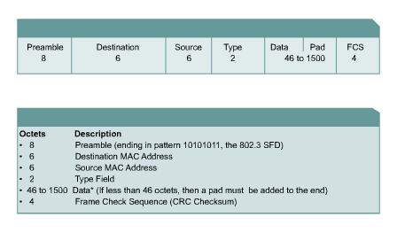
Ethernet II Frame Format

Slide 6
Ethernet II Frame Format
Field | Bytes
Preamble | 8
Destination Address | 6
Source Address | 6
Type | 2
Data | 46-1500
Frame Check Sequence | 4

Slide 7
Ethernet II Frame Format
Preamble
  This is a sequence of 7 bytes or 56 bits of alternating ones and zeros
  It is used for synchronization
  It gives components time to detect the signal, and be ready before the frame arrives
  It was set at this length because it took equipment used to take this long to sync up
  A preamble is not required for speeds above 10 Mbps

Slide 8
Ethernet II Frame Format
As just stated the preamble is not needed at speeds above 10 Mbps, which would be the case on a WAN circuit
Never the less, let’s look at it just to be complete
SFD - Start Frame Delimiter
  Also part of the preamble is a sequence of 1 byte or 8 bits having the bit configuration 10101011 that indicates the start of the frame

Slide 9
Ethernet II Frame Format
Note the similarity of the bit pattern between the Preamble and the SFD
The only difference is that the last two bits of the SFD are both 1’s
Many people do not separate the Preamble and Start Frame Delimiter

Slide 10
Ethernet II Frame Format
They consider it to all be the preamble
Because it takes a station an unknowable amount of time to lock on, it does not know how many bits of the Preamble have gone by
For this reason, it is said that the Preamble is lost in the synching up process

Slide 11
Ethernet II Frame Format
As such no part of the Preamble ever enters the NIC’s buffer
This is why the size of the Preamble/SFD is excluded when the minimum and maximum Ethernet frame sizes are discussed

Slide 12
Ethernet II Frame Format
Destination Address
  This is the MAC address of the station the message is for
  This address may specify either an individual address destined for a single station, a multicast address destined for a group of stations, or an address of all 1s bits that refers to all stations on the LAN and is called a broadcast address

Slide 13
Ethernet II Frame Format
Source Address
  This is the MAC address of the sending station
Type
  The Type or EtherType code, in hexadecimal, indicates the protocol type that the frame is destined for at the network layer, such as
    0800 for TCP/IP
    8137 for IPX

Slide 14
Ethernet II Frame Format
Data
  This is the important stuff and has a maximum size of 1500 bytes
  If the size is less than 46 bytes, then bytes are placed in the Pad field to bring the frame length up to at least 64 bytes
  What goes into this data area is the original message and the headers placed in front of that message at each of those layers

Slide 15
Ethernet II Frame Format
CRC - Frame Check Sequence
  This is used for error checking
  When the source station assembles a MAC frame, it performs a CRC calculation on all the bits in the frame from the Destination MAC Address through the Pad fields
  The source station stores the value in this field and transmits it as part of the frame
  When the frame is received by the destination station, it performs an identical check

Slide 16
Ethernet II Frame Format
  If the calculated value does not match the value in this field, the destination station assumes an error has occurred during transmission and discards the frame

Slide 17
Ethernet SNAP Frame
The other type of frame commonly seen on an Ethernet based local area network is a SNAP or Subnetwork Access Protocol frame
The SNAP frame allows EtherType codes to be used with all IEEE 802 protocols, as well as supporting proprietary protocols

Slide 18
Ethernet SNAP Frame
We will focus on the differences between this frame type and the Ethernet II frame type
The SFD, preamble, data, and trailer are the same in the SNAP frame
Here is a nice graphic of the SNAP frame format from Cisco

Slide 19
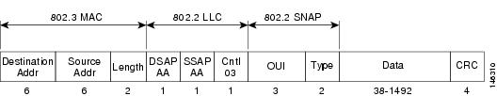
Ethernet SNAP Frame

Slide 20
Ethernet SNAP Frame
The Ethernet SNAP frame header is commonly divided into three sublayers as seen above
  802.3 MAC
  802.2 LLC
  802.2 SNAP
Let’s look at an actual Ethernet SNAP frame, and then at each of these sublayers in more detail

Slide 21
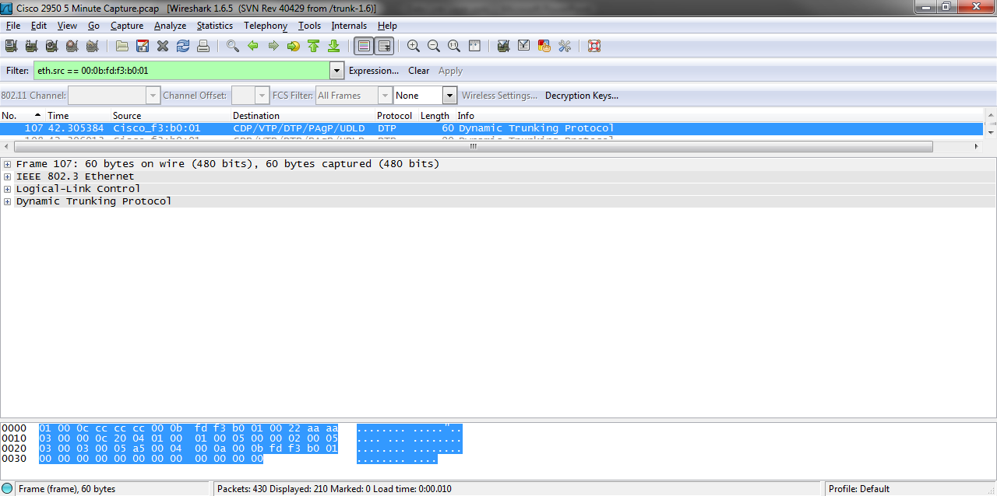
Ethernet SNAP Frame

Slide 22
802.3 MAC Sublayer
The 802.3 MAC sublayer contains the layer 2 address fields

Slide 23
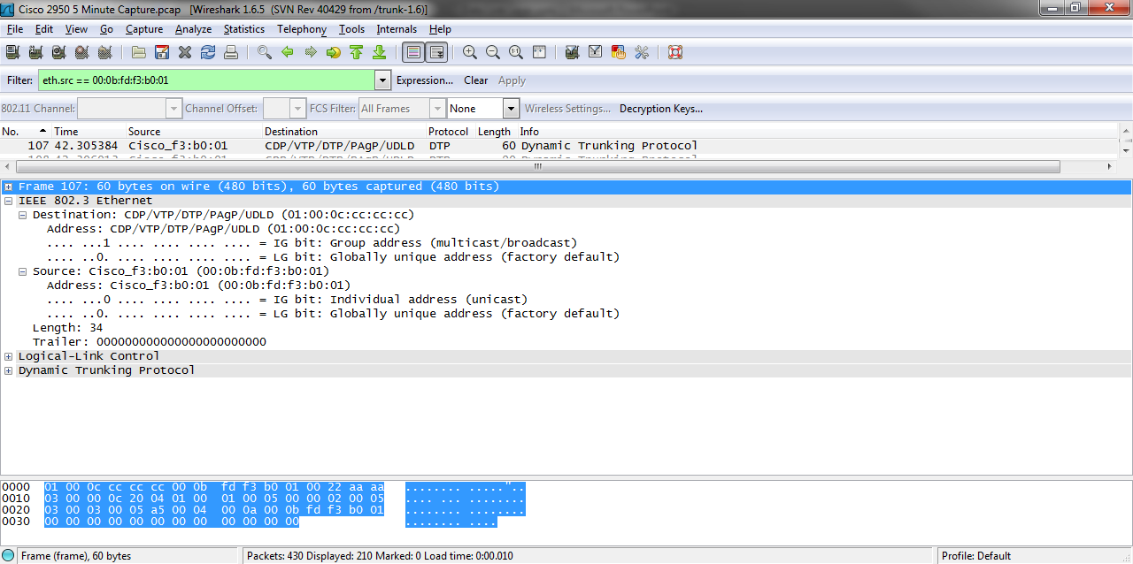
802.3 MAC Sublayer

Slide 24
802.3 MAC Sublayer
The destination address is in this example 01-00-0C-CC-CC-CC is a multicast address that is flooded out to all devices on the network
Cisco uses this address for proprietary protocols such as CDP, VTP, and so on
The source here is the MAC address of a Cisco 2950 switch

Slide 25
802.3 MAC Sublayer
The length filed shows the amount of data in the frame
In this case 34 bytes

Slide 26
802.2 LLC Sublayer
The next sublayer is the 802.2 LLC – Logical Length Control section
It contains the following main fields
  DSAP
  SSAP
  Control

Slide 27
802.2 LLC Sublayer
Wireshark shows this sublayer and the 802.2 SNAP sublayer as one section
The 802.2 LLC sublayer is outlined in the example below

Slide 28
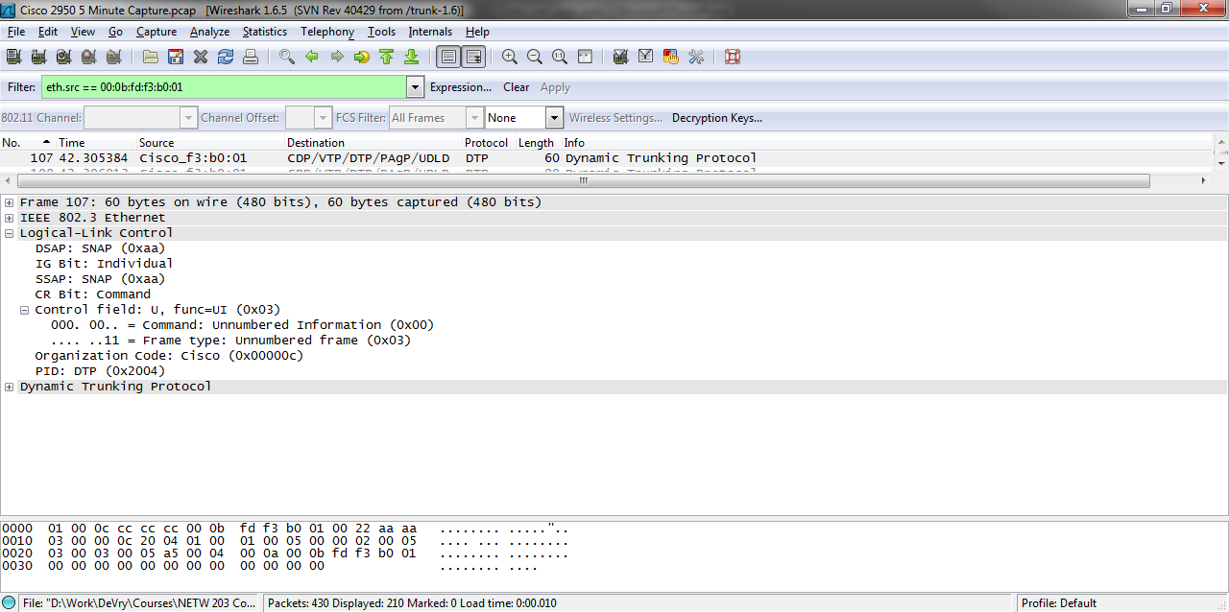
802.2 LLC Sublayer

Slide 29
802.2 LLC Sublayer
Let’s see what the IEEE says about the two SAP fields in a tutorial they published on this
  The LLC sublayer contains addressing information
  The Destination Service Access Point (DSAP) address field, and the Source Service Access Point (SSAP) address field
  Each of these is an 8-bit field and each is made up of two components

Slide 30
802.2 LLC Sublayer
  In the DSAP address field, the components are an address type designation bit, and seven bits of actual address
  When the address type designation bit is set to 0, it denotes that the actual address is an individual address
  When the address type designation bit is set to 1, it denotes that the DSAP actual address is a group address

Slide 31
802.2 LLC Sublayer
  In the SSAP address field, the components are the command or response identifier bit, and seven bits of actual address
  The actual address in the SSAP field is always an individual address
  In the general case, an individual actual address identifies a protocol, or set of protocols, in the next higher layer

Slide 32
802.2 LLC Sublayer
  In OSI environments, the next higher layer is the network layer
  In non-OSI environments, the next higher layer is dependent on the architecture in use

Slide 33
802.2 LLC Sublayer
Here is what Cisco says in part about the Control field
  The control field contains command, response, and sequence number information
  There are three types of frames
    I Frames
    Supervisory Frames
    Unnumbered Frames

Slide 34
802.2 LLC Sublayer
  Although each type has a different format for the control field, you can easily distinguish them through an examination of two bits in the control field
    X-X-X-X-X-X-X-0 = I Frame
    X-X-X-X-X-X-0-1 = Supervisory Frame
    X-X-X-X-X-X-1-1 = Unnumbered frame

Slide 35
802.2 SNAP Sublayer
The last sublayer is the 802.2 SNAP sublayer
It looks like this in Wireshark

Slide 36
802.2 SNAP Sublayer

Slide 37
802.2 SNAP Sublayer
This sublayer has two fields
The OUI field tells use who is responsible for the protocol that will follow
The PID or type field indicates what protocol that is
In this case it says the Cisco DTP is next
As we can see here sure enough it is

Slide 38
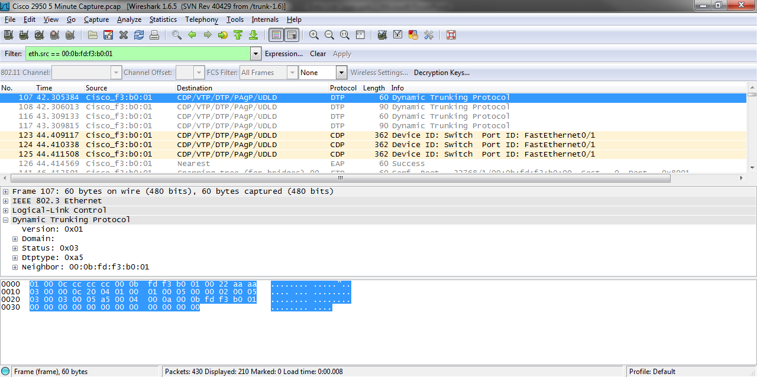
802.2 SNAP Sublayer

Slide 39
Ethernet SNAP Frame
This then is the structure and function of the second type of frame seen on an Ethernet based local area network
The frames do the work of the Data Link Layer

Slide 40
Ethernet Capture File
Let’s look at a typical Ethernet II frame
Download this file
  http.cap
Open it in Wireshark by double-clicking on it
Select frame 4
Expand the Ethernet layer

Slide 41
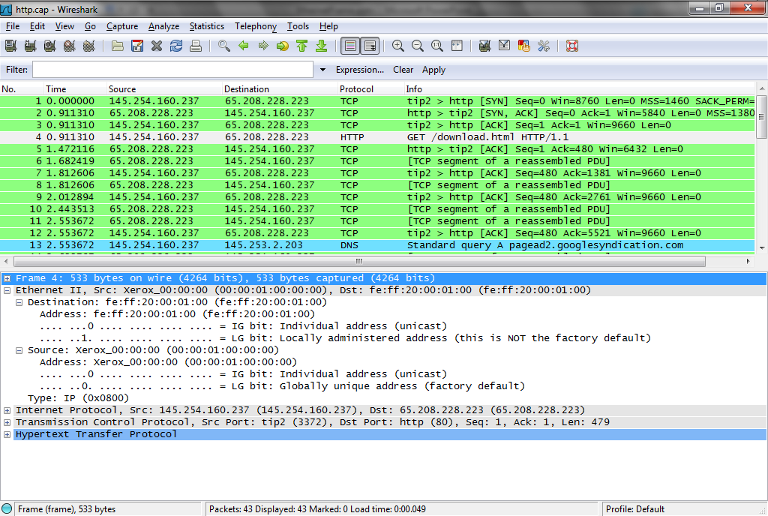
Ethernet Capture File

Slide 42
Ethernet Capture File
Here we see the source and destination MAC address
Then the EtherType code for IP
A typical Ethernet II frame

Slide 43
Carrier Ethernet Frame Format
In some cases an additional field may be added by either the service provider or the customer in order to identify a specific virtual circuit
If it is a added by the service provider then the field is called a S-Tag
If added by the customer, it is called a C-Tag

Slide 44
Carrier Ethernet Frame Format
Here are the fields as illustrated in a white paper from the MEF

Slide 45
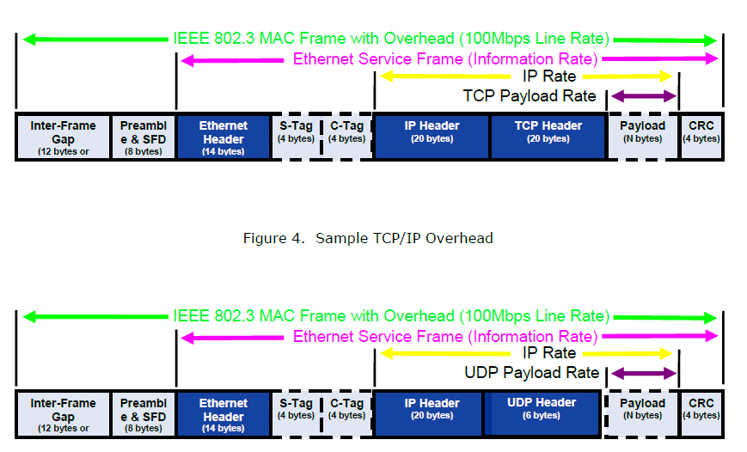
Carrier Ethernet Frame Format

Slide 46
Carrier Ethernet Configuration
Here is an example of a typical basic configuration for a Carrier Ethernet connection using a Gigabit or 10Gigabit Ethernet card in a router
A router, rather than a switch, is the best device to use to connect to the carrier
This example is for a ASR 9000 Carrier Ethernet router

Slide 47
Carrier Ethernet Configuration
Required configuration lines
  configure terminal
  interface gigabitethernet 0/1/0/0
  ipv4 address 172.18.189.38 255.255.255.224
  no shutdown
Optional configuration lines
  flow-control ingress
  mtu 1514
  negotiation auto

Slide 48
Lab
Let’s look at some Ethernet II frames as seen on LANs
Start Wireshark
Capture some traffic
Then we will examine a few of the interesting frames

