Slide 1
EWAN Equipment
Last Update 2010.02.01
1.0.0

Slide 2
Objectives of This Section
Learn what type of equipment to use to connect to an Ethernet connection outside of the LAN

Slide 3
What is an EWAN
The term EWAN is being used to refer to the use of Ethernet outside of the local area network
Ethernet migrated to the CAN years ago
Now it is moving out to the MAN and WAN as service providers provide native Ethernet connections directly to the customer site

Slide 4
What is an EWAN
Now once the traffic leaves the customer site the service provider may change it into any of a number of transport methods, but at each end of the path the customer sees Ethernet frames just as exist on the LAN

Slide 5
EWAN Equipment
The question for the customer of this type of service is what type of device should be connected to the service provider’s demarc
The choice is router or switch

Slide 6
EWAN Equipment
Cisco presented a nice discussion of this question in a 2009 white paper titled Ethernet Wide Area Networking, Routers or Switches and Making the Right Choice
Their discussion is summarized below by quoting parts of the paper

Slide 7
Router or Switch
When choosing Customer Premises Equipment to connect to an EWAN service, it comes down to the choice of either a router or a switch
Over the past decade the line between what is a router and what is a switch has been blurred
This trend stems from advances in Application Specific Integrated Circuits and their ability to perform more complex forwarding functions

Slide 8
Router or Switch
The original definitions for switches and routers were simple in that switches perform Layer 2 forwarding and routers performed more process intensive operations at Layer 3
However, as networks grew and as the EWAN market matured, switches were required to do more
They now run Layer 3 routing protocols and moved Layer 3 forwarding into ASICs

Slide 9
Router or Switch
In the mean time, routers advanced with faster Central Processing Units, the integration of unified voice, collaborative video, video surveillance, firewalling, intrusion protection, custom applications and Layer 2 switching, etc

Slide 10
Router or Switch
How does one define these two devices in today’s network
The original definitions center around what layer traffic was forwarded
However, this old paradigm no longer accurate, since both switches and routers have taken on new feature sets

Slide 11
Router or Switch
A newer, more practical differentiation is defined as
Switches forward traffic through hardware, in ASICs, providing a targeted set of pre-defined network services at Gigabit speeds
Routers forward traffic through software in a CPU and provide a flexible, expandable and rich set of network services at sub-Gigabit speeds

Slide 12
Router
Branch routers come in two categories, General Purpose and Integrated Services
General Purpose Routers
These typically focus on basic WAN routing, supporting a limited number of routing protocols and a variety of WAN interfaces
General purpose routers can be a good choice when one is interested in simple routing
A typical use case arises when customers need Layer 3 visibility with a full Internet routing table for a branch network with multiple WAN exit points, or when the service provider requires the customer to peer with the their network

Slide 13
Router
Integrated Services Router
This type of router allows the customer to take advantages in advanced technologies, allowing them to more effectively
From a single Cisco ISR platform, one can connect IP phones; wireless access points controlled by an internal wireless LAN controller module, IP-based video cameras to the network and power all of them using the IEEE 802.3af Power over Ethernet standard

Slide 14
Switch
For most vendors, switches come in two categories, general-purpose LAN and Metro Ethernet
General-purpose switches are designed for LAN applications and are not intended for WAN deployments
Metro Ethernet Switches retain much of the LAN feature sets found in general-purpose switches but add WAN connectivity features, including

Slide 15
Switch
Hierarchical Quality of Service to efficiently shape customer traffic to meet the service provider’s Service Level Agreement
Several variations of Multiprotocol Label Switching, used to interact with the service provider’s network
Ethernet Operations, Administration, and Management protocols used to configure, manage and detect errors across the EWAN

Slide 16
Switch
Cisco offers three EWAN switches
Cisco ME 3400 Series Ethernet Access Switches
Cisco ME 3400E Series Ethernet Access Switches
Cisco Catalyst 3750 Metro Ethernet Switch

Slide 17
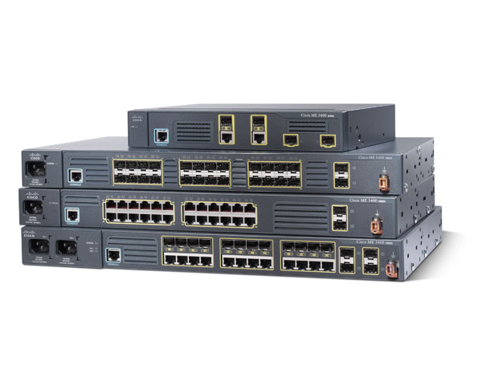
Switch

Slide 18
Deciding Which One to Use
The selection criteria uses five questions
What is the required throughput of the EWAN interface
Does the CPE need to hold the Internet routing table
Is Ethernet the only WAN interface needed and are EWAN services ready to use
Will the purchase be made with capital or operating funds
Do you need to use integrated wireless, voice, video, WAAS, application integration, or security

Slide 19
Throughput
Choosing a switch or a router based on speed is simple
Since routers are CPU based their performance decreases with the number and type of services added
On the other hand, since switches forwarding is performed in ASICs, they continuously forward at line rate Gigabit speeds
As rule of thumb, if one needs over 1 Gbps, bidirectionally, a switch is required

Slide 20
Routing Table Size
Currently a full Internet routing table is 240,000 routes
This number can typically be summarized down to 100,000 routes at the branch office
A large number of routes is typically needed when there are multiple WAN exit points and paths from the branch to the WAN
Most switches can hold between 12,000 and 32,000 routes

Slide 21
Routing Table Size
Therefore, if the EWAN service or connectivity policy requires a large number of routes, a router is needed

Slide 22
Multiple WAN Interface Media
High availability WAN requires multiple interfaces
Typically, this is an active-standby arrangement, where only one link is active at a time
In many cases the backup link is of lower speed and of a different medium type, 3G, xDSL, cable, satellite T1/E1
These interface types are not supported by switches

Slide 23
Multiple WAN Interface Media
Thus, a router is required
In the case where both links are active, sophisticated load balancing and Layer 3 visibility is required and thus, so is a router

Slide 24
Capex v Opex
The only decision here is from what pot of money will the, purchase price come from
In general a switch is less costly than a router
It could more easily be funded from operating funds

Slide 25
Other Services
If other services such as integrated wireless, voice, video, WAAS, application integration, or security are needed, then this will limit you to what devices provide these services

