Slide 1
Demarc
Last Update 2010.01.17
1.9.0

Slide 2
Objectives of This Section
Learn
What a demarc is
What a demarc is used for
How to identify demarcs

Slide 3
What is a Demarc
A demarc is a demarcation point
It is where you stop and the phone company starts
This means that whatever does not work on your side is your problem
Whatever does not work on their side is also your problem, but you’ll have to call them to get it fixed

Slide 4
What is a Demarc
The demarc can be called several things
For example, I use demarc as short for demarcation point
Others write demark
The BICSI, who certifies cable installers, calls it the RDP – Rate Demarcation Point

Slide 5
What is a Demarc
The phone company calls it several different things
Network Interface
NID – Network Interface Device
Network Interface Unit

Slide 6
What Does a Demarc Look Like
It does not matter what you call it
Demarcs have different looks depending on what type of service they are terminating
In general, slower speed lines use a simple biscuit type jack as shown next
This type of jack may also be used for an extended demarc for a higher speed line as will be discussed later

Slide 7
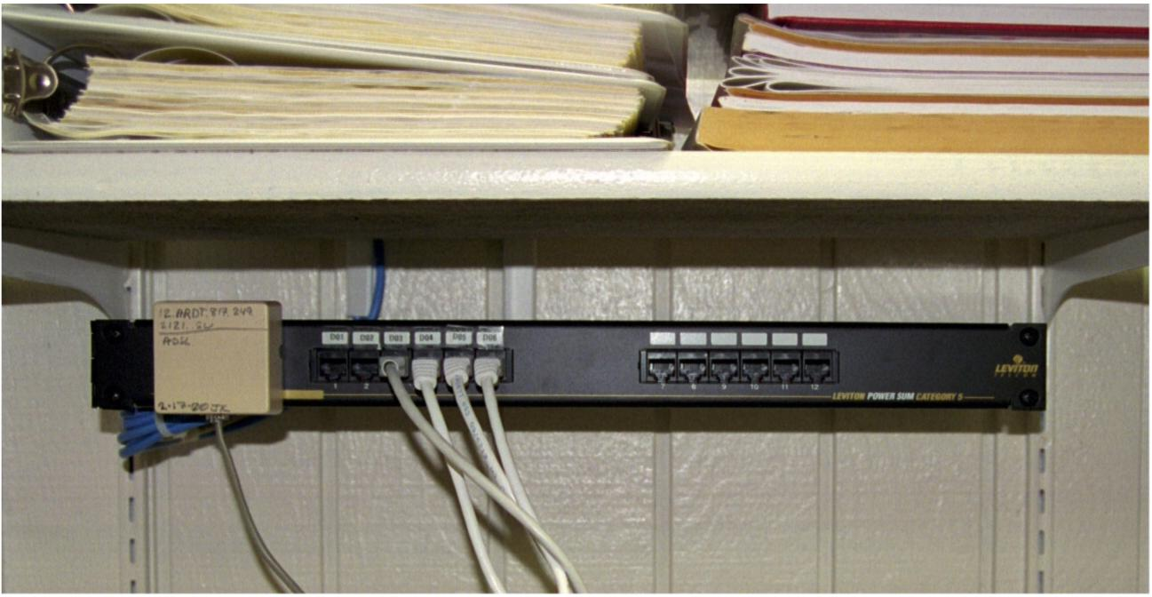
Slow Speed Line Demarc

Slide 8
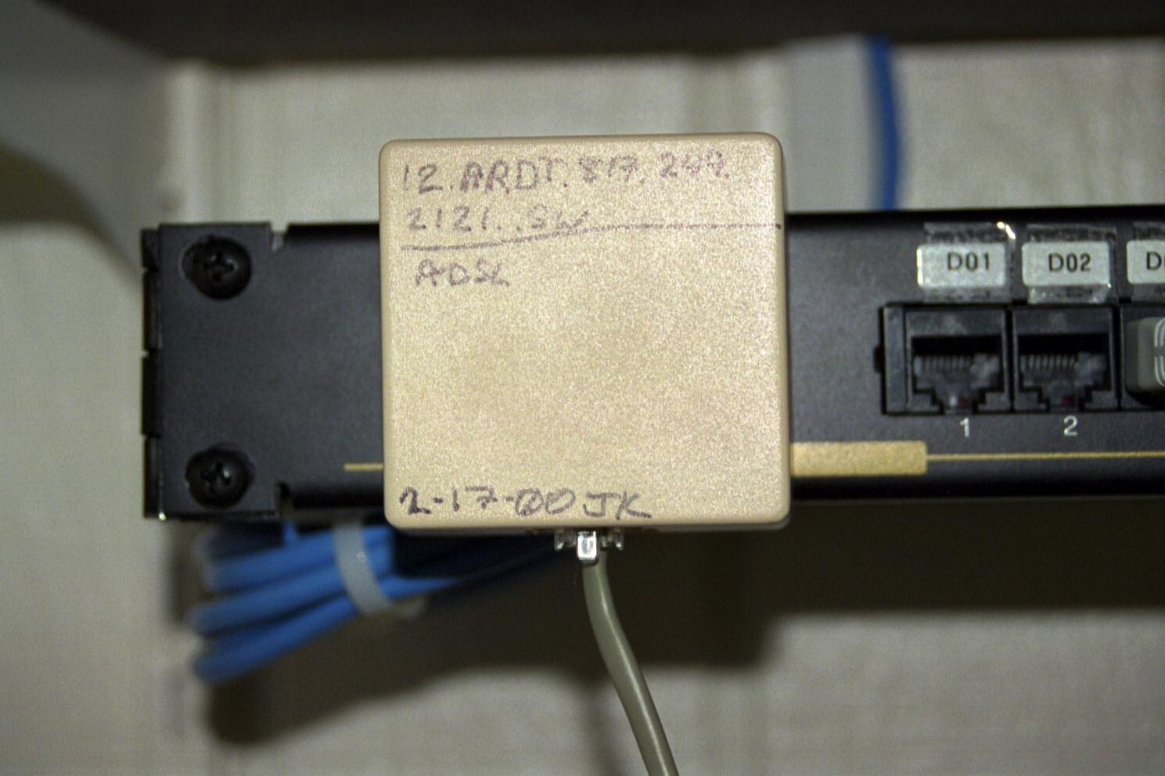
Slow Speed Line Demarc

Slide 9
Higher Speed Line Demarc
Higher speed lines and those with more intelligence require a more intelligent termination point
An example of this is the T1 Smart Jack shown in the following photographs

Slide 10
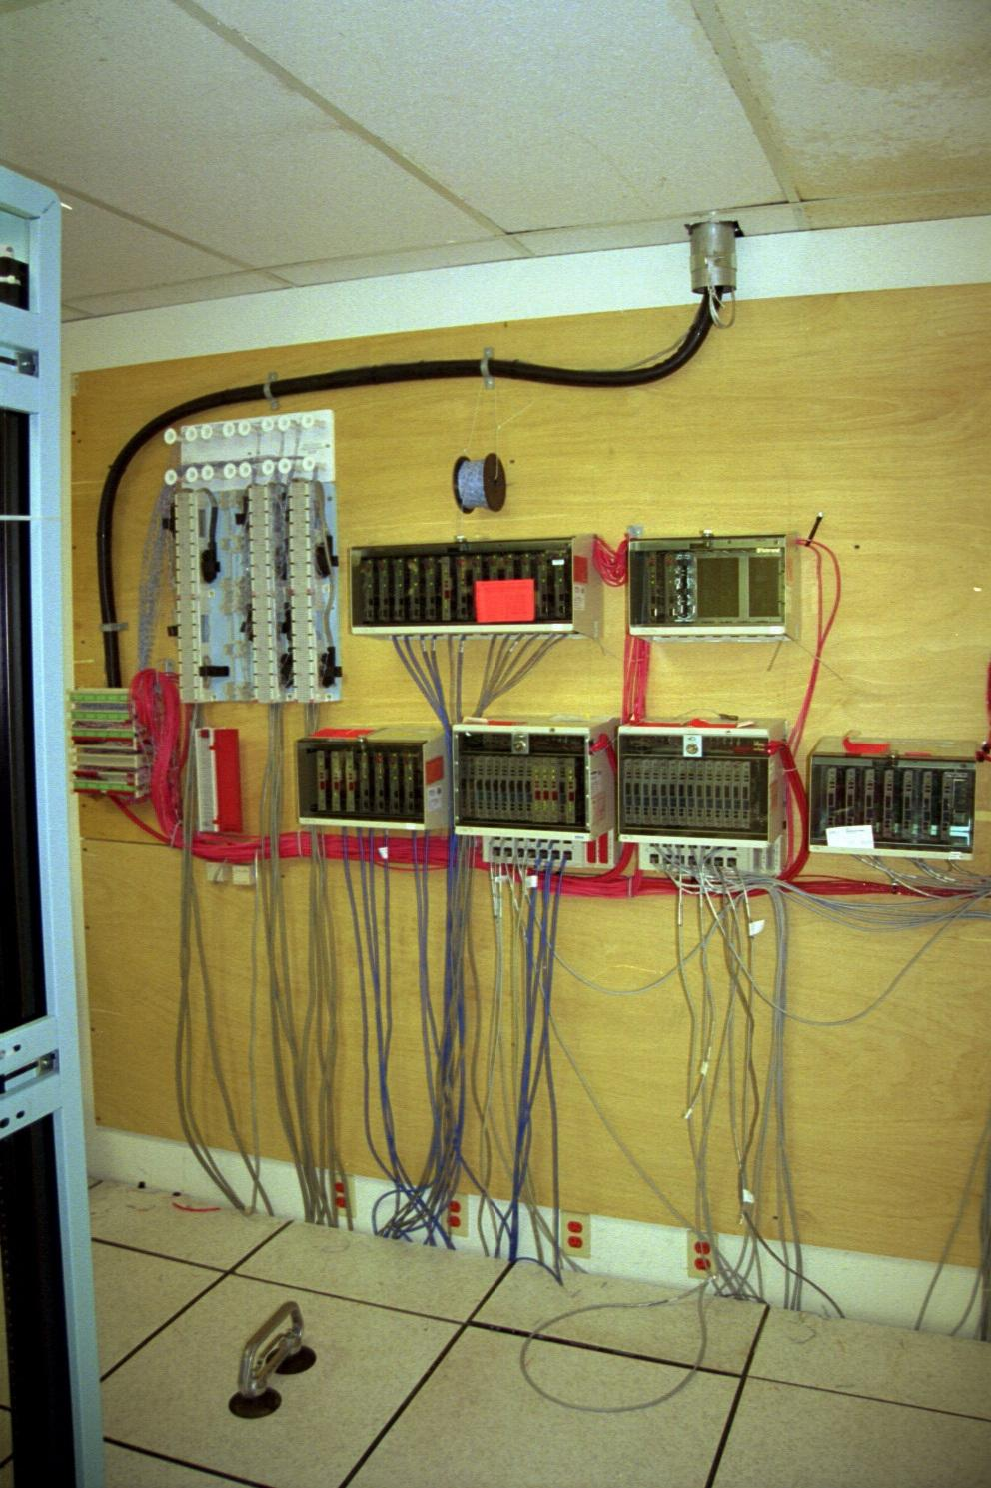
Higher Speed Line Demarcs

Slide 11
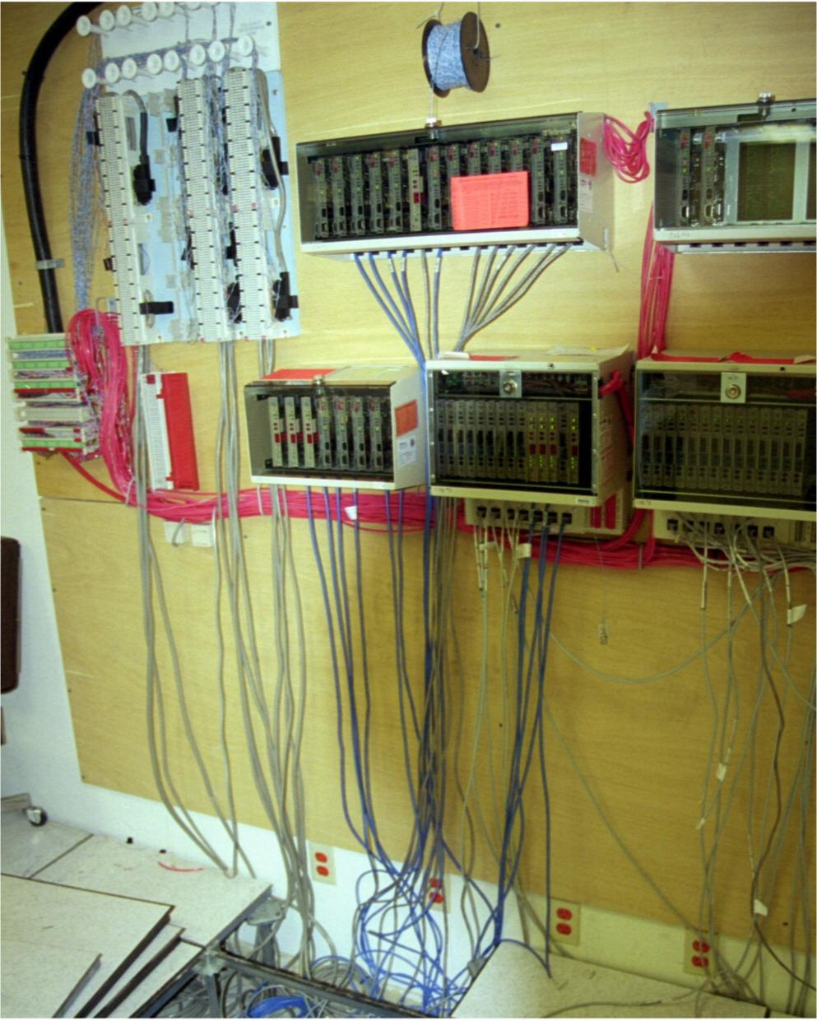
Higher Speed Line Demarcs

Slide 12
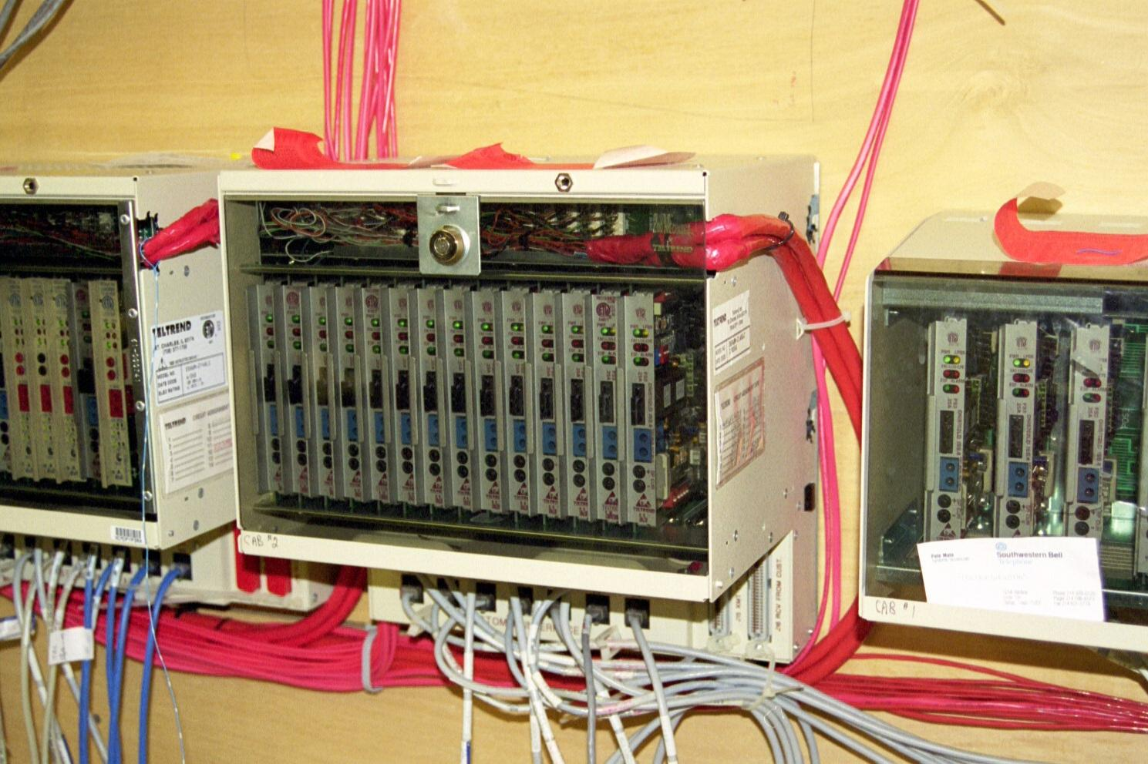
Higher Speed Line Demarcs

Slide 13
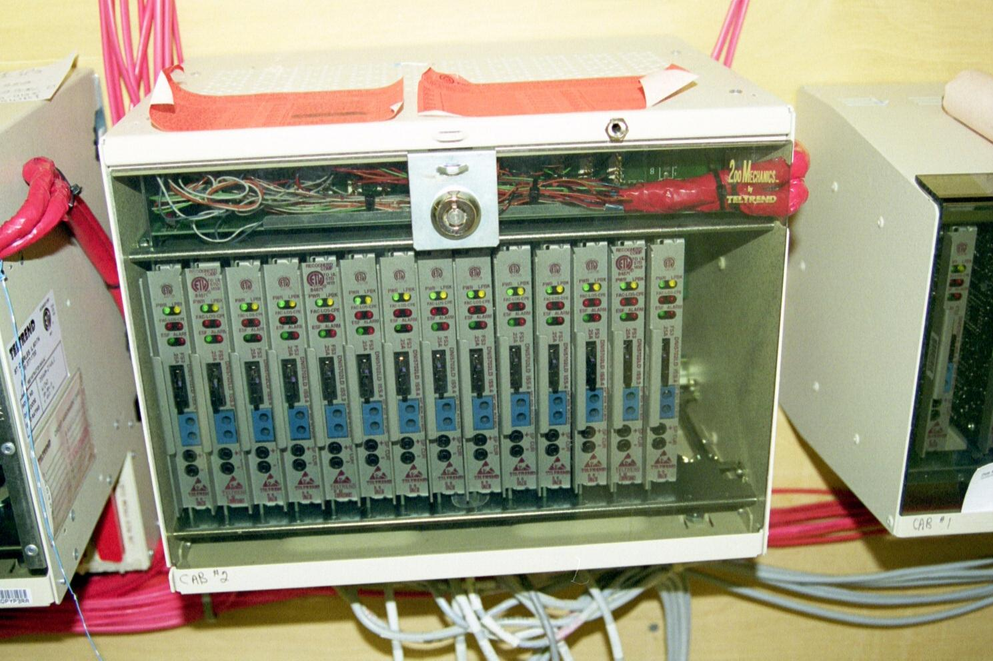
Higher Speed Line Demarcs

Slide 14
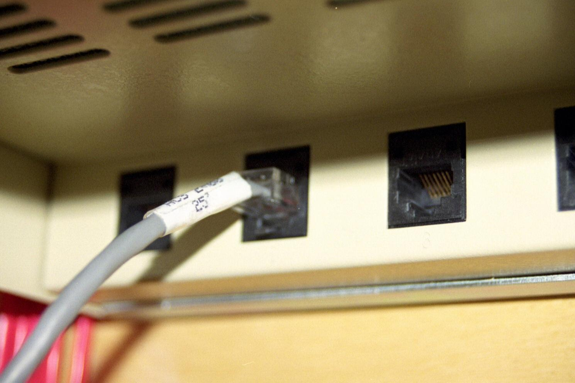
The Real Life Demarc Point
This is the demarcation point
The black jack belongs to the service provider
The gray cable belongs to you

Slide 15
Demarc Labels
It is always helpful if the service provider labels the demarc so that you can
Find it
Know the circuit number
Sometimes they do and sometimes they do not
Even when they do, sometimes it is hard to find the label

Slide 16
Demarc Labels
As labels can be easy to find orange stick-on labels or just a few cryptic marks with a felt tip pen

Slide 17
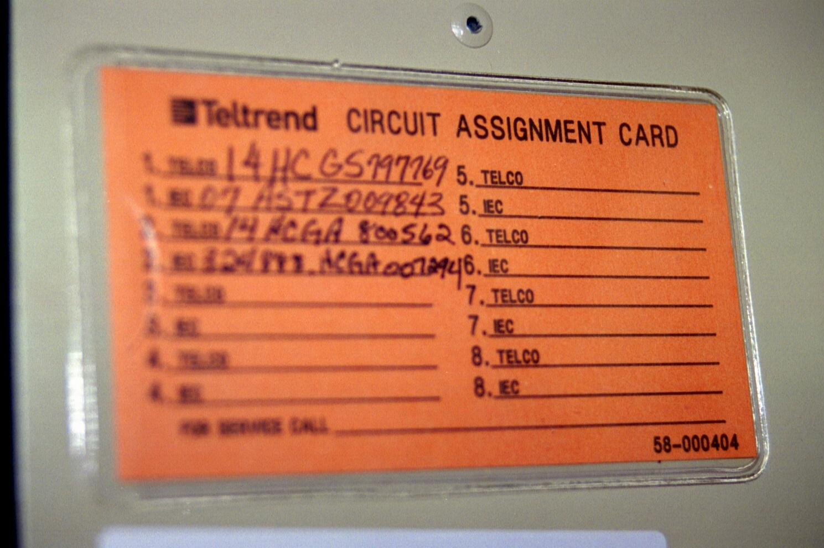
Demarc Label for Large Cabinet

Slide 18
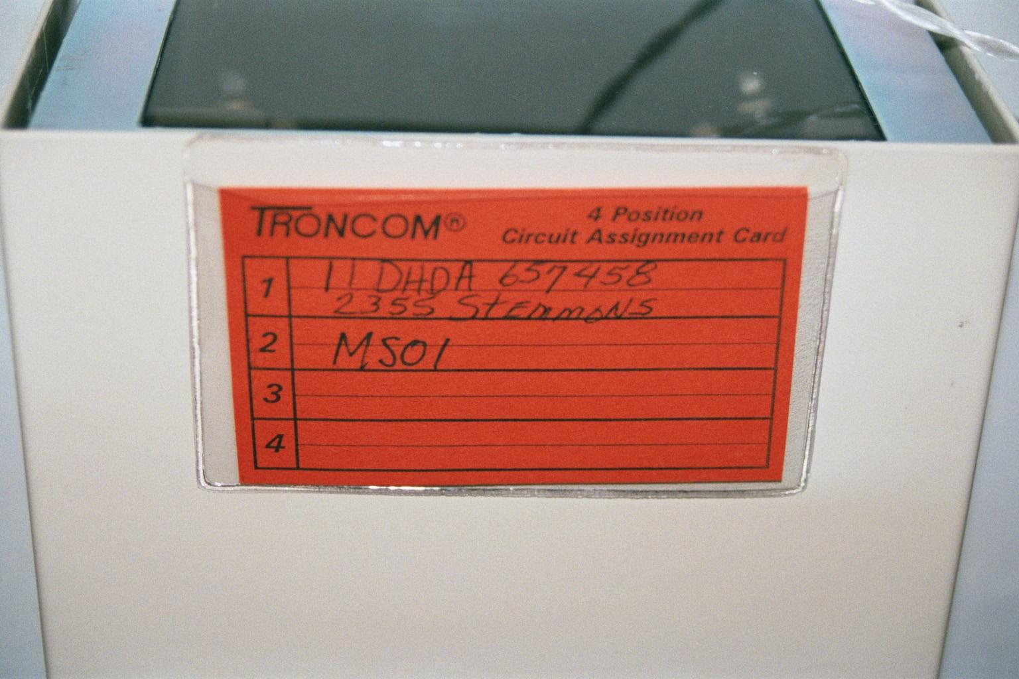
Demarc Label for Small Cabinet

Slide 19
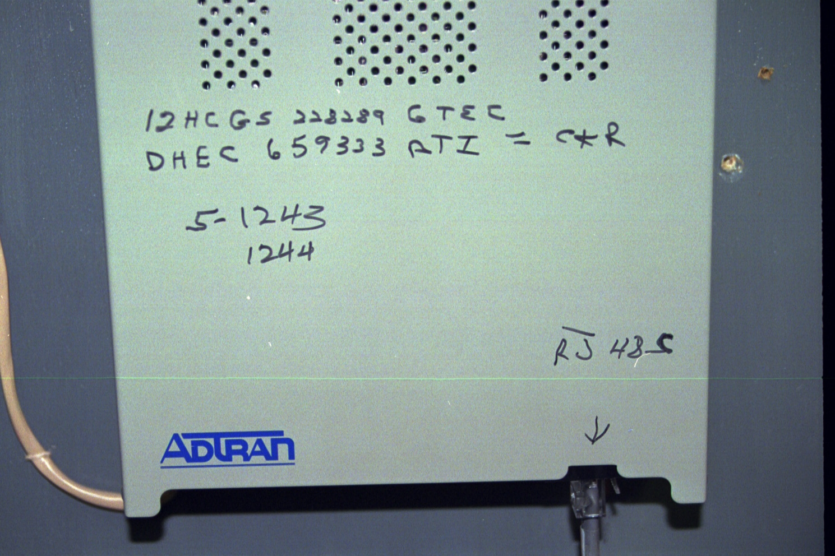
Demarc Label of a Sort

Slide 20
Where Do They Put Demarcs
A demarc can be almost anywhere in a building
The proper location is the entrance facility for the building
But depending on the size and age of the building this may or may not be a formal room

Slide 21
Where Do They Put Demarcs
If there is no entrance facility room, then the telephone closet or just a wall in a closet for a small building is a common location
For a large, old building look in the boiler room or the basement

Slide 22
Demarc at Remote Site
Let’s look at some example demarcs at smaller sites

Slide 23
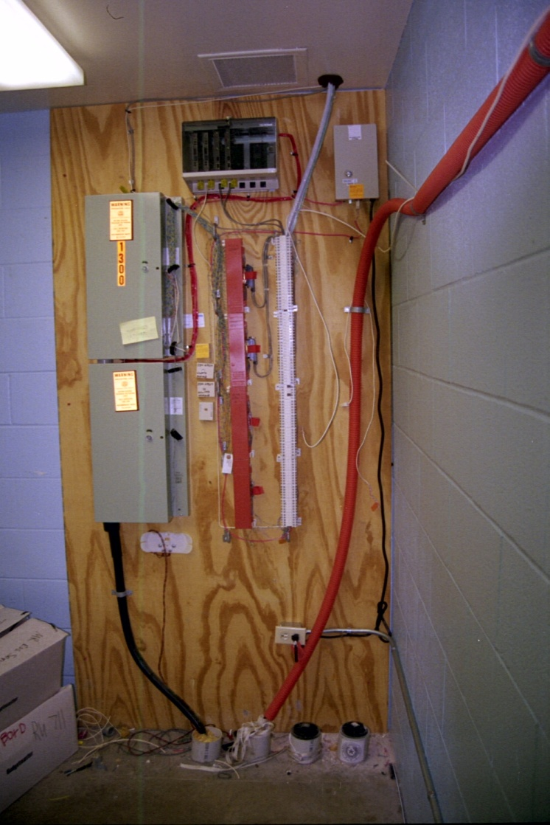
Demarc at Remote Site

Slide 24
Demarc at Remote Site

Slide 25
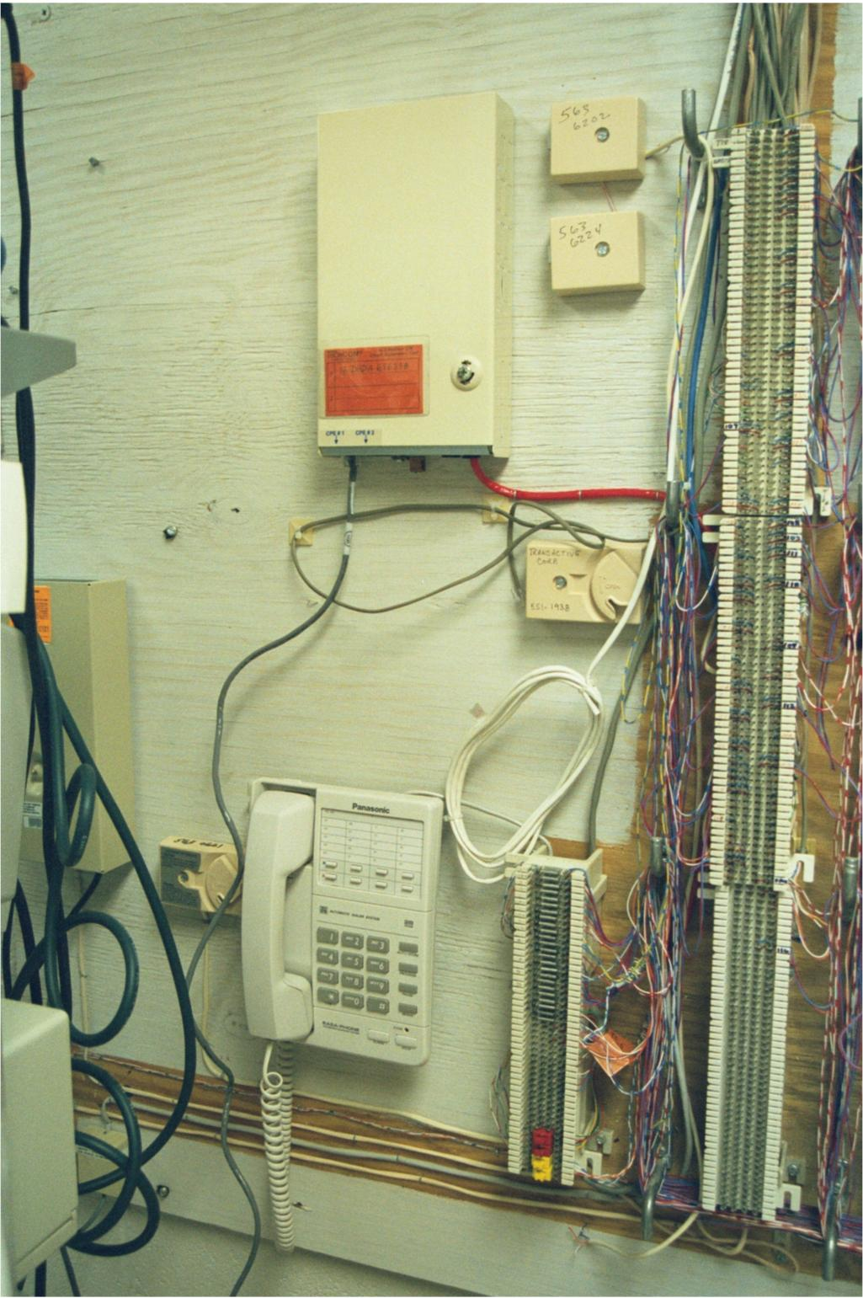
Demarc at Remote Site

Slide 26
Demarc at Remote Site

Slide 27
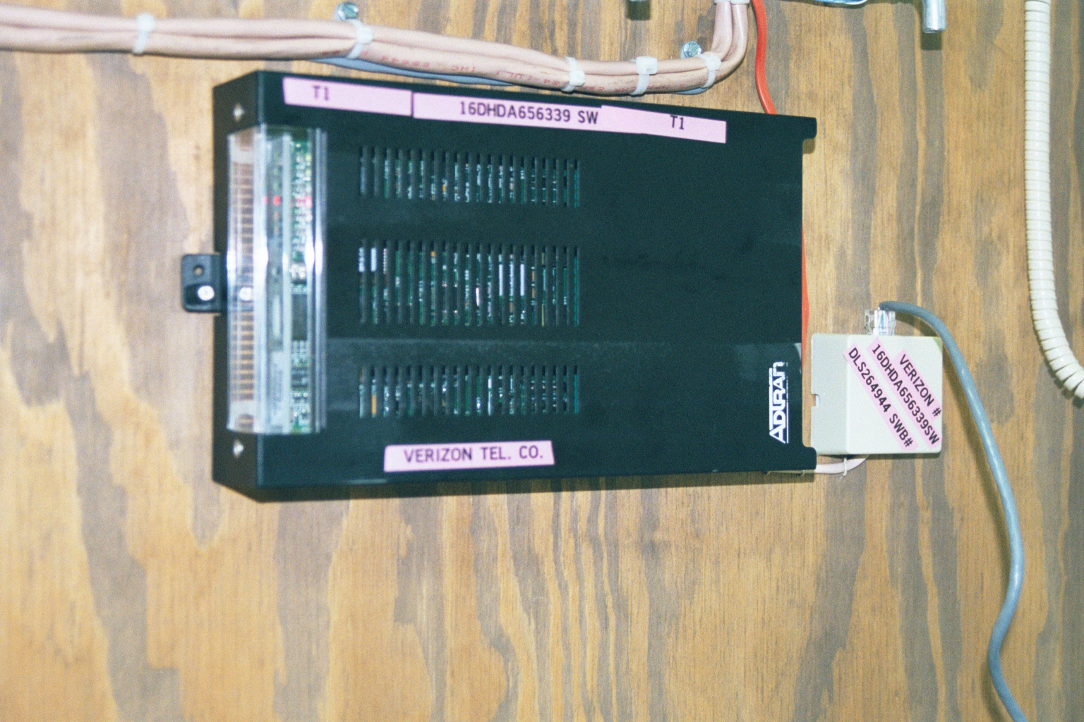
Demarc at Remote Site

Slide 28
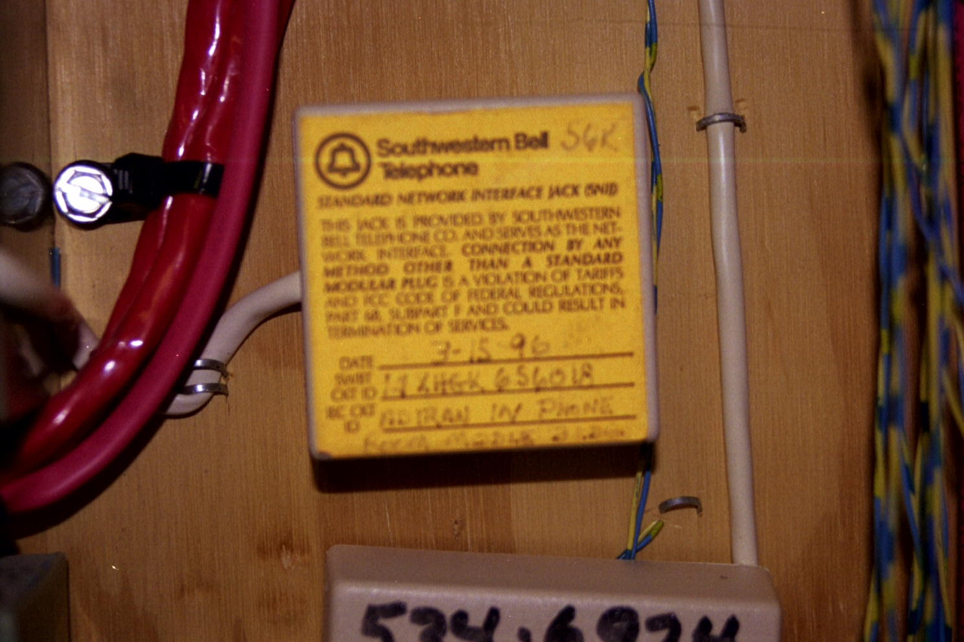
Demarc at Remote Site

Slide 29
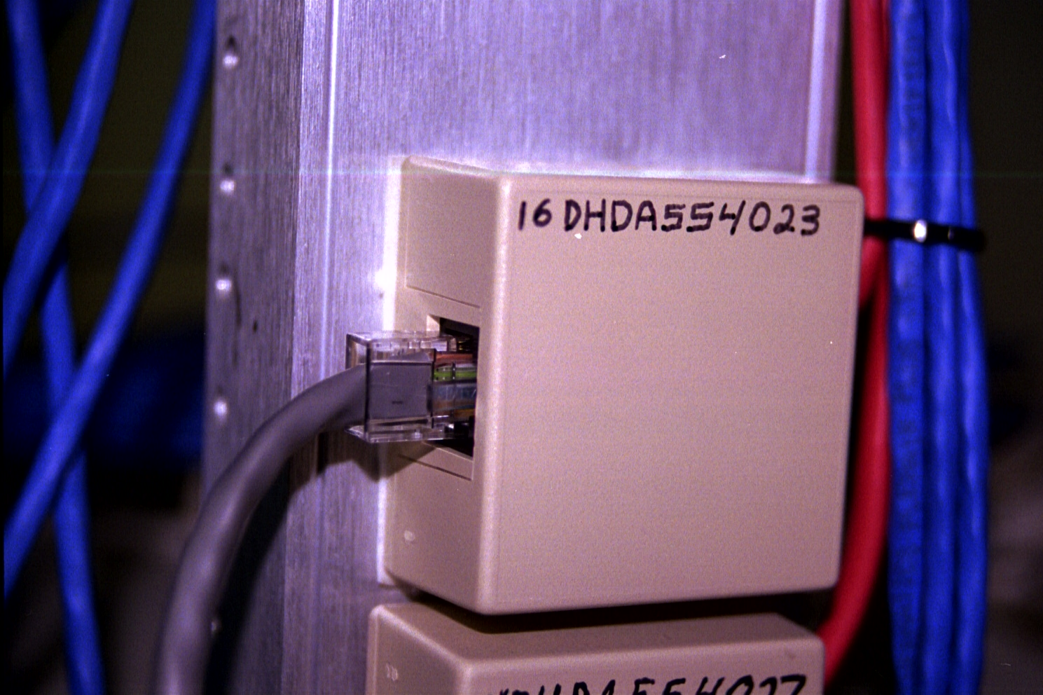
Demarc at Remote Site

Slide 30
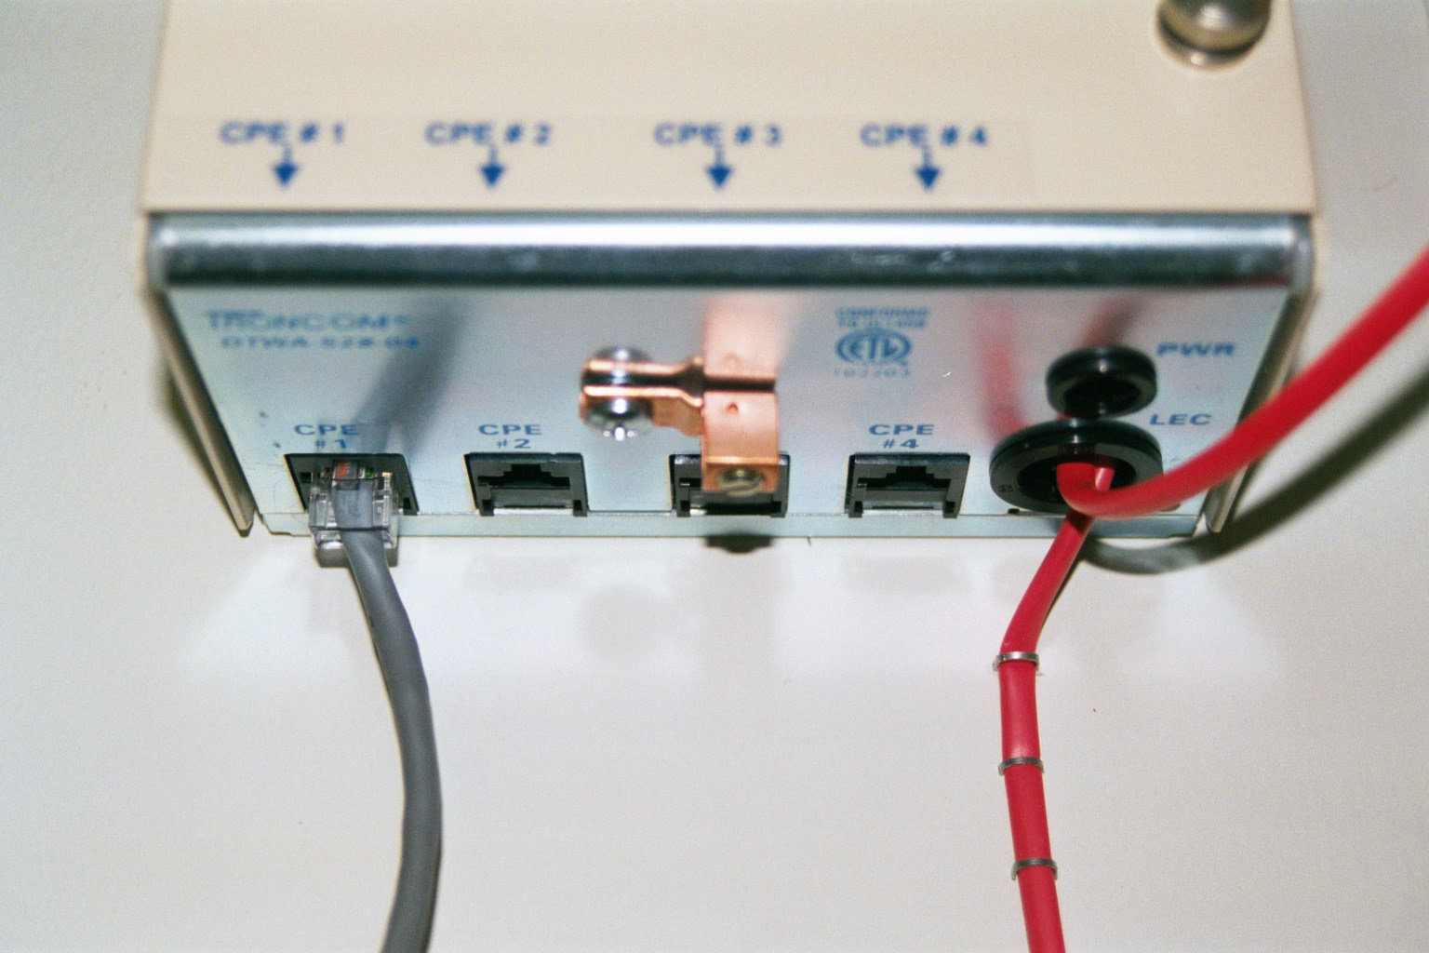
Demarc Point at Remote Site

Slide 31
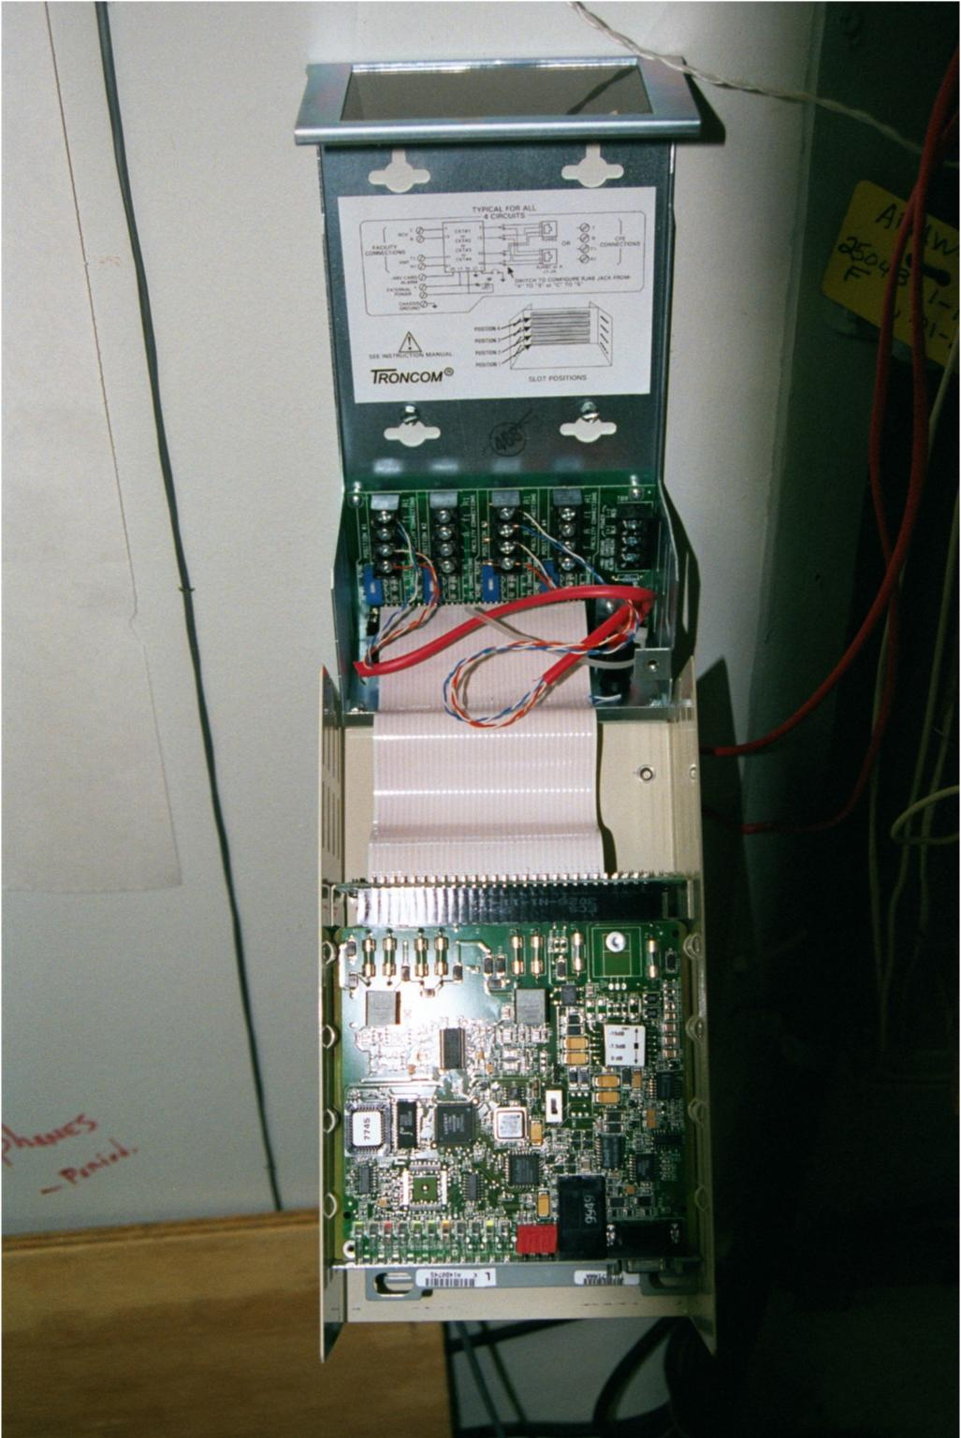
Demarc Cabinet Open

Slide 32
Demarc Indicator Lights
The lights on the demarc can be used to ensure it is configured and operating normally
For example shown next are the lights on a card

Slide 33
Demarc Indicator Lights
The relevant lights here are
ALM
When red means the circuit is not right
Usually this means the carrier never turned it on or did not configure the entire circuit end to end
If this is on, it’s time to call the carrier

Slide 34
Demarc Indicator Lights
B8ZS or AMI
This light indicates the coding the carrier has setup for the circuit
Again it had better be what you ordered and have the CSU/DSU setup for
In this case yellow means B8ZS and green means AMI

Slide 35
Demarc Indicator Lights
ESF or SF
The next light indicates the framing the carrier has setup for the circuit
It had better be what you ordered and have the CSU/DSU setup for
In this case yellow means ESF and green means SF

Slide 36
Demarc Indicator Lights
LBK
The last light of interest is the loopback indicator
If this is lit it means the carrier has the circuit loopbacked to them
In this condition no traffic will be able to exit the demarc to the CPE
Since any traffic will make a U turn inside the demarc and head back where it came from
Loopbacks are used for troubleshooting

Slide 37
Demarc Indicator Lights
Also notice the card is labeled HDSL even though it is for a T1 line
As was said before, most T carrier lines are actually deployed as HDSL lines today

Slide 38
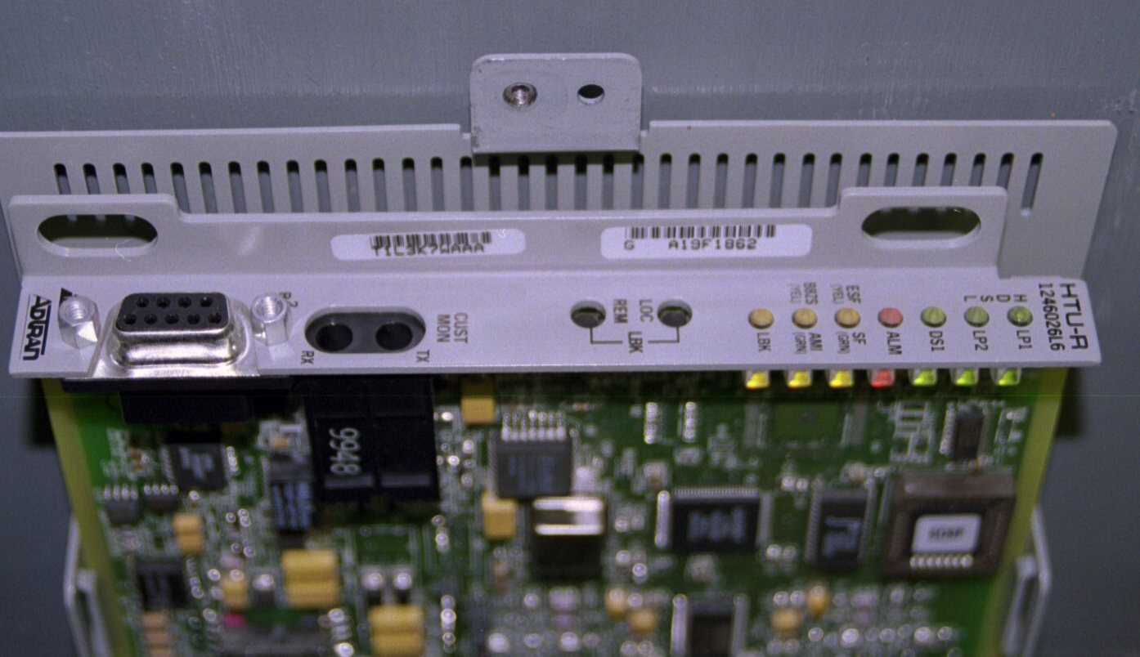
Demarc Indicator Lights

Slide 39
Demarc Indicator Lights

Slide 40
Demarc Indicator Lights
Let’s look at a real life example
Following is the page from the manual for the T1 demarc at my house
Note that in this case, with this particular model demarc, a red light may be on even though the circuit itself is fine
The RLOS light indicates the customer equipment is not plugged in

Slide 41
Demarc Indicator Lights
This is atypical as a red light is normally a bad sign

Slide 42
Demarc Indicator Lights

Slide 43
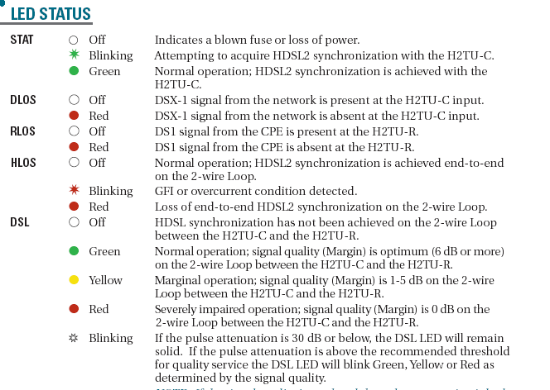
Demarc Indicator Lights

Slide 44
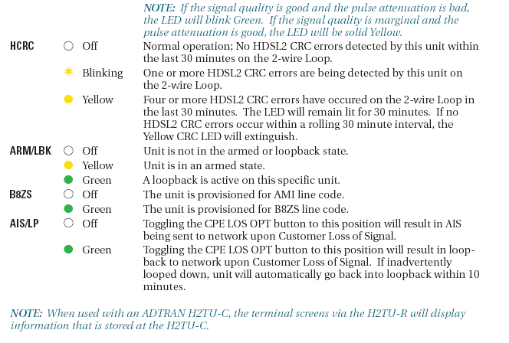
Demarc Indicator Lights

Slide 45
DS3 Demarc
A circuit that runs at a higher speed than a T1 needs shielding for the cables
This shielding is normally done by using coax cable to make the connections
The type of coax used in this case is
RG-59/U with 75 ohm of impedance

Slide 46
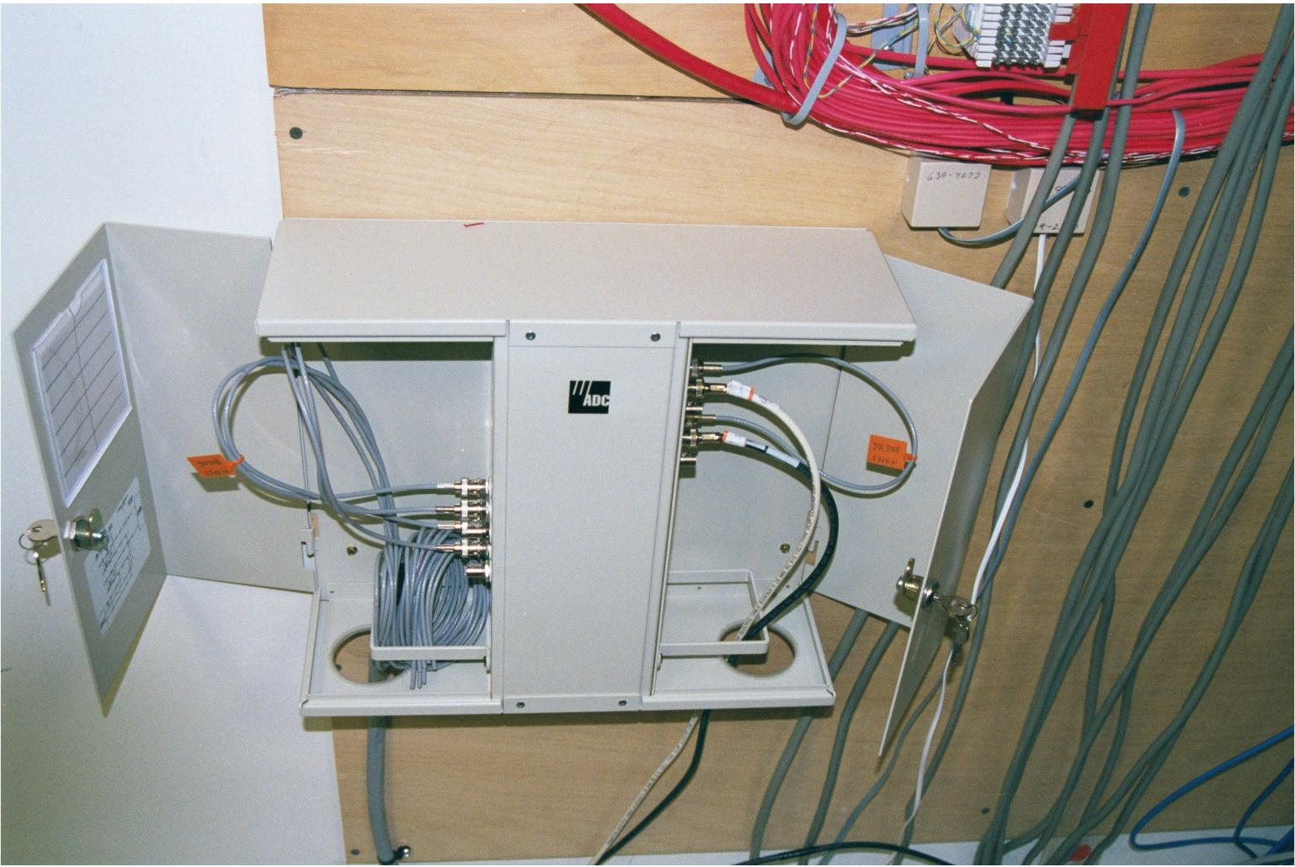
DS3 Demarc

Slide 47
Types of Demarcs by Location
There are technically two types of demarcs
The real demarc is wherever the phone company terminates their lines that come in from the street
This is almost never where the LAN and WAN equipment is installed

Slide 48
Types of Demarcs by Location
There may be several feet or several floors from there to where the termination point is needed
For example

Slide 49
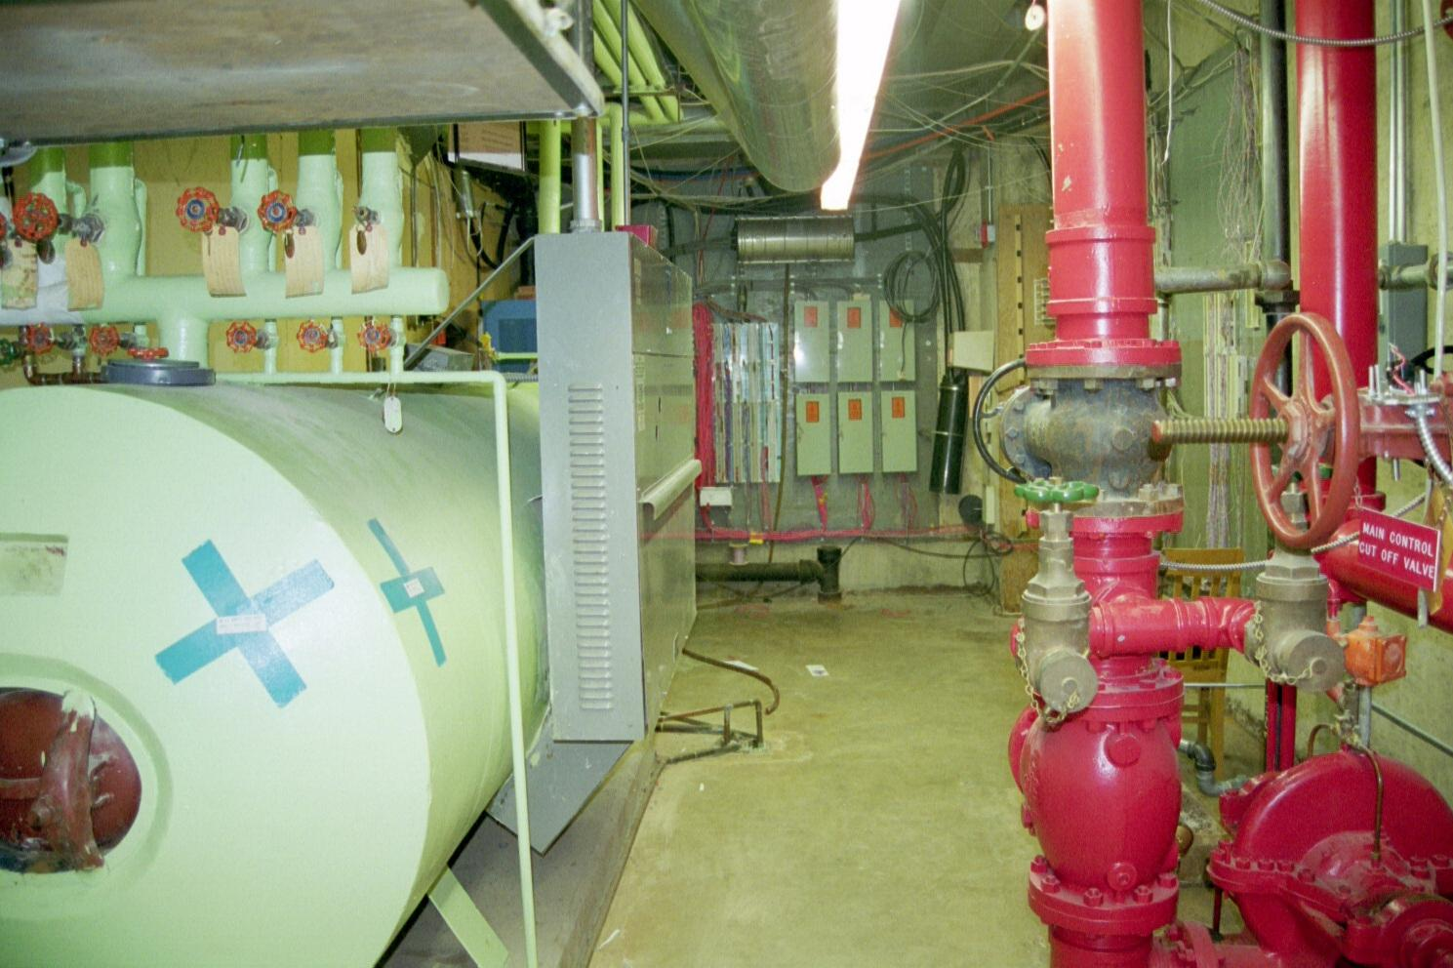
Demarc in the Boiler Room

Slide 50
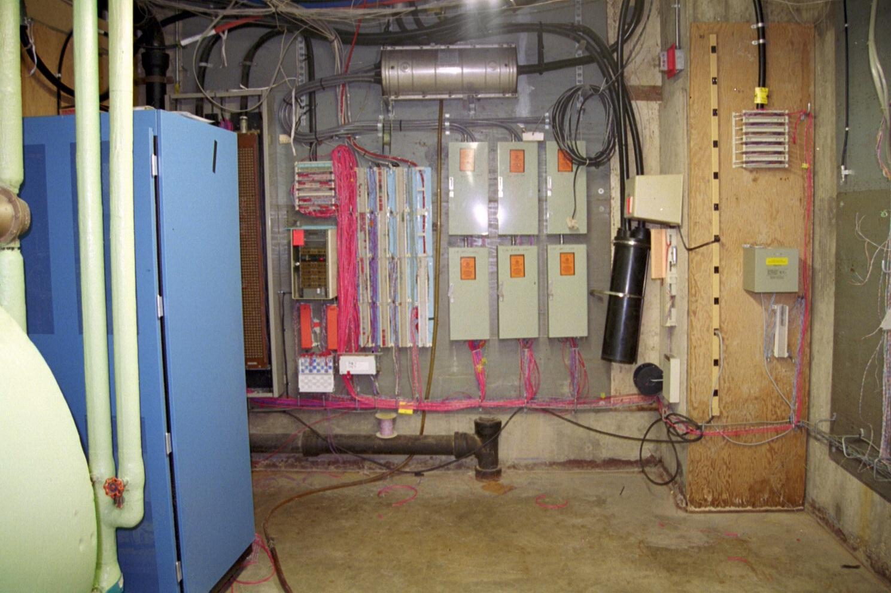
Demarc in the Boiler Room

Slide 51
Extended Demarc
To fix this have the phone company or a cabling contractor install an extended demarc
This will require that the installer string wire through your building
The phone company will object to this
They will tell you it costs more money
Tell them you do not care; do it anyway or hire someone else to do it for you

Slide 52
Extended Demarc
If the LAN room is on the 3rd floor a demarc in the basement is useless
An extended demarc for the installation above is down the hall in another room as shown below

Slide 53
Extended Demarc

Slide 54
Extended Demarc
There are two types of cables used to extend a demarc
The first one is the correct type according to the telecommunication’s industry standards
This is shielded twisted pair cable
The second type is what everybody uses in the real world

Slide 55
Extended Demarc
This is unshielded twisted pair cabling
In other words, plain old Cat 5 cable is used
To be safe it is best to use a shielded twisted pair cable if the extension is more than 1,000 feet
In shielded twisted pair cable each pair of wires is encased in a foil shield as shown below

Slide 56
Shielded Twisted Pair Cable

Slide 57
For More Information
T1: A Survival Guide
Michael S. Gast
ISBN 0596001274

