Slide 1
Dark Fiber
Last Update 2013.04.17
1.2.0

Slide 2
Objectives of This Section
Learn
What Dark Fiber is
Where Dark Fiber is used

Slide 3
Context
Layer | 1
Network Type | CAN MAN WAN

Slide 4
What is Dark Fiber
Most of the network access methods used for MANs and WANs discussed so far require preexisting data lines be used
Another way exists for setting up MANs and WANs using the equipment already covered, like Ethernet and ATM, but over privately owned fiber optic cable that is not currently being used

Slide 5
What is Dark Fiber
This type of fiber optic cable that is installed but carries no traffic, in fact has no devices at either end, is called dark fiber
Why dark fiber, because fiber that is being used carries light signals, therefore it is called lit fiber
Fiber not being used is correspondingly dark

Slide 6
What is Dark Fiber
Dark fiber is put in the ground by companies that are running cables for their own use or that are in the business of providing dark fiber
These unused strands can be leased for use by anyone that is near enough to their path or can afford to have that path extended

Slide 7
What is Dark Fiber
Here’s an example of such a network

Slide 8
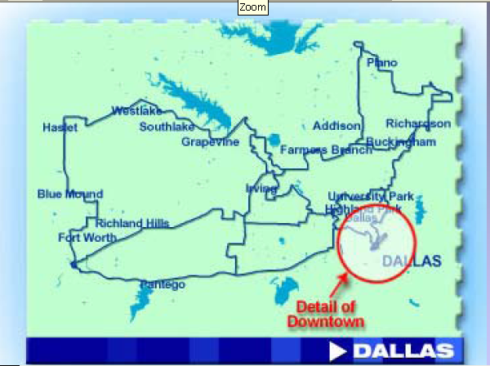
What is Dark Fiber

Slide 9
What is Dark Fiber

Slide 10
Dark Fiber Worldwide
Dark fiber is also used to connect the continents to each other using undersea submarine cables
In an April 2013 webinar presented by Ciena they discussed how to control latency in these long links
Here are average round trip latency times from shore landing to shore landing

Slide 11
Dark Fiber Worldwide

Slide 12
Dark Fiber Worldwide
Here is the cost as of the date of the webinar

Slide 13
Dark Fiber Worldwide

Slide 14
Dark Fiber Worldwide

Slide 15
Dark Fiber Worldwide
The most used route is the transatlantic route, but other routes are catching up

Slide 16
Dark Fiber Worldwide

Slide 17
Dark Fiber Worldwide

Slide 18
Dark Fiber Worldwide
Here are the elements in a typical link

Slide 19
Dark Fiber Worldwide

Slide 20
Dark Fiber Worldwide

Slide 21
Dark Fiber Worldwide
Ciena argues that the best way to reduce latency, if this even needs to be done, is to eliminate the optical electrical optical conversion steps

Slide 22
Dark Fiber Worldwide

Slide 23
Dark Fiber Worldwide

Slide 24
Dark Fiber Worldwide

Slide 25
Dark Fiber Worldwide

Slide 26
Dark Fiber Worldwide

Slide 27
Dark Fiber Worldwide
And do a few other things, such as

Slide 28
Dark Fiber Worldwide

Slide 29
Operation
To use this access method arrangements are made with the fiber owner
They can locate your equipment in a collocation facility at the end of the fiber run or they can extend the connection to you, if the economics work for both parties

Slide 30
Operation
At your end you need to purchase, install, and manage whatever method is used to drive the signal from one end of the link to the other

