Slide 1
DSL
Last Update 2011.07.21
1.18.0

Slide 2
Objectives of This Section
Learn
  What the DSL method of network access is
  The various versions of DSL
  Concerns about DSL network access

Slide 3
Context
Layer | 1
Network Type | WAN

Slide 4
Layers
As a layer 1 technology a DSL data line requires something at layers 2 through 7 in order to operate
Typically this is
  Layer 2
    PPPoE
  Layer 3 through 7
    TCP/IP and a VPN

Slide 5
Operation
DSL – Digital Subscriber Line uses the normal voice telephone system, but it uses frequencies above those used for voice to carry data
At the service provider’s central office end, the signal is split, the voice portion to a PSTN switch and the data portion to a DSLAM - DSL Access Multiplexer

Slide 6
Operation
DSLAMs have large banks of ports at their front ends, each of which accommodates a single DSL connection
The DSLAM aggregates all the connections into one or more high-speed ATM connections

Slide 7
Operation
ATM connections from several central offices are then combined into a regional switched ATM network, which in turn provides the connection to the ISP's local point of presence
This last point is an important point
DSL sends the data over the Internet
As such you have to add security on top of the DSL circuit, such as a VPN

Slide 8
Current Use
A DSL line can function as a site’s sole connection to the wider network or as a backup line
Keep in mind that this is not a dedicated data line
It is also considered to be a consumer grade line with the attendant SLA

Slide 9
Speeds
The speed varies with the exact technology used
Lets look at a table that lists the major versions

Slide 10
Speeds
Method | Download | Upload | Distance
ADSL | 1.5M to 15M | 640K to 1M | 18,000
ADSL2 | 12M | 3.5M | 6,000
VDSL2 | 50M to 200M | Up 10M | 6,000
HDSL | 1.5M | 1.5M | 15,000
SDSL | 768K | 768K | 22,000
IDSL | 144K | 144K | 36,000

Slide 11
ADSL
ADSL – Asymmetrical DSL is the most widely deployed form of DSL
It is common for residential and small office use
There are several versions of ADSL that are available and that have been proposed
It doesn’t matter which since the provider selects it, not you

Slide 12
ADSL
ADSL is fast downstream and slow upstream
It is very distance limited
As with all versions of DSL it works along with standard phone service on the same line
The actual downstream speed for any one customer depends on

Slide 13
ADSL
  The length of the copper line as attenuation increases with length
  The wire gauge of the copper line as attenuation increases as the size drops
  The presence of bridged taps, which are old techniques used in the days of party lines
  They cause reflection that can distort the high frequency signals used by DSL
  The existence on the line of load coils

Slide 14
ADSL
  The presence of cross-coupled interference in the line is also factor
Bridge taps and load coils are discussed in more detail below
New versions of ADSL, such as ADSL2+ are increasing the speeds that can be supported, but the end users location must be near, within 8,000 feet of the ADSL source equipment

Slide 15
ADSL in Operation
Here is an example of the setup for a ADSL circuit
Notice the ATM information as this is just part of a larger ATM circuit as are all voice based systems

Slide 16
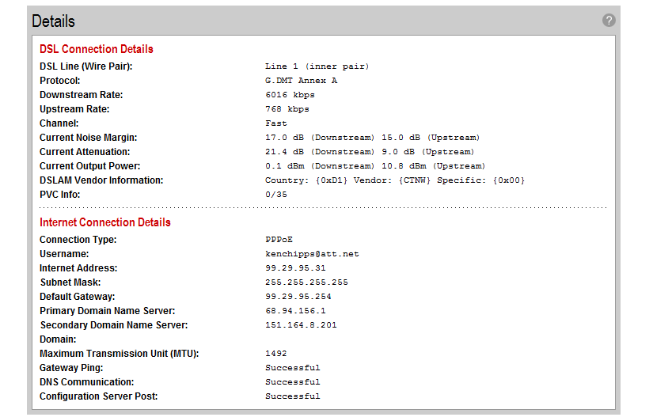
ADSL Operation

Slide 17
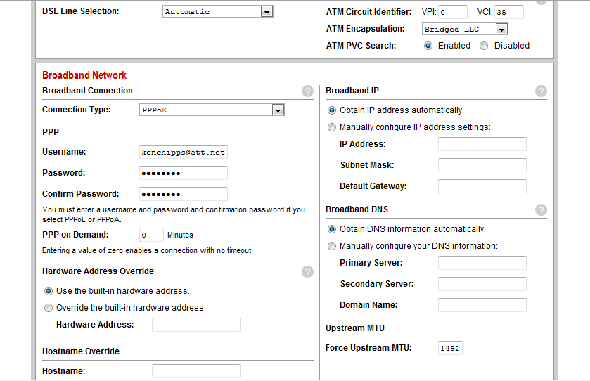
ADSL Operation

Slide 18
ADSL2
This is a speed upgrade to ADSL that takes the downstream speed to 12 Mbps and the upstream to 3.5 Mbps

Slide 19
VDSL2
VDSL2 is a follow-on to ADSL that provides higher speeds both up and down
It is very distance limited with one mile being the practical limit
Speeds drop off quickly with distance

Slide 20
HDSL
HDSL – High Bit Rate DSL is listed as a DSL method
It is actually widely deployed as a way to deliver T1 circuits
HDSL requires 4 wires
It is used for T Carrier circuits as it is quicker to install than the old way of delivering T1

Slide 21
HDSL2
HDSL2 is the same as HDSL
But only requires 2 wires

Slide 22
SDSL
SDSL – Symmetrical DSL is similar to HDSL, but at a slower speed
Where it can be used it provides good symmetrical speed at a reasonable price compared to T1 and Frame Relay
I would expect to see the use of this type of line to grow over the years

Slide 23
IDSL
IDSL – ISDN DSL is DSL service using ISDN technology
This is the slowest speed version of DSL
But can be deployed up to 55,000 feet with repeaters
Although this was the first version of DSL, being used first in 1986 for ISDN itself, this version sees limited use due to the slow speed

Slide 24
IDSL
It is most useful in serving rural areas
In my rural location the 2008 cost for such a line from Covad is $130 per month

Slide 25
VDSL
VDSL – Very High Bit Rate DSL is little used, due to severe distance limits
But it is very high speed
The speed, of course, depends on the line length

Slide 26
VDSL
Line Length Feet | Downstream Mbps | Upstream Mbps
1000 | 52 | 106
3000 | 26 | 3
5000 | 13 | 1.6

Slide 27
VDSL
When deploying VDSL, fiber optic cable is used to connect the service provider’s central office to the neighborhood, the copper goes from there to the customer

Slide 28
SHDSL
SHDSL – Single Pair High Bit Rate DSL is a new version of DSL based on the ITU G.991.2 standard
It is supposed to be out in a year or so
It is similar to SDSL
But it can travel much further without signal loss and only uses one wire pair
Watch for this one to see how widely it is deployed

Slide 29
DSL Physical Layer
The DSL physical layer contains three sublayers from the top down
  TPS-TC - Transport protocol specific transmission convergence
    This sublayer handles payload mapping, insertion and deletion of idle cells, and cell delineation
  PMS-TC - Physical media specific transmission convergence
    This sublayer deals with framing, error monitoring, and scrambling

Slide 30
DSL Physical Layer
  PMD - Physical media dependent
    PMD deals with line coupling, signal filtering, timing, equalization, echo cancellation, protection, and powering

Slide 31
Setup
One of the nice things about this technology from the standpoint of the WAN manager is that there is nothing that must be done on the customer end to setup this kind of data line
Just call the provider
Some providers are offering self install
Based on my experience, their procedures for this need some work

Slide 32
Security
As an always on media the site must be protected just like any other site
This requires a firewall running on a single machine or a small firewall to protect the site
In addition to the firewall a VPN should be used as well

Slide 33
Problems With DSL
DSL is not available everywhere for two main reasons
The first is that the major phone companies would rather spend money on lawyers rather than technology
The second has to do with the technology being used to deliver DSL
DSL is fundamentally limited by distance
This is the main reason it cannot reach all customers

Slide 34
Problems With DSL
In addition there are aspects of the voice based local loop that hinder its deployment as well
There are two main problems that may be present in the local loop
  Load Coils
  Bridge Taps

Slide 35
Problems With DSL
It was found that the quality of voice calls could be improved if load coils were placed every 6000 feet or so
Load coils are basically low-pass filters
In that they pass the voice frequencies at 250 to 3,500 hertz on down the line, while removed the high frequency overtones that were degrading the voice call

Slide 36
Problems With DSL
Of course, this also filters out data going down this same line as it is sent at higher frequencies
Bridge taps were used to pull circuits off of a community line to individual customers
The problem is when that customer no longer exists the tap was left in place

Slide 37
Problems With DSL
As the data signal goes down the line it goes down each of these bridge taps to a dead-end
It is then reflected back into the main circuit
This garbles up the signal

Slide 38
Problems With DSL
There are important issues that must be considered when using DSL for a business rather than just surfing the net from your house when you get home from work
Consider the problems Howard Berkowitz reported with a DSL line he was attempting to use

Slide 39
Problems With DSL
Keep in mind Howard Berkowitz is not the typical remote location user that your organization might have in some remote office using DSL that you arranged for as the telecommunications manager
Howard Berkowitz is the author of several books, RFCs, and so forth you will encounter during your time in the business

Slide 40
Problems With DSL
DSL has possibilities, but beware of the version being offered
As Howard reported
  First, be careful in all residential broadband, even before you get to the equipment. I went through a long and painful experience with “business grade" DSL, which often was down for a week at a time.

Slide 41
Problems With DSL
  My chief problem was that there were far too many players involved, all delaying and fingerpointing. I directly contracted with a DSL-supportive ISP (then CAIS, renamed Ardent, and then renamed something I forget).

Slide 42
Problems With DSL
  They contracted with Covad, who ran the actual DSL layer 1 network over facilities leased from Verizon.

Slide 43
Problems With DSL
  Even when I had an obvious local loop problem, the reporting had to go from CAIS to Covad to Verizon, which could take 24-48 hours at each stage, after which CAIS and Verizon might wait 3-5 days to dispatch technicians independently.

Slide 44
Problems With DSL
  If there was a question of Verizon being at fault, then it was necessary to wait a few more days to schedule both Verizon and Covad technicians to be at my site at the same time.
  Just to add to the fun, the first-line ISP often had 20-30 minute waits for trouble calls.

Slide 45
Problems With DSL
  One interesting sidebar about "business grade" DSL is Verizon has a 4-hour response commitment for T1, fractional T1, and Frame Relay loops, but only 24 hour for DSL. This 24 hour often seemed to be interpreted as 24 business hours.

Slide 46
Problems With DSL
  In frustration, I finally gave up on DSL both for technical reasons and the awareness that both Covad and CAIS were in financial trouble

Slide 47
DSL SLA
The main problem with using a DSL line for a business, especially the typical ADSL, is that the providers consider these to be consumer grade lines
As such, if there is a SLA, it will have long repair times
A typical response time for a DSL line problem is 23 hours

Slide 48
DSL SLA
Whereas, for a T1 line the SLA normally calls for a 4 hour response

